Slide 1

Numerical Study of Upward Flame Spread over Discrete Fuels
JeanHyuk Park and Ya-Ting T. Liao
Department of Mechanical and Aerospace Engineering
Case Western Reserve University, Cleveland, OH
The 8th Triennial International Aircraft Fire and
Cabin Safety Research Conference
Atlantic City, New Jersey, October 24-27, 2016

Slide 2
Outline
Background
Numerical Model
Computational Results
Upward Spreading
0g Concurrent Flow Spreading
Remarks

Slide 3
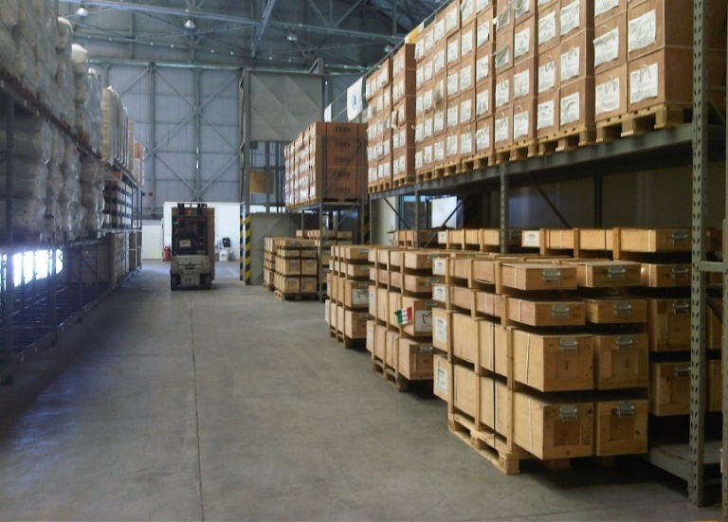


Background
Discrete fuel arrangement
Can be combustibles separated by inert materials or gaps. i.e.
Fuel – Inert – Fuel or
Fuel – Gap – Fuel
represents many practical fire scenarios, e.g. fires occurring in forests, urban areas, warehouses, building façades, airplane cabinets, etc.

Slide 4
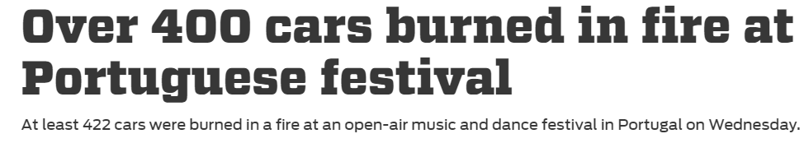
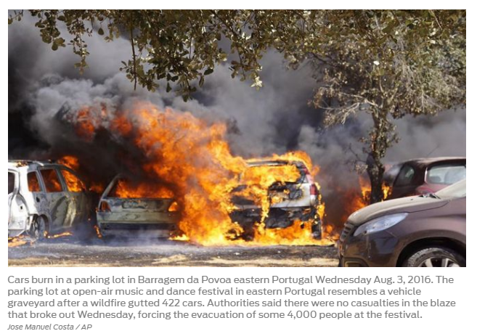
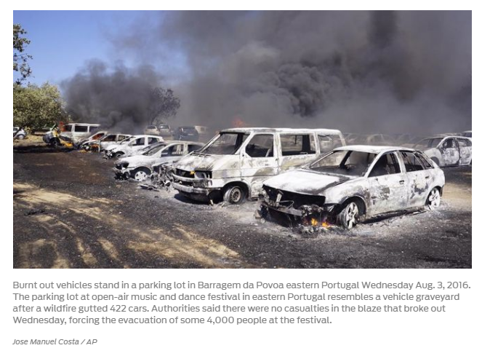
Background
http://www.foxsports.com/motor/story/portugal-fire-400-cars-festival-080616

Slide 5
Characteristics of Flame Spread over Discrete Fuels
  Non-propagation for large gaps
  (Abe et al, 2012)
  Faster flame spread for some configurations
  e.g. for larger separation distances (Gollner et al, 2012)
  for smaller fuel loading (mass/volume) (Wolff et al, 1991)
  Existence of optimal fuel percentage for flame spread rate
  (Miller and Gollner, 2015)
The fire concern for the discrete fuel elements can be more extreme compared with continuous fuels.

Slide 6
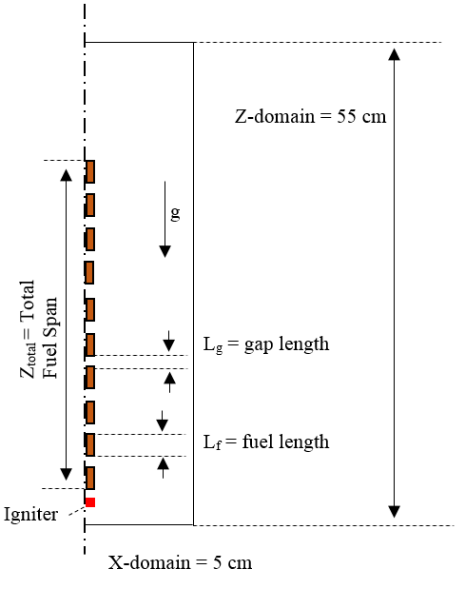
Numerical Model
Fuel and gap sizes
  L_{f} = 1 cm
  L_{g}=0.25~ 3cm
Igniter
  T =1000 ºC
  t = 0 ~ 3s,
  1 mm below the first block
  τ_{1/2, fuel} = 0.115 mm
Computational domain: 5 cm × 55 cm
Grid size: 66 × 387 = 25,542
Symmetric condition along z-axis
For 0g, flow velocity: 20 cm/s
z
x

Slide 7
Numerical Model
Fire Dynamics Simulator (Ver. 6.2.0, Revision 22352)
Fuel sample: cellulose (yielding 90% pyrolyzate, 10 % inert char)
Two-dimensional direct numerical simulation
  One-step second-order finite-rate gas-phase reaction
  One-step first-order solid pyrolysis
  Radiation: gray gas model

Slide 8
Simulation Results
Part 1: Upward Flame Spread over Discrete Fuels

Slide 9
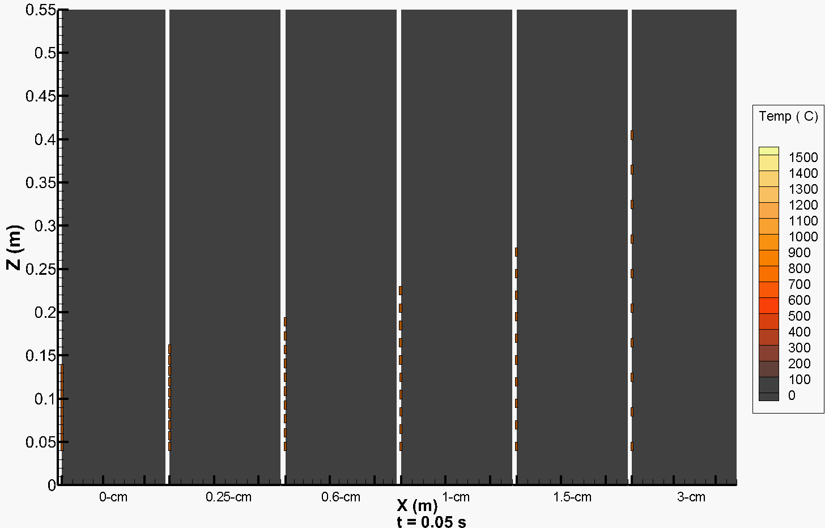

Upward Flame Spread over Discrete Fuels
*Black contour: ${\dot{Q}}^{′′′}=$ 15,000 kW/m³.

Slide 10
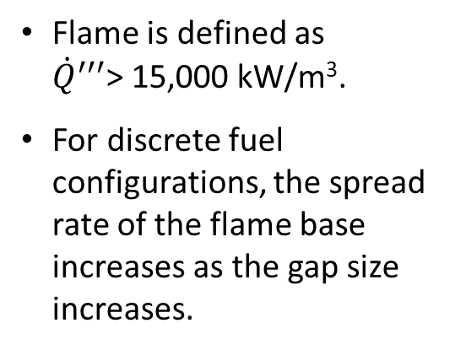
Spread Rate of the Flame Base
Flame is defined as
${\dot{Q}}^{′′′}$> 15,000 kW/m³.
For discrete fuel configurations, the spread rate of the flame base increases as the gap size increases.
Increasing Gap

Slide 11
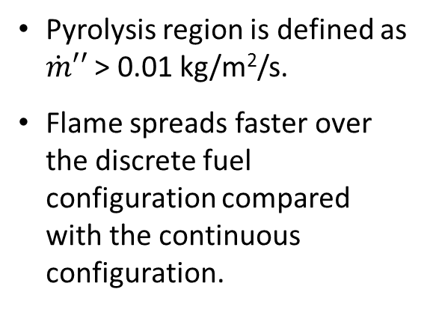
Spread Rates of the Pyrolysis Front and Base
Pyrolysis region is defined as $\dot{m}′′$ > 0.01 kg/m²/s.
Flame spreads faster over the discrete fuel configuration compared with the continuous configuration.

Slide 12
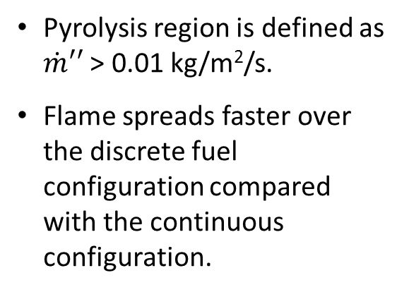
Spread Rates of the Pyrolysis Front and Base
Pyrolysis region is defined as $\dot{m}′′$ > 0.01 kg/m²/s.
Flame spreads faster over the discrete fuel configuration compared with the continuous configuration.

Slide 13
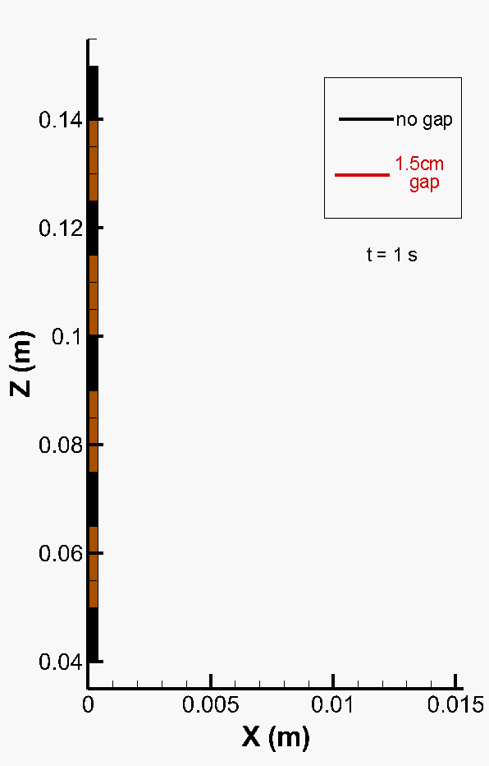
Characteristics of Flame Spread
For discrete fuels,
the flame jumps
the flame splits
the flame has a smaller standoff distance

Slide 14
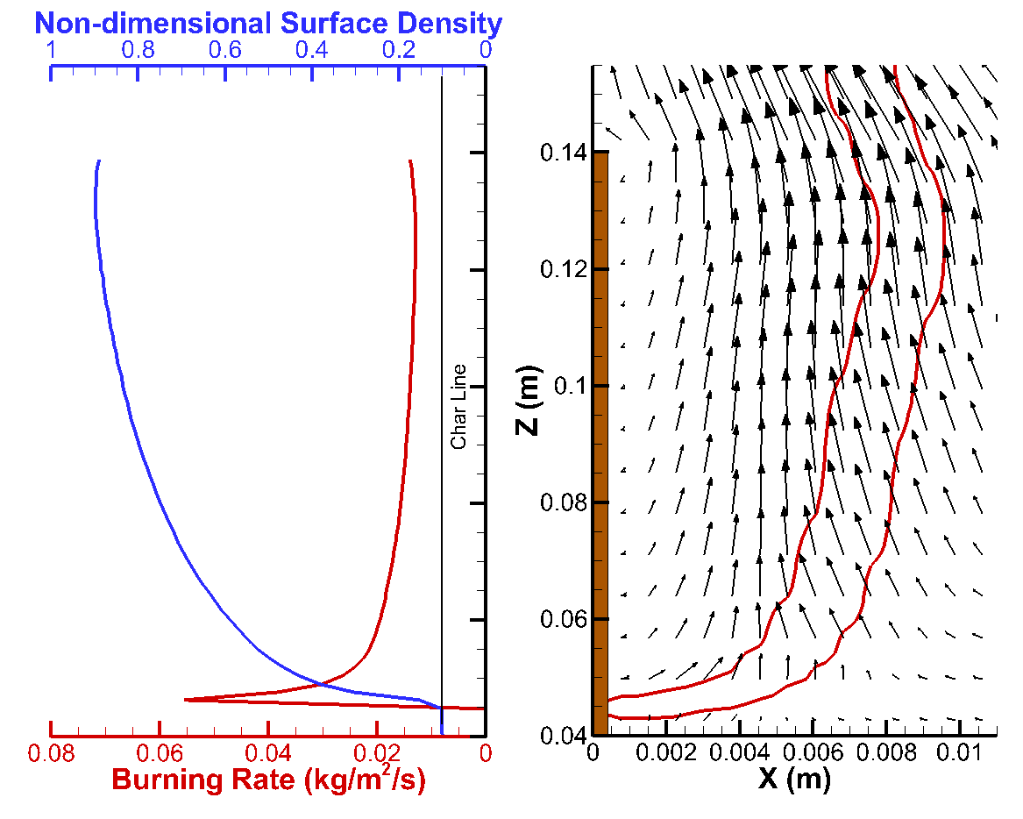
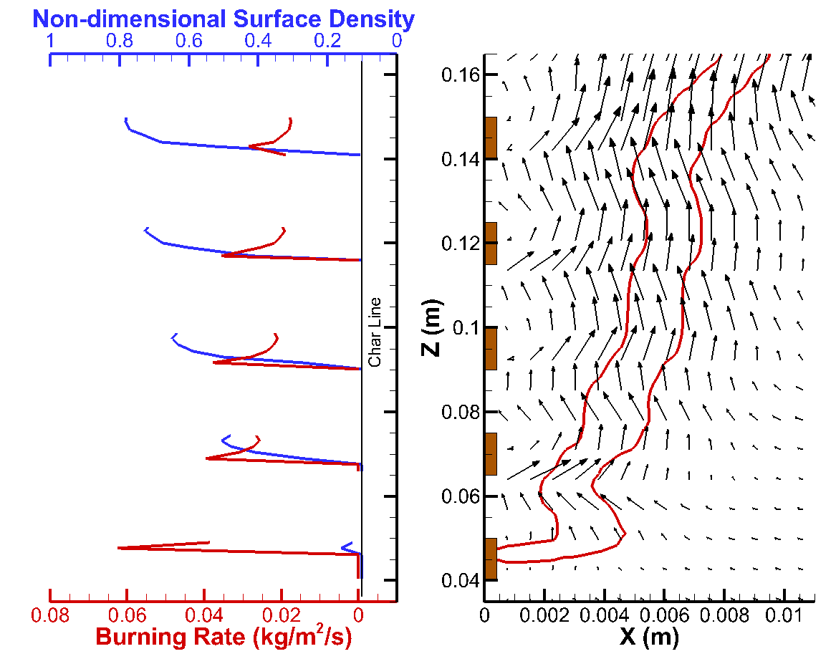
Continuous Fuel
Discrete Fuel
For the discrete fuel configuration,
the local flame standoff distance decreases near the end of each fuel segment, resulting in an smaller overall flame standoff distance.
the flame splits near the gaps when the standoff distance approaches zero.
multiple fuel segments burn simultaneously. When upstream fuel segments are fully consumed, the flame base needs to “jump” across the physical gap and the pre-burned (upstream) portion of the next fuel segment.

Slide 15
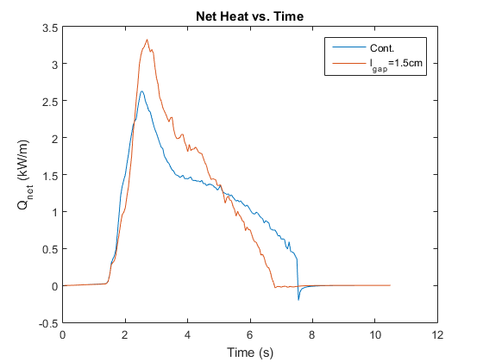
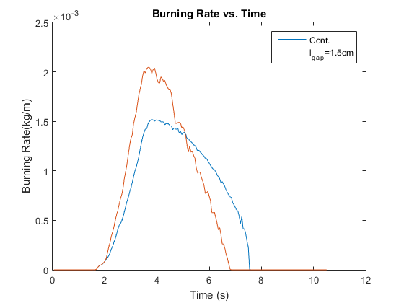
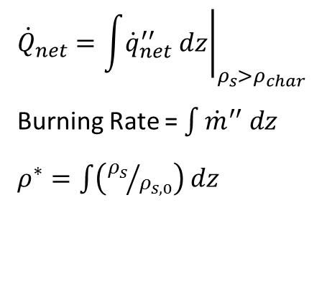
Burning Rate
(m)
.
$${\dot{Q}}_{net}={\left.\int{{\dot{q}}_{net}^{′′} dz}\right|}_{ρ_{s}>ρ_{char}}$$
Burning Rate = $\int{{\dot{m}}^{′′} dz}$
$ρ^{∗}=\int{\left({ρ_{s}}/{ρ_{s,0}}\right) dz}$

Slide 16
Simulation Results
Part 2: Concurrent Flow Flame Spread over Discrete Fuels

Slide 17
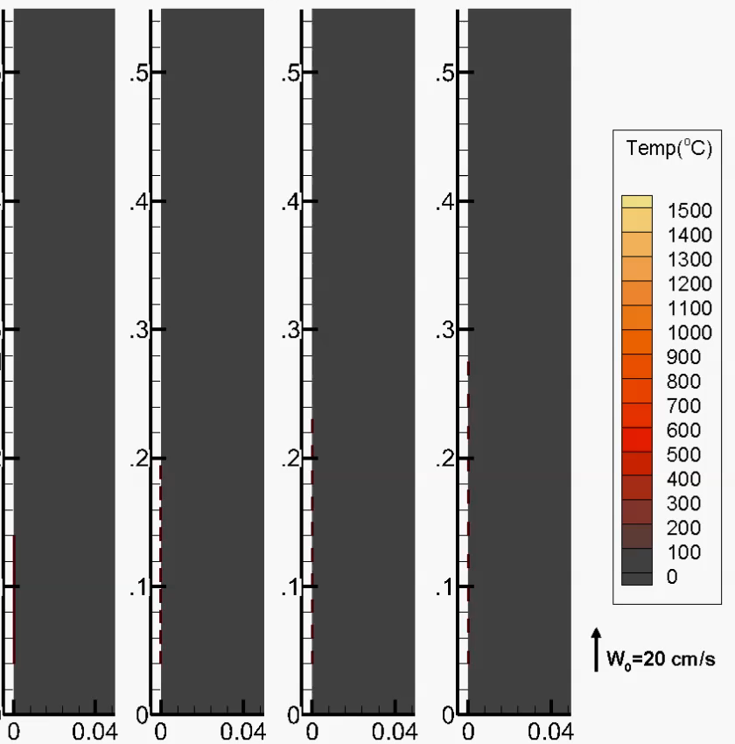
Concurrent Flow Flame Spread over Discrete Fuels
.5
.4
Z (m)
.3
.2
.1
0
X (m)

Slide 18
Spread Rate of the Flame Base
Flame is defined as
${\dot{Q}}^{′′′}$> 15,000 kW/m³.
For discrete fuel configurations, the spread rate of the flame base increases as the gap size increases.

Slide 19
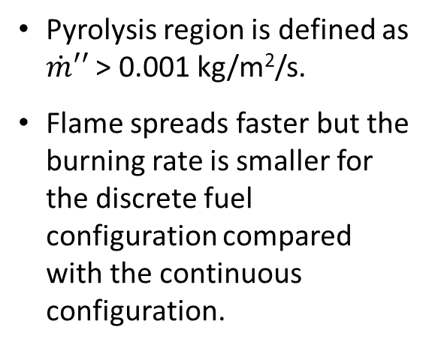
Spread Rates of the Pyrolysis Front and Base
Pyrolysis region is defined as $\dot{m}′′$ > 0.001 kg/m²/s.
Flame spreads faster but the burning rate is smaller for the discrete fuel configuration compared with the continuous configuration.

Slide 20
Spread Rates of the Pyrolysis Front and Base
Pyrolysis region is defined as $\dot{m}′′$ > 0.001 kg/m²/s.
Flame spreads faster but the burning rate is smaller for the discrete fuel configuration compared with the continuous configuration.

Slide 21
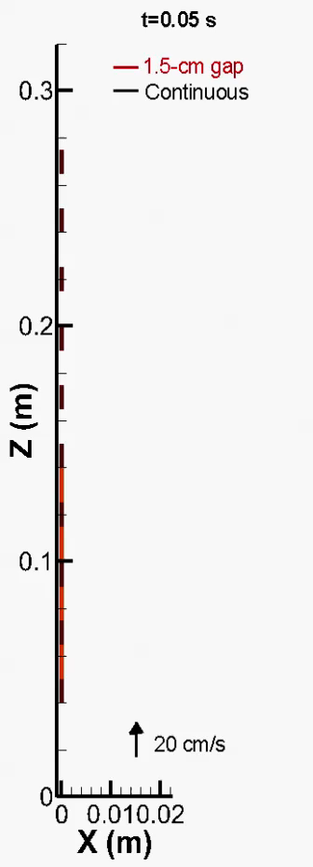
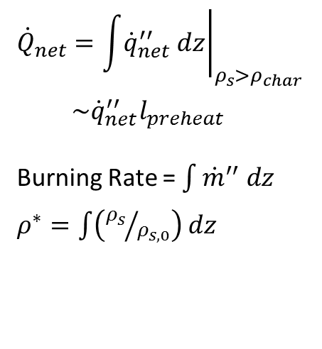
Burning Rate
(m)
.
$${\dot{Q}}_{net}={\left.\int{{\dot{q}}_{net}^{′′} dz}\right|}_{ρ_{s}>ρ_{char}}$$
$\sim {\dot{q}}_{net}^{′′}l_{preheat}$
Burning Rate = $\int{{\dot{m}}^{′′} dz}$
$ρ^{∗}=\int{\left({ρ_{s}}/{ρ_{s,0}}\right) dz}$
* x-z ratio: 1:6.076

Slide 22
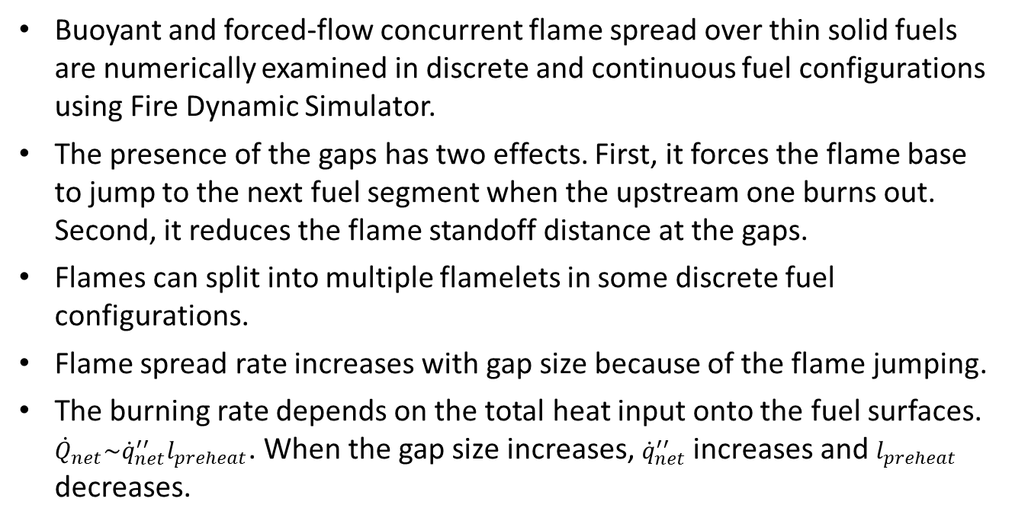
Remarks
Buoyant and forced-flow concurrent flame spread over thin solid fuels are numerically examined in discrete and continuous fuel configurations using Fire Dynamic Simulator.
The presence of the gaps has two effects. First, it forces the flame base to jump to the next fuel segment when the upstream one burns out. Second, it reduces the flame standoff distance at the gaps.
Flames can split into multiple flamelets in some discrete fuel configurations.
Flame spread rate increases with gap size because of the flame jumping.
The burning rate depends on the total heat input onto the fuel surfaces. ${\dot{Q}}_{net}\sim {\dot{q}}_{net}^{′′}l_{preheat}$. When the gap size increases, ${\dot{q}}_{net}^{′′}$ increases and $l_{preheat}$ decreases.

Slide 23



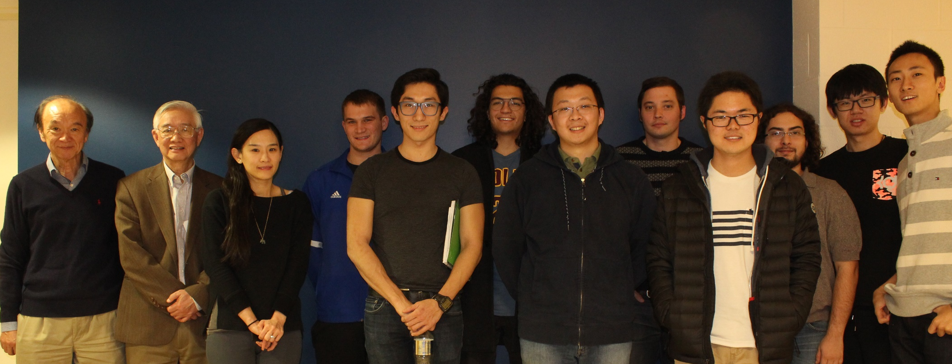
Acknowledgement
This work is supported by Underwriters Laboratories.
The authors thank each member of the fire group at Case Western Reserve University for the fruitful discussion.

Slide 24


Continuous Fuel
Discrete Fuel
Sample fuel: Whatman 40 Filter Paper
Sample width: 2.5cm
Sample thickness: 0.23mm
Continuous configuration
Sample length: 50 cm
Discrete fuel configuration
Sample length: 5cm
Separation distance: 5cm
Number of samples: 10
*Experiments performed by Daniel Villamil in Case Combustion Lab, 2016.

Slide 25
Backup Slides

Slide 26
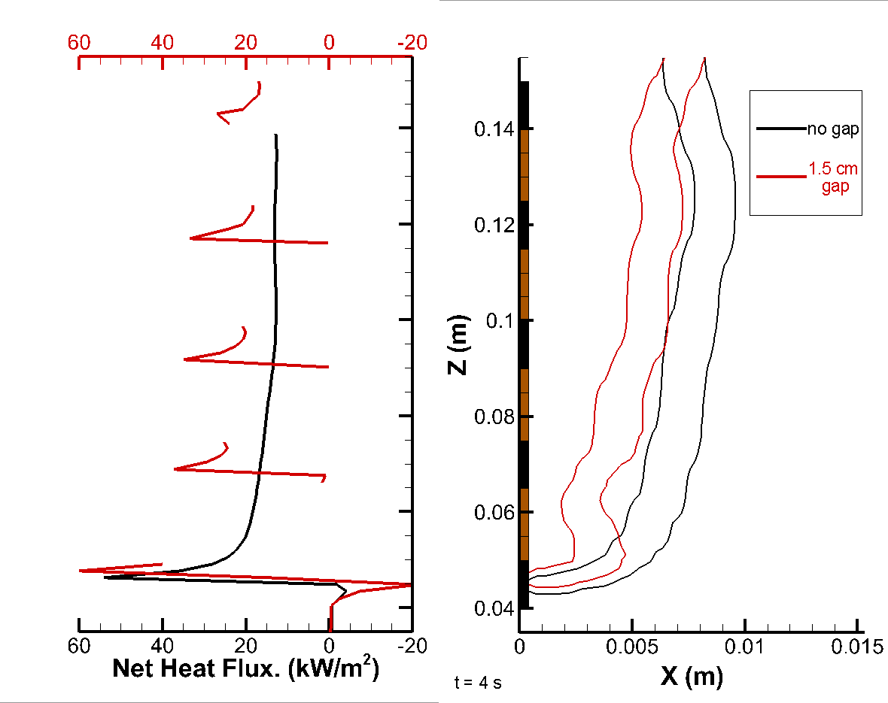
Backup Slide: Net Heat Flux Distribution (1g result)

Slide 27
Backup Slide: Grid Dependency Check (1g result)
 | Large Grid | Finer Grid
n_{x} | 66 | 132
n_{z} | 387 | 1000
n_{total} | 25,542 | 132,000
δ_{x} (mm) | 0.76 | 0.38
δ_{z} (mm) | 1.42 | 0.55

Slide 28
Backup Slide: Gas and Solid Properties
Solid Phase |  |  | Gas Phase
Property | Value | Units | Property | Value | Units
A_{s} | 1.00 × 10¹⁰ | 1/s | A | 4.23 × 10¹⁴ | cm³/g/s
C_{p,s} | 1.2 | kJ/kg/K | E | 1.13 × 10⁵ | kJ/kmol
E_{s} | 1.25× 10⁵ | kJ/kg | Δh_{c}⁰ | 1.58 × 10⁴ | kJ/kg
Δh_{r}⁰ | 752.8 | kJ/kg | P₀ | 101,325 | Pa
k_{s} | 0.06 | W/m/K | Pr | 0.7
ε | 1 |  | T₀ | 293.15 | K
ρ_{s0} | 555.3 | kg/m³ | ν_{g} | 0.9

