Slide 2
Motivation
Gas phase active flame retardants and mineral fillers are broadly applicable (as opposed to char promoting compounds).
Halogens (especially Br) are effective at low loading and are the only commercial materials exhibiting flame inhibition, but they are under duress.
Are there other atoms/compounds that are gas phase active?
If so, how can we find them, and what is their combustion toxicity?

Slide 3
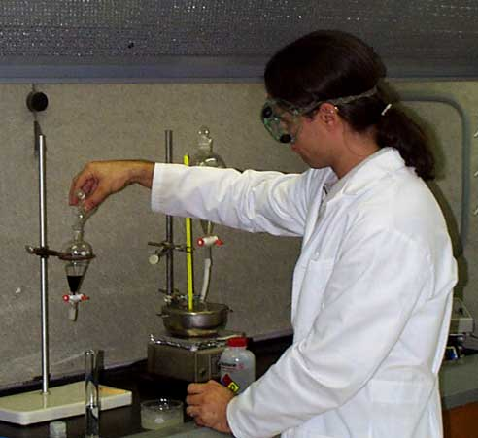
Scales of Fire Behavior & Testing
No methods available for studying fire behavior at the milligram (lab) size.
???

Slide 4
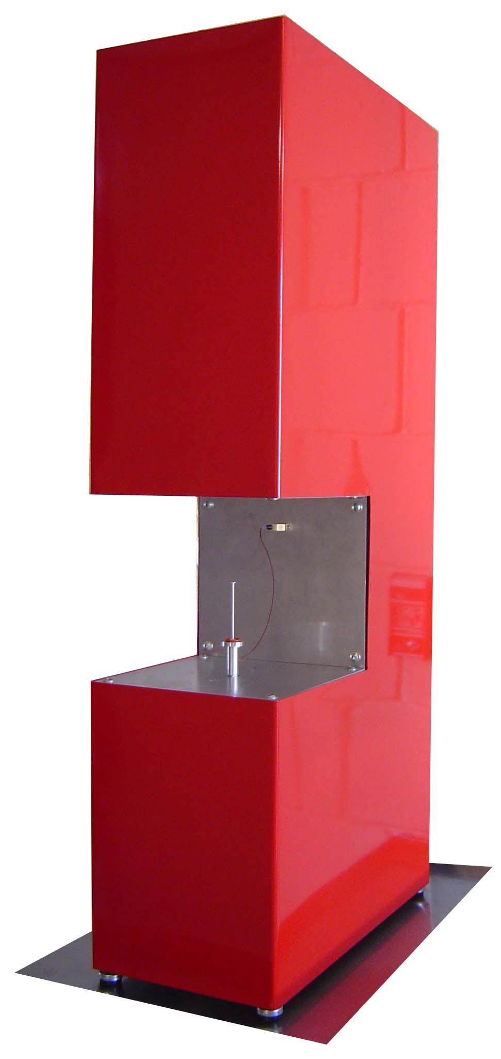
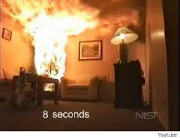
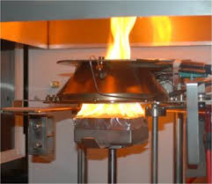
Approach
Develop rapid laboratory test to screen flame retardants and FR plastics for:
  Gas phase activity
  Combustion toxicity
10³ kg
1 kg
10⁻⁶ kg

Slide 5
Strategy
Measure Fire Effluents at Micro Scale
  Examine gas phase combustion chemistry using Microscale Combustion Calorimeter (MCC) to control
    Combustion temperature (Safronava, BCC 2016)
    Fuel/oxygen (Φ) ratio
  Measure combustion gases using
    CO and CO₂ analyzers
    Fourier Transform Infrared (FTIR) spectrometer

Slide 6
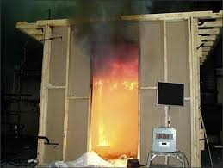
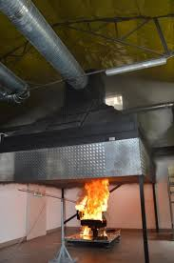
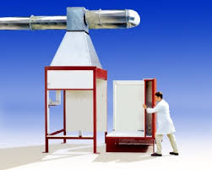
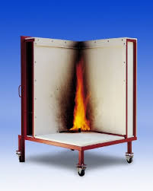
Background: Full Scale Fire Tests
Generation of Fire Effluents at Full or Large Scale
EN 1323
Single Burning Item (SBI)
ISO 9705 /ASTM E 2257
Room Corner Test
ISO 24473
Furniture Calorimeter

Slide 7
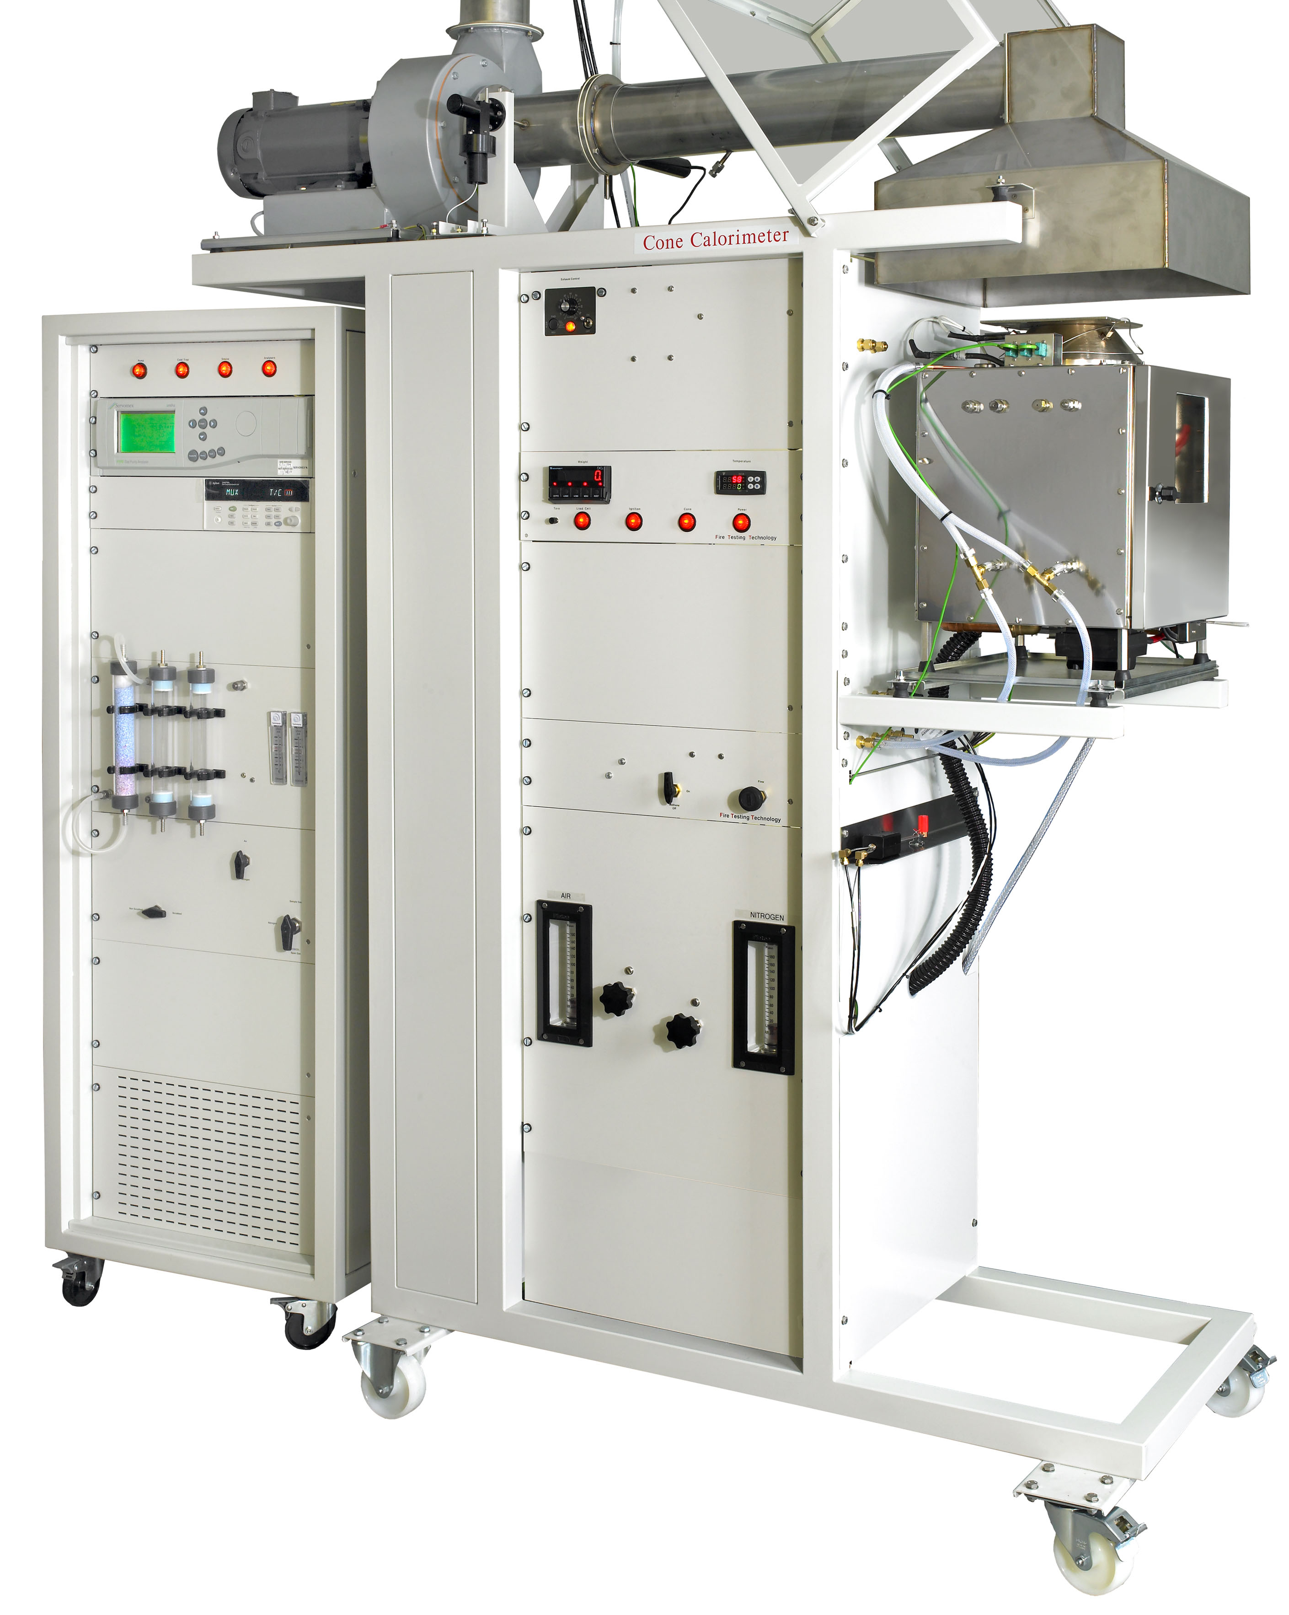
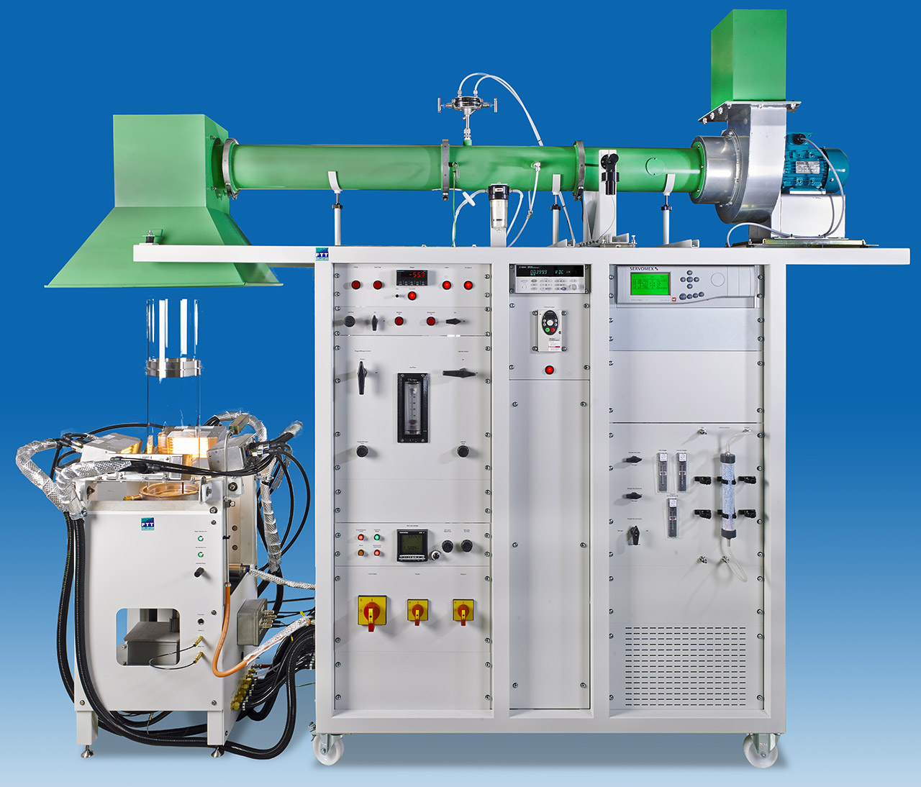
Background: Bench Scale Fire Tests
Vitiated Fire Effluents at Bench Scale
FTIR
Controlled Atmosphere
Cone Calorimeter
Fire Propagation
Apparatus
ASTM E 2058
Purser (Steady State Tube) Furnace
IEC 60695-7-50

Slide 8
Fuel / Oxygen Ratio in Full & Bench Scale
GER is the global equivalence ratio in fire tests
Mass Loss Rate (kg-fuel/s)/Ventilation Rate (kg-O₂/s)
GER
=
(m_{Fuel}/m_{O2} )_{stoichiometric}
GER < 1 = Fuel Lean (over-ventilated)
GER > 1 = Fuel Rich (under-ventilated)

Slide 9
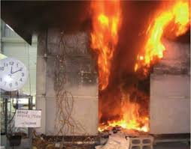
Combustion Chemistry
Fires generate toxic combustion products when oxygen becomes depleted (vitiated),
Incomplete & toxic combustion products
Fuel + Some Oxygen → CO + HCN + Hydrocarbons + Other Toxics
Excess Oxygen
Insufficient Oxygen
CO₂ + H₂O + N₂
Complete (less-toxic) combustion products
Early Stage Fire
Late Stage Fire

Slide 10
Toxic Gas Yields in Vitiated Full/Bench Scale
Polyhexamethyleneadipamide / PA66
(A. Stec & R. Hull, Fire Toxicity, 2010)
ISO Room
(1/3-Scale)
ISO Room
1000
100
ISO Room
FPA
100
Controlled Atmosphere
Cone Calorimeter
Controlled
Atmosphere
Cone Calorimeter
10
CO Yield (g/kg-volatiles)
HCN Yield (g/kg-volatiles)
10
1
1
Carbon
Monoxide
Hydrogen
Cyanide
0.1
0.1
0
0.5
1
1.5
2
2.5
0
0.5
1
1.5
2
2.5
Global Equivalence Ratio, GER
Global Equivalence Ratio, GER

Slide 11
Combustion Process of Solid Polymers
Pyrolysis
Combustion
Combustible +
Non-combustible Gases
POLYMER
Liquid Products + Tar
+ O2
Combustion Products
Solid Charred Residue
Endothermic, +∆
Exothermic, -∆
Thermal Feedback from Flame
* J. Troitzsch, International Plastics Flammability Handbook, 2nd Edition, Chapter 4, Hanser Publishers, Munich Germany, 1990

Slide 12
Microscale Combustion Calorimeter

Slide 13
Heat Release Rate
Heat release rate by oxygen consumption normalized to initial sample mass
Peak rate of heat release
Heat Release Capacity
… dependent only on material properties

Slide 14
Standard Test ASTM D 7309 (Method A)
Anaerobic pyrolysis at 1 K/s + complete combustion of gases at 900°C, 20% O₂
700
600
Heat Release Capacity, η_{c}
500
Peak Pyrolysis
Temperature
400
Onset (Ignition)
Temperature
Heat Release Rate Q′/β (J/g-K)
300
Heat of Combustion, Q∞
(Fire Load)
200
100
Pyrolysis Residue μ
(Char Fraction)
0
450
500
550
600
650
700
Temperature (°C)
Microscale Combustion
Calorimeter

Slide 15
Combustion in MCC versus in Flame
Products
Products
Controlled Combustor Temperature
Premixed
Combustion
Fuel/O₂/N₂
O₂ + N₂
(Air)
Fixed Flame Temperature
Controlled Fuel/O₂ ratio
Diffusion Controlled Fuel/O₂
O₂
Fuel
Plastic
Fuel
N₂
Premixed, Nonflaming
Combustion (MCC)
Diffusion-Limited
Combustion (Flame)

Slide 16
Fuel / Oxygen Ratio in MCC
Φ is the fuel/oxygen mass ratio relative to the stoichiometric mass ratio.
m_{Fuel} / m_{O2}
Φ
=
(m_{Fuel}/m_{O2} )_{stoichiometric}
Φ < 1 = Fuel Lean (excess oxygen)
Φ > 1 = Fuel Rich (oxygen starved)

Slide 17
Φ In Standard MCC vs GER in Standard Cone
MCC (ASTM D 7309)
Cone Calorimeter (ASTM E 1354)
β = 1 K/s
q″_{ext} = 50 kW/m²
1000
0.5
1200
0.5
800
0.4
1000
0.4
800
600
0.3
0.3
Specific Heat Release Rate, Q (W/g)
HRR, kW/m²
Local Equivalence Ratio, Φ
600
Global Equivalence Ratio, GER
400
0.2
0.2
400
200
0.1
200
0.1
0
0
0
0
350
400
450
500
550
0
50
100
150
200
Sample Temperature (°C)
Elapsed Time, seconds
High Impact Polystyrene/HIPS

Slide 18
Fuel / Oxygen Ratio in Flame
Varies from ∞ to 0 in diffusion flame
_{flame} = Average Value
Laminar
Diffusion
Flame
Sheet
∞
Air
Air
Φ
Fuel
Gases
Fuel
Combustible Solid
0
Distance into Flame Sheet

Slide 19
Method of Controlling Φ in MCC
Run material of mass m₀ at β = 1 K/s, X_{O2} = 0.2, and T_{c} = 900°C.
Measure ∆X_{O2}/m₀ at each sample temperature T for complete combustion of gases to obtain training set, (∆X_{O2}/m,T)₀.
Store training set (X_{O2},T,m)₀ for material.
Use (∆X_{O2}/m,T)₀ data to control O₂/N₂ flows such that:
3
∆X_{O2}(T)/m
m₀
∆X_{O2}(T)
Φ
=
=
2.5
(∆X_{O2}(T)/m)₀
m
(∆X_{O2}(T))₀
2
1.5
Percent of Oxygen Consumed, ∆ X_{O2}
1
Training Set
0.5
Program (Φ = 1)
0
Measured (Φ = 1)
200
300
400
500
600
700
Sample Temperature, T (°C)

Slide 20
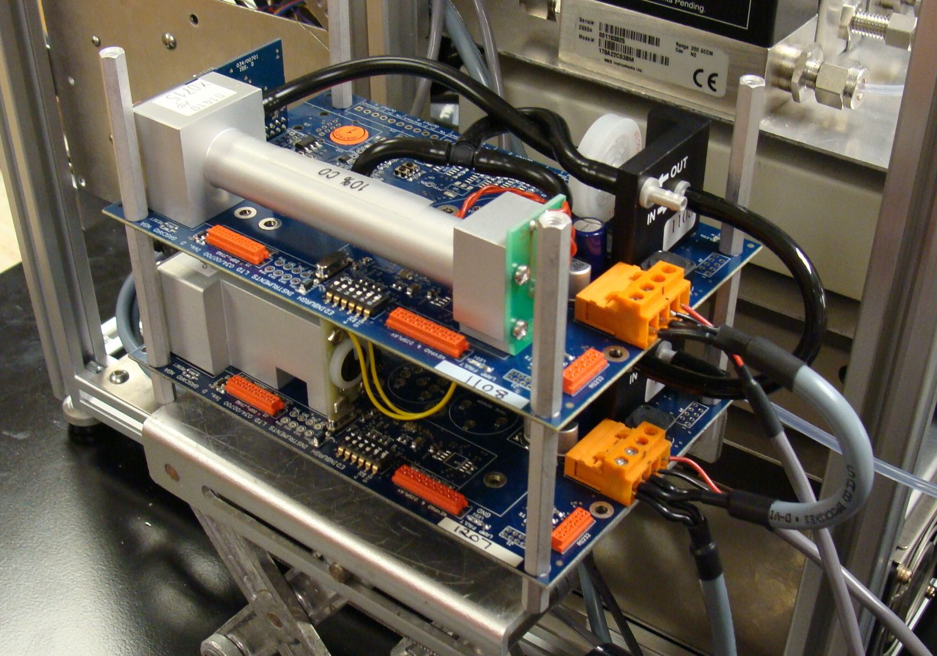
Fuel / O₂ Control and Measurement
Premixed
Combustion
Pyrolysis
Flow
Meter
Sample
Pyrolyzer
1000°C
Cold Trap
DAQ
O₂
Analyzer
N₂
O₂
Φ
CO
CO₂
Control From Look-up Table
Exhaust

Slide 21
Combustion Gas Analysis
Mass flow rate of gas
Where i = O₂, CO, CO₂
Time integral for total amount of gas consumed/produced
Yield of gas per mass of volatile fuel in sample

Slide 22
Maximum Gas Yields
Polypropylene
Stoichiometry
1 C₃H₆ + 4.5 O₂ 3 CO₂ + 3 H₂O

Slide 23
Mass Balance on Product Yields
Non-Charring
Charring

Slide 24
MCC Combustion Gas Histories

Slide 25
Combustion Chemistry Changes with Fire Stage
6
PE
Fuel + O₂ → CO + H₂O + …
CO + O₂ → CO₂ + O
HIPS
5
ABS
4
CO/CO₂ Ratio (g/g)
PA66
3
POM
2
PMMA
1
0
0
0.5
1
1.5
2
2.5
Fuel/Oxygen Ratio (Relative to Stoichiometric)

Slide 26
Matching Yields for CO & CO₂ Gives Φ_{flame} in Cone
For Low Soot Polymers, GER ≈ Φ_{flame} < 1
Premixed (MCC)
Diffusion Flame (Cone)
10
10
CO₂
CO₂
1
COx Yields kg/kg
1
0.1
CO
POM
0.1
PE
0.01
CO
0.001
0.01
0
0.5
1
1.5
2
0
0.5
1
1.5
2
Effective Equivalence Ratio, Φ
Effective Equivalence Ratio, Φ
10
CO₂
10
CO₂
1
1
COx Yields kg/kg
0.1
CO
0.1
0.01
PMMA
0.01
CO
PA66
0.001
0.001
0
0.5
1
1.5
2
0
0.5
1
1.5
2
Effective Equivalence Ratio, Φ
Effective Equivalence Ratio, Φ

Slide 27
Matching Yields for CO & CO₂ Gives Φ_{flame} in Cone
10
For Soot-Forming Polymers,
GER ≈ Φ_{flame} ≈ 1
CO₂
1
COx Yields kg/kg
0.1
Premixed (MCC)
Diffusion Flame (Cone)
ABS
CO
0.01
0
0.5
1
1.5
2
Effective Equivalence Ratio, Φ
10
10
CO₂
CO₂
1
1
COx Yields kg/kg
COx Yields kg/kg
0.1
0.1
CO
HIPS
PVDF
CO
0.01
0.01
0
0.5
1
1.5
2
0
0.5
1
1.5
2
Effective Equivalence Ratio, Φ
Effective Equivalence Ratio, Φ

Slide 28
Comparison of All Vitiated PA66 Yields
Carbon Monoxide
Hydrogen Cyanide
1000
100
10
100
CO Yield (g/kg)
HCN Yield (g/kg)
ISO Room
1
1/3 ISO Room
Controlled Atm.
Cone Calorimeter
10
Fire Propagation
Apparatus
0.1
Purser Furnace
MCC-FTIR
MCC-CO analyzer
1
0.01
0
0.5
1
1.5
2
2.5
0
0.5
1
1.5
2
2.5
Equivalence Ratio
Equivalence Ratio
(A. Stec & R. Hull, Fire Toxicity, 2010)

Slide 29
Combustion Chemistry at ^{χ}
POM
PMMA
PA66
PP
HDPE
PET
HIPS
DER 332
PC
ABS
PEI
PC 121R
PC ABS
PS
PVDF
PS FR
PPS
10% BBA
PVC
PC ABS FR
20% 542
20% BBA
30% BBA
40% 542
PH PC 35% F75
40% BBA
60% 542
PH PC 60% F286
80% 542
PH F297

Slide 30
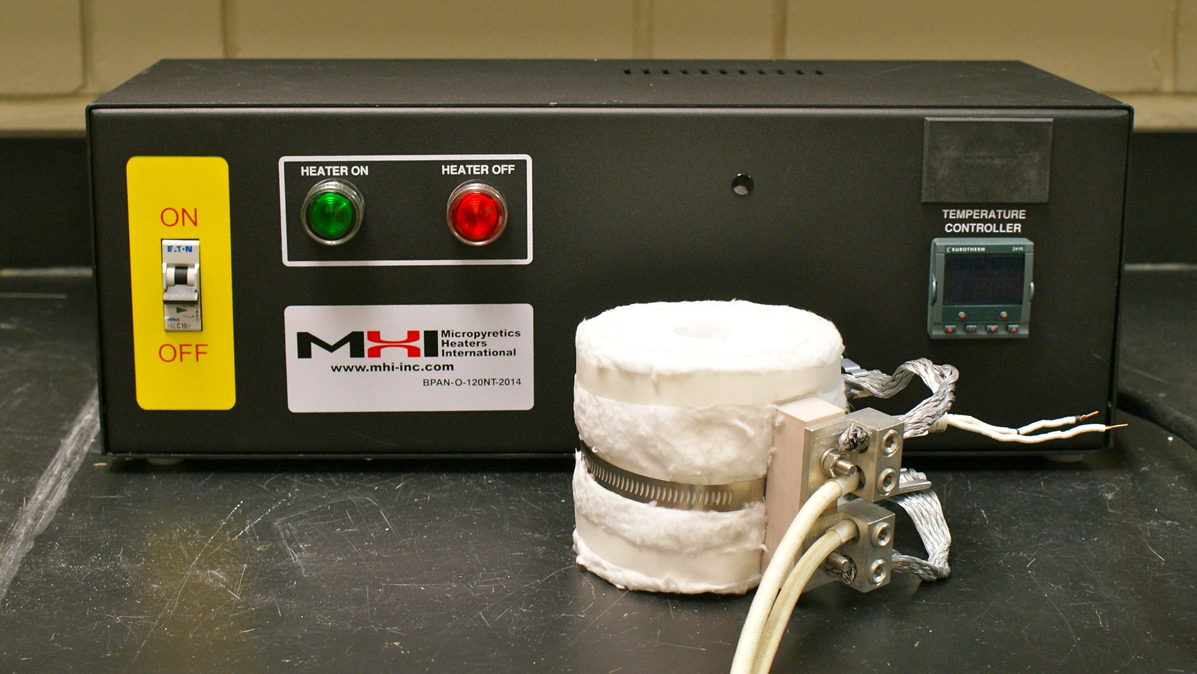
High Temp Combustion Furnace
Heater capable of reaching 1700°C
- Approaches flame temperatures
- Recreate flame chemistry

Slide 31
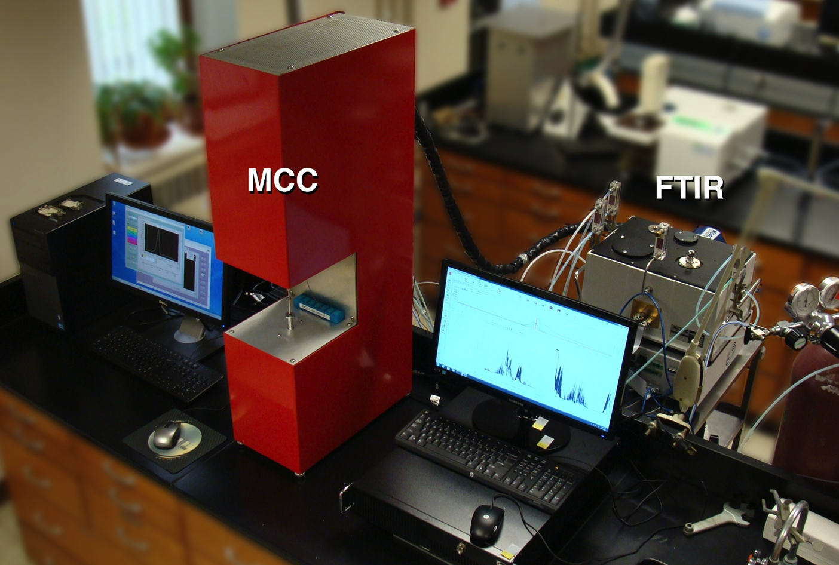
MCC w/ FTIR Evolved Gas Analysis

Slide 32
Present / Future Work
Generate new FT-IR calibration spectra & develop method more
Test more materials & flame retardants
Examine higher combustion temperatures
Derive a toxicity index

Slide 33
Conclusions
MCC-FTIR technique shows promise for monitoring combustion gas species using milligram samples in a 15 minute test with accurate control of equivalence ratio.
The MCC-FTIR methodology will be used to screen novel chemical compounds (e.g., organometallics) for gas phase flame inhibition activity.
The toxic gas yields may be incorporated into mixture fraction models for CFD.

