Slide 1
Combustion Products of Polymers at Constant Fuel/Oxygen Ratios
Louise C. Speitel, Richard N. Walters, & Richard E. Lyon

Slide 2
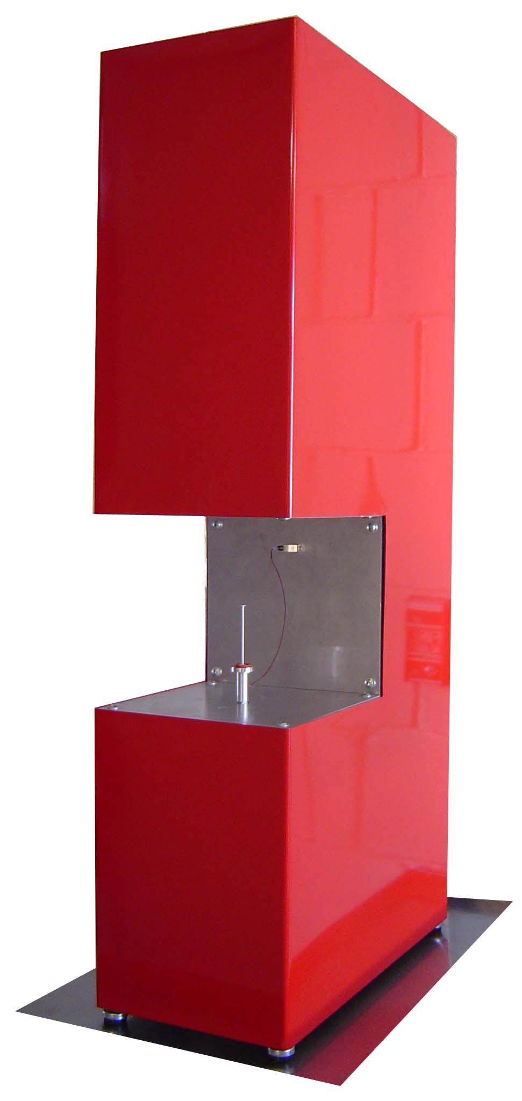
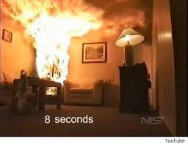
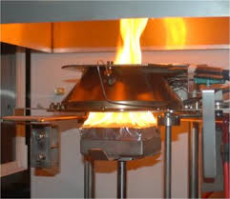
Approach
Develop rapid laboratory test to screen flame retardants and FR plastics for:
  Gas phase activity
  Combustion toxicity
10³ kg
1 kg
10⁻⁶ kg

Slide 3
Strategy
Measure Fire Effluents at Micro Scale
  Generate fire effluents in the the Microscale Combustion Calorimeter (MCC) at various fuel/oxygen (Φ) ratios
  Measure combustion gases using
    CO and CO₂ analyzers
    Fourier Transform Infrared (FTIR) spectrometer
  Develop FTIR method/s for those combustion gases

Slide 4
Microscale Combustion Calorimeter

Slide 5
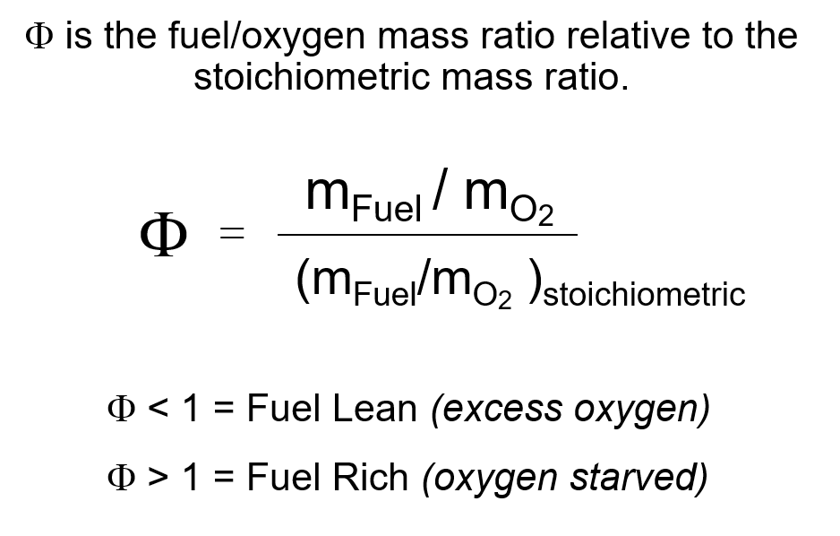
Fuel / Oxygen Ratio in MCC

Slide 6
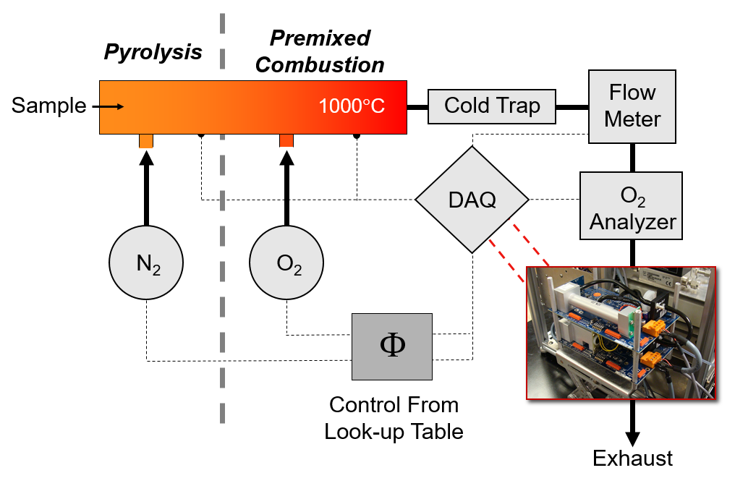
Fuel / O₂ Control and Measurement

Slide 7
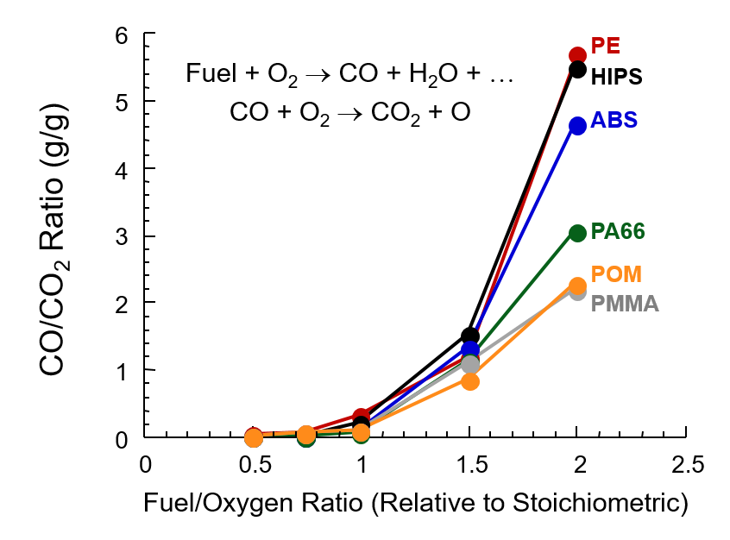
Combustion Chemistry Changes with Fire Stage

Slide 8
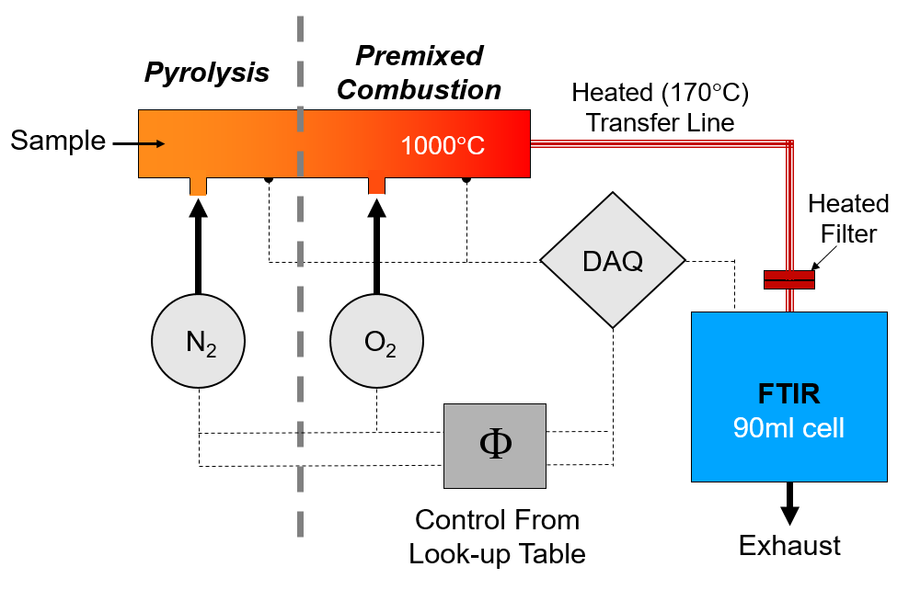
Schematic MCC-FTIR

Slide 9
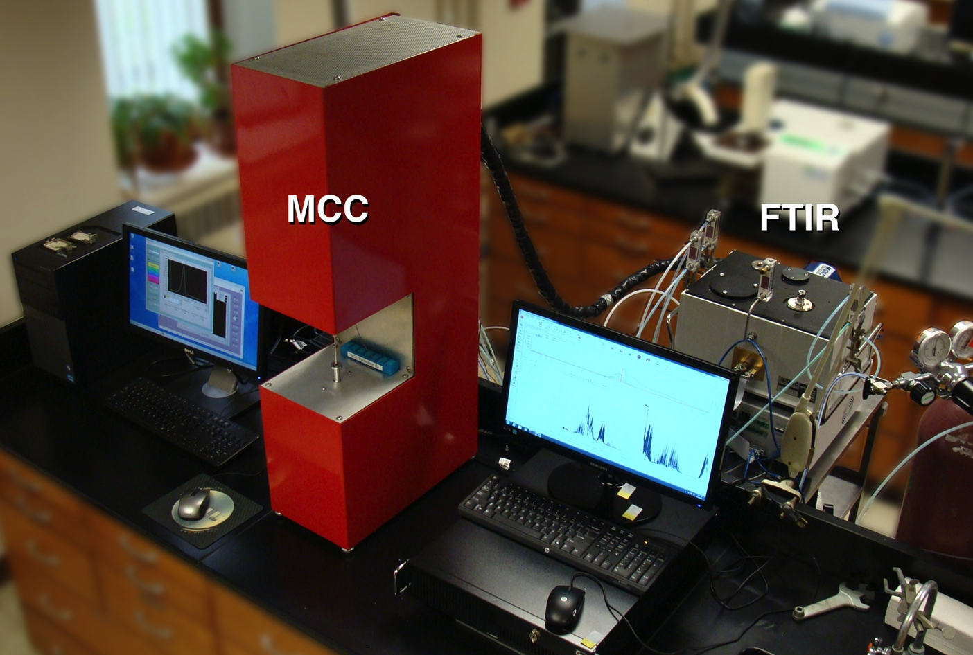
MCC w/ FTIR Evolved Gas Analysis

Slide 10
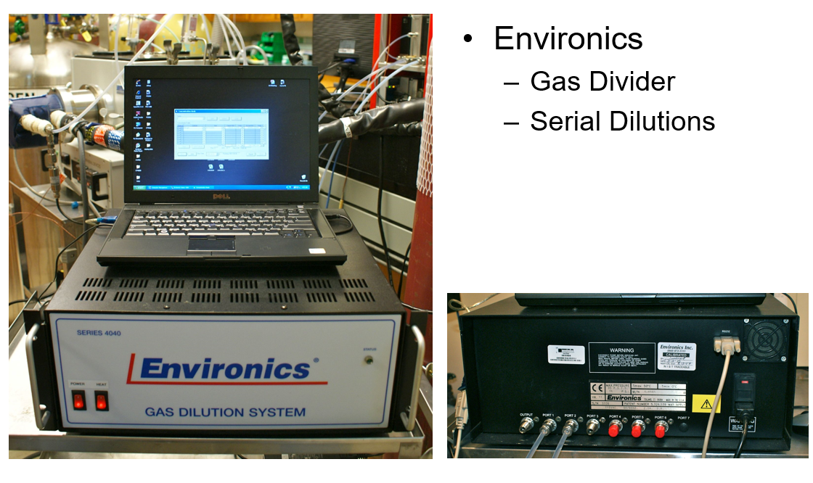
Multi-Point Calibration

Slide 11
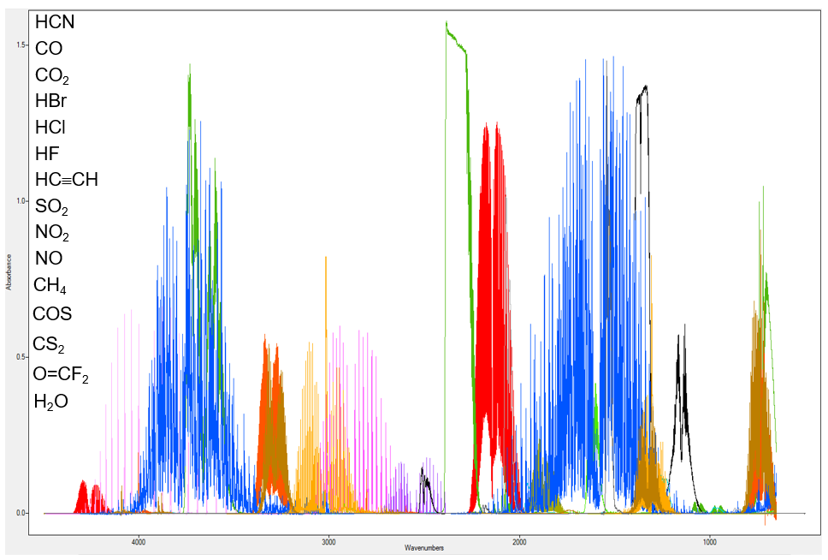
Spectra for 15 Combustion Gases

Slide 12
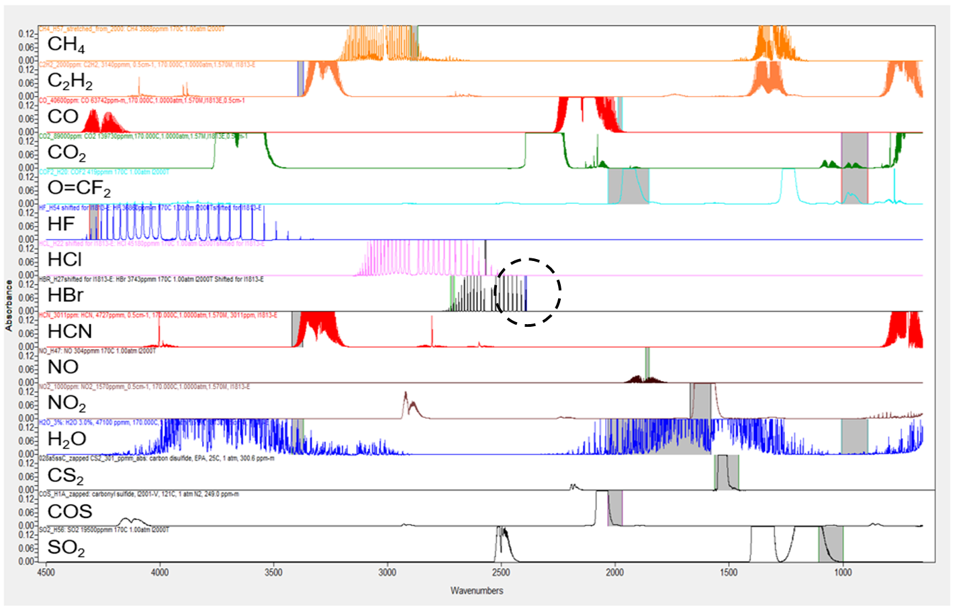
Spectral Regions for Combustion Gases:
Method 1

Slide 13
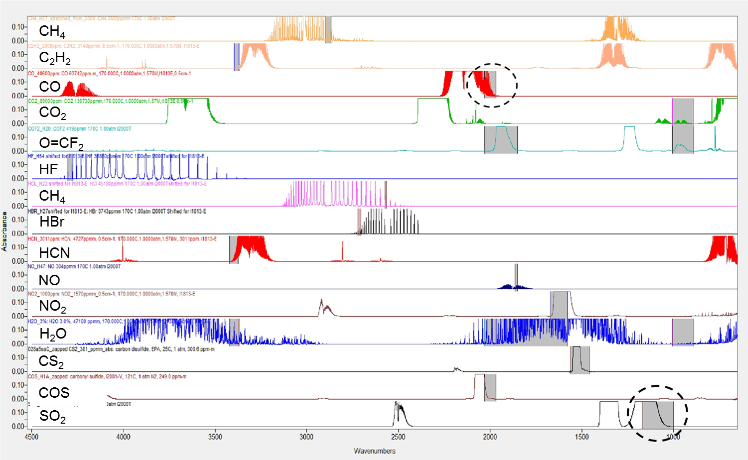
Spectral Regions for Combustion Gases:
Method 2

Slide 14
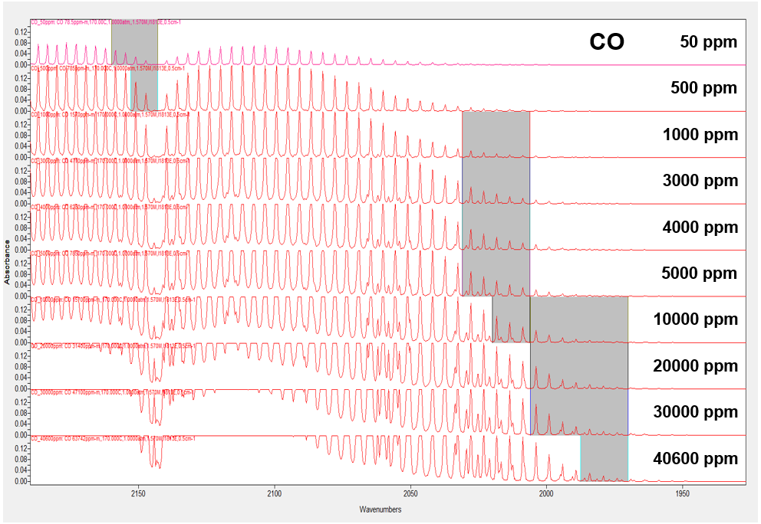
Multi-Point Calibration Spectral Regions

Slide 15
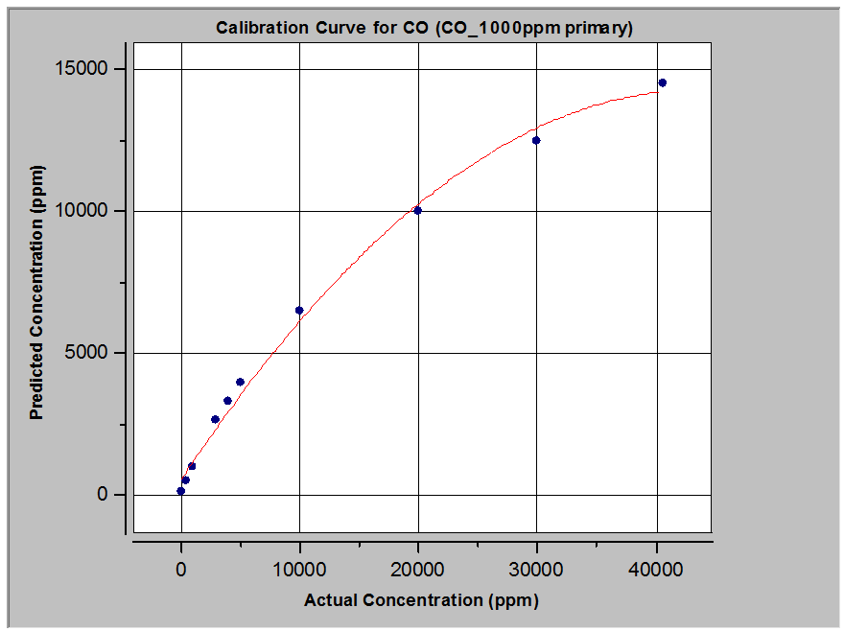
Multi-Point Calibration

Slide 16
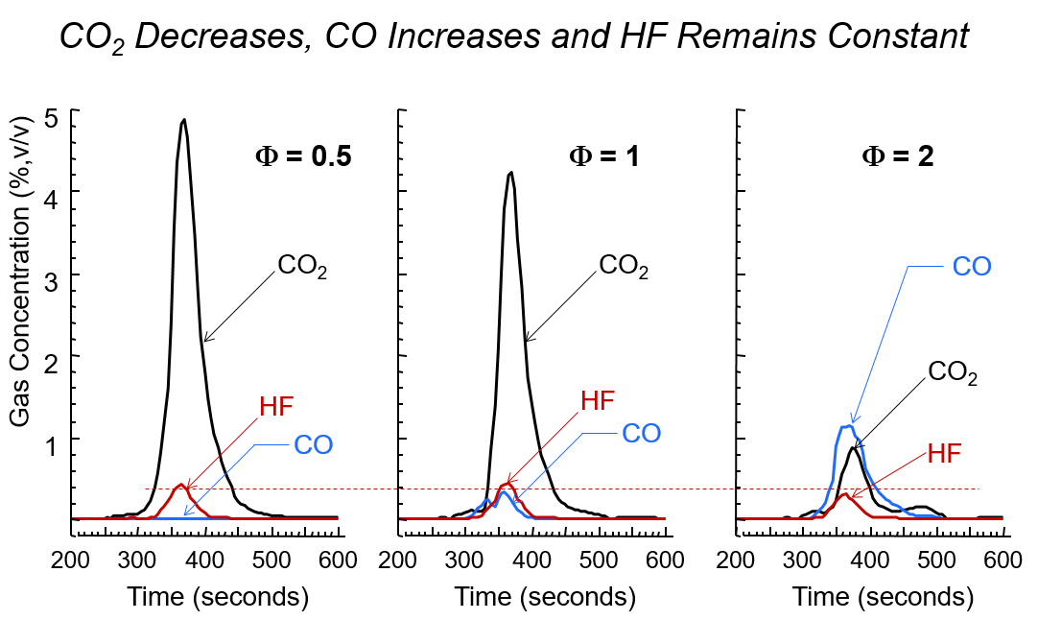
HF From Polyvinylflouride (PVF)

Slide 17
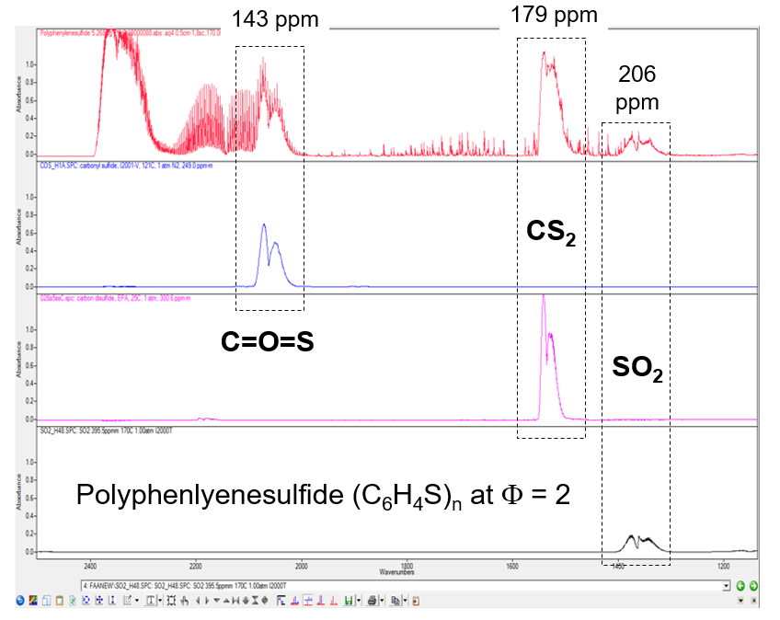
FTIR of Sulfurous Gases from PPS

Slide 18
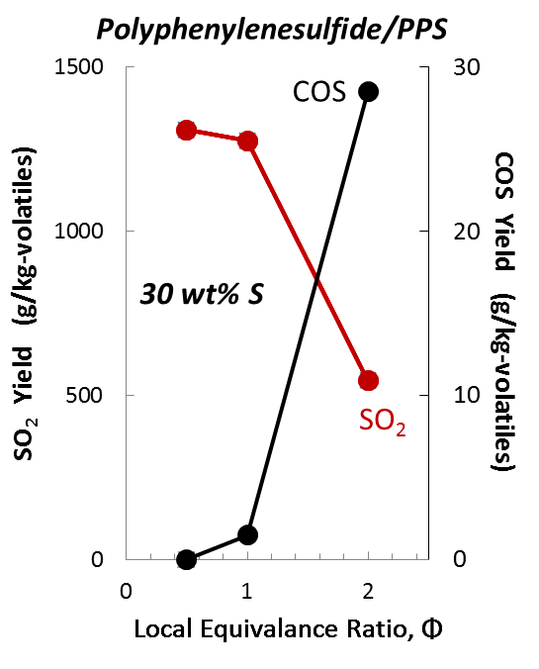
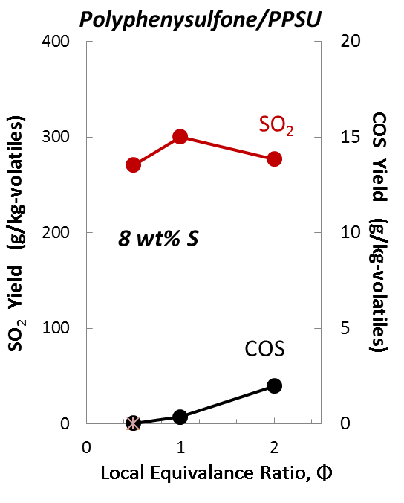
Sulfurous Product Yields ∝ Weight Fraction Sulfur

Slide 19
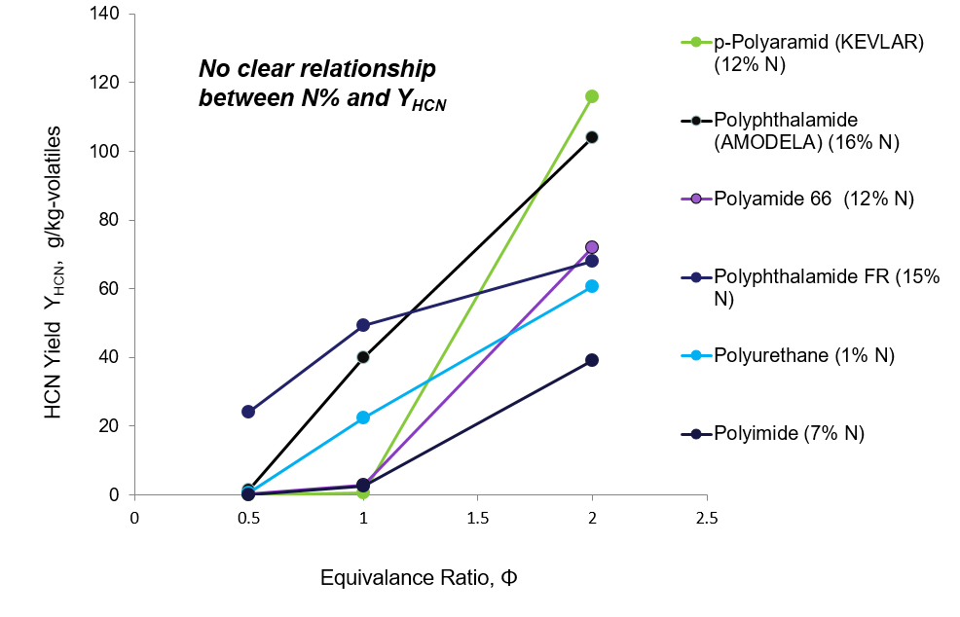
HCN vs Φ for N-Containing Polymers

Slide 20
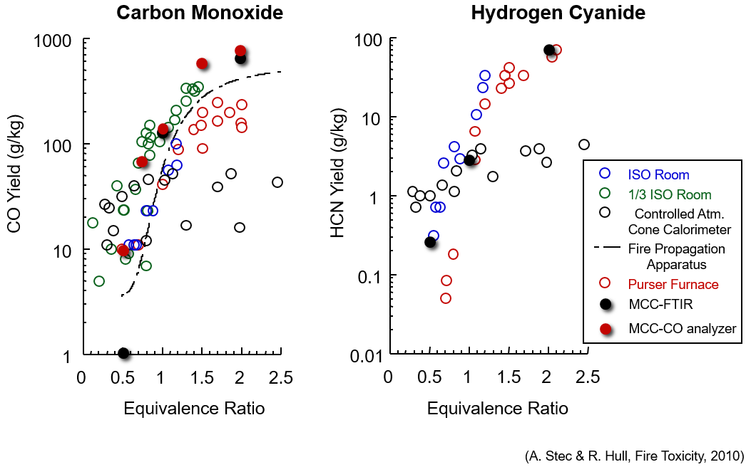
Comparison of All Vitiated PA66 Yields

Slide 21
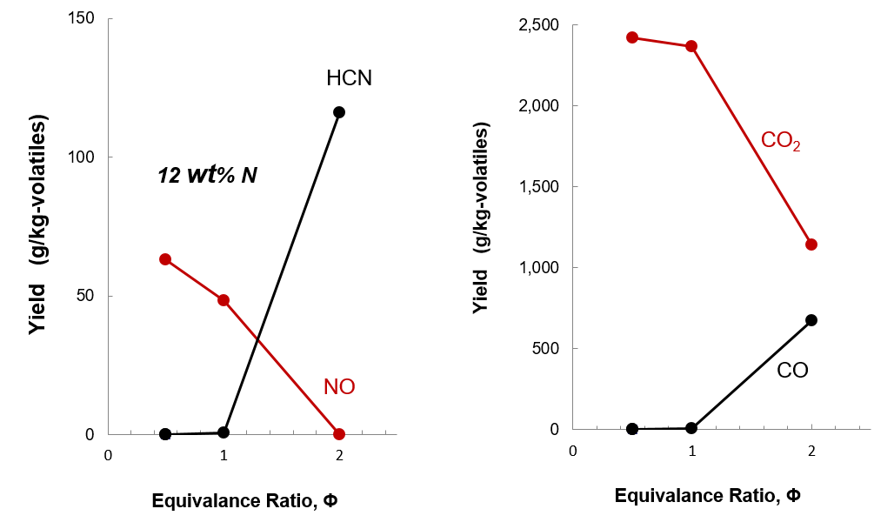
Toxic Gas Yields for p-Polyaramid (KEVLAR)

Slide 22
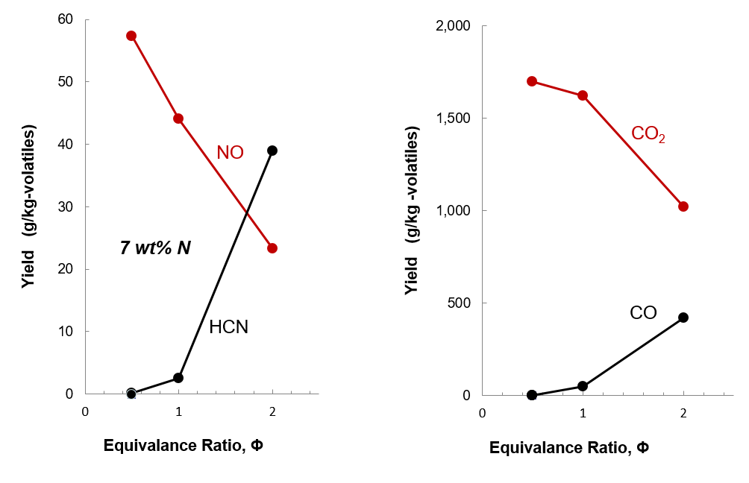
Toxic Gas Yields for Polyimide (KAPTON)

Slide 23
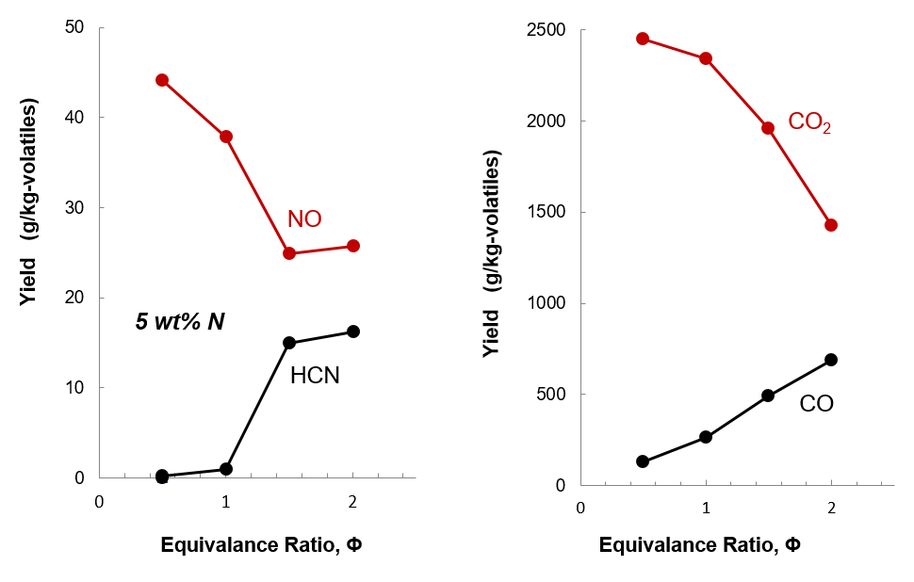
Toxic Gas Yields for Polyetherimide (ULTEM)

Slide 24
Toxic Gas Yields (FTIR): Weight Basis
Phi | Material | CO (g/g) | CO2 (g/g) | COF2 (g/kg) | COS (g/kg) | HBr (g/kg) | HCN (g/kg) | HCl (g/kg) | HF (g/kg) | NO (g/kg) | NO2 (g/kg) | SO2 (g/kg)
0.5 | ABS | 0.000 | 4.397 | 0.00 | 0.00 | 0.05 | 0.30 | 0.00 | 0.00 | 36.28 | 0.00 | 0.12
1 | ABS | 0.070 | 4.197 | 0.00 | 0.00 | 0.17 | 1.47 | 0.00 | 0.00 | 15.63 | 0.00 | 0.08
2 | ABS | 1.080 | 1.903 | 0.00 | 0.11 | 0.00 | 40.14 | 0.03 | 0.00 | 2.03 | 0.00 | 0.08
0.5 | AModelA-1002 | 0.007 | 3.134 | 0.00 | 0.00 | 0.00 | 1.36 | 0.12 | 0.62 | 37.57 | 0.00 | 0.00
1 | AModelA-1002 | 0.348 | 2.377 | 0.00 | 0.20 | 0.00 | 38.83 | 0.09 | 0.09 | 11.29 | 0.00 | 0.00
2 | AModelA-1002 | 0.670 | 1.213 | 0.09 | 0.21 | 0.00 | 101.50 | 0.16 | 0.00 | 5.20 | 0.00 | 0.00
0.5 | AModelAF-1133 | 0.136 | 1.425 | 0.00 | 0.03 | 0.00 | 13.84 | 0.15 | 0.00 | 15.10 | 0.00 | 0.06
1 | AModelAF-1133 | 0.246 | 1.070 | 0.03 | 0.07 | 0.00 | 28.51 | 2.90 | 0.09 | 11.42 | 0.00 | 0.00
2 | AModelAF-1133 | 0.372 | 0.649 | 0.05 | 0.03 | 0.00 | 38.91 | 6.41 | 0.21 | 6.66 | 0.01 | 0.00
0.5 | Boltaron 9815E | 0.003 | 0.533 | 0.60 | 0.07 | 13.19 | 0.10 | 401.47 | 12.58 | 1.54 | 0.00 | 0.66
1 | Boltaron 9815E | 0.046 | 0.458 | 0.14 | 0.02 | 3.65 | 0.15 | 387.16 | 7.20 | 1.44 | 0.04 | 1.08
2 | Boltaron 9815E | 0.168 | 0.230 | 0.00 | 0.06 | 9.89 | 0.34 | 378.41 | 10.28 | 1.03 | 0.00 | 0.20
0.5 | HIPS | 0.000 | 4.448 | 0.00 | 0.01 | 0.00 | 0.40 | 0.14 | 0.00 | 0.03 | 0.00 | 0.00
1 | HIPS | 0.042 | 4.230 | 0.00 | 0.01 | 0.04 | 0.09 | 0.07 | 0.00 | 0.00 | 0.00 | 0.08
2 | HIPS | 1.095 | 1.764 | 0.01 | 0.04 | 0.00 | 0.18 | 0.05 | 0.00 | 0.00 | 0.00 | 0.00
0.5 | Isoplast PU | 0.000 | 2.990 | 0.00 | 0.00 | 0.00 | 0.12 | 6.09 | 0.80 | 43.13 | 0.00 | 0.41
1 | Isoplast PU | 0.303 | 2.339 | 0.00 | 0.03 | 0.00 | 20.96 | 2.29 | 0.22 | 18.54 | 0.00 | 0.43
2 | Isoplast PU | 0.791 | 1.116 | 0.07 | 0.10 | 0.00 | 56.56 | 0.29 | 0.00 | 6.33 | 0.00 | 0.69
0.5 | Kadel E-1000 | 0.000 | 1.649 | 0.00 | 0.01 | 0.00 | 0.03 | 0.14 | 0.11 | 0.06 | 0.00 | 0.22
1 | Kadel E-1000 | 0.103 | 1.319 | 0.00 | 0.02 | 0.00 | 0.11 | 0.54 | 0.09 | 0.24 | 0.00 | 0.38
2 | Kadel E-1000 | 0.474 | 0.623 | 0.00 | 0.02 | 0.00 | 0.05 | 0.48 | 0.00 | 0.05 | 0.00 | 0.69
0.5 | Kadel E-1230 | 0.084 | 0.911 | 0.00 | 0.01 | 0.00 | 0.06 | 0.58 | 0.00 | 0.29 | 0.00 | 0.06
1 | Kadel E-1230 | 0.208 | 0.606 | 0.01 | 0.02 | 0.00 | 0.12 | 0.36 | 0.09 | 0.02 | 0.00 | 0.06
2 | Kadel E-1230 | 0.255 | 0.487 | 0.02 | 0.06 | 0.00 | 0.06 | 0.53 | 0.00 | 0.02 | 0.00 | 0.00

Slide 25
Toxic Gas Yields (FTIR): Weight Basis
Phi | Material | CO (g/g) | CO2 (g/g) | COF2 (g/kg) | COS (g/kg) | HBr (g/kg) | HCN (g/kg) | HCl (g/kg) | HF (g/kg) | NO (g/kg) | NO2 (g/kg) | SO2 (g/kg)
0.5 | Kevlar | 0.000 | 1.485 | 0.01 | 0.00 | 0.00 | 0.00 | 0.03 | 0.00 | 38.60 | 0.00 | 0.00
1 | Kevlar | 0.004 | 1.452 | 0.00 | 0.00 | 0.00 | 0.35 | 0.12 | 0.00 | 29.55 | 0.00 | 0.36
2 | Kevlar | 0.409 | 0.694 | 0.01 | 0.03 | 0.00 | 70.61 | 0.04 | 0.19 | 15.78 | 0.00 | 0.50
0.5 | PA66 | 0.000 | 3.169 | 0.00 | 0.00 | 0.00 | 0.25 | 0.16 | 0.00 | 31.99 | 0.00 | 0.47
1 | PA66 | 0.120 | 2.735 | 0.01 | 0.02 | 0.06 | 2.80 | 0.00 | 0.00 | 8.07 | 0.00 | 1.57
2 | PA66 | 0.634 | 1.333 | 0.05 | 0.02 | 0.25 | 71.33 | 0.15 | 0.00 | 1.69 | 0.00 | 0.24
0.5 | PE | 0.000 | 4.351 | 0.00 | 0.01 | 0.36 | 0.58 | 0.04 | 0.00 | 0.58 | 0.00 | 0.00
1 | PE | 0.491 | 3.319 | 0.11 | 0.01 | 0.00 | 0.00 | 0.06 | 0.00 | 0.02 | 0.00 | 0.23
2 | PE | 0.933 | 1.894 | 0.36 | 0.14 | 0.00 | 0.11 | 0.07 | 0.00 | 0.08 | 0.00 | 0.07
0.5 | Polyimide | 0.000 | 0.685 | 0.00 | 0.00 | 0.00 | 0.04 | 0.02 | 0.61 | 23.18 | 0.00 | 0.00
1 | Polyimide | 0.020 | 0.640 | 0.00 | 0.00 | 0.00 | 0.99 | 0.08 | 0.00 | 17.41 | 0.00 | 0.00
2 | Polyimide | 0.163 | 0.397 | 0.00 | 0.00 | 0.00 | 15.17 | 0.05 | 0.00 | 9.09 | 0.00 | 0.00
0.5 | Polybromo3styrene | 0.012 | 2.714 | 0.00 | 0.00 | 0.87 | 0.00 | 2.90 | 8.57 | 1.60 | 0.00 | 0.03
1 | Polybromo3styrene | 0.440 | 0.786 | 0.05 | 0.00 | 40.78 | 0.12 | 10.94 | 44.41 | 0.40 | 0.00 | 0.16
2 | Polybromo3styrene | 0.817 | 0.464 | 0.98 | 0.02 | 117.25 | 0.10 | 7.76 | 36.52 | 0.45 | 0.00 | 0.00
0.5 | POM | 0.000 | 2.484 | 0.00 | 0.02 | 0.00 | 0.23 | 0.06 | 0.00 | 0.06 | 0.00 | 0.00
1 | POM | 0.033 | 2.218 | 0.00 | 0.00 | 0.00 | 0.00 | 0.09 | 0.00 | 0.07 | 0.00 | 0.04
2 | POM | 0.470 | 0.949 | 0.00 | 0.02 | 0.00 | 0.14 | 0.00 | 0.00 | 0.16 | 0.00 | 0.04
0.5 | PPS | 0.001 | 1.343 | 0.00 | 0.01 | 0.00 | 0.00 | 0.07 | 12.25 | 1.95 | 0.00 | 777.48
1 | PPS | 0.086 | 1.215 | 0.00 | 0.86 | 0.07 | 0.07 | 0.85 | 6.20 | 1.21 | 0.00 | 757.49
2 | PPS | 0.481 | 0.517 | 0.01 | 16.12 | 0.00 | 0.31 | 4.40 | 8.41 | 0.56 | 0.00 | 306.87
0.5 | PVF | 0.000 | 2.401 | 0.14 | 0.02 | 0.00 | 0.04 | 10.88 | 270.02 | 0.00 | 0.01 | 0.00
1 | PVF | 0.136 | 1.931 | 0.00 | 0.12 | 0.12 | 0.49 | 2.22 | 287.25 | 0.12 | 0.00 | 0.00
2 | PVF | 0.780 | 0.497 | 0.00 | 0.25 | 0.12 | 0.12 | 0.99 | 230.64 | 0.00 | 0.00 | 0.12

Slide 26
Toxic Gas Yields (FTIR): Weight Basis
Phi | Material | CO (g/g) | CO2 (g/g) | COF2 (g/kg) | COS (g/kg) | HBr (g/kg) | HCN (g/kg) | HCl (g/kg) | HF (g/kg) | NO (g/kg) | NO2 (g/kg) | SO2 (g/kg)
0.5 | Radel R5200 | 0.000 | 1.759 | 0.00 | 0.02 | 0.02 | 0.11 | 1.09 | 0.78 | 0.02 | 0.00 | 241.19
1 | Radel R5200 | 0.010 | 1.822 | 0.00 | 0.03 | 0.00 | 0.10 | 0.69 | 0.24 | 0.02 | 0.00 | 236.54
2 | Radel R5200 | 0.402 | 0.622 | 0.00 | 2.14 | 0.14 | 0.15 | 1.84 | 0.23 | 0.01 | 0.00 | 198.52
0.5 | Radel R7200 | 0.019 | 1.029 | 0.12 | 0.00 | 0.00 | 0.06 | 0.03 | 0.13 | 0.02 | 0.00 | 171.70
1 | Radel R7200 | 0.120 | 0.906 | 0.07 | 0.23 | 0.00 | 0.04 | 0.33 | 0.30 | 0.00 | 0.00 | 190.16
2 | Radel R7200 | 0.271 | 0.519 | 0.13 | 1.29 | 0.00 | 0.12 | 1.04 | 0.19 | 0.02 | 0.00 | 175.44
0.5 | Radel R7700GY | 0.000 | 1.811 | 0.00 | 0.00 | 0.05 | 0.11 | 7.87 | 0.46 | 0.04 | 0.00 | 256.45
1 | Radel R7700GY | 0.047 | 1.798 | 0.01 | 0.07 | 0.00 | 0.26 | 8.03 | 0.88 | 0.13 | 0.00 | 267.21
2 | Radel R7700GY | 0.437 | 0.634 | 0.00 | 1.94 | 0.00 | 0.10 | 7.66 | 0.23 | 0.02 | 0.00 | 230.79
0.5 | Tedlar TCW20BE5 | 0.000 | 1.302 | 0.59 | 0.02 | 0.00 | 0.10 | 3.97 | 111.21 | 0.19 | 0.00 | 0.00
1 | Tedlar TCW20BE5 | 0.028 | 1.234 | 0.50 | 0.01 | 0.10 | 0.15 | 2.62 | 138.32 | 0.06 | 0.00 | 0.00
2 | Tedlar TCW20BE5 | 0.369 | 0.425 | 0.49 | 0.06 | 0.00 | 0.16 | 1.74 | 143.90 | 0.10 | 0.00 | 0.00
0.5 | Torlon 4203L | 0.000 | 0.741 | 0.00 | 0.03 | 0.13 | 0.04 | 0.73 | 0.00 | 22.44 | 0.00 | 0.00
1 | Torlon 4203L | 0.001 | 1.017 | 0.02 | 0.02 | 0.21 | 0.10 | 0.67 | 0.15 | 17.39 | 0.00 | 0.22
2 | Torlon 4203L | 0.131 | 0.524 | 0.00 | 0.07 | 0.09 | 9.74 | 0.14 | 0.00 | 12.19 | 0.00 | 0.72
0.5 | Ultem 9075 | 0.068 | 1.257 | 0.00 | 0.01 | 0.00 | 0.13 | 0.00 | 0.00 | 22.65 | 0.00 | 0.00
1 | Ultem 9075 | 0.137 | 1.212 | 0.01 | 0.00 | 0.00 | 0.48 | 0.07 | 0.00 | 19.58 | 0.00 | 0.00
1.5 | Ultem 9075 | 0.242 | 0.968 | 0.01 | 0.19 | 0.00 | 7.37 | 0.02 | 3.72 | 12.31 | 0.00 | 0.05
2 | Ultem 9075 | 0.360 | 0.746 | 0.06 | 0.01 | 0.00 | 8.46 | 0.04 | 0.00 | 7.83 | 0.00 | 0.00
0.5 | Xydar G930 | 0.000 | 1.286 | 0.00 | 0.00 | 0.00 | 0.00 | 0.35 | 0.00 | 0.05 | 0.00 | 0.21
1 | Xydar G930 | 0.020 | 1.117 | 0.00 | 0.00 | 0.00 | 0.28 | 1.36 | 0.00 | 0.12 | 0.00 | 0.16
2 | Xydar G930 | 0.251 | 0.569 | 0.01 | 0.02 | 0.00 | 0.07 | 0.99 | 1.25 | 0.03 | 0.00 | 0.05

Slide 27
Toxicity Modeling for MCC at Various Φs
  Fractional effective dose (FED): FED_{I} = ∑FED_{I Gases}
  “Incapacitation” (50%) occurs when FED_{Incapacitation} = 1
      CO, CO₂, HCN
      Do not include contribution of acid gases to incapacitation
  Lethality or post-exposure lethality (50%) occurs when FED_{Lethality} = 1
      Acid gases: HF, HCl, HBr, NO₂. SO₂
  Sensory irritation occurs well before lethality
  Sensory Irritant Model: Acid Gases: HF, HCl, HBr, NO₂, SO₂
  Sensory irritants may impede escape or cause irreversible damage.

Slide 28
Present / Future Work
Generate new FT-IR calibration spectra & develop method more
Test more materials & flame retardants
Examine higher combustion temperatures
Update toxicity models for asphyxiant and irritant gases:
Consider applying ISO 13571 standard
Consider using a sensory irritation model
Apply toxicity model to MCC-Φ gas yields

Slide 29
Conclusions
MCC-FTIR technique shows promise for monitoring combustion gas species using milligram samples in a 15 minute test with accurate control of equivalence ratio.
The MCC-FTIR methodology will be used to screen novel chemical compounds (e.g., organometallics) for gas phase flame inhibition activity.
The toxic gas yields may be incorporated into mixture fraction models for toxicity assessments.

