Slide 1



Threat-based Flammability Requirements for Military Vehicle Interior Ceilings
J. G. Quintiere, C. Houston, L. Speitel, S. Crowley, R. Lyon, H. Guo
Sponsored by
United States Army Tank Automotive Research Development and Engineering Center (TARDEC)

Slide 2
Objectives
A test protocol to measure the fire thermal and toxicity hazard of ceiling cushioning materials
For the occupant compartment of an armored military vehicle subject to accidental or war fire ignition incidents.
The ignition threat should not be of significant hazard to the occupants, and
Material acceptance criteria must be established with a foundational rationale.

Slide 3
Approach
Not adopt standard relative ranking test without relevance to scenario
Use material fire properties
  Extensive listings in reference texts
  Basis for modeling
  Underlie material performance in fire
Establish ignition threat and toxicity exposure

Slide 4
Material Properties

Slide 5

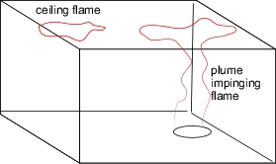
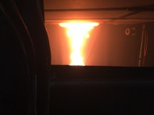
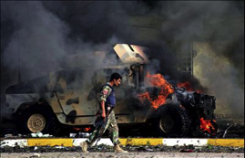
Defined Scenario
2. Ceiling Alone
1. Fire below

Slide 6
Acceptance Criteria
Ignitability Safety Factor
  No ignition: CHF > CHF_{crit} = 25 kW/m² 30
  Ignition after 2 min: TRP > TRP_{crit} = 274 kW-s^{1/2}/m², 350
  OR
No flame spread over ceiling
  HRP < HRP_{crit} = 140/(30 kW/m² –CHF) 70
  AEP < AEP_{crit} = TRP²(30-CHF)HRP/900 kJ/m²
  AND
No toxic hazard in 5 minutes (Narcotic and acid gases)
  FED_{I} < FED_{I crit} < 1 and FEC < FEC_{crit} < 1 0.3

Slide 7
Design Details
Scenario 1: fire below greater hazard than 2
Ignition fire
  No thermal or toxic hazard to occupants
  Must impinge on ceiling with flame extension
    65 kW heptane pool fire 0.3 m dia., 0.76 m below, flame radial extension 0.32 m.
    Need to obtain heat flux by this flame to ceiling
Cabin Size
  Smallest (2.2 x 3.2 x 2 m high) with with smallest vents (61 x 15.3 cm)

Slide 8
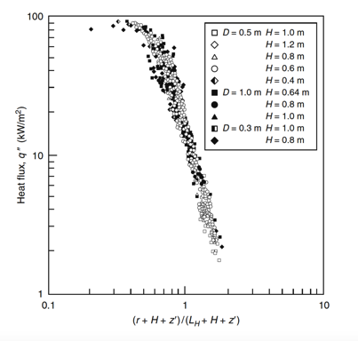
Ignition Flame Heat Flux

Slide 9
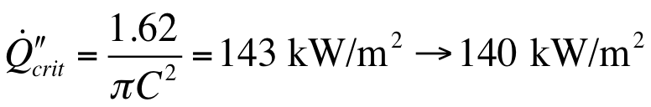
Flame Spread Critical Energy and Heat Flux
Minimum energy release rate per unit area needed to sustain flame spread
Flame heat flux in spread
70

Slide 10
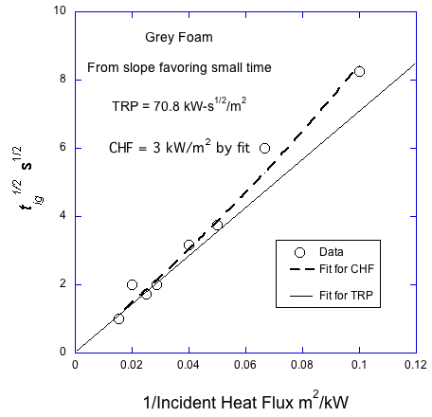
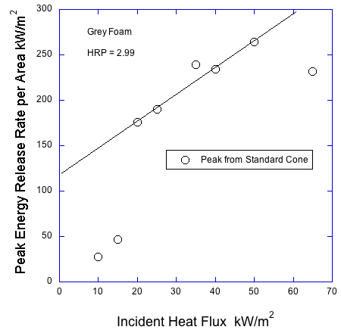
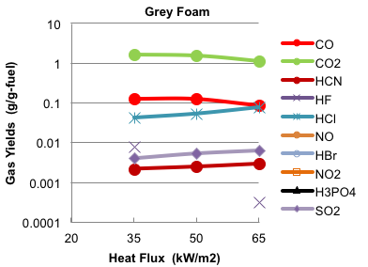
Example: Grey Foam

Slide 11
Performance of Grey Foam prediction in other tests
FAA/OSU:
ISO 9705:
UL 94:
ASTM E84:

Slide 12
Conclusions
Engineering design of test protocol for fire hazard.
Rationale for test performance is transparent.
Methodology can be improved with new knowledge.
Material fire properties can be used to judge performance in a fire scenario.
This process is superior to existing fire tests and regulations.

