Slide 1

A NATURALLY VENTILATED BENCH SCALE
FIRE CALORIMETER
James G. Quintiere¹, Sean Crowley, Haiqing Guo² , Richard E. Lyon
FAA Fire Safety Branch, Atlantic City International Airport, NJ
¹University of Maryland, College Park
²C-FAR Services, Marmora, NJ

Slide 2
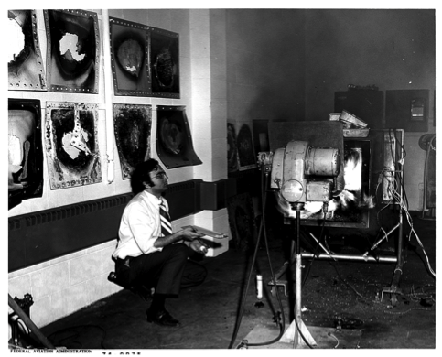
Background?
Constantine (Gus) Sarkos
Working on an Unrelated Project 1974

Slide 3
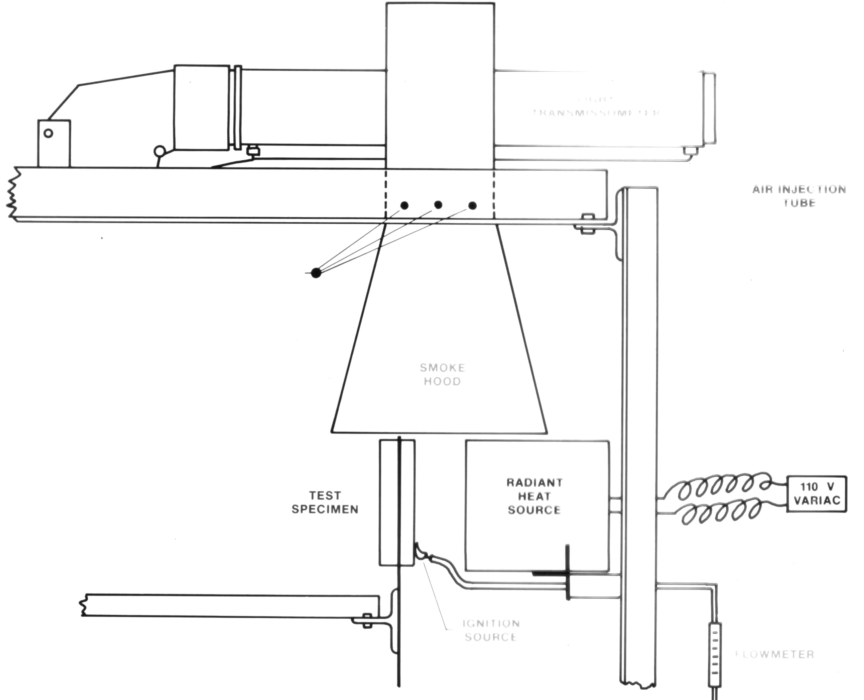

FAA Concept for a Naturally-ventilated, Bench-scale Fire Calorimeter (circa 1985)
Light Transmission
Air Injection
Tube (smoke)
Thermocouples
Smoke
Hood
Test Specimen
Radiant
Heat
Source
Methane
Flow Meter
Ignition
Source

Slide 4

2016 Redesign Objectives
Low Cost
Low Maintenance
Flexible operation
High Accuracy and Repeatability
High throughput for QC?
Approach
Buoyancy driven flow
Low cost oxygen consumption calorimetry
  Mass flow rate from gas temperature only
  Large oxygen consumption = low cost O₂ sensor
  Off-the-shelf (OTS) gas conditioning system

Slide 5
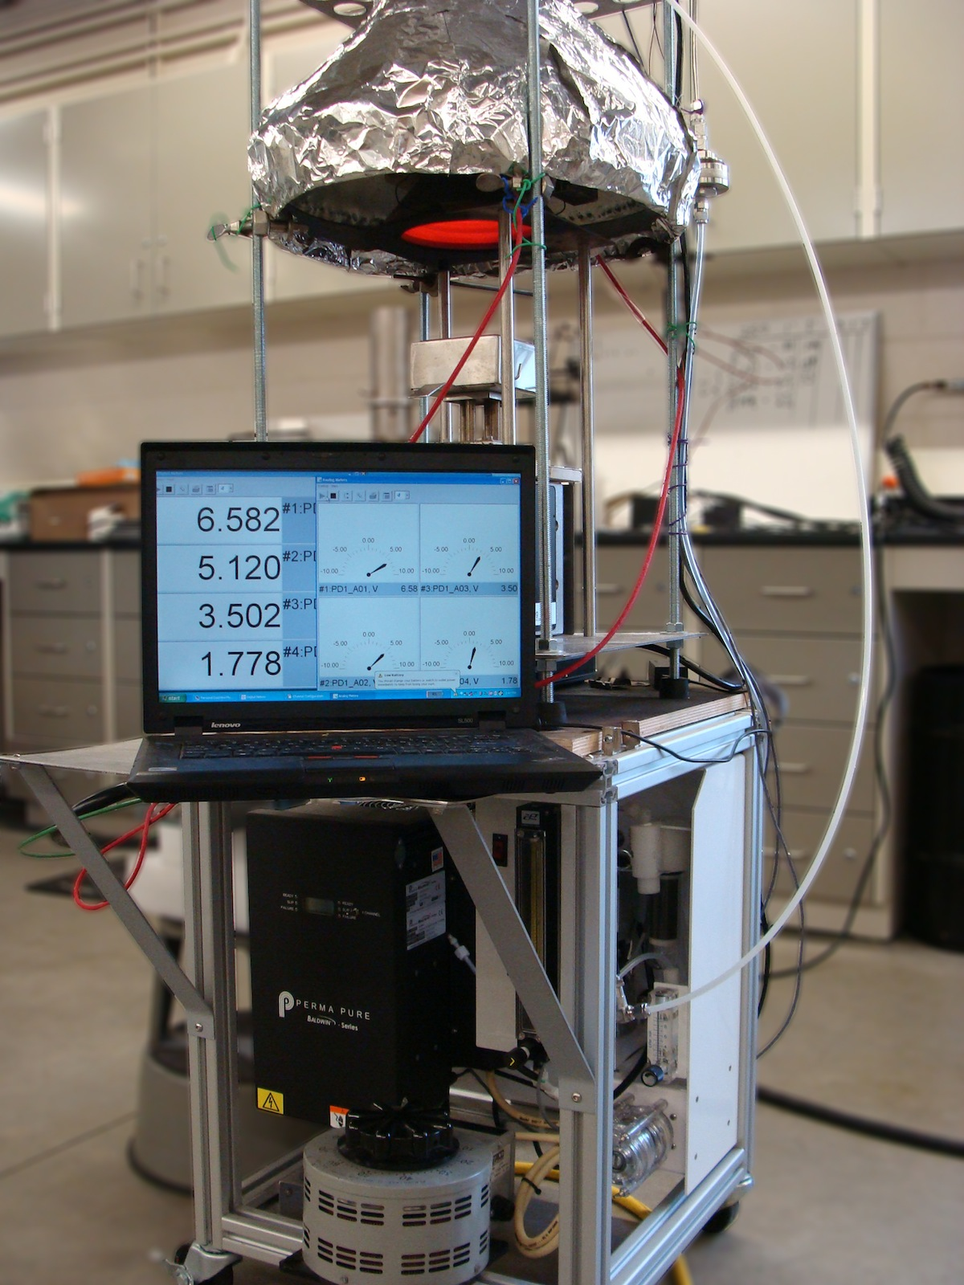
Design Variables
Buoyancy Controlled Fire Calorimeter/BCFC (FAA)
Heat release method
    Thermal method (e.g., OSU)
    Oxygen consumption
Chimney Diameter
    4-inch
    6-inch
Exit Flow Control on Chimney
    Nozzle
    No Nozzle
Standard HVAC

Slide 6
Materials
POM, PMMA, HIPS, Phenolic Aircraft Panel (low HRR)
Commercial FAA database polymers, 3-mm thick, 10-cm x 10-cm
High (99.99%) purity gases
BCFC Components
Galvanized HVAC ducting (4” and 6” diameter from Home Depot)
Micro Fuel Cell Oxygen Sensor (Teledyne 22A)
Sample gas conditioning system (PermaPure, Model 4S-9AA)
Conical radiant heater (ASTM E 1354) with constant voltage from 208V VARIAC

Slide 7


FAA concept circa 2016
Naturally-ventilated Fire Calorimeter
Chimney temperature, T_{c}
Optional Reducing Nozzle
Aspirated port for O₂ and gas temperature, T
Mixing Section
Insulated Chimney
Radiant heater
Igniter
Sample

Slide 8
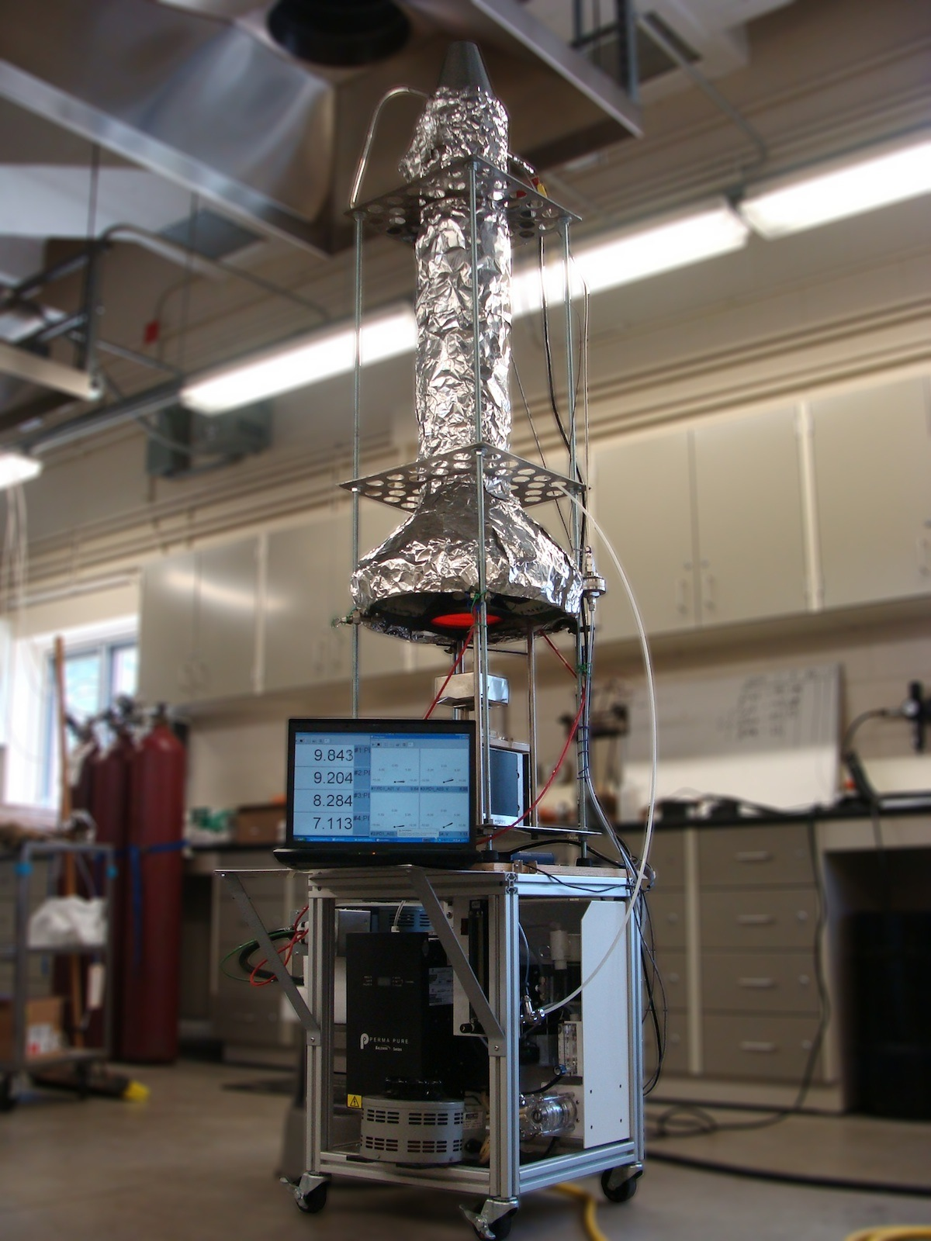
BCFC Prototype
Optional Nozzle (d/D = 1/2)
Sampling port (gas temperature, O₂)
1.5-m insulated chimney (1 inch mineral wool covered with aluminum foil)
Conical Radiant Heater (36 kW/m²)
Pilot flame (CH₄) igniter
Mass Balance
Combustion Gas Extraction and Conditioning With Chemical O₂ Sensor

Slide 9
Mass Flow Rate From Gas Temperature
Conservation of Mass
Hot Gases at T, v, ρ
T, ∆O₂
Conservation of Energy
L = 8d
H
Buoyant Pressure
d
Mass Flow Rate for (d/D)⁴ << 1
.
D
Ambient air at T∞, v∞, ρ∞

Slide 10
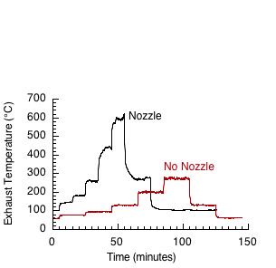
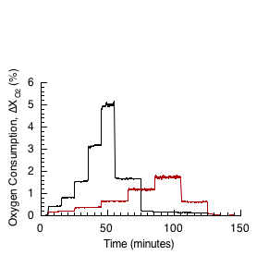
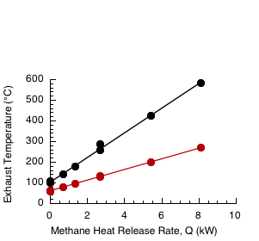
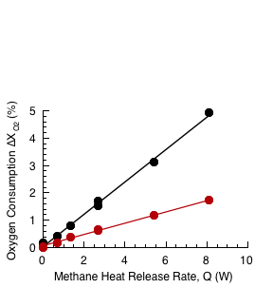
Methane Calibrations
6-inch Chimney, Nozzle vs. No Nozzle
Exhaust Temperatures
Oxygen Consumption
Nozzle
No Nozzle
Nozzle
Nozzle
No Nozzle
No Nozzle

Slide 11
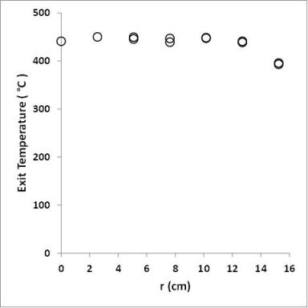
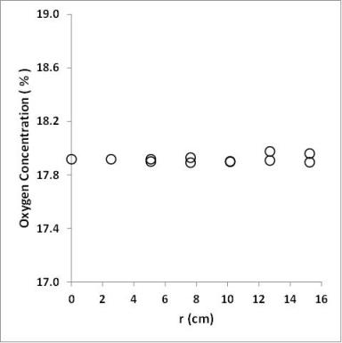
Chimney Gases Are Well Mixed
6-inch Chimney with Nozzle
Methane Diffusion Flame
Steady State Measurements
Uniform Temperature and Oxygen Profiles for Mixing Length L = 8d
Exiting Gas Temperature (°C)
Oxygen Concentration (%, v/v)
Distance from Centerline (cm)
Distance from Centerline (cm)

Slide 12
Calibrating Chimney Mass Flow Rate
From methane flow and oxygen consumption
.
.
Y_{ox} = mass fraction of O₂ in mixture
r₀ = stoichiometric ratio = 4 g-ox/g-CH₄
From buoyant gas temperature T in chimney
.
(T∞ = Ambient temperature)
C = Flow coefficient =
≈ 116 g/s (theory)
= 58 g/s (measured)

Slide 13
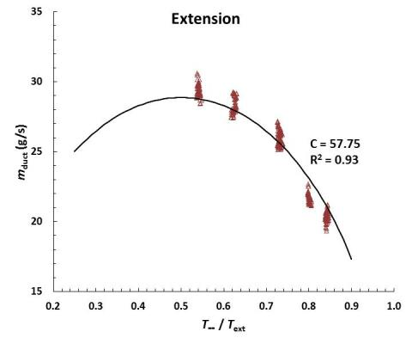
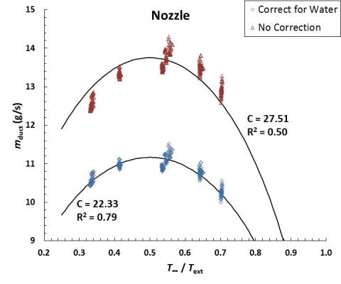
Mass Flow In 6-inch Chimney From ∆O₂ Vs. Temperature (T∞/T)
.
Solid lines are best fit of
for measured T∞/T
No Nozzle
(2X higher flow)
Nozzle
Corrected for H₂O
Duct Mass Flow From ∆O₂ (g/s)
Duct Mass Flow From ∆O₂ (g/s)
Theoretical Maximum
No H₂O correction
T∞ /T
T∞ /T

Slide 14
BCFC Heat Release Rate Calculation
.
Heat Release Rate Q (W) from O₂ and T only
Mass flow rate of oxygen
in combustion gases (g-O₂/s) = f(T)g(X_{O2})
.
Heat of combustion of O₂ with common fuels = 13.1 kJ/g-O₂
C = Empirical flow coefficient (g-gas/s)
X_{O2} = Volume (mole) fraction of O₂ in combustion gases
λ = Mass of O₂ / Mass of combustion gases = 1.11 (air)
α = H₂O volume correction factor = 0.7 ±0.3

Slide 15
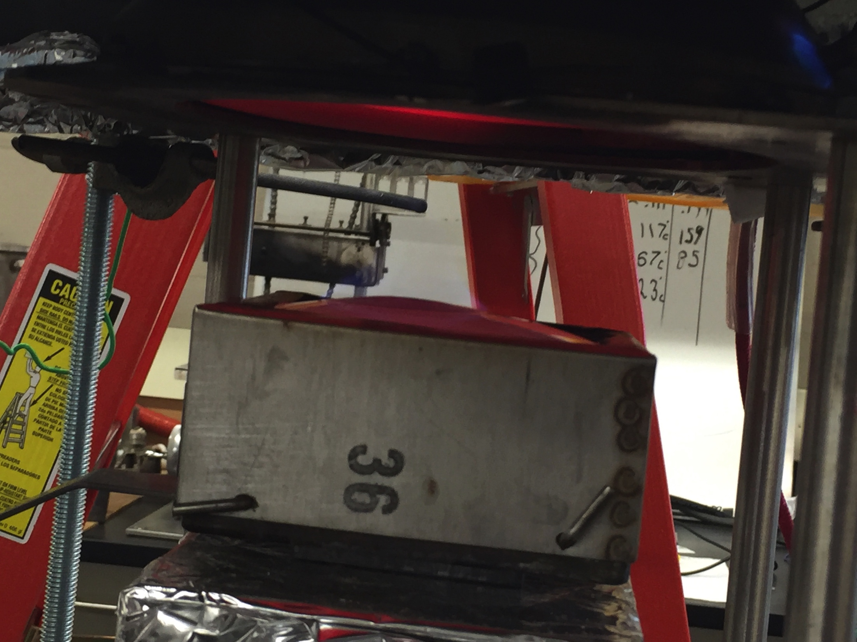
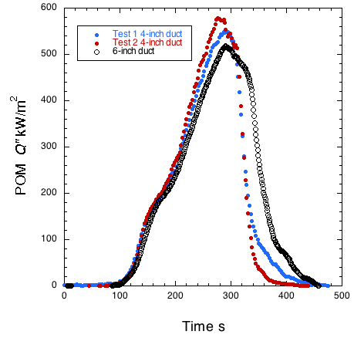
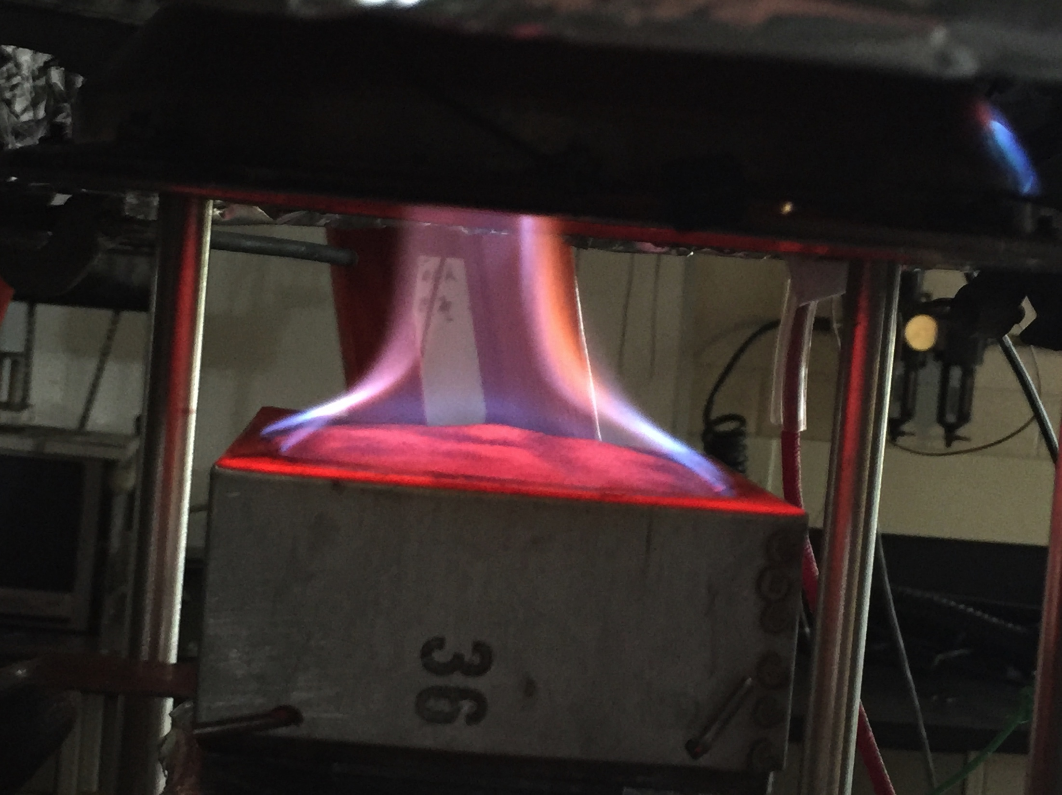
Comparing 4-inch & 6-inch Diameter Chimneys with Nozzles
Polyoxymethylene/POM
4-inch
6-inch
Before Ignition
Heat Release Rate, Q (kW/m²)
Irradiance
36 kW/m²
After Ignition

Slide 16
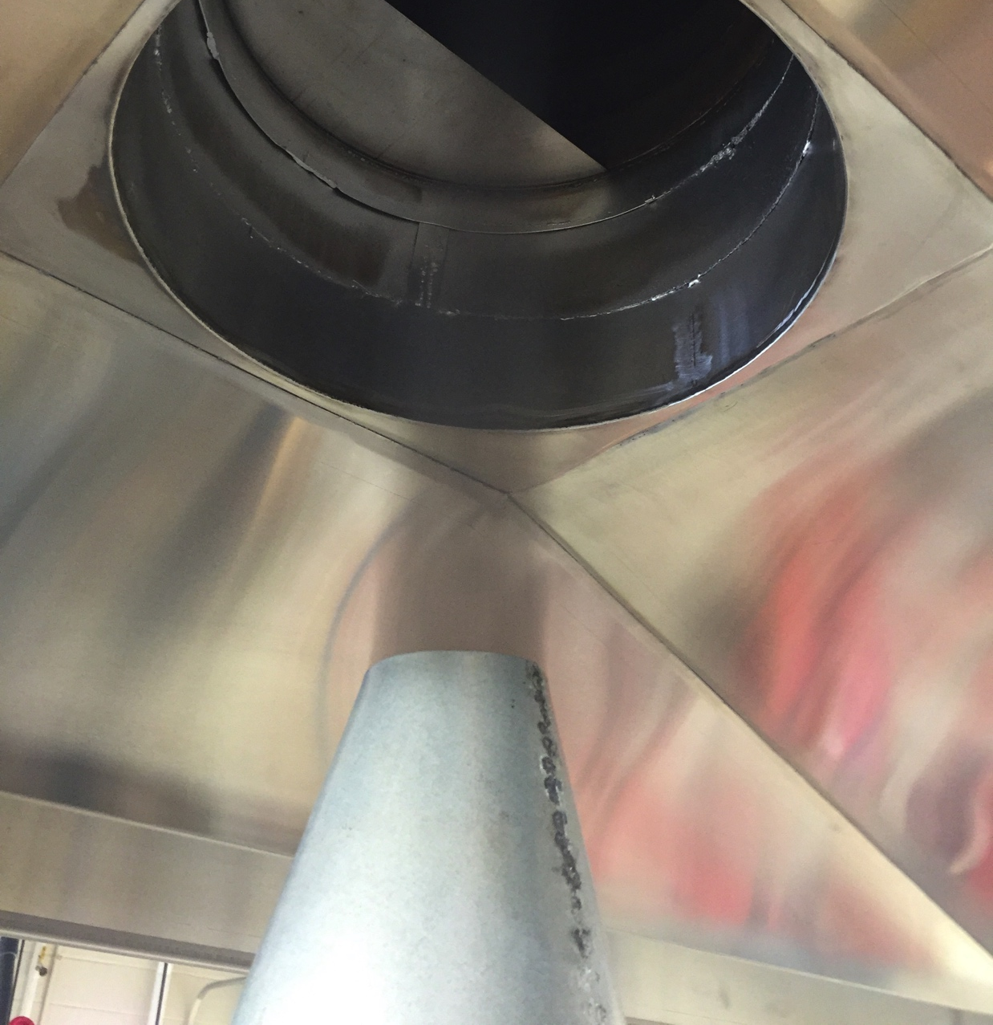
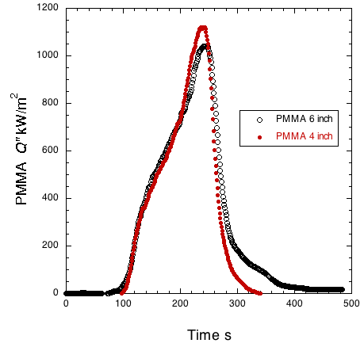
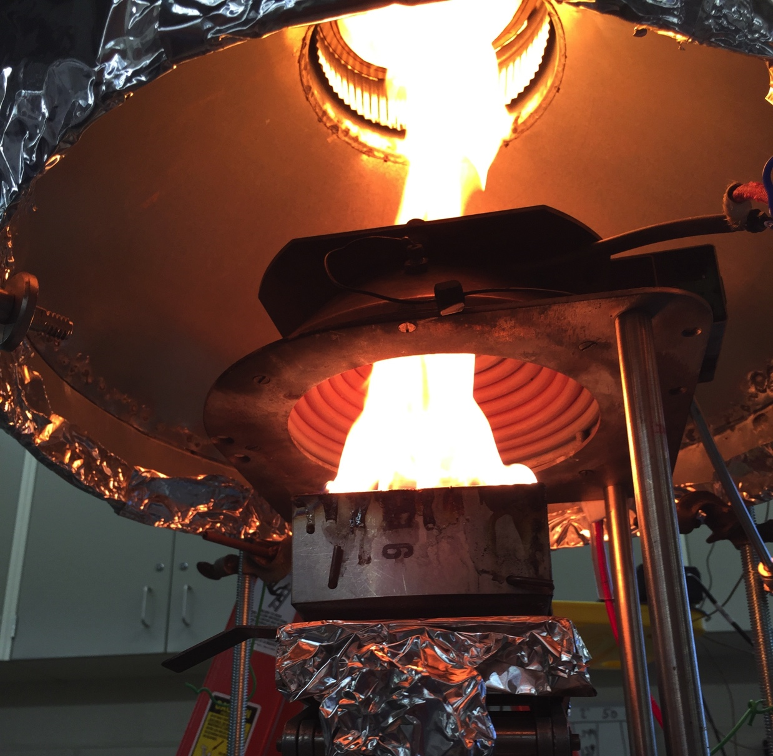
Comparing 4-inch & 6-inch Diameter Chimneys with Nozzles
Poly(methylmethacrylate)/PMMA
4-inch
Smoke exiting nozzle
Irradiance
36 kW/m²
Heat Release Rate, Q (kW/m²)
6-inch
PMMA Sample Burning

Slide 17
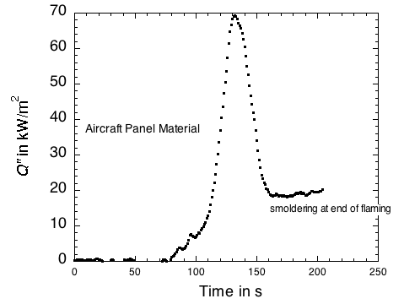
BCFC Test Of Aircraft Panel By ∆O₂
4-inch Chimney
with Nozzle
Schneller
glass/phenolic
panel
Irradiance
35 kW/m²
Heat Release Rate, Q (kW/m²)

Slide 18
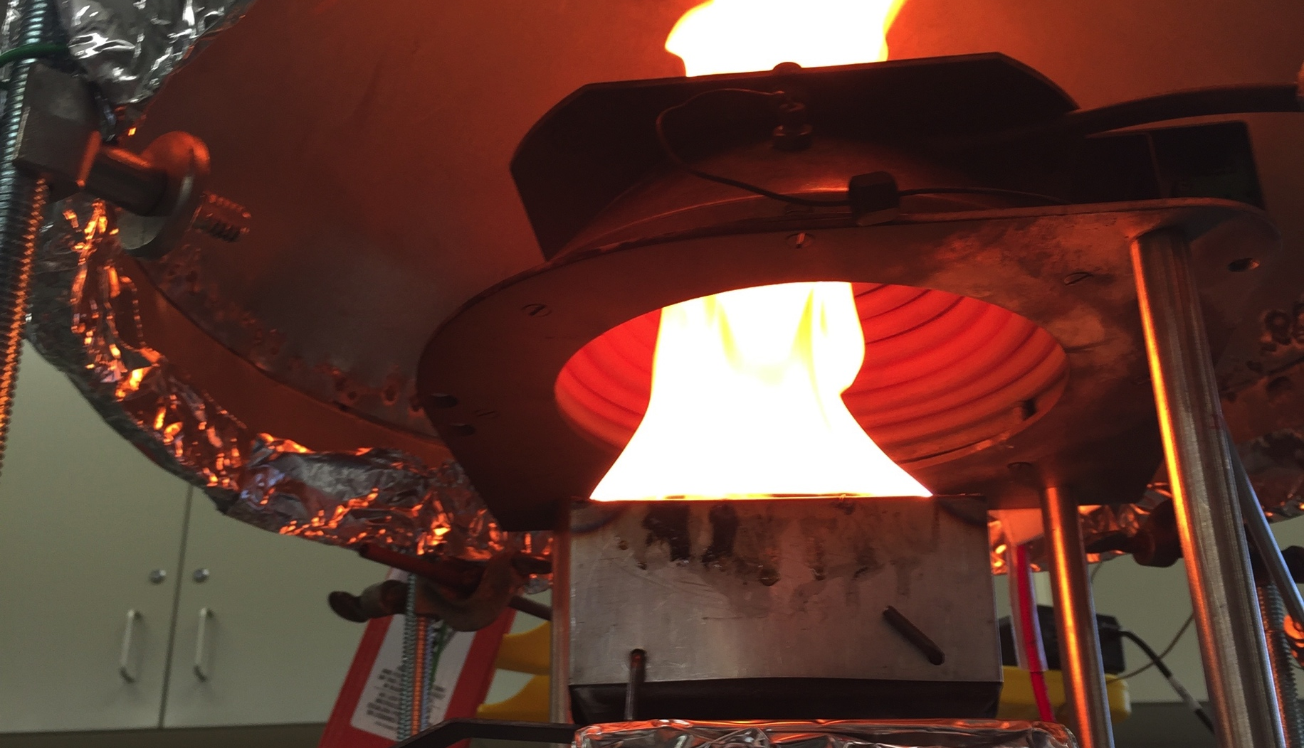
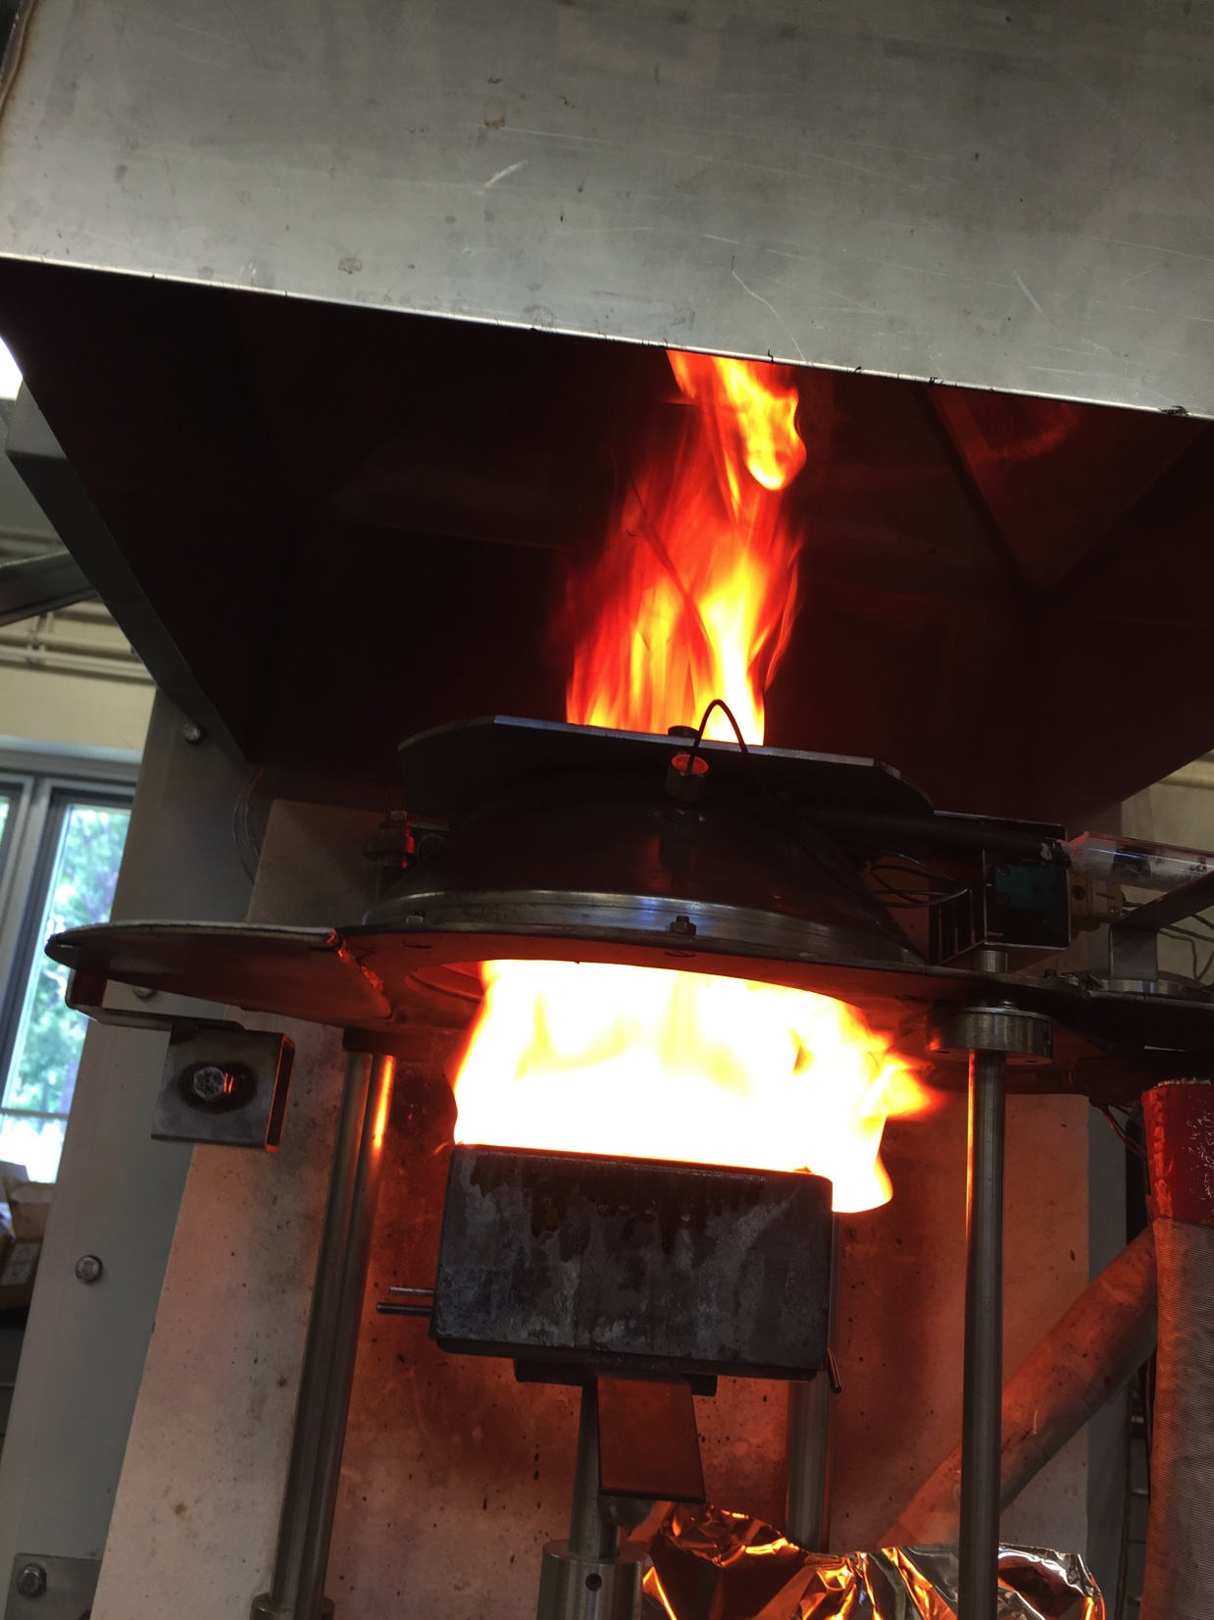
ASTM E 1354 (Cone Calorimeter)
Versus BCFC
HIPS in Cone Calorimeter
HIPS in Buoyancy Controlled Fire Calorimeter
Irradiance = 36 kW/m²

Slide 19
High Impact Polystyrene (HIPS) in Cone Calorimeter & BCFC
Cone
calorimeter
BCFC (6-inch w/nozzle)
3-mm thick HIPS
Irradiance = 36 kW/m²

Slide 20
PMMA in Cone Calorimeter & BCFC
BCFC (6-inch w/ nozzle)
3-mm thick PMMA
Irradiance = 36 kW/m²
Cone
calorimeter

Slide 21
Polyoxymethylene/POM in Cone Calorimeter & BCFC
BCFC (6-inch w/ nozzle)
3-mm thick PMMA
Irradiance = 36 kW/m²
Cone
calorimeter

Slide 22
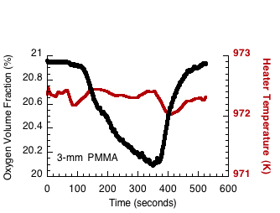
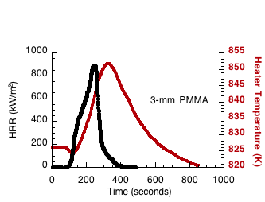
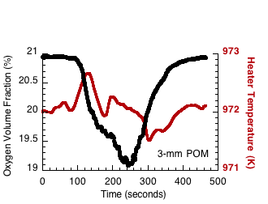
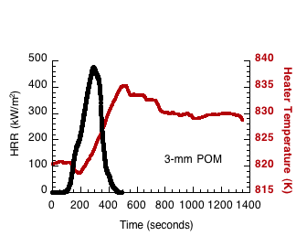
Higher Peak HRR In BCFC May be Due To Lack Of Heater Temperature Control
BCFC Heater ∆T ≈ 20K
ASTM E1354 heater ∆T ≤ 1K

Slide 23
Total Heat Release in BCFC & ASTM E 1354
Total Heat Release (MJ/m²)
PMMA
POM
HIPS
ASTM E 1354
BCFC
Difference
104
105
0%
69
77
11%
102
107
4%
Discrepancy in the heat release rate history may be due to the uncontrolled heater temperature in BCFC.
Total heat release is the same.

Slide 24

High Throughput HRR Testing?
Side View
Front View
∆T & ∆O₂
∆T & ∆O₂
Radiant Heater
Pilot flame
Drip pan

Slide 25
Conclusions
Only O₂ and T of gases are needed for HRR.
BCFC ≈ ASTM E1354 for peak HRR.
BCFC = ASTM E1354 for total HR.
Small chimney and/or nozzle = large ∆O₂ and ∆T (low HRR materials).
  Large and/or straight chimney = small ∆O₂ and ∆T (high HRR materials)
  Nozzle is less accurate than straight chimney because efficiency is T dependent.
  Thermal method is inaccurate (radiation losses) and irreproducible (BCFC thermal dynamics).

Slide 26
Future Work
Variable and controlled external heat flux (Irradiance)
Mass loss measurements
Optimize design for low HRR
    Smoldering combustion of structural composites
    Combustion toxicity of aircraft materials with natural ventilation

