Slide 1
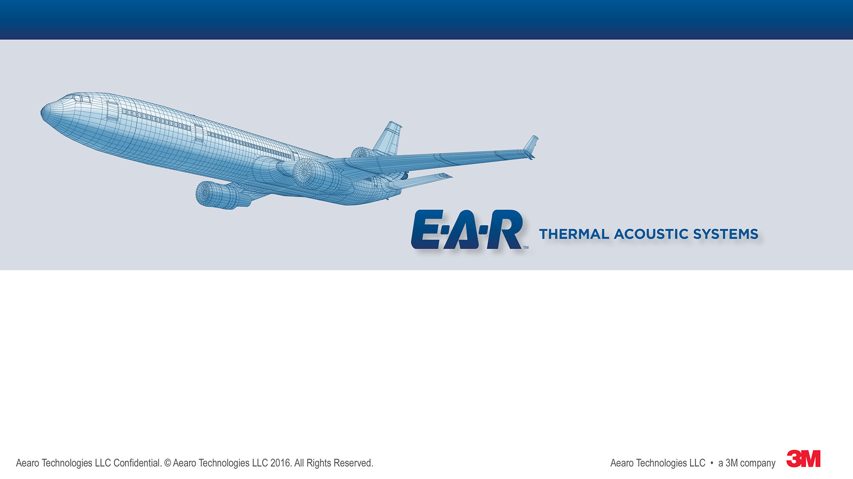
Challenges and Unexpected Benefits of Developing an Acoustic Barrier Film
8th Triennial International Aircraft Fire and Cabin Safety Research Conference
October 27, 2016
Fredrick Vance, Greg Simon, Daniel Robinson

Slide 2
Outline
Introduction to acoustic systems
Impact of global regulations on materials
Vulcanization primer and challenges
Flame, acoustic and other test results
Conclusions

Slide 3
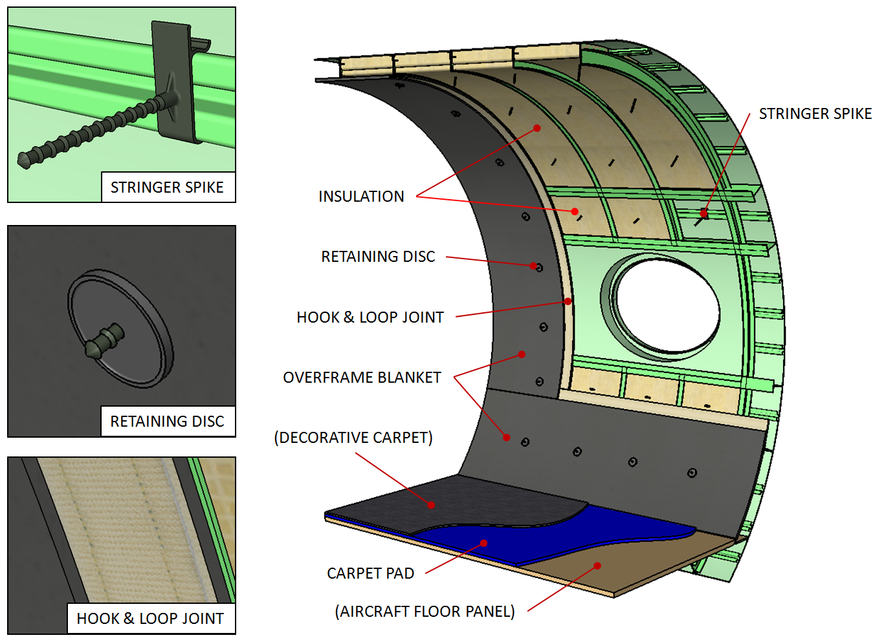
Acoustic System Overview
Skin Damping
Primary Insulation
Overframe Blanket
Carpet Pad
Installation aids
  Movable stringer spikes
  Performance lap joints

Slide 4
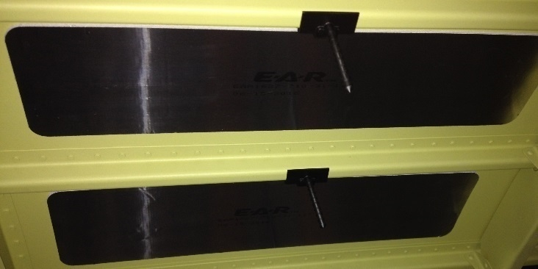
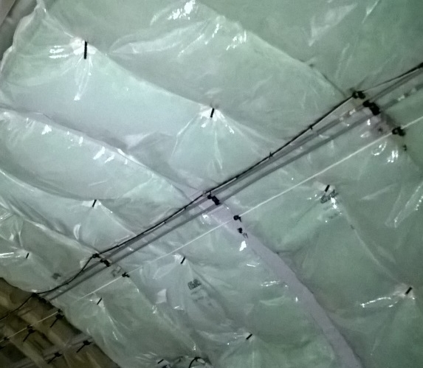
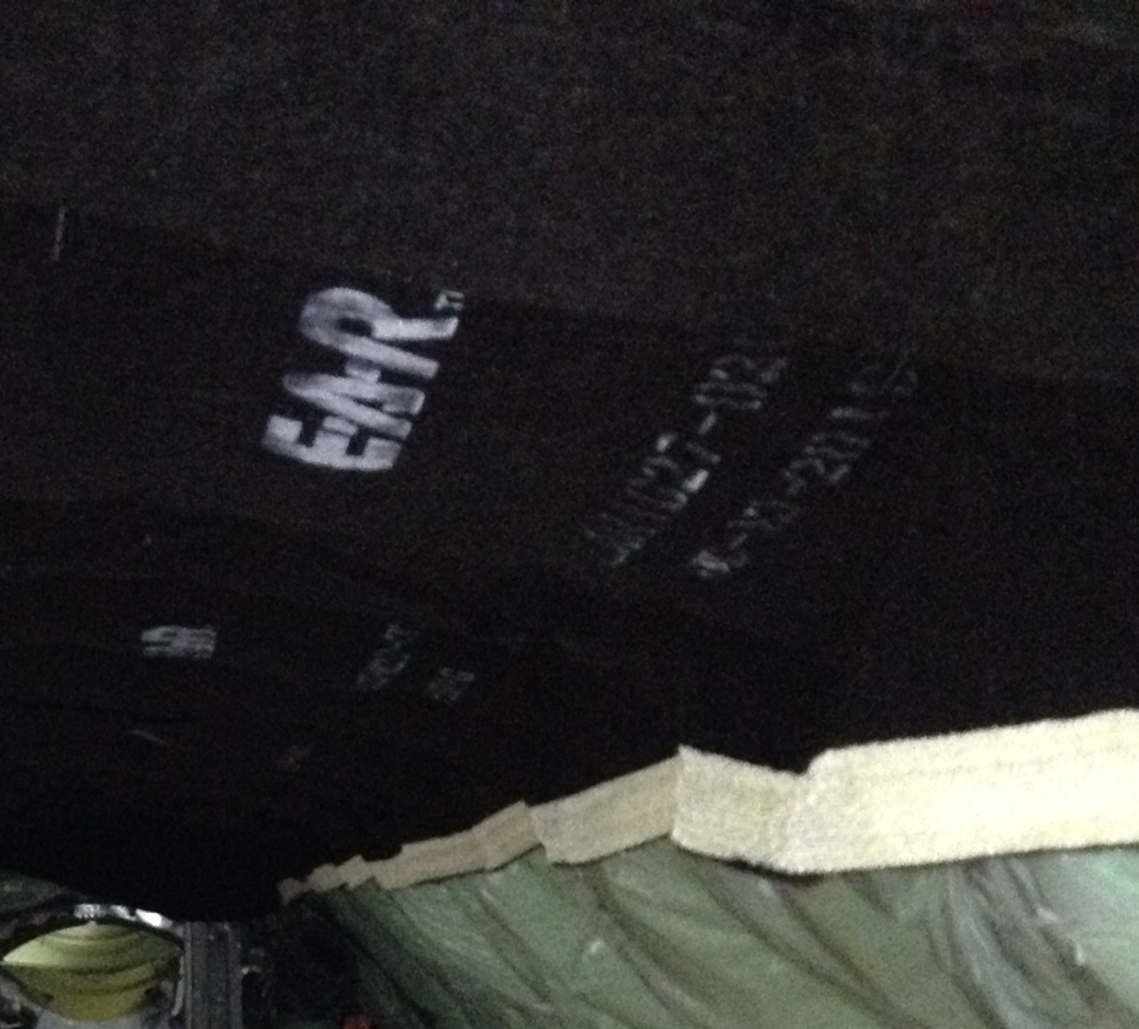
Acoustic System Components
Skin damping is applied to hull
Primary installation bags are installed over spikes
Overframe blanket is installed and secured with retaining disks

Slide 5
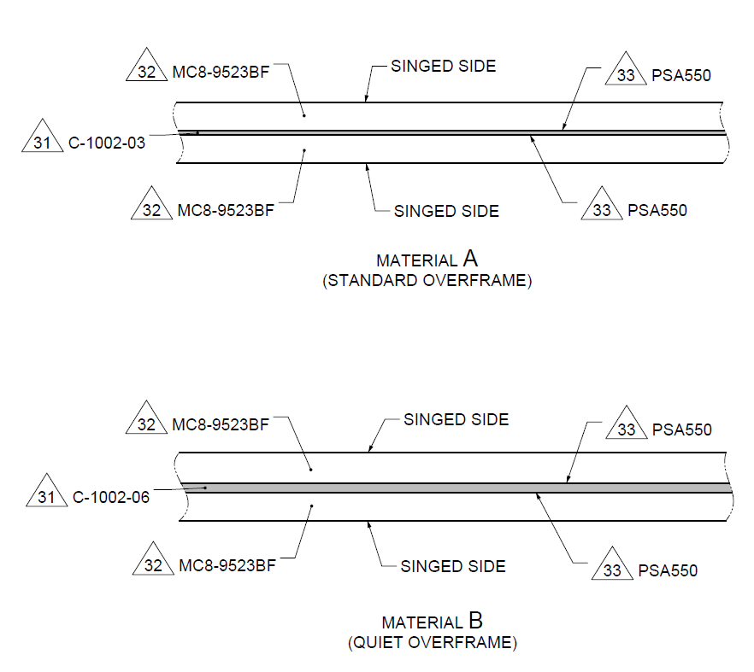
Overframe Blanket Components
Typical business jet overframe blanket specifies 5 layers
Exterior felt
Pressure sensitive adhesive (PSA)
Septum, or weighted barrier
2nd PSA
Interior Felt
Optionally may also include specific flame retardant barrier
FELT
SURFACE FINISH
SEPTUM
FELT
SURFACE FINISH
FELT
SURFACE FINISH
SEPTUM
FELT
SURFACE FINISH

Slide 6
Product Stewardship
Global regulations drive corporate compliance standards
Restriction of Hazardous Substances (RoHS) - Directive on the restriction of the use of certain hazardous substances in electrical and electronic equipment, was adopted in February 2003 by the European Union. Last updated March 31, 2015
  Lead (Pb), Mercury (Hg), Cadmium (Cd), Hexavalent Chromium (Cr⁶⁺), Polybromonated biphenyl ether (PBDE), Polybromonated biphenyls (PBB), Bis(2-ethylhexyl) phthalate, Butyl benzyl phthalate, Dibutyl phthalate, Diisobutyl phthalate
Registration, Evaluation, Authorization, and Restriction of Chemicals (REACH) European Union regulation (December 18, 2006). REACH addresses the production and use of chemical substances, and their potential impacts on both human health and the environment
  Substances of Very High Concern (SVHC) - Official recommendation from the European Chemical Agency (ECHA). Currently the List comprises a total of 168 SVHCs. Last updated June, 2016
Desire to develop materials free from these chemicals

Slide 7
Goals for an Advanced Barrier Film
Compliance Driven
RoHS and REACH compliant and free of SVHC’s
  *RoHS (EU) 2015/863, REACH (EC 1907/2006), SVHC – June 2016
Ability to pass FAR § 25.853(a) 12 second vertical and § 25.856(a) radiant panel as a stand alone film
Design Driven
Low modulus
Available in multiple areal weights
Ability to combine with acoustic absorbers to produce overframe blankets
Market Driven
Black
Dimensionally stable
Low odor
Low cost

Slide 8
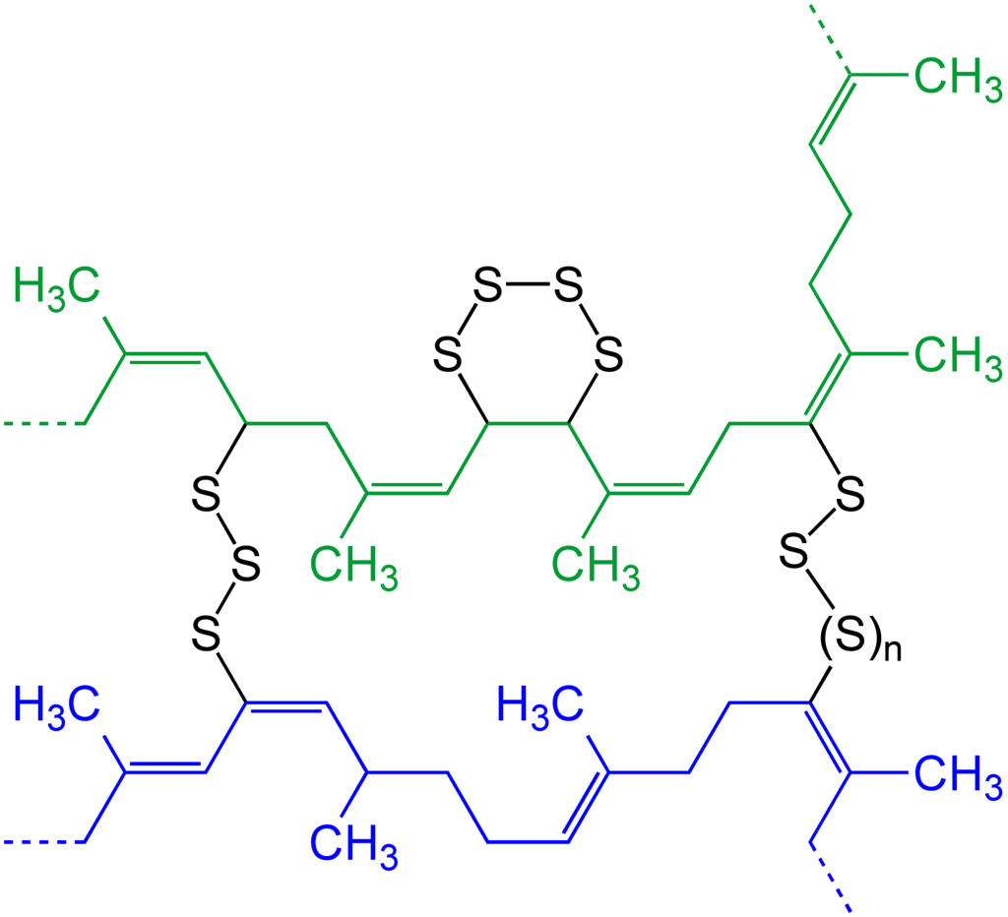
Approach : Vulcanization
Process by which individual polymer chains within the rubber compound are linked together to form a 3 dimensions network
Dimensional stability
Elasticity
Shape retention
Reduced Creep and Set
Temperature resistance
Strength
Charles Goodyear and Nathaniel Hayward discovered reaction of sulfur with rubber in the 1830’s

Slide 9
Vulcanization Details
Accelerators and retarders
  Accelerator / promoter examples
    Imidazolidine-2-thione (ethylene thiourea, ETU)
    zinc dimethyldithiocarbamate
  Retarder example: polyethylene glycol
Balance package for desired attributes in processing and finished good

Slide 10
Required Additives
Flame retardant fillers
  Regulatory drivers push toward inorganic oxides
Pigments
Processing aids
  Plasticizers for material flow
  Surface energy modifiers to control sticking

Slide 11
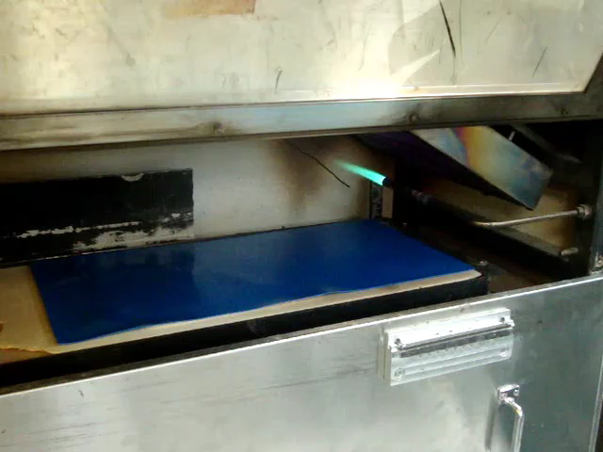
Radiant Panel After-flame Example
Unprotected material subjected to test under Appendix F, part VI, of US Federal Aviation Regulations § 25.856(a)
  Door left open for demonstration purpose
For this reference material, the flame continues to burn more than a few seconds after source removed

Slide 12
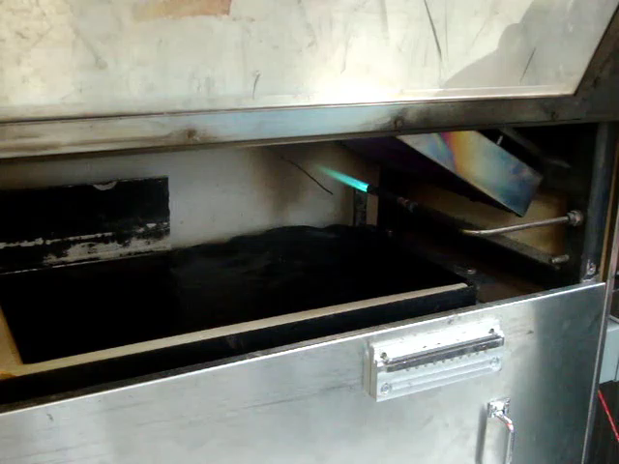
Self-Extinguishing Radiant Panel Burn
Unprotected material subjected to test under Appendix F, part VI, of US Federal Aviation Regulations § 25.856(a)
  Door left open for demonstration purpose
For new material, flame stops immediately
  New material passes

Slide 13
Acoustic Results
Acoustic Treatment
Higher transmission loss is better, increases sound attenuation
Increases with areal mass
Experiment matches theoretical predictions
  Physics Works!

Slide 14
Dimensional Stability
Aging 100 hrs @ 90C
Environmental cycle
  100 cycles, 8 hrs each
  Temps of 70 to -40 °C
  RH of 95% @ 70 °C
Upper limit
Grow
Shrink
Lower limit
Stability measured exceeds design targets

Slide 15
Unexpected! Enables simple design
2-sided Blanket
5 layer stack-up
1-sided Blanket
2 layer stack-up
Felt
PSA
Septum
PSA
Felt
*Up to 100 pounds weight saving on a medium sized Business Jet

Slide 16
Conclusions
Goals for material design are often in conflict
  Regulatory vs. engineering flexibility
  Weight vs. acoustic performance
  Cost vs. performance
Highly filled vulcanized rubber system can meet advanced goals for acoustic barriers

Slide 17
Questions?
Fredrick Vance, Ph.D.
fwvance@mmm.com

