Slide 1
Controlled Atmosphere Pyrolysis Apparatus II (CAPA II)
Josh Swann
Yan Ding
Mark McKinnon
Stanislav Stoliarov

Slide 2
Outline
Background and Objectives
Experimental Setup
Quantification of Boundary Conditions
PVC Case Study
Conclusions

Slide 3
Methodology
Comprehensive Pyrolysis Model
$$Kinetics$$
$$Thermodynamics$$
Milligram-scale
$$Thermal$$
$$Transport$$
Gram-scale
Rates of gasification, burning, and flame spread on bench-scale [1-6]

Slide 4
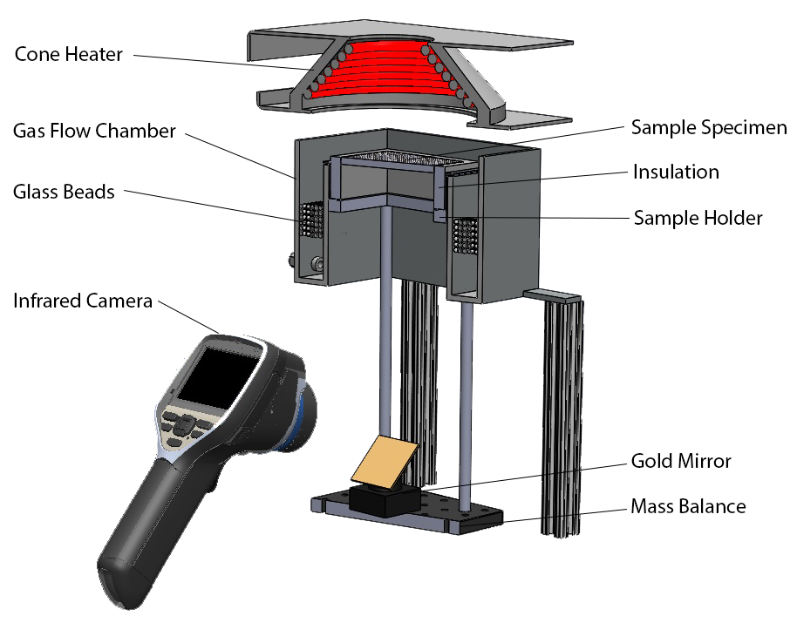
Controlled Atmosphere Pyrolysis
Apparatus (CAPA)
Augmentation to standard cone calorimeter
Sample size:
80 mm x 80 mm
Well-defined boundary conditions:
Typical heat flux range
Up to 80 kW m‾²
O₂ Concentration at surface
∼ 2.3 vol.% (225 SLPM N₂)
Convection coefficient for top and bottom surfaces determined through inverse analysis
Simultaneously measure sample temperatures and mass loss rate (for model validation)

Slide 5
Controlled Atmosphere Pyrolysis
Apparatus (CAPA)
Excellent mass and temperature measurements for non-swelling materials at relatively lower levels of radiation
Limitations for charring and intumescent materials:
Unstable boundary conditions
Non-thermally stable chamber walls
Non-uniform gaseous conditions above sample surface
Deviates from 1-D modeling framework
Unable to quantitatively measure the intumescing sample shape profiles
3-D behavior is very computationally expensive

Slide 6
Objectives
Extend the current methodology to charring and intumescent materials
Investigate the importance of multi-dimensional behavior

Slide 7
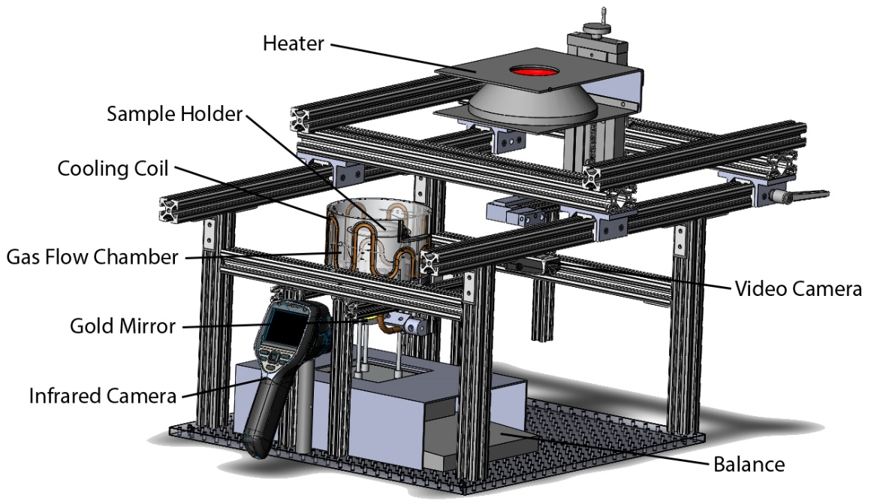
Experimental Setup
Well-defined boundary conditions:
Oxygen concentration below 1 vol.% (185 SLPM N₂)
Axisymmetric radiation mapping, including angular variations
Top and bottom surface convective losses from FDS modeling
Simultaneous measurements of:
Mass (1 mg resolution)
Back surface temperature
Quantitative shape profile
Sample size: 0.07 m diameter

Slide 8
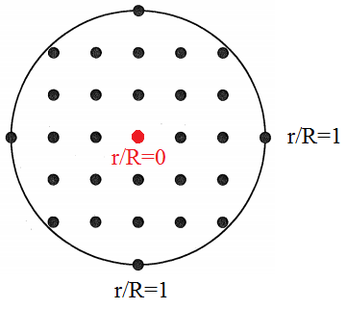
Boundary Conditions: Radiation
Measured with Schmidt-Boelter heat flux transducer
Normalized height, h/H
H = distance to bottom of heater from initial sample surface (0.04 m)
Normalized radius, r/R
R = radius of sample (0.035 m)
Measurements taken at equally spaced positions
r/R
1.25
Bottom of heater
h/H
0

Slide 9
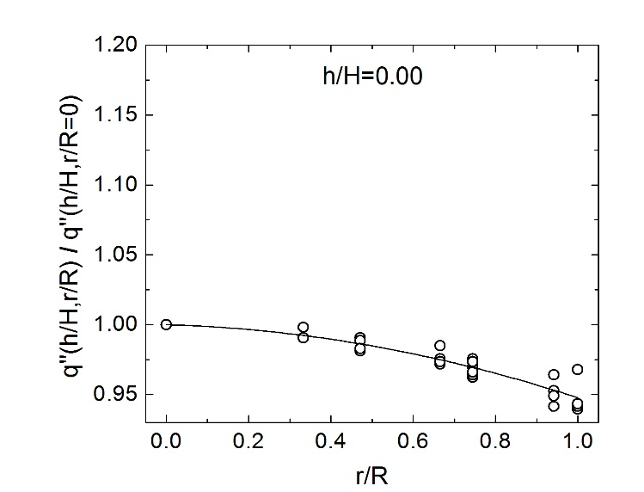
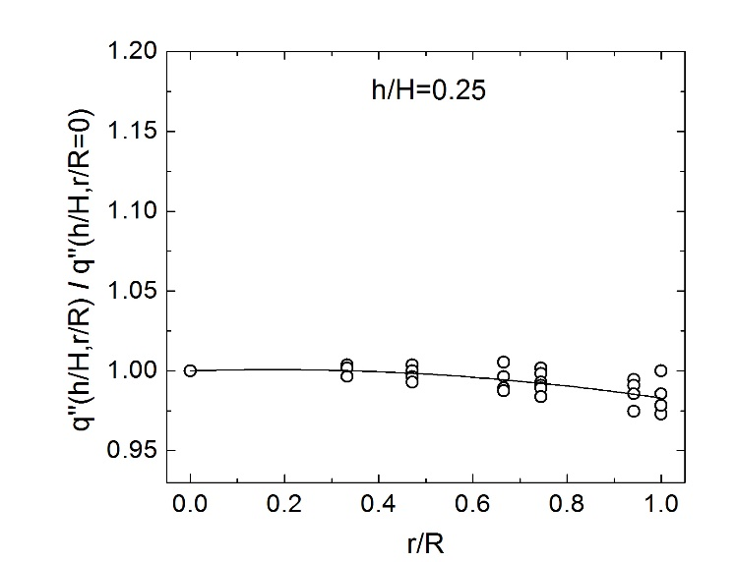
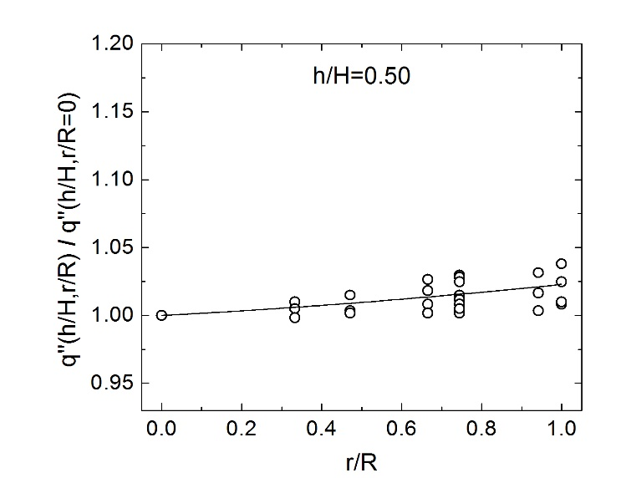
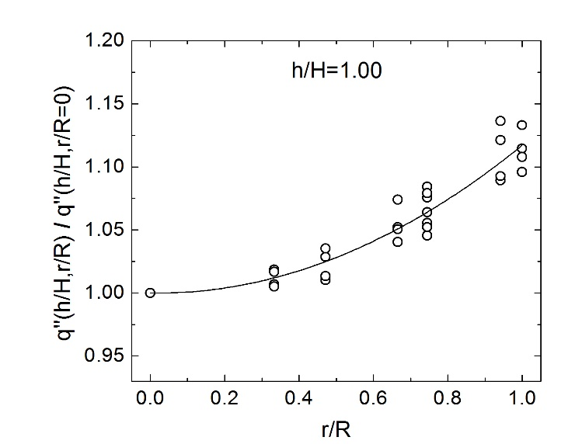
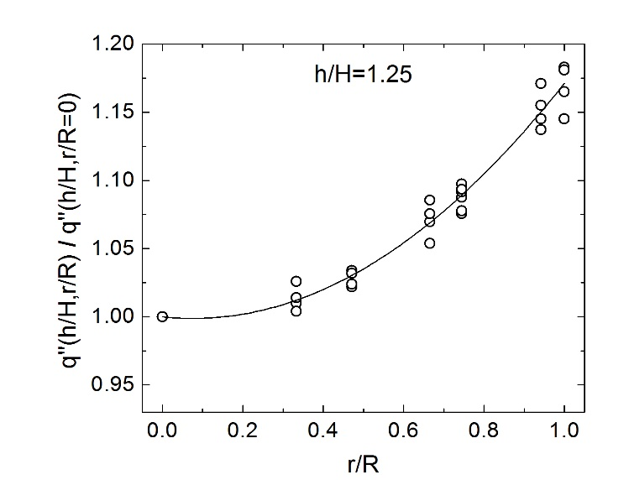
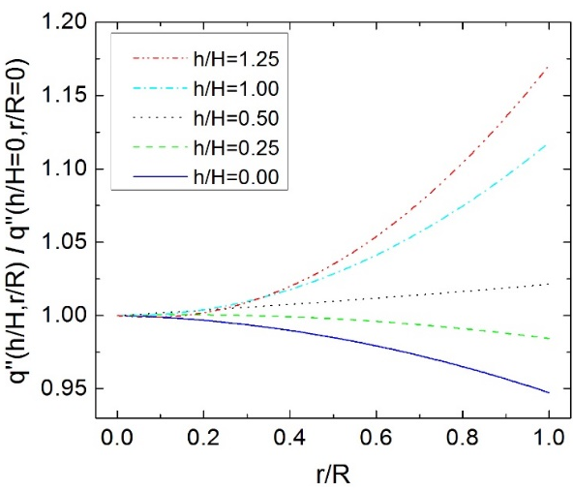
Boundary Conditions: Radiation

Slide 10
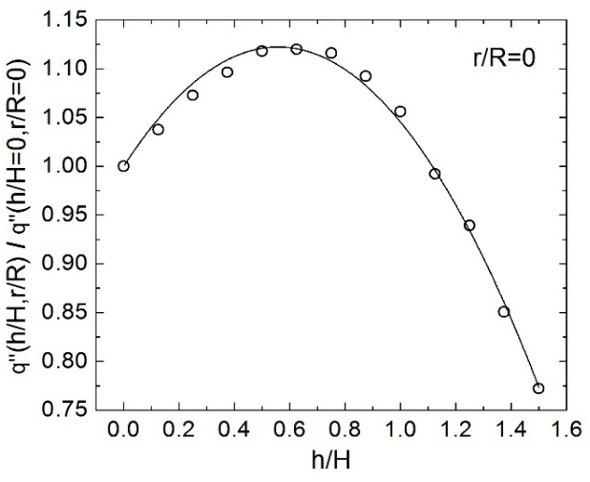
Boundary Conditions: Radiation

Slide 11
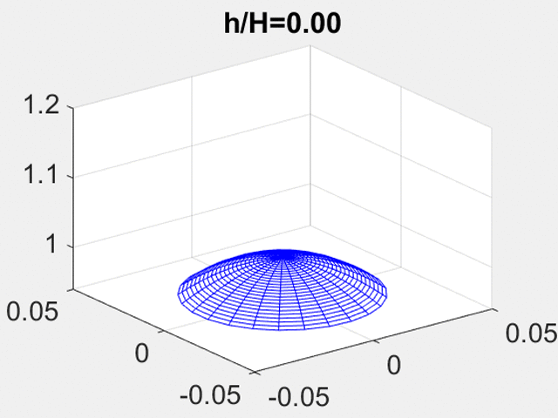
Boundary Conditions: Radiation
$$q^{′′}/q_{set}^{′′}$$
r/R
r/R
$$\frac{q^{′′}\left(h/H,r/R\right)}{q^{′′}\left(h/H=0,r/R=0\right)}=\left(a_{2}{\left(\frac{r}{R}\right)}^{2}+a_{1}\left(\frac{r}{R}\right)+1\right)\left(b_{2}{\left(\frac{h}{H}\right)}^{2}+b_{1}\left(\frac{h}{H}\right)+1\right)$$
$$q_{radius}^{′′}$$
$$q_{height}^{′′}$$
$$a_{2}=a_{22}{\left(h/H\right)}^{2}+a_{21}\left(h/H\right)+a_{20}$$
$$a_{1}=a_{12}{\left(h/H\right)}^{2}+a_{11}\left(h/H\right)+a_{10}$$

Slide 12
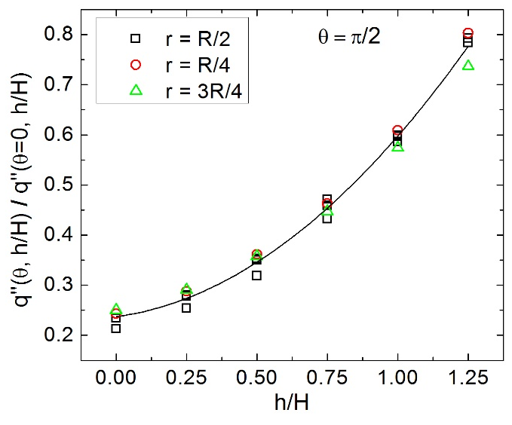
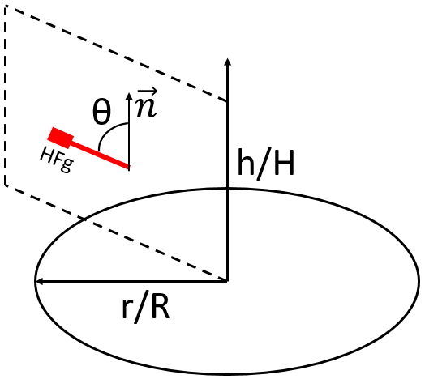
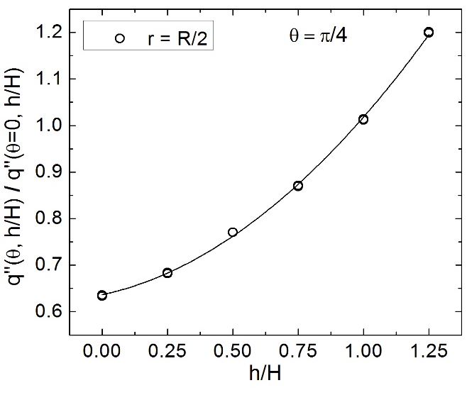
Boundary Conditions: Radiation
Angular radiation coefficient
$$\frac{q^{′′}\left(θ, h/H\right)}{q^{′′}\left(θ=0, h/H\right)}=\left(c_{2}θ^{2}+c_{1}θ\text{+1}\right)$$
$$c_{2}=c_{22}{\left(h/H\right)}^{2}+c_{21}\left(h/H\right)+c_{20}$$
$$c_{1}=c_{12}{\left(h/H\right)}^{2}+c_{11}\left(h/H\right)+c_{10}$$

Slide 13
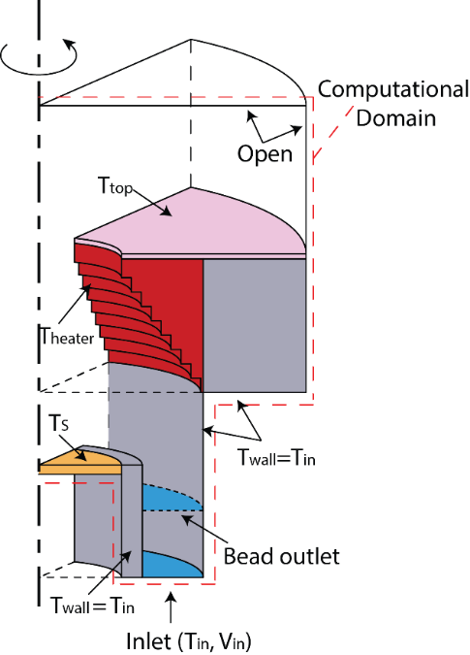
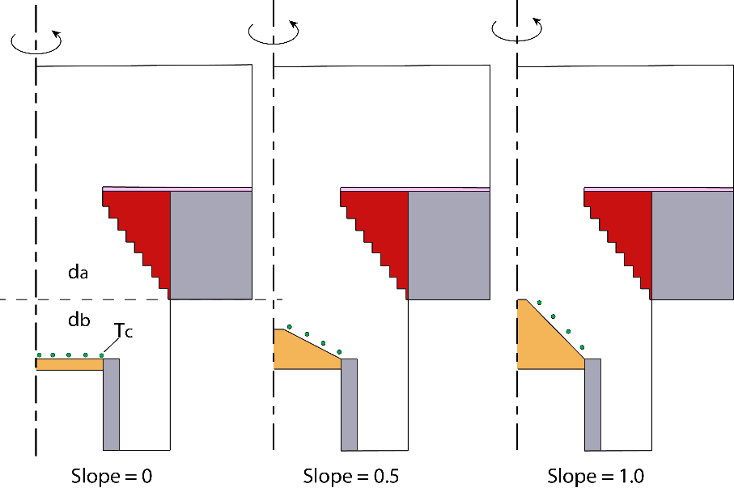
Boundary Conditions: Convection
Axisymmetric DNS model in FDS
Radiation was neglected
Constant wall temperatures
Insulator properties the same as sample
Neglected opening between outer chamber wall and heater
Three modeled geometries

Slide 14
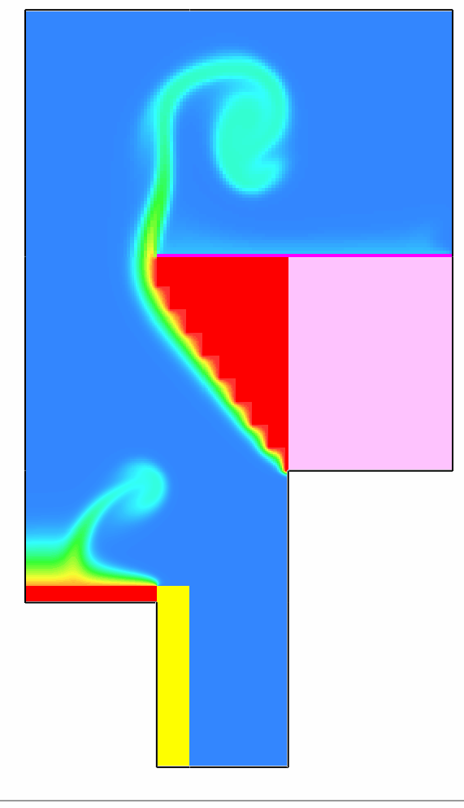
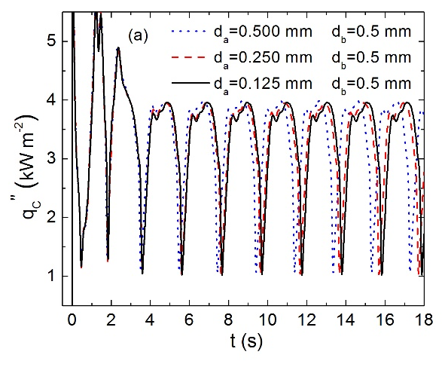
Boundary Conditions: Convection
T [K]
Convective heat flux, q’’, and convection coefficient, h_{c}:
$$q^{′′}=−k\frac{ΔT}{Δl}$$
$$h_{c}= \frac{q′′}{{(T}_{s}−T_{in})}$$
Period-averaged convection coefficient:
$$\overline{h_{c}}= {\int_{0}^{τ}{\left(2πrh_{c}\left(t\right)\right)dt}}/τ$$
t = 0 s
t = 18 s

Slide 15
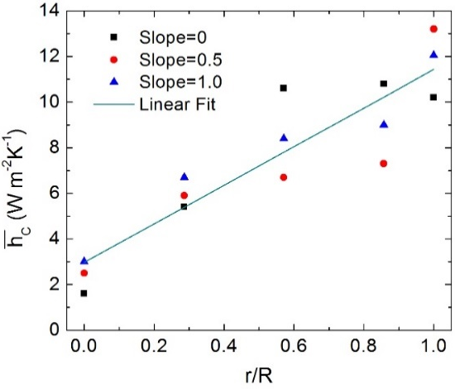
Boundary Conditions: Convection
T [K]
Convective heat flux, q’’, and convection coefficient, h_{c}:
$$q^{′′}=−k\frac{ΔT}{Δl}$$
$$h_{c}= \frac{q′′}{{(T}_{s}−T_{in})}$$
Period-averaged convection coefficient:
$$\overline{h_{c}}= {\int_{0}^{τ}{\left(2πrh_{c}\left(t\right)\right)dt}}/τ$$
t = 0 s
t = 18 s

Slide 16
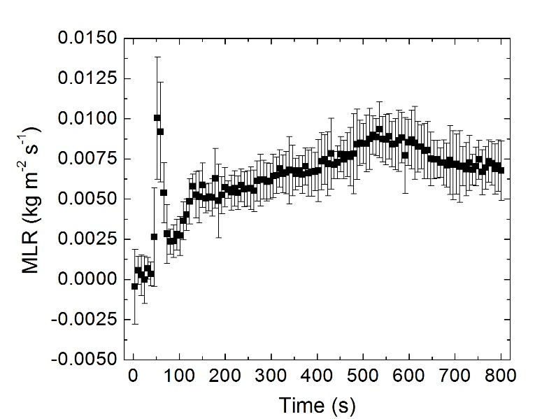
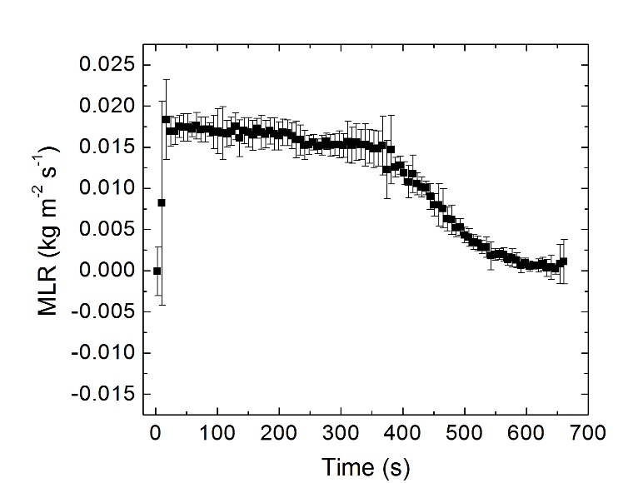
PVC Case Study – Mass
Poly(vinyl chloride) samples
6.35 mm thick
Conditioned in desiccator
Two step decomposition for lower fluxes as seen in TGA for PVC [7]
60 kW m⁻²
30 kW m⁻²

Slide 17
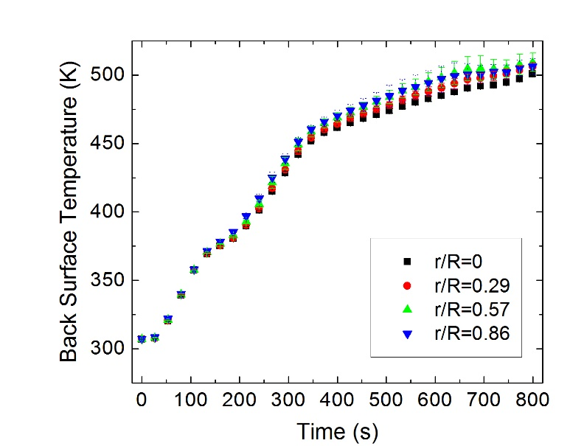
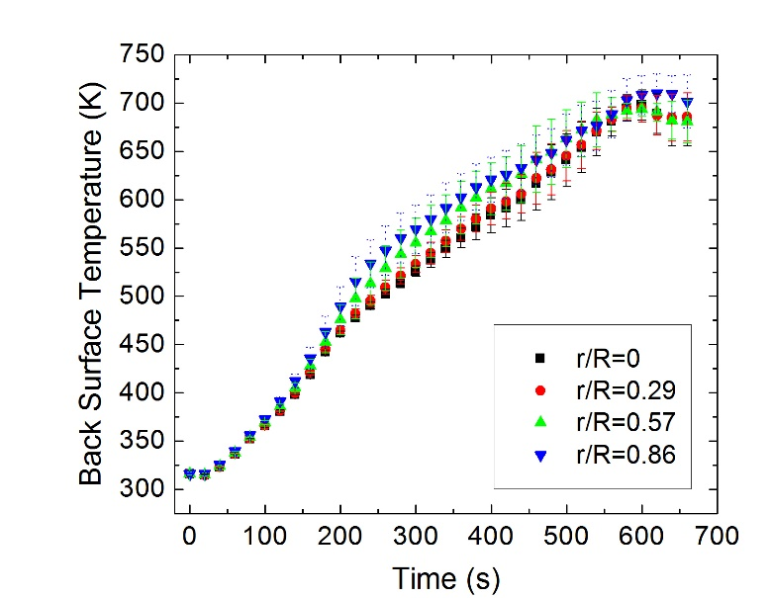
PVC Case Study – Temperature
Infrared Camera
Non-invasive measurements
Samples painted with high emissivity paint (≈0.95)
30 kW m⁻²
60 kW m⁻²

Slide 18
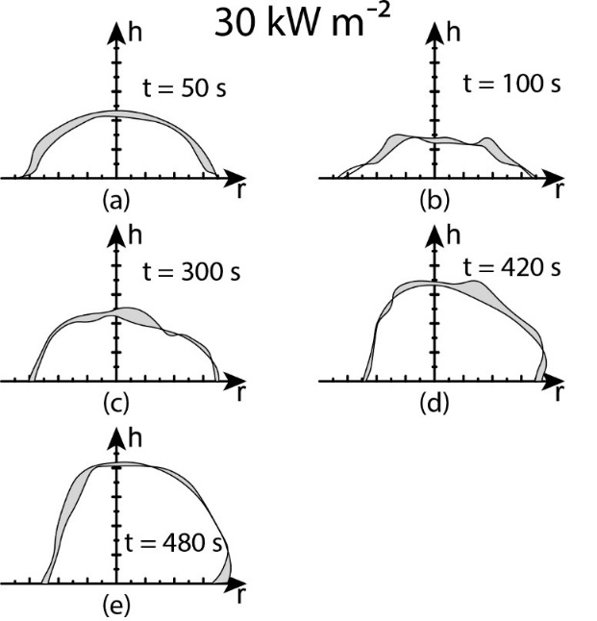
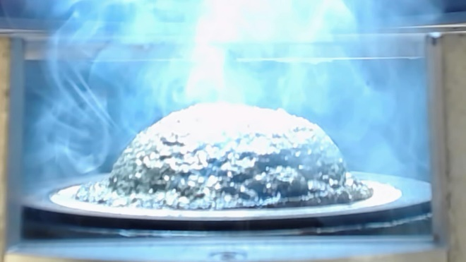
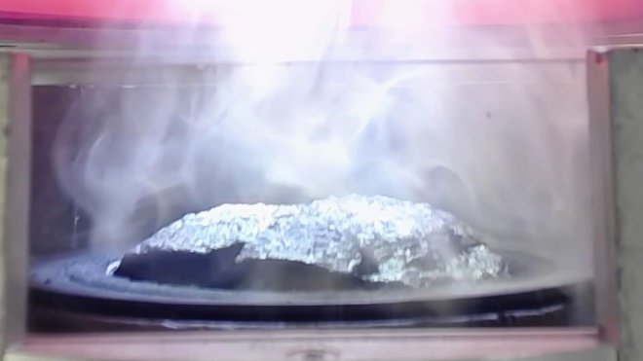
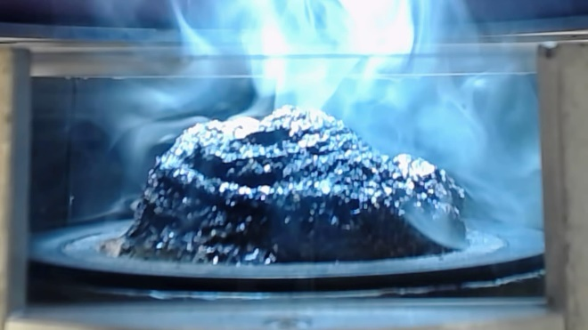
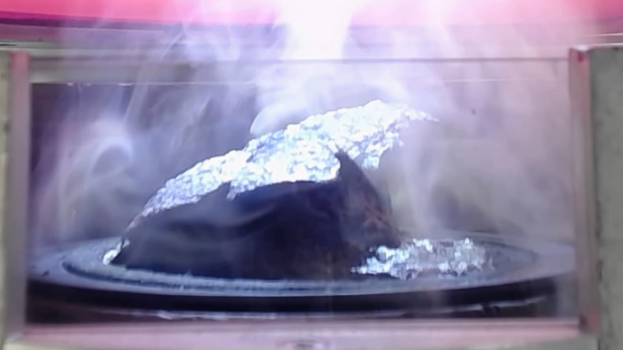
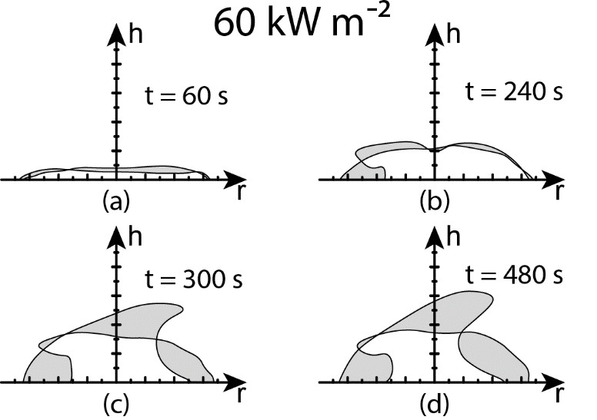
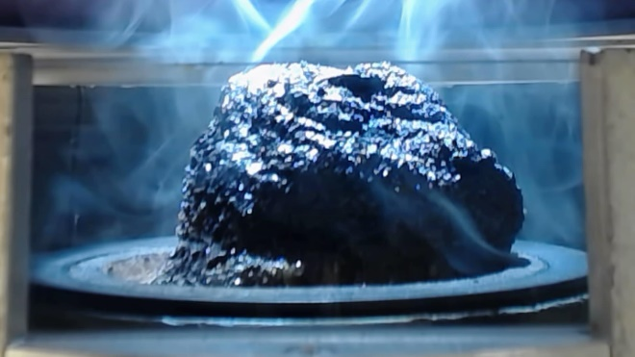
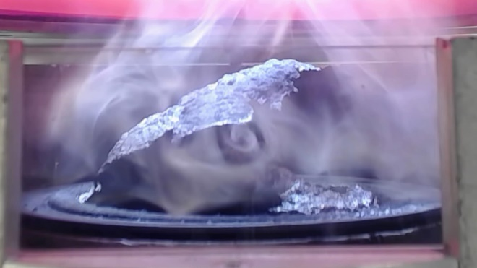
PVC Case Study - Shape
30 kW m⁻²
60 kW m⁻²
t=50s
t=240s
t=300s
t=300s
t=420s
t=480s

Slide 19
PVC Case Study – Projected Heat Flux
h/H
r/R
$$\frac{q^{′′}\left(h/H,r/{R,θ,A}\right)}{q^{′′}\left(h/H=0,r/R=0,θ=0,A_{p}\right)}=\frac{\left(a_{2}{\left(\frac{r}{R}\right)}^{2}+a_{1}\left(\frac{r}{R}\right)+1\right)\left(b_{2}{\left(\frac{h}{H}\right)}^{2}+b_{1}\left(\frac{h}{H}\right)+1\right)\left(c_{2}θ^{2}+c_{1}θ\text{+1}\right)}{\cos\left(θ\right)}$$

Slide 20
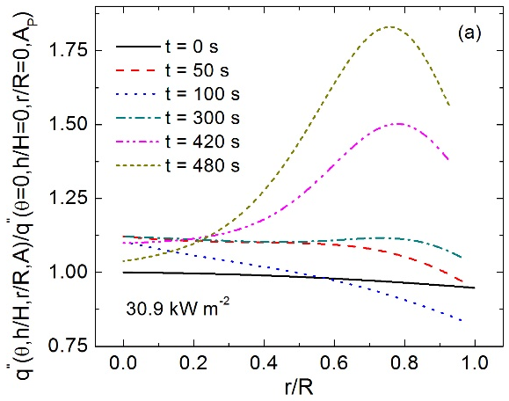
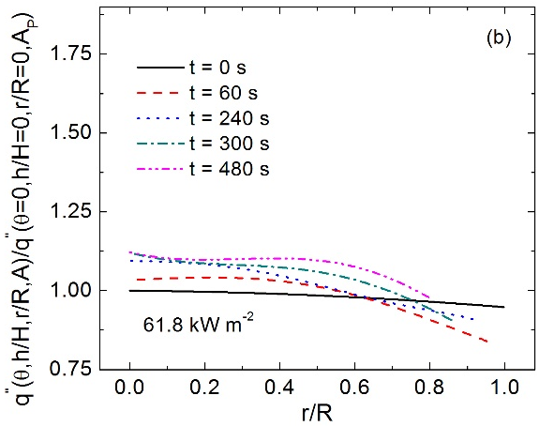
PVC Case Study – Projected Heat Flux
30 kW m⁻²
60 kW m⁻²
$$\frac{q^{′′}\left(h/H,r/{R,θ,A}\right)}{q^{′′}\left(h/H=0,r/R=0,θ=0,A_{p}\right)}=\frac{\left(a_{2}{\left(\frac{r}{R}\right)}^{2}+a_{1}\left(\frac{r}{R}\right)+1\right)\left(b_{2}{\left(\frac{h}{H}\right)}^{2}+b_{1}\left(\frac{h}{H}\right)+1\right)\left(c_{2}θ^{2}+c_{1}θ\text{+1}\right)}{\cos\left(θ\right)}$$

Slide 21
Conclusions
A new experiment was designed to provide highly accurate mass, spatially-resolved temperature, and multi-dimensional shape profile diagnostics for highly intumescent materials
Well-defined boundary conditions throughout the gasification chamber were achieved to account for the evolution of sample shape during pyrolysis
Results indicate a multi-dimensional framework is required to fully capture the thermal transport and swelling dynamics of highly intumescent materials

Slide 22
Acknowledgements
This and ongoing work is made possible by funding from:
The National Science Foundation CAREER Award #1347196 under the grant monitor Dr. Ruey-Hung Chen

Slide 23
References
[1] M.R. Semmes, X. Liu, M.B. Mckinnon, S.I. Stoliarov, A. Witkowski, A Model for Oxidative Pyrolysis of Corrugated Cardboard, Fire Saf. Sci. 11 (2014) 111–123. doi:10.3801/IAFSS.FSS.11-111.
[2] J. Li, J. Gong, S.I. Stoliarov, Gasification experiments for pyrolysis model parameterization and validation, Int. J. Heat Mass Transf. 77 (2014) 738–744.
[3] J. Li, J. Gong, S.I. Stoliarov, Development of pyrolysis models for charring polymers, Polym. Degrad. Stab. 115 (2015) 138–152.
[4] M.B. Mckinnon, S.I. Stoliarov, Pyrolysis model development for a multilayer floor covering, Materials (Basel). 8 (2015) 6117–6153.
[5] I.T. Leventon, J. Li, S.I. Stoliarov, A flame spread simulation based on a comprehensive solid pyrolysis model coupled with a detailed empirical flame structure representation, Combust. Flame. 162 (2015) 3884–3895. doi:10.1016/j.combustflame.2015.07.025.
[6] S.I. Stoliarov, R.E. Lyon, FAA Technical Note; DOT/FAA/AR-TN08/17.
[7] S.I. Stoliarov, S. Crowley, R.E. Lyon, G.T. Linteris, Prediction of the burning rates of charring polymers, Combust. Flame. 157 (2010) 2024–2034. doi:10.1016/j.combustflame.2008.11.010

Slide 24
Thank you!

