Slide 1
Materials Flammability Performance Open Database Overview
The 8th Triennial International Fire and Cabin Safety Research Conference
Carleen Houston and Sean Crowley
Thursday, October 27, 2016

Slide 2
Materials Flammability Performance Open Database Overview
In software development, a beta test is the second phase of software testing in which a sampling of the intended audience tries the product out.
Beta is the second letter of the Greek alphabet. Originally, the term alpha test meant the first phase of testing in a software development process. The first phase includes unit testing, component testing, and system testing. Beta testing can be considered "pre-release testing."
Beta testing is also sometimes referred to as user acceptance testing (UAT) or end user testing. In this phase of software development, applications are subjected to real world testing by the intended audience for the software. The experiences of the early users are forwarded back to the developers who make final changes before releasing the software commercially.
For in-house testing, volunteers or paid test subjects use the software. For widely-distributed software, developers may make the test version available for downloading and free trial over the Web. Another purpose of making software widely available in this way is to provide a preview and possibly create some buzz for the final product.

Slide 3
“OPEN’
available,
Discoverable (TP- retrievable), and
usable (TP-mangling for further processing and analysis)

Slide 4
Acknowledging continuous value of this fire performance data for the public, government and industry fire research community, the FAA Fire Research Lab recently embarked on development of a new, online relational database management system contingent to an SQL server for fire test results and materials flammability performance.
This web accessible research tool will initially showcase the expansive, cataloged consolidation of legacy and recent Cone Calorimeter test data generated at the FAA Fire research laboratory over the past decade. The retrievable raw file (.csv and .xls) and report (.pdf) formats evolved from cone analysis performed at various heat flux conditions on numerous samples of pedigreed, pure and fire resistant polymers including thermoplastics; thermoset resins; textile fibers and elastomers.
In software development, user acceptance testing (UAT) - also called beta testing, application testing, and end user testing - is a phase of software development in which the software is tested in the "real world" by the intended audience. UAT can be done by in-house testing in which volunteers or paid test subjects use the software or, more typically for widely-distributed software, by making the test version available for downloading and free trial over the Web. The experiences of the early users are forwarded back to the developers who make final changes before releasing the software commercially.

Slide 5
<Slide Title>
In software development, a beta test is the second phase of software testing in which a sampling of the intended audience tries the product out.
Beta is the second letter of the Greek alphabet. Originally, the term alpha test meant the first phase of testing in a software development process. The first phase includes unit testing, component testing, and system testing. Beta testing can be considered "pre-release testing."
Beta testing is also sometimes referred to as user acceptance testing (UAT) or end user testing. In this phase of software development, applications are subjected to real world testing by the intended audience for the software. The experiences of the early users are forwarded back to the developers who make final changes before releasing the software commercially.
For in-house testing, volunteers or paid test subjects use the software. For widely-distributed software, developers may make the test version available for downloading and free trial over the Web. Another purpose of making software widely available in this way is to provide a preview and possibly create some buzz for the final product.

Slide 6
http://www.fire.tc.faa.gov/preview/ConeCalorimeterDataMining/calorimeter.asp

Slide 7
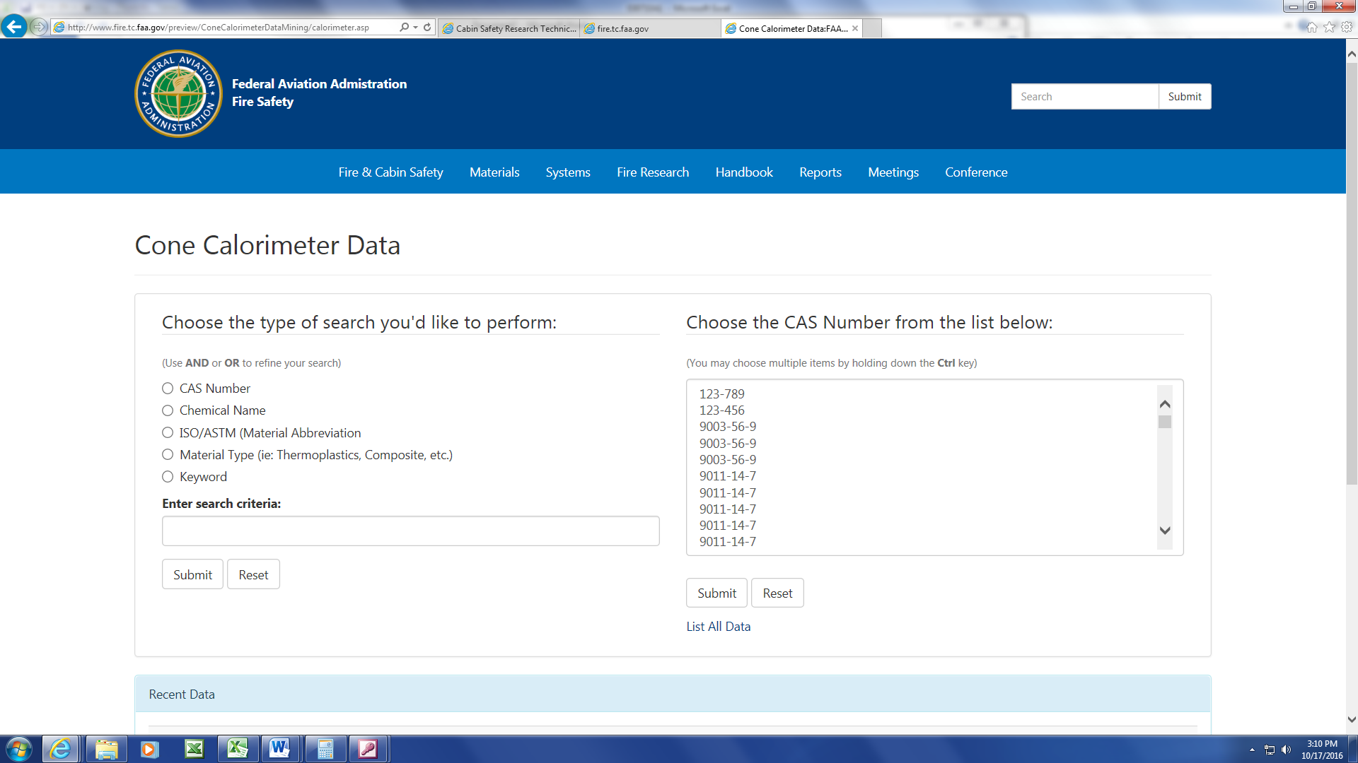
It’s not where you start, It’s where you finish…..

Slide 8
Beta Testing

Slide 9
?

