Slide 1
Inherently FST Thermosets Solution for Aerospace Interior Composites
Kuanqiang Gao, PhD
The Eighth Triennial International Fire & Cabin Safety Research Conference
October 24 – 27, 2016

Slide 2
Outlines
HUNTSMAN in Aerospace
Structural FST thermoset solution for interior composites Araldite® FST 40002 / 40003
Cost effective EHS friendly FST alternative to phenolics Benzoxazine Araldite® MT 35710 FST
Improving current composites epoxy systems LME 11082
New adhesives & syntactics for interior Epocast®1645 FR and Epibond® 8000 FR
Conclusion
Notes:
Huntsman has recently developed two new epoxies and one benzoxazine resins that meet FST/ heat release according to FAR 25.853/ABD 0031.
Aradite FST 40002/40003 is a two part epoxy system, it is meet FST requirements, and has good mechanical property to be used in structural application, such as interior wall panel,

Slide 3
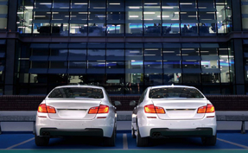
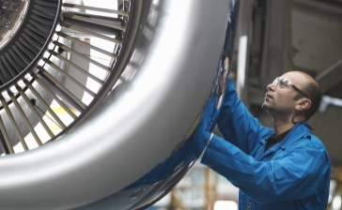
Our Business Divisions
Huntsman Corporation
Polyurethanes
Performance
Products
Advanced
Materials
Textile Effects
Pigments &
Additives
MDI
Polyols
PO/MTBE
TPU
PU Systems
Amines
Surfactants
Maleic Anhydride
Upstream Intermediates
Composites
Adhesives
Resins
Dyes
Chemicals
Apparel
Home & Institutional
Technical Textiles
Titanium Dioxide
Functional Additives
Color Pigments
Timber Treatment
Water Treatment

Slide 4
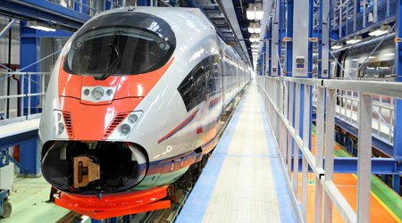
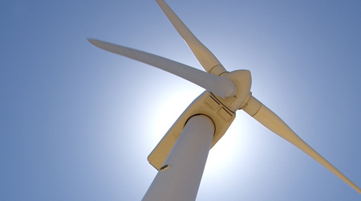
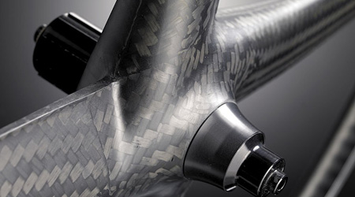
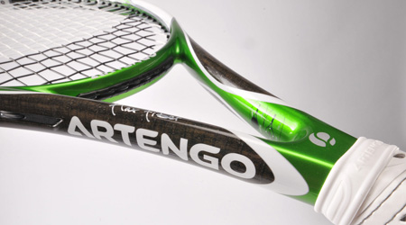
Advanced Materials Markets
Improving product performance through chemistry

Slide 5
HUNTSMAN in Aerospace
OEM
SPECIALTY
COMPONENTS
PREPREGGER
FORMULATOR
TIER
HUNTSMAN
AERO PORTFOLIO
FORMULATED SYSTEMS
TIER
SPECIALTY
COMPONENTS
200+ PRODUCTS (EPOXY, CURING AGENTS, BISMALEIMIDE, BENZOXAZINE)
5 QUALIFIED MANUFACTURING SITES
FORMULATED SYSTEMS
100+ PRODUCTS (ADHESIVES, SYNTACTICS, COMPOSITES, REPAIR)
2 QUALIFIED MANUFACTURING SITES

Slide 6
Outlines
HUNTSMAN in Aerospace
Structural FST thermoset solution for interior composites Araldite® FST 40002 / 40003
Cost effective EHS friendly FST alternative to phenolics Benzoxazine Araldite® MT 35710 FST
Improving current composites epoxy systems LME11082
New adhesives & syntactics for interior Epocast® 1645 FR, Epibond® 8000 FR
Conclusion

Slide 7
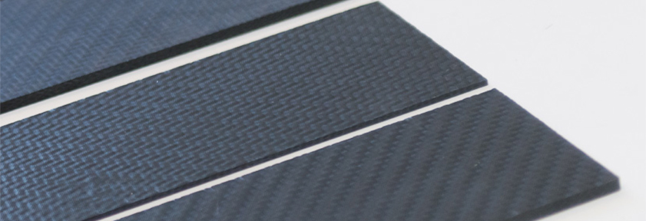
Unique combination of performance
Araldite® FST 40002 / 40003
FST
Design complexity
Structural
Phenolic Prepreg
1
1
2
Phenolic Liquid Process
3
Epoxy Liquid Process
2
4
Epoxy prepreg
Thermoplastic organosheets
4
5
5
Araldite® FST 40002 / 40003
3

Slide 8
Unique combination of performance
Araldite® FST 40002 / 40003
Features
Capability
Applications
Efficient production of interior
structural CFRP / GFRP
with maximized weight savings
Inherently flame
retardant
FST according to
FAR 25.853
Unfilled
Low viscosity
Latent
Design complexity
RTM & Infusion
Complex parts &
function integration
High productivity of
small / medium parts
Large parts
High thickness
High mechanicals
Structural applications
Fast cure
Low exotherm
High productivity

Slide 9
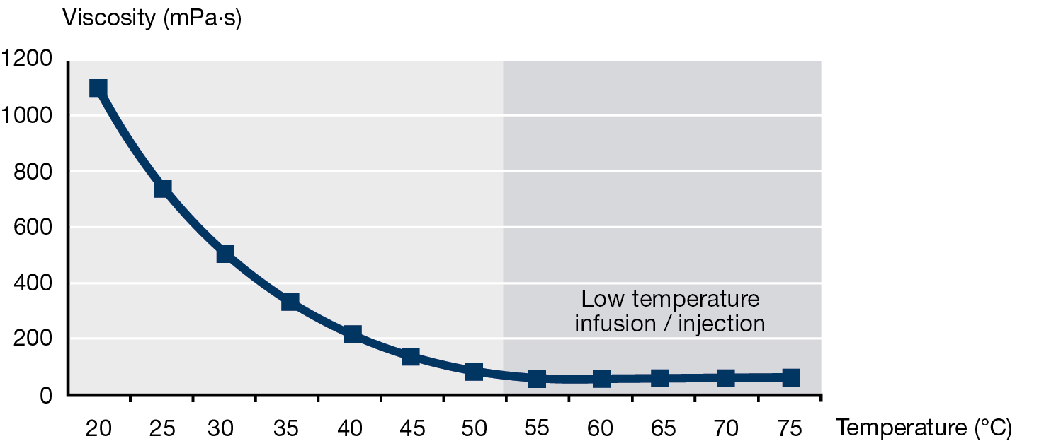
Processing
Araldite® FST 40002 / 40003
High quality versatile processing
2-component liquid system
Injection capability 50 -150°C
Very low reaction energy (ca. 220 J/g):
low risk of exotherm
high temperature injection of high thickness parts
Viscosity versus injection temperature

Slide 10
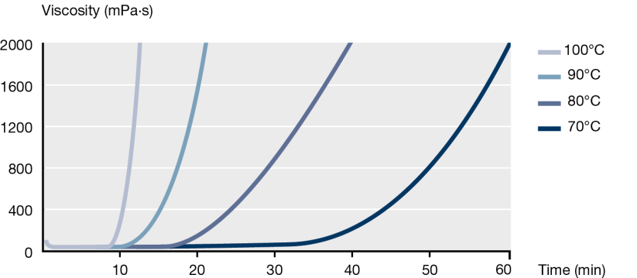
Processing
Araldite® FST 40002 / 40003
High quality versatile processing
Large part production with low cost / low temperature resistance molds
High productivity of small / medium part (pre-cure of 5 min 150°C)
Putrusion speed of ca. 10 meters / hour
Viscosity build-up versus temperature
Production cycle examples
 | In-mould cure | Free-stand post-cure ⁽¹⁾
Large part | 1H100ºC + 1H120ºC | 2H180ºC
ILSS 23ºC CFRP ⁽²⁾ | 56 MPa | 64 MPa
Small / medium part | 5 min 150ºC | 2H180ºC
ILSS 23ºC CFRP ⁽²⁾ | 54 MPa | 65 MPa
(1) optional depending on in-mould cure conditions
(2) 5H Satin, 370 gsm, TVf 50%

Slide 11
Mechanicals
Araldite® FST 40002 / 40003
Highly structural solution
High Tg and ILSS
High tensile and medium toughness
 | Test | Araldite® FST 40002 / 40003 | Standard
NEAT | Dry DMA Tg | 260ºC | ISO 6721
 | Wet DMA Tg | 185ºC
 | K_{1C} | 0.9 MPa.√m | ISO 13586
 | G_{1C} | 270 J/m²
 | Tensile modulus | 3000 MPa | ISO 527
 | Tensile strength | 100 MPa
 | Tensile elongation | 5 %
CFRP UD ⁽¹⁾ | ILSS at 23ºC | 97 MPa | ASTM D2344
 | ILSS at 120ºC | 65 MPa
 | ILSS at 160ºC | 55 MPa
(1) UD, 6K, 270 gsm, TVf 60%

Slide 12
Flame, Smoke & Toxicity
Araldite® FST 40002 / 40003
FST compliant solution
Meets FST in all configurations: glass & carbon in all thickness
Meets Heat release in low thickness. Heat release version under development (see Latest dev. column)
 | Araldite® FST 40002 / 40003 |  |  |  | Latest dev.
Fiber type | CFRP⁽¹⁾ |  | GFRP⁽²⁾ |  | GFRP⁽²⁾
Thickness (mm) | 0.3 | 2 | 0.3 | 4 | 4 | FAR 25.853 requirements
Vertical burn 12s Burn length (mm) After flame time (s) Drip flame time(s) | 88 9 0 |  | 48 15 0 |  |  | AITM 2.0002B <203 <15 <5
Vertical burn 60s Burn length (mm) After flame time (s) Drip flame time (s) | 82 0 0 | 47 6 0 | 65 0 0 |  |  | AITM 2.0002A <152 <15 3
Heat release HRR max (kW/m²) HR (kW.min/m²) | 63 32 | 85 90 | 45 25 | 74 16 | 32 11 | AITM 2.0006 <65 <65
Toxicity (flaming mode) Components toxicity level | pass |  |  |  |  | AITM 3.0005
Smoke After 4 min | 23 | 12 | 16 |  | 46 | AITM 2.0007A <200
5H Satin, 6K, 270 gsm, TVf 50%
(2) 8H Satin, 300 gsm, TVf 50%

Slide 13
Outlines
HUNTSMAN in Aerospace
Structural FST thermoset solution for interior composites Araldite® FST 40002 / 40003
Cost effective EHS friendly FST alternative to phenolics Benzoxazine Araldite® MT 35710 FST
Improving current composites epoxy systems LME 11082
New adhesives & syntactics for interior Epocast® 1645 FR, Epibond® 8000 FR
Conclusion

Slide 14
Unique combination of performance
Benzoxazine Araldite® MT 35710 FST
FST
EHS
Cost
Phenolic Prepreg
1
2
Bis-F Benzoxazine
Araldite® MT 35700
3
Benzoxazine
Araldite® XU 35710 FST
1
2
3

Slide 15
Unique combination of performance
Benzoxazine Araldite® MT 35710 FST
Features
Capability
Applications
Inherently Flame
Retardant
FST & heat release
FAR 25.853 &
ABD 0031
Liquid
Prepreg w/w and w/o
solvent &
Liquid Process
Cost effective,
high quality,
EHS friendly,
production of
non-structural up to
semi- structural
interior composites
No Volatile
EHS friendly
No porosity & high
laminate quality
Medium Mechanicals
Semi Structural
Cost effective
Competitive to
Phenolics

Slide 16
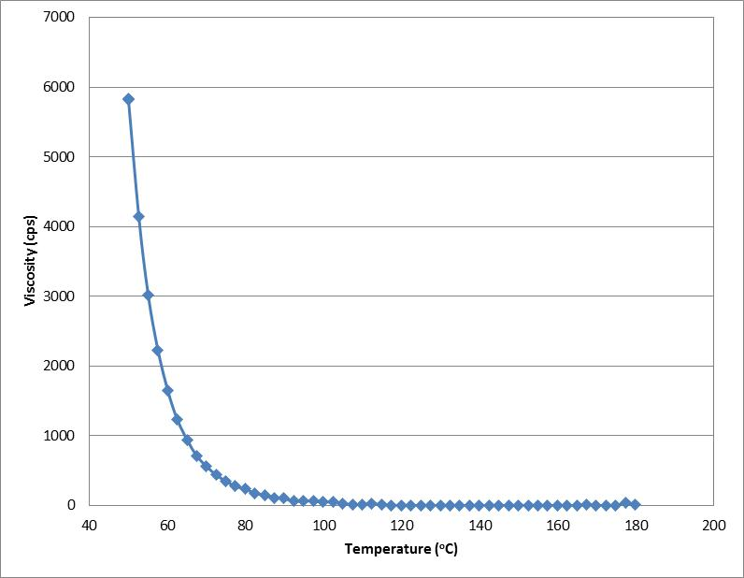
Processing
Benzoxazine Araldite® MT 35710 FST
Liquid
Prepreg w/w and w/o
solvent &
Liquid Process
Cost effective
Competitive to
Phenolics
Improvement vs. Araldite® MT 35700 (Bis-F Benzoxazine)
Liquid at 23°C, < 100 mPas above 100°C
Cost effective for phenolic substitution
can find applications in prepreg hot-melt and solvent based as well as direct process
 | Araldite® MT 35710 FST | Bis/F Benzoxazine Araldite® MT 35700
Physical Form | Amber viscous liquid | Solid
Viscosity at 60ºC | 1500 mPas
Melting point (°C) |  | 55 - 65

Slide 17
Mechanical & FST
Benzoxazine Araldite® MT 35710 FST
Inherently Flame
Retardant
FST & heat release
FAR 25.853 &
ABD 0031
Medium Mechanicals
Semi Structural applications
Semi-structural FST solution
Medium Tg of 140°C
Medium toughness
Meets FST and heat release
according to FAR 25.853 / ABD 0031
better performance than phenolics
 | Test | Araldite® MT 35710 FST | Typical Areo Phenolic | Standard
NEAT | Tg DSC (ºC) | 140 |  | ISO 11357-2
 | K_{1C} (MPa.√m) | 0.92 |  | ISO 13586
 | G_{1C} (J/m²) | 200
 | Tensile modulus (MPa) | 4900 |  | ISO 527
 | Tensile strength (MPa) | 60
 | Tensile elongation (%) | 1.3
GFRP ⁽¹⁾ | Tensile modulus (warp) (GPa) | 28 | 19-24 | ISO 527
 | Tensile strength (warp) (MPa) | 457 | 380-400
 | Compression modulus (warp) (GPa) | 29 | 20-24 | ISO 14126
 | Compression strength (warp) (MPa) | 555 | 350-380
 | ILSS (warp) (MPa) | 50 | 24-50 | ISO 14130
 | Araldite® MT 35710 FST
Fiber type | GFRP⁽¹⁾
Thickness (mm) | 0.6 | FAR 25.853 requirements
Vertical burn 60s Burn length (mm) After flame time (s) Drip flame time (s) | 94 0 0 | AITM 2.0002A <152 <15 <3
Heat release HRR max (kW/m²) HR (kW.min/m²) | 18 29 | AITM 2.0006 <65 <65
Toxicity (flaming mode) Components toxicity level | pass | AITM 3.0005
Smoke After 4 min | 11 | AITM 2.0007A <200
(1) 8H Satin, 300 gsm, TVf 50%

Slide 18
Outlines
HUNTSMAN in Aerospace
Structural FST thermoset solution for interior composites Araldite® FST 40002 / 40003
Cost effective EHS friendly FST alternative to phenolics Benzoxazine Araldite® MT 35710 FST
Improving current composites epoxy systems LME 11082
New adhesives & syntactics for interior Epocast® 1645 FR, Epibond® 8000 FR
Conclusion

Slide 19
LME 11082
New inherently FST epoxy
Structural inherently FST epoxy (tested with a typical high Tg curing agent):
Meets FST and heat release according to FAR 25.853 / ABD 0031
Similar mechanical performance as Bis-A epoxy
can substitute standard epoxy, novolac in structural prepreg and RTM (interior & exterior)
 | LME11082 XB 3473
Fiber type | GFRP⁽¹⁾
Cure cycle | 2H120ºC + 2H140ºC + 2H180ºC
Thickness (mm) | 0.3 | FAR 25.853 requirements
Vertical burn 12s Burn length (mm) After flame time (s) Drip flame time (s) | 80 0 0 | AITM 2.0002B <203 <15 <5
Vertical burn 60s Burn length (mm) After flame time (s) Drip flame time (s) | 85 0 0 | AITM 2.0002A <152 <15 <3
Heat release HRR max (kW/m²) HR (kW.min/m²) | 38 21 | AITM 2.0006 <65 <65
Toxicity (flaming mode) Components toxicity level | pass | AITM 3.0005
Smoke After 4 min | 43 | AITM 2.0007A <200
Test |  | LME 11082 | Bis-A | Standard
 |  | With hardener XB 3473
NEAT | DMA Tg (ºC) | 180 | 185 | ISO 6721
 | K_{1C} (MPa.√m) | 0.6 | 0.6 | ISO 13586
 | G_{1C} (J/m²) | 140 | 165
 | Tensile modulus (MPa) | 2700 | 2500 | ISO 527
 | Tensile strength (MPa) | 50 | 47
 | Tensile elongation (%) | 2.5 | 2.65
(1) 8H Satin, 300 gsm, TVf 50%

Slide 20
Outlines
HUNTSMAN in Aerospace
Structural FST thermoset solution for interior composites Araldite® FST 40002 / 40003
Cost effective EHS friendly FST alternative to phenolics Benzoxazine Araldite® MT 35710 FST
Improving current composites epoxy systems LME 11082
New adhesives & syntactics for interior Epocast® 1645 FR, Epibond® 8000 FR
Conclusion

Slide 21
New adhesives and syntactics
Drivers
Fast assembly
REACH
Weight savings
100% FR / FST
in Interior
Product
Epibond® 8000 FR A/B
Two-part epoxy adhesive
Epocast® 1645 FR A/B
Two-parts epoxy syntactic
Application
Honeycomb panels bonding
Metals and composite bonding
Insert bonding
Honeycomb edge filling
Honeycomb void filling
Features
FST acc to FAR 25.853
High shear, peel & compressive strength
High productivity, 55 min work life
Extrudable 2:1 cartridge
Ultra low density 0.48
12s vertical (FAR 25.853B)
Fast gel time of 65 min
Quickly sandable

Slide 22
Inherently FST Thermosets Resins
Summary
All meets FST/ heat release according to FAR 25.853/ABD 0031
Araldite® FST 40002/40003
Benzoxazine Araldite® MT 35710FST
LME 11082
Low viscosity
Unfilled
Latent
High mechanicals
Fast cure
Low exotherm
Liquid resin
No volatile release
Medium mechanicals
High quality laminate w/o porosity
Competitive to phenolics
Special epoxy resin
Similar mechanical performance to DGEBA
Design complexity
RTM & Infusion
Structure Application
High productivity
EHS Friendly
Prepreg or infusion
Interior application
Cost effective
Substitute standard epoxy novolac
Prepreg /RTM Process
Structural application

Slide 24
Question?
kuanqiang_gao@huntsman.com
todd_holder@huntsman.com
Advanced Materials

