Slide 1
Evaluation of Aerospace Seat Belt Webbing Material Under Dynamic Test Conditions

Slide 2
Overview
Standards
Replacement of Restraints
Methods
Results
Conclusions

Slide 3
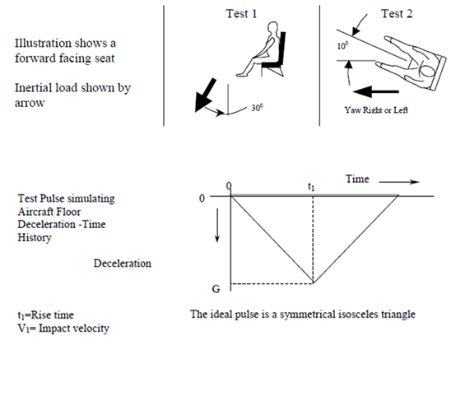
Dynamic Impact Standards
Title 14 CFR 2X.562
Corresponding injury metrics
Part Test | 23 (fps - g) | 25 (fps - g) | 27/29 (fps - g)
1 | 31 – 19/15 | 35 - 14 | 30 - 30
2 | 42 – 26/21 | 44 - 16 | 42 – 18.4
Notes:
50/60 – 90 – 71 ms rise time.

Slide 4
Replacement of Restraint Systems
Policy Memorandum ANM-115-05-10 dated August 10, 2005
  Provides an acceptable method compliance to
  § 25.562 for replacement restraint systems:
    Lap safety belts (2-point restraint systems)
    Torso restraint systems (3, 4, and 5-point restraint systems)
  Link
    http://rgl.faa.gov/Regulatory_and_Guidance_Library/rgPolicy.nsf/0/4667691DEA8713F88625705E006437F9?OpenDocument&Highlight=115-05-10

Slide 5
Replacement of Restraint Systems
Comparative test
  Side by side rigid seat
  2 seats, 2 ATDs
  Replicate seat geometry
  25.562 pulse
Equivalence
  Anchor loads within 6%
  Head path within 1.0“

Slide 6
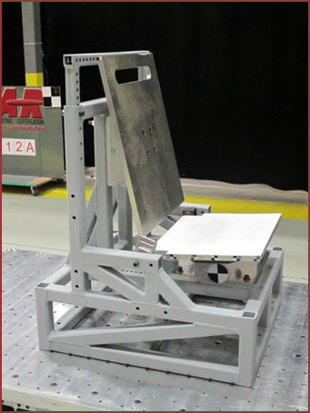
Methods
Two tests for each comparison
  New belt/newly repaired belt
  One ATD (different for each phase)
  Normal pulse variability
  SRP to Anchor point variation (Phase 1)
  Varying belt properties (Phase 2)
Static Elongation tests
  Similar to SAE AS 8043
Used a single seat
  Same ATD

Slide 7
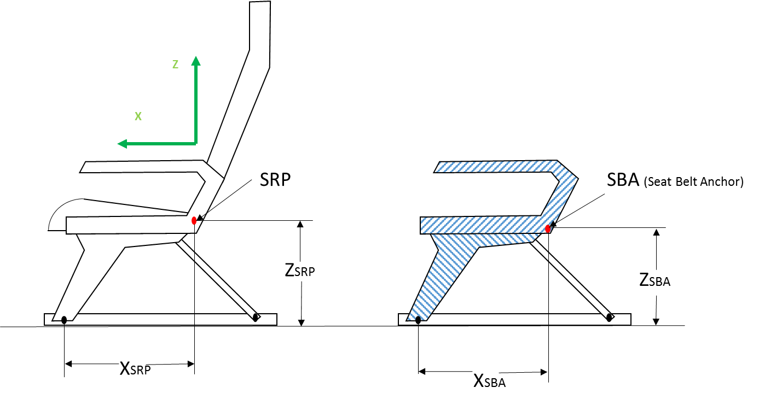
Configurations
Survey of existing seats
Chose common configurations
 | Distance from SRP to SBA (in) |  | Seat | Nominal* Belt Angle in XZ plane
 | X_{SRP} (in) | Z_{SRP} (in) | width (in) | WRT horz (degrees)
Configuration 1 | 0.5 | -2.65 | 18 | 46.2
Configuration 2 | 5.0 | -2.8 | 18 | 64.1
Configuration 3 | 2.5 | -0.4 | 18 | 45.6
Configuration 4 | 3.0 | -2.5 | 18 | 54.6
Configuration 5 | ----- | ------- | 18 | 54.6
* = Nominal Belt Angle calculated per AS8049B paragraph 3.2.15
Notes:
Configurations 1 and 3 were selected because they were considered common geometries.
Configuration 2 was selected because it was a possible design with the most forward anchor point likely in service.
Configuration 4 was selected because it was a possible design with the anchor point located such that the belt angle was between the others chosen.
Configuration 5 was a modification of configuration 4 in which the anchor points were moved to force the buckle to be offset greater than 1.5” from the centerline of the ATD. This was done to investigate the effect of buckle offset which may lead to increased loading and possible failure of the belt.

Slide 8
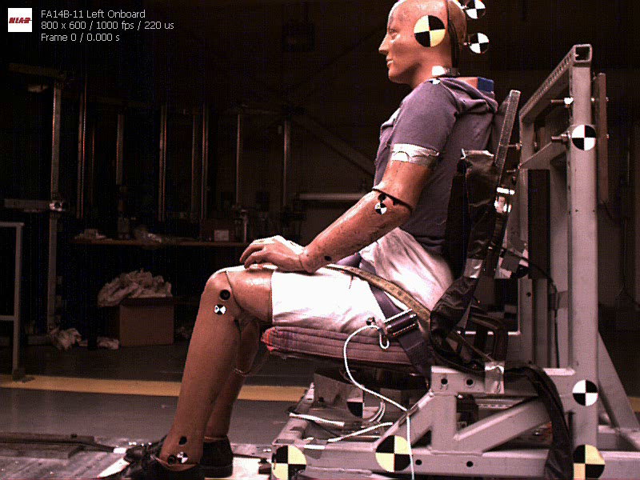
Typical Response

Slide 9
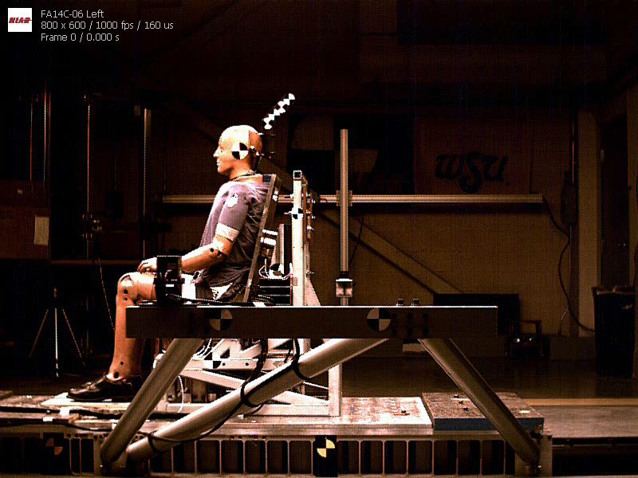
Un-predictable response

Slide 10
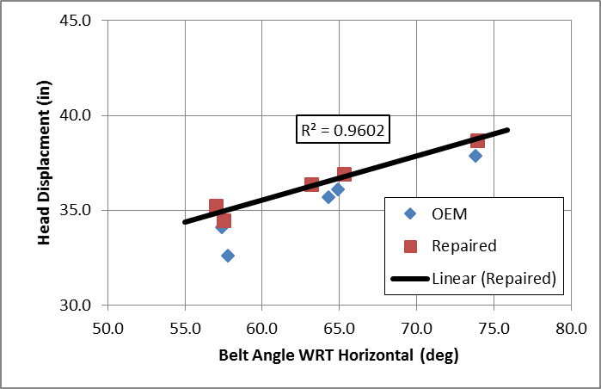
Head Displacement vs. Belt Angle

Slide 11
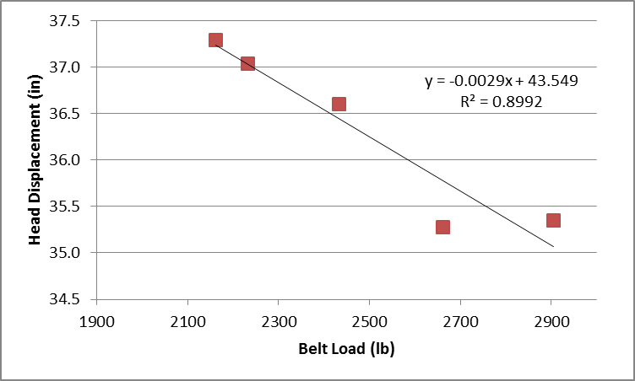
Head Path vs. Belt Loads (Phase 2)

Slide 12
Phase 1 and Phase 2 Comparison
 | Phase | Test # | Belt Load (lb) | Head Disp (in) | Anchor Load LHS (lb) | Anchor Load RHS (lb)
Original | 1 | Test 5 | 2029 | 35.7 | 2057 | 2253
 | 2 | Test 1 | 2162 | 37.3 | 1949 | 2237
 | Diff |  | 6% | 1.6 | 5.5% | 0.7%
Scaled | 1 | Test 5 | 2016 | 35.5 | 2044 | 2239
 | 2 | Test 1 | 2110 | 36.4 | 1903 | 2184
 | Diff |  | 5% | 0.9 | 6.9% | 2.4%

Slide 13
Static Elongation
Sample | Measured | Reported
OEM | 18.0% | -----
Repaired # 1 | 6.8% | 6.9%
Repaired # 2 | 19.3% | 19.3%
Repaired # 3 | 18.1% | 15.0%
Repaired # 4 | 8.0% | 8.3%
Repaired # 5 | 14.3% | 13.5%

Slide 14
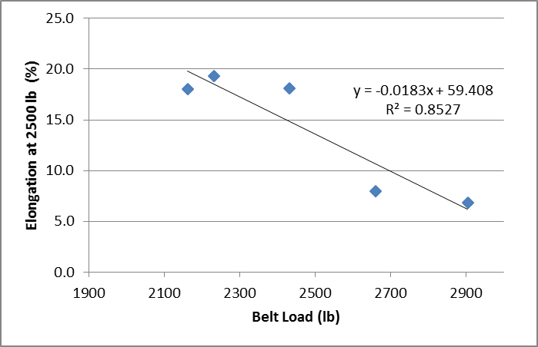
Static vs. Dynamic

Slide 15
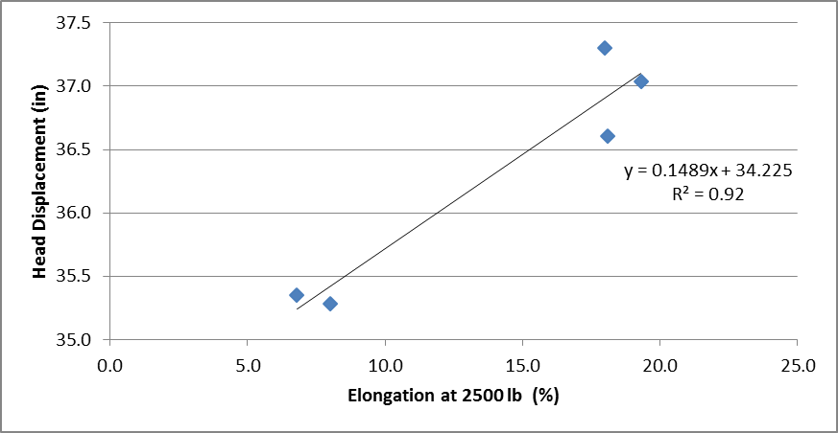
Head Displacement vs. Static

Slide 16
Discussion
No failures
Initial belt angle related to head displacement
  Belt angle not correlated with belt loads
SRP location
  Steeper belt angles increased head displacement
  No clear trend to belt loads
Head displacement inversely related to peak belt load

Slide 17
Discussion
Meeting SAE AS 8043 (20% allowed) does not guarantee equivalence
Baseline belt of 18%
Repaired belts varied but of those that met SAE AS 8043
  Belt loads of 3.2% to 34.4% higher
  Head displacement 0.3 to 2.0 inches lower

Slide 18
Conclusion
Static belt stiffness can be used to characterize relative belt performance in dynamic tests
+- 3% variation in static elongation could result in 15% variation in belt loads and 1.0 inch in head displacement
Using webbing materials that have similar properties will minimize differences of the repaired assemblies

Slide 19
Questions?

