Slide 1
Finite element modeling of lumbar spine biomechanics under oblique loading conditions
Jessica Coogan Ph.D., Daniel Nicolella Ph.D.
Southwest Research Institute
San Antonio, TX

Slide 2
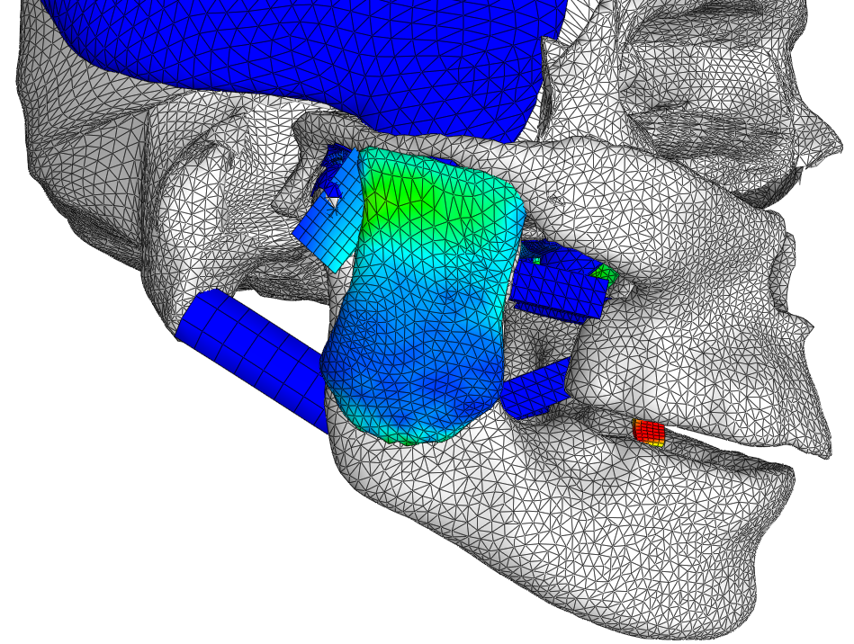
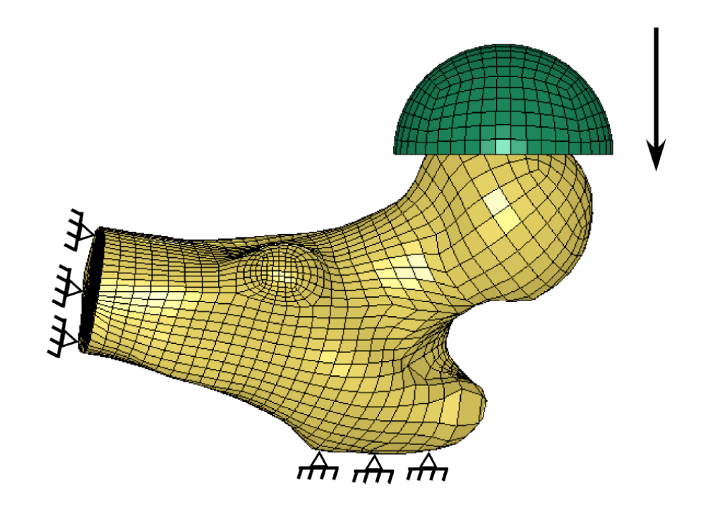
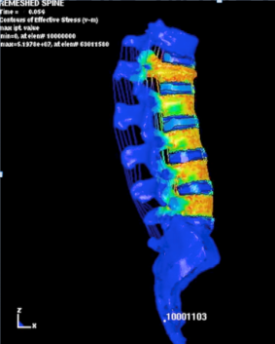
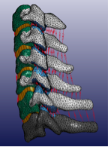
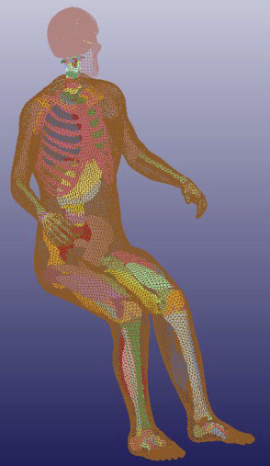
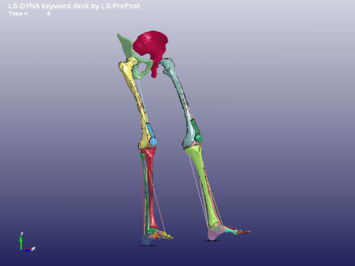
Computational Modeling for Biomechanical Analysis
Relatively easy to construct high fidelity models from high quality 3D image data
  powerful geometry modeling and meshing software
  high performance computational resources
  Resulting models “looks” almost identical to the actual biological system.
Non-linear material constitutive models with properties either derived from experimental data or reported in the literature
Large deformation, and motion defined by sliding contact between complex, deformable articulating surfaces

Slide 3
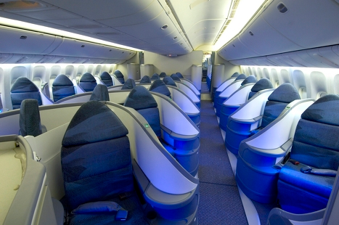
Application to aircraft seats
Passenger seats are evolving, with seats oriented obliquely with respect to aircraft centerline.
Oblique seats present a different loading environment, with significant flailing and off-axis loading.
New spine injury criteria are necessary for oblique seating
Computational modeling was used to investigate injury to the lumbar spine due to oblique loading conditions

Slide 4
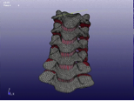
Model Verification and Validation (V&V)
High fidelity should not be confused with model credibility
High fidelity is necessary but not sufficient
  Fidelity is the result of modeling tools (pre-processor, FE code, etc.) computational speed, etc.
Model credibility is the result of specific and rigorous model V&V
  What is the error between the model and the tests?
  How much confidence do we have in the model predictions?
Fidelity ≠ Accuracy

Slide 5
Establishing a Predictive Capability
Verification
  Credibility from understanding the mathematics
  Are the equations being solved correctly?
  Compare computed results to known solutions
Validation
  Credibility from understanding the physics
  Are the correct equations being solved?
  Compare computed results to experimental data
Uncertainty Analysis
  Credibility from understanding the uncertainties
  How accurate is the model prediction?
  Quantify uncertainty & variability from all sources
Mathematical
Evidence
Experimental
Evidence
Statistical
Evidence

Slide 6
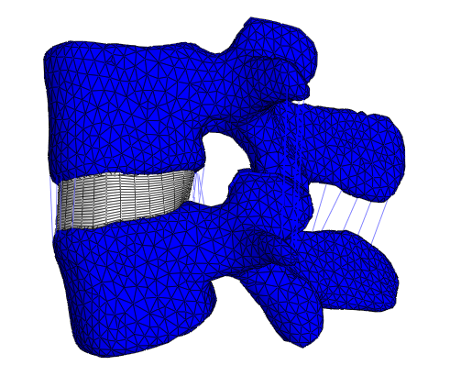
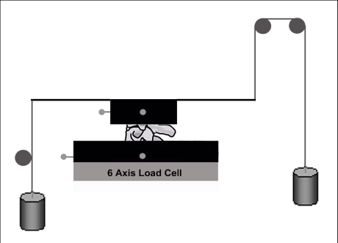
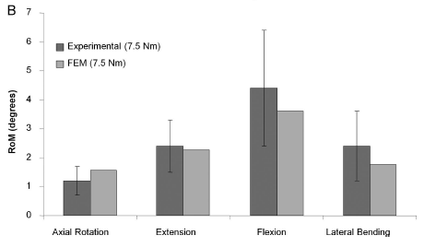
Model Validation Example
Typical Approach
Common approach: model is valid if prediction falls within experimental corridors
Issues
  Mismatch not quantified
  Corridor limits are arbitrary (±1σ?)
  Reducing the quality of the experimental data improves the chance that the model is valid (not good!)
Rundell, et al. Spine 34(19):2022-2032

Slide 7
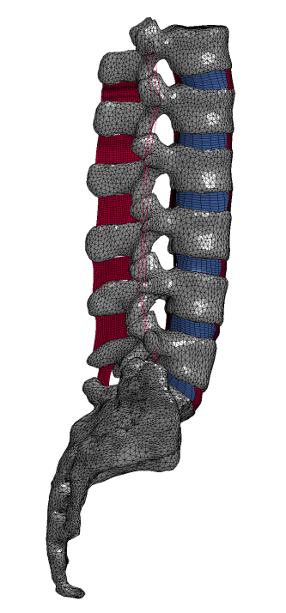
Hierarchical Model V&V Approach
ASME V&V-10 Guidelines
Validation hierarchy
  Breaks the problem into smaller parts
  Validation process employed for every element in the hierarchy (ideally)
  Allows the model to be challenged (and proven) step by step
  Dramatically increases likelihood of right answer for the right reason
Customer/stakeholder establishes intended use and top-level validation requirement
Validation team constructs hierarchy, establishes sub-level metrics and validation requirements
  Modeling and experiment teams work closely together to define hierarchy and experiments/simulations
  Experiments are designed expressly for model validation
Subsystem
Single Physics
Component
Notes:
In general, validation requirements will be increasingly more stringent in lower levels
Full system (un-validated) sensitivity analysis can provide guidance

Slide 8


Characterizing Uncertainties
Probabilistic Computational Model
Aleatory uncertainty
Operational Conditions
Population Group
Finite Element Model
Predicted Probabilistic Response
COV’s~100%
Material Property
unknown &
variable
Forces
unknown &
variable
Model Response
Forces, Stress, Strain, Deflections, etc.
Boundary Conditions
COV’s~20%
Geometry

Slide 9
Validation Metrics
How do you define valid?
A metric is the quantitative measure of the mismatch between model predictions and experimental data
Typically some type of a difference measure in system response quantities (statistics, probability distributions, etc.)
Generally, multiple response quantities and associated metrics are better than one (right answer for the right reason)
Desired features of a validation metric
  Consider uncertainties in both the model and the experiment – implies a statistical comparison
  Reflect only the comparison (not the adequacy)
Rundell, et al. Spine 34(19):2022-2032

Slide 10
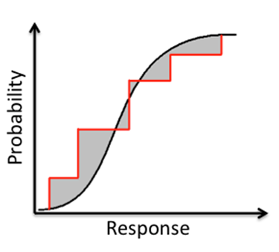
Probabilistic Validation - Area Metric
Calculates the area between the experimental CDF and predicted model CDF
  Compares mean response and variability between prediction and experiment
  Give quantitative measure of model performance but there is no pass or fail number
  Requires expert opinion to determine what is good enough
Model CDF
Experimental CDF

Slide 11

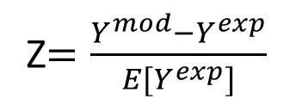
Probabilistic Validation - Probabilistic Error Metric
Absolute error between a model prediction and an experimental response quantity
  Model prediction and experimental measurement are uncertain
  Normalized by the experimental mean value (to simplify solution)
  Validation Requirement
    p < p_{r}, or z < z_{r}
Y^{exp}
Y^{model}
Z
Z$=\frac{Y^{mod}−Y^{exp}}{E[Y^{exp}]}$
Probability that the error will not be exceeded
|Z|
Notes:
Z = Probabilistic Error Metric

Slide 12
Probabilistic Validation - Probabilistic Error Metric
Interpretation
CDF (integration of PDF) of Z
  X-axis is error - Z
  Y-axis is probability level - p
90% probability that the error will not be greater than 15.6%
61% probability that the error will not be greater than 10%
The error between the model and the experiment is fully defined
The benchmark level of error is the error of the experiment compared to itself at a 90% probability level
Z = error between model and experiment

Slide 13
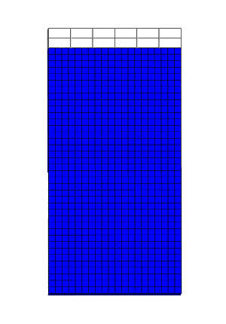
Example Bottom Level Optimization
Experimental setup
Isolate individual lumbar disc lamellae
Loaded in tension until failure
Resulting stress-strain relationship recorded
67 experiments performed
Simulation optimization
Simulations performed in FEBio, an open source FE code
Optimize material properties and viscoelastic properties for disc annulus
Target is stress-strain curve
Mean and standard deviation of parameters determined
Parameter | Average | StDev
c1 | 2.97e5 | 2.92e5
c3 | 3.13e4 | 2.60e4
c4 | 25.7 | 8.1
c5 | 1.80e7 | 1.16e7
λ | 1.14 | 0.05

Slide 14
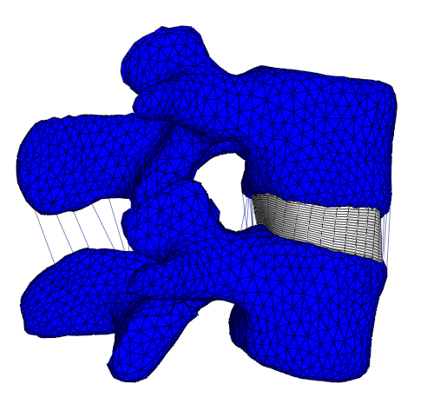
Example Second Level Validation
Experimental set-up
Pure moment loading of complete motion segment to 6 N-m
Rotation of superior vertebrae recorded
Simulation
Perform probabilistic analysis incorporating variability of material properties (Disc and all ligaments)
Calculate area metric and probabilistic error metric
Qualitative
Validation

Slide 15
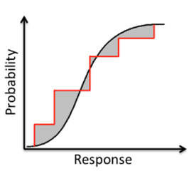
Example Second Level Validation
Probabilistic error metric
Area metric
Flexion
Motion | e_{benchmark} | FEM p = P[|Z| ≤ e_{benchmark}]
Flexion | 48% | 98%
Extension | 222% | 97%
R Axial Rotation | 172% | 81%
L Axial Rotation | 260% | 91%
R Lateral Bending | 45% | 61%
L Lateral Bending | 48% | 77%
Motion | Area Metric
Flexion | 0.11
Extension | 0.60
R Axial Rotation | 0.61
L Axial Rotation | 0.67
R Lateral Bending | 0.54
L Lateral Bending | 0.17

Slide 16
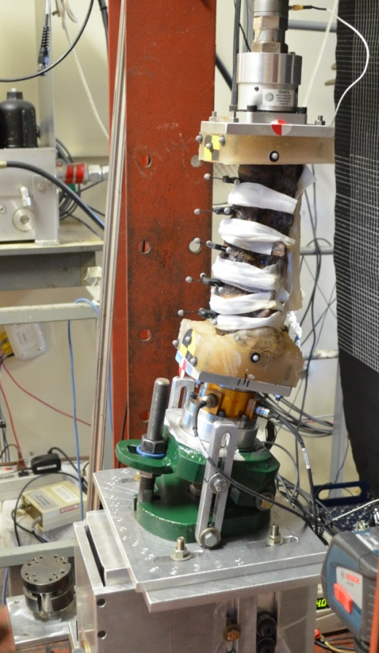
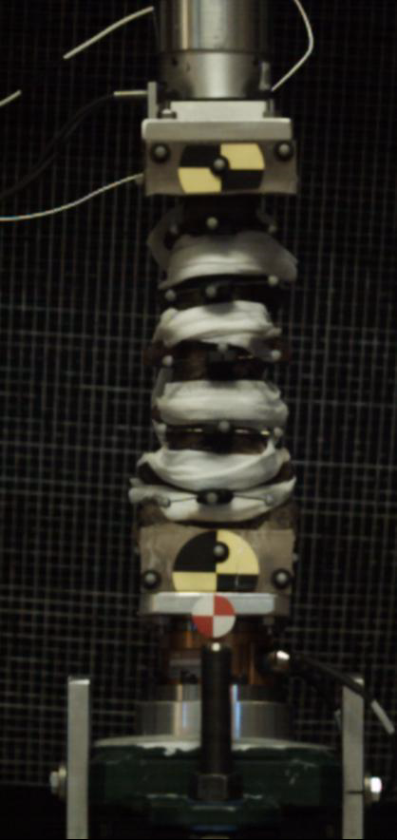
Oblique seat research
An ongoing project at the Medical College of Wisconsin (MCW) and SwRI is investigating the spine biomechanics associated with oblique loading
Experimental protocol:
T12 to sacrum isolated lumbar spine
15 degrees flexion with varying degrees of obliqueness
Displacement-controlled axial tension applied

Slide 17
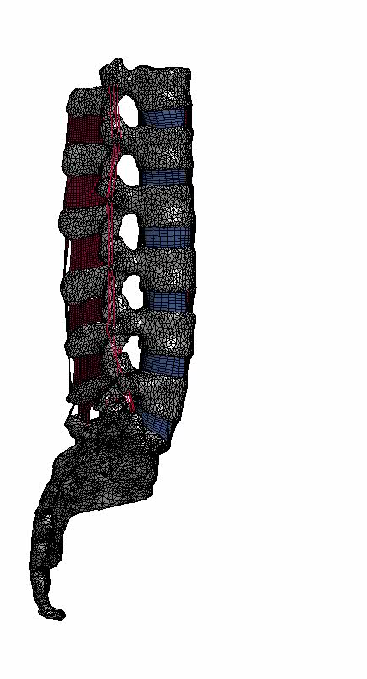
Computational Model
Lumbar spine model developed to replicate currently ongoing experimental testing on isolated lumbar specimens
Computational model will be validated against experimental testing and used to simulate orientations and loads not tested experimentally
Implicit – explicit switching employed
  Flexion applied implicitly
  Tension applied explicitly

Slide 18
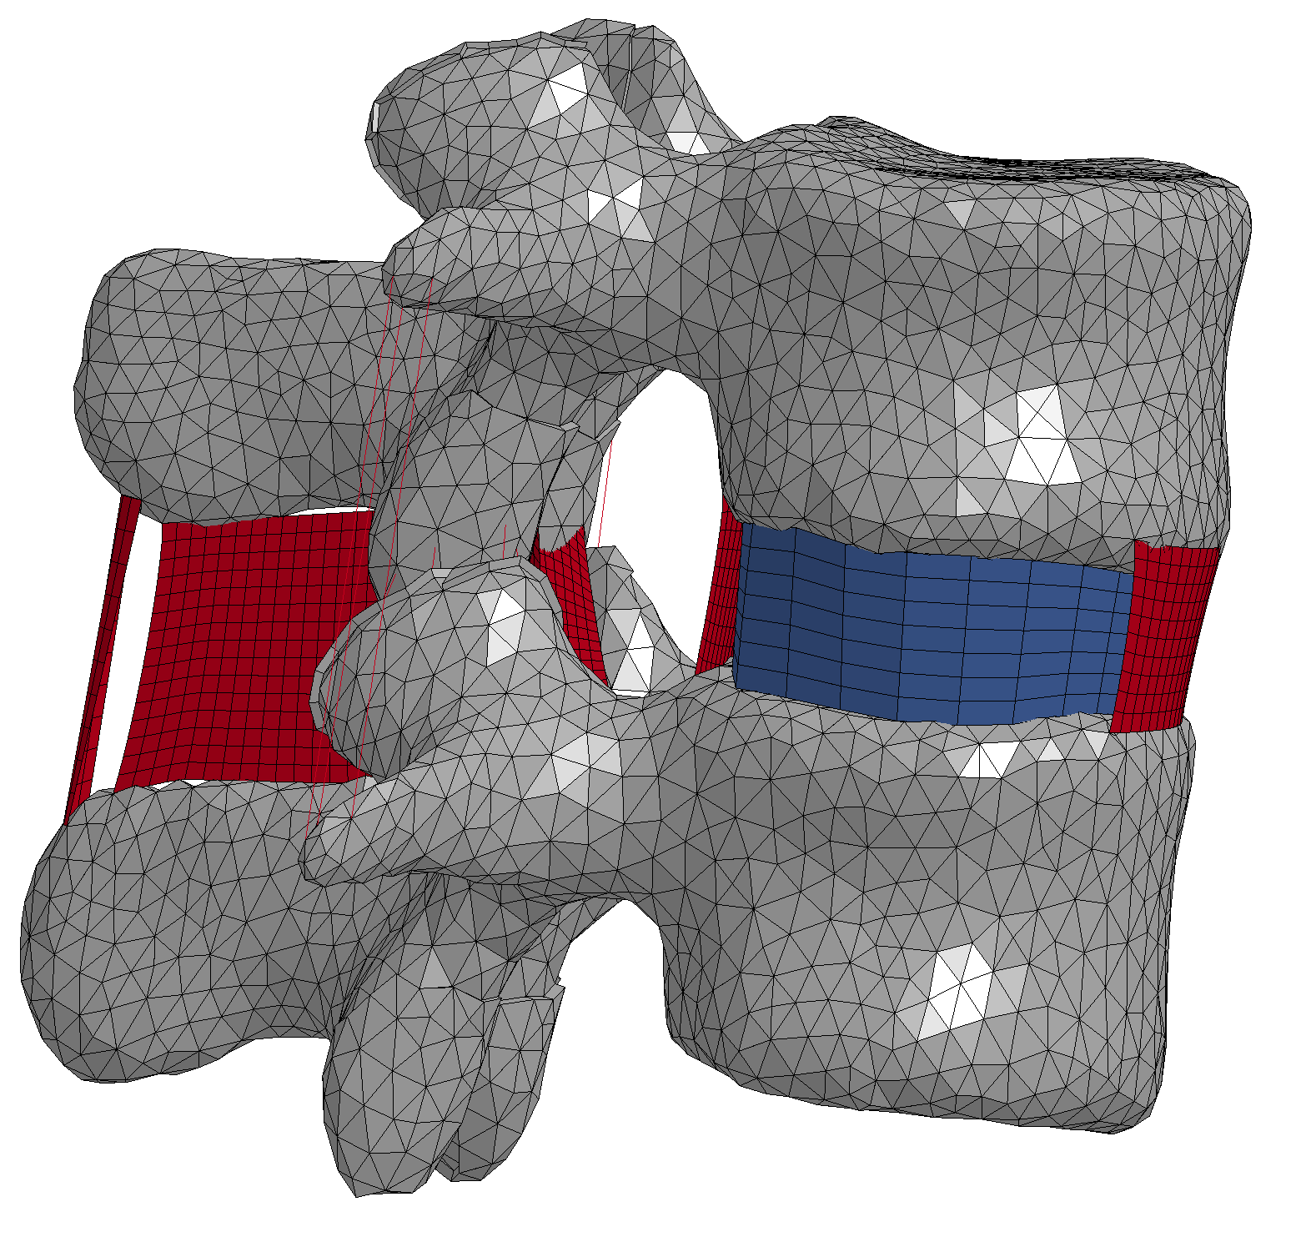
Sensitivity Analysis
Probabilistic analysis used to determine the sensitivity of model outputs to inputs (soft tissue material properties)
  Disc and ligament properties all have significant variability
  Sensitivity of axial tensile force to disc and ligament properties was determined
ITL
JC
LF
SSL
ISL
PLL
ALL
Disc
Ligaments

Slide 19

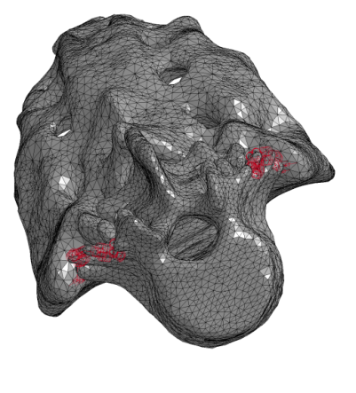

Effect of oblique angles
Aircraft centerline
The model was used to investigate different levels of obliqueness
Experimentally, accomplished by changing the rotation of the tilt adjustment device
Computationally, rotate the model to change flexion direction
Tilt adjuster
that rotates
30°
Flexion
Impact

Slide 20
Effect of oblique angles
A key output of the experimental testing is the force measured during applied axial tension
Our simulations show that 30 degree obliqueness has the greatest force, and 60 degree obliqueness has the least amount of force

Slide 21
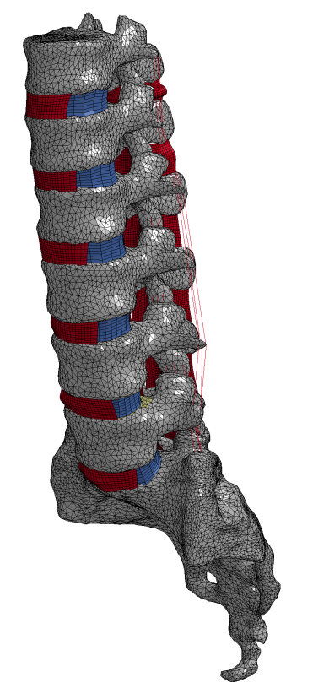
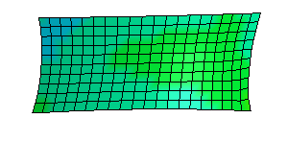
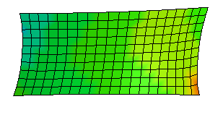
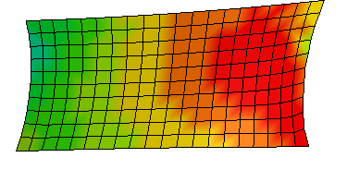
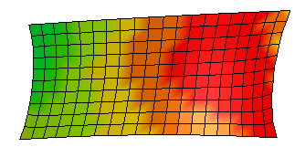

Effect of oblique angles
Simulations allow investigation into stress within ligaments and discs.
60 and 90 degree obliqueness, which had the lower force, have the higher stresses in the ligaments
T12-L1 ALL
T12-L1 ALL
0
30
60
90
0 100 200 300 400 500 600 700 800 900 1000
Von-Mises Stress (Psi)

Slide 22
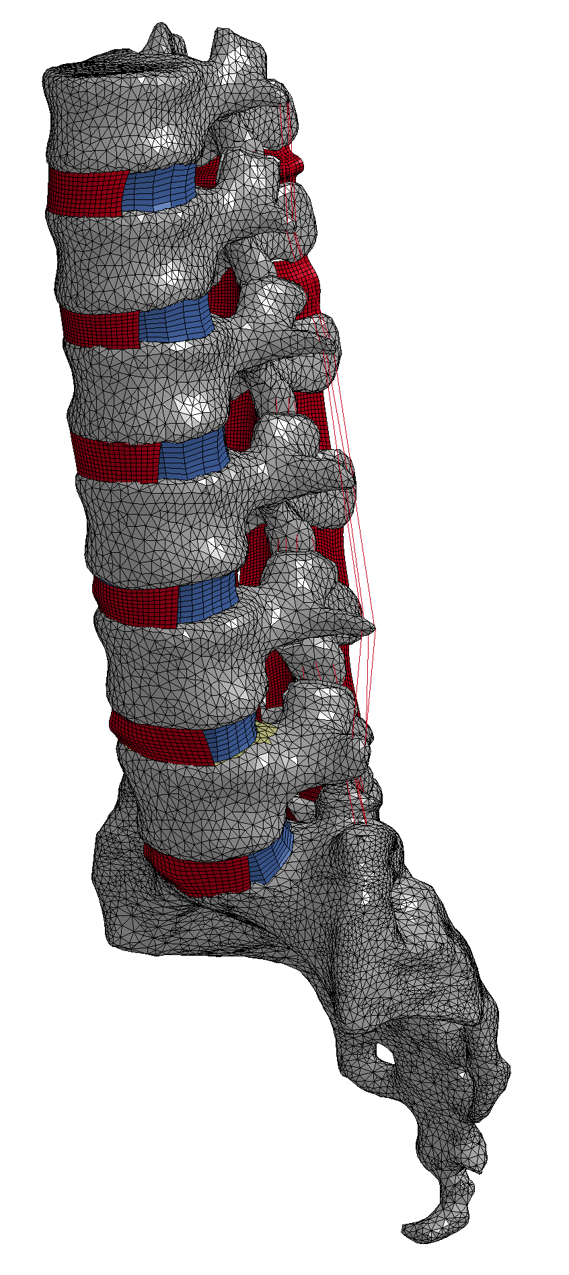
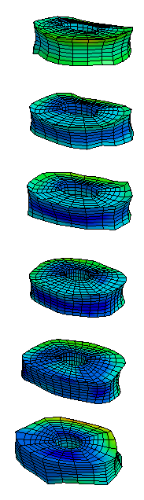
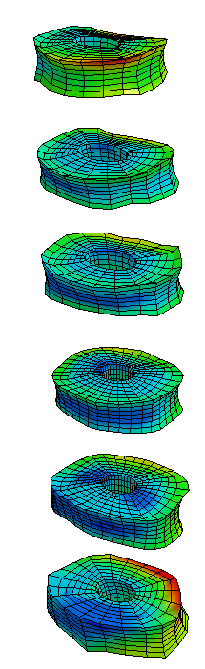
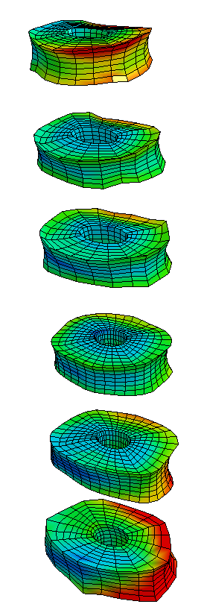
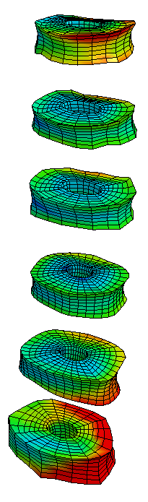

Effect of oblique angles
Disc stress are on average higher for 60 and 90 degree obliqueness compared to 0 and 30 degree obliqueness
Von-Mises Stress (Psi)
450
405
360
315
270
225
180
135
90
45
0
0
30
60
90

Slide 23
Injury prediction
Using probabilistic methods, variability in material properties was incorporated.
Experimental failure stress of the disc (435 psi) was used to determine the probability of injury
With forward facing, probability of injury = 11%
With oblique facing (60°), probability of injury = 17%

Slide 24
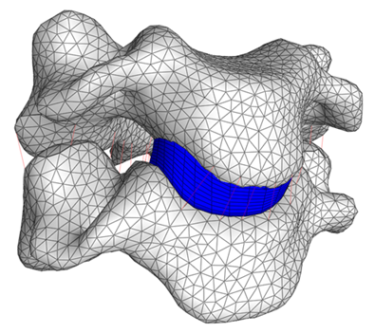
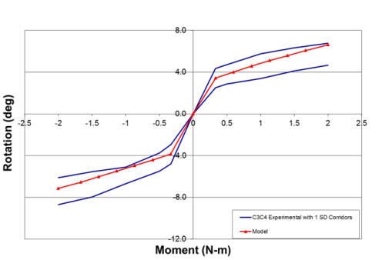
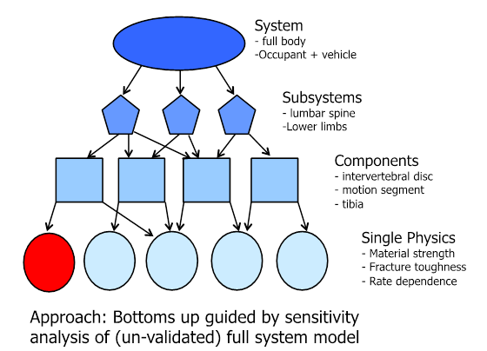
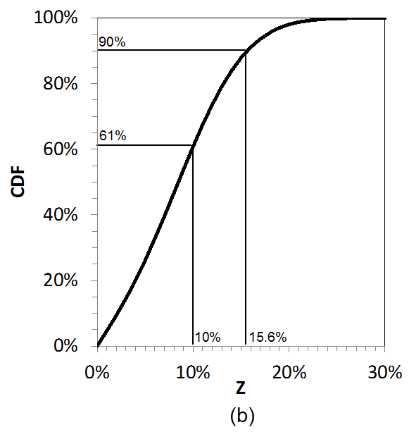
Summary
Modeling tools allows the development of complex, high fidelity models
  Model fidelity ≠ model validity
Ubiquitous use of computational modeling requires a model validation plan
    How much confidence do we have in the model predictions?
Hierarchical approach (ASME V&V-10 Committee)
  Breaks the problem into smaller parts
  Validation process employed for every element in the hierarchy (ideally)
  Allows the model to be challenged (and proven) step by step
  Dramatically increases likelihood of right answer for the right reason
Account for uncertainty in both model and experiment
Validation metric is the measure of the mismatch between model and experiment - Quantitative
Notes:
Modeling and experiment teams need to work together
Experiments should be designed for model validation

Slide 25
Summary
Current research is investigating the result of oblique loading for application to new airline seating configurations
A combined experimental – computational program is determining the spinal kinematics associated with oblique loading
30 degree off-axis loading results in the highest levels of force, while 60 and 90 degree off-axis loading results in the largest soft tissue stresses
Additional analysis is ongoing to determine the effect of different loading profiles, including the FAA pulse

Slide 26
Acknowledgements
This work is to support the Fire & Cabin Safety Technical Community Representative Group 2011/12 Project 2: Injury Criteria for Obliquely-Oriented Seats through FAA Aviation Research Grant 16-G-001

Slide 27


Thank You
Contact: daniel.nicolella@swri.org
Southwest Research Institute®
Benefiting government, industry and the public through innovative science and technology

