Slide 1
Cargo Compartment Testing at UTAS FPS
UTC AEROSPACE SYSTEMS PROPRIETARY
PROPRIETARY NOTICE
THIS DOCUMENT IS THE PROPERTY OF UTC AEROSPACE SYSTEMS. YOU MAY NOTPOSSESS, USE, COPY OR DISCLOSE THIS DOCUMENT OR ANY INFORMATION IN IT, FOR ANY PURPOSE, INCLUDING WITHOUT LIMITATION, TO DESIGN, MANUFACTURE OR REPAIR PARTS, OR OBTAIN ANY GOVERNMENT APPROVAL TO DO SO, WITHOUT UTC AEROSPACE SYSTEMS‟ EXPRESS WRITTEN PERMISSION. NEITHER RECEIPT NOR POSSESSION OF THIS DOCUMENT ALONE, FROM ANY SOURCE, CONSTITUTES SUCH PERMISSION. POSSESSION, USE, COPYING OR DISCLOSURE BY ANYONE WITHOUT UTC AEROSPACE SYSTEMS‟ EXPRESS WRITTEN PERMISSION IS NOT AUTHORIZED AND MAY RESULT IN CRIMINAL AND/OR CIVIL LIABILITY.
EPORT CONTROL NOTICE
THIS DOCUMENT DOES NOT CONTAIN ANY EXPORT CONTROLLED TECHNICAL DATA.
CLS07348367

Slide 2
Table of Contents
Introduction
Overview of Tests
Test Results
Design considerations
Conclusions
UTC AEROSPACE SYSTEMS PROPRIETARY. THIS DOCUMENT DOES NOT CONTAIN ANY EXPORT CONTROLLED TECHNICAL DATA.

Slide 3
Introduction
UTAS FPS has carried out extensive cargo compartment testing against all 4 of MPS elements
Agents
Gaseous (vaporising liquid) agents
Water mist plus Inert gas
Inert gas only
We would like to share our findings with you
UTC AEROSPACE SYSTEMS PROPRIETARY. THIS DOCUMENT DOES NOT CONTAIN ANY EXPORT CONTROLLED TECHNICAL DATA.

Slide 4
Introduction
Environmental aspects
UN Halon Technical Options Committee (HTOC) has estimated that the worldwide supply of Halon 1301 (“the bank”) is between 13,648 and 16,681 metric tonnes.
This halon bank is being consumed at a growing rate as the world’s aviation fleet continues to grow in size.
It is estimated that this supply will be exhausted between 2041 (best case, low emission rate) and 2034 (worst case, high emission rate)
Now is the time to find a solution.
UTC AEROSPACE SYSTEMS PROPRIETARY. THIS DOCUMENT DOES NOT CONTAIN ANY EXPORT CONTROLLED TECHNICAL DATA.

Slide 5
Overview of tests

Slide 6
Overview of tests
Scope of work carried out at UTAS FPS Colnbrook, UK
  Exploding aerosol can
  Cargo compartment tests
  Bulk load fire
  Containerized fire
  Surface burning fire
UTC AEROSPACE SYSTEMS PROPRIETARY. THIS DOCUMENT DOES NOT CONTAIN ANY EXPORT CONTROLLED TECHNICAL DATA.

Slide 7
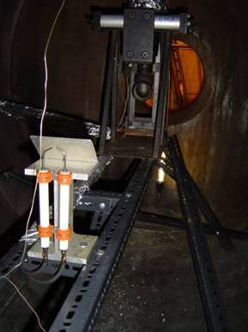
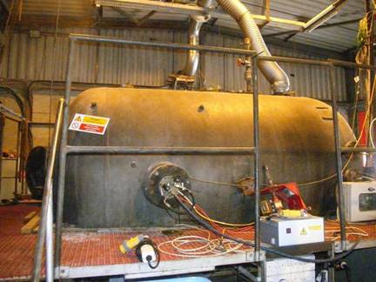
Exploding aerosol can tests
  100 + tests in 6.2 m³ explosion vessel
  Agents tested: Halon 1301, 2-BTP, Novec 1230, water mist, inert gas and mixtures of inert gas and water mist
Aerosol can
simulator
Spark igniters
Oxygen sampling
Pressure transducer
Explosion pressure
6.2 m³ pressure vessel
Heater and ignition control unit
UTC AEROSPACE SYSTEMS PROPRIETARY. THIS DOCUMENT DOES NOT CONTAIN ANY EXPORT CONTROLLED TECHNICAL DATA.

Slide 8
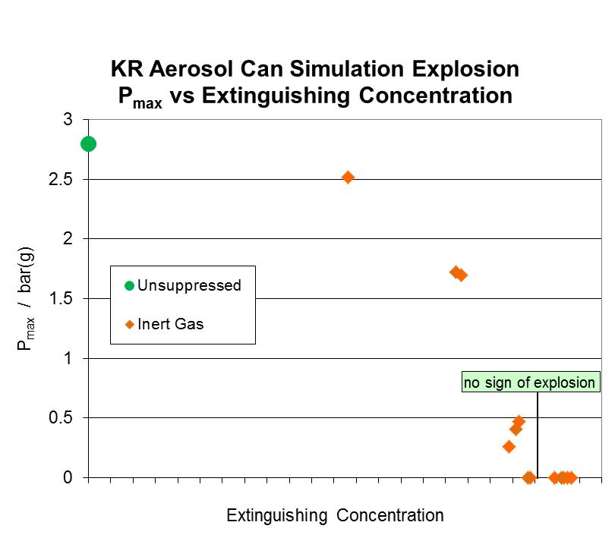
Exploding Aerosol Can Results*
  Novec 1230 and 2-BTP at low concentrations enhanced the explosion
  Water mist alone could not inert against explosions
  Inert gas at low concentrations mitigated explosions
  Combining inert gas with water mist still required same amount of inert gas
  We selected Inert gas to test in
  the cargo compartment at full scale
* Alternative means of compliance is to carry out “long version” of cargo
compartment test
UTC AEROSPACE SYSTEMS PROPRIETARY. THIS DOCUMENT DOES NOT CONTAIN ANY EXPORT CONTROLLED TECHNICAL DATA.

Slide 9
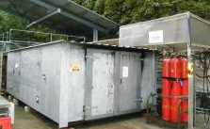
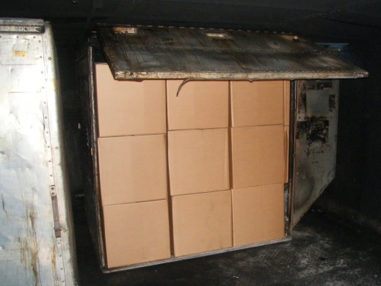
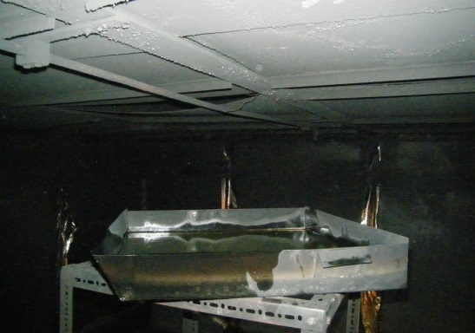
Cargo compartment tests
  Full scale cargo compartment tests were carried out
  High rate discharge: inert gas, water mist, and combinations thereof
  Low rate discharge with nitrogen enriched air (OBIGGS)
  Bulk load, containerized and surface burning fire threats
  In addition tests were carried out to assess the influence of discharge flow rates and geometry of the distribution network
UTC AEROSPACE SYSTEMS PROPRIETARY. THIS DOCUMENT DOES NOT CONTAIN ANY EXPORT CONTROLLED TECHNICAL DATA.

Slide 10
Results
In all three scenarios inert gas alone provided good initial suppression of the open flame stage and rapid cooling of the test chamber.
If the oxygen concentration is then kept below a threshold then effective suppression will be achieved.
MPS can be passed satisfactorily with inert gas alone.
Unsuppressed test
Suppressed test
Unsuppressed test
Suppressed test
Unsuppressed test
Suppressed test
UTC AEROSPACE SYSTEMS PROPRIETARY. THIS DOCUMENT DOES NOT CONTAIN ANY EXPORT CONTROLLED TECHNICAL DATA.

Slide 11
Design considerations

Slide 12
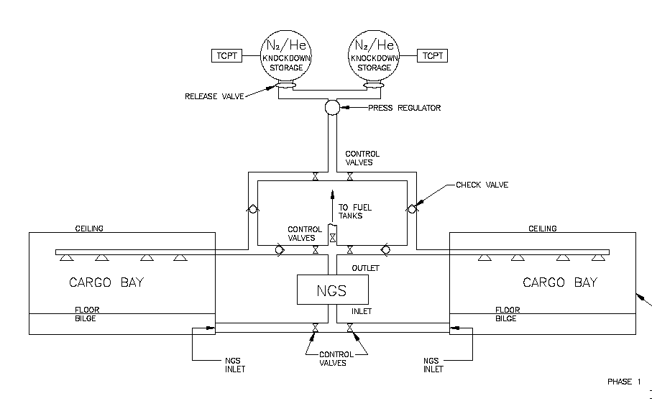
Concept Design
INERT
GAS
INERT
GAS
UTC AEROSPACE SYSTEMS PROPRIETARY. THIS DOCUMENT DOES NOT CONTAIN ANY EXPORT CONTROLLED TECHNICAL DATA.

Slide 13
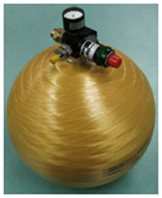
Inert Gas HRD
Stored inert gas in pressurized bottles
Pressure range 3000 - 5000 psi
Composite, Titanium or
Stainless Steel bottles
Valve (pressure control) and manifold to distribution system used by both HRD and LRD, check valves where required
UTC AEROSPACE SYSTEMS PROPRIETARY. THIS DOCUMENT DOES NOT CONTAIN ANY EXPORT CONTROLLED TECHNICAL DATA.

Slide 14
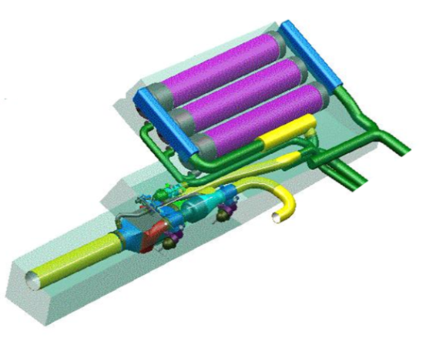
LRD Aspects
LRD Provided by diverting OBIGGS from Fuel Tank to Cargo compartment
Reliability improved by adding redundant components
In some cases existing NGS can meet LRD flow requirements
In other cases growth in NGS needed
Larger heat exchanger
Additional canister(s) in
Air Separator Module (ASM)
UTC AEROSPACE SYSTEMS PROPRIETARY. THIS DOCUMENT DOES NOT CONTAIN ANY EXPORT CONTROLLED TECHNICAL DATA.

Slide 15
Weight comparison with Halon 1301
System weight estimate for typical narrow body aircraft
Helium is lightest for any ventilation or ETOPS
Nitrogen benefit is greater for longer ETOPS
And for typical wide body aircraft
Inert gas benefit over Halon is greater for longer ETOPS
Agent | ETOPS (min) | Overall System Weight (pounds)
 |  | 1500 CFH
Halon 1301 | 75 | 90.8
Halon 1301 | 195 | 164.1
Nitrogen | (Any) | 122.3
Helium | (Any) | 83.4
Agent | ETOPS (min) | Overall System Weight (pounds)
 |  | 3000 CFH
Halon 1301 | 75 | 148.0
Halon 1301 | 195 | 279.7
Nitrogen | (Any) | 263.2
Helium | (Any) | 180.1
UTC AEROSPACE SYSTEMS PROPRIETARY. THIS DOCUMENT DOES NOT CONTAIN ANY EXPORT CONTROLLED TECHNICAL DATA.

Slide 16
Safety Aspects

Slide 17
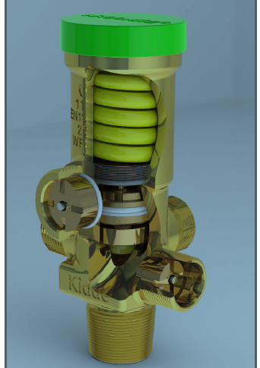
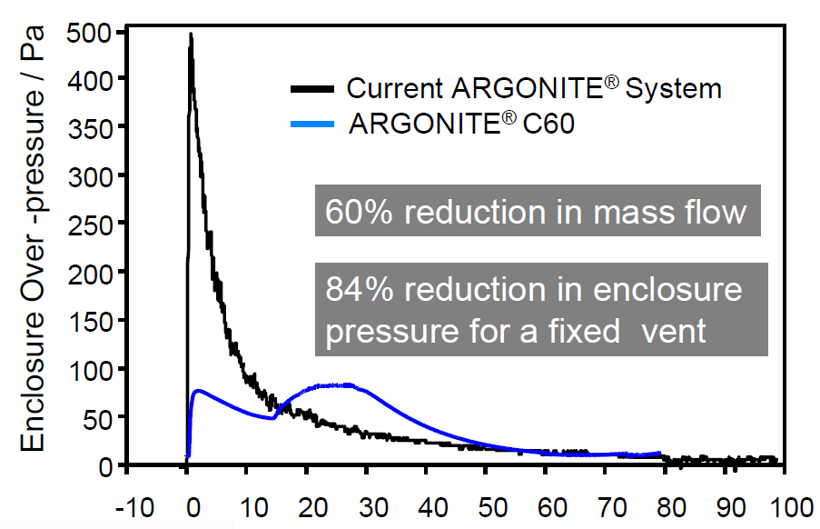
Overpressure mitigation
Patented valve – flow rate can be adjusted
60% reduction in peak mass flow
84% reduction in enclosure overpressure
Normal discharge
Patented Valve
Patented Valve
Time /s
UTC AEROSPACE SYSTEMS PROPRIETARY. THIS DOCUMENT DOES NOT CONTAIN ANY EXPORT CONTROLLED TECHNICAL DATA.

Slide 18
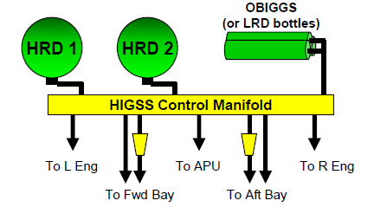
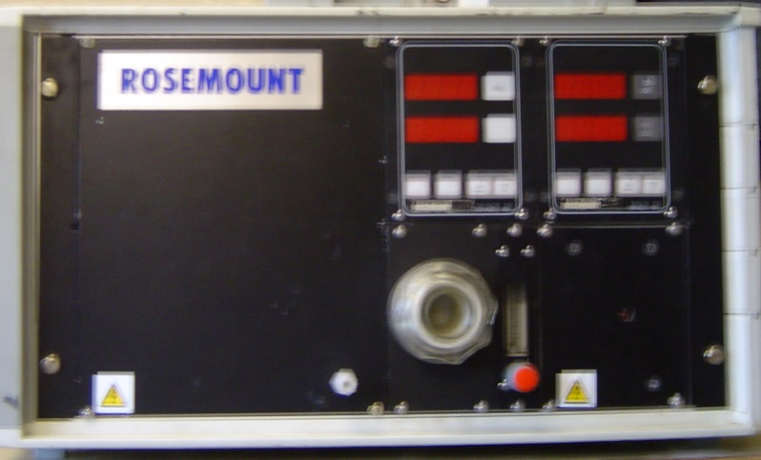
Other considerations
System Integration
LRD Supply
Fuel Cell /
Distribution of the inert gas to engine nacelles, APUs and other areas can bring system level benefits
Certification
Technology exists for easy certification to all possible areas of application
UTC AEROSPACE SYSTEMS PROPRIETARY. THIS DOCUMENT DOES NOT CONTAIN ANY EXPORT CONTROLLED TECHNICAL DATA.

Slide 19
Other Safety Considerations
Use of Odorant can serve as warning that system has been discharged (Patented & Patent Pending)
Inadvertent discharge directed overboard (Patent Pending)
Oxygen sensors to control discharge (Patented & Patent Pending)
UTC AEROSPACE SYSTEMS PROPRIETARY. THIS DOCUMENT DOES NOT CONTAIN ANY EXPORT CONTROLLED TECHNICAL DATA.

Slide 20
Conclusions and summary
  UTAS FPS has a suitable test article and has completed all four of the MPS test elements
  Inert gas alone has been shown to be capable of passing the MPS
  Adding water mist to inert gas does not provide any benefit in the aerosol can tests
  Inert gas could be a simple, straightforward replacement for Halon 1301 in cargo compartment applications
UTC AEROSPACE SYSTEMS PROPRIETARY. THIS DOCUMENT DOES NOT CONTAIN ANY EXPORT CONTROLLED TECHNICAL DATA.

Slide 21
Questions ?

