Slide 1
Kevlar® XF for Fire-Resistant Air Cargo Containers
Ley Richardson, Ph.D., Dariusz Kawka, Ph.D., Tomas Perez
DuPont Protection Technologies
8th Triennial International Aircraft Fire and Cabin Safety Conference
27 October 2016
Disclaimer: This information corresponds to our current knowledge on the subject and may be subject to revision as new knowledge becomes available. It is your responsibility to investigate other sources of information on this issue that more appropriately addresses your product and its intended use. This information is not intended for use by you or others in advertising, promotion, publication or any other commercial use. DUPONT MAKES NO WARRANTIES OF ANY KIND REGARDING THIS INFORMATION AND ASSUMES NO LIABILITY WHATSOEVER IN CONNECTION WITH ANY USE OF THIS INFORMATION. This information is not a license to operate under, or intended to suggest infringement of, any existing trademarks or patents.
The DuPont Oval Logo, The miracles of science™, and Kevlar® are registered trademarks or trademarks of E.I. du Pont de Nemours and Company or its affiliates.

Slide 2
Summary
Kevlar® XF is a new DuPont panel material for ULDs that:
Meets technical requirements in the draft SAE AS 6278 and ISO 19281 standards for Fire-Resistant Containers (FRCs), including 14 CFR 25 Appendix F Part III flame penetration requirements
Maintains Part III-compliant fire resistance following simulated in service abuse
Is lightweight compared to other commercially available ULD panels while maintaining similar or enhanced mechanical properties
Additional Data Available from DuPont:
Smoke Emission
Toxic Gas Emission
Heat Release Rate (OSU)
Fungus Resistance
UV and Humidity Exposure
Puncture Resistance
Abrasion Resistance
Residual Strength After Part III Fire Test Exposure
© 2016 DuPont. All rights reserved.

Slide 3
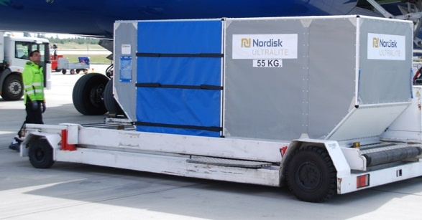
DuPont History in Air Cargo Systems
Worked with unit load device (ULD) manufacturers over past ~20 years on application-specific developments employing Kevlar® composites
Blast-resistant HULD
(Kevlar®)
Ultralite® ULD
(Kevlar®)
© 2016 DuPont. All rights reserved.

Slide 4
DuPont Perspective on Fire Protection
In general, fires are unpredictable
Intensity (temperature, duration, heat flux/energy density)
Propagation (direction, rate)
Advocate multiple approaches and layers of protection/suppression for maximum risk mitigation
Prevention
Passive suppression
Active suppression
Combinations
Use of fire-resistant materials can reduce risks
© 2016 DuPont. All rights reserved.

Slide 5
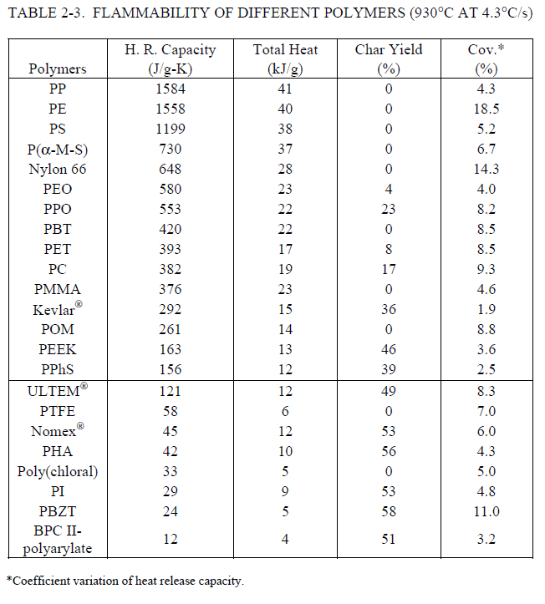
Flammability of Materials Employed in Cargo Containers
Existing commercial composite ULDs frequently employ polypropylene (PP) or polyethylene (PE) resins or fibers
Upon burning, PP and PE exhibit high heat release capacities and no char yield relative to many other polymers
DuPont has studied flammability of commercially available ULD panel materials via cargo liner test (14 CFR 25, Appendix F, Part III)
Table from DOT/FAA/AR-04/11 Technical Report by Zhang
© 2016 DuPont. All rights reserved.

Slide 6
14 CFR 25 Appendix F Part III Fire Test

Slide 7
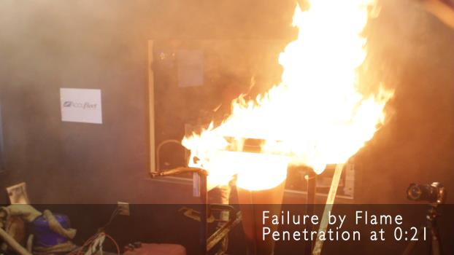
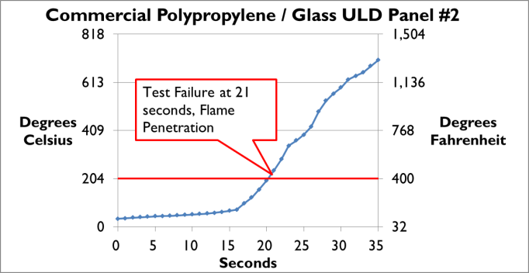
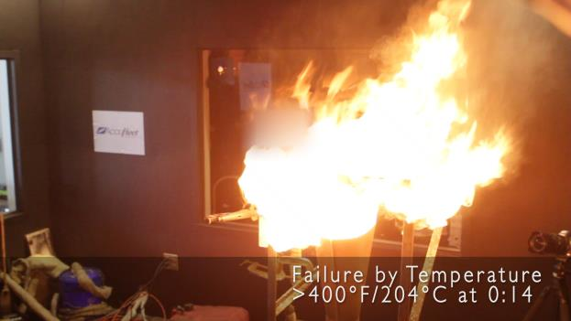
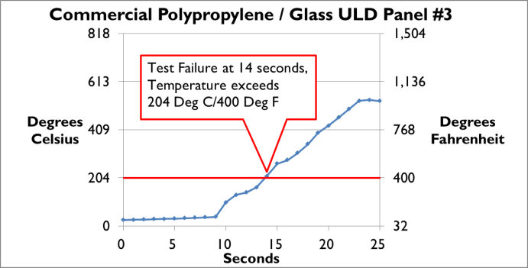
Commercial Polypropylene / Glass ULD Panels
The three different commercially available PP / glass ULD panel types tested failed 14 CFR 25 Appendix F Part III fire test

Slide 8
14 CFR 25 Appendix F Part III Fire Test

Slide 9
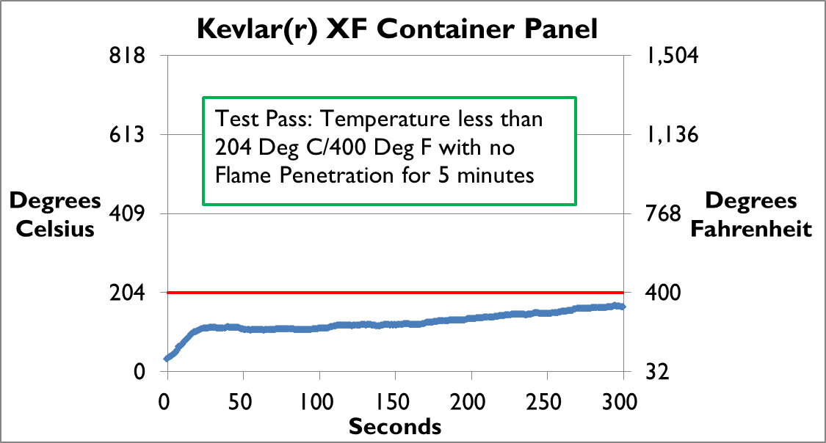
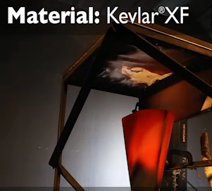
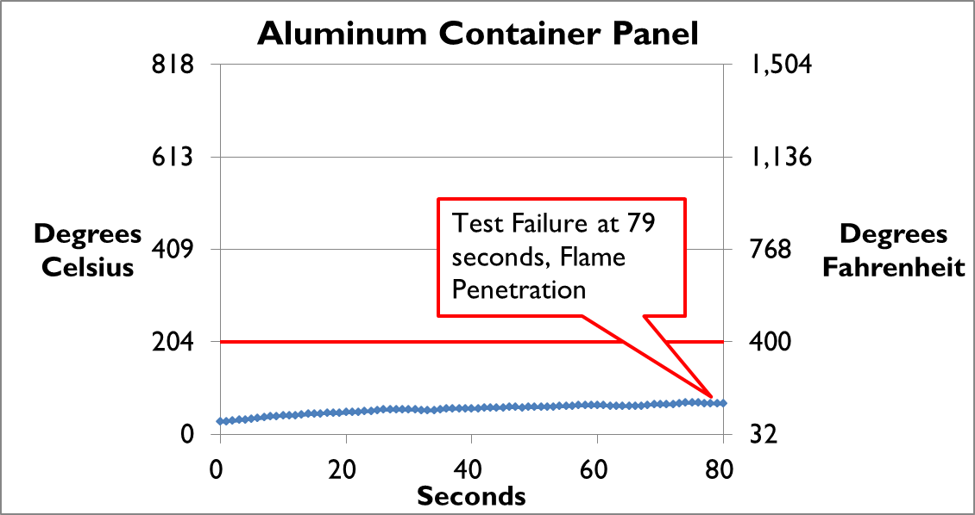
Kevlar XF vs. Aluminum in 14 CFR 25 App F Part III Test
Material: Aluminum

Slide 10
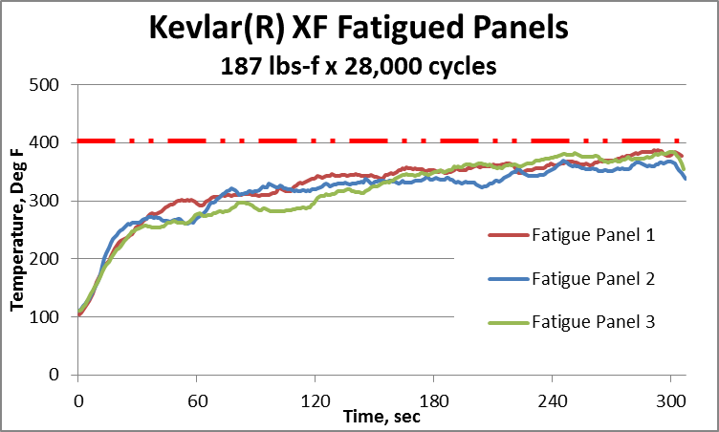
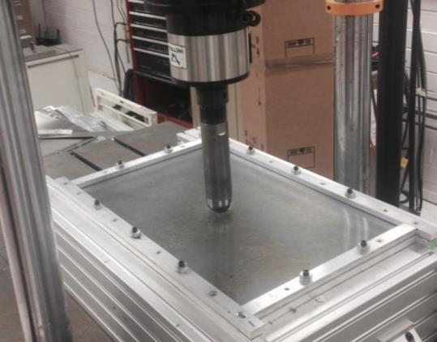
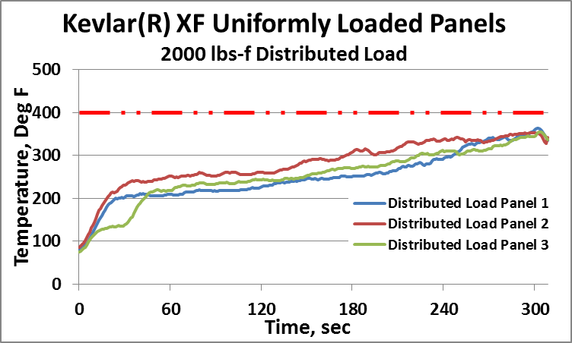
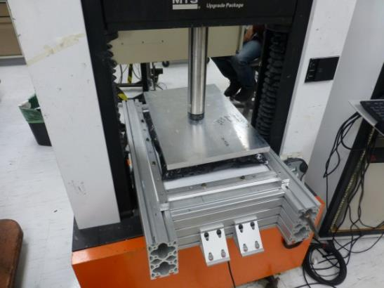
Kevlar® XF Fire Resistance After Simulated In-Service Abuse
14 CFR 25 App F Part III fire testing following mechanical testing and 24 hr water immersion
No flame
penetration
No flame
penetration

Slide 11
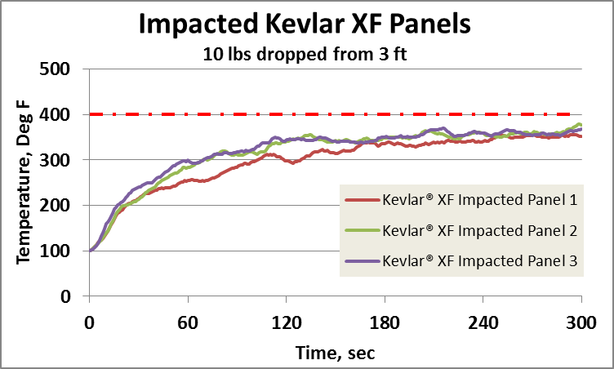
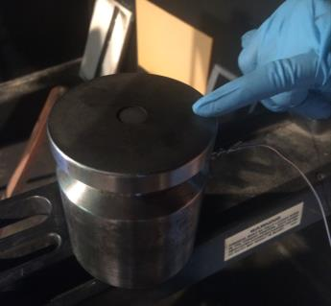
Kevlar® XF Fire Resistance After Simulated In-Service Abuse
14 CFR 25 App F Part III fire testing following mechanical testing and 24 hr water immersion
No flame
penetration
Additional 14 CFR 25 App F Part III fire testing of sidewall-ceiling combinations of Kevlar® XF panels simulating fire in a ULD corner concluded at 15 min. without flame penetration.

Slide 12
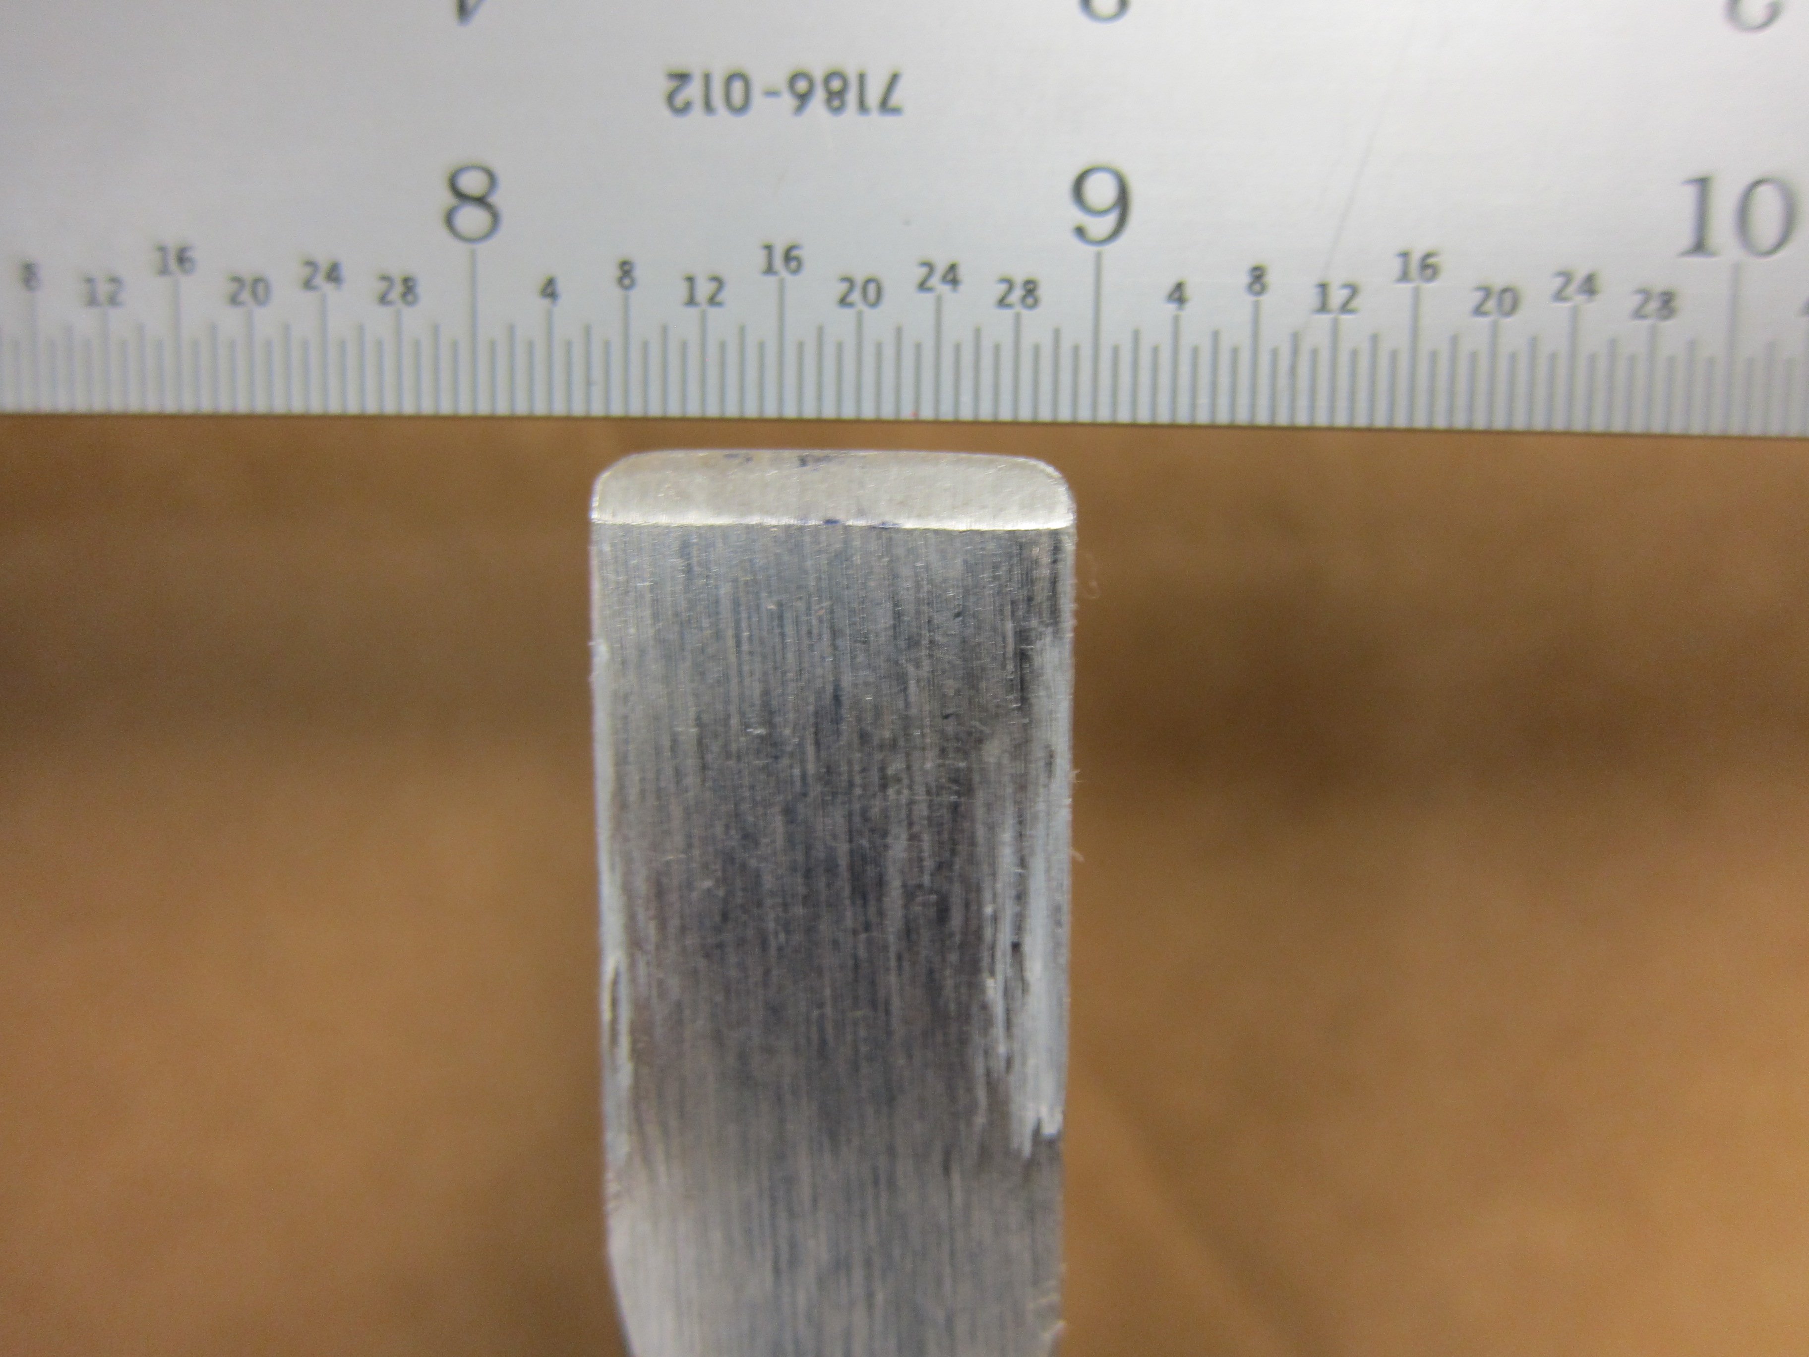
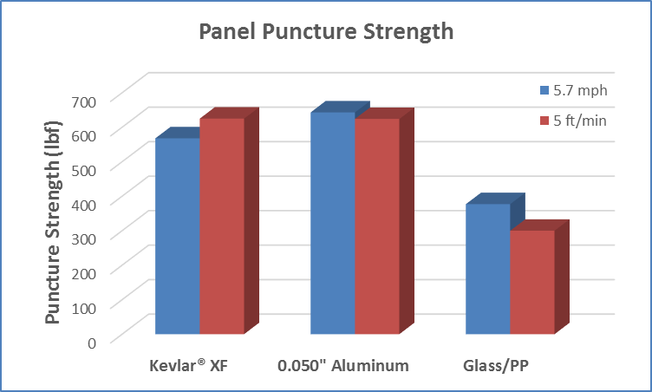
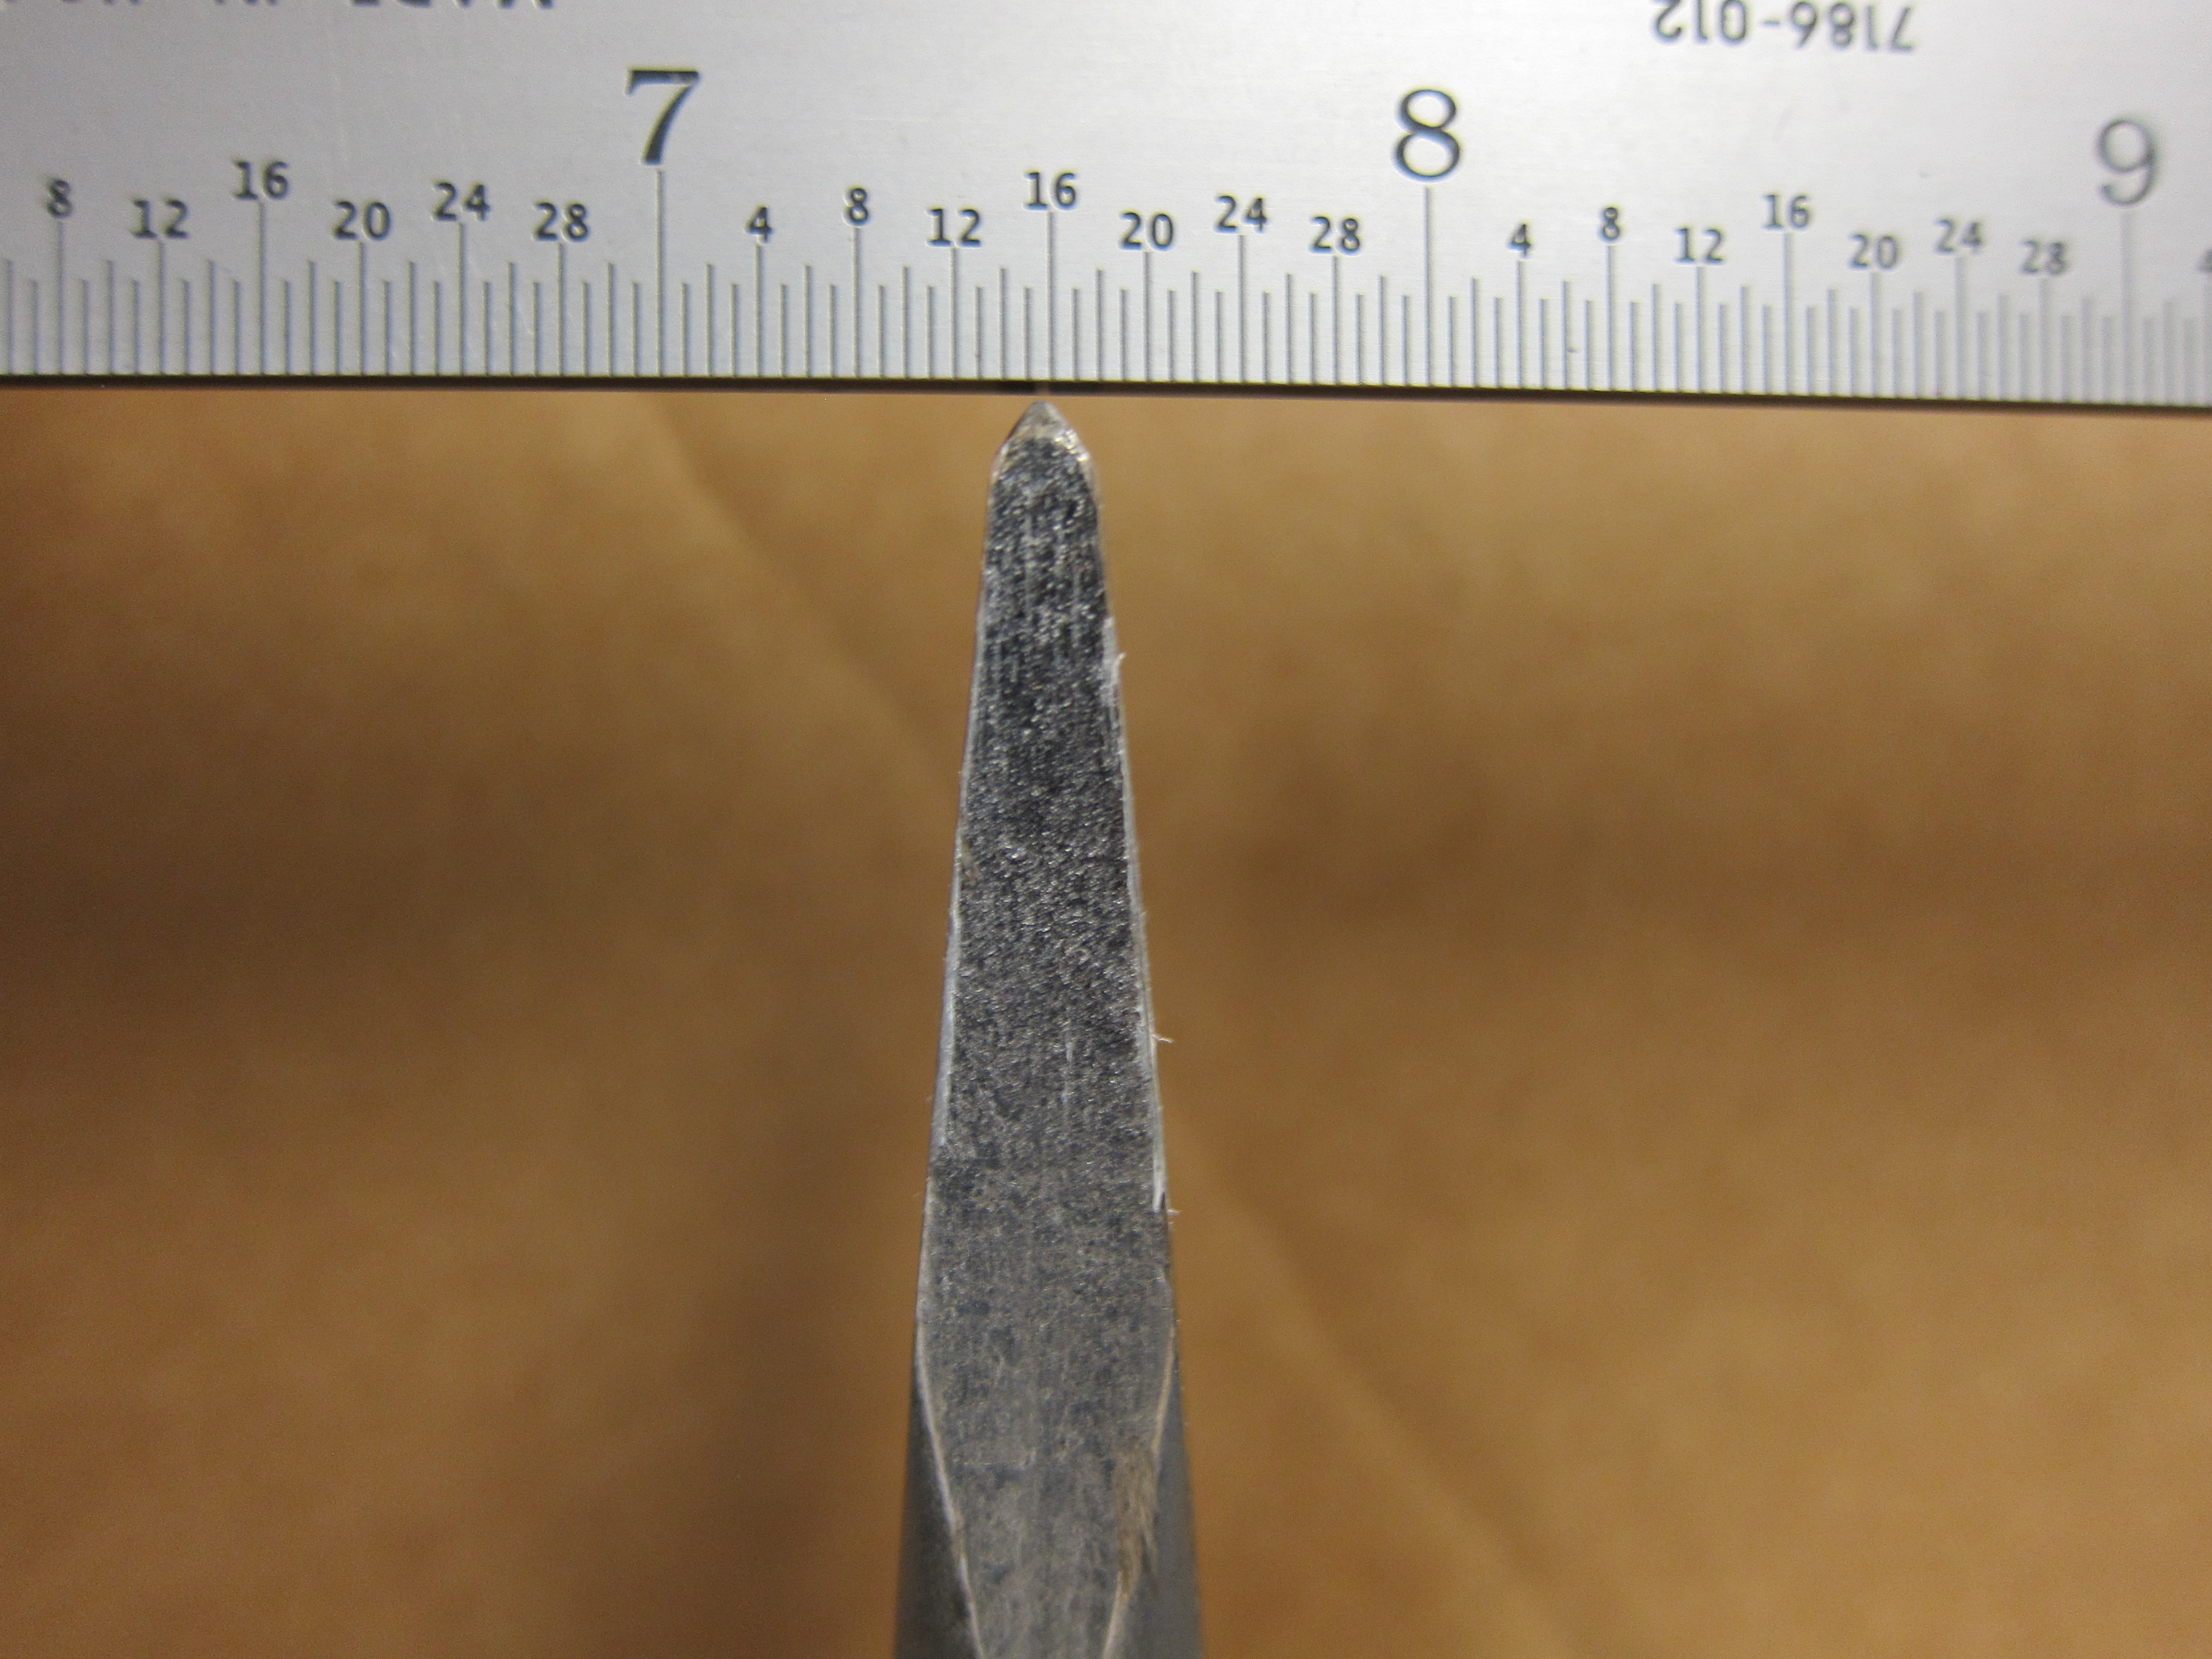
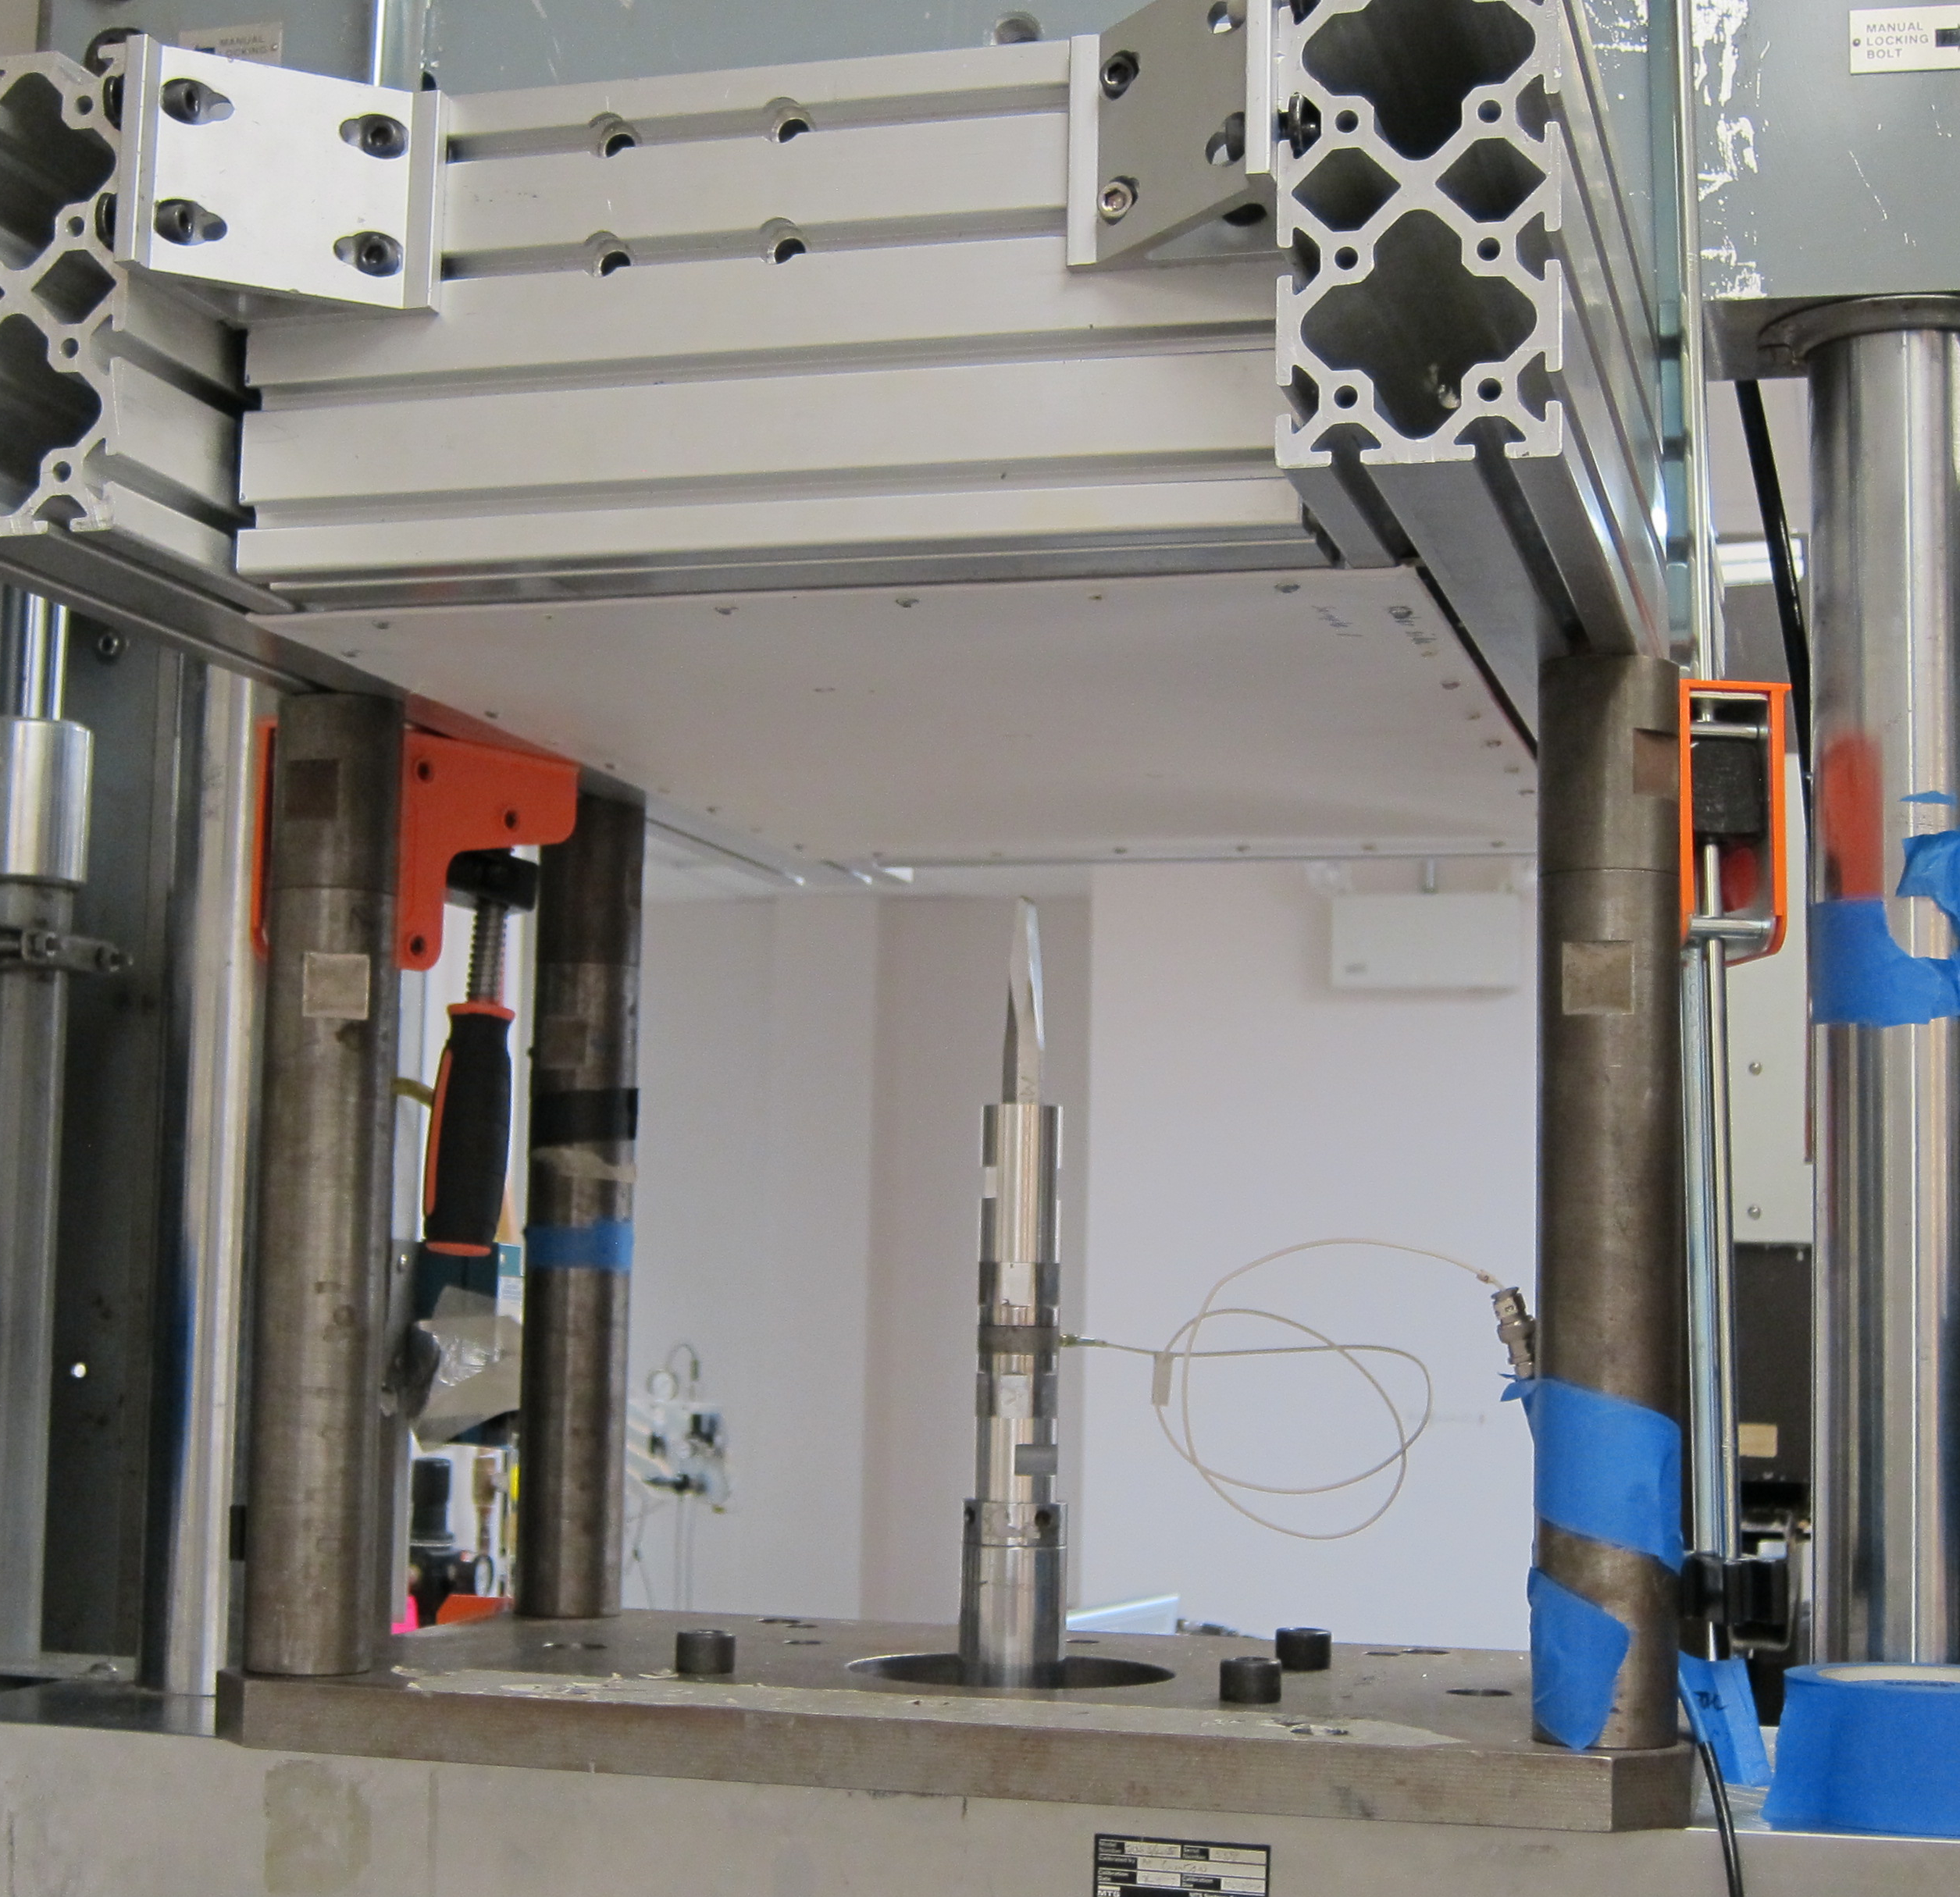
Simulated Forklift Puncture Material Comparison
Kevlar® XF has puncture strength similar to 0.050” thick Al and greater than Glass/PP while offering significant weight savings over both ULD panel options.

Slide 13
Summary
Kevlar® XF is a new DuPont panel material for ULDs that:
Meets technical requirements in the draft SAE AS 6278 and ISO 19281 standards for Fire-Resistant Containers (FRCs), including 14 CFR 25 Appendix F Part III flame penetration requirements
Maintains Part III-compliant fire resistance following simulated in service abuse
Is lightweight compared to other commercially available ULD panels while maintaining similar or enhanced mechanical properties
Additional Data Available from DuPont:
Smoke Emission
Toxic Gas Emission
Heat Release Rate (OSU)
Fungus Resistance
UV and Humidity Exposure
Puncture Resistance
Abrasion Resistance
Residual Strength After Part III Fire Test Exposure
© 2016 DuPont. All rights reserved.

