Slide 1
Class E Cargo Compartment Mitigation Strategies Subjected to Class-A Fires
The 8th Triennial International Aircraft Fire and Cabin Safety Research Conference
Dhaval Dadia, FAA Technical Center
October 27, 2016

Slide 2
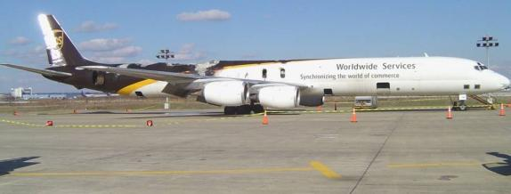
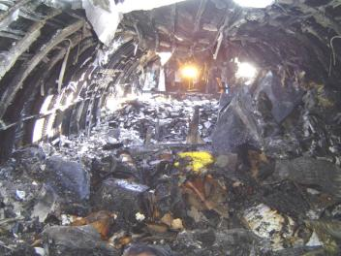
Accident History
UPS DC-8
Feb. 7, 2006
Philadelphia, PA
  Cargo smoke warning lights illuminated 20 minutes after the presence of odor
  Heavy smoke in cockpit once the plane came to a stop
  A smoldering fire that grew once cargo doors were opened for firefighting efforts
  Fire spread to adjacent containers and ultimately through the fuselage crown
Notes:
Plane landed safely but was damaged substantially from a cargo fire.

Slide 3
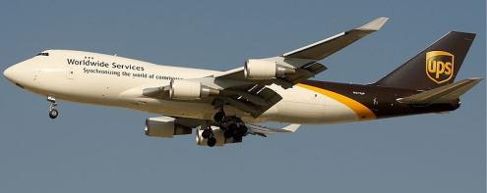
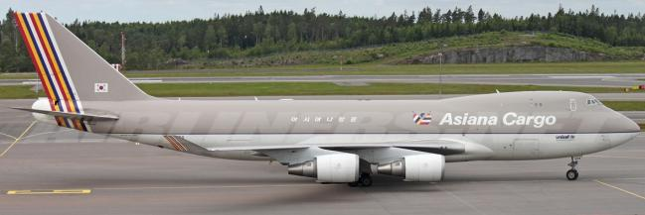
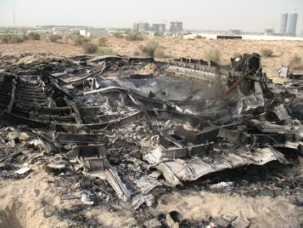
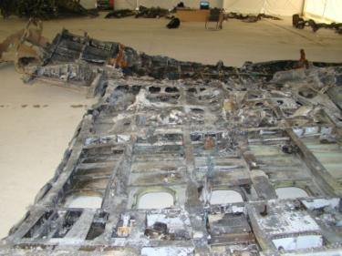
Accident History
UPS Boeing 747
Sept. 3, 2010
Dubai, UAE
Asiana Airlines Boeing 747
July 28, 2011
South Korea
Notes:
Declared an emergency and crashed. Within a short amount of time after the warning, the crew observed flight control and aircraft system failure.

Slide 4
Common Events Leading to Accident
Short time between cargo fire alarm and difficulty in maneuvering the aircraft
Smoke filling the flight deck
Loss of control of the aircraft
Crash resulted in loss of crew and aircraft
Hazardous cargo on board the aircraft
  Collapsible polypropylene ULD containers
  Large shipments of lithium batteries and other hazardous materials present in the class-E cargo compartment

Slide 5
NTSB Safety Recommendation
“Container design has a significant effect on the time it takes for an internal fire to become detectable to a smoke detector outside the container.”
“Container construction materials have a significant effect on the total fire load and energy release rate of a cargo fire.”

Slide 6
Engineering a Solution
  Identify dangers in class-E cargo compartments
    Hazardous goods
    Collapsible polypropylene containers
  Identify ways to suppress fires in class-E cargo compartments
    Fire Containment Cover (FCC)
    Aerosol Fire Suppression Agent
    Oxygen Starvation in a Fire Resistant Container (FRC)
    FRC + Aerosol Fire Suppression Agent

Slide 7
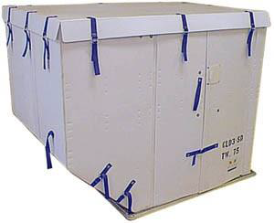
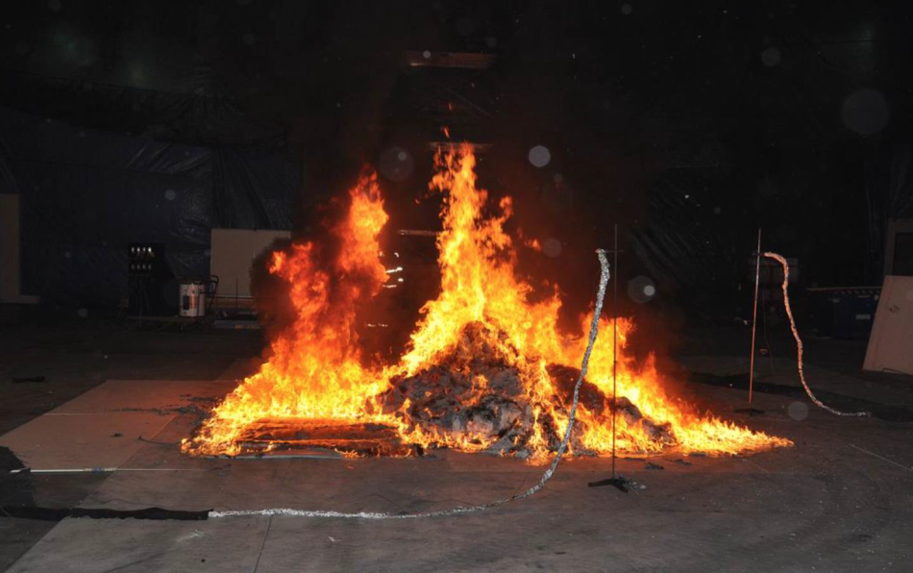
Collapsible Polypropylene Containers
Polypropylene containers not governed by FAA and hence are not required to meet flammability requirements.
Polypropylene contributes to the fire as a fuel.
  Heat of Combustion is 42.66kJ/g
The peak heat release rate (HRR) is more than twice as great in a polypropylene ULD vs a standard ULD
TSO that requires cargo container construction materials with low flammability is still under development.

Slide 8
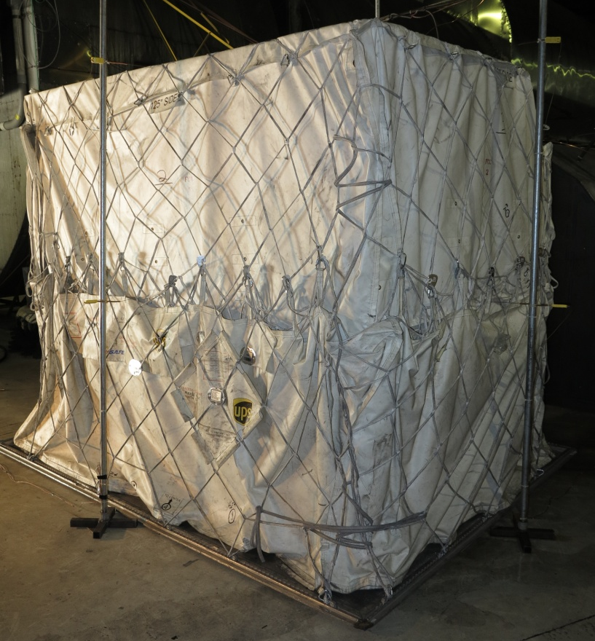
Fire Containment Covers
SAE AS6453 issued August, 2013
Standard Requirements
  Contain a class-A fire for 6 hours
  External temperatures cannot exceed 400°F
  Material must be able to pass the Cargo Liner Flammability Test
Ongoing Issues
  Net flammability standards
  Methods of recording external temperatures.

Slide 9
Observation from FCC Tests
Multiple FCCs have been tested to the standard.
The FCCs were able to contain the class-A fire for a period of 4 hours.
Issues
  Cargo net melting and burning on the pallet for short periods of time.
  Validity of the external temperature measurement being questioned

Slide 10
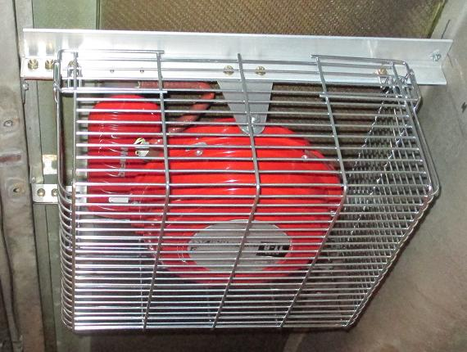
Aerosol Fire Suppression Agent
Detects fires and activates agent within the container.
Extinguishes the fire within the container by interrupting the chemical chain reaction
Maintains a low oxygen concentration environment.
Excess aerosol triggers smoke detectors outside the container.

Slide 11
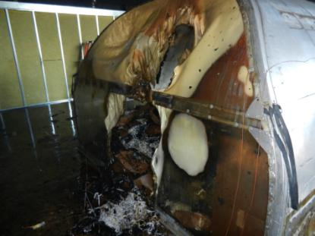
Aerosol Fire Suppression Agent
UPS tested the agent in a Lexan-Al ULD
  Container suppressed the fire for approximately 8 minutes.
  Agent escaped from the door.
  Fresh air entering the container feeds the fires leading to a failure.
Notes:
Normally used AAY container with a fire suppression agent.

Slide 12
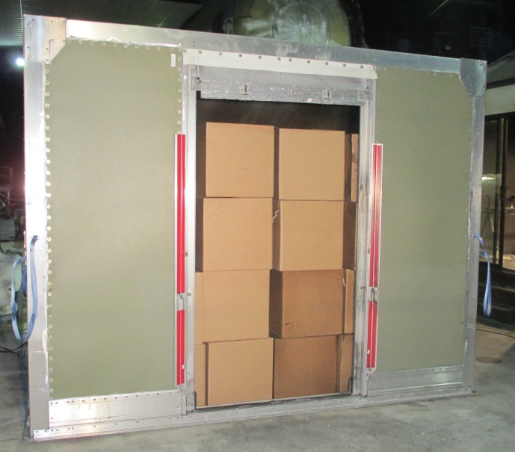
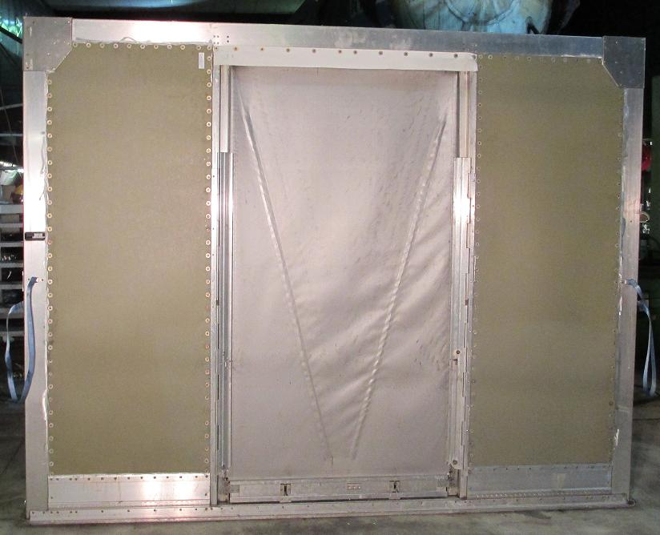
Oxygen Starvation (FRC)
Replaced the polycarbonate and some aluminum with a composite fire resistant material
Advantages
  Reduce the air exchange rate to minimize oxygen replenishment
  Reduce amount of agent escaping the container
  Reduction in the weight of the container

Slide 13
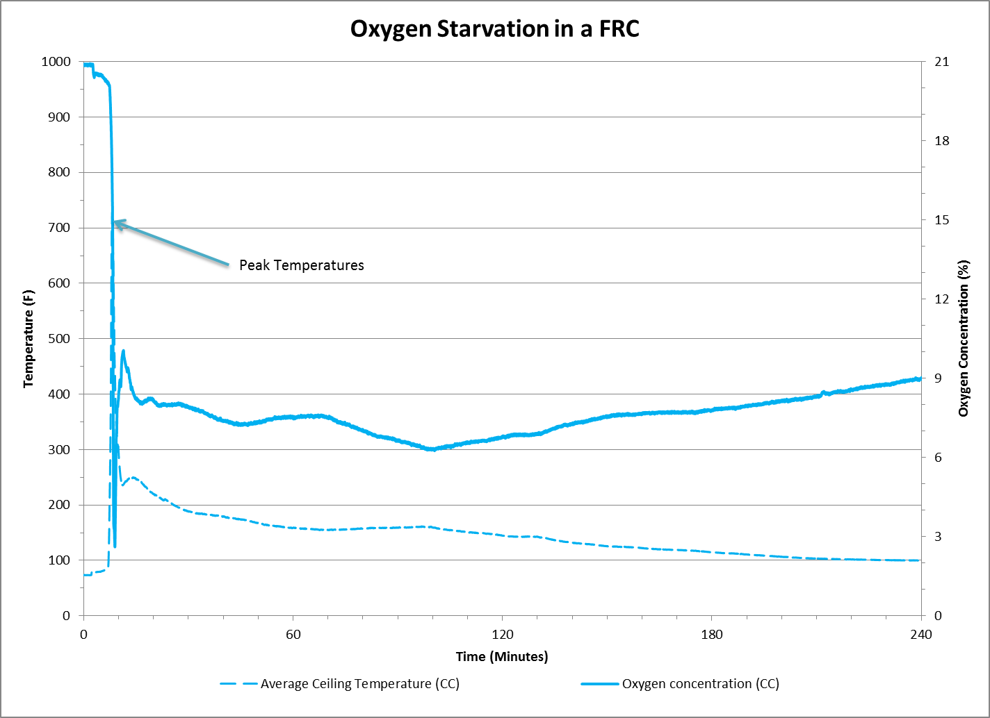

Slide 14
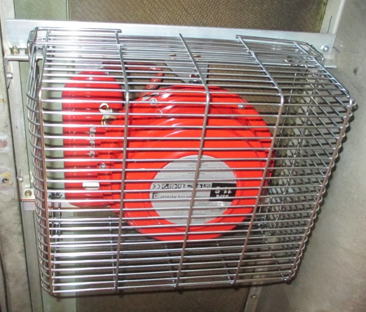
FRC with Aerosol Agent
Combine the oxygen starvation methodology with fire extinguishing capabilities of the aerosol agent.
Smoke detector detects the fire and activates the agent autonomously.

Slide 15
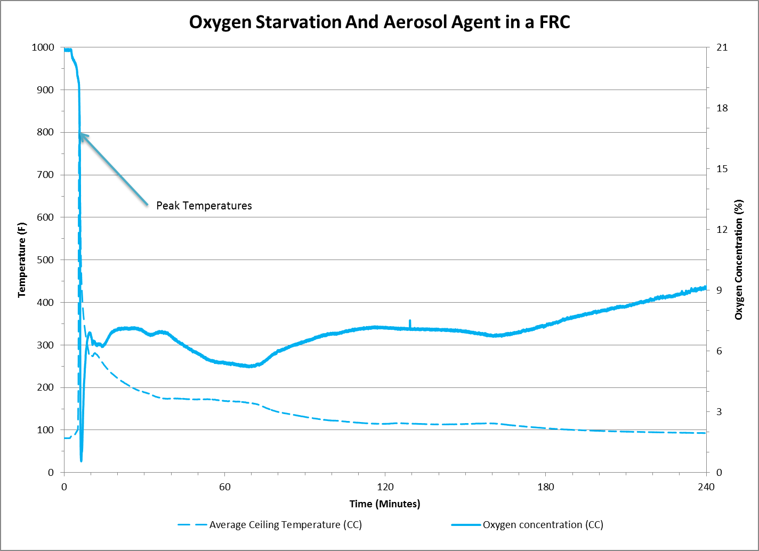

Slide 16

Video of FRC with Aerosol Test
Notes:
Make the video shorter

Slide 17
Observation from FRC Tests
FRCs were tested in multiple scenarios with class-A fire loads.
Oxygen Starvation tests showed the FRC to be capable of suppressing a class-A fire for over 4 hours. Flashover did occur once the containers were opened at the end of the test.
Combining the aerosol agent with the oxygen starvation capabilities of the FRC extinguished the fire with no flashover upon opening the container at the end of the test.
Aerosol escaping the container could trigger the aircraft smoke detection system.

Slide 18
Impact on Regulations
Appendix F to Part 25 – Materials used in the construction of cargo equipment.
  Part I - (a)(iv) avg. burn rate less than 2.5 inches/minute
  Part I - (a)(v) avg. burn rate less than 4 inches/minute
SAE AS6453 developed as a standard for the design, performance, and testing requirements for FCCs.
  TSO-C203 refers to this standard.
SAE AS6278 still being developed as a standard for the design, performance, and testing requirements for FRCs.

Slide 19
Questions?
Dhaval Dadia
dhaval.dadia@faa.gov
(609) 485-8828

