Slide 1
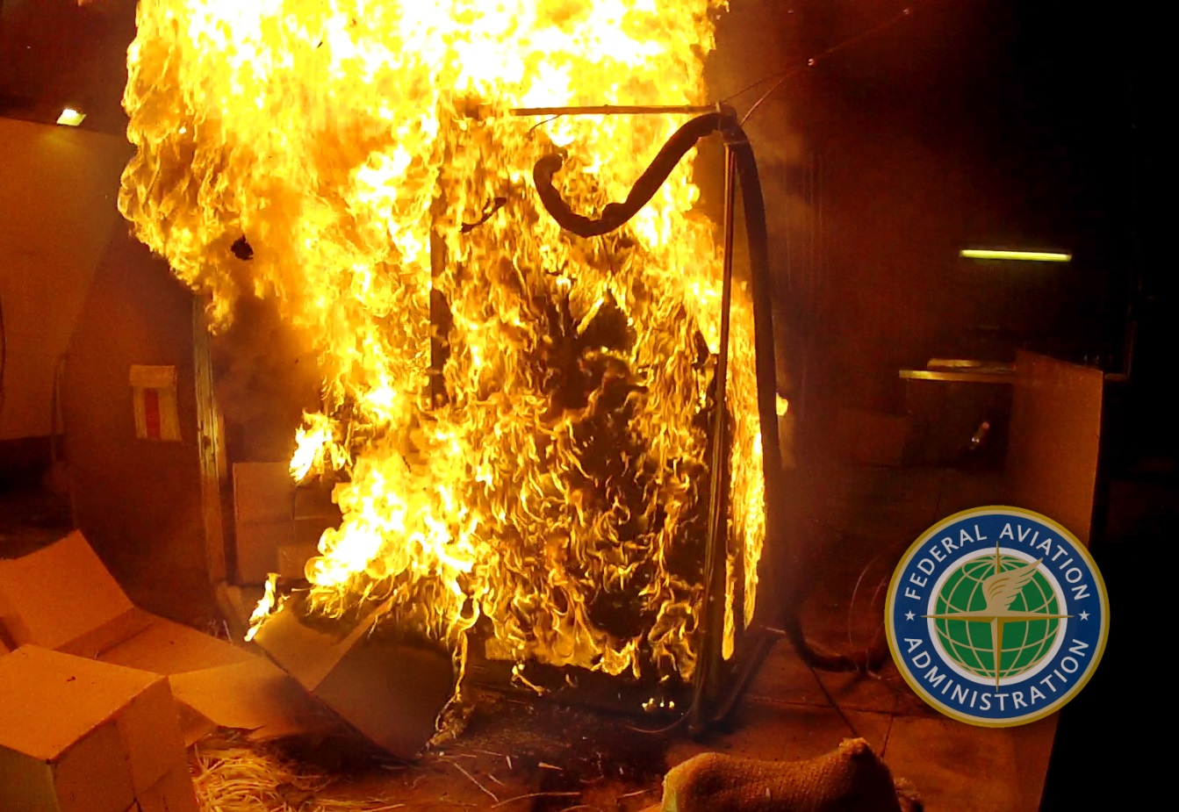
Class E Cargo Compartment Mitigation Strategies Subjected to Lithium Battery Fires
The 8th Triennial International Aircraft Fire and Cabin Safety Research Conference
Dhaval Dadia
October 27, 2016

Slide 2
Background
Increase in bulk shipment of lithium batteries via air freight.
R.G.W. Cherry study predicts increase in cargo fire accidents as more lithium batteries are transported by air freight.
3 major air freighter accidents had large shipments of batteries on board.

Slide 3
“There are two possible outcomes: if the result confirms the hypothesis, then you've made a measurement. If the result is contrary to the hypothesis, then you've made a discovery.”
~Enrico Fermi

Slide 4
Motivation
FCCs and FRCs capable of suppressing class-A fires.
Test capabilities of FCCs and FRCs against
Lithium metal battery fires
Lithium-ion battery fires
Regulations
Bulk shipment of lithium metal batteries banned on passenger aircraft.

Slide 5
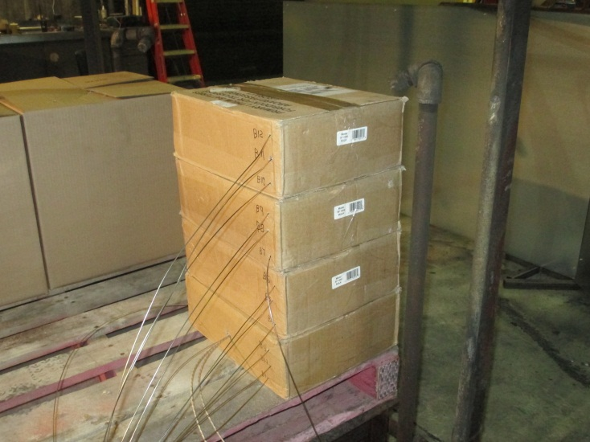
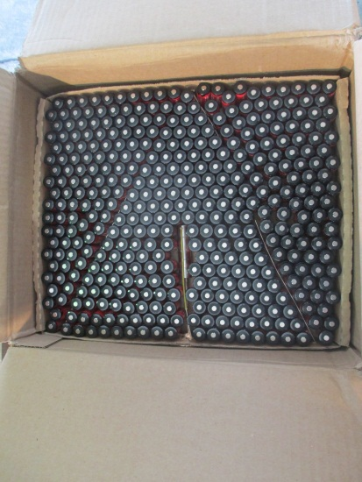
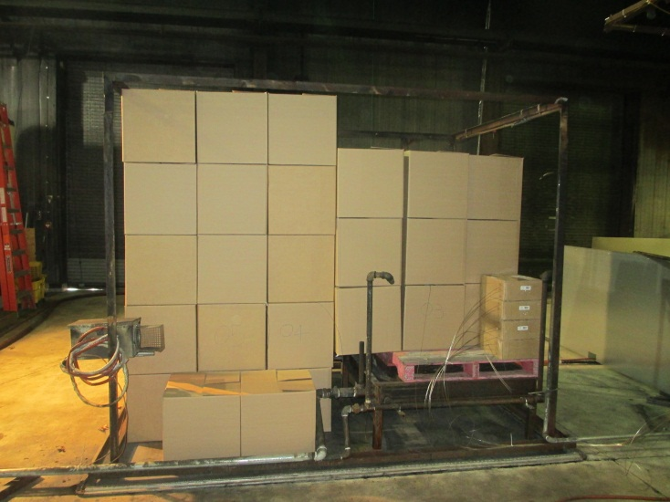
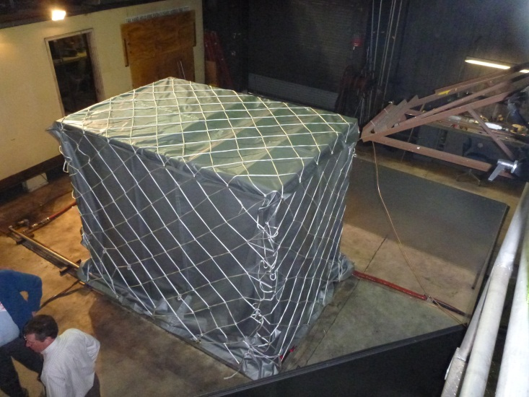
Setup of 4800 Lithium Metal Batteries

Slide 6
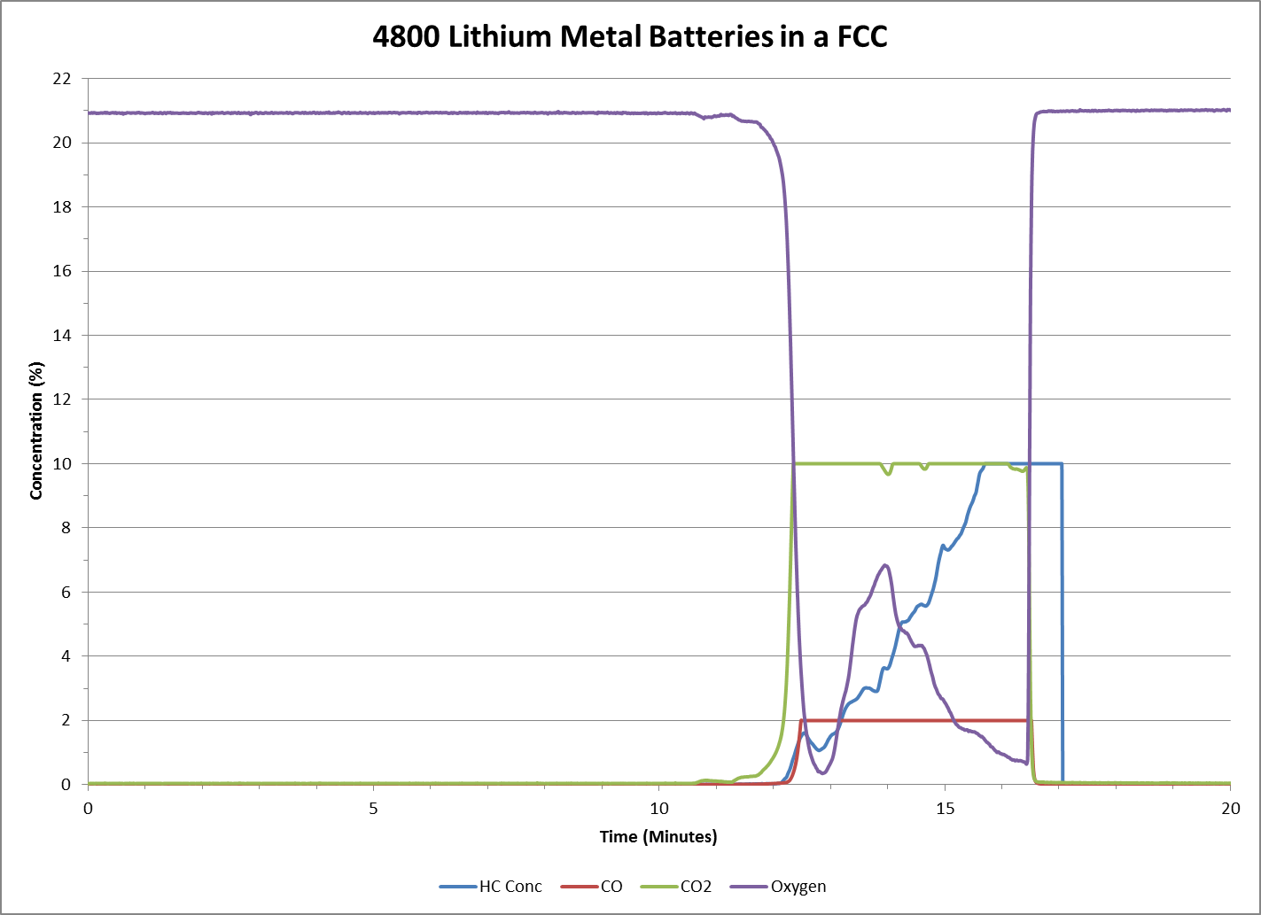

Slide 7
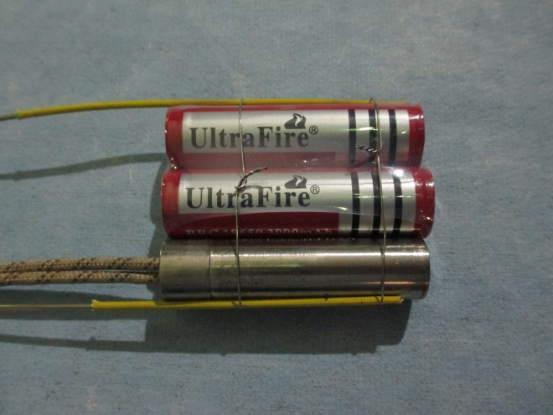
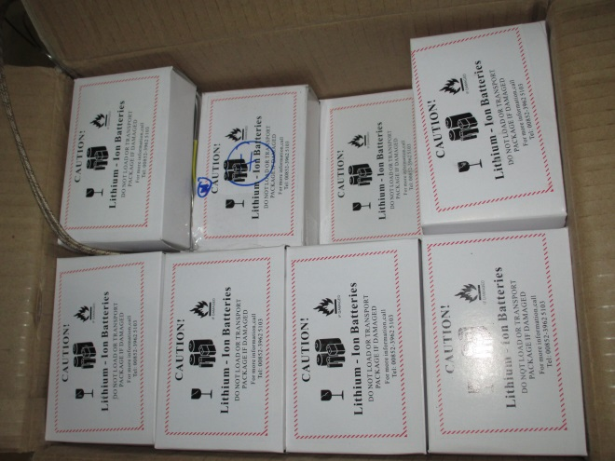
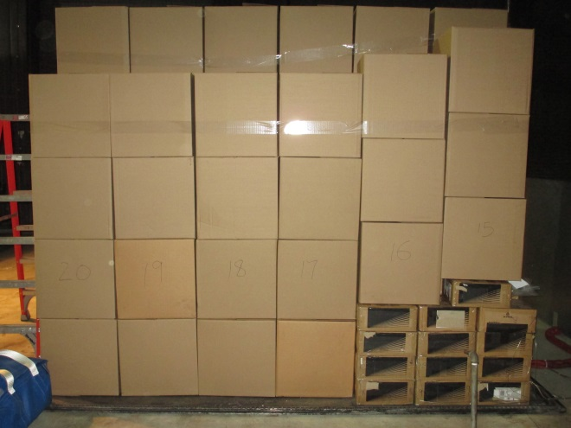
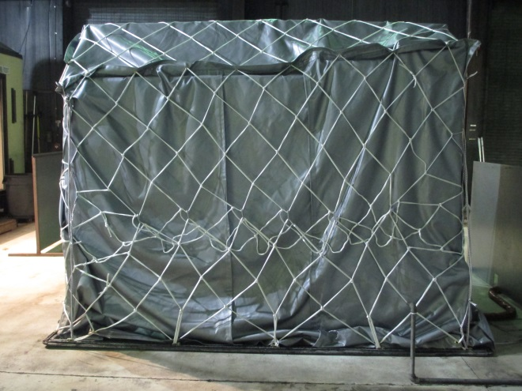
5000 Lithium-ion Batteries in a FCC Setup

Slide 8
1000 Lithium-ion Batteries in a FCC

Slide 9
Observations-Lithium Battery Fires in FCCs
Tests revealed that a FCC cannot contain bulk shipments of lithium metal or lithium-ion batteries.
Lithium metal battery fires resemble a flammable metal fire to penetrate the FCC.
In lithium-ion battery fires, pockets of gases were observed to burn within the FCC. As the fire spread further flames escape from underneath the FCC and batteries in thermal runaway escape the bounds of the FCC.

Slide 10
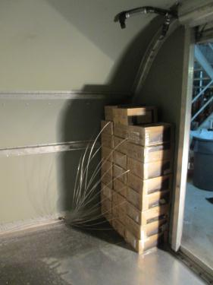
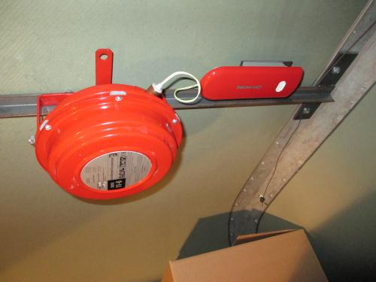
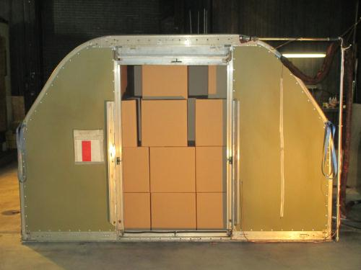
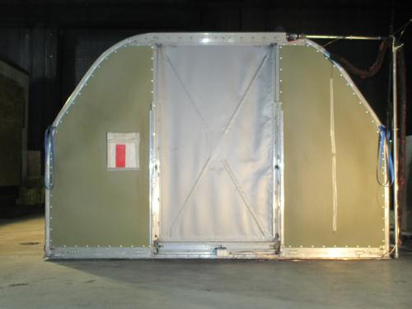
5000 Lithium-ion Batteries in a FRC

Slide 11
FRC Lithium-ion Battery Fire Test

Slide 12
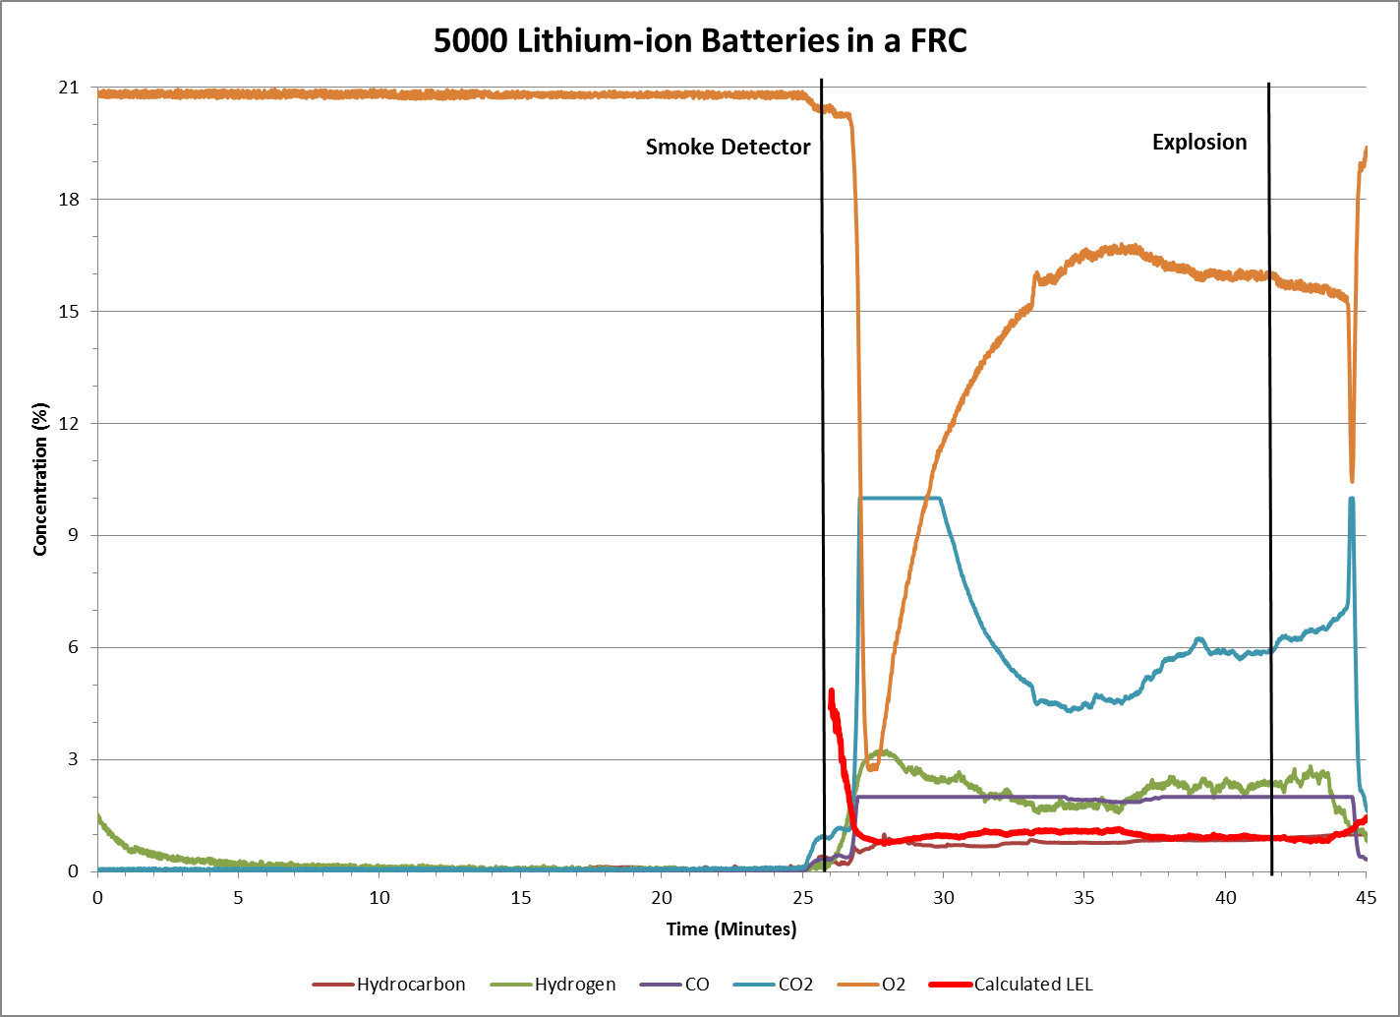
Notes:
We will focus on the hydrogen and hydrocarbon concentrations. The concentration of hydrogen is below the lower flammability limit of Hydrogen in during the time of explosion. We intend to study the effect of high temperatures and the influence of other hydrocarbons that would lead us to lower explosive limit.

Slide 13
Observations–Lithium Battery Fires in FRCs
Fire suppression agent is unable to prevent the propagation of thermal runaway.
Flammable gases released from the lithium-ion batteries collect within the FRC.
The flammable gases combust rapidly to create an overpressure within the container.

Slide 14
Impact on Regulations
Airlines voluntarily banned the bulk shipment of lithium-ion batteries on passenger aircraft.
Effective April 1 2016, ICAO banned shipment of lithium-ion batteries as cargo on passenger aircraft.

Slide 15
Questions?
Dhaval Dadia
dhaval.dadia@faa.gov
(609) 485-8828

