Slide 1
SAE/ISO Fire Containment Covers (FCC) and Fire Resistant Containers (FRC) Standards
International Fire and Cabin Safety Research Conference. Atlantic City, NJ
David Blake, Federal Aviation Administration
October 27, 2016

Slide 2
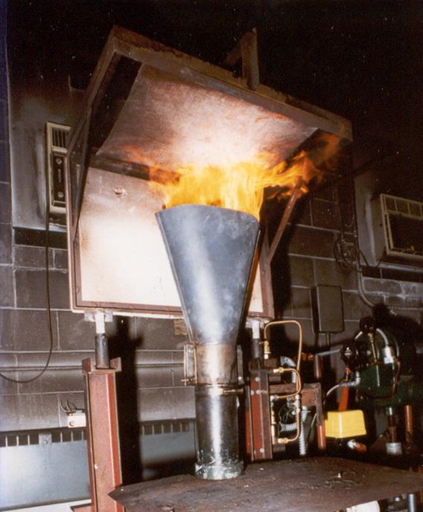
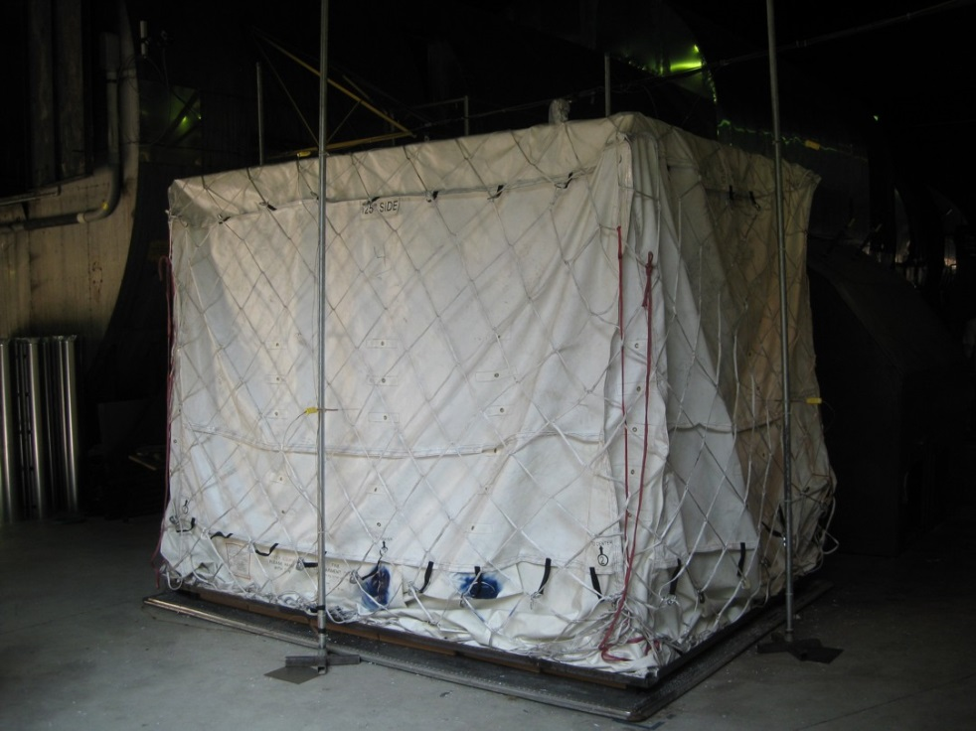
Fire Containment Covers
TSO 203 (published in July 2014) references SAE AS6453 standard with modifications.
Modifications are mostly for removal of references to non FAA requirements, maintenance, and pallet and net requirements.
Cargo liner oil burner test
Full scale mockup fire test

Slide 3
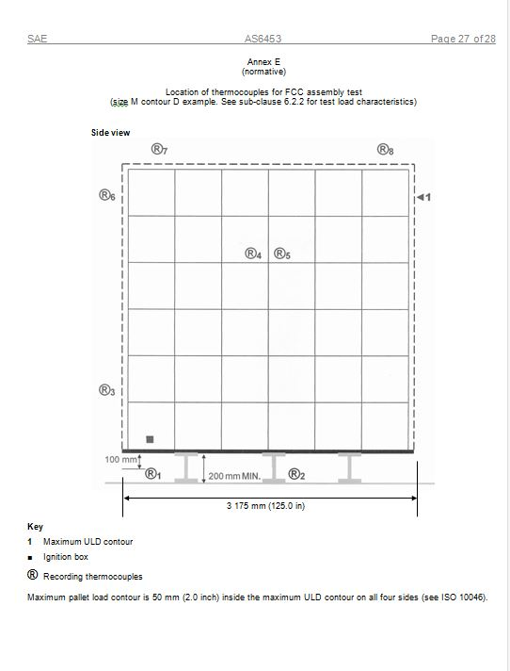
<Slide Title>
Current AS6453
Suggested T/C Locations

Slide 4
Current AS6453
6.2.4 The pallet shall be supported at least 200 mm (8 inches) over a non heat reflecting, e.g. concrete, floor. A minimum of 8 recording thermocouples shall be located 100 ± 10 mm (4 ± ½ inches) away from the initial pallet contour and under the pallet, at the fixed locations defined in Annex E hereafter, not to be readjusted if the cover deforms either inside or outside its initial contour during the test. Where the distance from a thermocouple significantly varies from 100mm (4 inches) during the test as a result of internal load shift, the concerned thermocouple’s reading should not be taken into account from that moment.
NOTE 14: Additional thermocouples may be used, if deemed necessary according to previous testing results.

Slide 5
A new project was approved to revise SAE AS6453 Fire Containment Covers in October 2015. The current version allows unlimited external flaming on the FCC if either:
The external flame is not in close proximity to a thermocouple, or
The fire load had shifted and measured temperatures from thermocouples that are no longer within 4 +/- ½ inch from the FCC are no longer valid.
It was previously agreed that this was not acceptable.

Slide 6
FCC External Flaming

Slide 7
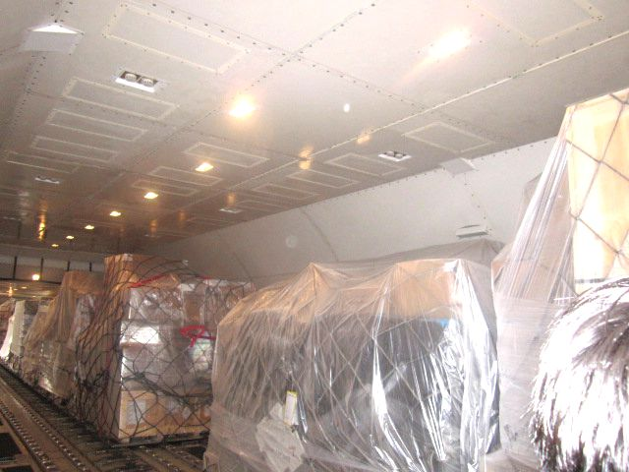
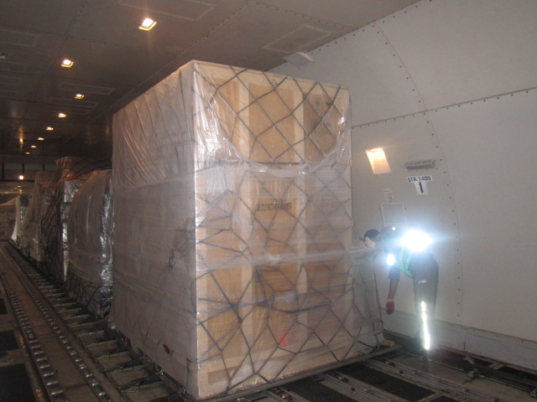
Overall goal of FCC performance is to not only contain the fire but to also prevent ignition of adjacent cargo or damage to airplane systems.

Slide 8
Possible Solutions
Presented at SAE meeting on Oct 18-19, 2016 in San Antonio. A working group meeting on revising AS 6453 was not held.
Increase density of required TCs in area where external fire would be expected and insure 4” distance is maintained.
Require additional testing if external fire is observed. Oil burner in a horizontal position impinging on a vertical FCC sample. External burning criteria would apply.
IR camera with pass/fail criteria used during full scale mockup test. Peak temperature? Average Temperature?

Slide 9
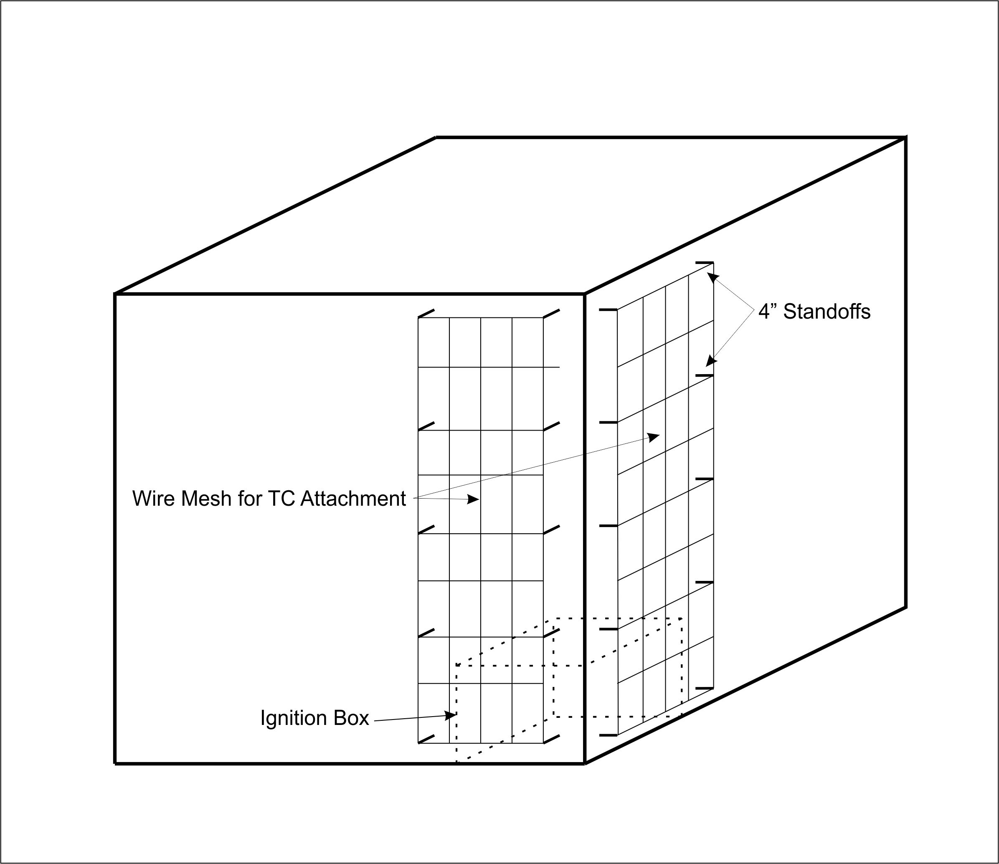

Slide 10
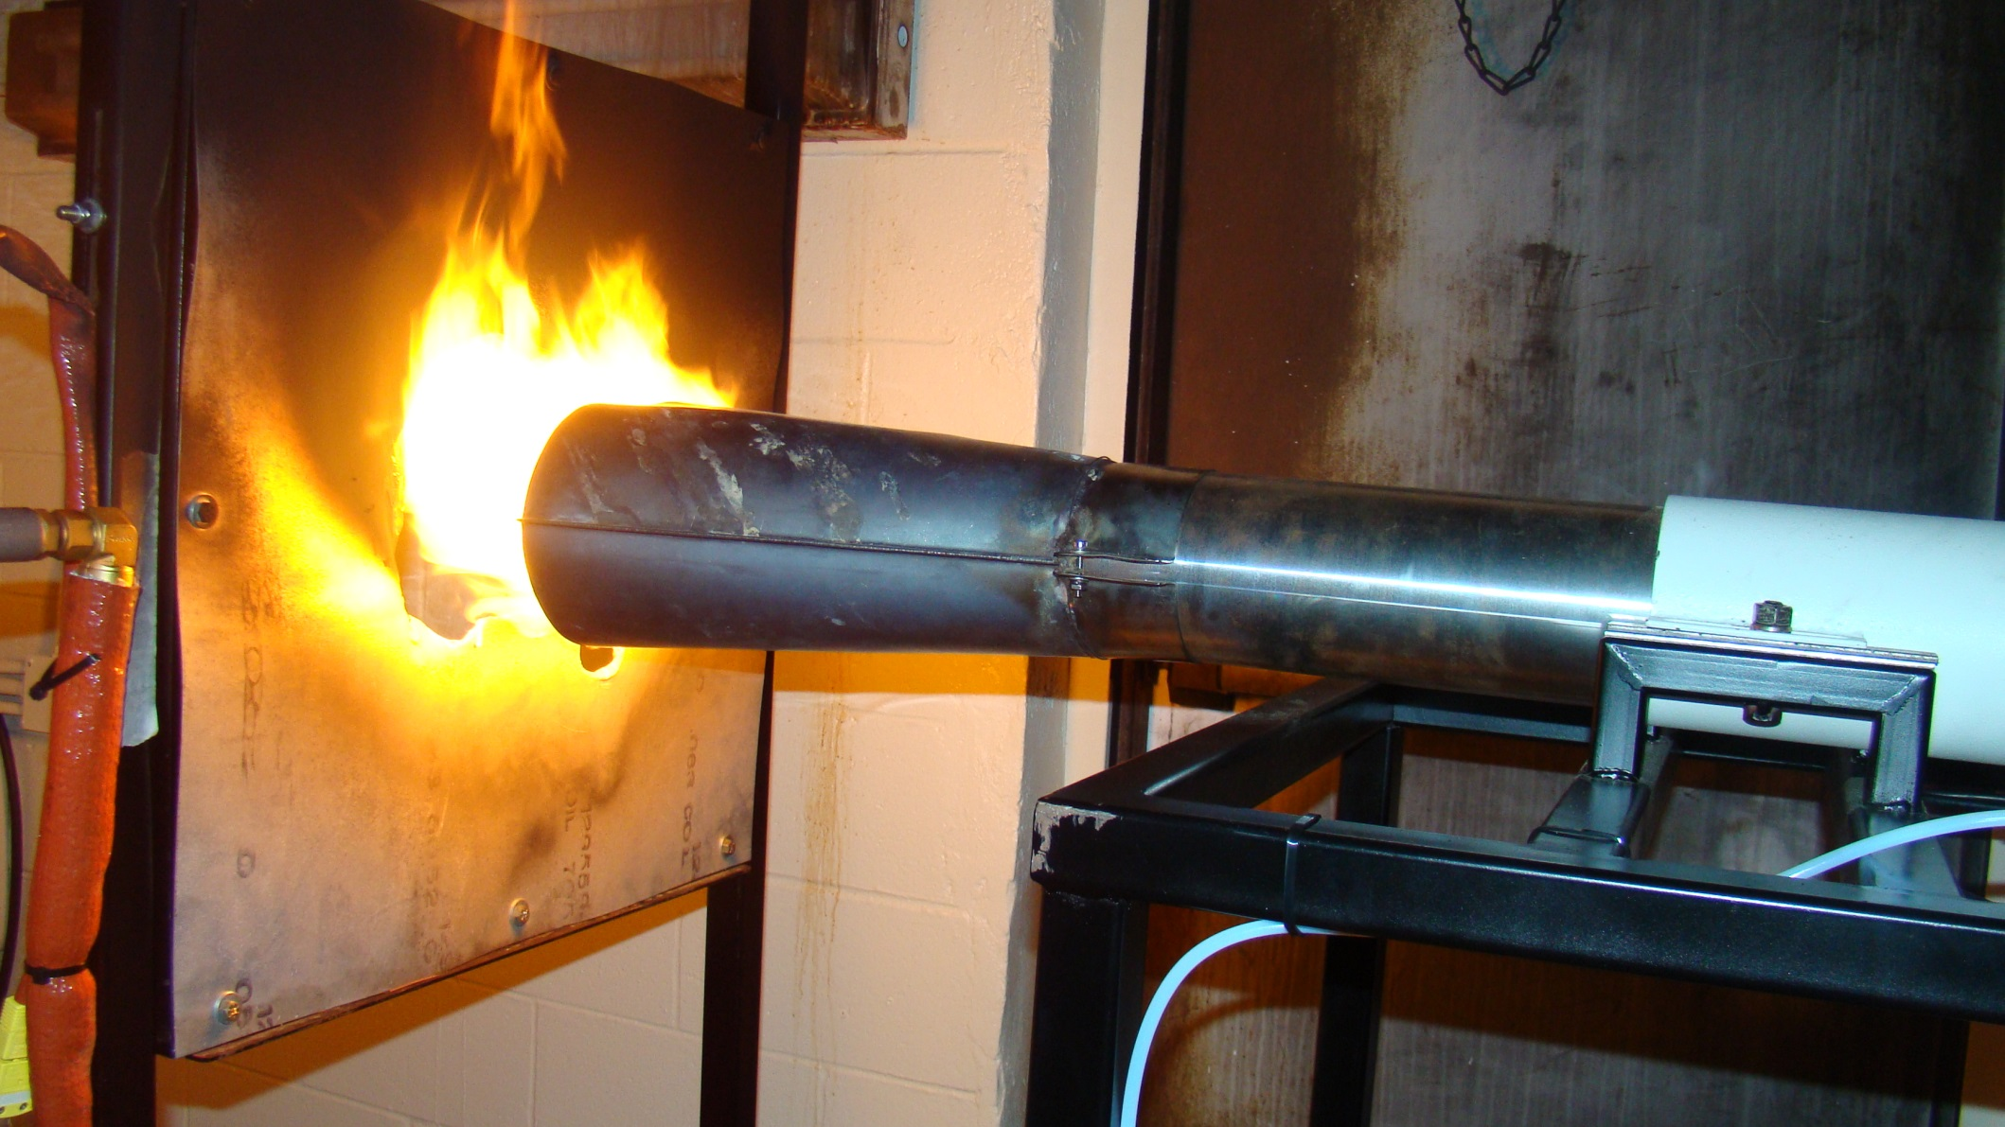

Slide 11
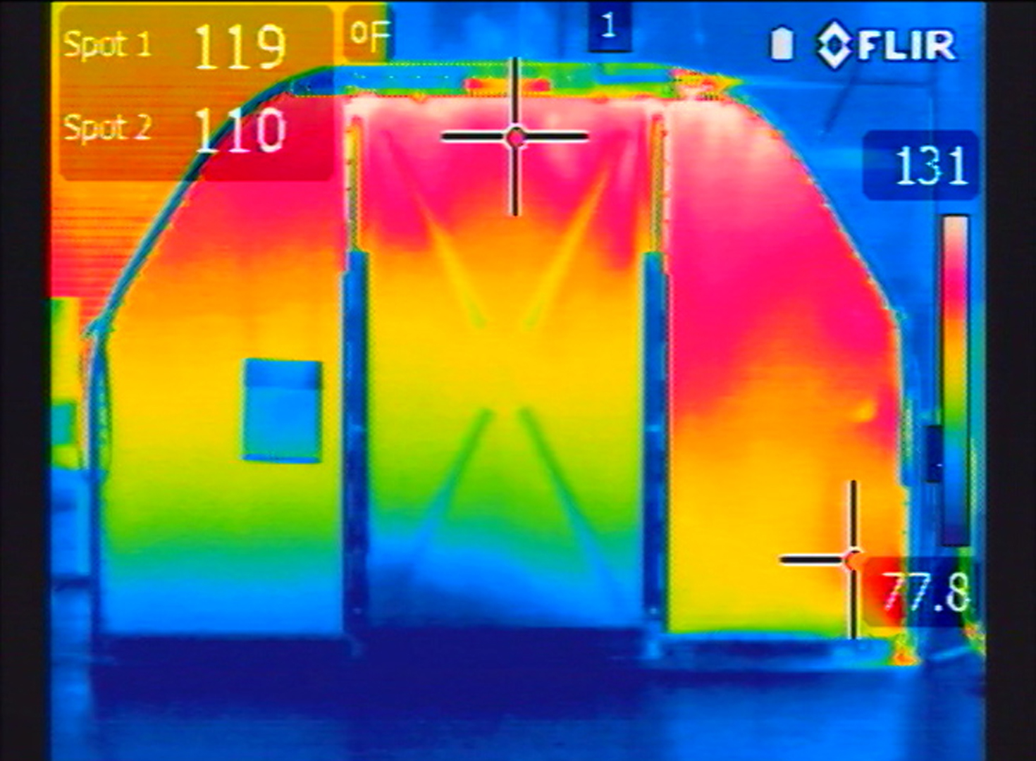

Slide 12
Fire Resistant Containers (FRC)
ISO/CD 19281 was published on Feb. 1, 2016.
SAE standard AS 6278 Fire Resistant Containers is under development. Differences exist between the two standards. The main difference is the SAE standard only requires the main panels of the FRC be subjected to the cargo liner oil burner test (CFR Part 25 Appendix F, Part III) while the ISO standard requires all materials used in the construction of the FRC be subjected to the test. (Floor panel is not required to meet oil burner test in either standard)
ISO/SAE harmonization is desired.

Slide 13
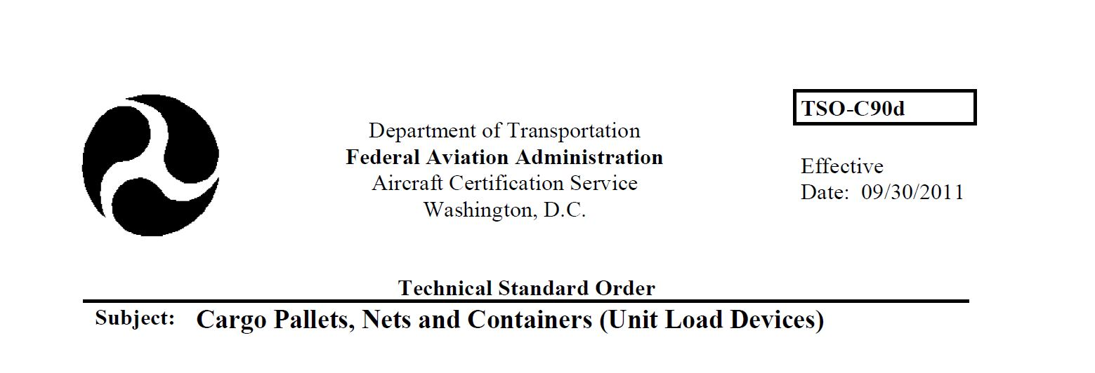
The FAA intends to revise TSO C90 “Cargo Pallets, Nets and Containers (Unit Load Devices)” to create a Fire Resistant Container category and reference AS 6278 when published.

Slide 14
Unresolved Issues:
Lithium Battery fire load.
Possible delayed smoke detection from a fire originating in either a FCC covered pallet or inside a FRC.
FRCs with built in detection and/or suppression systems.
External flaming on FRC.
SAE position is to publish revised FCC and new FRC standards without consideration of the above issues in the near term. Future meetings will include discussion on revised/new standards to address these areas.
Next meeting is scheduled for April 25-27, 2017 in Memphis, TN

