Slide 1
Effectiveness of Locator Lights on Inflatable Aviation Life Preservers
Cynthia L. McLean
FAA Cabin Safety Human Factors Researcher- Retired
SAE S-9 Cabin Safety Provisions Technical Committee Chair
Prime Stratagem, LLC

Slide 2
Collaborative Research Project
Massport Fire-Rescue Department Marine Division
FAA Cabin Safety Research/SAE S-9 Cabin Safety Provisions Technical Committee
Evaluate detection, signal, and illumination features of aviation life preservers
Naked eye
Search light
In conjunction with Operation Ready 2014

Slide 3
Why it’s important
179 certified US airports are located within 5 miles of a significant body of water (NTSB, 1985).
44 of the 50 busiest US airports are located within 5 miles of a significant body of water (DOT/FAA, 1997).
State of the art emergency equipment is likely to become more important than ever as air operations continue to increase.
Notes:
Data from:
http://www.faa.gov/data_research/research/med_humanfacs/oamtechreports/1990s/media/AM98-19.pdf
NTSB 1985 Safety Study, Air Carrier Overwater Emergency Equipment and Procedures (NTSB/SS/85/02)
DOT/FAA 1997 Administrator’s Fact Book

Slide 4
Rescuers report difficulty in detecting the survivor locator lights on inflatable aviation life preservers.
The SAE S-9 committee was in the process of developing an industry design/performance standard for life preservers (AS1354).
The FAA was in the process of revising the Technical Standard Order (TSO-C13f) for life preservers. Reflective materials were not required.
FAA Cabin Safety Research was already studying life preservers.

Slide 5
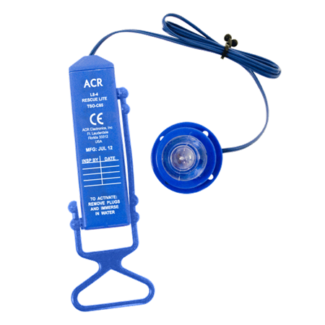
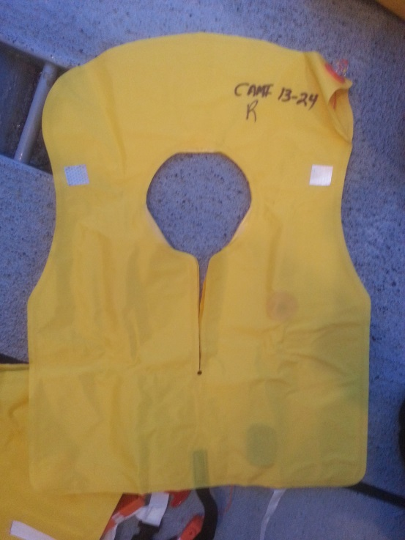
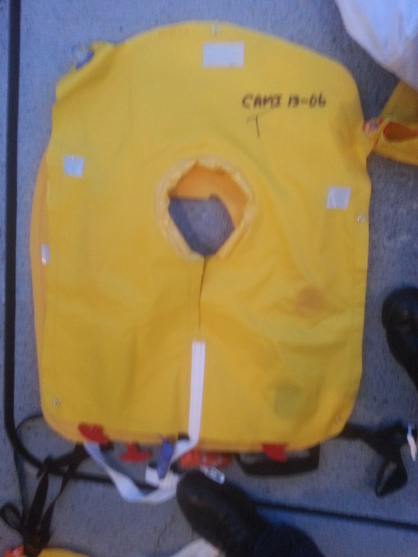
Research Design
4 brands FAA TSO-C13f-approved dual-inflation chamber life preservers equipped with survivor locator lights
Notes:
Background graphic US Airways Flt 1549 Hudson River January 15, 2009
TSO –C13f requires that the life preserver be equipped with a survivor locator light meeting the requirements of TSO-C85. The light must be automatically activated. This can be accomplished upon contact with water, upon inflation or by any other means not requiring additional user action.
This assembly is water activated but requires that the tab be pulled before use. It has an incandescent lamp.

Slide 6
Light Beam Requirement
Notes:
TSO-C85b requires that survivor locator lights meet the minimum performance standards in SAE Aerospace Standard (AS) 4492:
4.3 Light Characteristics:
General: Survivor locator lights may be steady on (Type I) or flashing (Type II). Emitted light shall be white, in the spectral range of 380 to 780 nanometers, or yellow-green, in the spectral range of530 to 560 nanometers. The device shall be capable of functioning at or above minimum light intensities while the integral battery is immersed in fresh or seawater at 2° C, uninterrupted, for a period of 8 h at the end of the rated service life of the battery.
Steady-Type Lights (Type I): The steady-type survivor locator light shall be shown by test to provide a minimum effective luminous intensity of 1 .O candela over the operating regime established in 4.3.1. The minimum light output shall be provided within a minimum 1 degree beam width centered on the horizon (±10°) over a minimum of 300° of arc in the horizontal plane with gaps of no more than 30°, and within a minimum 1° beam width centered on the vertical (±10°).
AS4492 is currently in revision to include LEDs.

Slide 7
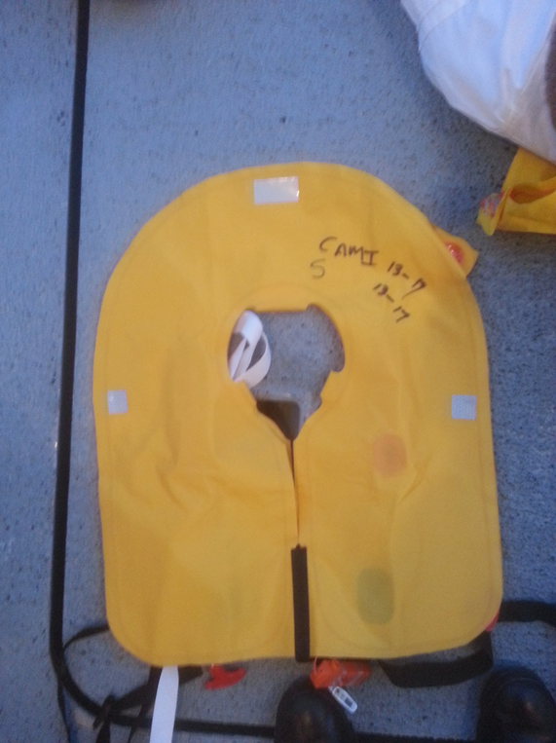
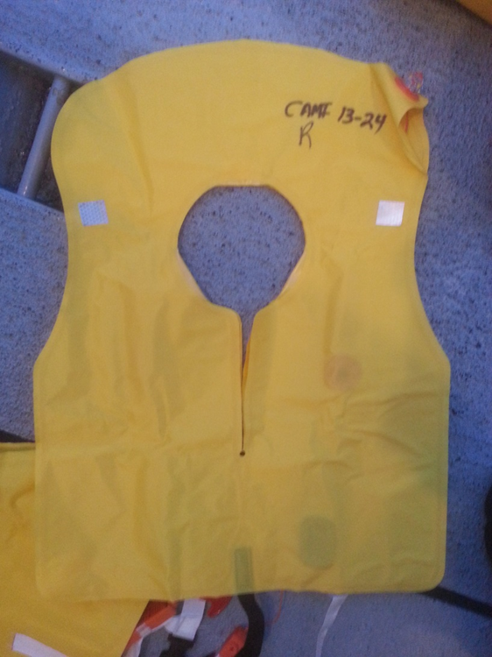
SOLAS retroreflective material added to
aviation life preservers
1 in² swatch on each “lapel” front/back = 4 in²
Additional 1” x 2” swatch on “collar” front/back = 8 in²
Notes:
Background graphic World airways Flt 30 in Boston harbor, January 23, 1982
The US Coast Guard approved SOLAS material was an adhesive-backed gray and white tape with a reflective surface comprised of encapsulated glass lens beadlets, specifically designed to enhance visibility of life preservers, ring buoys, survival suits, and inflatable rafts in marine environments.
Left shows life preserver with 1 in² swatches on each lapel
Right shows lapel swatches and 1”x2” swatch on collar.
Note orientation of survivor locator light when the life preserver is flat on the floor.
Retroreflective material was not required on life preservers when we did this study.

Slide 8
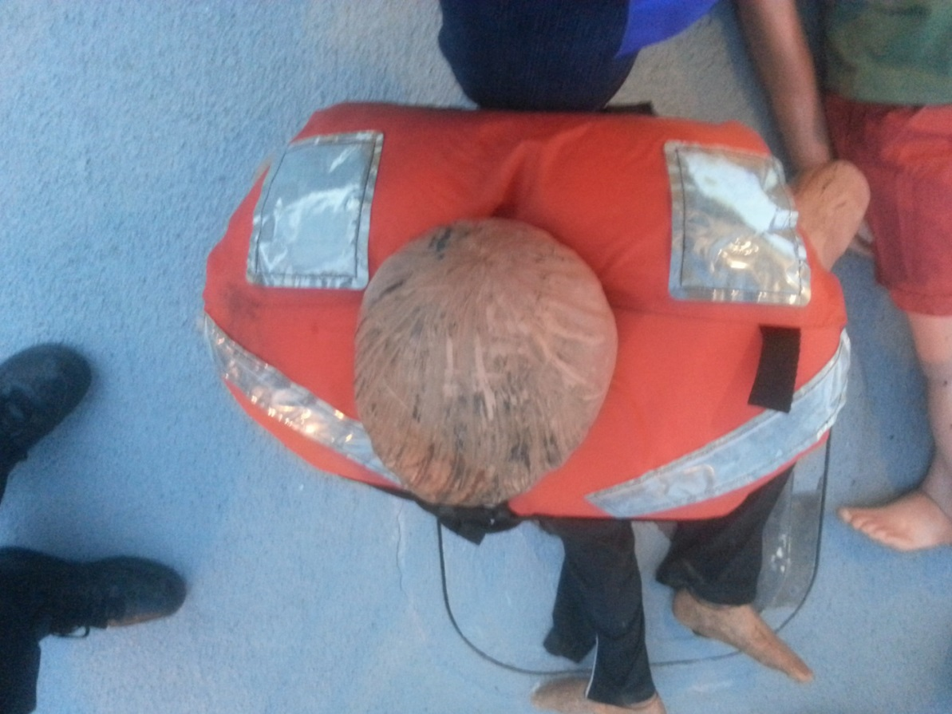
US Coast Guard approved marine life preservers were used to compare the reflective material with that added to the aviation life preservers.
Notes:
Background Graphic National Airlines Flt 193, Escambia Bay, Pensacola May 8, 1978
Non-inflation life preservers with significant amount of reflective material.

Slide 9
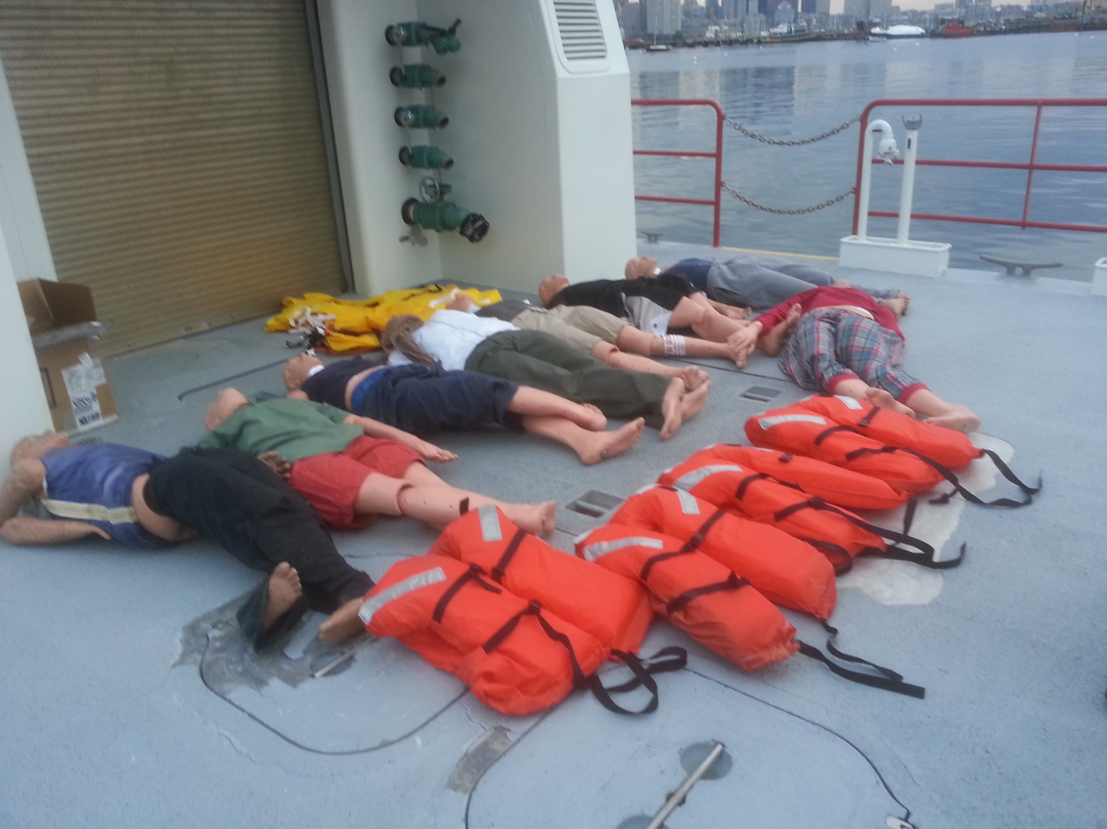
Man-overboard scenario with water rescue manikins wearing life preservers

Slide 10
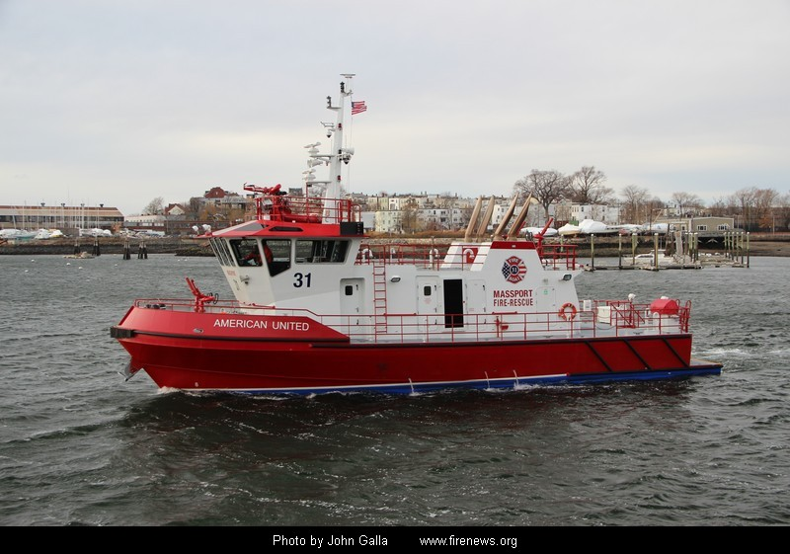
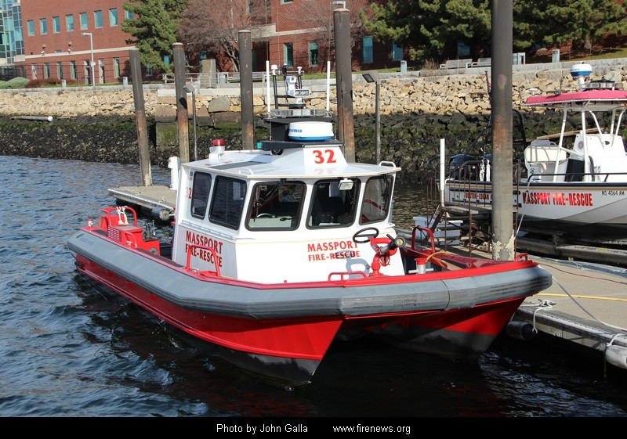
Massport Fire-Rescue Marine Vessels 31 and 32 were used to compare visibility at different heights above the water.
Notes:
Background Graphic Air Florida Flt 90 January 13, 1982 crashed into 14th Street Bridge over the Potomac, 2 miles from the White House.
Marine 31 Commissioned in 2011 - 79 ft. Named “American United” Ranger Class Custom Fireboat - Displaces 131 Gross Tons
Marine 32 2008 - Mooseboat, Model M2-37, 37’ Catamaran High Speed Rescue Boat

Slide 11
Procedure
Saturday, May 3, 2014, approximately 2000 hrs.
Boston Harbor, Federal Anchorage #2
Notes:
Background graphic Pan Am Flt 6 Oct 16, 1956 Pacific Ocean NE of Hawaii
On Saturday, May 3, 2014, at approximately 2000 hours, the Massport Fire Rescue Department Marine Division and FAA/SAE researcher, Cynthia McLean, conducted a series of “man overboard” exercises in Boston Harbor, Federal Anchorage #2.

Slide 12
Notes:
Point out Federal Anchorage #2 area

Slide 13
Notifications
Conditions
Waxing crescent moon 24%
Average sky cover, light easterly wind, calm sea
Sunset 1946 hrs.
Air temp, approximately 50 °F
Notes:
Background Graphic Escambia Bay, Pensacola FL National Airlines Flt 193 May 8, 1978
Notification of the exercises was made over Marine VHG Channel 16 and by phone to Boston Police Harbormaster, USCG Sector Boston, Boston Fire Department Marine Unit, and the Winthrop Fire Department.

Slide 14
Deployment of water rescue manikins
4 sets of 3
USCG marine life preserver
Inflated aviation life preserver 4 in² reflective material
Inflated aviation life preserver 8 in² reflective material
Belts, buckles, straps properly secured
Face down
Once buoyancy assured, vessel moved away from manikins
Evaluation
Manikin retrieval
Notes:
Four sets of 3 manikins were deployed ( one set at a time) from Massport Fire-Rescue Marine 31 or Massport Fire-Rescue Marine 32 and then repeated with the other vessel. One manikin in each set wore a USCG marine life preserver and the other two wore fully inflated aviation life preservers, one with the 4 in² of reflective and the other with 8 in² of reflective material. All belts, buckles, and straps were properly secured. The manikins with the aviation life preservers were deployed face-down the assess the life preserver’s ability to right the wearer within 5 seconds so that the mouth and nose are clear of the water line.
Once buoyancy was assured, the vessel moved away from the manikins.
Evaluation included inflation of aviation life preserver chambers, buoyancy, righting ability, observation of survivor locator lights and reflective material.
The manikins were retrieved, refitted with life preservers and the program repeated from the other vessel.

Slide 15
Results
All of the aviation life preservers inflated properly.
The brands of life preserver didn’t differ in their performance.
All of the aviation life preservers were able to right the manikin to get its mouth and nose above the water line, but some didn’t turn the manikin completely onto its back.

Slide 16
Notes:
The partially turned water rescue manikin is in the foreground, about 50 yards from the vessel. The manikin’s face is out of the water. The survivor locator light cannot be seen; it’s under water.
The reflective material on the marine life preserver, about 75 yards from the vessel, is reflecting light from the camera flash. Since the reflective material on the aviation life preserver isn’t facing the flash, it isn’t reflecting any light in the camera’s direction.

Slide 17
Notes:
The aviation life preserver on the right is lighted by the search light. The survivor locator light on the life preserver on the left is visible as it was turned toward the vessel. Both were about 75 yards from the vessel.

Slide 18
Notes:
The marine life preserver does not right the manikin as the aviation life preserver is required to do. However, the camera flash is well reflected by the reflective material.

Slide 19
The small reflective swatches on the aviation life preservers were effective, but more directionally dependent to the source light than was the large amount of reflective material on the front, back, and shoulders of the marine life preserver.
The reflective swatches on only the lapel sections of the aviation life preservers were better seen from the higher viewpoint of Marine 31 vessel.
The addition of the reflective swatch on the collar of the aviation life preservers provided another direction for reflectivity.

Slide 20
Conclusions
The visibility of survivor locator lights and reflected light is dependent on the orientation of the light assembly and reflective material to the rescuer.
Reflective material should be a required component of aviation life preservers.
The high visibility international orange-yellow color is identifiable in spot light, although it was not a variable of consideration in the study.

Slide 21
Final Thoughts
Dual chamber life preservers were used in this study. Single chamber life preservers are becoming more prevalent on aircraft required to carry life preservers. Once donned, the survivor locator light may be directed toward the back, making if ineffectual.

Slide 22
Life preserver materials are required to pass stringent flammability tests. Currently produced reflective materials may not comply with flammability requirements.
SAE AS1354 Individual Inflatable Life Preservers was published in February 2016. A new requirement for at least 4 in² of reflective material on each side of the life preserver was included.

Slide 23
The revision of TSO C-13f is still in progress.
The revision of SAE AS4492 Survivor Locator Lights should include a requirement for more effective “lamps” with increased luminous intensity of LEDs.
Notes:
The FAA is expected to refer to AS1354 for most of the requirements but will likely include some modifications. Other than flammability testing, it is unclear what other modifications will be made.
The findings of this study will influence the revision of AS4492 with the intent of making the survivor locator lights more effective.

Slide 24
Thank You to
Ted Costa, Deputy Chief, MassPort Fire Rescue
The Massport Fire-Rescue Department Marine Division and the crews of Marine 31 and 32 for generous support of the study.
FAA ARFF Researcher Keith Bagot for the referral.
Life Preserver manufacturers that donated the test life preservers: Zodiac/Air Cruisers, Regent, Switlik, and Eastern AeroMarine.

