Slide 1
Air Transport of Lithium Batteries
FAA 8th Triennial Conference
Michael D. Givens
FAA Hazmat Specialist
October 26, 2016

Slide 2
Introduction

Slide 3
Introduction
ICAO & UN Two Year Cycles
ICAO Technical Instruction Changes regarding Lithium Batteries
SAE G-27: Packaging Standard
NTSB Recommendations
Operator Equipment
Lithium Battery Testing
Lithium Battery Third Party Oversight

Slide 4
ICAO & UN
Two Year Cycles

Slide 5
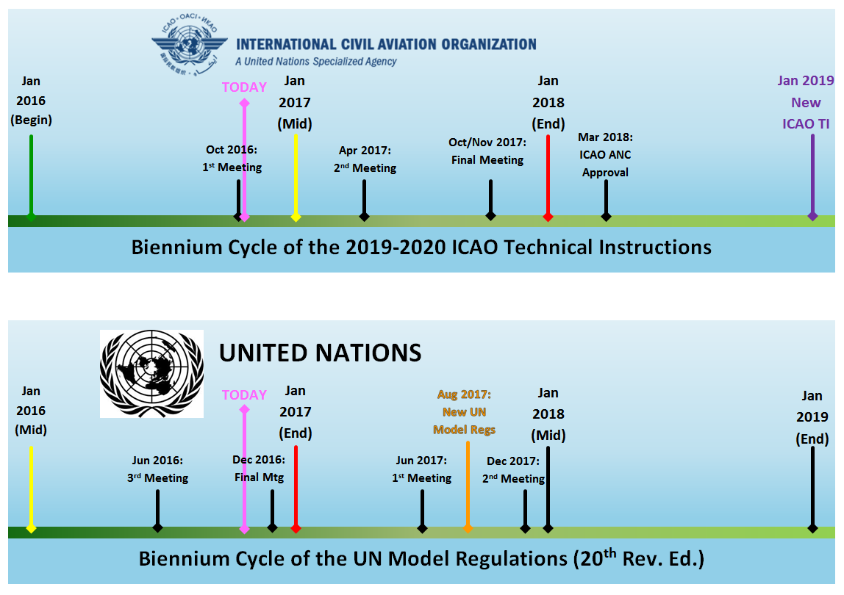

Slide 6
ICAO Technical Instructions: Lithium Batteries

Slide 7
ICAO Technical Instructions
UN 3090, Lithium metal batteries (by themselves with no equipment)
Prohibited in Cargo on Passenger Aircraft
Effective January 1, 2015
The U.S. made the same rulemaking change in 2004 (Title 49 CFR)

Slide 8
ICAO Technical Instructions
2015-2016 ICAO Technical Instructions
  Addendum 3, Effective April 1, 2016
  For UN3480, Lithium ion batteries, in Packing Instruction 965, must be offered at a state of charge not to exceed 30% in cargo
  Applies to UN3480, Lithium ion batteries in Packing Instruction 965, Section IA, Section IB, & Section II packages

Slide 9
ICAO Technical Instructions
2015-2016 ICAO Technical Instructions
  Addendum 3, Effective April 1, 2016
UN 3480, Lithium ion batteries, & UN 3090, Lithium metal batteries, Section II Packages
  One package per consignment
  Packages must be offered separately
  One package per overpack

Slide 10
ICAO Technical Instructions
2015-2016 ICAO Technical Instructions
  Addendum 4, Effective April 1, 2016
Prohibited UN 3480, Lithium ion batteries (by themselves with no equipment) in cargo on Passenger Aircraft
Other consequential amendments were made to include the requirement for the Cargo Aircraft Only Label

Slide 11
Class 9 Label Change for Lithium Batteries
A new Class 9 label for lithium batteries
It includes a picture in the lower half of the label

Slide 12

Class 9 Label Change for Lithium Batteries

Slide 13
Lithium Battery Handling Mark Change
A new lithium battery handling label will be required on all modes of transportation, not just air.
UN number(s) would be required on the handling label. Now you will be able to tell the difference between metals and ions, as well as bulk and contained in/packed with packages

Slide 14
Lithium Battery Handling Mark Change

Slide 15
Label & Handling Mark Changes
Both the Class 9 label and the Lithium Battery Handling Mark are incorporated into the 2017-2018 ICAO Technical Instructions
Voluntary use as of January 1, 2017
Mandatory use as of January 1, 2019

Slide 16
SAE G-27: Packaging Standard

Slide 17
SAE G-27: Packaging Standard
A briefing was given earlier today on the specifics of this Packaging Standard
Once completed, the Standard will go to ICAO for review and consideration for implementation
It is more than the just the Dangerous Goods Panel at ICAO (Flight Ops Panel, Airworthiness Panel, Air Navigation Commission, etc.)

Slide 18
NTSB Recommendations

Slide 19
NTSB Recommendations
Asiana 991, B747-400F, crashed into the ocean on July 28, 2011
Aviation and Railway Accident Investigation Board (ARAIB) finalized the accident report on July 24, 2015
NTSB Issued 2 Recommendations on February 9, 2016 to DOT/PHMSA

Slide 20
NTSB Recommendations
A-16-001: Require that Class 3 flammable liquids and fully regulated Class 9 lithium batteries be physically segregated when stowed on board an aircraft such that packages containing these materials may not be placed on the same or adjacent pallets or ULDs.
A-16-002: Establish maximum loading density requirements that restrict the quantities of Class 3 flammable hazardous materials or Class 9 lithium batteries stowed on a single pallet or ULD, or on a group of pallets or ULDs, within an aircraft such that cargo fires can be effectively managed by on-board fire suppression capabilities.

Slide 21
NTSB Recommendations
A-16-001: …Class 3 flammable liquids and fully regulated Class 9 lithium batteries be physically segregated…
DOT (PHMSA & FAA) and Int’l Federation of Airline Pilot’s Assoc. (IFALPA) brought forward two separate papers on the subject of segregation to the ICAO DGP meeting (Oct 17-21, 2016)

Slide 22
NTSB Recommendations
A-16-002: …loading density…restrict the quantities of Class 3 flammable hazardous materials or Class 9 lithium batteries…cargo fires can be effectively managed by on-board fire suppression capabilities.
This needs further work to be done in conjunction with the A-16-001 Segregation recommendation.
FAA is looking at the many variables encompassing this recommendation to see what are the best possibilities to address it.

Slide 23
Operator Equipment

Slide 24
Operator Equipment
Handheld portable electronic devices (PED), (e.g. iPhones), external PED battery packs, electronic card readers, In-Flight Entertainment tablets, electronic baggage tags, etc.
This type of operator equipment that is not installed on the aircraft is increasing in demand

Slide 25
Operator Equipment
What type of tests, procedures, manufacturing standards are appropriate before such equipment should be allowed to be brought aboard an aircraft?
Can you imagine if the Samsung Galaxy Note 7 had been chosen and issued to every cabin safety crew member of a major passenger operator?

Slide 26
Lithium Battery Testing

Slide 27
Lithium Battery Testing
For transportation: Are the UN Manual of Tests and Criteria, sub-section 38.3 tests really adequate anymore to classify by risk?
Do we need to explore more of a risk based classification system for lithium batteries in transportation?

Slide 28
Lithium Battery Testing
The batteries in the Samsung Galaxy Note 7 passed all the UN 38.3 tests.
In the UN 38.3 tests for lithium ion batteries, it allows a 20% increase in Voltage or Watt-hours and the cell/battery would still be considered the same design type.
UN 38.3: “a change that would lead to the failure of any of the tests…”
  How do you enforce something so subjective?

Slide 29
Lithium Battery Third Party Oversight

Slide 30
Third Party Oversight
Lithium Battery Industry, IATA, and others are stressing the concerns about a lack of enforcement of non-compliant lithium battery shippers for transportation.
The ICAO Technical Instructions and UN Manual of Tests and Criteria testing requirements are very complex and difficult to enforce as currently written

Slide 31
Third Party Oversight
No State/Country is going to have enough inspectors or oversight capability to be able to effectively eliminate non-compliant lithium battery shipments on its own
The regulations are minimum standards, but to ensure an acceptable level of safety it may take more than just following the regulations

Slide 32
Third Party Oversight
The Dangerous Goods/Hazardous Materials Transportation Regulations are not setup to regulate the manufacturing process for an article like lithium batteries
Is it time for the industry to create a lithium battery manufacturer and shipper qualification and certification process?
Need to look at other industries that have had similar problems to find solutions (e.g. explosives, etc.)

Slide 33
Summary
ICAO Technical Instruction Changes regarding Lithium Batteries
SAE G-27: Packaging Standard
NTSB Recommendations
Operator Equipment
Lithium Battery Testing
Lithium Battery Third Party Oversight

Slide 34
Questions?

Slide 35
Michael D. Givens
Federal Aviation Administration (FAA)
Office of Hazardous Materials Safety (ADG)
Aviation Hazardous Materials Specialist
michael.givens@faa.gov

