Slide 1
Status of SAE G-27 Lithium Battery packaging performance Committee
Presented to Eighth Triennial International Aircraft Fire and Cabin Safety Research Conference
October 24-27, 2016
Atlantic City, NJ, USA
Doug Ferguson, Co-Chair G-27 Committee
Claude Chanson, Co-Chair G-27 Committee Jordanna Bucciere, SAE Specialist G27 Committee

Slide 2
SAE G27 Committee
Why is committee formed and why a packaging standard?
The Council of the International Civil Aviation Organization (ICAO) established a prohibition on the transport of lithium batteries as cargo on passenger aircraft as a temporary measure until controls were put into place which establish an acceptable level of safety. A performance-based packaging standard was identified as one of the controls.
SAE International chosen to lead this effort through creation of an SAE Aerospace standard.
“Performance based package standard for lithium batteries as cargo on aircraft” (AS6413)
This SAE Aerospace Standard (AS) specifies a minimum performance package standard that supports the safe shipment of lithium batteries as cargo on aircraft.

Slide 3
SAE G27 Committee Charter
SAE G-27, Lithium Battery Packaging, is a technical committee in SAE’s General Projects Systems Group with the responsibility for the development and maintenance of minimum performance package standards that support the safe shipment of lithium batteries as cargo on aircraft. The committee works in conjunction with related bodies such as the International Civil Aviation Organization (ICAO), International Air Transport Association (IATA), International Federation of Airline Pilots Association (IFALPA), International Coordination Council for Aerospace Industry Association (ICCAIA), European Association for Advanced Rechargeable Batteries (RECHARGE), Rechargeable Battery Association (PRBA), Battery Association of Japan (BAJ), defense agencies, and regulatory authorities.
The committee was established at the request of ICAO to develop a package performance standard for lithium batteries and packaging based on the high-level performance standards developed during the third Multidisciplinary Lithium Battery Transport Coordination Meeting.

Slide 4
SAE G27 Committee Charter
The objectives of the G-27 Committee are to:
Develop Aerospace Standards (AS) for a minimum performance standard to safely ship lithium batteries as cargo on aircraft. The standard may include packaging design, qualification, test procedures and any other related tasks.
Provide a forum for the exchange of technical information related to lithium battery packaging for transportation by air.

Slide 5
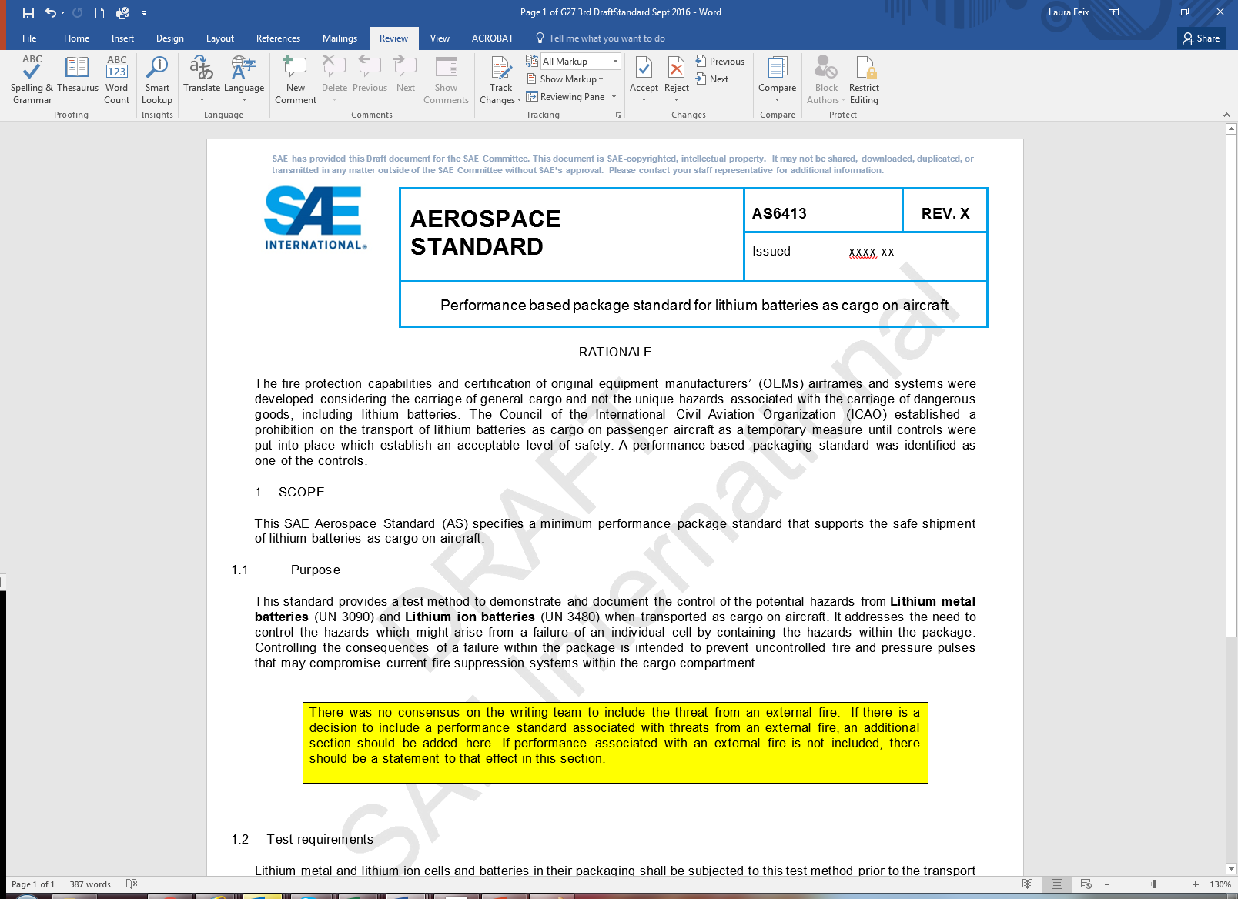
AS 6413 Development and Writing Team
Standards Development Process
      Writing Team developed draft for standard (~20 people)
      Draft standard circulated to entire G-27 committee (over 160 people) for review and comments (iterative process to incorporate comments)
      Balloting process involves all stakeholders with opportunity to comment on proposed standard:
          Ballot disapprovals must be resolved between the commentor and document sponsor.
          Comments from non-voting members must be reviewed and considered.
      Voting members (~50) are being identified

Slide 6
Optimistic AS 6413 Projected Timeline
(As of October, 2016)
2016 2017
1)
Feb
2)
Mar
3)
May
4)
June
5)
Nov
6) and 8)
Jan
7)
Mar
9) and 10)
Apr
11)
May
1) Initial G-27 meeting
2) Document Development
(face to face followed by virtual - ongoing)
3) Document Review
(face to face and virtual - ongoing)
4) Development Testing
5) Document finalization
(~ 4 weeks from final comments)
6) Committee Balloting
(28 days)
7) Resolve Disapprovals
(~3 weeks)
8) Validation Testing
(continues until end of affirmation balloting)
9) Affirmation Balloting
(14 days)
10) Council Balloting
(28 days)
11) Publication

Slide 7
AS 6413 Development and Writing Team
Standards Development Process
      One telephone conference of full G27 committee per month since February
      Draft standard writing team of ~20 people have met multiple times starting with a 1 week face-to-face in March.
      Face to face meeting of G-27 committee May 19-20 in Toulouse, France
      3rd Preliminary draft of AS6413 on SAE G-27 website for comments
      Next G-27 face to face meeting November 17-18 in Huntington Beach, CA, USA.

Slide 8
AS 6413 Development and Writing Team
Writing Team
Approximately 20 individuals with standards and test experience balanced with geographic representation from the following stakeholders:
      Aircraft cargo fire protection specialists
      Regulatory authorities
      Operators
      Pilots
      Packaging manufacturers
      Battery manufacturers
      Test houses

Slide 9
AS 6413 Draft Content
    This standard provides a test method to demonstrate and document the control of the potential hazards from Lithium metal batteries (UN 3090) and Lithium ion batteries (UN 3480) when transported as cargo on aircraft.
    It addresses the need to control the hazards which might arise from a failure of an individual cell by containing the hazards within the package.
    Controlling the consequences of a failure within the package is intended to prevent uncontrolled fire and pressure pulses that may compromise current fire suppression systems within the cargo compartment.
    The intent of this test is to severely abuse a single cell such that it is most likely to enter thermal runaway with the presumption that a single cell may enter thermal runaway during transport.

Slide 10
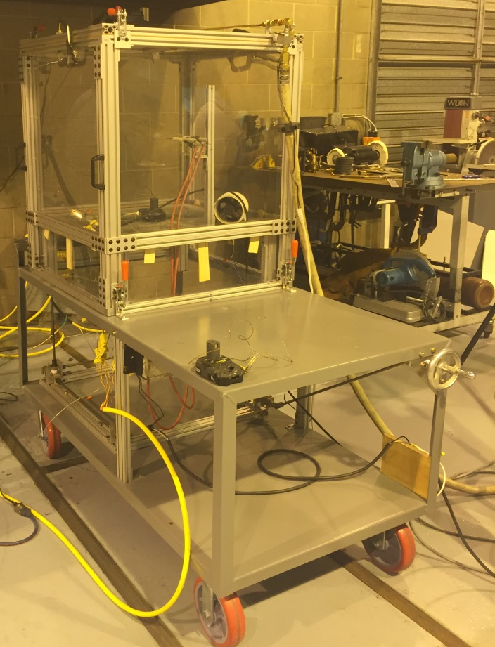
AS 6413 Draft Content
    The package will be placed in a transparent box with a [0.3] m³ free volume that will contain gases generated from Thermal Runaway (TR). The box will have a rapid overpressure opening that will be sealed with a rupture foil. A spark ignition source will be energized continuously within the box volume, capable of igniting vapors reaching a flammable concentration within the box.
    Rationale for volume size is explained within draft standard

Slide 11
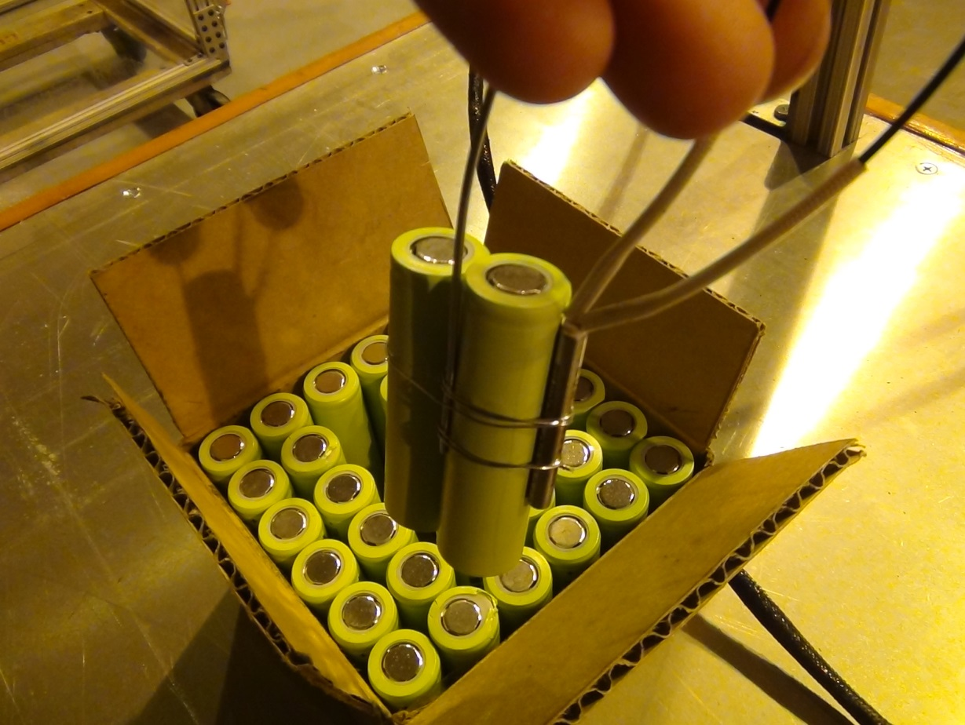
AS 6413 Draft Content
    For testing individual cells, Use a heat source (e.g. tape, cartridge) to create a temperature rise at 5 to 10 °C (9 to 18 °F) per minute as measured at an external point on the cell that is most representative of the cells internal temperature.

Slide 12
AS 6413 Draft Content
    If there is clear external evidence of cell thermal runaway, power to the heat source will be stopped.
    If clear evidence of cell thermal runaway has not occurred, monitor the cell temperature as measured at an external point on the cell that is most representative of the cells internal temperature and hold at 200°C (392°F) for 1 hour then remove power to the heat source.
    The unit under test will be monitored for 5 hours after removal of power to the heat source.
    Test to be run until failure occurs or for 6 hours minimum in case no failure is observed.
    For testing batteries, the goal is to use the same methodology applied to a single cell within the battery, but there may be more than one single method for triggering TR, depending on the battery type and construction.

Slide 13
AS 6413 Draft Content
    The pass test criteria shall include evidence of:
      Non-hazardous flame: (A flame exiting the package under test that does not contain sufficient energy to ignite adjacent packages.)
        No flame
        A flame of short duration (less than 0.2 seconds), a short length [less than 5 cm] and a small rate of occurrence [<3 times total] during the test
      Non-hazardous Fragment: (A fragment that has exited the package with insufficient energy to pass through or ignite adjacent packaging.)
        No visible fragments exiting the package (smoke particles are not considered fragments)
        At the end of test, the outer package shall be examined and the outside packaging shall not have any penetrations (no fragments may exit any vent mechanisms).
      Non-hazardous Surface temperature:
        Temperature measured at center of each package surface will not exceed a peak maximum temperature of 200 C for [3] minutes with a tbd minute integrated average not to exceed 150 C.
      Non-Hazardous Quantity of Flammable Vapor:
        There shall be no evidence of flame other than allowed per non-hazardous flame.

Slide 14
G27 Open Issues
A subcommittee is being formed to address the potential hazards of lithium batteries packaged as required by the Dangerous Goods Technical Instructions in the event of a cargo fire due to some external event.
      What would be the rationale for including this scenario?
      What are the conditions that may be representative of an external fire event?
      What is an appropriate location for identification and/or test of possible mitigation means– in the packaging standard, in guidance to be used with the packaging standard, or in a different document?
  A section of the document is intended to address an appropriate analytical method to use test data involving specific cells and specific minimal packaging as the basis for not repeating the testing for similar configurations (e.g. same cell part number and characteristics, but fewer cells, etc). Wording is being proposed and will be discussed.
  Acceptability of sub assembly test for large format batteries.
  Possibility to test cells and batteries with no or benign hazards in case of thermal run-away, allowing for transport in any case of package.
  It is anticipated that these open issues will need to be addressed prior to final approval of the packaging standard.

Slide 15
QUESTIONS?
Doug Ferguson
Boeing Associate Technical Fellow
SAE G-27 Co-Chair
o +1 562.593.2950
douglas.e.ferguson@boeing.com
Jordanna Bucciere
Aerospace Standards Specialist
SAE International
o +1.724.772.7517
m +1.724.612.5339
Jordanna.lehman@sae.org
Claude Chanson
General Manager - RECHARGE
SAE G-27 Co-Chair
o +32 (2)777-0567
cchanson@rechargebatteries.org

