Slide 1
8th Triennial International Aircraft Fire and Cabin Safety Research Conference
Chris Egloff, Americase

Slide 2
Overview and Company History

Slide 3
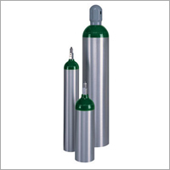
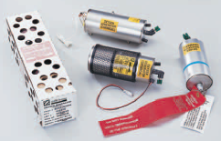
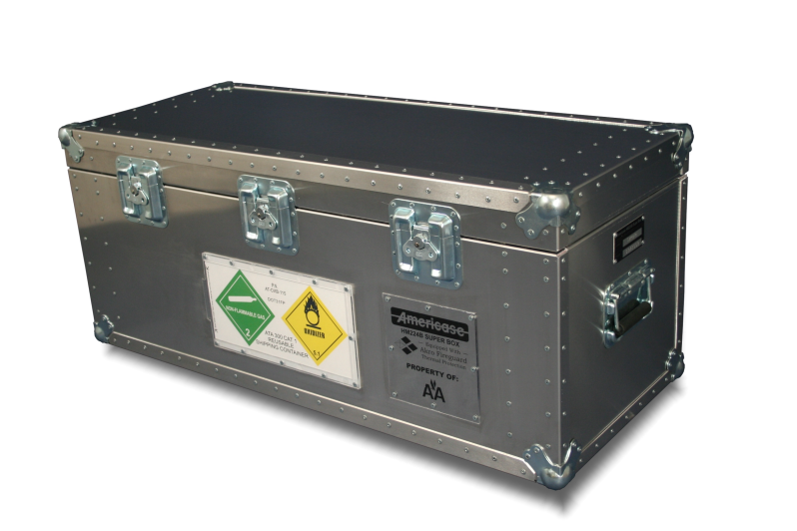
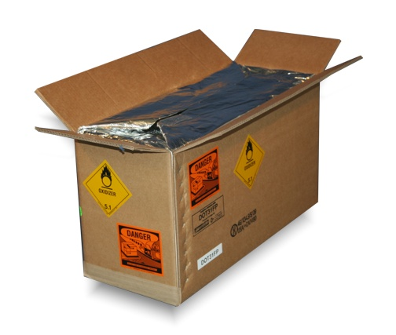
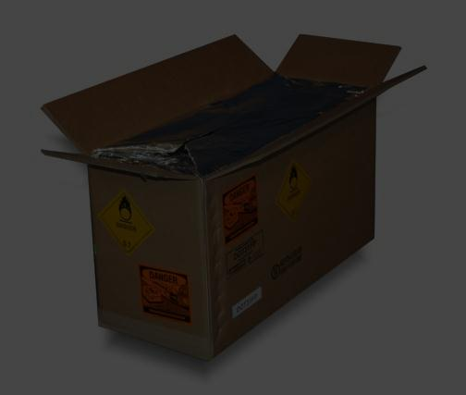
Oxygen by Air HM224B

Slide 4
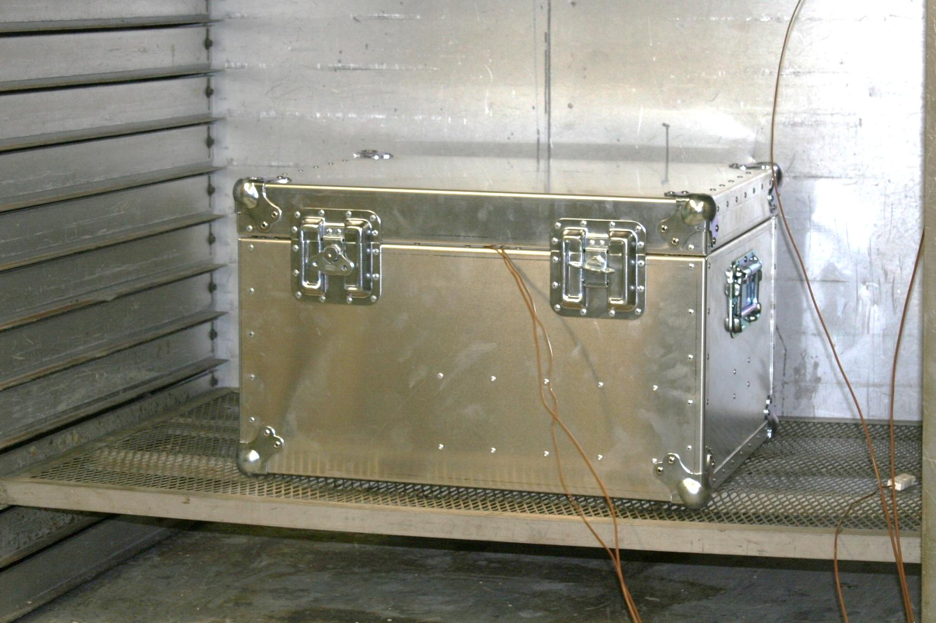
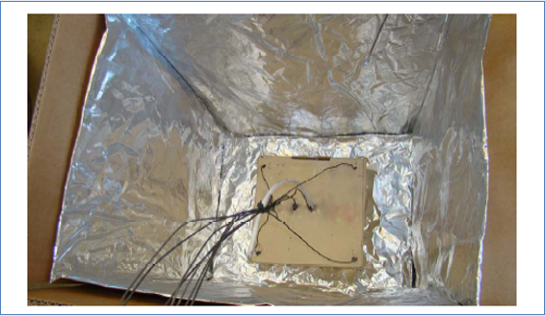
Preliminary Lithium Solutions

Slide 5
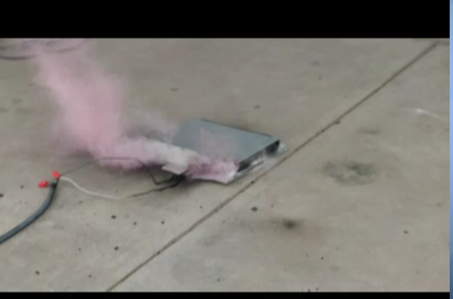
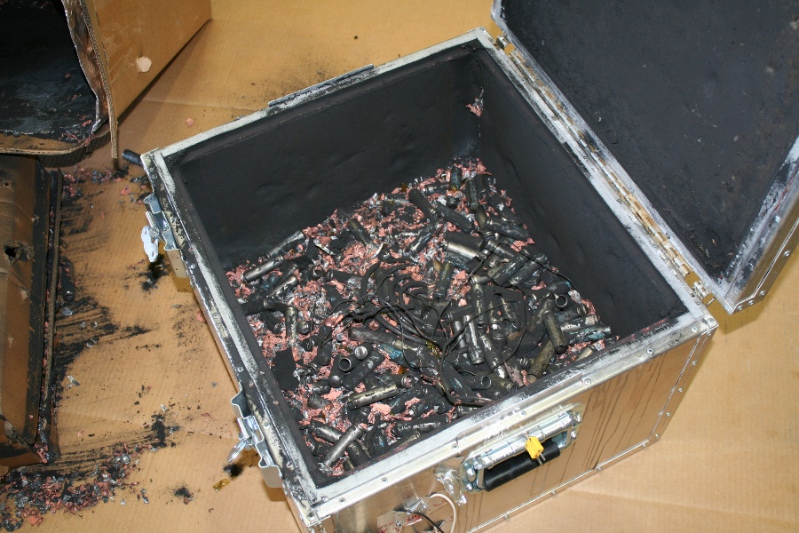
Testing

Slide 6
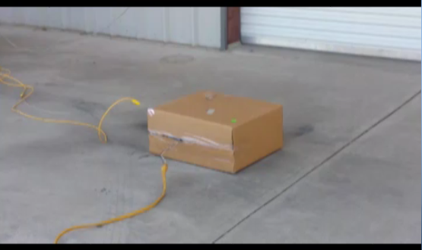
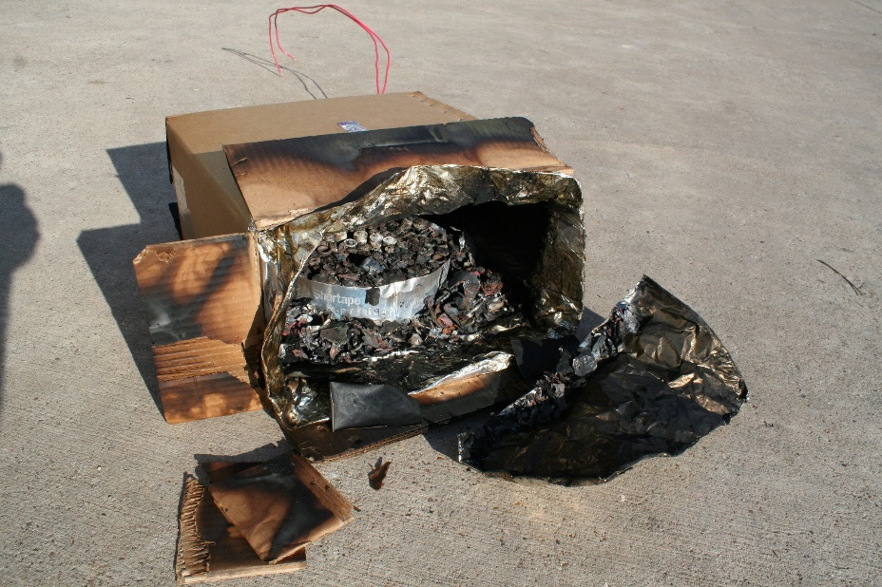
Testing

Slide 7
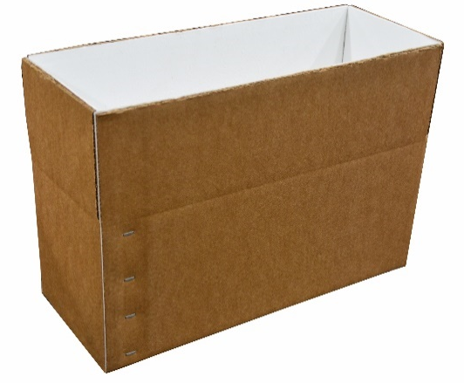
Americase Mass Recall Solutions
c
DOT-SP16531
Damage/Defective
DOT-SP16510
Recall
DOT-SP16011 (Rev.1)
By air
DOT-SP16011 (Rev.3)
Multiple devices with Wh limitations
c

Slide 8
SAE G-27
Third revision has been released
Test parameters
No escaping dangerous projectiles
No escaping dangerous flames
Spark ignitor
3 cubic feet
3 video recorders (1 being Infrared)
6 hour test period

Slide 9
Fulcrum Test Labs
Need for targeted test lab for testing Li-ion
Partnered with local test lab (Fulcrum) to create a dedicated test branch for client testing and R&D for emergent packaging solutions
Currently partnered with PRBA for early “whitepaper” feedback on SAE G-27
Early testing for internationally recognized, industry leaders (various testing)

Slide 10
Future of Lithium Packaging
Akro: PyroPacs
LableMaster: GelTech Solutions
Nexceris: Thermal runaway precursor “gas detector”
Akro Fire

Slide 11
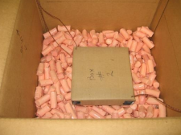
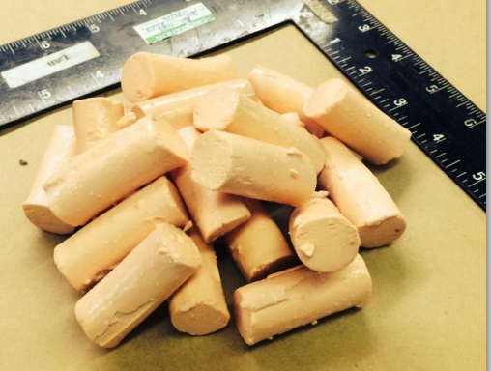
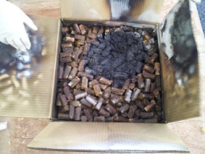
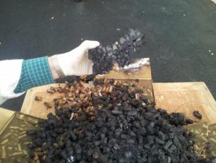
AkroFire/Americase

Slide 12
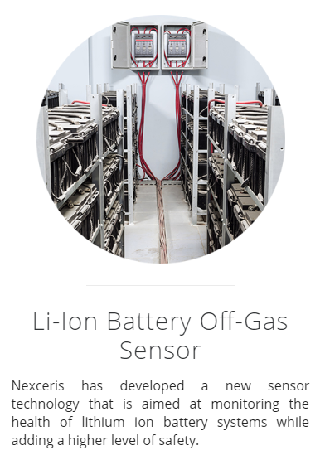
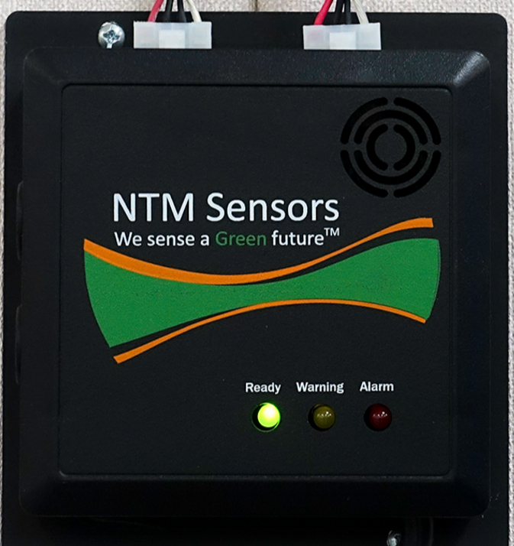
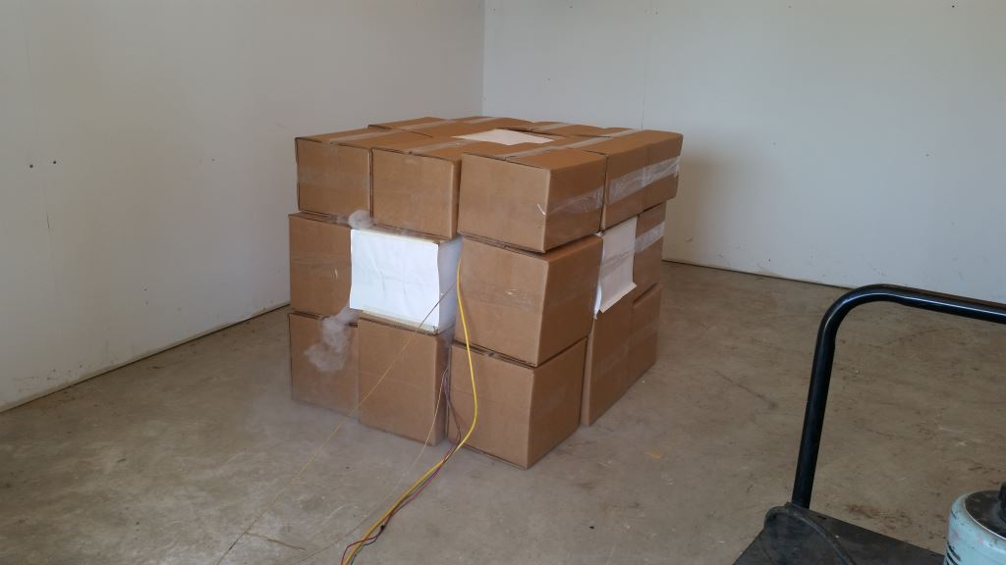

Slide 13
Questions

