Slide 1
Summary of FAA Research on Lithium Battery Hazards
Packaging Standard Considerations
8th Triennial Conference
Harry Webster, FAA Fire Safety
October 26, 2016

Slide 2
Background
The 1999 LAX ramp fire involving lithium batteries was the basis for the FAA Technical Center initial investigation into the hazard of shipping these items by air. In the 1999 incident, a pallet of 120,000 lithium batteries was dropped on its side. The pallet erupted in flames 3 hours and 40 minutes later. Airport fire rescue had difficulty extinguishing the fire. This incident, coupled with the projected near exponential increase in lithium cell production, warranted investigation into the potential hazards of shipping these items by air. The likelihood that lithium cells may be involved in any cargo fire is directly related to the number of cells shipped as cargo.
The FAA has conducted numerous research projects from 2002 until the present date on the flammability hazard of lithium batteries.

Slide 3
Cell Characterization Studies
Initial studies focused on the unique characteristics of lithium cells.
It was found that lithium cells differ from other conventional batteries in that the lithium cells are constructed with a flammable electrolyte. This electrolyte can be forcibly released from a cell that is in a state of thermal runaway.

Slide 4
Thermal Runaway
Thermal runaway is a chemical reaction within the cell that results in a dramatic, uncontrolled temperature and pressure rise. This results in the cell expelling its contents, including the flammable electrolyte and gases, which can be ignited by the hot cell case or burning packaging. Lithium metal cells can self ignite.
The exterior temperature of the cell casing can reach temperatures in excess of 1400°F.

Slide 5
Thermal Runaway Initiation
Thermal runaway may be initiated by many circumstances.
These include internal cell failure, heating (exposure to an external fire), physical abuse, rapid discharge, over-charging, or the latent manifestation of a manufacturing contaminant.
Externally heating the cells to a temperature of approximately 400°F, will initiate the thermal runaway reaction within the cell.

Slide 6
Thermal Runaway Propagation
The heat produced by a single cell in thermal runaway may also be sufficient to heat adjacent cells, causing them to go into thermal runaway.
This is a process called thermal runaway propagation and is key to understanding the hazard presented in shipping these cells.
The typical fiberboard bulk packaging does not prevent the propagation of thermal runaway.

Slide 7
Thermal Runaway Vent Gas Analysis
Tests were conducted to analyze the gases that are vented from lithium cells in thermal runaway.
It was found that the gases consisted of primarily CO, Hydrocarbons, and Hydrogen.
The concentration of hydrogen can be as high as 30%.
The volume of gas generated increases with the state of charge.

Slide 8
Halon 1301 Effectiveness
Halon 1301 is the current fire suppression agent typically installed in class C cargo compartments.
Initial tests with small numbers of cells predicted that the Halon 1301 extinguishing agent would suppress the open flames but not prevent the propagation of thermal runaway from cell to cell.
Later full scale tests with large numbers of cells confirmed that Halon 1301 has little effect on stopping propagation of thermal runaway.
Halon 1301 at the design concentration of 5% cannot suppress the ignition of gases vented in thermal runaway that include high concentrations of hydrogen.
Explosive gases may accumulate even in a suppressed cargo compartment.

Slide 9
Effect of State of Charge
Cells were typically shipped at a nominal state of charge of 50% of capacity.
Initial tests with lithium-ion cells indicated that reducing the cell state of charge had safety benefits.
By reducing the SOC of a typical cobalt oxide lithium-ion cell to below 30%
  The severity of thermal runaway is reduced
  Propagation of thermal runaway is slowed or eliminated
  The volume of flammable gases vented during thermal runaway is reduced.

Slide 10
Hazard by Cell Chemistry, Type and Size
Cells of various chemistries, form factors, and capacity were studied
Some chemistries such as LiFePO₄ yielded the lowest temperature rise in thermal runaway and were the least likely to propagate. Where as, other chemistries such as LiCoO₂ exhibited the highest temperature rise and most likely to propagate.
Some cells, such as Thionyl Chloride, while technically not flammable, explode violently when heated.
The presence, or lack of, cell safety features such as vents made a difference in the hazard.
The hazard increases with the size of the cell, both physical size as well as capacity.

Slide 11
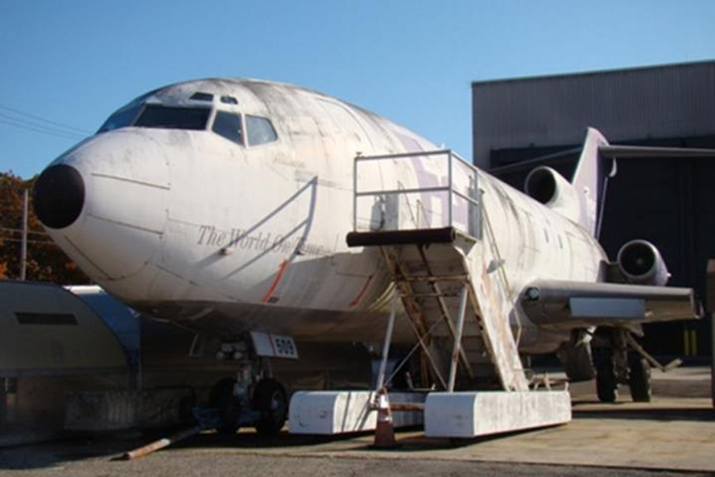
Full Scale Aircraft Fire Tests
Tests with 5000 lithium-ion cells and lithium metal cells were conducted in both the class E cargo compartment as well as the class C cargo compartment.
The aircraft was configured to simulate inflight conditions.
Fire control procedures, including ventilation settings were followed.

Slide 12
Full Scale Aircraft Fire Tests
Lithium-ion fires, initiated by simulating a single cell in thermal runaway, propagated through out the shipment in both compartments.
Fires initiated by an external fire propagated in the class E, but not the class C.
Halon 1301 was able to suppress the open flames, but did little to slow the rate of propagation of thermal runaway.
Tests in both locations were terminated to prevent damage to the aircraft

Slide 13
Full Scale Aircraft Fire Tests
Lithium metal fires propagated rapidly in both cargo compartments, generating extreme temperatures and smoke.
Smoke obscured the flight deck in minutes.
Halon 1301 was not effective in slowing the rate of propagation.
Each test had to be terminated to prevent damage to the aircraft.

Slide 14
Fire Containment Covers
FCCs work by restricting the oxygen under the cover.
FCCs are capable of containing a class A fire for four or more hours.
Tests where a quantity of lithium-ion cells are included in the fire load, were not successful, failing at 70 minutes.
Lithium metal tests failed in 16 minutes.
Thermal runaway vent gases leaked out from the bottom and ignited.

Slide 15
Fire Resistant Containers
FRCs work by restricting the oxygen and may also have active fire suppression systems.
Successful tests were conducted with class A materials.
Lithium-ion tests resulted in an explosion of flammable vent gases that destroyed the container.
Lithium metal tests burned through the sides of the container within 3 minutes.
The fire suppression agent was ineffective on either the lithium-ion or lithium metal fires.

Slide 16
Vent Gas Explosions in Cargo Compartments
Tests were conducted to:
  determine the effect of a vent gas explosion in a cargo compartment.
  determine the minimum amount of vent gas that when contained and ignited would compromise the compartment integrity.
Class C compartment are designed to withstand a one psi pressure differential before pressure relief devices activate.
These pressure relief devices, when activated, will allow the fire suppressant agent to leak out.
Six cells at 100% SOC and 20 cells at 50%, in thermal runaway, generated sufficient vent gas, that when ignited, activated the pressure relief devices.

Slide 17
Packaging Considerations
ICAO has banned the shipment of lithium cells and batteries as cargo on commercial passenger aircraft.
  Pending the development of safer means of transport.
  SAE G27 committee
Remedies may include:
  Safer chemistries
  Aircraft based solutions (FCCs, FRCs, separation)
  Improved packaging

Slide 18
Packaging Considerations
Goal: Reduce the hazard to a level that the cargo compartment can contain the event.
Considerations
  Recognize that lithium cells can be both an ignition source and a fuel.
  Prevent package to package propagation of thermal runaway.
  Prevent the ignition of adjacent cargo.
  Minimize the generation of smoke.
  Minimize heat released
  Contain fragments to within the package
  Restrict the amount of flammable vent gases released.
Consider ignition sources
  Internal cell failure
  External fire

Slide 19
Packaging Considerations
Consider matching package to the level of hazard
  Chemistry, size and capacity and number of cells will affect the package design.
Consider layered approach.
  Packaging in conjunction with:
    State of charge restrictions
    Cargo separation
    FCCs and FRCs

Slide 20
Report
Summary of FAA Studies Related to the Hazards Produced by Lithium Cells in Thermal Runaway in Aircraft Cargo Compartments
DOT/FAA/TC-16/37
June 2016
Harry Webster, et al.
www.fire.tc.faa.gov

Slide 21
Questions?
Contact Information
Harry Webster
FAA Fire Safety Branch
Harry.Webster@faa.gov
609-485-4183

