Slide 1
Propagation of Lithium Battery Fire in an Inert Environment

Slide 2
Background / Introduction
Argon propelled foam was proposed as a means of mitigating a lithium battery fire.
Would argon be more effective than nitrogen at suppressing a lithium battery fire?
  Heat capacity of Argon: .8637 kJ/m³ K
  Heat capacity of Nitrogen (N₂): 1.2116 kJ/m³ K
  Nitrogen is more reactive than Argon.

Slide 3
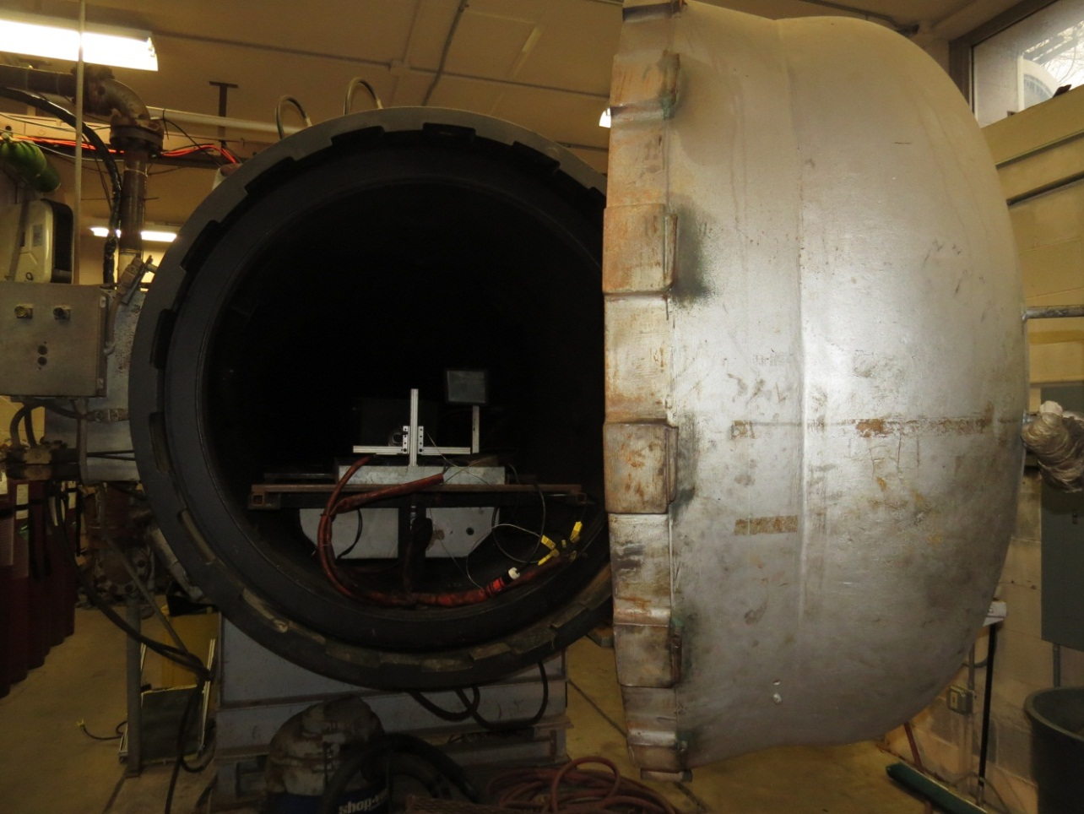
Pressure Chamber
Vacuum down to .5 psi
Maximum 750°F at 600 PSI

Slide 4
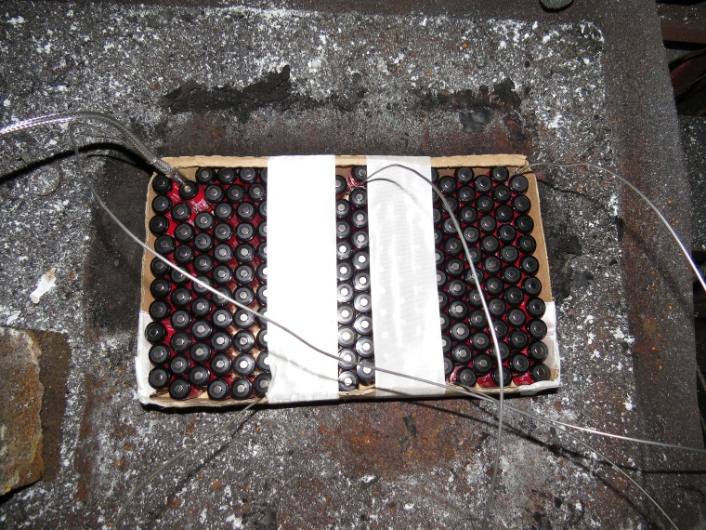
Test Setup
200 CR123a LiMnO2 cells were positioned in a 10 m³ pressure chamber.
Tests were first performed in air followed by nitrogen and argon.
For the argon and nitrogen tests partial pressures were used to achieve 9% O2.
thermocouples

Slide 5
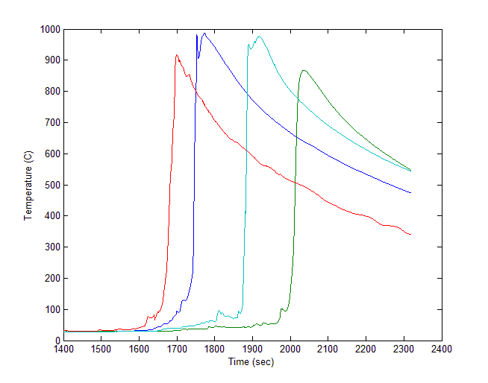
Typical Cell Temp. Plot (N2)
Propagation time

Slide 6
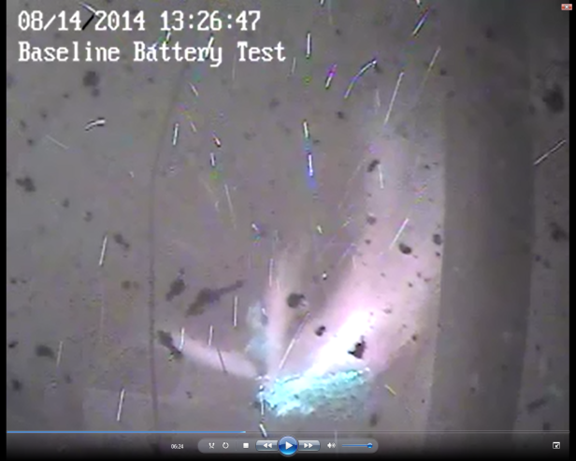
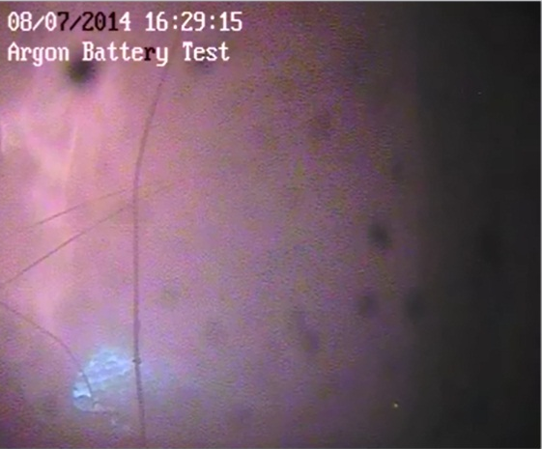
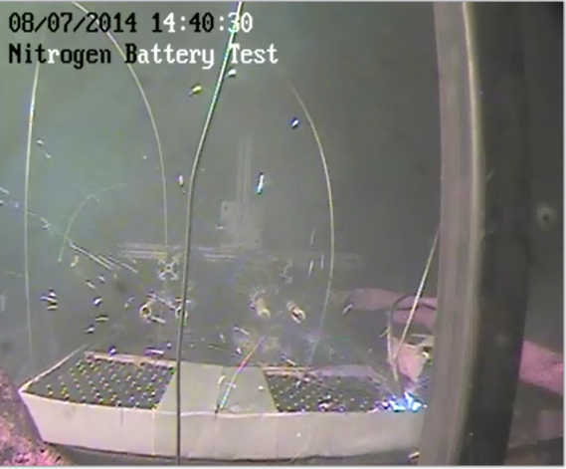
Battery Fires in Reduced O₂ Environment
200 CR123A Manganese Dioxide cells in chamber
Air
Argon
Nitrogen
Initial O₂: 21%
Initial O₂: 9%
Initial O₂: 9%
Propagation Time: 187 sec
O2 Depletion: 7.25%
Max THC: .2237%
Max Ave. Chamber Temp. 118.1C
Propagation Time: 339 sec
O2 Depletion: 3.67%
Max THC: .7394%
Max Ave. Chamber Temp. 165.5C
Propagation Time: 337 sec
O2 Depletion: .633%
Max THC: .8746%
Max Ave. Chamber Temp. 37.63C

Slide 7
Summary
Propagation of cells is slowed by oxygen depletion with either Argon or Nitrogen
No noticeable difference in the propagation time when inerted with Argon or Nitrogen
At 9% O_{2,} Argon was insufficient to fully prevent the battery fire, while Nitrogen did prevent the fire.

Slide 8
Questions?
Contact Information:
Steve Summer
609-485-4138
Steven.Summer@faa.gov
Thomas Maloney
609-485-7542
Thomas.Maloney@faa.gov

