Slide 1
3rd Generation Separators: Using Thermally Stable Separators to Turn the Aluminum Current Collector into a Fuse
First and Second Generation Separators
Third Generation Separators
Safety Testing
Nail Penetration Tests & Autopsies
Benefits of Third Generation Thermally Stable Separators

Slide 2
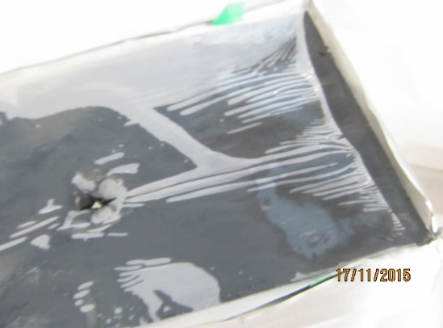
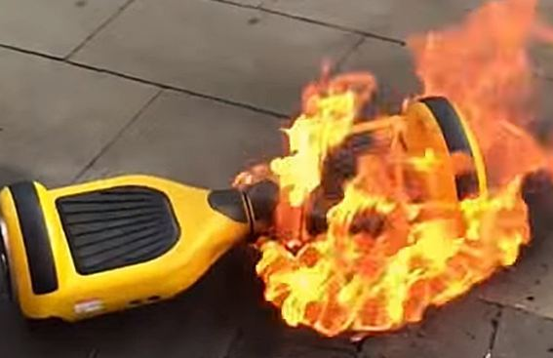
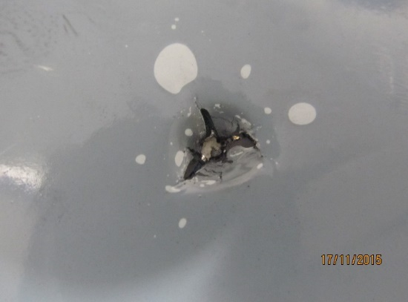
The Problem
Shrinkage
Shrinkage and splitting

Slide 3
Samsung Note 7 Recall: What We Know
65/35 supplier split Samsung SDI/ATL
Negative and positive electrodes come together
“minor flaw in the manufacturing process”
Could be related to fast charging
2.5 million phones recalled
Samsung SDI is #1 lithium battery supplier, with reputation for very high quality and product design
Could this type of event be prevented with advanced separator materials?

Slide 4
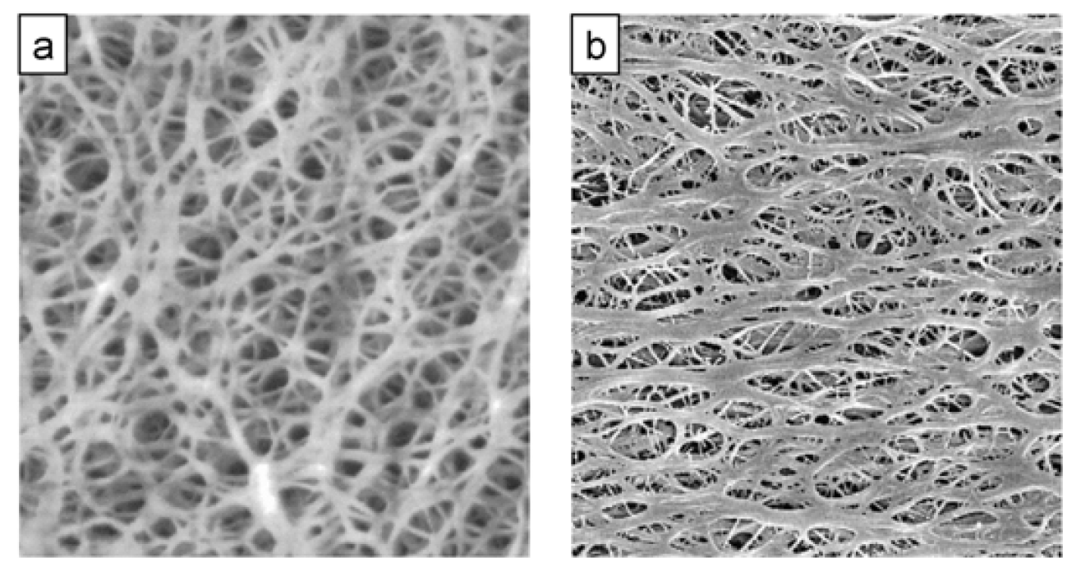
First Generation Separators
Dry Process
PP
Shrinks >130 C
Melts ~160 C
MD Strong, CD weak
Wet Process
PE
Shrinks >90 C
Melts ~135 C
MD & CD strong
Notes:
First Generation battery separators made by the wet process and dry process have served the industry for 20 years starting in 1990, and are suitable for small batteries where the total energy is not very high and energy density is critical.

Slide 5
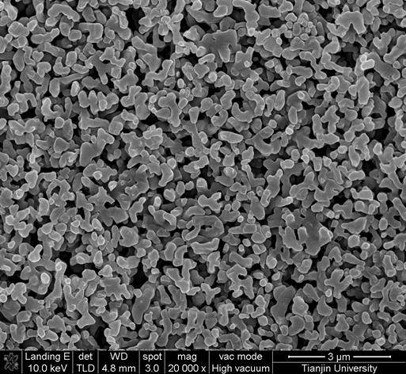
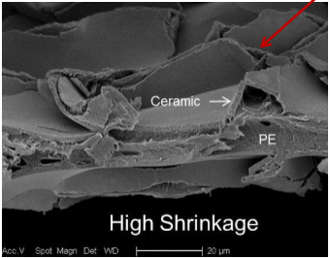
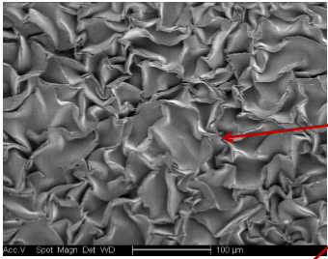
Second Generation Separators
Ceramic coating on first generation separators
Can increase shrinkage temp to 180 C
Increases depend on the thickness of separator and of ceramic coating
Expensive, slow coating process
At high temperatures, ceramic coating buckles and separator shrinks
Base separator still melts and burns
Ceramic Coating
First Generation Separator
Ceramic Coating
Heat
Thin ceramic coatings that have bucked under modest heating.
Notes:
Second generation separators consist of first generation separators that have been coated with a high temperature coating, generally ceramic or aramid. The thermal shrinkage temperature can be increased by up to 50 C, and safety tests are improved for modest size cells. However, the shrinkage improvement depends strongly on the morphology and thickness of the ceramic coatings. For every 2nd generation separator, there is a temperature at which the polymer film shrinkage overcomes the ceramic coating, and shrinkage occurs.

Slide 6
Third Generation Separators
1st generation shrink ~ 130 C
2nd generation shrink ~175 C
3rd generation stable >300 C
No unstable polymer component
High temperature materials incorporated in homogenous composite
Often stable to 500 C
Thermo Mechanical Analysis—measures shrinkage as a function of temperature
Notes:
TMA can be used to measure shrinkage as a function of temperature. First generation separator begin to shrink at 90 – 130 C. Second generation separators can be stable to 180 C or so. Third generation separators are stable to 300 – 500 C

Slide 7
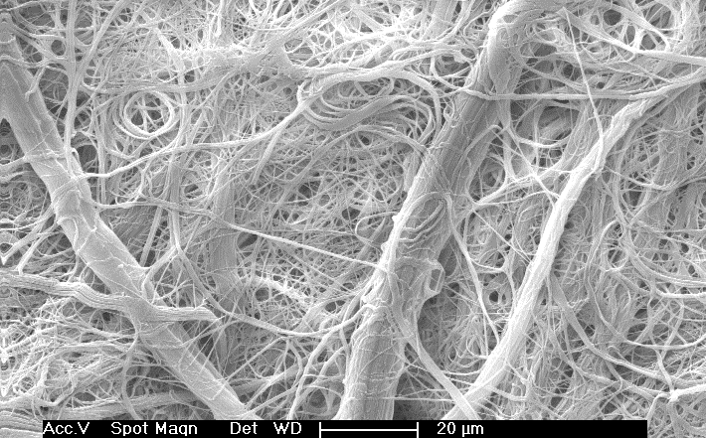
Dreamweaver 3rd Generation Separators
Nanofiber on microfiber
“spider-web-on-Tinkertoy”
Nanofibers form good barrier
Microfibers give open structure
good window
Microfibers also add strength
Has potential to be thinnest high temperature separator in the world
Notes:
Dreamweaver’s third generation separators are composed of a combination of microfibers and nanofibers, all of which have good thermal stability. The nanofibers give good separation, while the microfibers add length and strength. Thicknesses currently available range from 15 to 25 microns, with plans for materials as low as 10 microns in 2017-18.

Slide 8
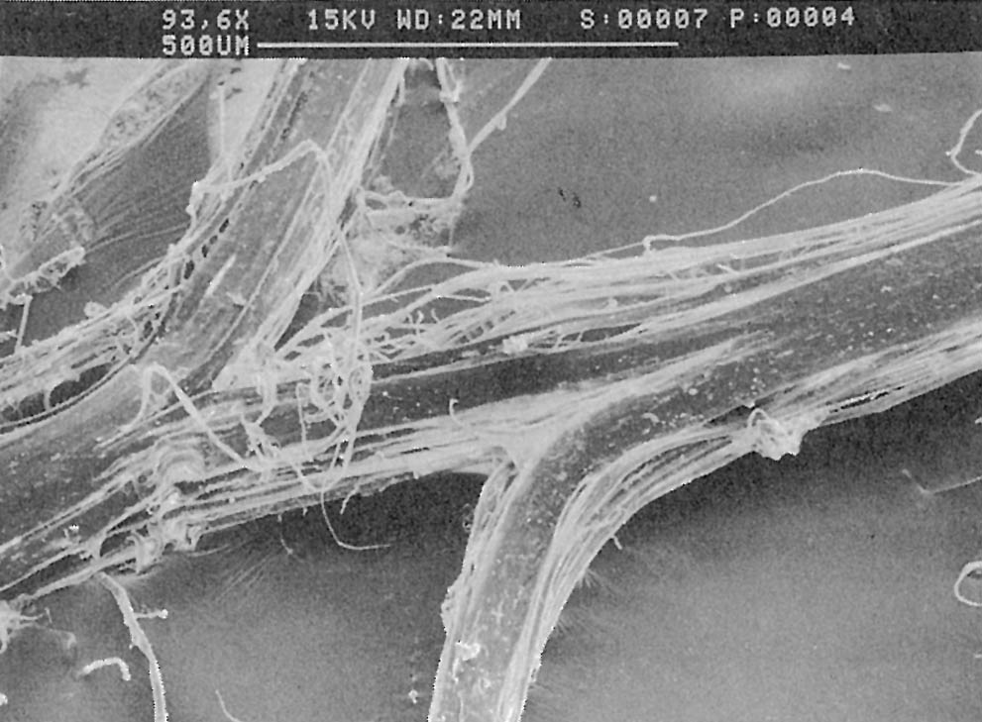
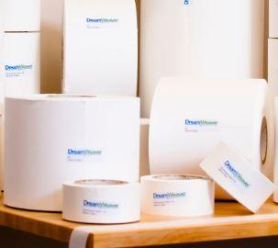
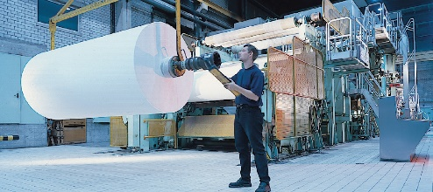
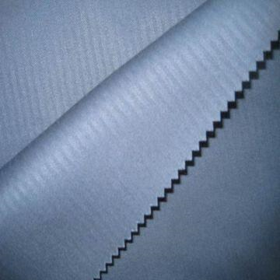
Dreamweaver’s Solution
Refining
Papermaking
Start with textile
grade fibers.
Choose materials with high
chemical, thermal stability.
Finished product with
highest performance,
lowest cost
Calendering

Slide 9
DWI Tech #1: Swell Fibers: Rate & Cycle Life
Silver Product Design
Benefits in Lithium Ion Battery
Nanofiber #1 swells in electrolyte
Nanofiber #2 gives high temperature
Easy, fast processing in papermaking
Swollen fibers are ion conductors
Swollen fibers reduce pore size
Swollen fibers adhere anode to cathode: act like gelled electrolyte

Slide 10
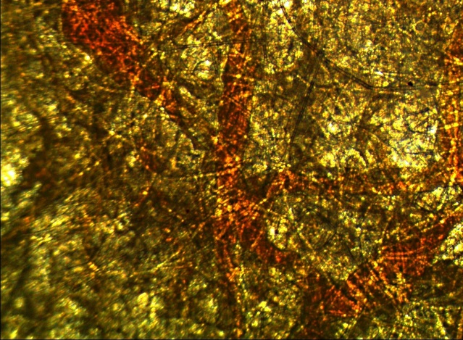
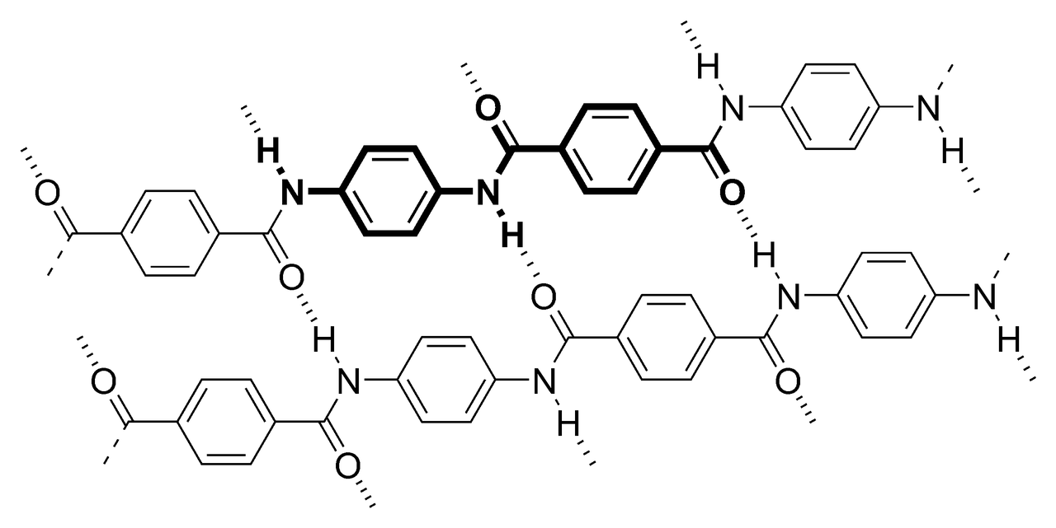
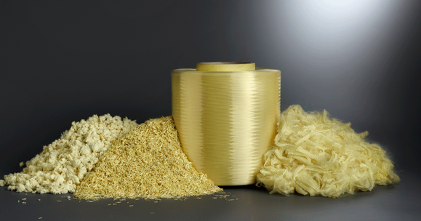
DWI Tech #2: Unprecedented Safety
Polyolefin on fire, a fraction of its original size.
Aramid liquid crystal fiber stable to 550 C.
Does not melt, shrink or burn. Oxidizes in place.
Gold after burning retains its original shape & size.

Slide 11
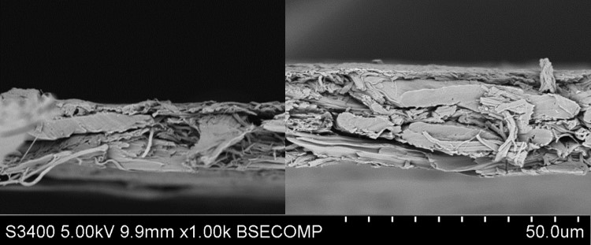
DWI Tech #3: Thinnest Nonwoven Separators
Use supercalendering to compress membranes
Control porosity 25-70%
15 micron today
10-12 microns in 2018
Silver 15
15 microns
30% Porosity
Silver 20
20 microns
35% Porosity
Silver 25
25 microns
53% Porosity
Titanium 15
15 microns
35% Porosity
Titanium 30
30 microns
60% Porosity

Slide 12
1. Good Electricals
3.2 Ah 26650 cells
Production cells
Li FePO cathode
Drop-in separator replacement
Equivalent at 1.6, 4.7 C
DWI higher at 9.4 C
Equivalent 25 C, 65 C cycling
1.6 C
4.7 C
9.4 C
Notes:
In both pouch and cylindrical cells, the electrical properties match those of first and second generation separators, including both discharge curves as well as cycle life, which is on the next slide. The cells tested here are 26650 lithium iron phosphate production cells produced in China. The only change in the cell was to replace the separator.

Slide 13
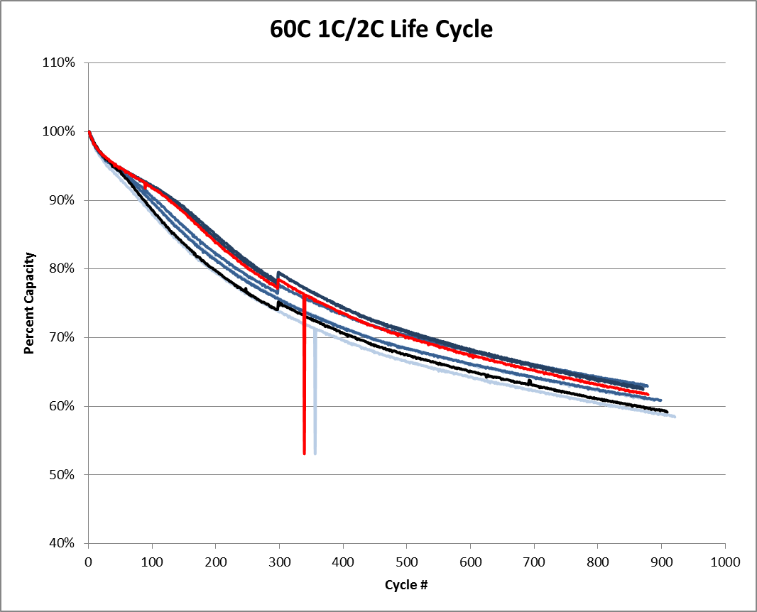
Cycle Data: 1000 Cycles at 25 C, 60 C
Notes:
Cycle life at both 25 C and 60 C match the first generation comparison separator.

Slide 14
3rd Generation Safety: A Complete Paradigm Shift
Prior to test, electrodes are isolated
Nail closes circuit from aluminum to copper
HEAT is generated
Aluminum
Cathode
Separator
Anode
Copper
Notes:
Third generation separators provide safety in a cell with a completely different mechanism. By providing separation between the electrodes up to very high temperatures, other components of the cell are forced to break down first. We all know that when a nail penetrates a cell, it shorts the copper and aluminum layers, generating a significant amount of heat. But if the separator doesn’t fail, what happens? Let’s see.

Slide 15
Flame Test: Saturated with Electrolyte
WATCH THE VIDEO➔
https://youtu.be/j9XWJgTlT1w
Notes:
First, let’s look at what happens when we saturate the separators with electrolyte and then light them on fire. The Dreamweaver separators on the right and in the middle allow the electrolyte to burn off with little change in the separator. The first generation separator on the left shrinks, melts, curls into a ball and then continues to burn itself. This is a significant difference which plays out inside the cell differently as well.

Slide 16
170 C Hot Box Tests
170 C Hot Box Temperature vs Time
170 C Hot Box Voltage vs Time
Polyolefin separators failed at softening point of polymer. DWI separators did not fail.
Notes:
Most people test cells with 1st and 2nd generation separators in a hot box at 130 or 150 C. But there is nothing magic about those temperatures. At 170 C, the cells with 1st and 2nd generation separators fail after about 30 minutes, while the cells with Dreamweaver separators persist for over an hour. The cells tested here, and in all the results shown later are 3 Ah pouch cells with LFP / graphite electrodes. The separators tested are a PP dry process separator (1st generation), a PE wet process coated with ceramic (2nd generation), and Dreamweaver Silver and Gold (two 3rd generation separators)

Slide 17
Nail Penetration
Voltage
Temperature
DWI Silver & Gold maintained their voltage and functionality during the test, unlike polyolefin separators.
DWI Silver & Gold had slower temp increase and reached a lower maximum temperature than polyolefin separators
Notes:
Everyone knows that when you drive a nail through the cell, the nail shorts the aluminum and copper current collectors, and the voltage at the tabs goes immediately to zero and stays there. This is exactly what happened with the 1st and 2nd generation separators. But the two Dreamweaver 3rd generation separators show only a ~100 mV drop, and a slow rise in voltage. This means that a break has occurred somewhere in the copper – iron nail – aluminum short. We’ll see later where it happened. But first, look also at the temperatures. The ceramic/PE cell went straight to 115 C, and the PP cell to 75 C, while the DWI Silver maxed out at 60 C, and the Gold only went to 40 C—barely even warm.

Slide 18
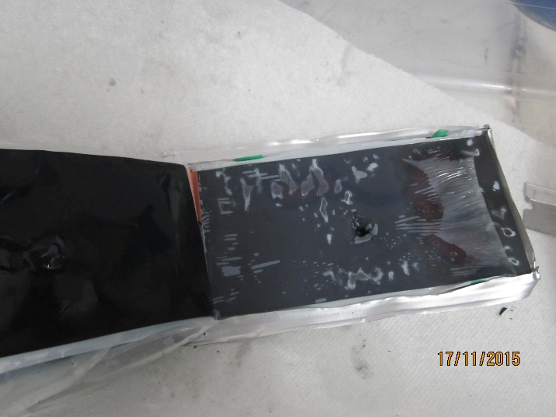
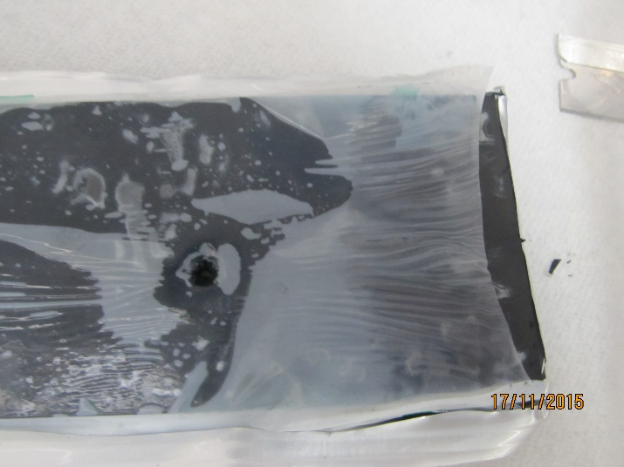
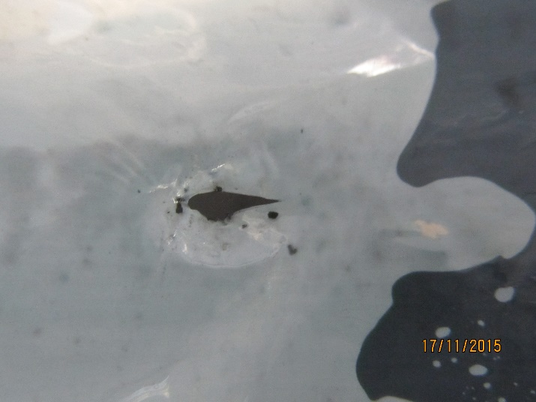
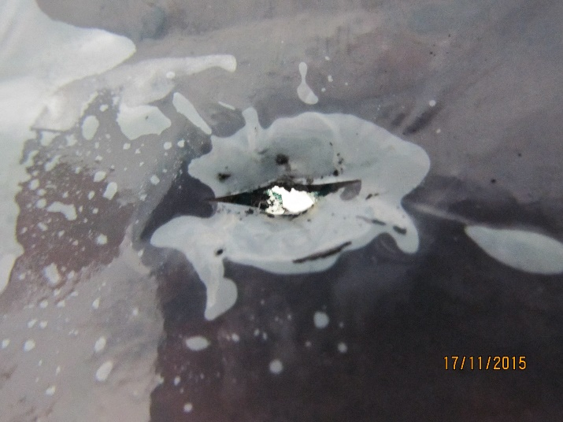
PP 1st Generation Separator
Maximum cell temperature 75 C
Significant shrinkage around nail
Significant shrinkage far from nail
Splitting character around nail
Anisotropic tear characteristics
Significant exposed electrode
Notes:
The cells were dissected and photos taken of every layer. This is the cell made with PP. There is macroscopic shrinkage at the right edge of the cell, exposing the edges of the electrode to a significant short. Also, in the bottom pictures, the break came in the form of a split, which is what you might expect given the strong anisotropy of the strength of the material. In the edges of the split, the electrodes are also shorted, generating more heat.

Slide 19
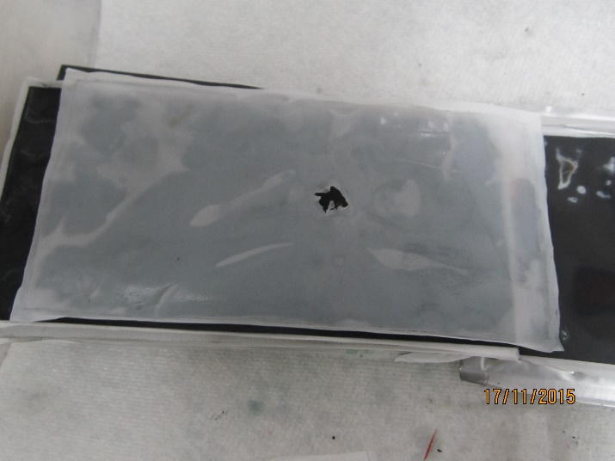
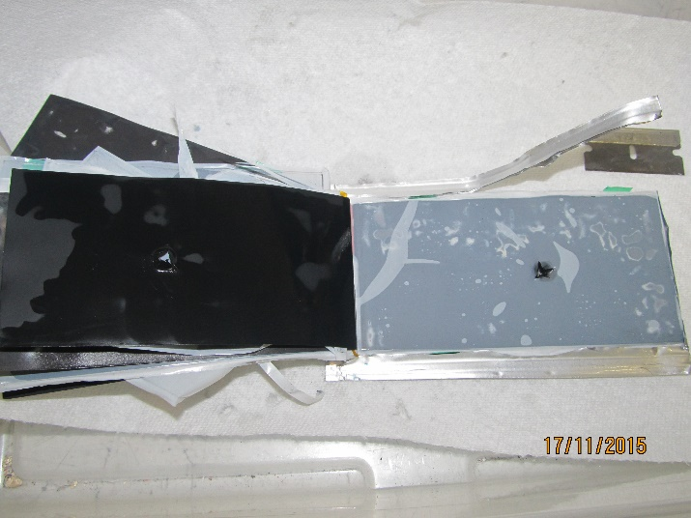
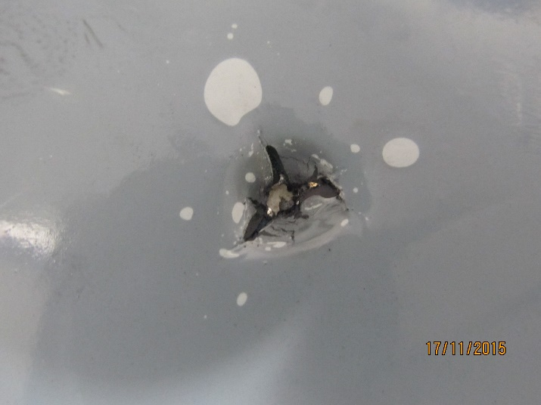
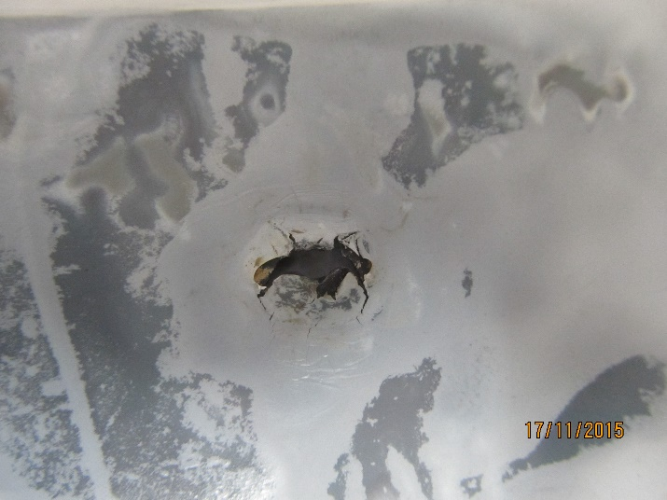
PE/Ceramic (2nd Generation)
Maximum cell temperature 115 C
Significant shrinkage around nail
Cracking and splitting around nail
Isotropic strength character
Significant exposed electrode
Notes:
In the cell made with the 2nd generation ceramic coated separator, there was no macroscopic shrinkage, even though the cell temperature was higher. But if you look at the hole, there is very significant cracking and shrinking of the separator, which created a larger short. We made a mistake in not including a ruler in the pictures, but the nail was about 4 mm diameter, which means that the cracks were at least 6-8 mm by these photos. This is a large short, which gave rise to the high temperature of the cell shortly after the nail was input.

Slide 20
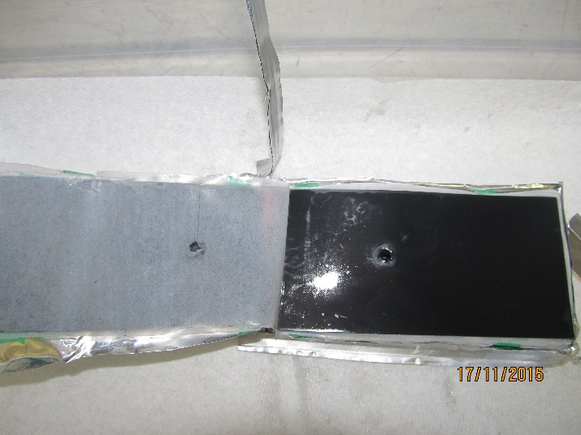
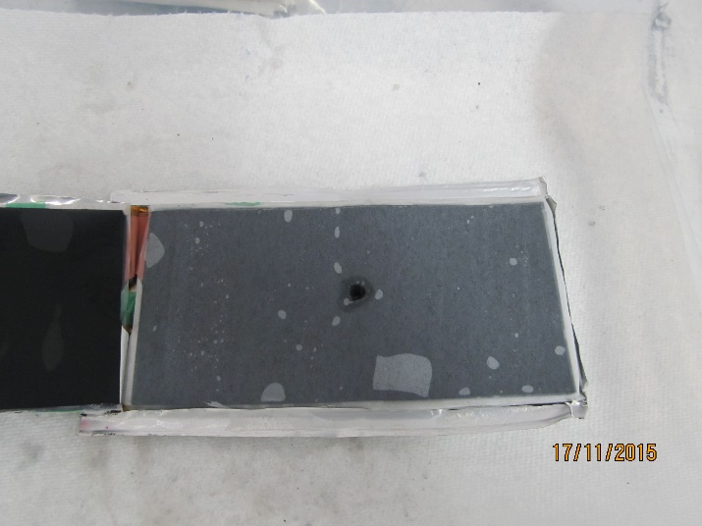
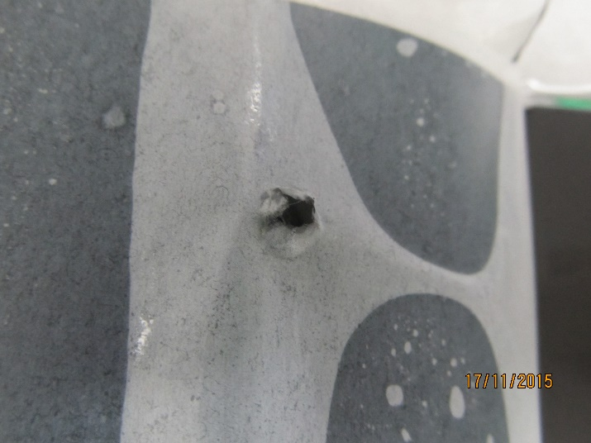
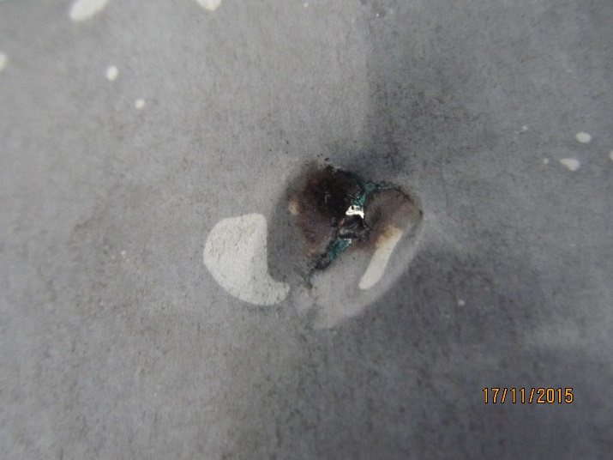
Dreamweaver Silver (3rd Generation)
Maximum cell temperature 63 C
No shrinkage
No cracking or splitting
Physical damage from nail penetration
Some charring around nail
No visible exposed electrode
Notes:
With the first 3rd generation separator (Dreamweaver Silver), the first thing you notice is no macroscopic shrinkage. But also there is no shrinkage around the hole—only mechanical damage. The bottom right picture is the worst layer we could find, out of two cells with 10 layers each. There is charring of the separator, but no shrinkage, so even though it began to oxidize, it still separated the electrodes.

Slide 21
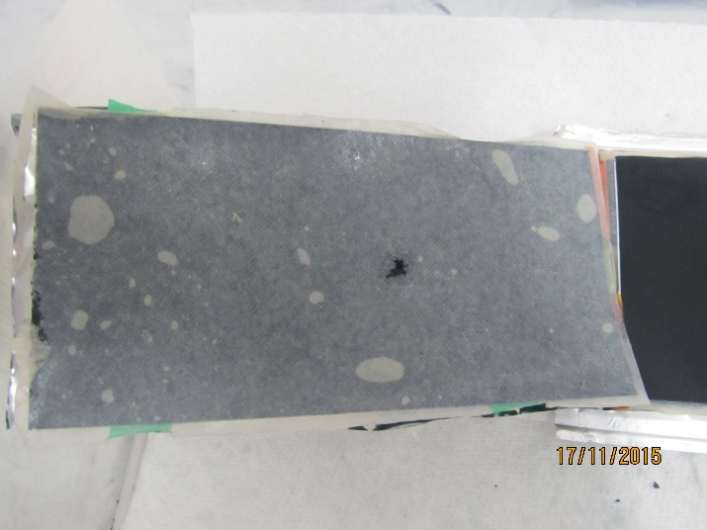
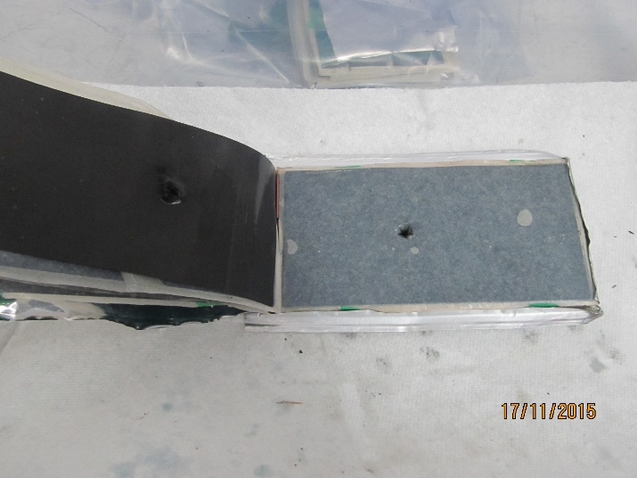
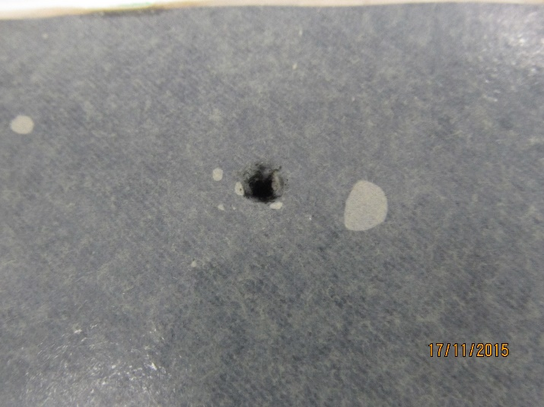
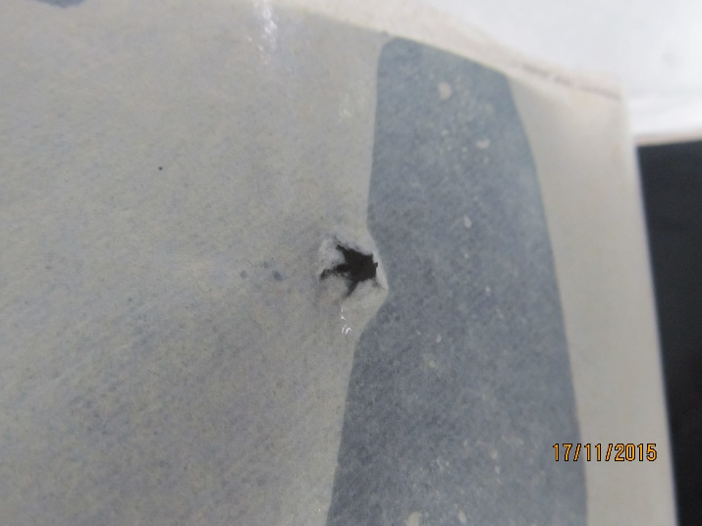
Dreamweaver Gold
Maximum cell temperature 41 C
No shrinkage
No cracking or splitting
Physical damage from nail penetration
No charring
No visible exposed electrode
Notes:
And for the Dreamweaver Gold, the other 3rd generation separator, there is only mechanical damage, with no shrinkage of any kind. And this makes sense, as the cell only went to 40 C, and it continued to work even with the nail sticking through it.

Slide 22
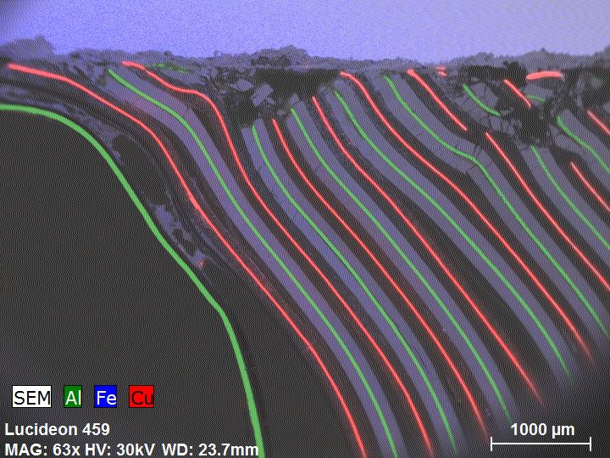
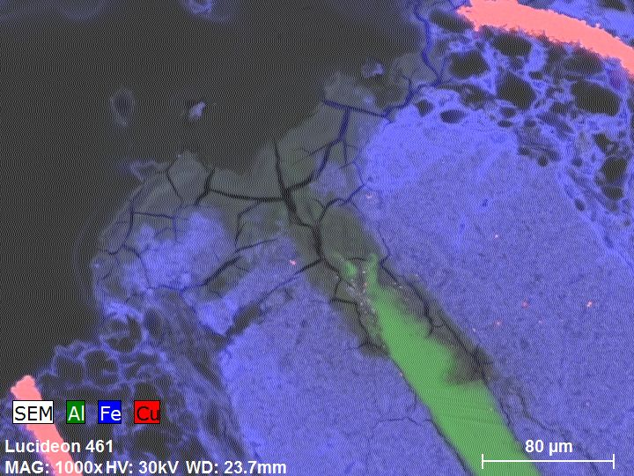
Aluminum Oxide
Nail (blue Fe)
BEI of the nail and battery with EDS maps of aluminum (Al), iron (Fe), and copper (Cu) superimposed. Many of the copper layers appear to touch the oxides on the nail, while many of the aluminum layers do not.
A close up of an aluminum layer shows significant buildup of aluminum oxide (grey cracked matter), an insulator.
The aluminum has oxidized and retreated from the nail under heat, breaking the circuit. If this were an electronics class, we would call it a fuse.
Notes:
Notes are on the slide.

Slide 23
SEMs of Metal Layer Edges
Edge of copper is clean cut with some smearing
Edge of aluminum is covered with corrosion products
No clean aluminum edge is present
SEMs of metal layer edges show two distinctly different features:
Copper is cleanly cut with smearing.
Aluminum if covered with corrosion products, giving no clean aluminum edge.
When nail penetrates, current runs from copper to aluminum, heating areas with most resistance.
Surface resistance dominates.
This continues until circuit is broken, and is very fast and local.
Weak link is aluminum (mp 600 C) compared to copper (mp ~1000C) and iron (mp 1400 C)
Aluminum corrodes and retreats
Aluminum
Cathode
DWI Separator
Anode
Copper
Notes:
The pictures to the right show and SEM of the edge of a copper current collector layer, with clean edges and some smearing, but little or no oxidation. The bottom image is the edge of an aluminum layer, showing no clean edge, but significant oxidation product on the layer. The cartoon to the bottom left represents what happens with a 3rd generation separator: the aluminum layer retreats, with some oxidation product building up between the aluminum and the nail. The aluminum and copper are no longer shorted, allowing the cell to go to its normal voltage.

Slide 24
3rd Generation Separator: the New Safety Paradigm
1st and 2nd Generation Separators
Separator retreats from heat generated by nail
Large openings surround the nail, creating permanent shorts.
3rd Generation Separator
Separator does not retreat from nail.
Aluminum oxidizes, breaking the short
Once the short created by the nail is broken by the buildup of AlO, the cell continues to work.
Aluminum
Cathode
Polyolefin
Separator
Anode
Copper
Aluminum
Aluminum
Cathode
DWI Separator
Anode
Copper
Aluminum shutdown breaks circuit before
separator failure, acting as an internal fuse
Notes:
The notes above and cartoon seem to be enough…

Slide 25
Other Third Generation Separator Suppliers
Dreamweaver
Freudenberg
Electrovaya
Optodot
Mitsubishi Paper

Slide 26
THANK YOU!
Brian Morin
(864) 908-4763
Brian.Morin@Dreamweaverintl.com

