Slide 1
The aircraft hazards of flammable gasses produced by lithium batteries in thermal runaway
Triennial
FAA Fire Safety
10/2016

Slide 2
Background
Many tests have been conducted to evaluate the hazards of lithium-ion cells aboard aircraft.
Packaging
Handheld Extinguishment
Differences in Chemistries
Differences in Size
Vent Gasses

Slide 3
Introduction
Ongoing tests have been conducted to study the gasses vented by lithium cells and their effect on an aircraft.
Effect of vent gas combustion (with and without halon 1301)
Vent gas composition/volume
Minimum quantity of cells capable of producing enough gas to compromise aircraft safety.
Hazard of gasses from lithium-metal button cells.

Slide 4
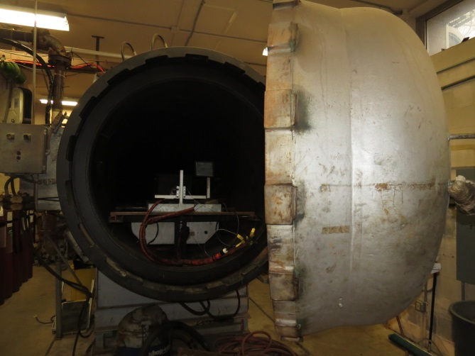
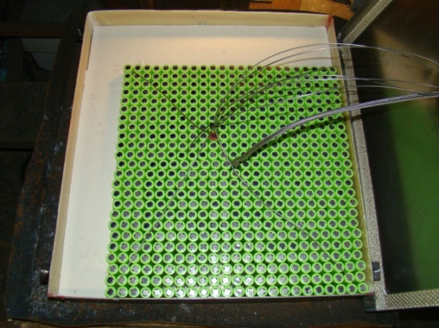
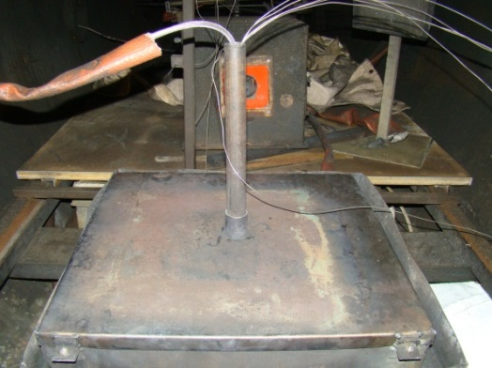
Halon Tests
Tests were performed in a 10.8m³ chamber to evaluate the effectiveness of Halon 1301 with vent gasses.
Runaway was initiated => Halon was introduced => Spark was activated => Pressure was recorded

Slide 5
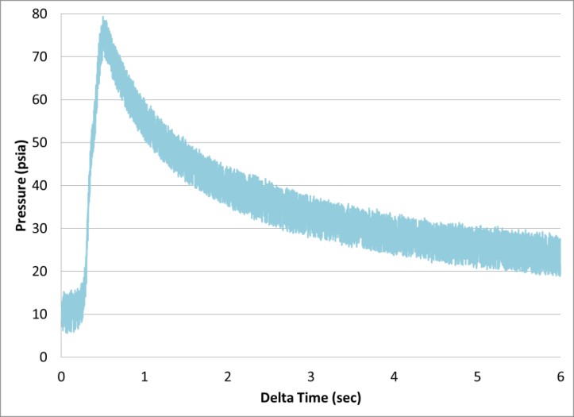
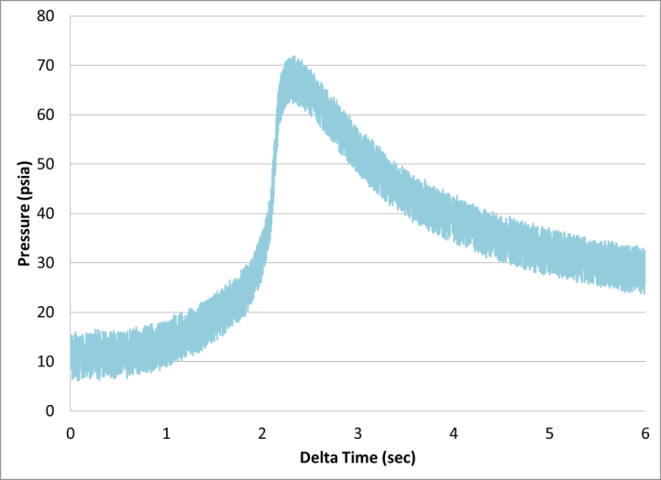
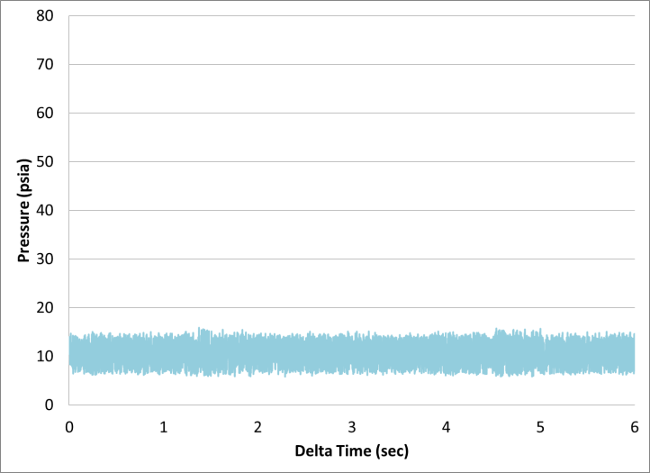
Halon Results
Test without suppression
Test with 5.28% Halon
Test with 10.43% Halon

Slide 6
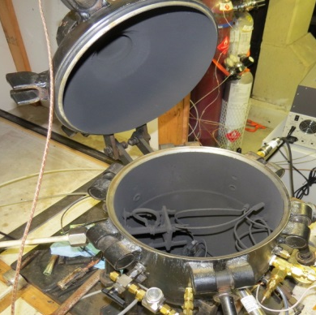
Gas Analysis from Cells
Tests were performed in a 21.7L combustion sphere to determine vent gas composition and quantity.
Composition measured with GC, NDIR, Paramagnetic
Volume measured with pressure calculations
Pressure Transducer (1Hz, 0-15psia)
Spark Igniter
Clamp-style cell holder (for cell and cartridge heater)
Gas collection port for sample bag.
Pressure Transducer (500Hz, 0-100psia)

Slide 7
Gas Analysis Results
Tests conducted at cabin pressure at altitude (10psia)

Slide 8
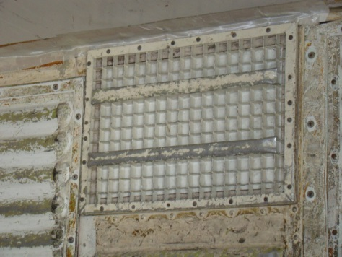
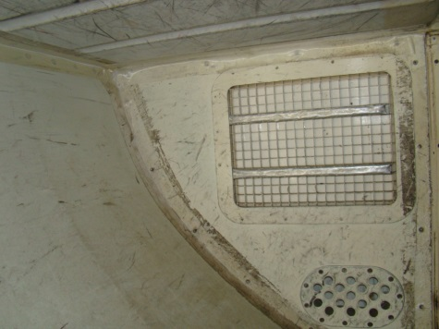
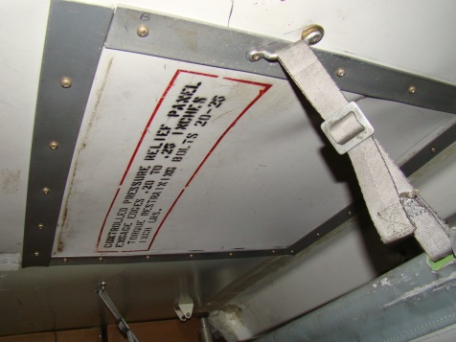
Cargo Compartment Tests
Cargo compartments are created with pressure relief panels that are designed to activate in the case of rapid pressure change.
A fire event without the panels in place would have reduced suppression due to halon 1301 leakage.
Fwd. Panel
Aft Panel
Ceiling Panel

Slide 9
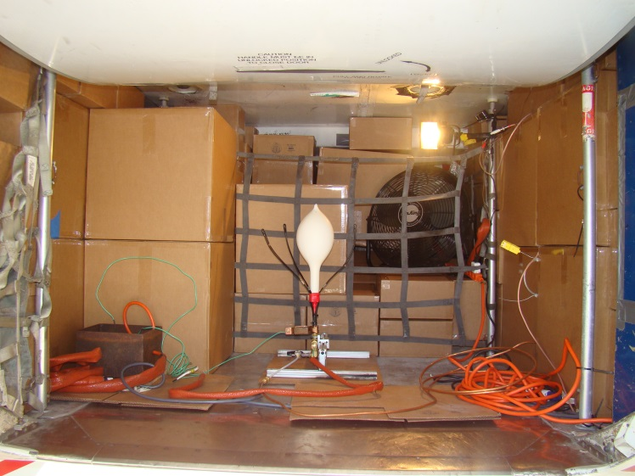
Pressure Chamber Cargo Compartment Tests
Tests were conducted with small pockets of gas (in a balloon) to determine how many 18650 sized cells would compromise fire suppression in a cargo compartment.
1st series of tests: Pressure Chamber
(represents 70% loaded 737 aft cc)
2nd series of tests: 737 fwd. Cargo Compartment
(70% loaded)

Slide 10
Bottled Gas
Rather than collect Li-Ion vent gasses for subsequent tests, a bottle of mixed gas was purchased that matched the composition from previous analysis.
30.1% CO₂
27.6% H₂
22.9% CO
6.37% CH₄
4.48% C₃H₆
2.21% C₂H₄
1.57% C₄H₁₀
1.17% C₂H₆
.56% C₄H₈
.268% C₃H₈

Slide 11
Bottled Gas
We then verified that pressure rise from bottled gas was identical to pressure rise from actual gas.
Max pressure from actual gas at altitude: 70.1 psia
Max pressure from bottled gas at altitude: 71.4 psia

Slide 12
Pressure Chamber Test – Sample Video

Slide 13
Results (Pressure Chamber)
Tests at Sea Level:
Tests at Altitude:

Slide 14
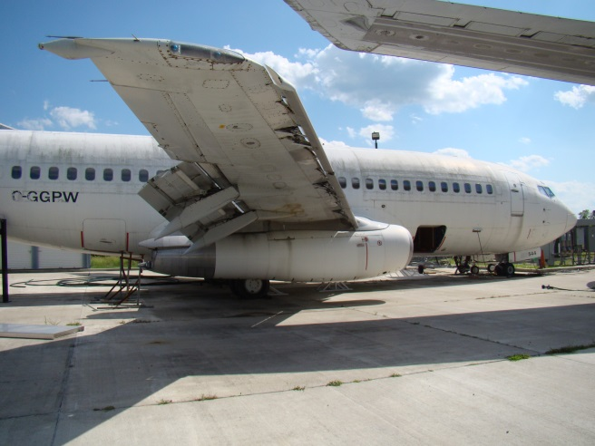
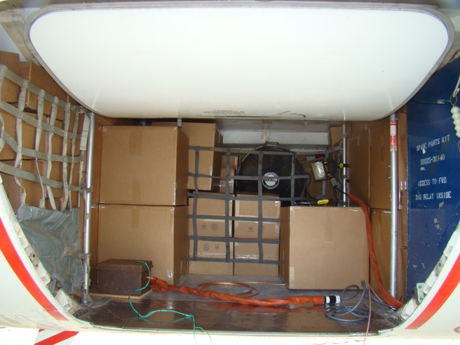
Verification in 737 Cargo Compartment
Pressure chamber tests were repeated in fwd. cargo compartment of 737 with 70% loading.
Total volume of compartment (documented): 370ft³
Volume of boxes based on 70% loading: 259ft³

Slide 15
737 Cargo Compartment Results
5 cells at 50% SOC
1.61 cells at 100% SOC
.252 psi peak pressure

Slide 16
737 Cargo Compartment Results
20 cells at 50% SOC
6.44 cells at 100% SOC
1.22 psi peak pressure
Additional panel behind door (not shown) and panel on sidewall (not shown) were also compromised.

Slide 17
737 Cargo Compartment Results
8 cells at 50% SOC
2.6 cells at 100% SOC
.594 psi peak pressure

Slide 18
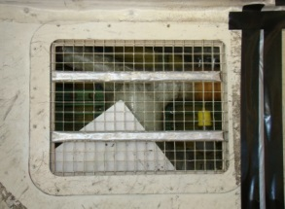
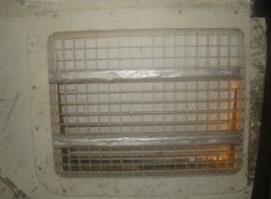
737 Cargo Compartment Results

Slide 19
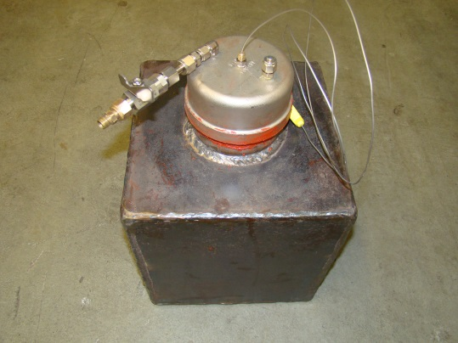
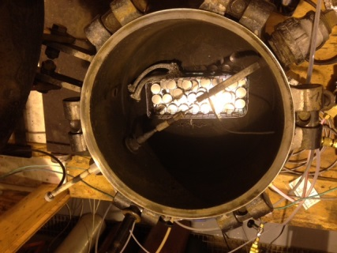
Li-Metal Button Cell Tests
5 tests were conducted to evaluate the vent gasses of button cells in thermal runway.
Oven Tests (gas analysis)
2032 button cells strapped together
2032 button cells not strapped together
2477 button cells not strapped together
Heat Plate Tests (combustion)
2477 button cells on hotplate
2477 button cells on hotplate with
enclosure (similar to oven)
Note: 2032: .225mah, 2477: 1000mah

Slide 20
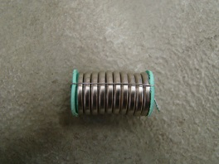
Results - oven tests
Tests were first conducted in a pressure chamber that was entirely placed in an oven.
CR2032 strapped together
THC: 19.83% H₂: 18.53% CO: 2.66% CO₂: 50.88% Volume: .077 liters/cell
CR2032 not strapped together
THC: 13.84% H₂: 1.99% CO: 4.27% CO₂: 79.16% Volume: .108 liters/cell
CR2477 not strapped
THC: 6.18% H₂: 7.67% CO: 2.41% CO₂: 85.04% Volume: .526 liters/cell

Slide 21
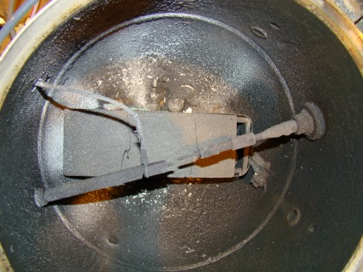
Results - heat plate tests
Combustion tests were then conducted in a pressure chamber with a heat plate to initiate runaway.
26 CR2477 Without enclosure around hotplate
.115 liters/cell
10.2% battery gas → no combustion
45 CR2477 With enclosure around hotplate
.916 liters/cell
25% battery gas → combustion maximized the
pressure transducer at 41psia.

Slide 22
Additional Test
2477 button cell test conducted at .16 psia on hotplate yielded .03 liters/cell
→ Cell popped open much sooner because of lower ambient pressure preventing significant reaction.
Fresh Cell
Cathode
Lithium Anode

Slide 23
Summary
If gasses from 8 18650 cells at 50% SOC
or
If gasses from 3 18650 cells at 100% SOC
accumulate in a loaded 737 fwd. cargo compartment and ignite, the halon suppression system would be compromised.
Volume and composition of button cell vent gasses vary depending on environment.
Oven test (heated surroundings) showed that cells can produce up to 900% more gas volume.
Cells that were strapped together produced more flammable gas
Cells that were heated with higher pressure produced a greater volume of gas.

