Slide 1

Lithium Battery Hazards
Detection, Mitigation, and Safety
Presented by: Dr. Daphne Fuentevilla
daphne.fuentevilla@navy.mil
NSWC Carderock Division, Code 636
8th Triennial International Fire & Cabin Safety Research Conference
DISTRIBUTION STATEMENT A. Approved for public release: distribution unlimited.

Slide 2
Background & Outline
The information in this presentation is unclassified and approved for public release.
The purpose of this presentation is to provide general information covering:
  Basic introduction to Navy’s history with lithium battery technology in military and aerospace applications
  Overview of the Navy’s Lithium Battery Safety Program and recent updates
    Navy lithium battery hazard analysis
    Platform oriented safety assessment and hazard management
  Emerging early failure detection technologies
Some of the images shown in this presentation are the result of extreme, aggressive and deliberate cell and battery abuses
Notes:
Lot of discussion within the aviation community about how to deal with the use and transport of lithium batteries and in this talk I intend to share insights into the parallel ongoing discussions within the navy – how we regulate safety, how we assess safety, and mitigation technologies including some information on emerging early failure detection technologies.

Slide 3


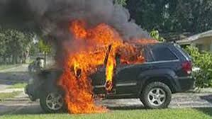
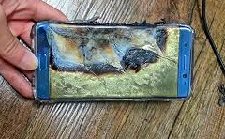
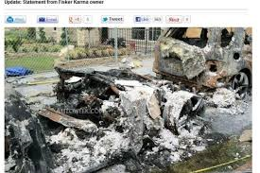

Lithium batteries in the news…

Slide 4
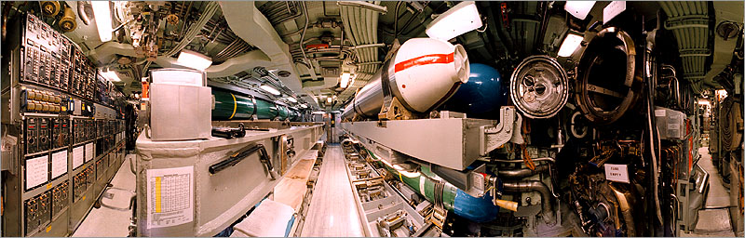


Navy Safety Addresses Special Platform Issues
Submarine
Helicopter
Aircraft
Notes:
Subsafe = whole other level of risk intolerance
Carried on, stored in, deployed from, power – COLOCATED WITH ORDNANCE, SMALL SPACES, HYBARIC (acute exposure guideline limit) AEGL issues – MISSION CRITICAL ITEMS
Xxxx
that means we work to MINIMIZE HAZARDS to ACCEPTABLE levels – or must elevate the acceptance of RISK to personnel, platform, mission to HIGHER AUITHORITIES (pay grade, responsibilities)

Slide 5
Historical Perspective
1970 1975 1980 1985 1990 1995 2000 2005 2010 2015 2020
Lithium Primary Batteries in Navy
Lithium-Ion Secondary Batteries in Navy
Lithium Batteries first marketed in early 1970, primarily for military applications
Navy Lithium Battery
Defining Accidents
Flight Deck Events (‘74)
Bermuda incident
Sonobuoy Failures
DoD Hawaii Battery /Platform Fire
Underwater Vehicle
Lithium-Ion Test
NSWC Facility Fire
2.5kWhr Battery
Site / Facility Fires
Apple Recall
Boeing 787
battery fires
MinuteMan
SOCl₂ Event
Galaxy 7 recalls
SONY
Recall
Chevy Volt
Battery Fire
Tesla Car
battery fires
(‘78)
Seven personal injuries reported 1976-1983, incl. one death
(’94-98)
manufacturer ½-string fire
In-service platform
destroyed
Significant facility and
equipment damage
Navy Lithium Battery Safety Program
NAVSEA Notes
Navy Li-Ion
Safety Initiative
Navy High Energy
Chemical Storage Tiger Team
.1C for
signature
Instructions
Tech. Manuals
R3 planned
High Energy Tech. Man.
R2 planned
Notes:
A SERIOUS LITHIUM BATTERY EVENT – THE BERMUDA INCIDENT – THAT CAUSED A SPECIAL DEVICE TO EJECT A PRESSURE BOTTLE END-PLATE – CAUSED PERMANENT INJURY (NON-FATAL) LOSS OF LEG ****INITIATED**** THE NAVY LITHIUM BATTERY SAFETY PROGRAM AFTER A SERIES OF PRECURSOR TAIL-WING TRANSPONDER FIRES ON CARRIER LANDING – CONSIDERED NUISANCES – UNTIL THE NEAR FATAL **BERMUDA** EVENT 1979 STARTED THE NAVY LITHIUM BATTERY SAFETY PROGRAM

Slide 6
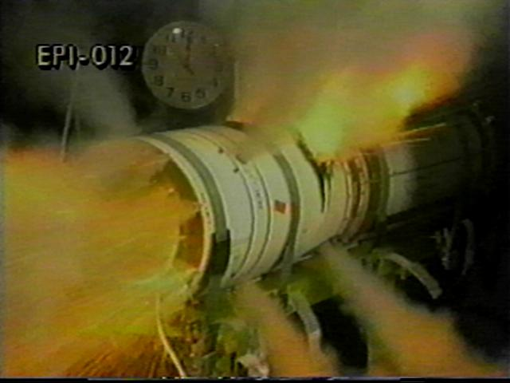
Sometimes Things Go Wrong
Short-Circuit and Severe Failure of Li-Thermal Battery With Secondary Ignition of Coolant In Missile Flight Hardware
Notes:
Deliberate abuse, sometimes with safeties removed
Carried underwing or in weapons bay

Slide 7
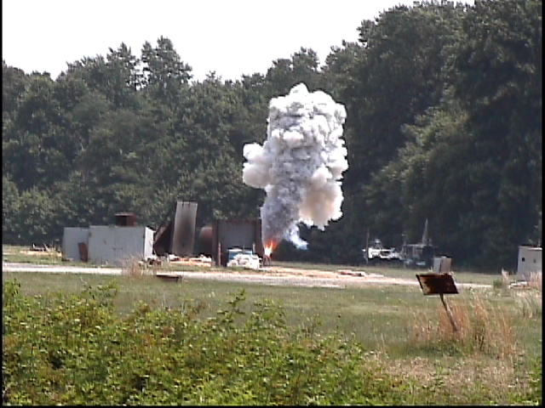
Sometimes Things Go Wrong
Severe Thermal Abuse
Large Li/SOCl₂ Battery
Notes:
Cascading to Adjacent Units
These were 1200 AH stacked plate cells from HEDB Corp (now defunct) using a special technology – intended to be a 24-cell assembly in a UUV for submarine carriage – this is one of several hazards assessment tests conducted by NSWC Carderock in mid -90s

Slide 8
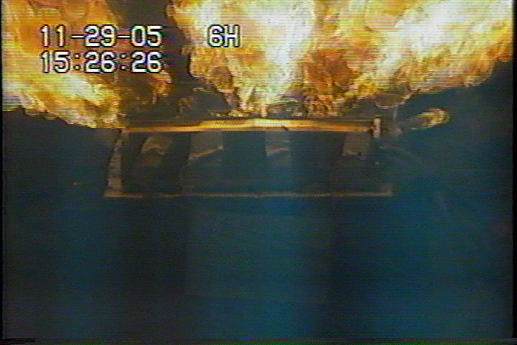
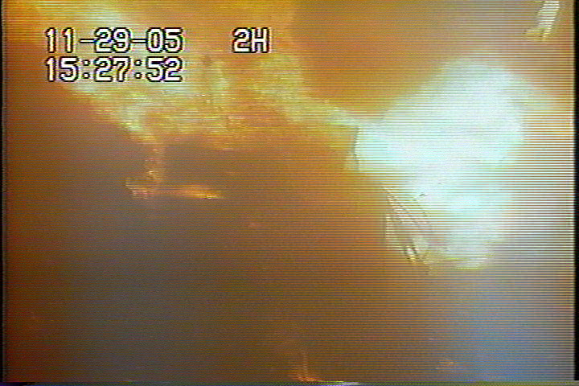
Li-Ion Battery Electronic Safety Device Verification Study
Over-charge protection circuit failure
Notes:
MESSAGE - THE IMPORTANCE OF BMS CIRCUITRY DESIGN and ELECTROSTAIC PROTECTION CANNOT BE OVER EMPHASIZED – ESD damage to MOSFET effectors for CHARGE PREVTION/DISCONNECT or Voltage comparator OUTPUT legs – can be critical to safety – HERE 30% of a 1st run product FAILED electrical safety device check – MAJOR PROGRAM STUMBLING BLOCK and DELAY

Slide 9
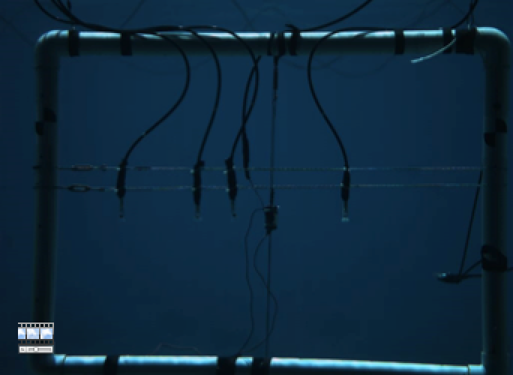
The Mighty Bubble

Slide 10
Documentation for the Navy’s Lithium Battery Safety Program
Instruction -- Defines the Process
  NAVSEAINST 9310.1c of 12 Aug 2015
Technical Manual -- Guidelines for Design, Review and Procedures for Testing
  Technical Manual for Batteries, Navy Lithium Safety Program and Procedures, Rev 2 S9310-AQ-SAF-010 of 15 July 2010
Technical Manual -- Guidelines for High Energy Storage Systems
  HESS SG270 Tech. Manual of 27 April 2011

Slide 11
Documentation for the Navy’s Lithium Battery Safety Program
Instruction -- Defines the Process
  NAVSEAINST 9310 Initial Release in 1979
  NAVSEAINST 9310.1a of 11 March 1982
  NAVSEANOTE 9310 of 11 June 1985
  NAVSEAINST 9310.1b of 13 June 1991
  NAVSEAINST 9310.1c of 12 Aug 2015
Technical Manual -- Guidelines for Design, Review and Procedures for Testing
  Technical Manual for Batteries, Navy Lithium Safety Program and Procedures, Rev 2 S9310-AQ-SAF-010 of 15 July 2010
  Update to harmonize TM process to new INST in preparation, with release planned for early FY17
Technical Manual -- Guidelines for High Energy Storage Systems
  HESS SG270 Tech. Manual of 27 April 2011
  “Maximum reasonable assurance that [systems are designed for minimum risk and that] failures of these systems can be safely mitigated to avoid endangering Navy platforms or Navy personnel”
Notes:
Systems are design for minimum risk
that means we work to MINIMIZE HAZARDS to ACCEPTABLE levels – or must elevate the acceptance of RISK to personnel, platform, mission to HIGHER AUITHORITIES (pay grade, unenviable responsibilities)

Slide 12
Navy Safety Program Characteristics
Evaluate, Communicate, Accept Hazards
System Specific
    cell, battery, system design, use scenario, and platform
Object Quality Evidence
    Safety data package → tech. evaluation/recommendation → safety certification
Cell and Battery Casualty Characterization
  Most likely failure scenario AND worst credible event
    thermal abuse, overcharge, overdischarge, short circuit (hard short, crush, drop, bullet penetration), cell-to-cell propagation, electrical safety device validation
Platform Characterization and Mitigation
  Do platform features mitigates risks associated with batteries
    Heat release rate, volatile off-gas ignition, implosion, shock, vibration, etc.
  Hazard Analysis, Failure Modes and Effects Analysis, Manufacturing Audit, Hazard Log
Notes:
No “pre-approved” list of batteries
SDP is the OQE for the unit being certified
(fire fighting, special stowage, charging capabilities)
OQE is a statement of fact, either quantitative or qualitative, pertaining to the quality of a product or service based on observations, measurements, or tests that can be verified.
Test to failure – sometimes with safeties removed. Need to know what your risk is in order to do anything about it.

Slide 13
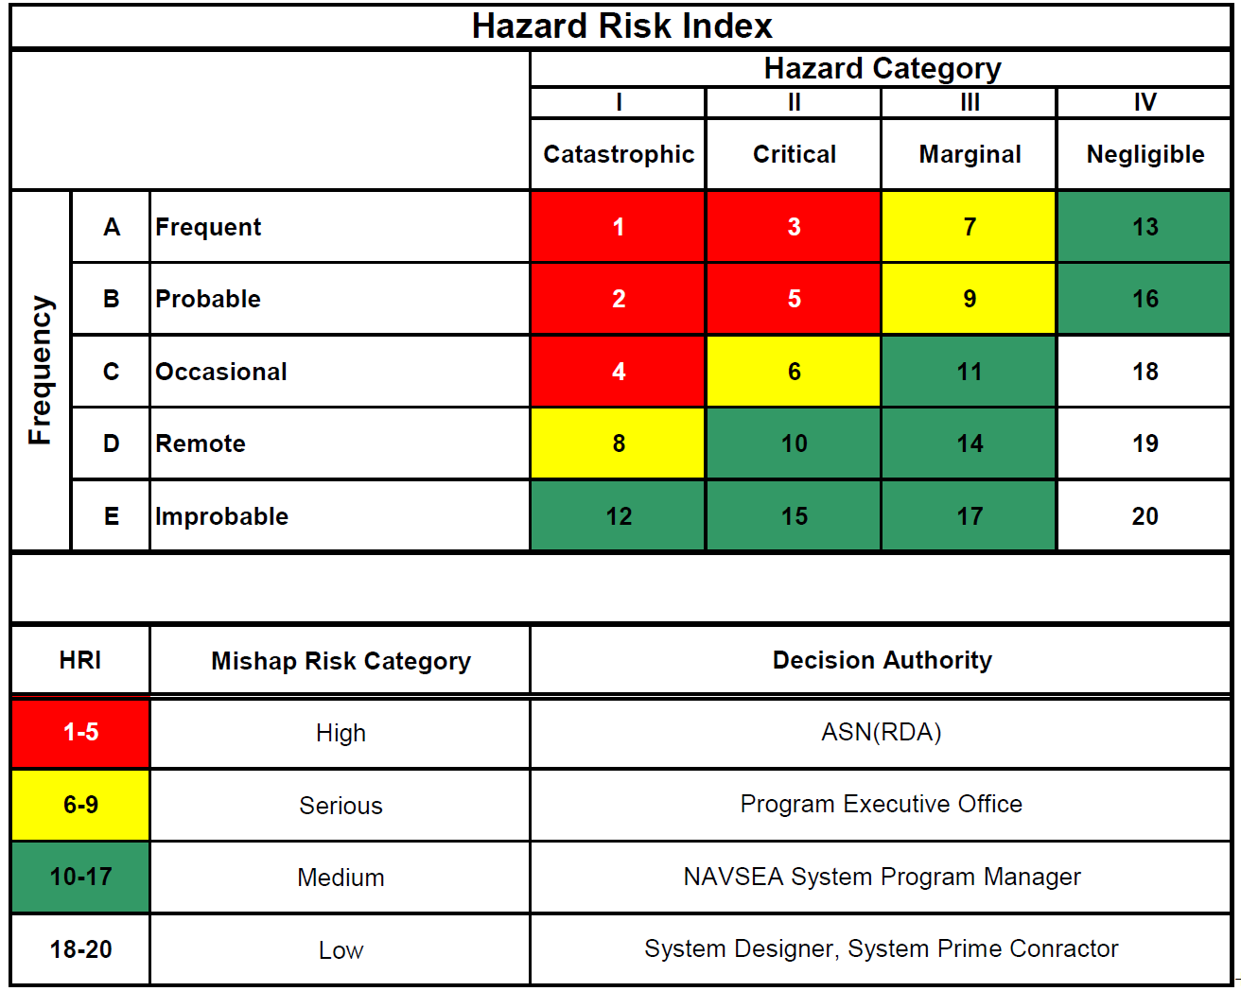
Hazards: Evaluate, Communicate, Accept
Notes:
SDP is the OQE for the unit being certified
Probability is not well established, so severity is critical and how close to threshold is critical

Slide 14
Navy Safety Program Updates
Continual evaluation of blanket approval thresholds and categories
  Commercial-off-the-shelf size/chemistry restrictions
  Small battery exceptions
Evolving thresholds for additional platform-specific testing
  1 kWH level discriminator too limiting – shifting to personnel hazard chemical, electrical, thermal based
Incorporate all high energy technologies
  SG270 – e.g. AIP/non-AIP Fuel Cell Systems, non-lithium high-energy storage systems
  S9310 – e.g Li/Sulfur

Slide 15




Response comparison for various “6T” truck batteries
All batteries in 6T form factor, 100% SOC
Battery Type | Mass (kg) | Chemistry | High Temperature Abuse
 |  |  | Vent? Fire? | Propagation*?
#1 | 26 | LFP |  | 100% prop. over 120+ min
#2 | 22 | LFP |  | 100% prop. over 30-60 min
#3 | 20 | LFP |  | Fire + 100% prop. in 1 test. No fire + partial prop. in 2 tests.
#4 | 19 | NCA |  | 100% prop. over 4-5 min
*Slow is good. Propagation times are inexact as can be difficult to say when complete. Treat as semi-quantitative metric.
Notes:
LFP batteries have different cell sizes and different chemical additives
NATO standardized form factor, Standardized From Factors Used in 95% of military vehicles

Slide 16
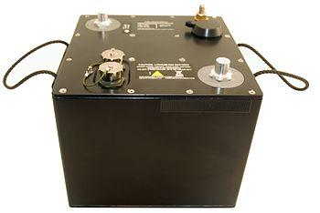
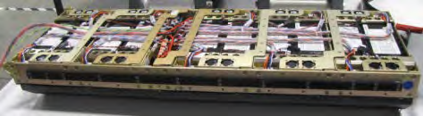
Response comparison for different size batteries
UUV battery
6T battery
Battery Type | Mass (kg) | Chemistry | Energy (kWh) | High Temperature Abuse
 |  |  |  | Vent? Fire? | Propagation*?
UUV (50% SOC) | 39 | LCO | 5.6 |  | ~90 min for 100% prop. Slow moving fire.
6T (100% SOC) | 26 | LFP | 1.4 |  | ~120+ min for 100% prop.
6T (100% SOC) | 19 | NCA | 2.6 |  | ~5 min for 100% prop. Violent fire.
*Slow is good. Propagation times are inexact as can be difficult to say when complete. Treat as semi-quantitative metric.

Slide 17
Additional guidelines
Navy Safety Program documentation also includes recommendations for:
  Designing safe lithium batteries
  Storage and transportation packaging and conditions
  Disposal guidelines
  Emergency response procedures

Slide 18
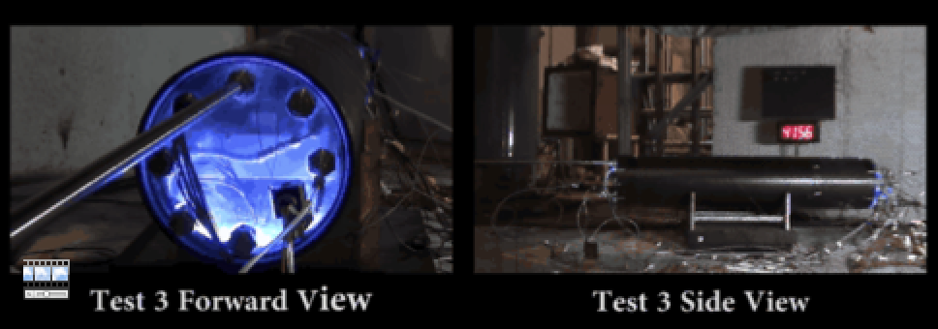
Navy Mitigation Testing

Slide 19
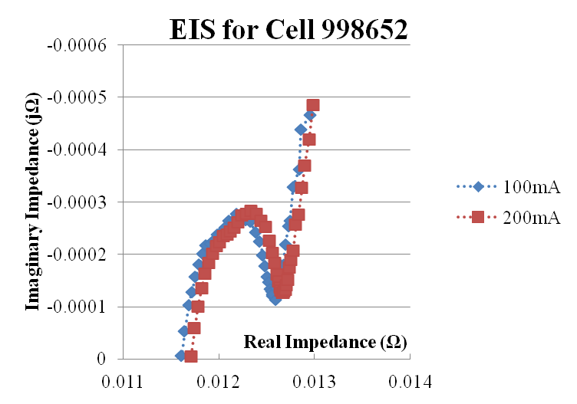
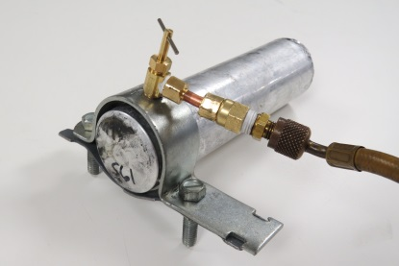
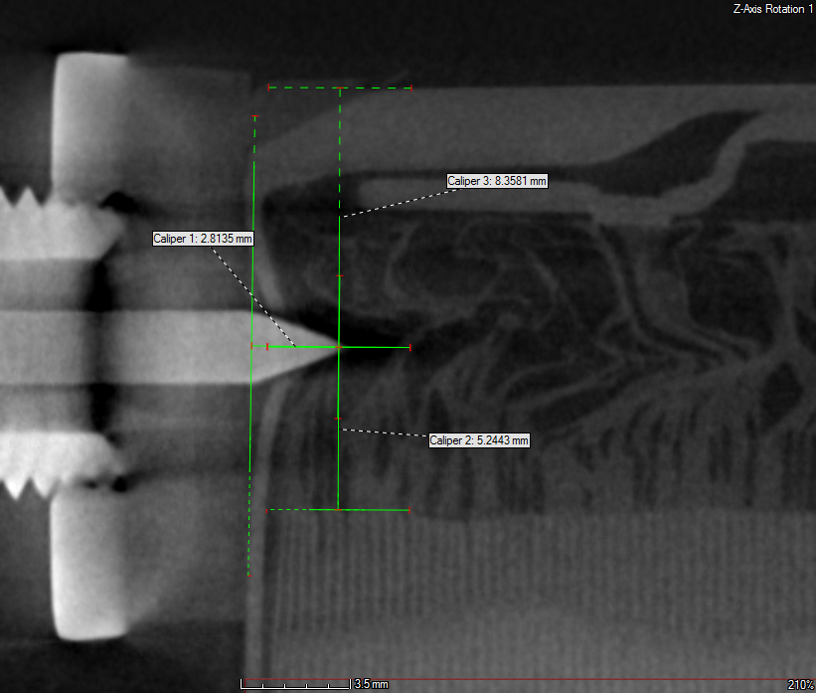
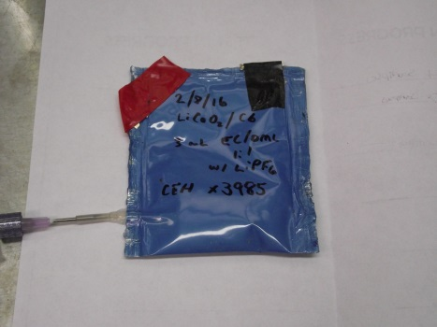
Hazard Mitigation: Early Detection Technologies
Lithium batteries presents challenges for containment of failure events.
Technologies that detect failure events earlier can inform choice of mitigation options and activate mitigation earlier to improve effectiveness.
Objectives:
Assess effectiveness of emerging technologies for early detection of lithium battery failure
Notes:
NTSB req A-12-68 on early failure detection.
The energy density of bulk packages of lithium batteries presents challenges for containment of failure events. Detection technologies that detect failure events earlier can inform choice of mitigation technologies and activate mitigation earlier to improve effectiveness.

Slide 20
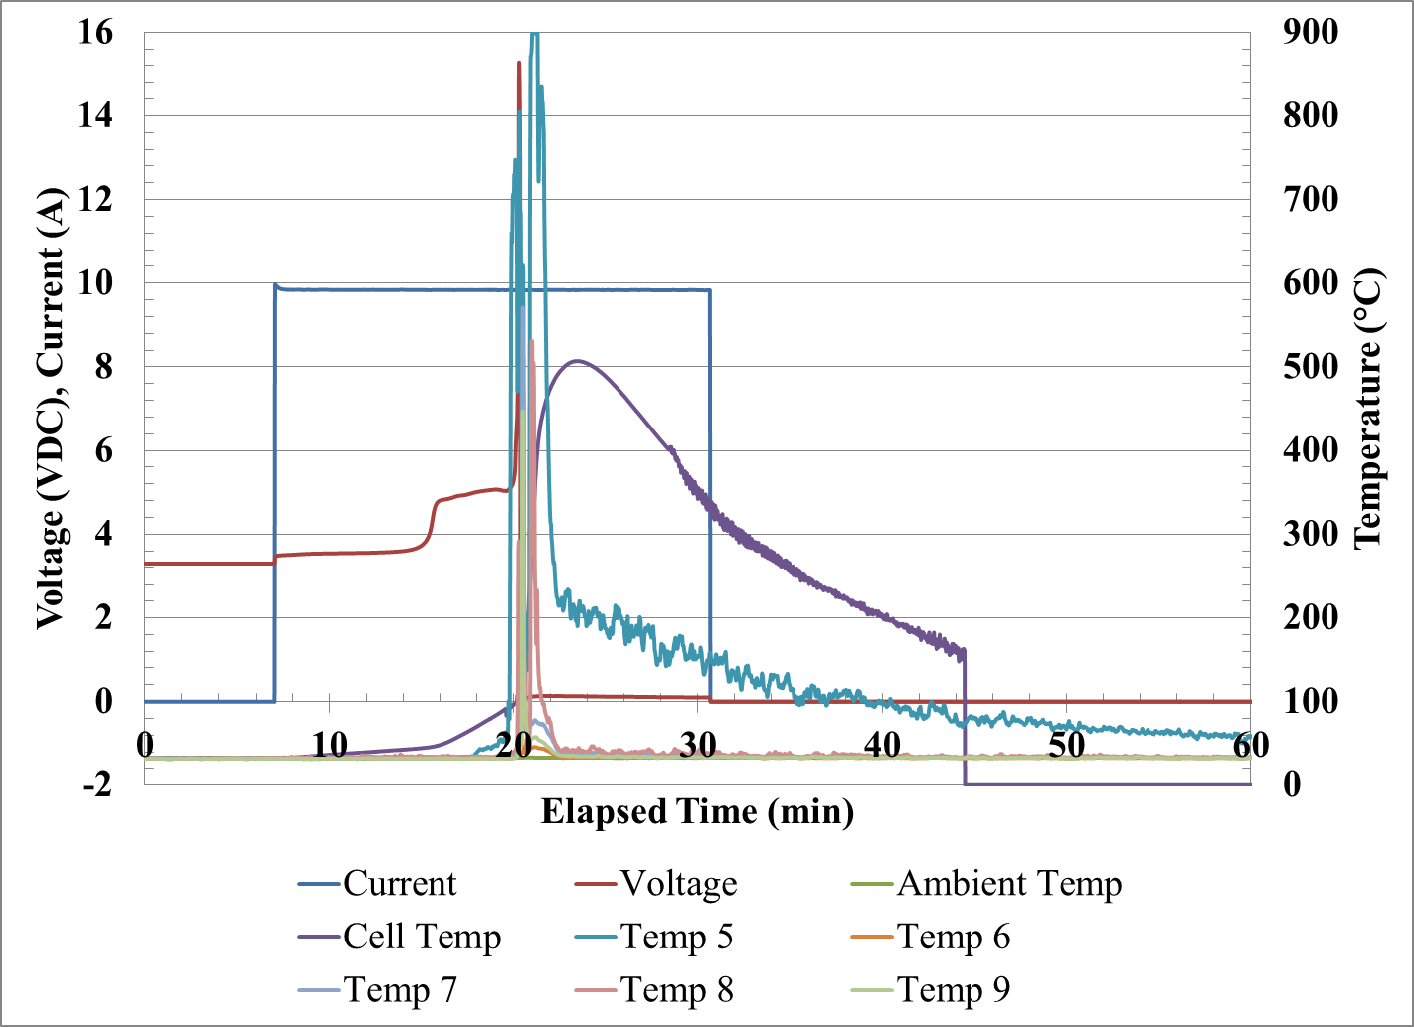
Traditional Detection
Battery Management Systems (BMS)
  Temperature, Voltage, Current data
  Well-established, manufacturer provided limits
  Not always sufficient for preventing event, or propagation
Example: 26650 li-ion overcharge
Value | Time to Fire
Voltage >4.1 | 4 min
Cell temp >60ºC | 2.5 min
Cell temp >85ºC | 0.5 min
Local temp >40ºC | 1.5 min
Box temp >+3ºC | never
Notes:
Or providing sufficient time for mitigation technologies (water, etc)
Smoke detection, VOC detection, pressure sensing, moisture detectors

Slide 21
A Priori Detection Options
Gas emissions
(VOCs, electrolyte vapor)
Strain-Pressure
Particulate emission
Thermal, acoustic, optical properties
Voltage, temperature, current
Electrical, magnetic fields
Moisture
Resistance and Impedance
Other?
Notes:
SOME OF THESE ARE – pre-event possible, some can be intrusive, spome need special sensors or manufacturing
All of these signatures are being leveraged in commercial or prototype early failure detection systems

Slide 22
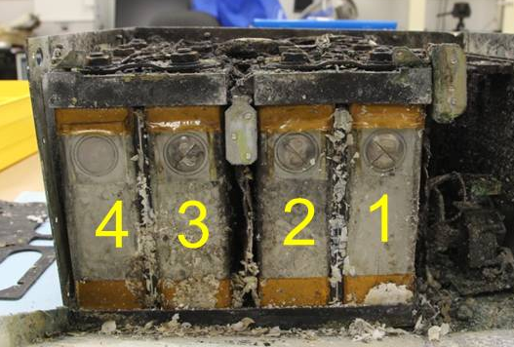
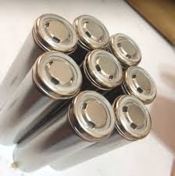
Remote Detection Technologies
Chemical Sniffing
  Miniaturized VOC, electrolyte detection; spectroscopy
  Prototypes currently under development by industry
  Limited Navy testing to-date
    chemical/environment compatibility under evaluation
  May operate remotely, sans interface with battery
  May be integrated to supplement traditional battery BMS
  Location exterior to battery pack correlates to detection after cell failure, electrolyte leakage
Notes:
Venting from cell failure, increased leakage from some cells pre-failure
Glass-to-metal or glass-to-ceramic seal should be hermetic (all oxyhalide and so2 cells – strongly oxidizing depolarizers where high vapor pressure toxic and highly corrosive). Polymeric compression seals, crimped seals, may allow electrolyte leakage paths (wettability of organic electrolytes not controlled with hydrophobic coatings like alkaline batteries with aqueous electrolytes, so capillary forces and wettability harder to control). Corrosion cracks, improper welds, abusive treatments allowing partial venting.

Slide 23
Physics Based Remote Detection Technologies
Remote sensing of internal shorts
  Electrical, magnetic, acoustic changes
  Prototypes currently under development by industry
  Proposed Navy testing FY17
  May operate remotely, sans interface with battery
  May be integrated to supplement traditional battery BMS
  Detection dependent on location, proximity to system
voltage
Shorting → Acoustic noise
Current → Electric field
Characteristics may be modeled on first-principals and “a priori” basis and compared/evaluated for sensitivity
Separator
Electric field → Magnetic field
Anode
Cathode
Notes:
NEED MORE.
adds in red and diagonal bar words
There are electroactive polymers that can be used and tailored to a cell chemistry as a separator that can EITHER shunt an OVERCHARGE into a discharge limiting the overpotential achieved on the cathode - - OR provide a low level magentic field to be detected....if structured correctly in assembly and processingh……(that last is an axpansion of th ecurrent tech that I thought about but jas not been demsontarted but is a natural outcome of the self-discharge if pathway oreinted)
electroactive polymers

Slide 24
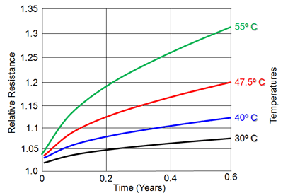
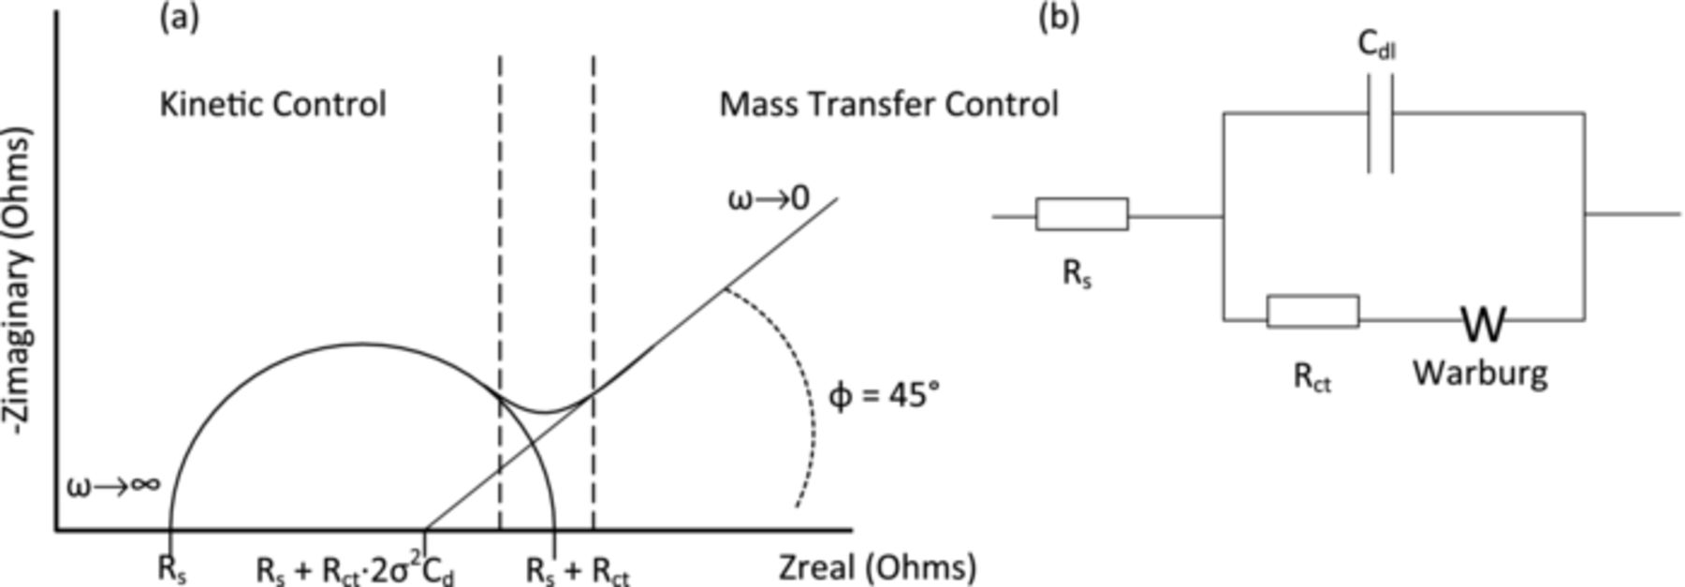
Battery Integrated Detection Technologies
Resistance and Impedance Monitoring
DC and AC response, battery and cell
  In-situ Electrochemical Impedance Spectroscopy (EIS) – internal resistance
Prototypes under development by government and industry
Demonstrated early detection of overcharge and short
Requires electrical interface with battery/cells, initial characterization of cell/battery to establish acceptable ranges, some prototypes require steady-state (sec to hrs) to take measurement
Notes:
Internet pictures
EIS, EIS to get internal temperature

Slide 25
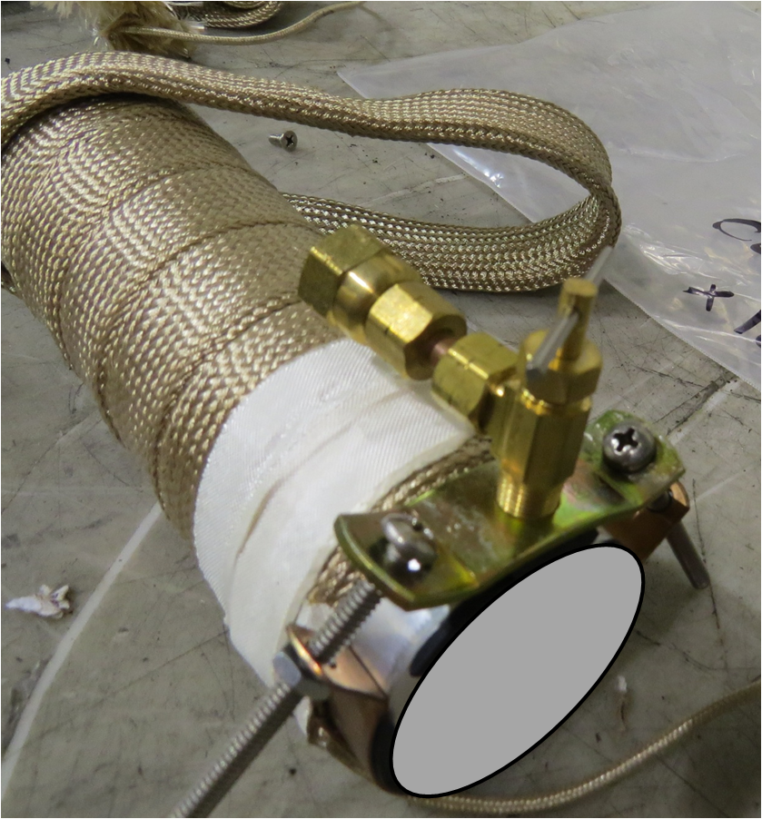

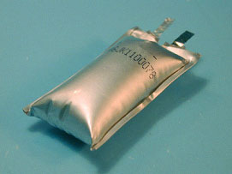
Battery Integrated Detection Technologies
Strain – Pressure – Gas generation, volume change
Recent proposed separator sensor to detect Anode-Seperator or Cathode-Seperator dendrite formation and current flow
Strain gauge or fiber-optic sensor to sense gas generated or temperature
Government and industry prototype development
Demonstrated in-situ correlation between strain gauge, gas generation, and health;
Requires integration interior to cell; exterior to cell or battery
Notes:
or voltage signature internal/external
Middle internet picture

Slide 26
Technologies Planned For Evaluation by NSWC Carderock
INL/Sandia EIS – preliminary discussion
NRL prototype – agreement to test
JHU APL prototype – preliminary testing
TIAX – under test
Nexceris – tested for Navy program under separate effort
Carderock modeling – ongoing
Parthian – agreement to test
Redondo Optics, PARC, others of interest

Slide 27
Points of Contact and Collaborators
NSWC Carderock Research Team
  POC: Dr. Daphne Fuentevilla, daphne.fuentevilla@navy.mil,
  301-227-1641
  Mr. Paul Jawlik, Dr. Azzam Mansour, Dr. Jonathan Ko, Mr. Christopher Hendricks, Dr. Gordon Waller, Mr. Clinton Winchester, Ms. Julie Simmons, Mr. Joshua Garvin, Dr. Jack Price, Mr. Kane Ivory (Australian DSTG), Mr. Mike Wartelsky
Collaborators and Sponsors
  DoT PHMSA
  Naval Research Laboratory (Dr. Corey Love)
  Expeditionary Energy Office, USMC
  NSWC Indian Head
  Industry collaborators

Slide 28
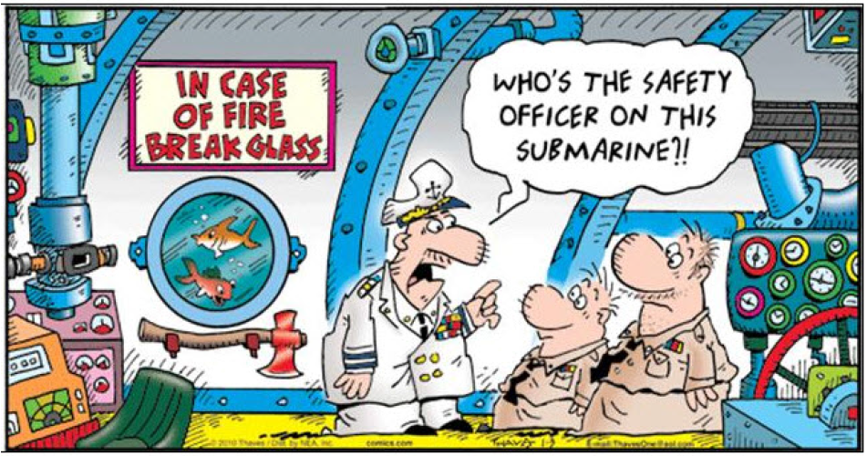
Early Concept Torpedo Room Lithium Battery
Powered UUV Water Casualty Suppression System
QUESTIONS?

Slide 29
Documentation for the Navy’s Lithium Battery Safety Program
Instruction -- Defines the Process
  NAVSEAINST 9310 Initial Release in 1979
  NAVSEAINST 9310.1a of 11 March 1982
  NAVSEANOTE 9310 of 11 June 1985
  NAVSEAINST 9310.1b of 13 June 1991
  NAVSEAINST 9310.1c of 12 Aug 2015
Technical Manual -- Guidelines for Design, Review and Procedures for Testing
  Technical Manual for Batteries, Navy Lithium Safety Program and Procedures, Rev 2 S9310-AQ-SAF-010 of 15 July 2010
  Update to harmonize TM process to new INST in preparation, with release planned for early FY17
Technical Manual -- Guidelines for High Energy Storage Systems
  HESS SG270 Tech. Manual of 27 April 2011

Slide 30
Navy’s Lithium Battery Safety Program
Program Authority of Naval Lithium Battery Safety Program is NAVSEA 05Z34 under NAVSEAINST 9310
  Covers all Navy and USMC use, storage, carriage of lithium batteries
Program Office owning the battery powered system requests a Lithium Battery Safety Certification
Technical Agents conduct the technical review
  NSWC Carderock and NSWC Crane
Technical Authorities for system/platform concurrence to lithium battery safety recommendation
  NAVSEA Code 05Z34 for Surface Ship & Submarine Carriage
  MSCHQ for Military Sealift Command platforms
  NAVAIR 4.4.5.2 for Aircraft Carriage
  NOSSA N84 for Ordnance and Weapons Systems
  USMC HQ for USMC unique systems (soon to be stood up)
Safety Certification Authority for lithium batteries delegated to responsible SYSCOMs (NAVAIR, USMC, MCSC, NAVSEA)
Notes:
COMNAVSEASYSCOM assigned li battery safety and delegate that to SEA05 (CHENG) under 5100.24G assigned further to NAVSEA05Z34 TECHNICAL WARRANT AND CERT AUITHORITY - and futher delineated by SYSCOM owninng the system - CROSS CONCURRENCES required when used across SYSCOM COG platofmrs.

Slide 31
General Response Trends
Li/CF_{x} and Li/CF_{x}MnO₂ primary batteries
  May vent with flame in response to a variety of conditions including age, charge, short circuits and high temperature exposure
  Severity depends on temperature and case design
Li-Ion (FePO₄ cathodes) rechargeable batteries
  May vent with flame in response to high temperatures
  Relatively resistant to lower rate overcharge compared with other lithium ion chemistries.
Li-Ion (CoO₂, NMC, NCA) rechargeable batteries
  May vent with flame in response to overcharge conditions, high temperature exposure, short circuit
  Severity depends strongly on combination of current rate, over-voltage and duration
Notes:
Excitign chemistry right now – D =-sized 16 Ahr instead of 11Ahr. Get to thionyl chloride. But MnO2 electrolylte with good percentage of THF flash point of MINUS 38C or less and lithium perchlorate slat autoreduces/oxidizes with electrolyte. BANG at 140oC. Chemical constrained combustion. Lithium dendritic short circuit on SO2 overcharge does approach develoment of velocity of detonation. Shock involved is supersonic since in water not air and contributes to additional reaction sets. FePO4 fails rapidly on high order overcharge where mixed metal oxides take and have no issues. Current rate issue. Regen charge on PO4 has no where to go. No excess lithium. Anode cathode coulometric matching is such as no excess lithium. 96% removed. Mixed metal oxide is more resistant to that. BUT ITHas ½ lithium left over that allow overcharge triggered failures. BOTH CAN PLATE LITHIUM under COLD CHARGE – if Li Dendrites are a significant concern…...

Slide 32
General Response Trends
Li/SO₂ primary batteries
  May vent mildly in response to a variety of conditions including age, short circuits, overdischarge/reversal and high temperature exposure
  Vent violently, rapid deflagration when charged at moderate to high current rates to greater than 100% capacity
Li/MnO₂ primary batteries
  May vent with flame in response to moderate to high rate discharge into voltage reversal
  Severity depends on both abuse conditions (rate and duration) and chemical composition of the battery
Li/SOCl₂ and oxyhalide primary batteries
  Violent vent with flame in response to charge; cold temperature overdischarge-> ambient temperature
  Severity depends strongly on combination of current rate, duration, electrolyte
Notes:
SO2 - High temp, forced reversal, shorting – pressure build up and vent. Charging – rapid deflagrated burn
MnO2 – shorting, high temp combustion and burning. Can is not a highly dependent pressure vent system so get to higher temp danger area before venting. Perchlorite electrolyte 140-160oC exothermic reaction with organic solvent (but some triflate in commercial cells). Bobbin cells chunks of lithium flying 20-30 feet ejection plug.
XOCl2, SO2Cl2 oxyhalide – highly dependent on cell design and config. Cylindrical cells. Carbon limited design – capacity extracted from cell dictacted by weight of graphite than by lithium or electrolyte, and have li excess, can find in condition – especially in prismatic cells, where moderate reversal, under cold conditions, will establish to ineffective short circuits that only become apparent on warming. Some sub-clusers of discharge pathways that result in metastable oxychloride/oxysulfur chloride compounds, as well as pure composite sulfur tetrahedrals in lithium dendrite matrix next to carbon – akin to black powder – shock or temperature sensitive upon rewarming. Discharge pathways MnO2 and SO2 are limited. Oxyhalide discharge pathways have several different chemical pathways. Most cylindrical thyionyl chloride cells hav some overlap of lithium – double over wrap of lithium. HEDB prismatics susceptible to cold heating event, demonstrated on different sizes of HEDB cell types. Never got to it with thionyl chloride cylindrical cells. Levy and Bro battery safety on Clint’s desk with White Oak thionyl chloride behaviors.

Slide 33
General Response Trends
Manufacturing Controls
  Automated vs Manual assembly
  Comercial vs Militray “boutique” except when unavoidable
Auditing Controls/Quality Management System
  6sigma as a minimum; ISO9000 marginally ok; AS8100 better but not sufficient
FOD inspection
  At every possible step for Ferrous and non-Ferrous metal
  Nickel, iron, zinc,
CT Scan and Pre-Post Acceptance Test criteria for run-of-plant exemplars for some contracts
Critical Design Choices – lowering ED to allow self-thermal management and mitigation control
Notes:
Excitign chemistry right now – D =-sized 16 Ahr instead of 11Ahr. Get to thionyl chloride. But MnO2 electrolylte with good percentage of THF flash point of MINUS 38C or less and lithium perchlorate slat autoreduces/oxidizes with electrolyte. BANG at 140oC. Chemical constrained combustion. Lithium dendritic short circuit on SO2 overcharge does approach develoment of velocity of detonation. Shock involved is supersonic since in water not air and contributes to additional reaction sets. FePO4 fails rapidly on high order overcharge where mixed metal oxides take and have no issues. Current rate issue. Regen charge on PO4 has no where to go. No excess lithium. Anode cathode coulometric matching is such as no excess lithium. 96% removed. Mixed metal oxide is more resistant to that. BUT ITHas ½ lithium left over that allow overcharge triggered failures. BOTH CAN PLATE LITHIUM under COLD CHARGE – if Li Dendrites are a significant concern…...

