Slide 1
Status of EASA’s Lithium Battery Projects
Fire and Cabin Safety Conference
Atlantic City
24-27 October 2016
TE.GEN.00409-001

Slide 2
Lithium Battery Study – Objectives and Scope
RESEARCH PROJECT WITH THE EC: TRANSPORT OF LITHIUM BATTERIES BY AIR
Scope: Fire risk(s) associated to the transport of Lithium metal and ion batteries in transport aircraft.
Objectives: study mitigating measures and conditions that would enhance safety during transport of lithium metal and lithium ion batteries on board an aircraft.
Status: Call for tender published
Budget: 1,000.000 Euros
Duration: 24 months (total)
Notes:
http://ted.europa.eu/udl?uri=TED:NOTICE:288997-2016:TEXT:ES:HTML

Slide 3
Specific objectives
Propose and evaluate specific packaging solutions and other operational measures aimed at the safe transportation of lithium metal and ion batteries on board cargo and passenger aircraft.
Validate effectiveness of these solutions and measures through a series of studies/tests representative of the conditions encountered in transport by air.
Develop a risk assessment method to support air transport operators in using such solutions and measures in their daily operations.
Notes:
http://ted.europa.eu/udl?uri=TED:NOTICE:288997-2016:TEXT:ES:HTML

Slide 4
Expected achievements
Assessment of existing solutions:
  Effectiveness of packaging
  Effects of external fires and solutions
  Benefits of multi-layered approaches
Identification of measures to reduce effects of thermal runaway
Evaluation of capabilities of aircraft’s fire-detection and suppression systems and their influence in the effectiveness of other measures
Develop a risk assessment methodology to support operators in deciding which methods to choose for transport
Conclusions based on data:
  Study the need for imposing limitations in density, location, etc
  Highlight where mitigating measures may not have positive result
Identification of needs for future research:
  Relation thermal runaway – conditions of operation
  Extension of research to passenger’s items
Provide support to authority in ICAO and SAE International
Notes:
http://ted.europa.eu/udl?uri=TED:NOTICE:288997-2016:TEXT:ES:HTML

Slide 5
Expertise of the Tender
Fire/smoke/explosion risks associated with lithium batteries;
Developing and conducting fire tests for dangerous goods transport by air;
ICAO dangerous goods transport regulations and air cargo operations;
Battery modelling and simulation; and
Electric/electronic architectures.
Notes:
http://ted.europa.eu/udl?uri=TED:NOTICE:288997-2016:TEXT:ES:HTML

Slide 6
Tasks
1 - Definition of the Baseline for the Project: Review of State-of-the-Art and Hazard Identification.
2 - Identification of packaging solutions and assessment of their effectiveness
3 - Identification and assessment of additional mitigating measures to packaging and multi-layered approaches
4 - Characterisation of on-board fire-protection – viz. monitoring and suppression – facilities; assessment of their contribution to the effectiveness of the proposed packaging solutions
5 - Risk assessment for the air transport of battery consignments
6 - Conclusions and Recommendations
8 - Provision of technical assistance to the Contracting Authority
Notes:
http://ted.europa.eu/udl?uri=TED:NOTICE:288997-2016:TEXT:ES:HTML

Slide 7
Agency’s Awareness Project
Objective:
  Minimise risks associated with transport of Lithium batteries by raising awareness
2 parts:
  Info to Operators – SIB published- http://ad.easa.europa.eu/ad/2015-19
  Passenger Awareness – through ECAST (see next slide)

Slide 8
Passenger Awareness – Achievements by Q4 2015
Poster:
  ECAST website, social media (fcb, twitter)
  distributed to airport operators, NAAs, Airline Operators, etc.
SIB on Passenger Awareness
Air OPS (Regulation 965/2012) modified to include lithium batteries in the GM on passenger briefing (RMT.0516)
IATA – request operators to combine info with sec. info, and include it in the boarding passes
Bag-tags with picture/pictogram, and statement: “in case of doubt, ask staff” – by DGAC France
ADR Rules – Modification to include provisions of the Technical Instructions for Airport Operators (IR, AMC and GM). (RMT.0591)
Notes:
Poster link in ECAST: http://essi.easa.europa.eu/ecast/?page_id=1618
Link to SIB: http://ad.easa.europa.eu/ad/2015-28
NPA 2015-18 (C): http://www.easa.europa.eu/document-library/notices-of-proposed-amendment/npa-2015-18
GM2 CAT.OP.MPA.170 Safety Briefing
(…)
portable electronic devices:
allowed versus forbidden devices;
use in various flight phases including during safety briefing;
stowage;
danger of fire in case the device is damaged;
the need to call for immediate assistance in case a device is damaged, hot, produces smoke, is lost, or falls into the seat structure with the associated risk of manipulating the seat;
the need to monitor devices during charging;
Text to be included in the ADR Rules:
AMC1 ADR.OPS.B.095(a) Dangerous goods
Designated areas may vary and include facilities such as cargo areas, or even open-air areas.
Aircraft stands should also be designated for aircraft that carry dangerous goods.
AMC1 ADR.OPS.B.095 (b) Dangerous goods
DANGEROUS GOODS INFORMATION
Information to passengers about dangerous goods forbidden to be carried aboard the aircraft should:
take into account the need to be understood by the passengers;
include visual examples of dangerous goods forbidden from transport aboard an aircraft; and
be arranged and displayed so that passengers can see it during their normal progression through departure procedures at the aerodrome.
Such information should be provided at:
ticket sales areas;
check-in counters, self-check-in facilities and other places where boarding passes are issued;
baggage drop-off areas, and other places where checked baggage is accepted;
departure gates;
gate lounges; and
frequent flyer lounges.
DANGEROUS GOODS INFORMATION - SELF-CHECK-IN FACILITIES
Where a self-check-in facility is provided at an aerodrome, allowing the completion of check-in process without the involvement of any other person, it should be ensured that information on the types of dangerous goods, which a passenger is forbidden to transport aboard an aircraft, is efficiently communicated to passengers. The Information must be such that the check-in process cannot be completed until the passenger has been presented with this information and indicated that it has understood the restrictions on dangerous goods in baggage.
GM1 ADR.OPS.B.095 (b) Dangerous goods
DANGEROUS GOODS INFORMATION
Depending on the area, different means may be used for providing the necessary information to the passengers. For example, such information may be provided through:
warning notices, posters, brochures;
the Flight Information Displays or equivalent systems that are available at various areas of the aerodrome;

Slide 9
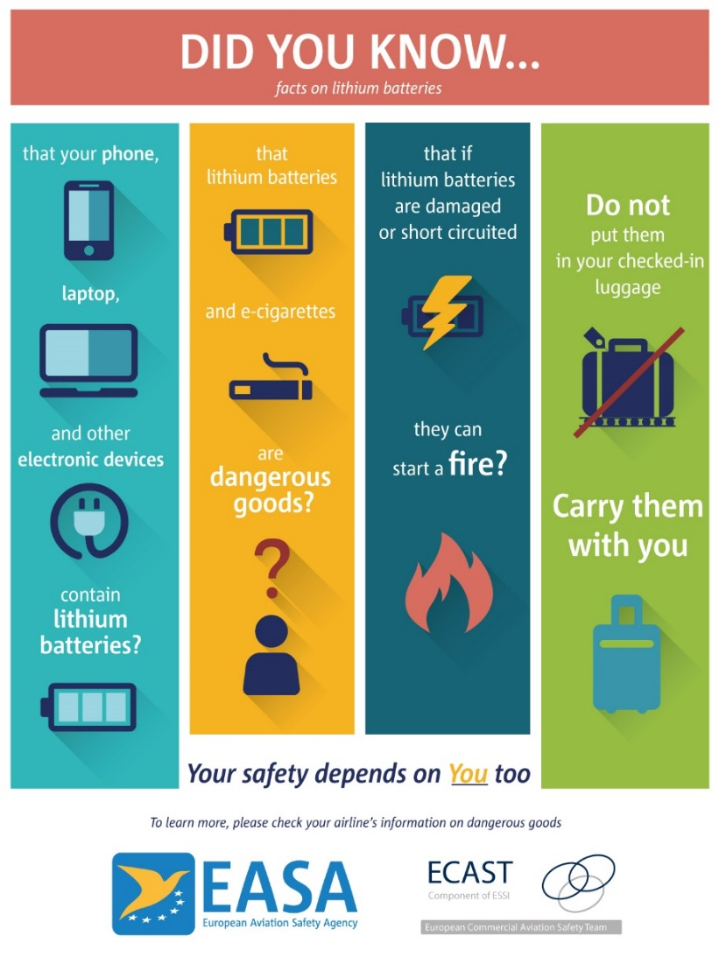

Slide 10
Passenger Awareness – Achievements by Q2/Q3 2016
EASA Safety Promotion Webpage on Dangerous Goods:
  DG with subpages:
    Lithium batteries
    E – cigarettes
    Personal transportation devices
    Use of mobile phones and laptops onboard (Personal Electronic Devices - PEDs)
    FAQ and practical info on lithium batteries
    Links to European MS related websites
Video – Short film on lithium batteries and other dg
Notes:
https://www.easa.europa.eu/easa-and-you/passengers/dangerous-goods
https://www.youtube.com/watch?v=pwwdH_wNEeo
Pending: provide a list of dg items (this was being done by communications)

Slide 11

Questions? air_ops@easa.europa.eu
Lia.calleja-barcena@easa.europa.eu

