Slide 1
Effect of Passenger Position on Crash Injury Risk in Transport-Category Aircraft
Seventh Triennial International Fire & Cabin Safety Research Conference
Amanda Taylor
3 December 2013

Slide 2
Talk Overview
Background
National Transportation Safety Board Recommendation
Testing
Instrumentation
Test Matrix
Seat Back
Injuries
Observations
Proposed Brace Position

Slide 3
Background
Brace position protects occupants from secondary impact
  That is the impact between a body segment, such as the head, and whatever it might hit in a crash.
During the 1980s, brace position recommendations were adjusted based on the then-new dynamic impact test techniques.
These formed the basis of AC 121-24B Appendix 4.

Slide 4
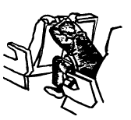
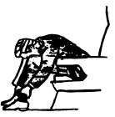
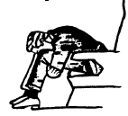
Background
Passenger brace positions in AC 121-24B

Slide 5
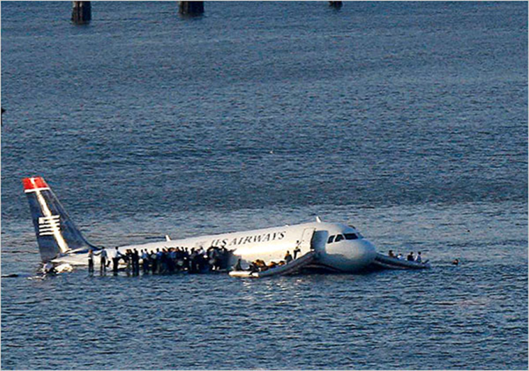
Background
January 15, 2009 US Airways flight 1549, an Airbus A320, ditched in the Hudson River about 8.5 miles from LaGuardia Airport.
4 passengers sustained serious injuries, 3 of which occurred during the impact.
NTSB Safety Recommendation A10-78
Photo: Brendan Mcdermid/Reuters

Slide 6
Background
2 females sustained similar shoulder fractures, both described assuming similar brace positions.
Placing their arms on the seat in front of them and leaning over, this is similar to the one depicted in the US Airways safety card.
NTSB Safety Recommendation A10-78
Passenger brace positions shown in the US Airways safety information card.

Slide 7
NTSB Recommendation
  “Conduct research to determine the most beneficial passenger brace position in airplanes with non-breakover seats installed. If the research deems it necessary, issue new guidance material on passenger brace positions.”
NTSB Safety Recommendation A10-78

Slide 8
Testing
Civil Aerospace Medical Institute (CAMI) investigated this by conducting a series of sled impact tests representative of the most common scenarios seen in the current flying fleet.
This was done by varying:
  Seat pitch
  Brace position (both arm and leg position)
  Seat back type
  Seat frame stiffness (where the femur contacts)

Slide 9
Testing
Seventeen tests on the deceleration sled at CAMI were completed with the 16G, 44 feet per second impact severity as defined in 14CFR25.562.
No yaw was included in this test series to limit variability.

Slide 10
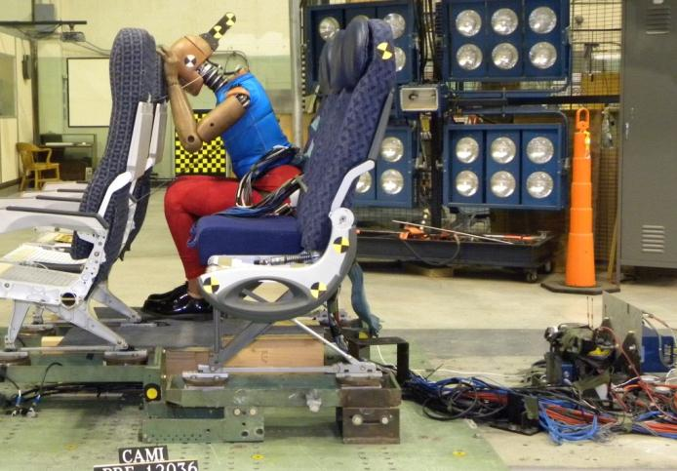
ATD Instrumentation
To assess different injuries
many instruments were
utilized such as:
  Accelerometers
    Head, Thorax, Pelvis
  Angular Rate Sensor,
    Head, Thorax, Pelvis
  Load Cells
    Upper Neck, Lower Neck, Thorax (T12), Lumbar, Right Femur, Right Upper and Lower Leg, Left Femur, Left Upper and Lower Leg
Notes:
A total of 91 channels including lap belt loads, sled accelerations knee clevis and knee string pots.

Slide 11
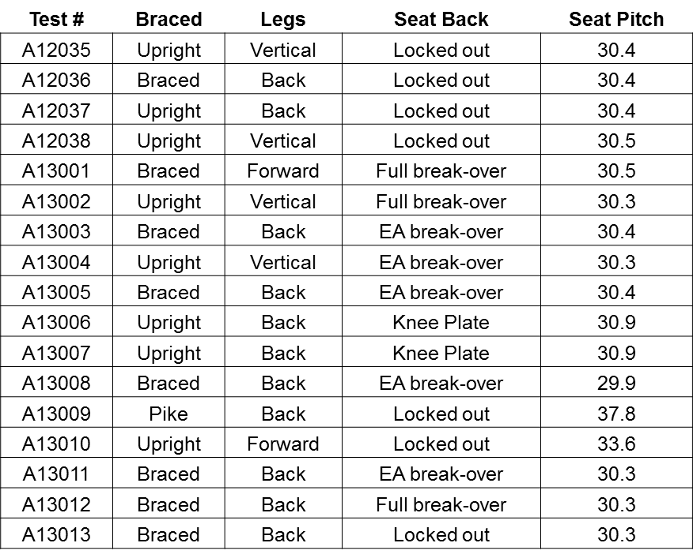
Test Matrix

Slide 12
Seat Back Types
Locked-Out
Energy-Absorbing
Full Break-Over

Slide 13
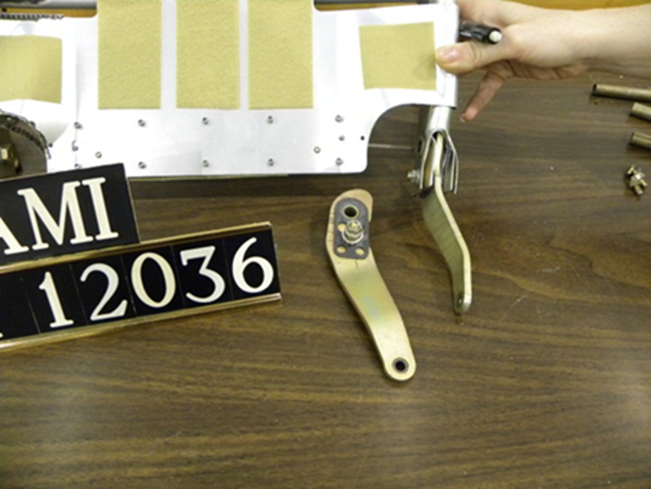
Locked-Out Seat Back
A seat back, when struck from behind, will flex forward but will stay in a mostly upright configuration post test.
This usually results in permanent deformation to the seat frame.

Slide 14
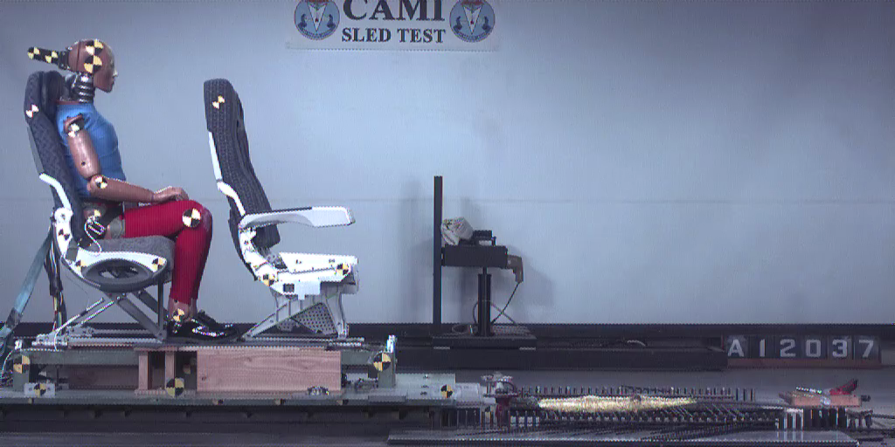
Locked-Out Seat Back
Upright Position

Slide 15
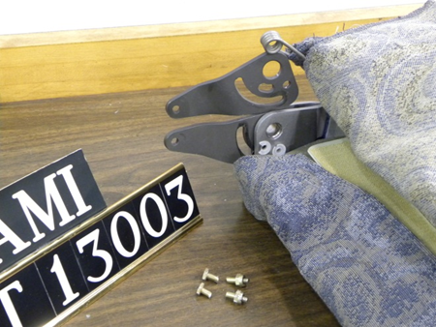
Energy-Absorbing Seat Back
This seat had a dual shear mechanism where the seat back frame connects to the hydro lock as well as a friction washer on a bolt that travels in a slot.

Slide 16
Energy-Absorbing Seat Back
Shear pins are sized to limit the contact force produced when the head of the occupant strikes the seat back from behind.
This allows the seat to absorb some of the occupant’s energy prior to folding over to contact the seat pan or occupant in front.
The friction washer was tuned by pushing at the top of the seat tray with 35 lbs.

Slide 17
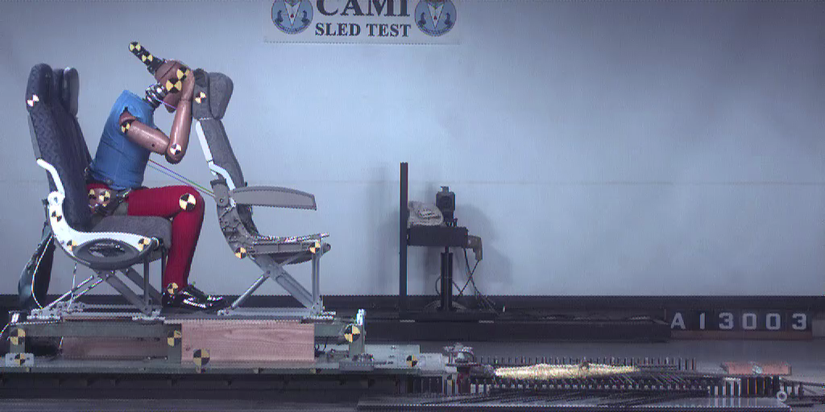
Energy-Absorbing Seat Back
Current Brace Position

Slide 18
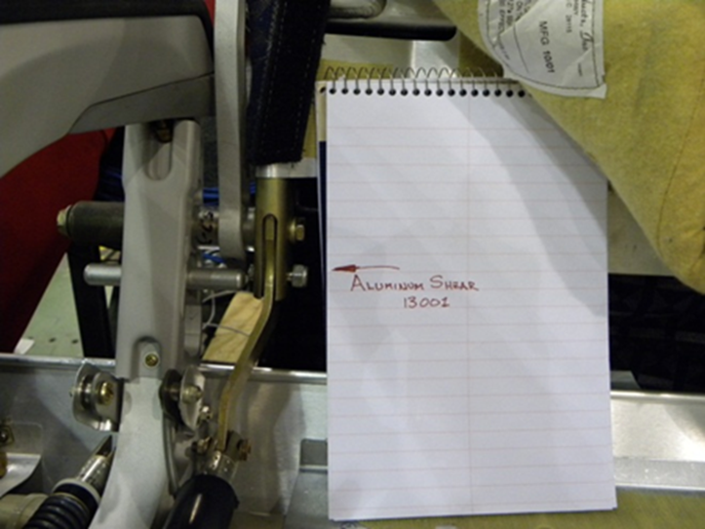
Full Break-Over Seat Back
Seat back that when struck will completely fold over, limited only by coming into contact with the seat bottom or occupant in front.
Weak shear pin used to ensure consistent initial break-over force.

Slide 19
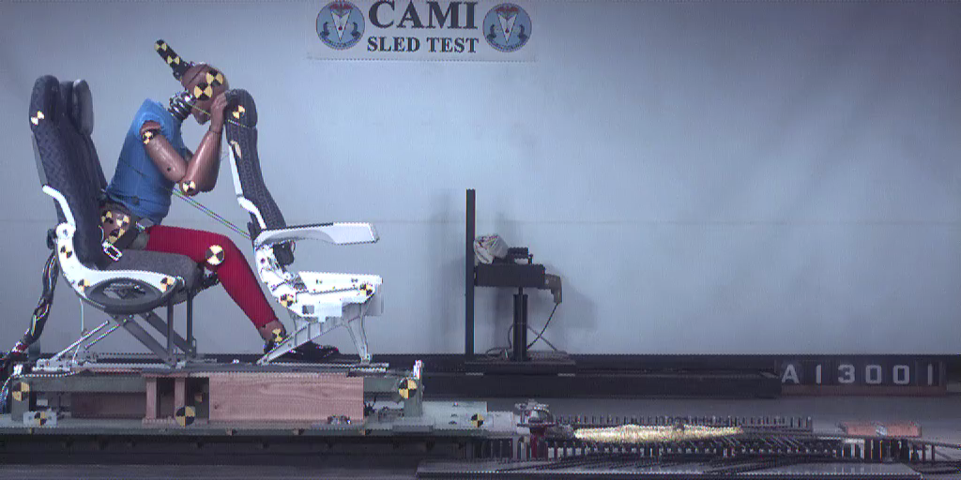
Full Break-Over Seat Back
Current Brace Position

Slide 20
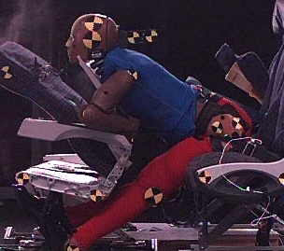
Full Break-Over Seat Back
There were multiple tests where the head destroyed the tray table latch.
In two cases, this created potentially injurious neck loading.

Slide 21
Injuries
To assess injuries, an evaluation of loads and accelerations recorded from the ATD are compared against existing injury criteria derived from humans.
Head, neck, upper leg, and lower leg injuries were evaluated.

Slide 22
Injuries
The Abbreviated Injury Scale (AIS) is an anatomical-based coding system created by the Association for the Advancement of Automotive Medicine to classify and describe the severity of specific individual injuries.
AIS is ranked on a scale from 1 to 6, with 1 being minor and 6 being fatal.

Slide 23
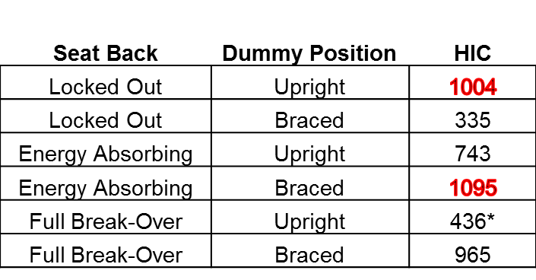
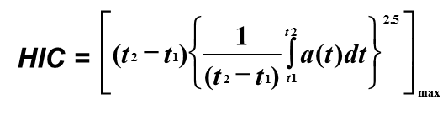
Head Injuries
Head Injury Criteria (HIC) is the maximum integral value of the head acceleration.
The HIC limit is 1000, which represents a 23% risk of a serious (AIS 3+) head injury
*In this test the chin of the dummy caught on the top of the tray table, causing excessive bending moments and loads, which in turn lowered the HIC.

Slide 24
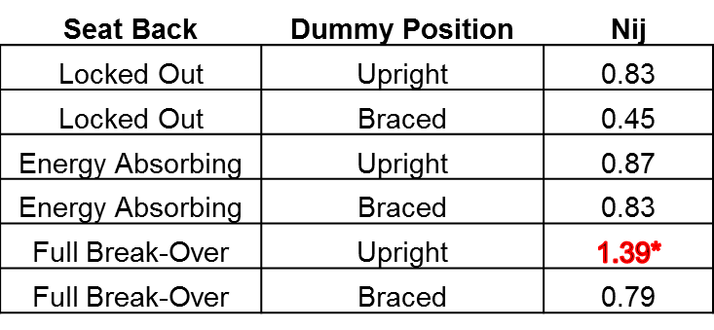

Neck Injuries
Normalized neck injury criteria (N_{ij}) was used to evaluate neck injury risk.
Not currently used in aviation testing, but a limit of 1 is called out in automotive testing (FMVSS 208).
*In this test the chin of the dummy caught on the top of the tray table, causing excessive bending moments and loads, which in turn lowered the HIC.

Slide 25
Upper Leg Injuries
Risk of injury is based on the load measured in the femur.
Fz limit is 2250 lbs, which represents a 15% risk of serious (AIS 3+) injury to the knee-thigh-hip complex.
Seat Back | Dummy Position | Leg Position | Right | Left
Locked-Out | Upright | Back | 103 | 340
Locked-Out | Braced | Back | 21 | 28
Energy Absorbing | Upright | Vertical | 28 | 564
Energy Absorbing | Braced | Back | 5 | 9
Full Break-Over | Upright | Vertical | 75 | 305
Full Break-Over | Braced | Forward | 878 | 692

Slide 26
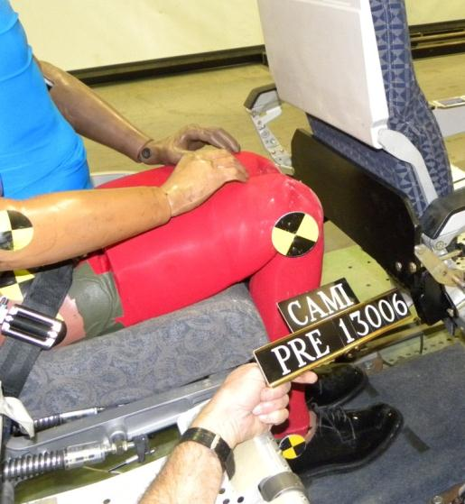
Upper Leg Injuries
To determine the maximum likely axial loading into the femur, a rigid plate was attached to the seat frame where the knee would contact.

Slide 27
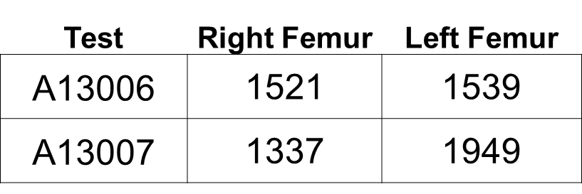
Upper Leg Injuries
Two tests were run, one with symmetrical loading and the other with asymmetrical loading (2-degree pelvic twist).
The asymmetrical impact of the knee into the rigid plate is likely to be the worst case loading scenario.
All loads were less than the regulatory limit.

Slide 28
Upper Leg Injury
In addition to axial loading, excessive bending moment can cause serious injuries.
A limit of 2655 in-lb has been adopted by the European Enhanced Vehicle Safety Committee (EEVC) for pedestrian impacts.

Slide 29
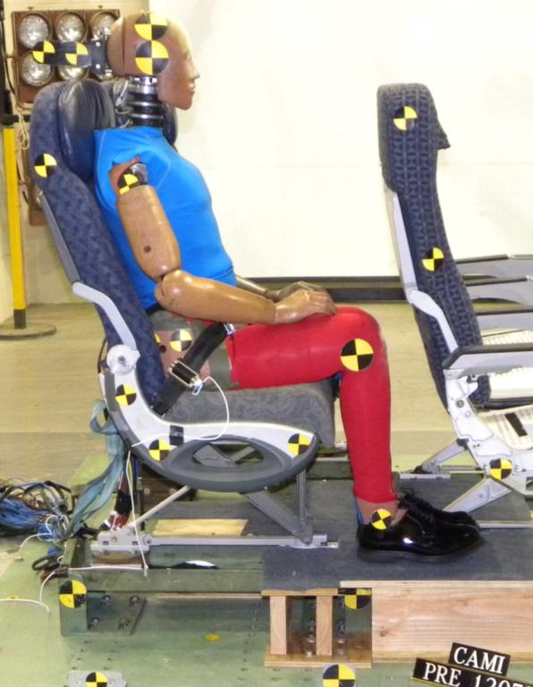
Upper Leg Injury
The moment (M_{y}) limit of 2655 in-lb represents a 20% risk of moderate (AIS 2+) injury to the femur.
There were four tests where the moment exceeded the limit.
In all tests exceeding the limit, the ATD was positioned upright.

Slide 30
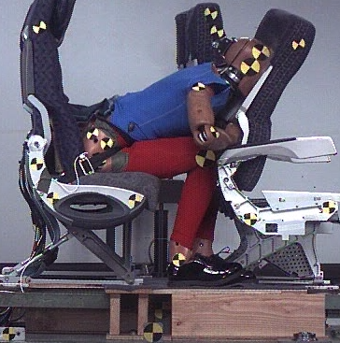
Upper Leg Injury
The seat belt becomes taught and loads the pelvis.
The body then rotates around the seat belt which loads the proximal end of the femur.
The distal end of the femur is effectively fixed because of the geometry restricting the leg from rotating forward.
There is loading in the middle of the femur from the front tube.
All these forces cause a moment in the femur.

Slide 31
Lower Leg Injuries
To evaluate lower leg injuries, the tibia index (TI) was utilized.
TI incorporates the bending moments, as well as axial force.
Measured at both the upper and lower ends of the tibia for each leg.
The position of the legs were altered between vertical, forward, and aft to find the most effective way to limit flail.

Slide 32
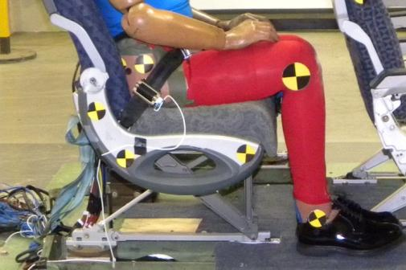
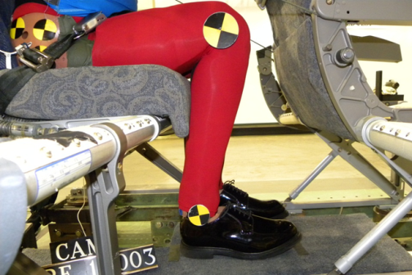
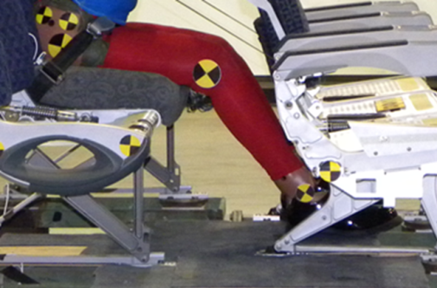
Lower Leg Injuries
Legs Vertical
Legs Aft
Legs Forward

Slide 33
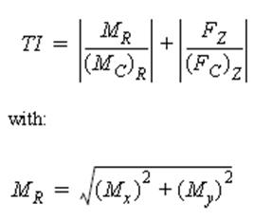
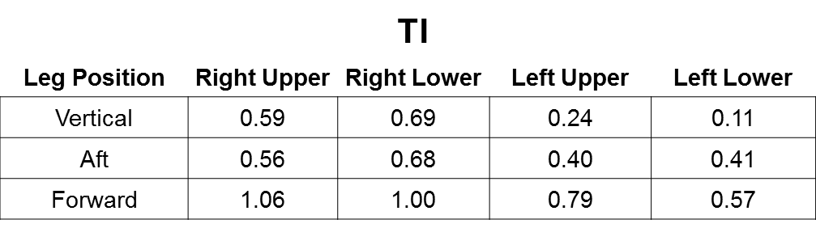
Lower Leg Injuries
Lower leg injuries are not currently a pass/ fail testing criterion in aviation.
Currently, the EEVC limits the TI to 1.3 for automotive testing.

Slide 34
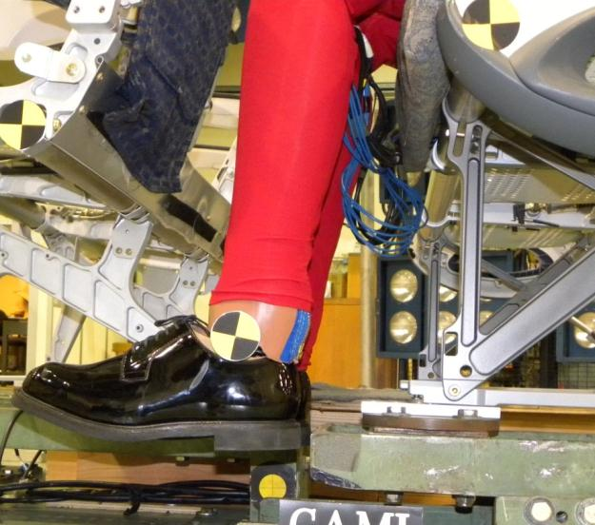
Lower Leg Injuries
A test was run with no floor to simulate a shorter stature occupant whose legs do not touch the floor and will flail forward unimpeded.
The TI was well within the injury limits.
Injury risk was on par with the baseline tests.

Slide 35
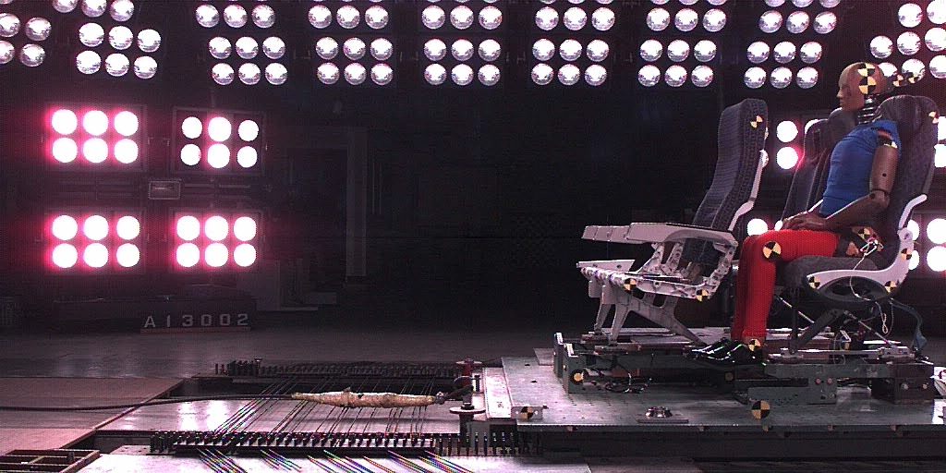
Lower Leg Injuries
Upright Position

Slide 36
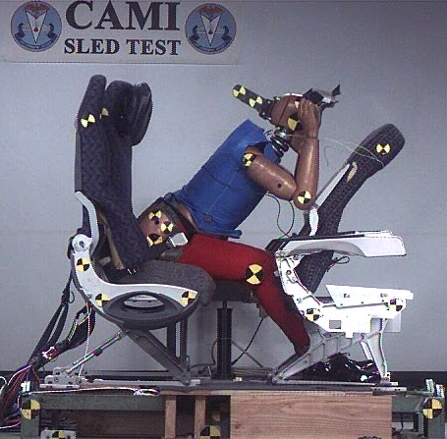
Observations
HIC values were above the limit on several tests.
The arms were observed pushing the seat back away from the occupant both in braced and upright positions.
This effectively allowed the occupant’s head to accelerate relative to the seat back, increasing injury risk.

Slide 37
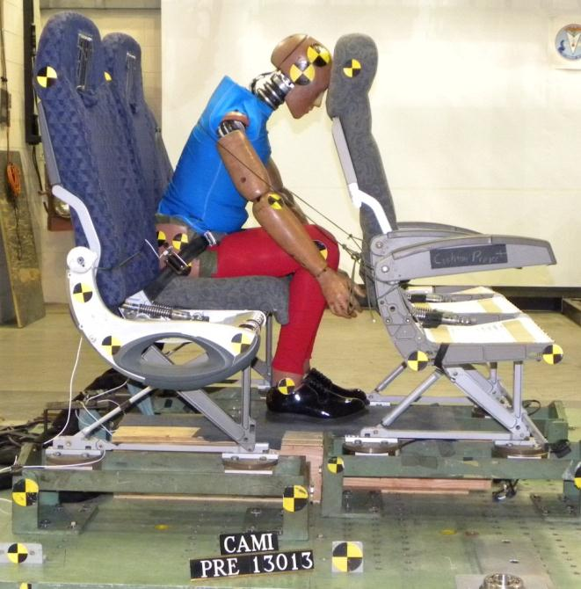
Proposed Brace Position
A need to keep the arms from interacting with the seat back was indicated.
Placing the arms down by the side of the lower legs prevents them from interacting with the seat back.
Holding onto the lower legs may provide a more stable position.

Slide 38
Proposed Brace Position
The TI numbers for the lower legs indicate that the leg position did not change the injury potential significantly.

Slide 39
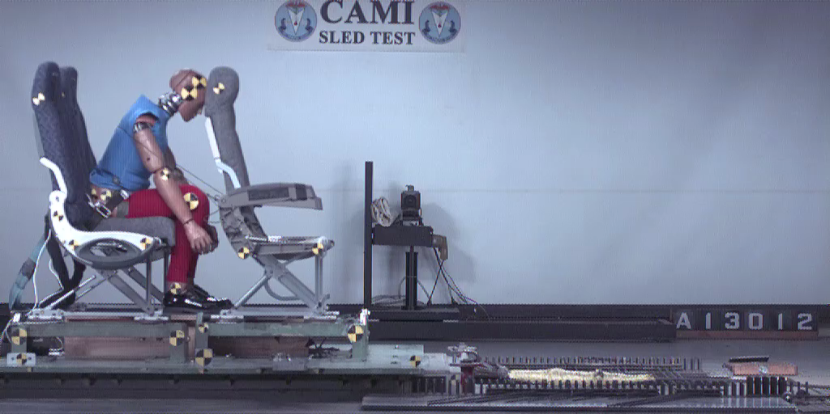
Proposed Brace Position
Full Break-Over Seat Back

Slide 40
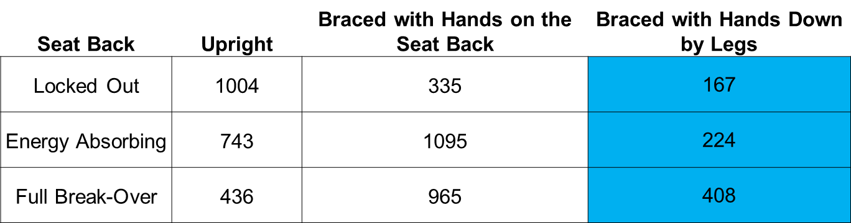
Proposed Brace Position
The HIC for the new brace position was lower for each type of seat back.

Slide 41
Proposed Brace Position
When the upper leg injury limits were evaluated with the new brace position, all values were below the regulatory limit.
By reducing upper body flailing, the moment produced in the femur was below the pedestrian limit for each type of seat back.
Seat Back Type | Femur Axial Force 2250 (lbs) | Femur Bending Moment 2655 (in-lb)
EA Break-Over | 7.2 | 1498
Full Break-Over | 156.9 | 1847
Locked-Out | 16.1 | 1682

Slide 42
Proposed Brace Position
Being subjected to combined vertical/horizontal loads while in the current or proposed brace positions could alter the spinal injury risk, compared to the upright position, due to spinal misalignment.
An evaluation of this difference in injury risk requires data relating injury tolerance to spine bending angle (currently not available).
Since the current and proposed brace positions result in a similar initial torso angle and torso kinematics, a difference in spinal injury risk is not expected.

Slide 43
Conclusion
Research was in answer to the NTSB recommendation to “Conduct research to determine the most beneficial passenger brace position in airplanes with non-breakover seats installed.”
Testing showed that as the seat technology has changed the most effective brace position has as well.
The older brace position was effective in lowering HIC locked-out seats, but it amplified HIC in the energy absorbing seats that are more prevalent on newer aircraft.

Slide 44
Conclusion
The proposed brace position reduced HIC in all tested seat configurations, making it a good candidate for use in nearly all passenger seats in the flying fleet.
This finding is based on results of impact tests with test dummies, but further study is necessary to determine whether the proposed position is practical to implement from a human factors perspective.
This work is to support the Fire & Cabin Safety Technical Community Representative Group Project 2011-05/2012-06: Prevention of Injuries That Impede Egress.

Slide 45

Questions?

Slide 46
Locked-Out Seat Back
Locked-Out Seat Back |  |  |  |  |  |  | *No Floor
Test parameter | Criteria Limit | Test Number
Test Number |  | A12036 | A12037 | A13038 | A13009 | A13010* | A13013
Torso Position |  | Braced | Upright | Upright | Pike | Upright | Braced
Arm Position |  | Seat Back Top | Thigh Top | Thigh Top | Down by legs | Thigh Top | Down by legs
Leg Position |  | Back | Back | Vertical | Back | Vertical | Back
Restraint |  | Lap belt | Lap belt | Lap belt | Lap belt | Lap belt | Lap belt
Seat Pitch |  | 30 | 30 | 31 | 38 | 34 | 30
Impact velocity (ft/s) |  | 45 | 45 | 45 | 45 | 45 | 45
Impact Acc (g) |  | 17 | 17 | 17 | 17 | 17 | 16
HIC | 1000 | 335 | 1004 | 1285 | 262 | 520 | 167
Nij | 1 | 0.45 | 0.83 | 0.85 | 0.63 | 1.57 | 0.52
Right Leg Ti (Upper) | 1.3 | 0.59 | 0.50 | 0.37 | 0.88 | 0.84 | 0.58
Right Leg Ti (Lower) | 1.3 | 0.69 | 0.83 | 0.32 | 0.62 | 0.83 | 0.34
Left Leg Ti (Upper) | 1.3 | 0.24 | 0.40 | 0.72 | 0.60 | 0.67 | 0.30
Left Leg Ti (Lower) | 1.3 | 0.11 | 0.18 | 0.43 | 0.23 | 0.31 | 0.18
Peak Knee Velocity (ft/s) |  | 11 | 13 | 12 | 12 | 12 | 13
Right Femur Fz (lb) | 2250 | 21 | 103 | 567 | 256 | 98 | 16
Left Femur Fz (lb) | 2250 | 28 | 340 | 509 | 71 | 110 | 25
Right Femur My (in-lbs) | 2265 | 2480 | 3334 | 2718 | 2373 | -1855 | 1682
Left Femur My (in-lbs) | 2265 | 873 | 1165 | 1667 | 1654 | -1821 | 942

Slide 47
Energy Absorbing Seat Back
EA Seat Back
 | Criteria Limit
Test Number |  | A13003 | A13004 | A13005 | A13008 | A13011
Torso Position |  | Braced | Upright | Braced | Braced | Braced
Arm Position |  | Seat Back Top | Thigh Top | Seat Back Top | Back of Head | Down by legs
Leg Position |  | Back | Vertical | Back | Back | Back
Restraint |  | Lap Belt | Lap Belt | Lap Belt | Lap Belt | Lap Belt
Seat Pitch |  | 30 | 30 | 30 | 30 | 30
Impact velocity (ft/s) |  | 45 | 45 | 44 | 45 | 45
Impact Acc (g) |  | 18 | 18 | 17 | 17 | 17
HIC | 1000 | 1095 | 743 | 760 | 411 | 224
Nij | 1 | 0.83 | 0.87 | 0.90 | 0.66 | 0.51
Right Leg Ti (Upper) | 1.3 | 0.56 | 0.63 | 0.58 | 0.70 | 0.66
Right Leg Ti (Lower) | 1.3 | 0.68 | 0.28 | 0.67 | 0.53 | 0.41
Left Leg Ti (Upper) | 1.3 | 0.40 | 1.37 | 0.39 | 0.28 | 0.29
Left Leg Ti (Lower) | 1.3 | 0.41 | 0.70 | 0.33 | 0.18 | 0.15
Peak Knee Velocity (ft/s) |  | 14 | 13 | 14 | 13
Right Femur Fz (lb) | 2250 | 5 | 28 | 19 | 13 | 7
Left Femur Fz (lb) | 2250 | 9 | 564 | 17 | 17 | 29
Right Femur My (in-lbs) | 2265 | 2572 | 3518 | 2650 | 2516 | 1498
Left Femur My (in-lbs) | 2265 | 2104 | 1370 | 2243 | 1709 | 800

Slide 48
Full Break Over Seat Back
Full Break Over
 | Criteria Limit
Test Number |  | A13001 | A13002 | A13012
Torso Position |  | Braced | Upright | Braced
Arm Position |  | Seat Back Top | Thigh Top | Down by legs
Leg Position |  | Forwards | Vertical | Back
Restraint |  | Lap Belt | Lap Belt | Lap Belt
Seat Pitch |  | 31 | 30 | 30
Impact velocity (ft/s) |  | 45 | 45 | 45
Impact Acc (g) |  | 17 | 18 | 17
HIC | 1000 | 965 | 436 | 408
Nij | 1 | 0.79 | 1.39 | 0.43
Right Leg Ti (Upper) | 1.3 | 1.06 | 0.59 | 0.58
Right Leg Ti (Lower) | 1.3 | 1.00 | 0.29 | 0.43
Left Leg Ti (Upper) | 1.3 | 0.79 | 0.72 | 0.37
Left Leg Ti (Lower) | 1.3 | 0.57 | 0.32 | 0.16
Peak Knee Velocity (ft/s) |  | 11 | 12 | 9
Right Femur Fz (lb) | 2250 | 878 | 75 | 157
Left Femur Fz (lb) | 2250 | 692 | 305 | 10
Right Femur My (in-lbs) | 2265 | 1480 | -959 | 1847
Left Femur My (in-lbs) | 2265 | 1188 | -1422 | 976

