Slide 1
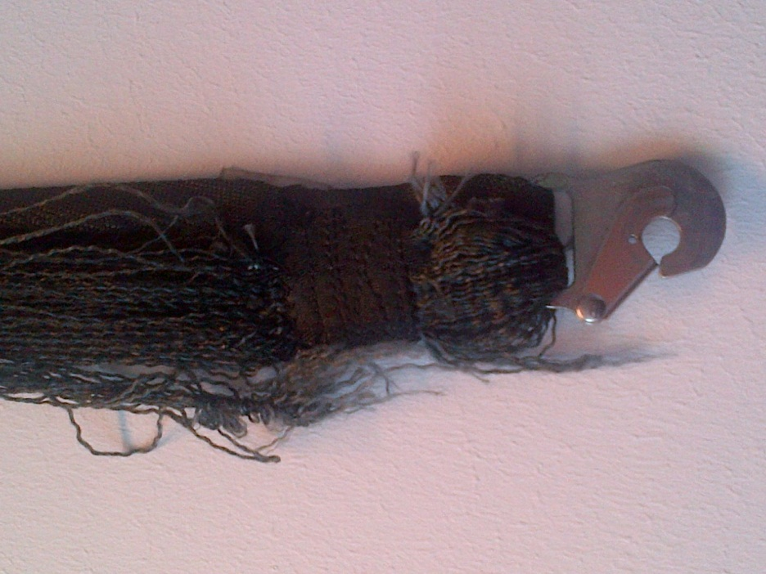
EASA research project:
Seat Belt Degradation
Michael Singer
PCM, Parts & Appliances
December 2013

Slide 2
content
Background
Objectives/Preparation
Part 1
    Static testing
    Dynamic testing
    Test results
    Conclusions
Part 2
    Small scale test rig
EASA AD for restraint systems
Alternative MoC for webbing replacement

Slide 3





background
EASA research on Cargo Nets in 2008 did show a high degree of fabric degradation with up to 50% loss of the initial strength.
http://easa.europa.eu/safety-and-research/research-projects/miscellaneous.php
The webbing of seat belts and torso restraint systems may also degrade:
  Normal daily use
  Exposure to environmental conditions
  Natural aging of fabric (seen on cargo nets)
  Cleaning or maintenance
Seventh Triennial International Aircraft Fire and Cabin Safety Research Conference
3

Slide 4
objectives
Research performed by MIRA Ltd (UK) and Health & Safety Laboratory (HSL/UK).
Objective 1:
  Static and dynamic testing of new and used seat belts to assess if there was a difference in strength and elongation properties with age.
Seventh Triennial International Aircraft Fire and Cabin Safety Research Conference
4

Slide 5
objectives
Objective 2:
  Development of a small scale test rig to simulate the loading conditions of seat belts during dynamic seat testing.
  Perform a statistical analysis to compare dynamic test data with data from testing on the small scale rig.
Seventh Triennial International Aircraft Fire and Cabin Safety Research Conference

Slide 6
preparation
About 300 samples in total:
  new belts for benchmark testing,
  used belts up to an age of 13 years,
  unused re-webbed belts,
  used re-webbed belts,
  unused belts after 6 years storage.
Note:
Sourcing of samples proved to be difficult due to reluctance of Airlines.
Seventh Triennial International Aircraft Fire and Cabin Safety Research Conference

Slide 7
preparation
Suitable samples were tested as follows:
73 static tests,
36 dynamic tests,
25 tests on small scale rig.
A large number was not suitable for testing:
illegible labels
mismatched parts (different male/female part of seat belt)
Seventh Triennial International Aircraft Fire and Cabin Safety Research Conference

Slide 8
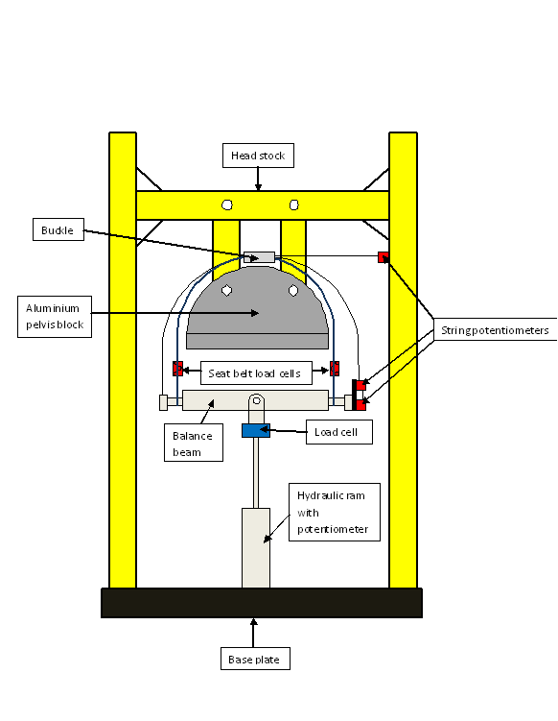
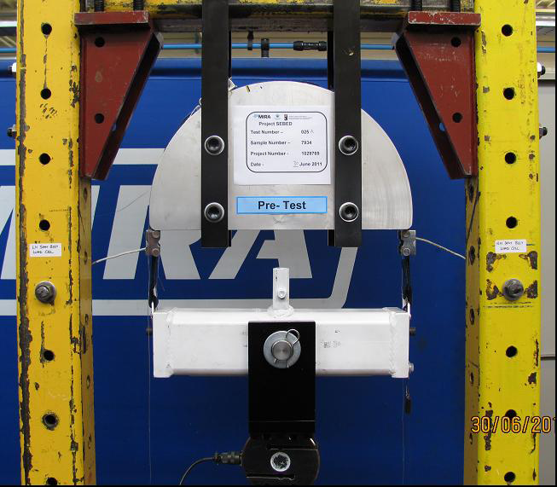
part 1: static testing
Static test set-up (SAE AS8043A):
Seventh Triennial International Aircraft Fire and Cabin Safety Research Conference

Slide 9
part 1: static testing
Static testing:
Elongation property test by application of 18kN (rate 9kN/min.).
Static strength to ultimate load 26.6 kN (SAE AS8043A)
Note:
18kN was assessed to correspond with seat belt loads measured by MIRA in various dynamic aircraft seat tests
Seventh Triennial International Aircraft Fire and Cabin Safety Research Conference

Slide 10
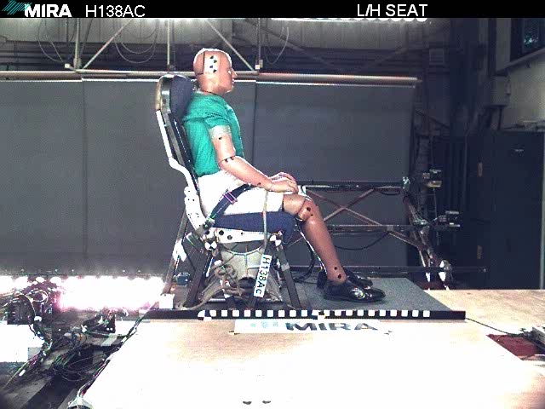
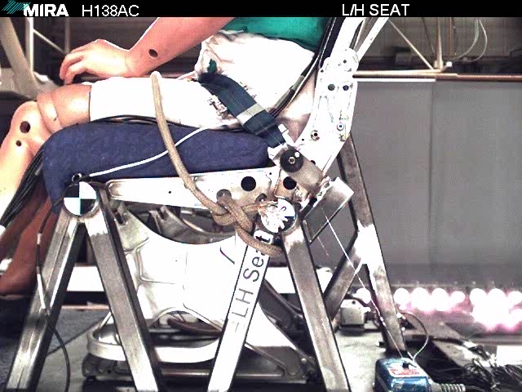
part 1: dynamic testing
Dynamic testing:
Seventh Triennial International Aircraft Fire and Cabin Safety Research Conference

Slide 11
part 1: dynamic testing
Dynamic testing:
HyGe deceleration test sled,
Test pulse and ATD per SAE AS8049A,
Rigidized single tourist class seat,
Recording of:
  Seat belts loads,
  Seat belt elongation,
  Head path data.
Seventh Triennial International Aircraft Fire and Cabin Safety Research Conference

Slide 12
part 1: results
Nylon belts qualified to TSO-C22g rated at 3000lb showed an increase in elongation when tested statically.
Note: dynamic testing showed greater scatter than static testing
Seventh Triennial International Aircraft Fire and Cabin Safety Research Conference

Slide 13
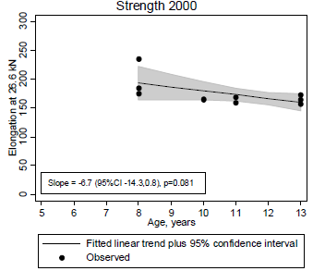
part 1: results
Nylon belts qualified to earlier TSO-C22f rated at 2000lb showed a slight decrease in elongation when tested statically.
Note: Trend is less conclusive due to low number of data points.
Seventh Triennial International Aircraft Fire and Cabin Safety Research Conference

Slide 14
part 1: results
unused nylon
belts stored
for 6 years
new nylon belts
Elongation vs. age for 3000lb belts tested statically to 18kN
Seventh Triennial International Aircraft Fire and Cabin Safety Research Conference

Slide 15
part 1: results
Dynamic seat belt loads were comparable to those seen during 18kN static load tests.
Elongations were uniformly lower than in static testing.
Seventh Triennial International Aircraft Fire and Cabin Safety Research Conference

Slide 16
part 1: conclusions
Conclusions from dynamic and static testing
No issue regarding ultimate static strength.
Increase in elongation for nylon belts rated at 3000 lb.
Decrease in elongation for nylon belts rated at 2000 lb.
Stored nylon belts exhibit same elongation characteristics as those been in service.
The correlation between the results suggests that there may be less need to test seat belts dynamically, and that the information obtained by static testing may be sufficient.
Seventh Triennial International Aircraft Fire and Cabin Safety Research Conference

Slide 17
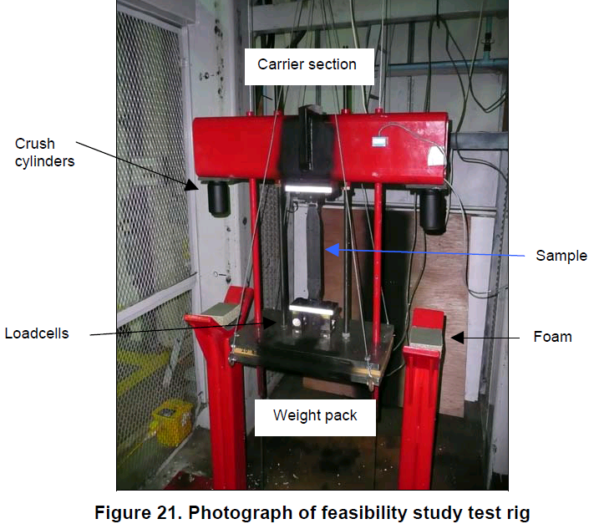
part 2: small scale test rig
Drop test set-up:
A force pulse is applied comparable to the pulse experienced by a seat belt in a full scale dynamic seat test.
Seventh Triennial International Aircraft Fire and Cabin Safety Research Conference

Slide 18
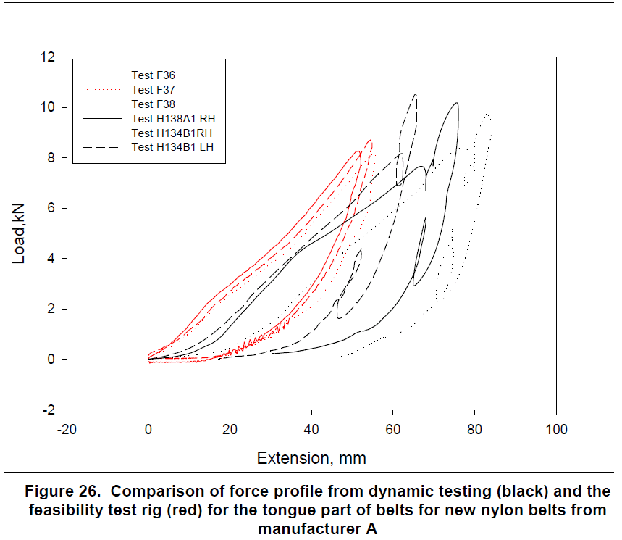
part 2: small scale test rig
Seventh Triennial International Aircraft Fire and Cabin Safety Research Conference

Slide 19
part 2: small scale test rig
Elongation results from small scale test and dynamic full scale testing were compared using statistical analysis.
Conclusions:
Used belts: No consistency between the two methods due to a large amount of scatter in dynamic testing.
New belts: Consistency in results indicates that the small scale test is comparable to a dynamic full scale test.
Note: A drop tower rig is difficult to calibrate to replicate proper loading conditions.
Seventh Triennial International Aircraft Fire and Cabin Safety Research Conference

Slide 20
report on EASA webpage
The complete report is published on the EASA webpage:
http://easa.europa.eu/safety-and-research/research-projects/miscellaneous.php
Seventh Triennial International Aircraft Fire and Cabin Safety Research Conference

Slide 21
EASA AD 2013-0020R2
AD 2013-0020 was published in January 2013.
Reason:
A number of European 3rd-party maintenance organizations performed re-webbing on restraint systems without being in possession of current applicable maintenance data.
Seventh Triennial International Aircraft Fire and Cabin Safety Research Conference

Slide 22
EASA AD 2013-0020R2
Risk:
Restraint systems may have been refurbished using webbing materials having mechanical properties significantly different with respect to the materials used on the original restraint systems (e.g. nylon instead of polyester).
As a consequence, safety belts and torso restraint systems could fail to perform their intended function to protect each occupant during an emergency landing condition and to minimise the effects of survivable accidents.
Seventh Triennial International Aircraft Fire and Cabin Safety Research Conference

Slide 23
EASA AD 2013-0020R2
AD applicability:
All aircraft having §2n.562 (emergency dynamic landing conditions) in their T/C basis.
Consequence from AD 2013-0020R2:
In co-operation with EASA some organizations developed 3rd-party repair data for restraint systems installed on dynamically tested seats.
Note: approval via STC process only.
Seventh Triennial International Aircraft Fire and Cabin Safety Research Conference

Slide 24
Alternative Means of Compliance (MoC)
Alternative Means of Compliance (MoC) could be accepted without the need to run full-scale 16g tests with original seats:
“… the results of uniaxial tensile testing performed with high stress rate are considered to be adequate to assess if the webbing of a refurbished seat belt is equivalent to that of the original restraint system certificated as part of a seat tested under the criteria of CS25.562.”
Seventh Triennial International Aircraft Fire and Cabin Safety Research Conference

Slide 25
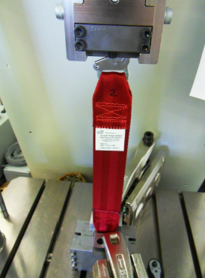
Alternative Means of Compliance (MoC)
seat belt installed in tensile test machine
Seventh Triennial International Aircraft Fire and Cabin Safety Research Conference

Slide 26
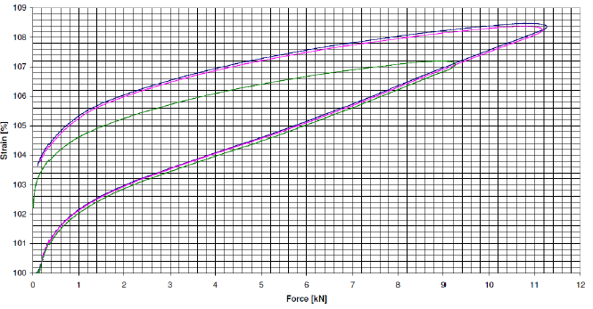
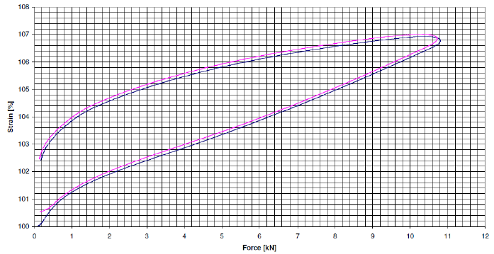
Alternative Means of Compliance (MoC)
original webbing replacement webbing
Note: above graphs are not to scale but do show the principle
Seventh Triennial International Aircraft Fire and Cabin Safety Research Conference

Slide 27
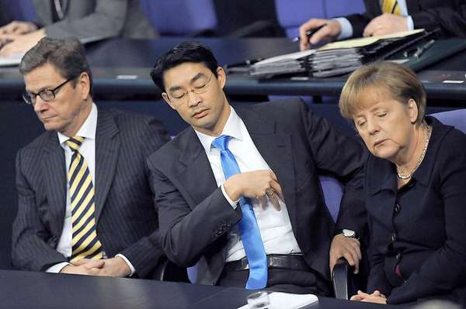
Questions
Seventh Triennial International Aircraft Fire and Cabin Safety Research Conference

Slide 28

Thank you for your attention

