Slide 1
Lap Belted Occupant Kinematics: Injury Outcomes from a School Bus Accident
Kristin Poland, Ph.D. Office of Research and Eng.
Thomas Barth, Ph.D. Office of Highway Safety
Notes:
Good morning.

Slide 2
Overview
Accident scenario
On-board video recording
Lap belts
Simulations
Injury coding
Public reports

Slide 3
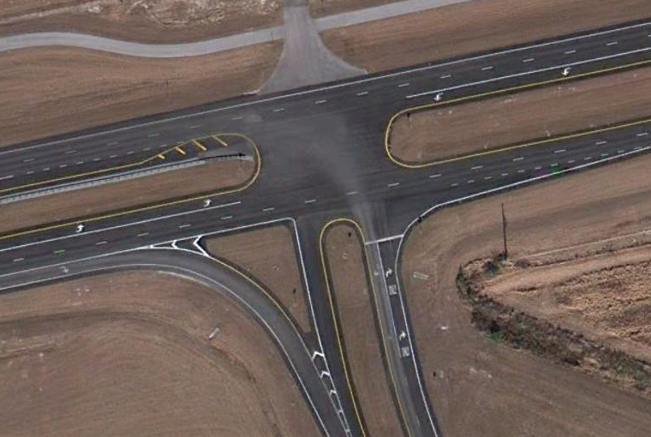
Accident Scene
Okeechobee Rd
Midway Rd
Notes:
The school bus was traveling [CLICK] westbound on Okeechobee Road. The bus was occupied by 30 students and was driven by a 56-year-old male driver. At the same time, a 24-year-old male driver [CLICK] was operating a 1998 Peterbilt truck tractor in combination with a flatbed semitrailer loaded with sod, eastbound in the right lane on Okeechobee Road. The speed on this road was 55 mph. The school bus had entered a left-turn-only lane and was preparing to turn across the center median and eastbound travel lanes onto Midway Road [CLICK]. The school bus turned in front of the eastbound combination vehicle, [CLICK] and the front of the truck tractor collided with the right side of the school bus in the vicinity of the rear axle. Following the impact, the school bus spun clockwise [CLICK] approximately 180-degrees and came to rest [CLICK] facing Okeechobee Road. The combination vehicle rolled over [CLICK] and departed the roadway, coming to rest upside down in the grass right-of-way along the southeast side of the intersection.
There was 1 fatality on the school bus in this accident.

Slide 4
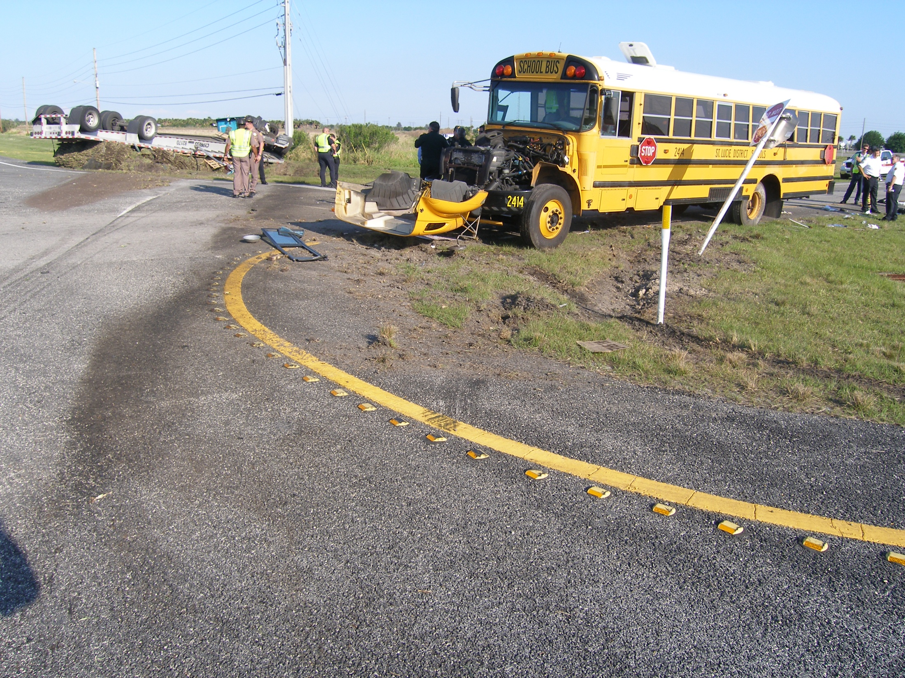
Port Saint Lucie, Florida
Notes:
In this picture, you can see the final rest positions of the [CLICK] school bus and the [CLICK] overturned tractor trailer that was carrying sod.

Slide 5
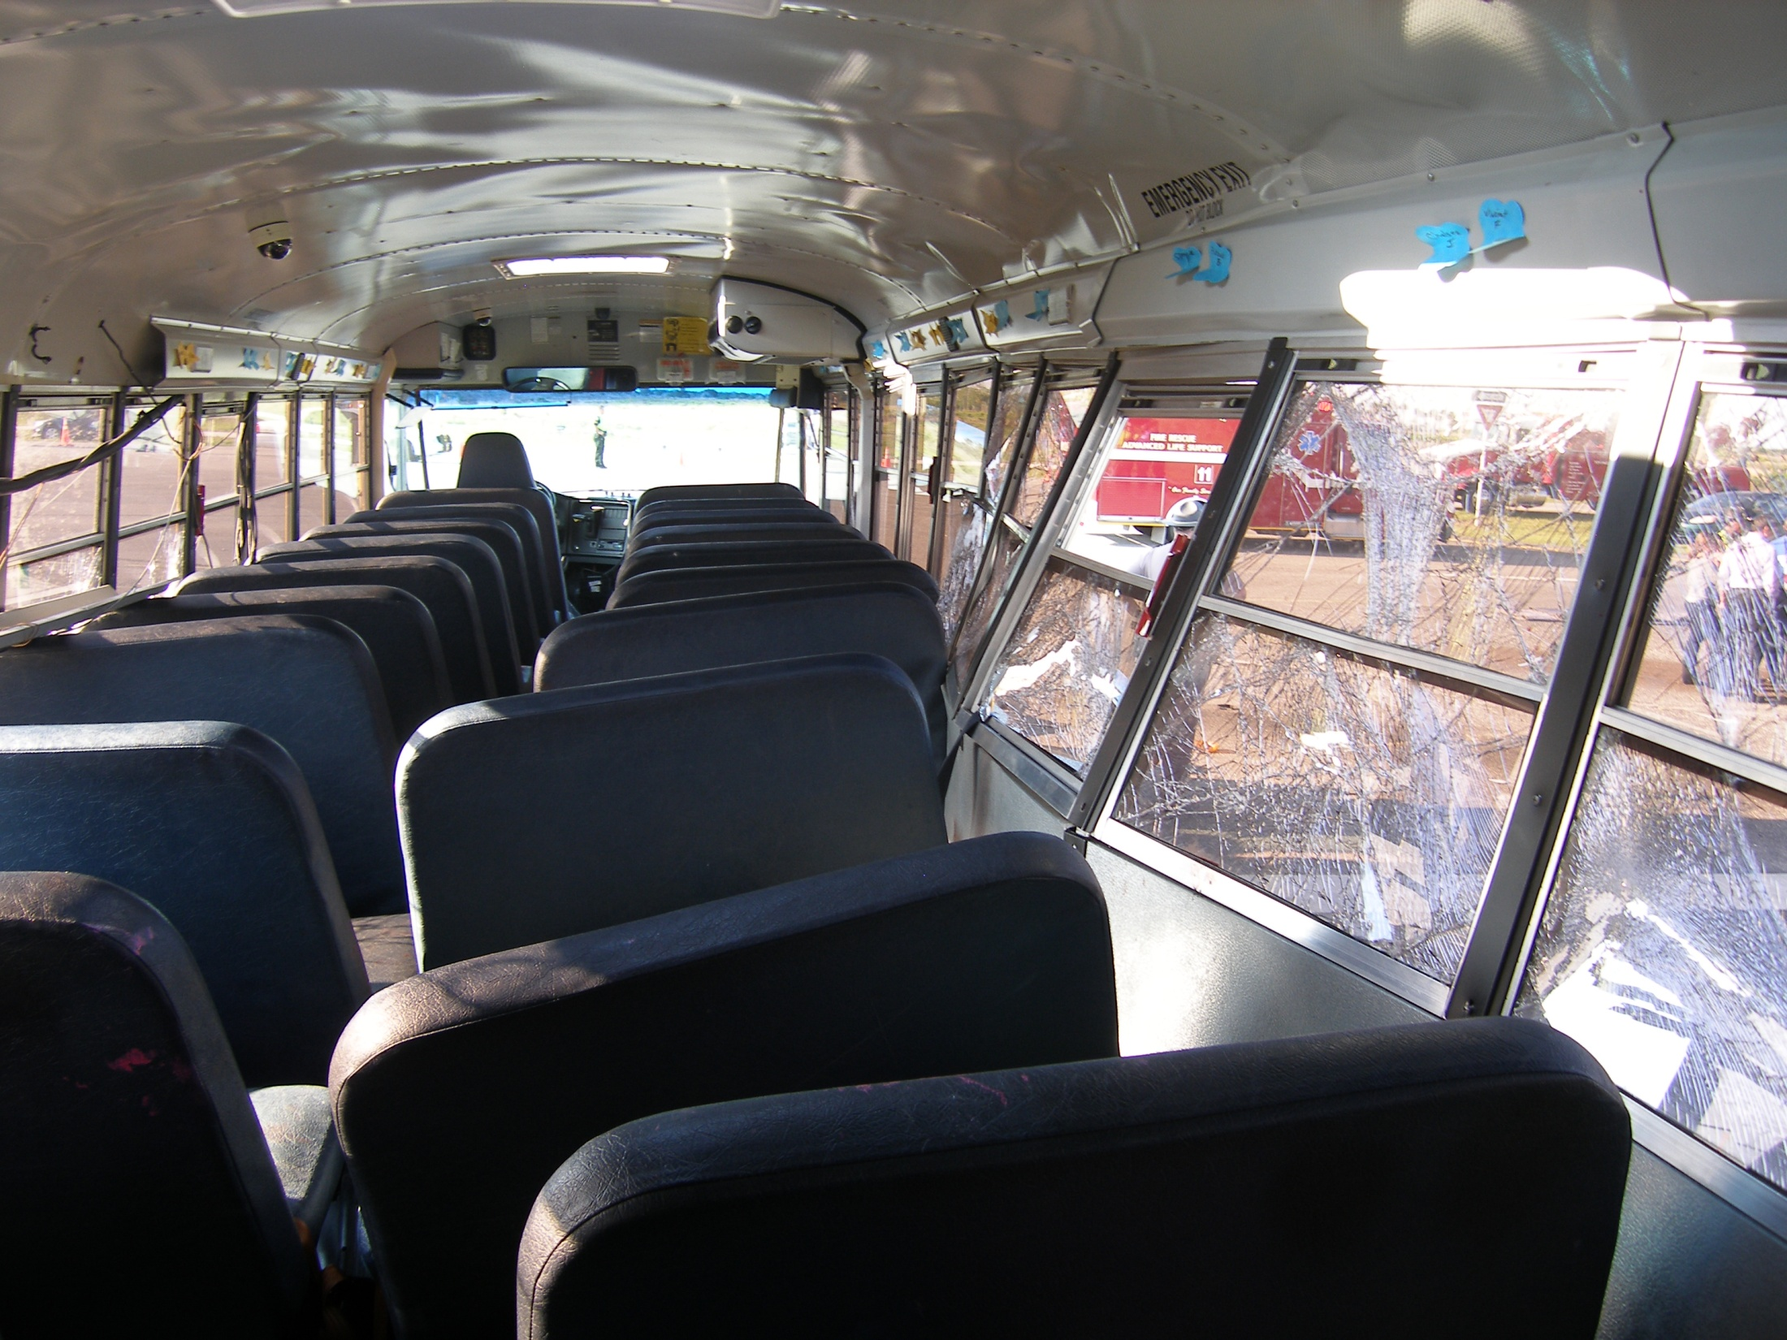
Port Saint Lucie School Bus Interior
Notes:
This a view looking toward the front of the bus interior showing deformation to the [CLICK] sidewall and [CLICK] seats.

Slide 6
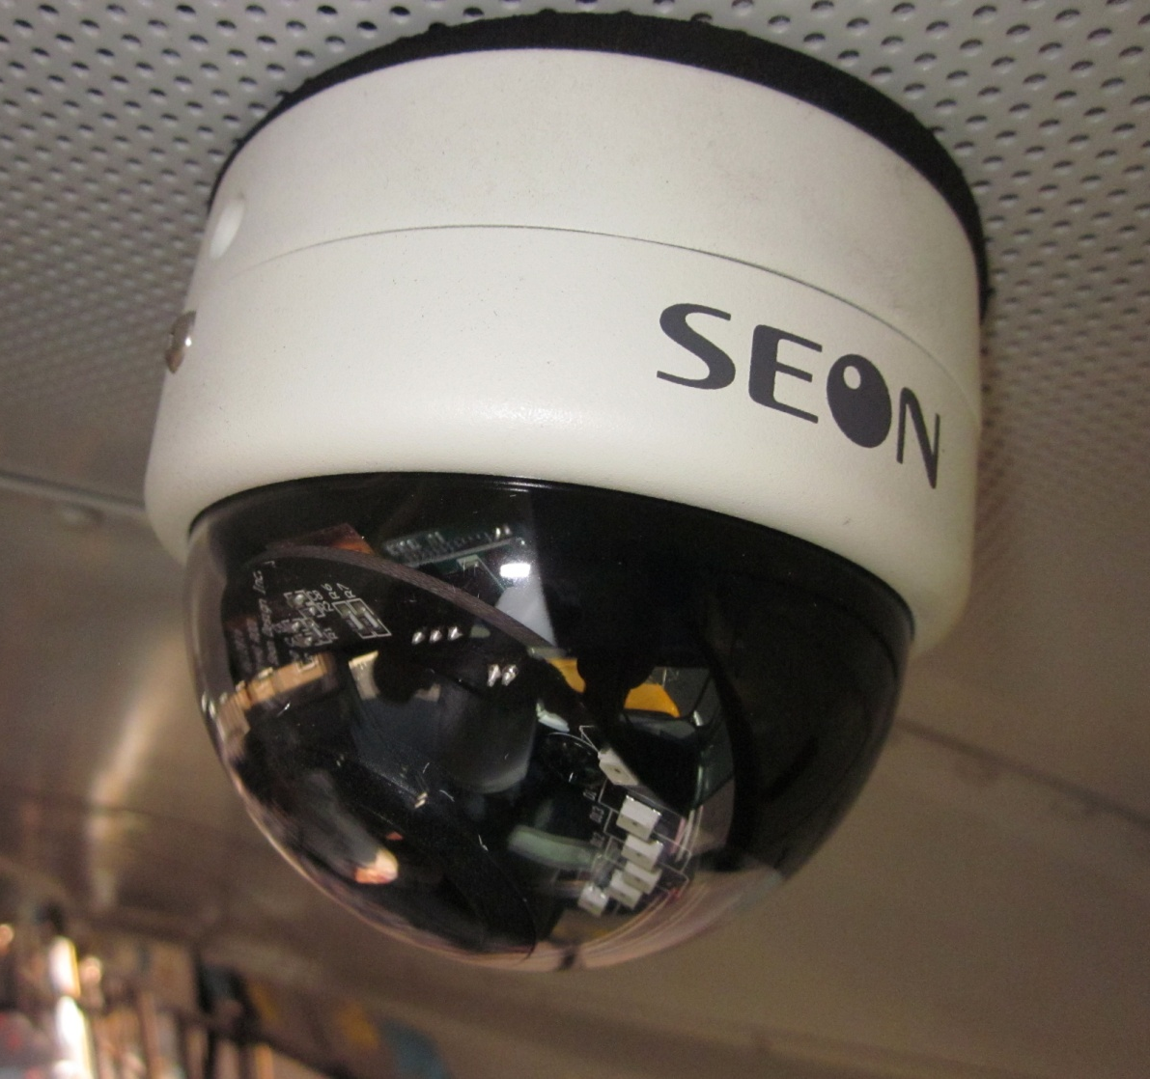
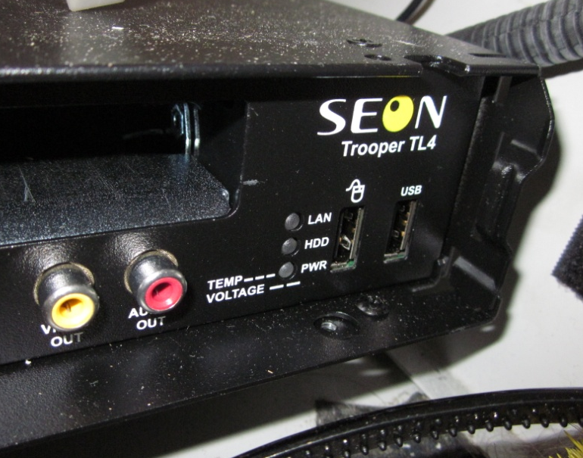
Port Saint Lucie, Florida –
On-Board Video and Audio System
Notes:
Interestingly, the accident school bus was equipped with an on-board video and audio recording system manufactured by Seon Design Inc. with 4 active cameras. These cameras recorded at a rate of 15 frames per second. The recording documented student loading of the bus, the entire bus ride from the school, the impact, occupant kinematics during the crash, motion to final rest and over 10 minutes after the crash showing the emergency response.

Slide 7
Video Camera Locations
Notes:
There were two cameras in the front of the bus, one in the middle, and one in the back, as shown here.
Visible in the camera views were: the driver and loading door, and the passenger seats except the last row of seats and a portion of the second to last row of seats which were not visible in any of the camera views.
These cameras were voluntarily installed on the school bus and were primarily used for behavioral or disciplinary purposes.
We wouldn’t be able to do this work without the video cameras – no other recording devices…

Slide 8
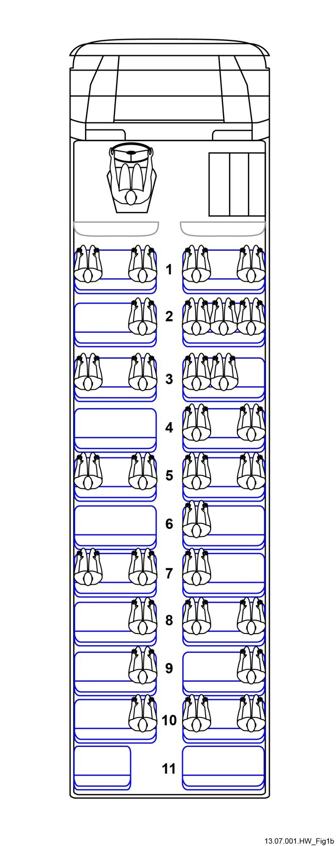
School Bus Interior Passengers
Seat Position Reference
A B C aisle D E F
AOI
Notes:
This figure shows the passenger portion of the bus interior. There were 11 rows of seats, and we referred to the seats from left to right in each row as A, B, C on the left side of the aisle, and D, E, F, on the right side of the aise.
The video and audio recordings also allowed us to establish the exact seating locations of all students.
They were enabled us to view belt usage for some students along with detailed occupant kinematic information.

Slide 9
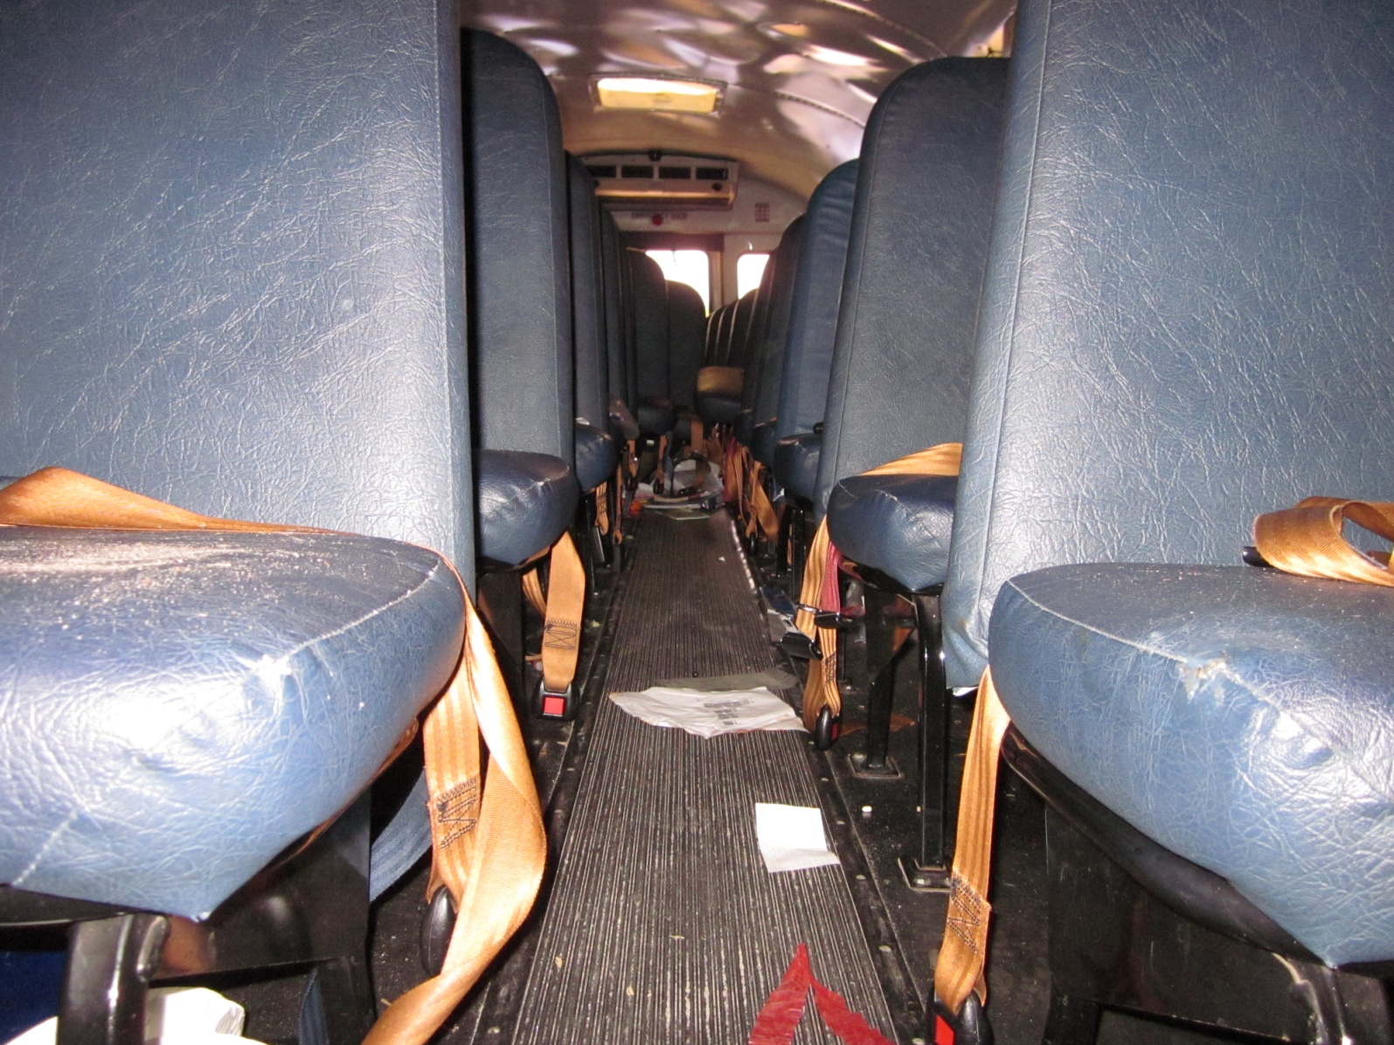
Lap Belts
Notes:
In addition to the cameras, the bus was also equipped with lap belts at all passenger seating positions.

Slide 10
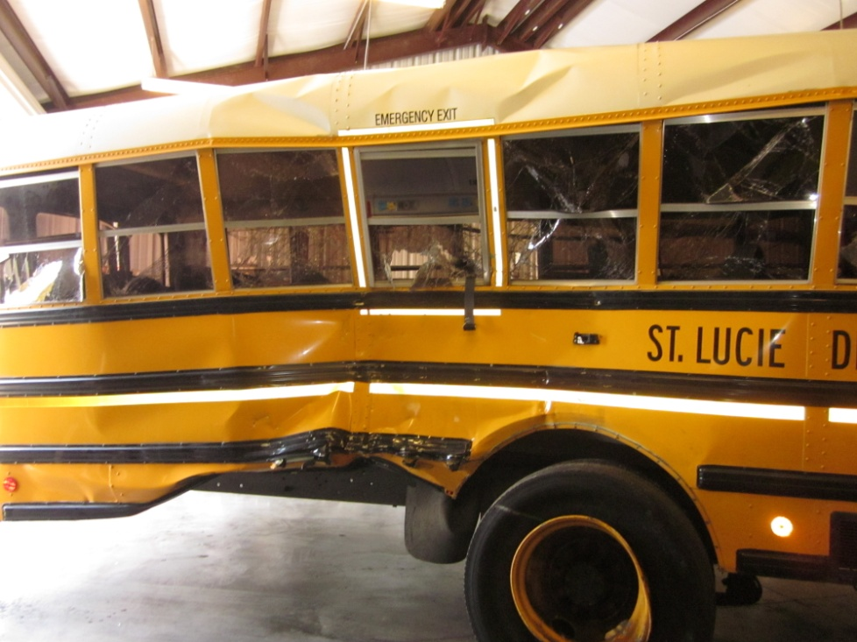
School Bus Lap Belts
Florida requires
passenger seat belts
on school buses
Lap belts:
  Most worn properly
Notes:
Florida is one of 6 states that requires that school buses of all sizes be equipped with seat belts. In this accident, we found that most passengers wore the lap belts and appeared to manually adjust them properly so that the lap belt was worn low and fairly tight on the hips.

Slide 11
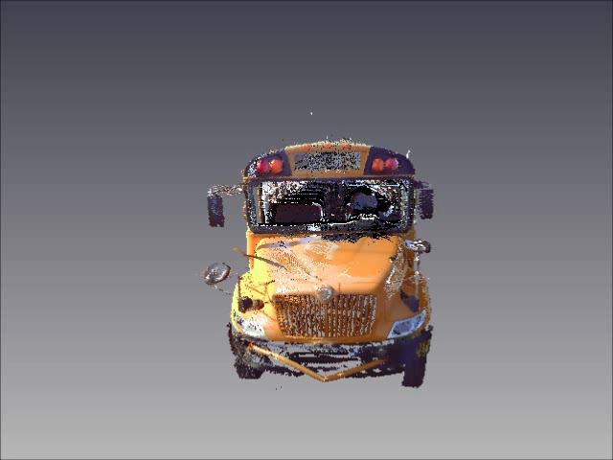
Video from Scanned Bus
Notes:
In this accident, we also used a tool that was new to the safety board – a 3D laser scanner. The laser scanner captures a PointCloud of three-dimensional data that can then be used for imaging, documentation, measurement and long term evaluation. Here is a video showing both the exterior and interior of the accident school bus. Although this looks like a grainy video of the school bus, it is actually a video created from the PointCloud data.
Virtual accident bus.

Slide 12
Technical Collaboration
Technical experts
  Children’s Hospital of Philadelphia
    Kristy Arbogast, Ph.D.
    Mark Zonfrillo, MD, MSCE
  University of Virginia
    Richard Kent, Ph.D.
  Vital data for future research
Notes:
Due to the complexity of the lap belted occupant motion in this severe lateral impact along with the existence of cameras documenting so much of the crash sequence, we worked with pediatric biomechanical and medical experts from the Children’s Hospital of Philadelphia and from the University of Virginia. These technical experts volunteered their time to assist staff in evaluating and documenting the complex passenger dynamics, the occupant-to-occupant interactions, and the injuries. This effort will provide invaluable data for biomechanical engineers and trauma specialists into the future.

Slide 13
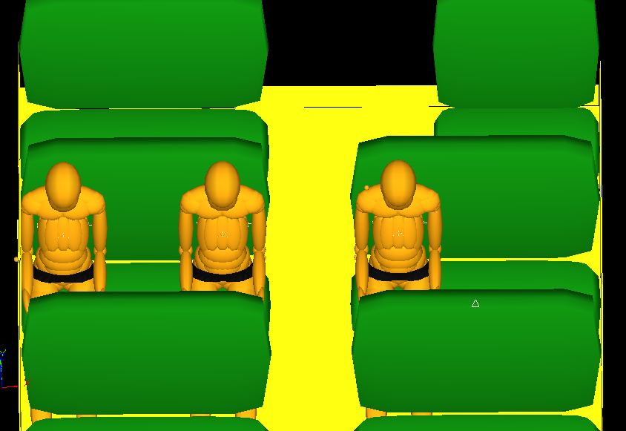
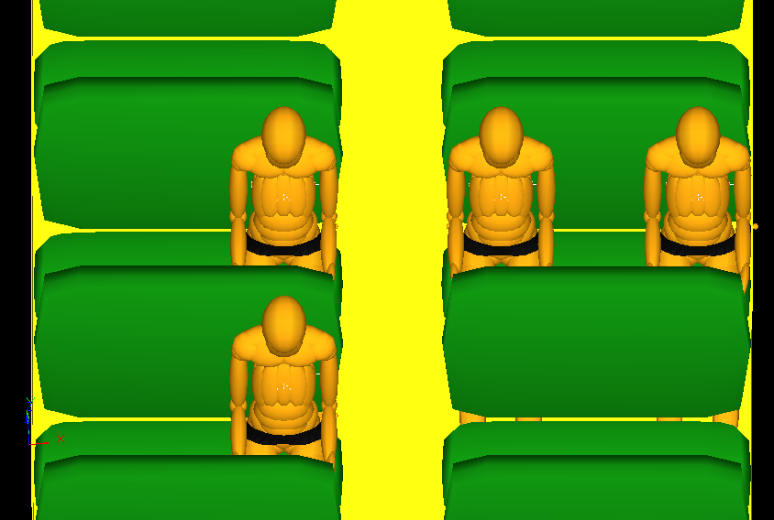
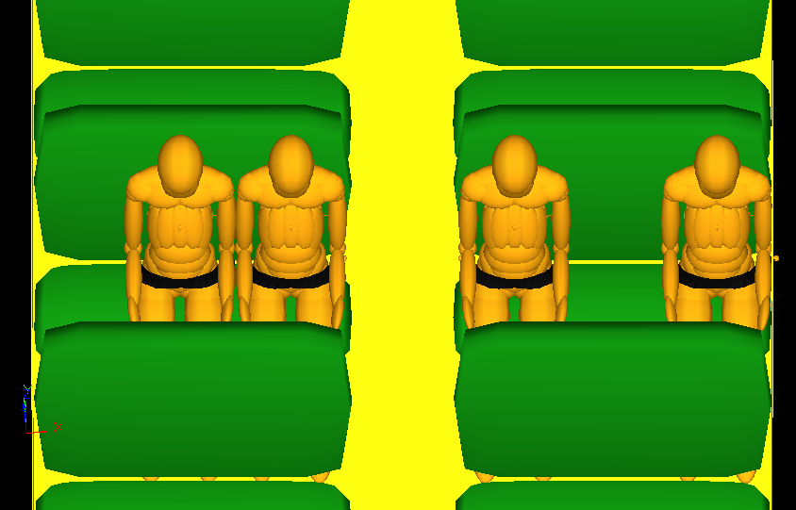
Madymo Simulations
10F
10D
10C
Rear
7D
7C
7A
6D
Middle
3E
3D
3C
3A
Front
Notes:
Due to privacy concerns and the protections for onboard video recordings, we are not able to show you the actual recordings from the accident bus. What we can show are simulations of occupant motion based on the reconstruction of the bus motion from the videos.

Slide 14
Accelerations Based upon Seating Position
Notes:
Of course, due to the length of the bus and the nature of this side impact, occupants in different portions of the bus experienced vastly different crash environments. This graph shows the calculated lateral accelerations at various occupied positions. You can see that the highest accelerations were at the back of the bus (yellow line). Meanwhile, at the front of the bus, near the modesty panel separating the students from the driver, the lateral accelerations were small (pink dotted line).

Slide 15
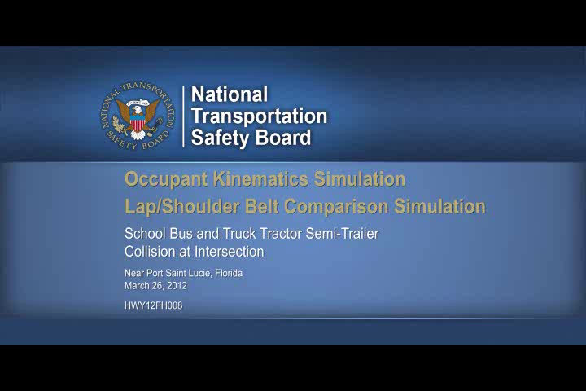
Notes:
Madymo simulation….

Slide 16
On-Board Video Recording
Total video length = 55 minutes 39 seconds
10 seconds from impact to final rest
15 minutes post impact
Notes:
The Madymo simulation that I just showed you represented only a small portion of the video. In total, the video was 55 minutes and 39 seconds long which showed the entire bus ride from the school. From the moment of impact until the bus was at final rest was 10 seconds….very long in comparison to typical crash tests. In addition, the recording continued for an additional 15 minutes giving us an opportunity to watch as children regained consciousness and as bystanders and EMS provided assistance to the children.
Unique time frame that we weren’t able to generate before…. (video gives us this new time frame)

Slide 17
Injury Coding
Title 49 CFR 830.2
  Fatal, Serious, Minor, None (Uninjured)
Abbreviated Injury Scale (AIS)
    Classifies injury by body region and threat
    1 – 6 (minor to maximal)
Injury Severity Score (ISS)
    Represents multiple injuries
Notes:
I’m going talk about the injury characterizations that were done with cooperation of our experts that Kris mentioned. This accident was a unique opportunity to collect both impact and injury data, so we wanted to make as much detail as possible publicly available.
Out investigations typically classify according to CFR Title 49 CFR 830.2, which defines a fatal injury as: any injury that results in death within 30 days of the accident. A serious injury as: an injury which requires hospitalization for more than 48 hours commencing within seven days from the date the injury was received; results in a fracture of any bone (except simple fractures of the fingers, toes, or nose); causes severe hemorrhages, nerve, muscle, or tendon damage; involves any internal organ; or involves second or third degree burns, or any burns affecting more than 5 percent of the body surface.
For this accident we also coded each passenger according to AIS:
The Abbreviated Injury Scale was developed by a joint committee and led by the Association for the Advancement of Automotive Medicine. It is a global severity scoring system that classifies each injury by body region according to its relative threat to life on a 6-point scale with 1=minor and 6=maximal.
AIS is then the basis for the ISS score for the multiply injured patient. ISS is calculated by squaring the AIS score of the three most injured body regions and adding those scores together. (0-75)

Slide 18
AIS Coding: One Patient Example 7D (7C)
ISS Body Region | AIS Code | Description
Head or Neck | 161002.2 | Concussion with LOC
 | 150206.4 | Basilar skull fracture, right, comminuted
 | 150206.4 | Basilar skull fracture, left, comminuted
 | 150402.2 | Temporal bone fracture, left
 | 131699.2 | Cranial nerve VII palsy, right
 | 131499.2 | Cranial nerve VI palsy, right
Face | 240499.1 | Eye hematoma, right
Chest | 441402.3 | Pulmonary contusions, unspecified
Abdominal or Pelvic Contents | None | None
Extremities or Pelvic Girdle | 856151.2 | Pelvic ring fracture, anterior iliac spine
External | 210402.1 | Face hematoma, unspecified
 | 810402.1 | Abdomen/pelvic hematoma, right
 | 810202.1 | Pelvic abrasion, anterior
 | 710202.1 | Forearm abrasion, left
 | 210600.1 | Ear laceration, right
Notes:
Here is an Example of AIS for the occupant in 7D. [CLICK] note the detail in the AIS injury code – which is why we needed specialists with experience in pediatric injury coding. [CLICK]
Also note that you can look at the injuries by body region using the AIS code only. (Typically, you only see the last number of the code representing the injury (1-6) but the AIS code is the entire number.

Slide 19
AIS Coding: One Patient Example 7D (7C)
ISS Body Region | AIS Code | Description
Head or Neck | 161002.2 | Concussion with LOC
 | 150206.4 | Basilar skull fracture, right, comminuted
 | 150206.4 | Basilar skull fracture, left, comminuted
 | 150402.2 | Temporal bone fracture, left
 | 131699.2 | Cranial nerve VII palsy, right
 | 131499.2 | Cranial nerve VI palsy, right
Face | 240499.1 | Eye hematoma, right
Chest | 441402.3 | Pulmonary contusions, unspecified
Abdominal or Pelvic Contents | None | None
Extremities or Pelvic Girdle | 856151.2 | Pelvic ring fracture, anterior iliac spine
External | 210402.1 | Face hematoma, unspecified
 | 810402.1 | Abdomen/pelvic hematoma, right
 | 810202.1 | Pelvic abrasion, anterior
 | 710202.1 | Forearm abrasion, left
 | 210600.1 | Ear laceration, right
ISS = 29
Notes:
The injury severity score or ISS takes the highest AIS score from three body regions and sums the squares. For example, here we have an AIS 4 at the head, a 3 at the chest and a 2 at the pelvis. This would result in an ISS score of 29.

Slide 20
Port Saint Lucie – CFR Coding
School bus occupants
  30 passengers
    1 fatality
    8 serious injuries
    11 minor injuries
    10 uninjured
  Driver – minor injuries
AOI
Uninjured
Serious
Minor
Fatal
Notes:
Here the traditional CFR injury coding shows the general injury severity patterns in the bus.
[CLICK] The single fatality in Port Saint Lucie, marked with the red circle, was seated in the back of the bus, on the opposite side and behind the area of intrusion, but in the area with the highest accelerations. Most of the [CLICK] seriously injured passengers were seated in the back of the bus. Although many of the minorly [CLICK] injured occupants, marked with yellow circles, were seated toward the front of the bus and away from the impact, some were also in the intrusion region. The uninjured [CLICK] are marked with the green circles.

Slide 21
CFR Coding
Max AIS Coding
AIS Code
1 =
2 =
3 =
AOI
AOI
4 =
5 =
Notes:
If we now compare the CFR coding to the AIS coding, we see a slightly different picture emerge. One the left is that same image that you saw previously. On the right, I have removed all the circles for the occupants that we received detailed medical records, which enabled the AIS coding. First, [CLICK] let’s add in all the maximum AIS 1 injuries marked with the brown stars. Next, AIS 2 [CLICK]. AIS 3, AIS 4, 5…
Although all the AIS 3, 4, and 5s are in the back of the bus, we have a few AIS 1 and 2s in the back as well. What was different for these passengers with the lower AIS scores? Factors could be belt tightness, interactions between the occupants or the interior, or maybe packing of passengers in a single had an effect. AIS provided the detail to do these sorts of evaluations.

Slide 22
Focusing on Head Injuries in Overlay
Max Head AIS Coding
AIS Code
None =
1 =
2 =
3 =
AOI
4 =
5 =
Notes:
I’d like to point out another example of using AIS for a specific body region. If we consider only the coding with maximum AIS for the head, we see some changes. Notice that we see a decrease for some occupants outside of the intrusion zone or on the non-impact side of the bus.
The video data provided an alternate method to look at head injury. It documented a range of loss of consciousness, which I’ll show in the next slide.

Slide 23
Loss of Consciousness
Max Head AIS Coding
AIS Code
None =
No LOC
1 =
2 =
Dazed
3 =
Probable
AOI
4 =
Certain
5 =
Unknown
Notes:
I’ve started with coding for maximum AIS - for the head only. I we then overlay a classification for loss of consciousness, we can look for correlations. In this example the colored square show these categories for LOC. The unknown white squares indicate that we were unable to clearly see the passenger response in the video. This was the case when, for example, the child had slumped over and was hidden from view by the seatback.

Slide 24
Injury Severity Score – Multiple Injuries
ISS Coding
ISS
1-9 =
10-15 =
16-24 =
25+ =
AOI
ISS
1-9 = minor
10-15 = moderate
16-24 = moderate/severe
25+ = severe/critical
Notes:
Here is an example showing the Injury Severity Score. Remember, this is the sum of the squares of the highest AIS score for three different body regions. This score accounts for multiple injuries in a given occupant rather than just the highest injury to a single body region.
A logical pattern emerges for occupants in the direct area of intrusion, showing a severe to critical risk of mortality. In addition, those in the back of the bus, who experienced the highest accelerations also had a similar risk of mortality.

Slide 25
New Injury Severity Score – Multiple Injuries
ISS Coding
New ISS
1-9 =
10-15 =
16-24 =
25+ =
AOI
New ISS
1-9 = minor
10-15 = moderate
16-24 = moderate/severe
25+ = severe/critical
Notes:
Criticism of ISS is that it doesn’t account for multiple injuries to a single body region. If we code so that we sum the scores for the highest three injuries independent of body region, you see that only one occupant is changed….6D. [CLICK] This occupant had multiple very severe head injuries and now we see that his threat to life is more represented based on the outcomes that we saw on the video and the medical information.
Conclusion: Different coding methods can result in different interpretations of the data.

Slide 26
Port Saint Lucie Factual Reports
http://www.ntsb.gov/investigations/dms.html
  Survival Factors Factual
  Injury Coding Factual
  3D Laser Scanning Factual
  Electronic Control Module Factual
  Video Factual
  Video Study
  Biomechanics Simulation Study
Notes:
You will notice that we’ve provided examples and shown some trends, but not made any conclusions related to injury causation, medical outcomes, or crash forces.
This can be done in future work, but instead, we wanted to give you a taste of the information we’ve gathered and what you or other researchers may be able to do with it.
All of the factual information is currently available from out public docket system. The reports listed here cover each aspect of the data collected. These reports include …

Slide 27
Thank You
Kristin Poland, Ph.D.
Office of Research and Engineering
Kristin.Poland@ntsb.gov
Thomas Barth, Ph.D.
Office of Highway Safety
Thomas.Barth@ntsb.gov

Slide 28
Notes:
Thank you. That concludes my presentation. Staff are now prepared to answer your questions.

Slide 29
Duration of Loss of Consciousness
Notes:
Plot showing the average time of loss of consciousness versus the maximum AIS code for the head only. Note the obvious trend between mAIS and LOC.

Slide 30
Injuries: CFR / ISS / AIS
CFR Minor Serious
ISS (1 to 75)
AIS 1 2 3 4 5
1
1
1
AOI
Notes:
As we saw earlier in the Chesterfield crash, [CLICK] the single fatality in Port Saint Lucie, marked with the red circle, was seated in the back of the bus, on the opposite side and behind the area of intrusion, but again in the area with the highest accelerations. Most of the [CLICK] seriously injured passengers were seated in the back of the bus. The PSL school bus was also equipped with passenger lap belts at all seating positions.

Slide 31
Extra Slides??

Slide 32
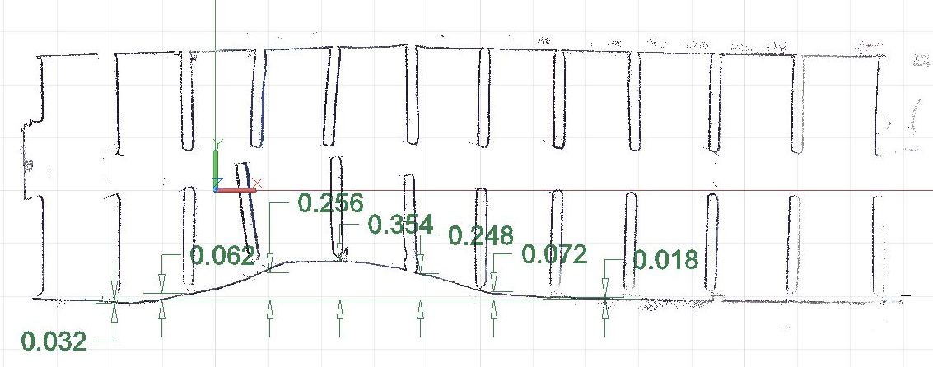
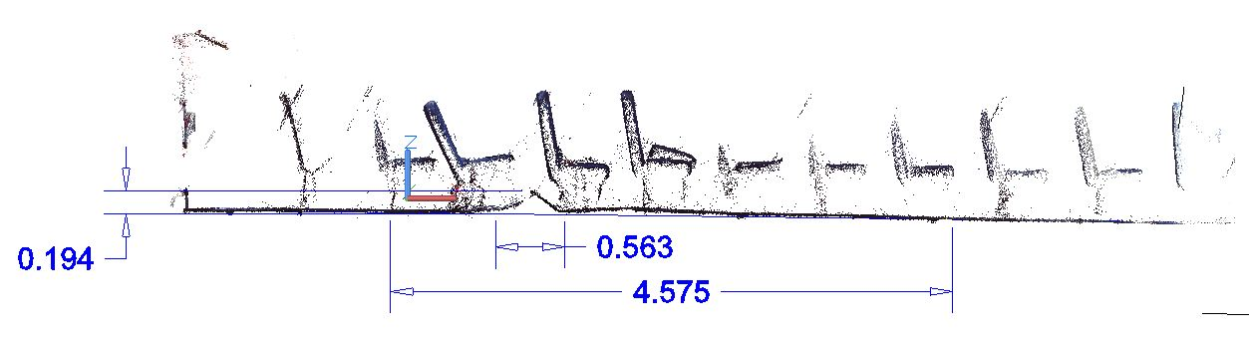
Port St. Lucie, FL

Slide 33
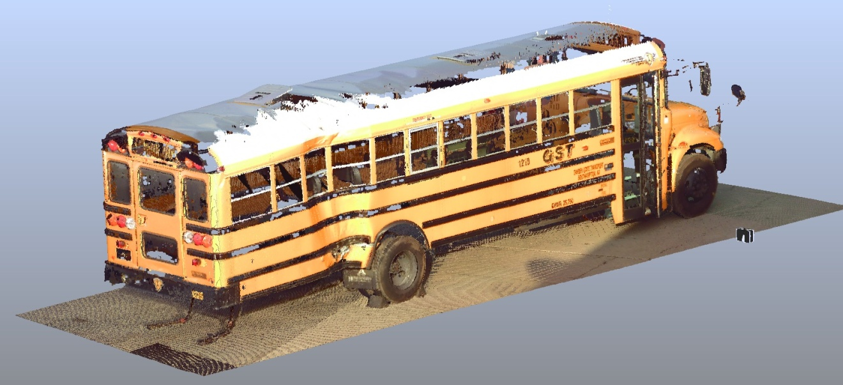
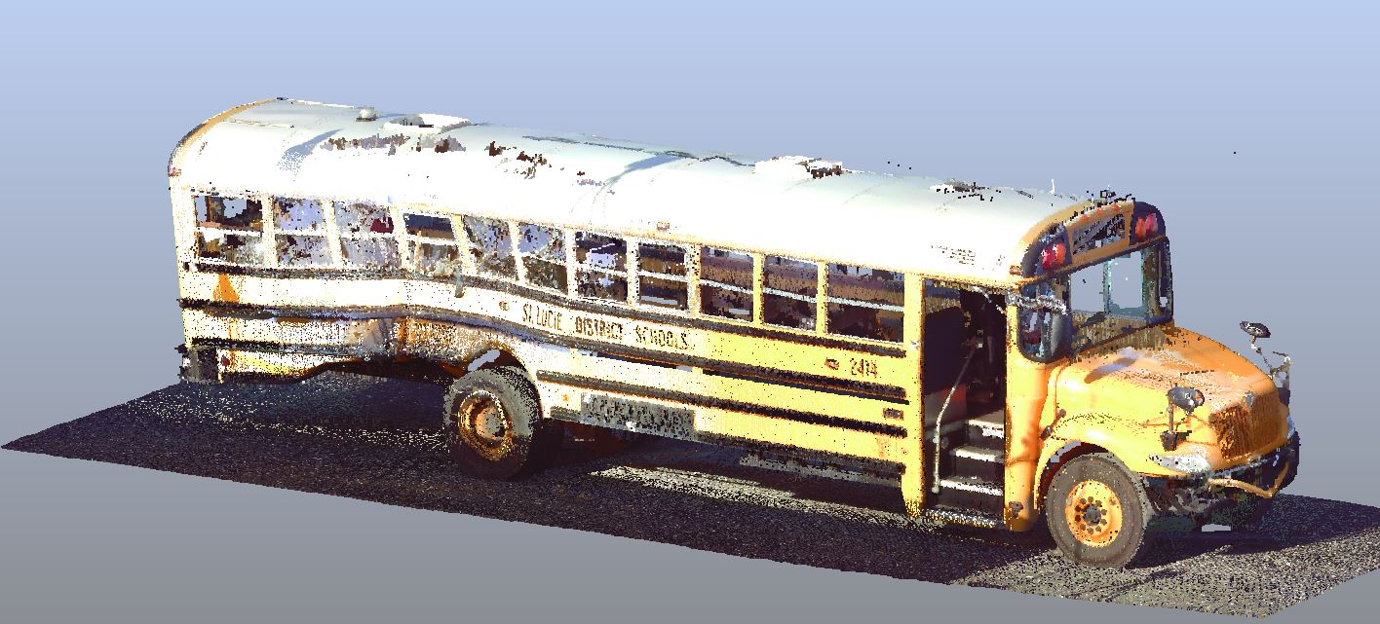
Comparison of School Buses
Chesterfield
Port St. Lucie
Notes:
In addition, as you can see from these two scanned images of the Chesterfield and Port St. Lucie school buses, the damage patterns were similar.
In both of these two crashes, investigators used 3D laser scanner technology to fully document the damage to the exterior and interior of the school buses.

Slide 34
Duration of Loss of Consciousness

