Slide 1
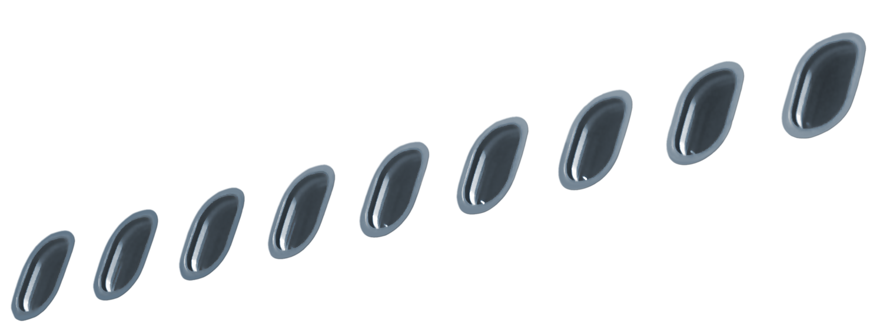
Magnesium small scale test
Triennial Fire and Cabin Safety Research Conference
Test method and test results
Presented by
Heinz-Peter Busch/ Expert

Slide 2
Outline
Test apparatus
  Test rig
  Test sample arrangement
  Important parameters
  Test method abstract / requirements
  Test results
    Single test results
    Influence of coating
    Influencing parameters
    Medium versus small scale test
  Improvement
  Conclusion

Slide 3
Test rig
415 mm
100mm
82mm
500 mm
150 mm
82mm
A Teclu-burner, supported with propane gas, provided a temperature underneath the stainless steel plate of1190°C ± 15°C.
The upper surface temperature of the
steel plate, measured in the centre is
865°C ± 15°C
315 mm
      The test rig shall be shielded with high temperature resistance boards on three sides below the steel plate level

Slide 4
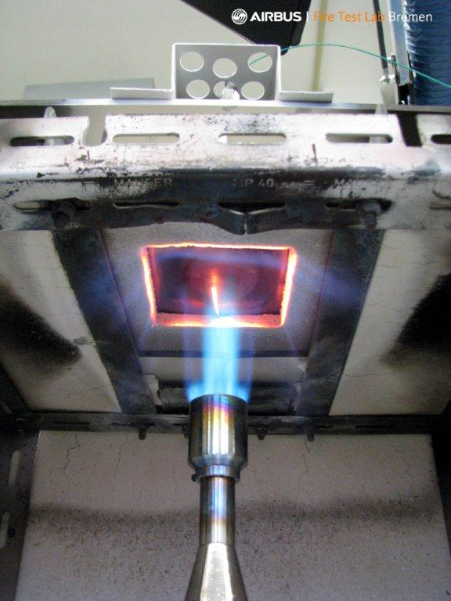
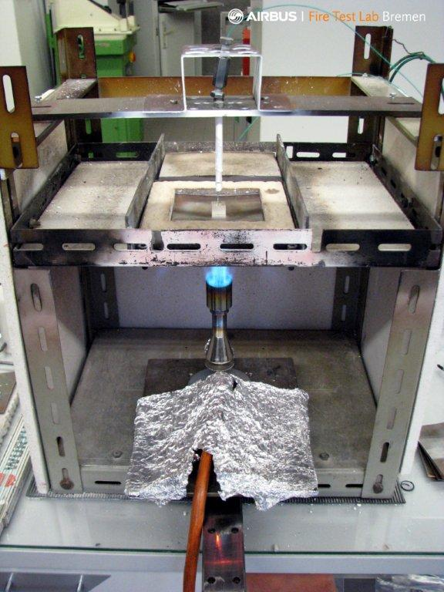
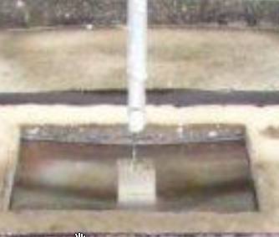
Test rig
Steel-plate
Thermo couple
Teclu burner
Thermo couple
Bottom view
Global view
Steel-plate with specimen

Slide 5
Test Rig Description
Burner: Teclu type, operate with Propane,
      Pressure: 1bar (14.5 psi)
      Air supply : 100% opening
      Steel plate: 100 mm x 100 mm x 1.5 mm stainless steel acc. to DIN X8CrNiTi18-10, (ASAI 321 H)
      Insulation: Kaowool M board (19 mm), high density
      Thermocouple: 0.5mm type K, glass isolated for test sample temperature 1.5 mm type K, mantle thermocouple for flame temperature
      Data recording: Pico USB TC-08 Thermocouple Data Logger
      The test rig shall be shielded with high temperature resistance boards on three sides below the steel plate level

Slide 6
Test Sample Arrangement / Test Sample
stainless steel plate (1,5 mm)
Investigation of two different sample sizes:
  (10 x 10 x 10) mm³
  (15 x 15 x 10) mm³
  All samples have a drilled hole in the centre of their specimen top:
    1.7mm in Ø and 6.6 ± 0.2mm in depth to measure the temperature during testing
  10 different Mg alloys were tested
    all without coating
    some with corrosion protection
    some with corrosion protection and
    topcoat
10 mm
5 mm
15 mm
1.7 mm
6.6 mm
100 mm
100 mm
Tested Magnesium alloys:
AZ31, AZ80A, AZ91E, ZK60, ZE10, ZE41, AM50, EP21, WE43, EP675

Slide 7
Important Test Parameter
To generate comparable test results within a small tolerance
< 10% following test parameter shall be kept constant
  Steel pate: Material, thickness, size
  Temperature: Steel plate centre temperature
  Thermocouple: Location inside the test specimen
Weight
To eliminate the distance change
caused by the thermal stress of the
steel plate and to measure the sample
temperature always at the same location
the thermocouple will be automatically
adjusted by the weight.
ΔH
Thermocouple, specimen
T = Rt
T = 870
ΔH
Thermocouple, flame
Exact thermocouple positioning

Slide 8
Test Method description
Burner calibration to a steel-plate temperature of 870°C
Burner in push back position
Insert steel-plate for measurement when test rig frames cooled down below 40°C
Insert test sample in centre of steel-plate and place the thermocouple in position
Start temperature recording
Ignite burner and move it into test position
Remove burner when test sample starts burning
Stop temperature reading when sample cool down below 400°C
Save test data

Slide 9
Requirement
All three specimens tested must not ignite in less than 100 seconds during which they are exposed to the flame.
If samples ignite in between 100 to 110 seconds, all three samples must self-extinguish after the burner was removed
Alloys that do not ignite after an exposure time >110 seconds are recommended.

Slide 10
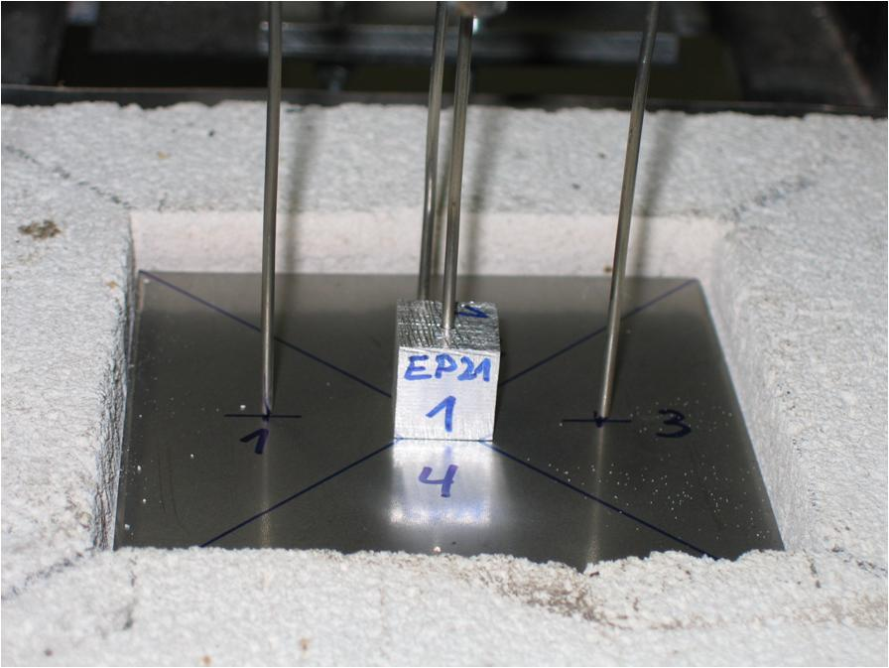
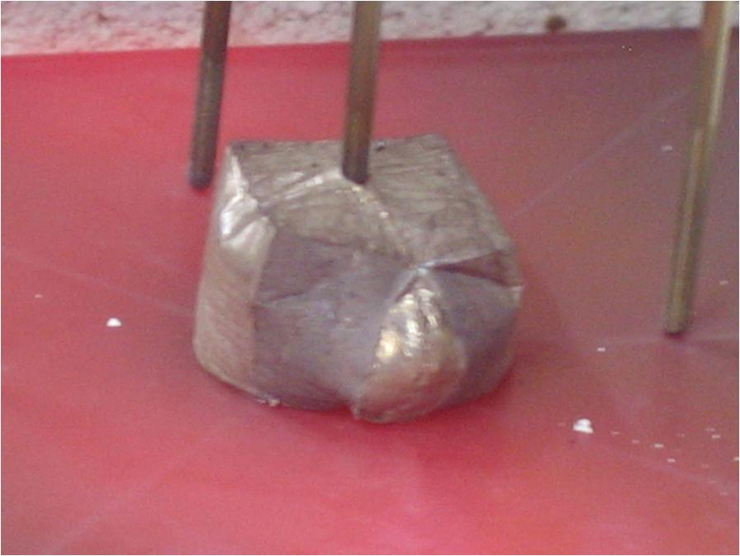
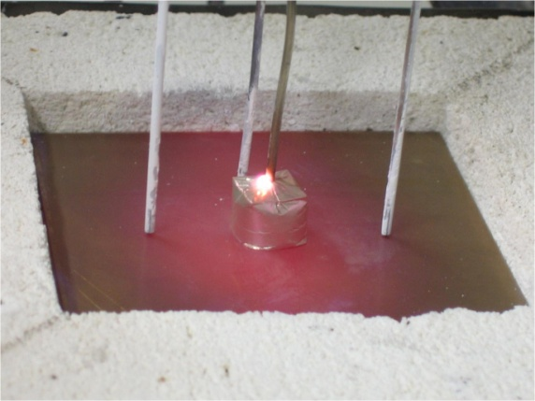
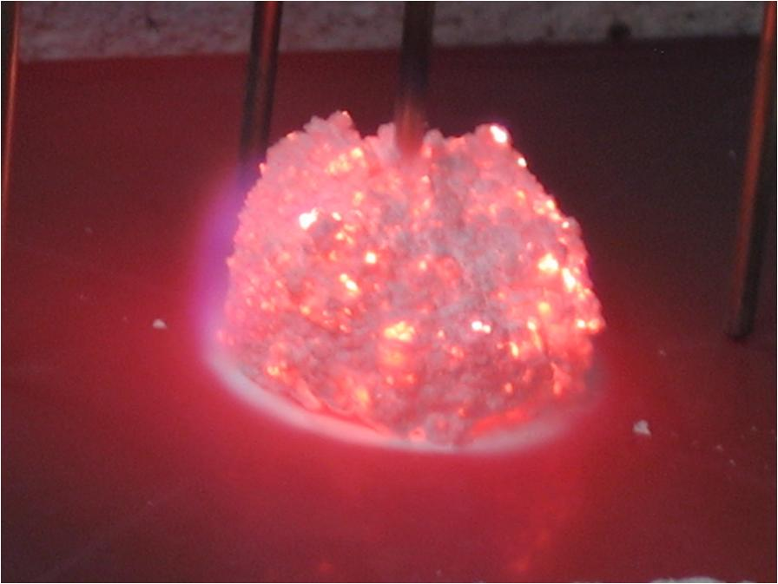
Test results: EP21 – 10x10 versus 15x15 cubes
1
4
3
2
1
enthalpy plateau
2
exothermic reaction
3
Because of their smaller mass, the 10 x10 cubes reached the melting temperature earlier (app. 25s). The temperature, when the first reaction after the enthalpy plateau had been reached, was comparable. If the test coupon is self extinguishing, this will also be indicated by the exothermic reaction during cooling
4

Slide 11
Test results: Overview
100s
110s
At least two alloys fulfil the requirements

Slide 12
Single test results - reproducibility
EP21
ZE41
WE43
ZK60

Slide 13
Single test results - reproducibility
AZ80A
AZ91E
Notes:
AM 50: Probe rot nicht mittig auf der Platte ; Unterseite nicht abgeschmirgelt 400er:

Slide 14
Influence of coatings
AM50
AZ31
WE43
Pure => without coating
CP => corrosion protection
CP + TC => corrosion protection and top coat
CP + P +TC => corrosion protection, primer and top coat
The coating positively influenced the time to ignition but the influence was not used for the material ranking. It provides an additional safety margin.

Slide 15
Influence of coatings
The coating shifts melting of the Mg to a higher temperature before ignition occurs
This effect should be validated in the FAA Mg-alloy test.

Slide 16

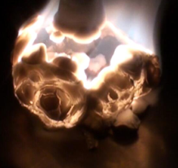

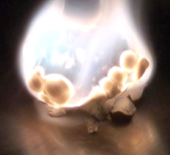
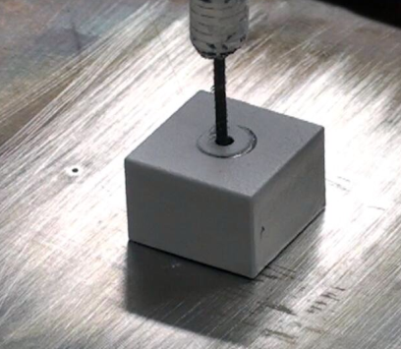
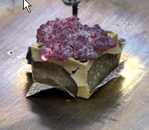
Influence of coatings
The corrosion protection keeps the liquid “in place”. The ignition starts in and on top of the unprotected thermocouple hole.

Slide 17
Influencing parameter
Sample 1 (11.8x12.0x12.3) mm³ => 3 g and sample 2 (10x10.1x 10) mm³ => 1.78 g have been tested on a 0.6 mm steel-plate and a flame temperature of app 1000°C.
Sample 3 (12x12x12.5) mm³ => 3.09 g has been tested on a 2.1mm steel-plate and a flame temperature of app 1150°C.
The results show that sample size, sample mass, flame temperature and steel-plate thickness must be kept constant for data comparison.

Slide 18

Comparison WE43 – AZ31

Slide 19
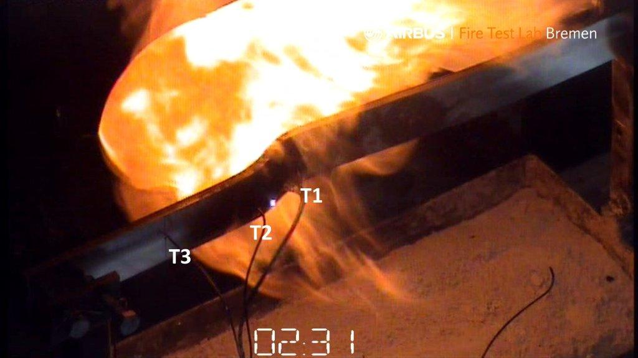
Oil burner versus Small Scale Mg-Test
AZ 31 starts to burn during the oil-burner
test at 630°C in an 1000°C open flame
environment at app.150s
An AZ 31, (15 x 15 10)mm³ cube starts
burning also at 630°C under radiant heat
environment of 870°C but because
different mass/energy ratio app. 50s earlier.
151°C
first flame
103°C
AZ 31 sample during oil burner RR test

Slide 20
Improvement for better reproducibility and sensibility
To increase reproducibility, an improvement was made. The steel-plate was replaced by a 3 mm graphite plate. The presented EP 675 results are tested with this graphite plate and show a sufficient reproducibility (±10 °C and ± 5 s) and provide excellent sensibility to show special characteristics of the alloy.

Slide 21
Conclusion
  The presented data demonstrated that the test method lead to reproducible
and accurate results
  The test set up is small, economical and simple in application
  The test method allows a quick check of new alloys with only a small
  amount of material needed
  The method leads to the same material ranking was found in the FAA
  Mg-oil burner test
  Additional material information is provided for a better characterisation
  of the tested materials
  If this test method is not accepted by the authorities as an equivalent means
  for seat structure application, it can be used however for magnesium testing for
  other interior applications in future

Slide 22
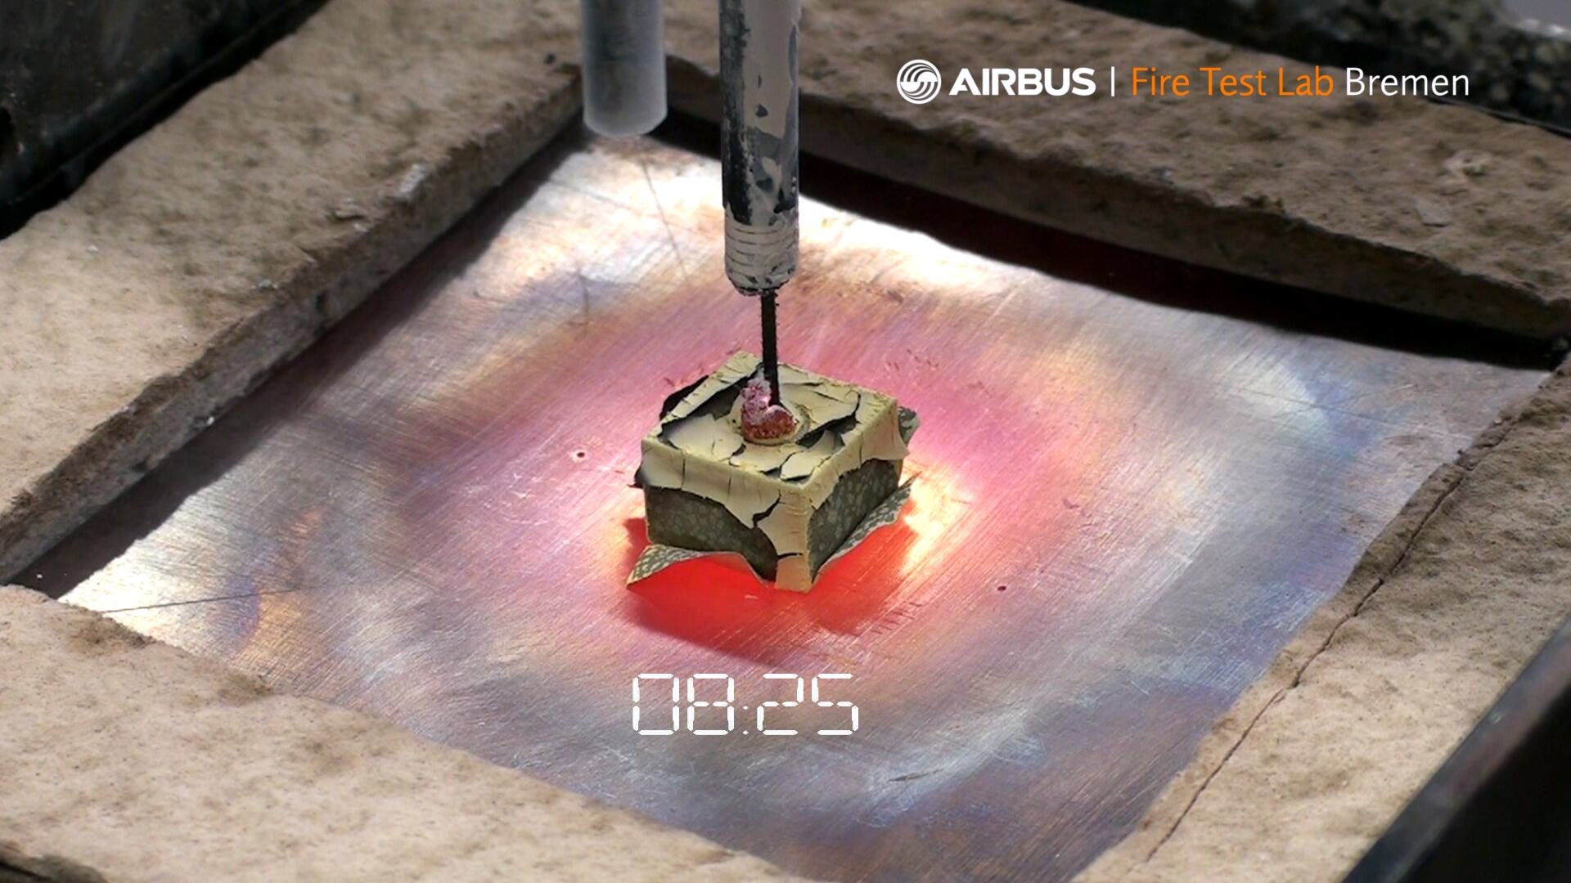
End
Thank you!
Questions?

Slide 23
© AIRBUS Operations GmbH. All rights reserved. Confidential and proprietary document. This document and all information contained herein is the sole property of AIRBUS Operations GmbH. No intellectual property rights are granted by the delivery of this document or the disclosure of its content. This document shall not be reproduced or disclosed to a third party without the express written consent of AIRBUS Operations GmbH. This document and its content shall not be used for any purpose other than that for which it is supplied. The statements made herein do not constitute an offer. They are based on the mentioned assumptions and are expressed in good faith. Where the supporting grounds for these statements are not shown, AIRBUS Operations GmbH will be pleased to explain the basis thereof.
AIRBUS, its logo, A300, A310, A318, A319, A320, A321, A330, A340, A350, A380, A400M are registered trademarks.

