Slide 1
MAGNESIUM IN SEAT STRUCTURE
The Seventh Triennial International Aircraft Fire and Cabin Safety Research Conference December 2-5, 2013, Philadelphia, Pennsylvania, USA Materials Fire Safety

Slide 2
Agenda
RECARO Aircraft Seating Company Profile
Global Status of Proceedings for Magnesium in the Cabin
Status of Magnesium Application Possibilities for Seats
Green Aspects for Using Magnesium in Seats
Summary and Outlook

Slide 3
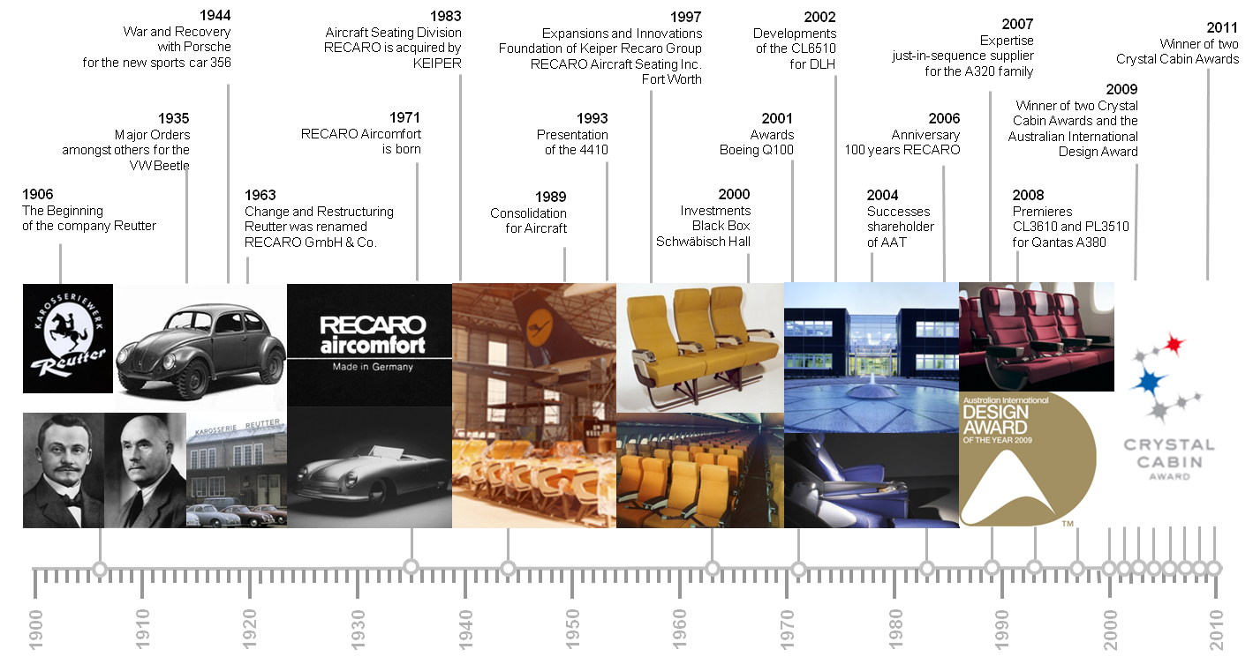
Company Profile
Our Tradition
Notes:
Hinweis im Vortrag, dass Merger event. nie richtig stattgefunden hat

Slide 4
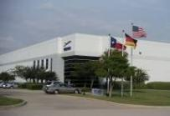
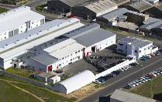

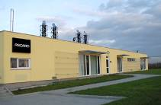

Company Profile
Locations
Fort Worth
Assembly
Cape Town
AAT Composites
Schwäbisch Hall
Headquarters – Assembly
Świebodzin
Assembly
Hamburg
On-Site Airbus,
Customer Service
Seattle
On-Site Boeing,
Customer Service
Bishop’s
Stortfort
Stockholm
Atlanta
Alphen
a. d.
Rhin
Beijing
Paris
Chengdu
Rome
Shanghai
Dubai
Hong Kong
Toulouse
On-Site Airbus,
Customer Service
Singapore
RECARO Aircraft Seating
Locations
RECARO Service Centers
RECARO OEM On-Site Support
Strategic Partnerships:
Avio-Diepen
Globavia
Sao Paolo
Melbourne
Victoria

Slide 5
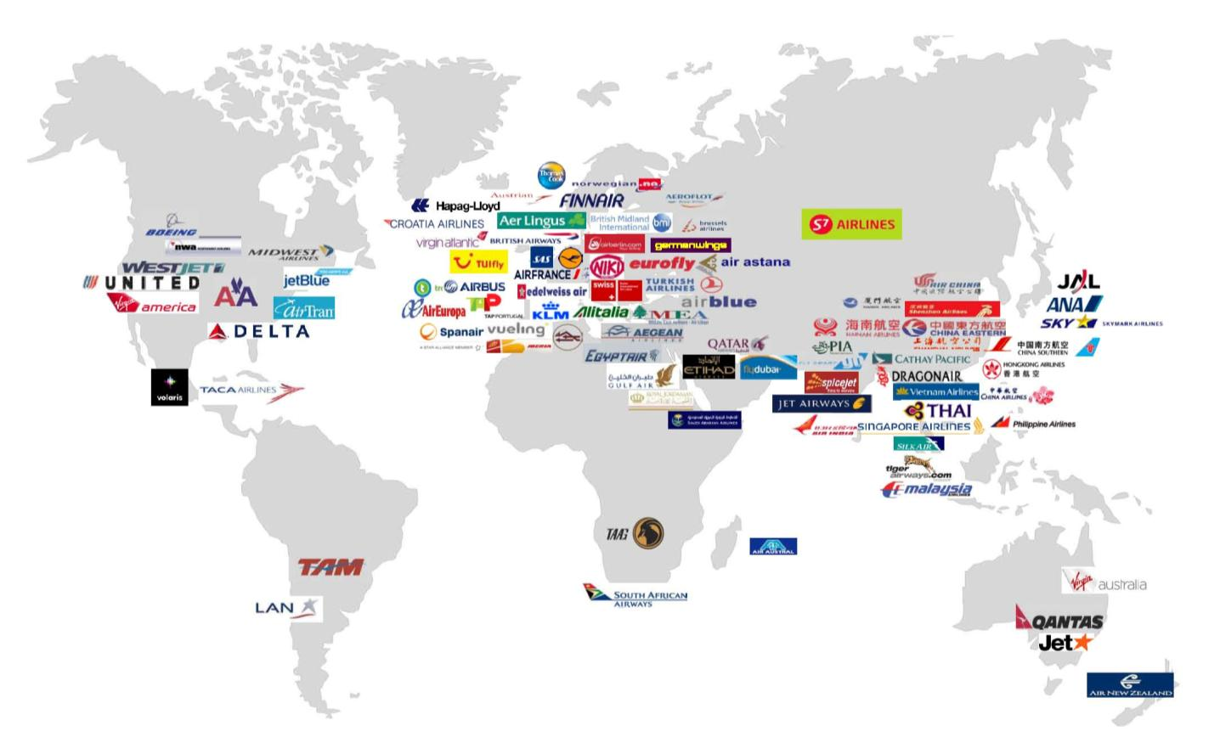
Company Profile
Customers Worldwide
Notes:
5

Slide 6
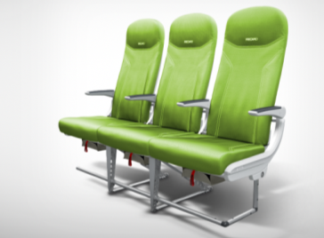
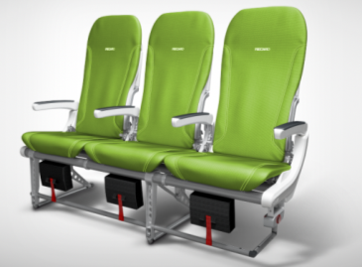
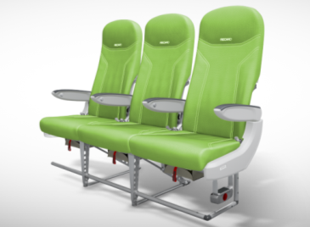
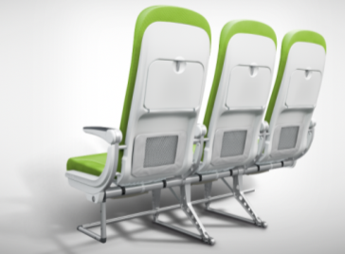
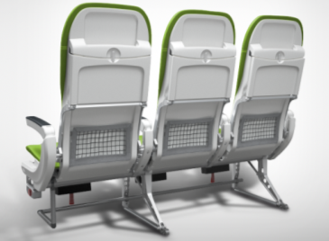
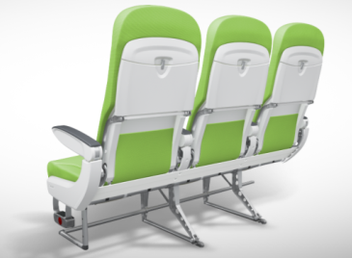

Company Profile
Products: Economy Class
Smart Line SL3510
Basic Line BL3520
Basic Line BL3510
Winner of the
Crystal Cabin Award 2011
Category
Industrial Design/
Interior Concept

Slide 7
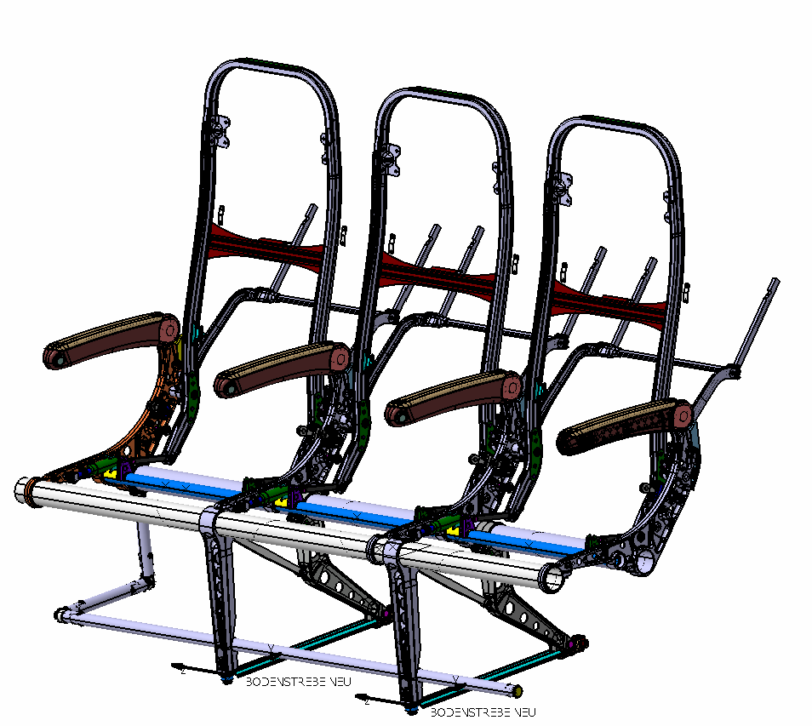
MAGNESIUM IN SEAT STRUCTURE
2. Status of Magnesium Application Possibilities for Seats
Magnesium Project Results
Evaluate weight reduction potential of average 15% per selected part
Gain know-how about integration of magnesium parts into the seat structure
Construction and production of magnesium parts with adjusted dimensions upon magnesium alloy material data evaluation & stress calculation
4. Support the certification of magnesium in the cabin

Slide 8
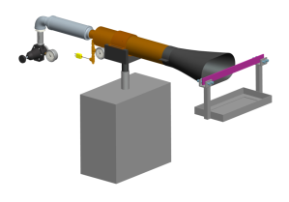
MAGNESIUM IN SEAT STRUCTURE
1. Global Status of Proceedings for Magnesium in the Cabin
Extracts from Magnesium Working Group*
√ Additional tests conducted
  Ran additional 99 tests for grand total of 521 tests
  With “poor” and “good” alloys like ZE41, AZ80, WE43, EL21
√ Draft test method completed
  Sample thickness: 0.250 inches
  Burner exposure time: 4 minutes
  Minimum time for sample to start burning: 2 minutes
  Maximum time for sample to self extinguish: 3 minutes after burner off
  Maximum weight loss: 6% to 10% (replaces time measurement of residue burning)
√ Round Robin II completed
* Source: Bruce Gwynne ; Magnesium Working Group; Dublin, Ireland; September 17 -19, 2013

Slide 9
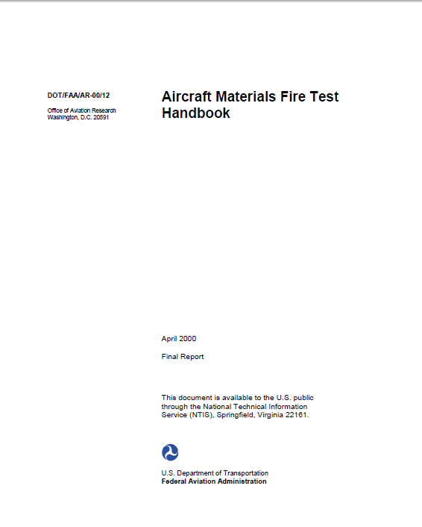
MAGNESIUM IN SEAT STRUCTURE
1. Global Status of Proceedings for Magnesium in the Cabin
Extracts from Magnesium Working Group*
SAE AS8049 - Aircraft Seat Standard
Para 3.3.3 “Magnesium alloys shall not be used.”
Start
Qualification and verification
for test method
and test article definition
http://www.fire.tc.faa.gov/pdf/AR11-13.pdf
AIR 6160
Aircraft Materials Fire Test Handbook
http://www.fire.tc.faa.gov/pdf/handbook/00-12_ch1.pdf
Update AS 8049 para. 3.3.3
With suggested wording
Suggested wording: *
“Magnesium alloys may be used in aircraft seat construction provided they are tested to and meet the flammability performance requirements in the FAA Fire Safety Branch document: Aircraft Materials Fire Test Handbook – DOT/FAA/AR-00/12.”
Situation for Aircraft Seat Manufacturers:
TSO C127 can be granted via special condition from now on
however not yet for
ETSO C127
Goal
* Source: Bruce Gwynne ; Magnesium Working Group; Dublin, Ireland; September 17 -19, 2013

Slide 10
MAGNESIUM IN SEAT STRUCTURE
2. Status of Magnesium Application Possibilities for Seats
Starting Point at Sixth Triennial Conference :
Typical Structure of a RECARO seat
Table arms
Cross Beam
1. Front Leg
3.2382.6 Al
0.3535 kg
WE43 - extruded & milled
Spreader + Backrest Structure
Front Leg
horizontal bar
Rear Leg
Only 5 parts permitted by FAA for Magnesium design: cross beam, front leg, horizontal .bar, spreader, (table arms- accepted during run of the project)

Slide 11
MAGNESIUM IN SEAT STRUCTURE
2. Status of Magnesium Application Possibilities for Seats
Time, Cost, Risk and Experience of New Material
high
Level of novelty
risk
cost
time
Level of Experience
low
Situation
Complete new material
Material new for industry
Material new for company
first use in product
Well-known material
Decision
Situation
Innovation at
market
Material substitution
Decision for material
types
Different scope of validation according to level of maturity

Slide 12
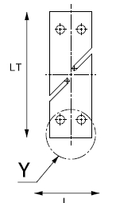
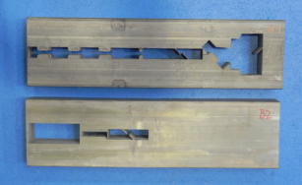
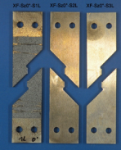
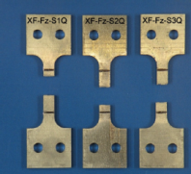
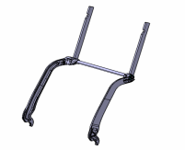

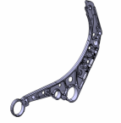
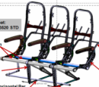
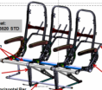

MAGNESIUM IN SEAT STRUCTURE
2. Status of Magnesium Application Possibilities for Seats
Magnesium Data Evaluation & Validation Concept
Test Specimen Definition, incl. drawings
Test Specimen Production
Weight Saving Potential Calculation
EL43 Tests at IWM
→ Output Material Data
Component Tests with EL43 Parts (Alu Geometry)
→ Output Material Data
Final Parts Dimensions
& Drawings for Mg Parts
Mg Parts with Adjusted Geometry
EL43 Material Data from Magnesium Electron
Testing
with Mg parts
4g Side Static Validation Test
Component Validation Tests
Fatigue
Validation Tests
16g forward
Validation Test

Slide 13
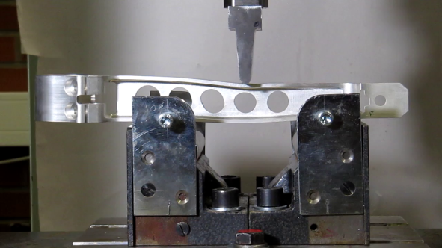
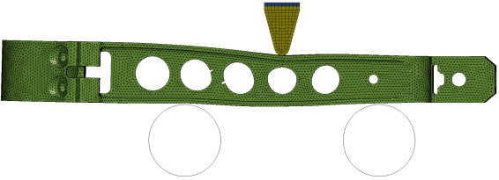
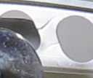

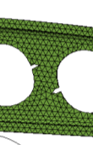
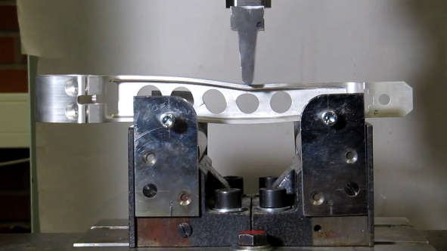
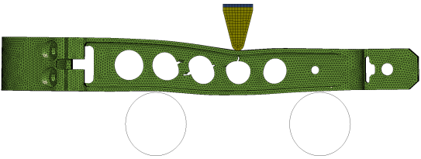
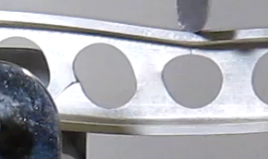
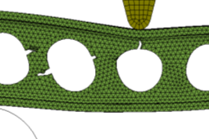
MAGNESIUM IN SEAT STRUCTURE
2. Status of Magnesium Application Possibilities for Seats
T3
Magnesium Data Evaluation & Validation Concept
Δs=3.5 mm
T2
Fig. 7-1
Test @ s = 3.5 mm
T3
Δs=4.7 mm
Fig. 7-3
Test @ s = 4.7 mm

Slide 14
MAGNESIUM IN SEAT STRUCTURE
2. Status of Magnesium Application Possibilities for Seats
Project Results (1/2)
Project Goal | Results
Show weight reduction potential (>15%) “Weight reduction on a TPL Eco up to 15% just by substitution of aluminum by magnesium material” | Component 1 | Producible as milling part 20% weight reduction COMMENT: High raw material costs
 | Component 2 | Producible as milling part 15% weight reduction COMMENT: High raw material costs
 | Component 3 | Milling process does not yet show proper economical benefit over the life cycle for substitution. Special attention must be paid for cyclic strength characteristics.
Demonstrate substitutability of aluminum parts “Substitution of selected aluminum parts by magnesium parts” (original text)
 | Component 4 | Material data need special attention accompanied by aspects for tolerances, contact corrosion, surface treatment.
 | Component 5 | Producible as milling part 25% weight reduction COMMENT: High raw material costs

Slide 15
MAGNESIUM IN SEAT STRUCTURE
2. Status of Magnesium Application Possibilities for Seats
Project Results (2/2)
Project Goal | Results
Gain insight about feasibility of magnesium parts | Listed parts technical feasible Supplier network (raw material + milling) set up Reviewed alloys allow investment casting and milling yet
Investigate weight saving potential in relation to price increase | Milling process is not yet suitable enough for large solid type parts, however casting and forging technology could give potential to gain a good relation between price and weight benefit.
Supporting the integration of magnesium into the cabin | FAA test procedure available FAA general acceptance of magnesium to the cabin is given via special condition EASA decision is pending on update of AS 8049 Para. 3.3.3. Only 5 parts of permitted : cross beam, front leg, horizontal bar, spreader, table arms. Parts in „larger shell type“ are not yet in the focus however with an interesting potential
Aluminum alloys with medium strength requirements in the seats can be replaced by EL43 (or EL21) magnesium.
The high strength 7xxx series alloys can‘t be replaced by standard magnesium due to lower strength, and elongation data which must be observed.
A successful approach for introduction can be parts with full automated processes in secondary structural elements.

Slide 16
MAGNESIUM IN SEAT STRUCTURE
2. Status of Magnesium Application Possibilities for Seats
Magnesium Project Results
Evaluate weight reduction potential of average 15% per selected part – target achieved
Gain know-how about integration of magnesium parts into the seat structure – target achieved
Construction and production of magnesium parts with adjusted dimensions upon magnesium alloy material data evaluation & stress calculation – target achieved
4. Support the certification of magnesium in the cabin – target achieved

Slide 17
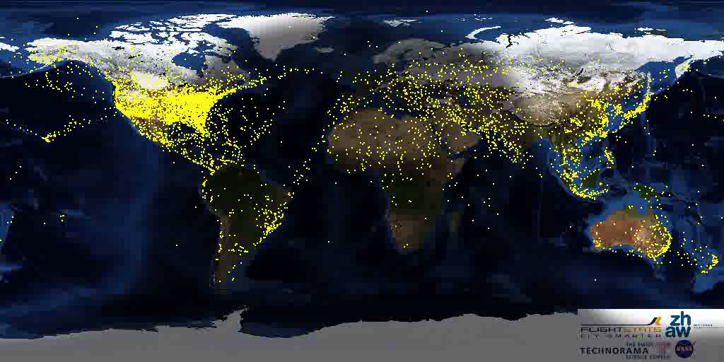
Life cycle Assessment
Global Airtraffic

Slide 18
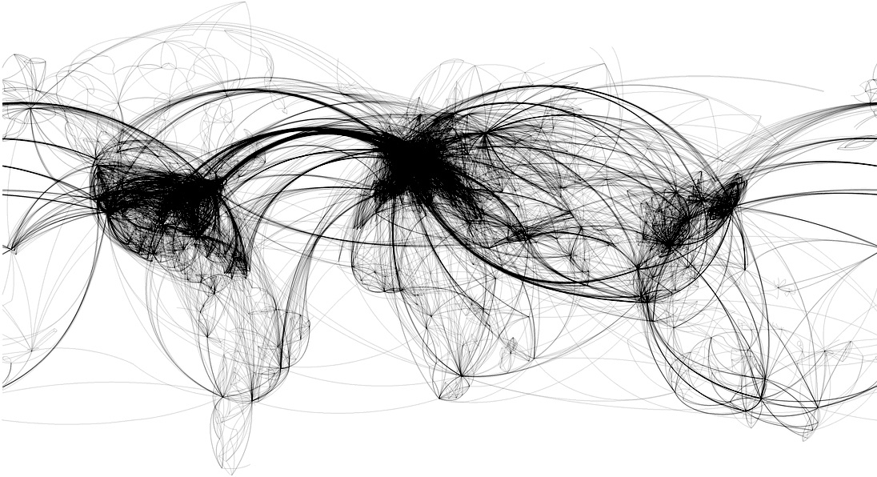
Life cycle Assessment
Global Airtraffic

Slide 19

Life cycle Assessment
Global Airtraffic
World Annual Traffic
(RPKS-Trillion)
ICAO
Total traffic
Airbus
GMF 2011
20-year
World annual
Traffic growth
14
2021 – 2031
4.7%
4.4%
2011 – 2021
5.1%
05
Air traffic has
doubled every
15 years
Air traffic will
double in the
Next 15 years
1971
1981
1991
2001
2011
2021
2031
Airbus S.A.S

Slide 20

Life cycle Assessment
global Airtraffic
Brent oil price will continue rising
Brent oil price
(current US Dollar bbl)
140
History
Forecast
100
60
20
1980
1990
2000
2010
2020
2030
IHB CERA, Airbus, Average price in the year displayed, quoted in Airbus S.A.S., "Navigating the Future – Global Market Forecast 2012-2031", published 2012, downloaded from the http://www.airbus.com/company/market/forecast website,
accessed 08.10.2012, S. 12

Slide 21
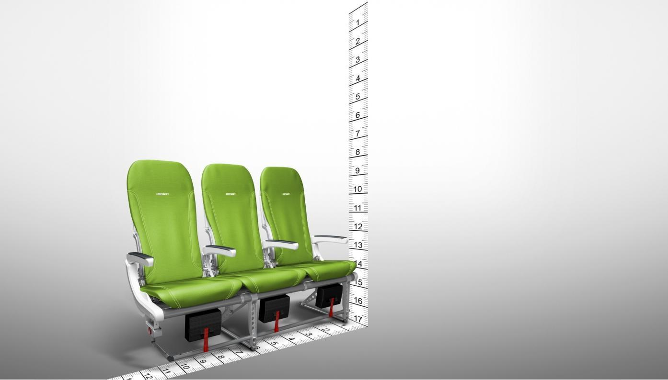
Life cycle Assessment
Measuring dimensions
We know everything about dimensions…

Slide 22
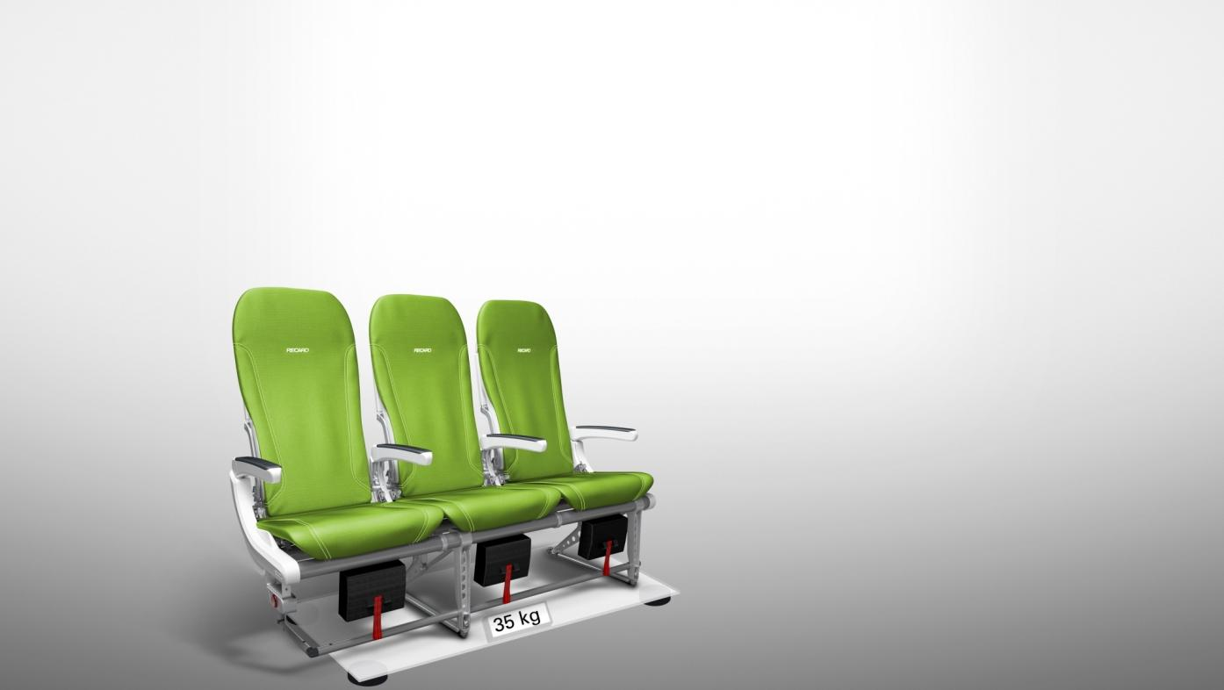
Life cycle Assessment
Measuring weight
We know everything about weight…

Slide 23

Life cycle Assessment
Measuring Ecological Impact
But how do we measure ecological impact…?

Slide 24
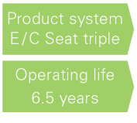
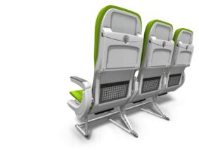
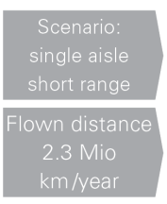

MAGNESIUM IN SEAT STRUCTURE
3. Green Aspects for Using Magnesium in Seats
Life Cycle Assessment as means to compare ecological and
economical benefit
Life cycle assessment framework
Direct applications:
Product development and improvement
Strategic planning
Public policy making
Marketing (for magnesium)
others
STEP 1:
Goal and scope definition
STEP 4:
Interpretation
STEP 2:
Inventory analysis
Functional Unit
STEP 3:
Impact assessment
Source: DIN EN 14040:2006

Slide 25
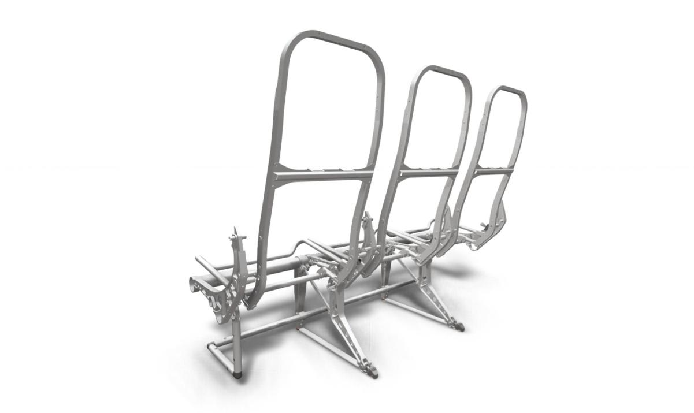
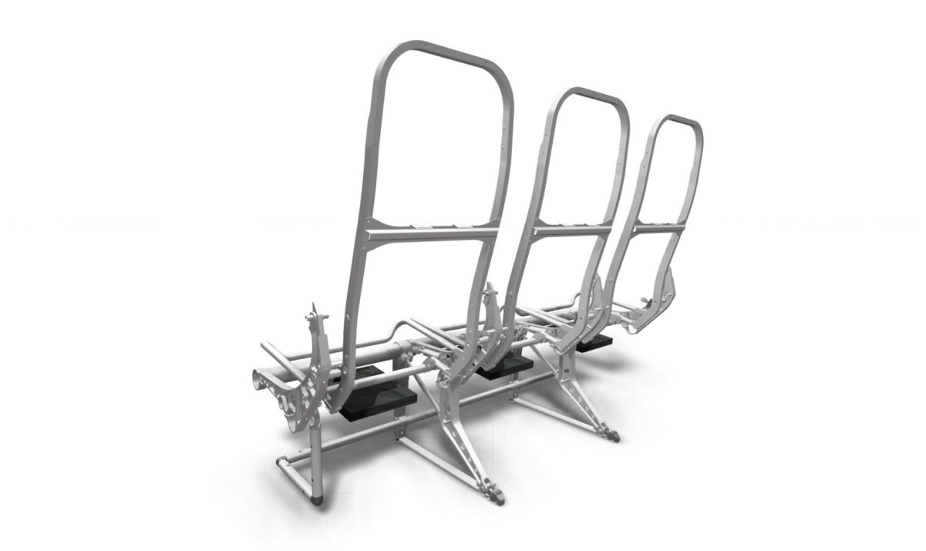
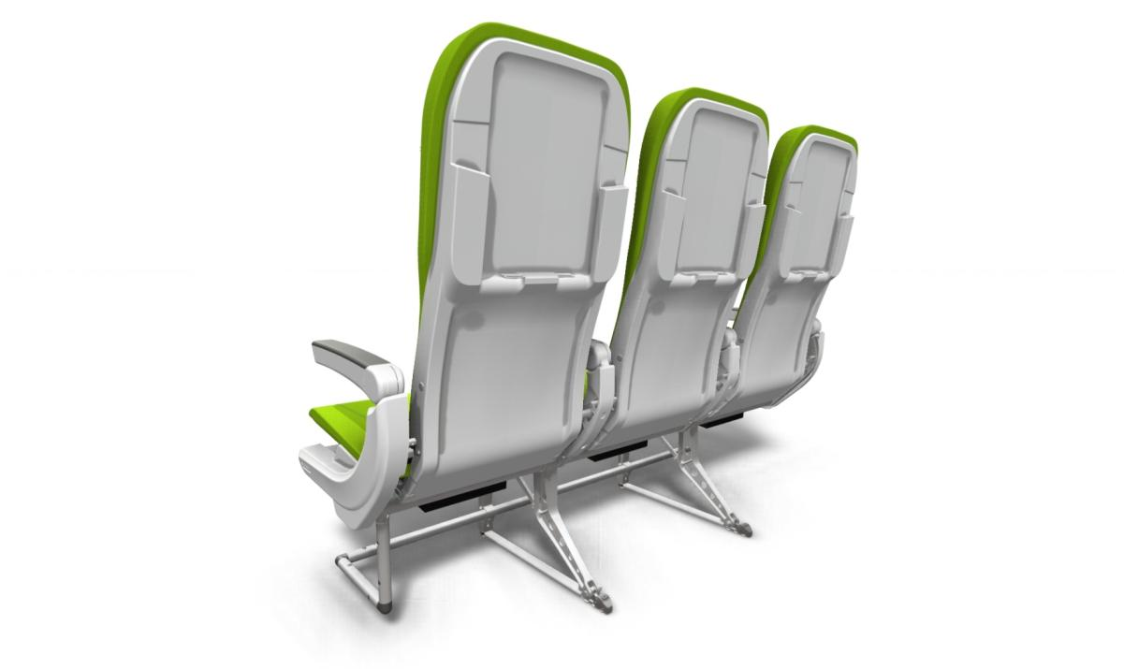
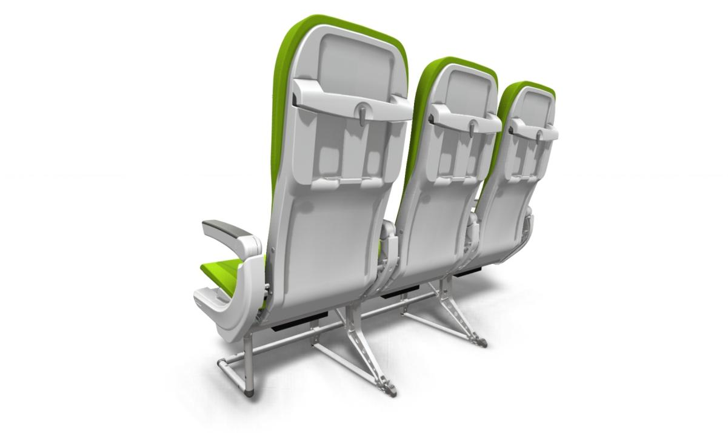
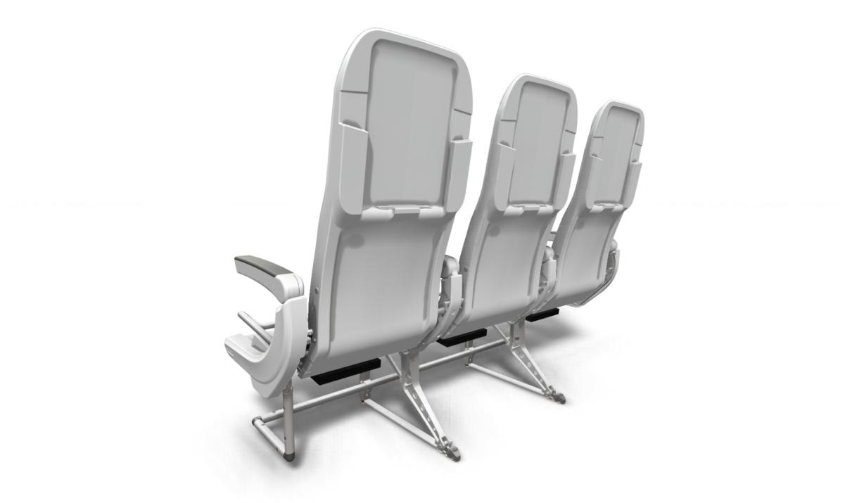
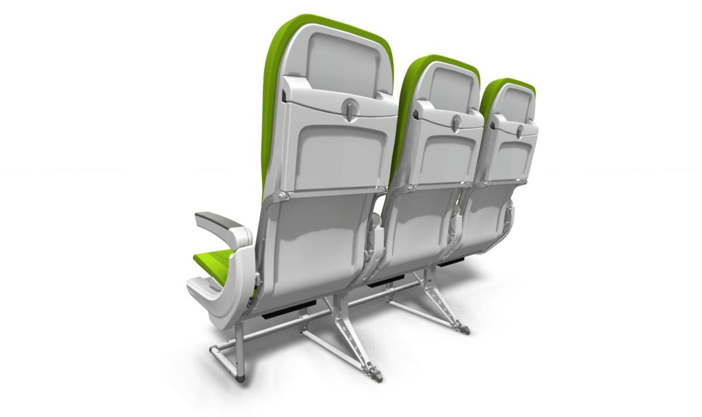
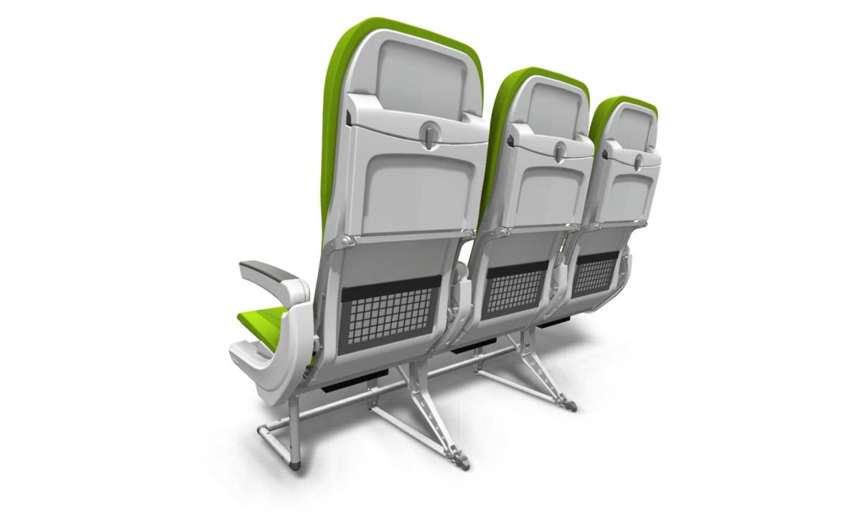
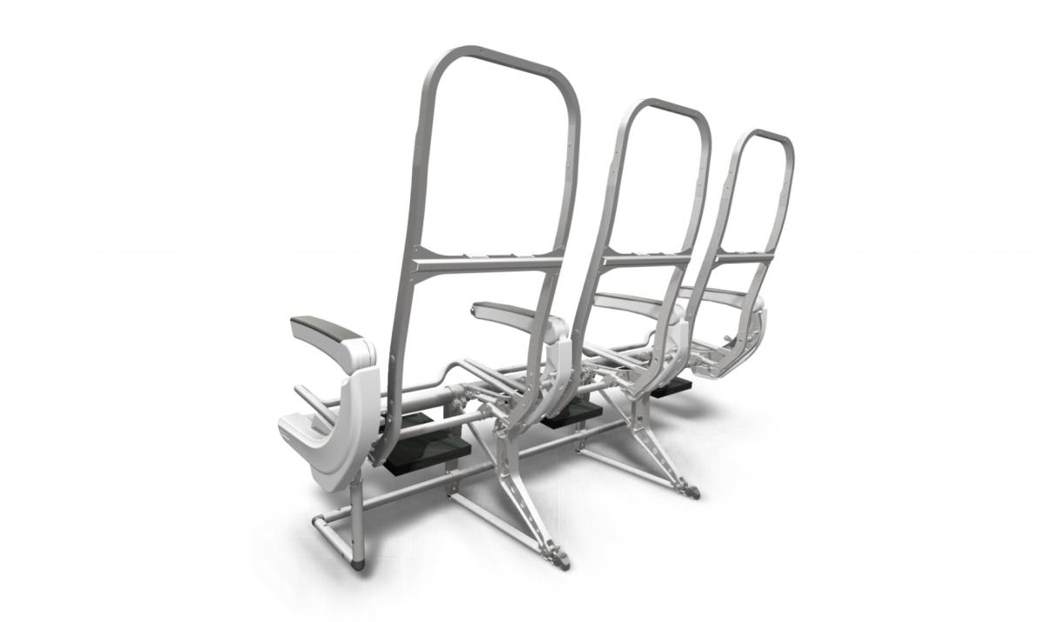
Life cycle Assessment
Conducting of LCA
We investigated every single seat part…
about 1000 different parts considered
more than 50 different materials
manufacturing processes

Slide 26

Life cycle Assessment
Conducting of LCA
Product Life-Cycle
Material
Production and Assembly
Product
Recycling
Use Phase

Slide 27
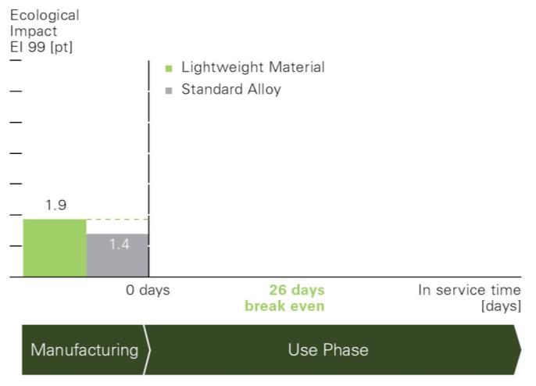
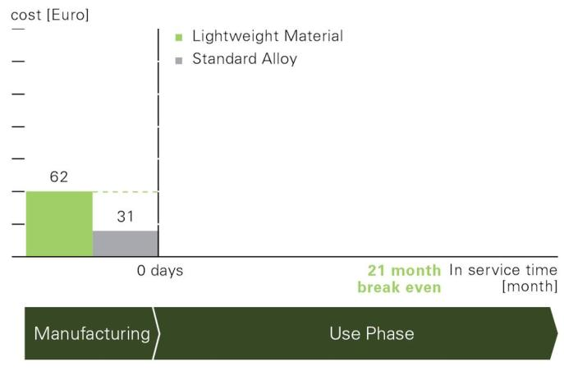
MAGNESIUM IN SEAT STRUCTURE
3. Green Aspects for Using Magnesium in Seats
Results from Life Cycle Assessment
Material Substitution:
XYZ
[currency]
Price A
Price B
....more efficient aircrafts in the future
and increasing fuel prices

Slide 28

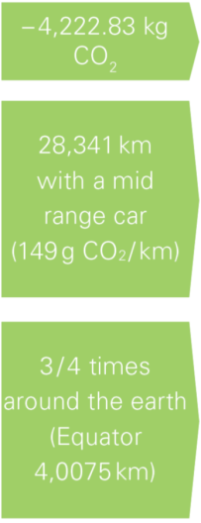
MAGNESIUM IN SEAT STRUCTURE
3. Green Aspects for Using Magnesium in Seats
Results from Life Cycle Assessment
Material Substitution - Reduction of the carbon footprint

Slide 29
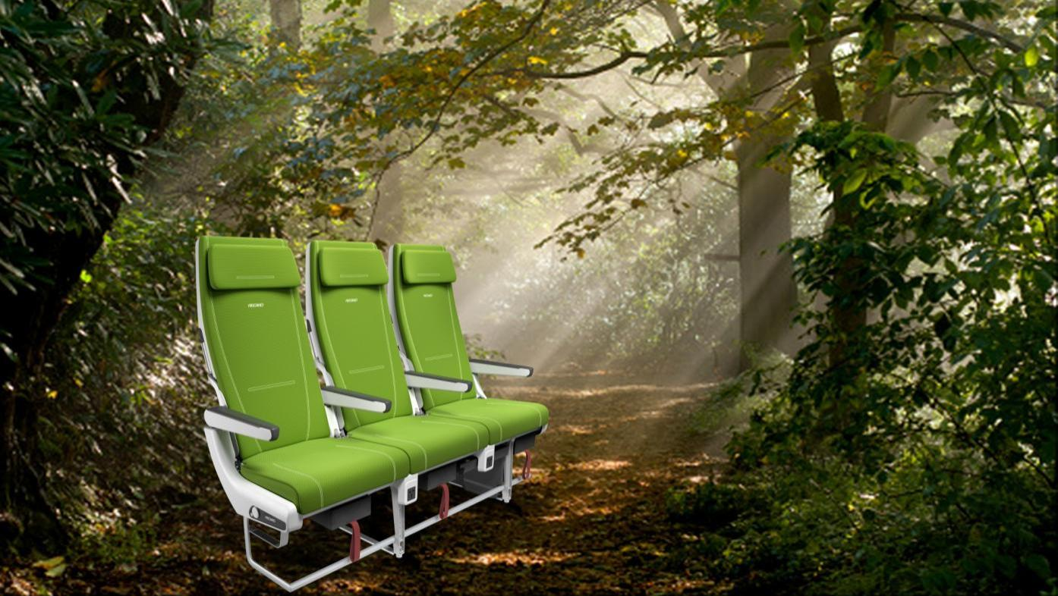
Life cycle Assessment
Conclusion
We made ecological impact measurable
and gained the ability to minimize it.
long lasting parts
lightweight materials
sustainable manufacturing processes
lightweight concepts
recycling strategy
enforce re-use
easy disassembly

Slide 30
MAGNESIUM IN SEAT STRUCTURE
4. Summary and Outlook
Summary
  Conclusion:
  Decisive FAA documents are ready to be used i.e. Aircraft Materials Fire Test Handbook; Evaluating the Flammability of Various Magnesium Alloys During Laboratory and Full Scale Aircraft Fire Tests.
  AS 8049 Para. 3.3.3 have to be updated according to “suggested wording” shown in Dublin in order to make it possible for European seat suppliers to implement magnesium directly into seats (possible via FAA TSO with special condition but not yet via ETSO with special condition).
  Usage of magnesium needs special knowledge about the peculiarity of magnesium and its production processes in order to achieve price attractive and reliable parts.
  In future more parts than the 5 allowed parts – especially thin shell type parts - will be necessary in order to bring magnesium into the cabin with an appreciable percentage.
  Life Cycle Assessment can help us to support airlines and installers thinking in life cycle costs with ecological benefit supported by introduction of new light weight materials like magnesium.

Slide 31
Thank you for your attention
Dr. Martin Waeldele Christoph Hennrich
Head of Innovation Development Engineer Metals
RECARO Aircraft Seating GmbH & Co. KG
Daimlerstrasse 21
74523 Schwaebisch Hall
Telephone: +49 791 503-7000
Fax: +49 791 503-7163
Email: info@recaro-as.com
Internet: www.recaro-as.com

