Slide 1
FAA 7th Triennial Aircraft Fire & Cabin Safety Conference
Development of Fire-proof ECO-Mg alloys
with process diversity
[Part1] Key factors for fire-proof Mg alloys
[Part2] Fire-proof ECO-Mg alloys with cost-effectiveness & design-flexibility
Presented to: FAA 7th Triennial Conference, Philadelphia
By: Shae K. Kim, KITECH, Korea
Data: December 3, 2013
Notes:
Enter speaker notes here.

Slide 2
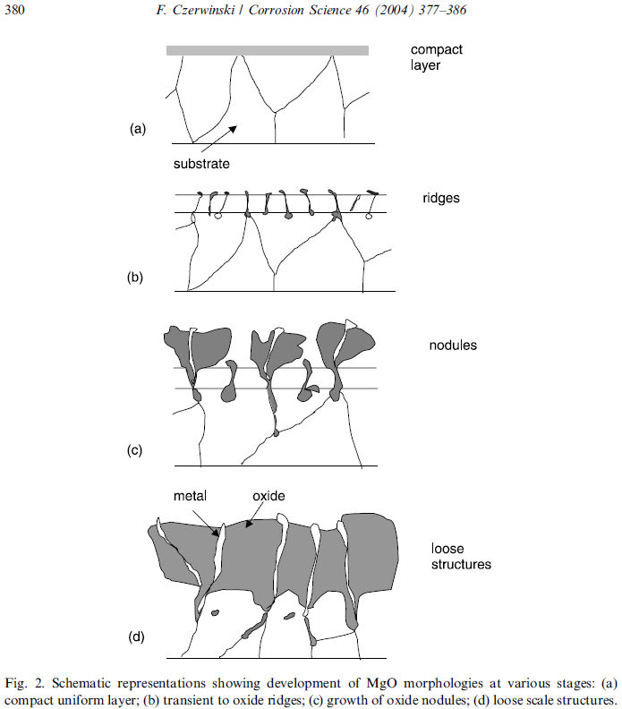
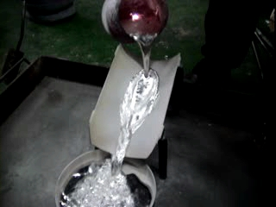
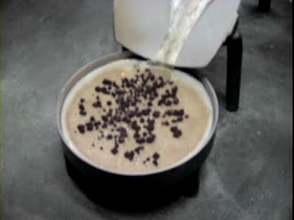
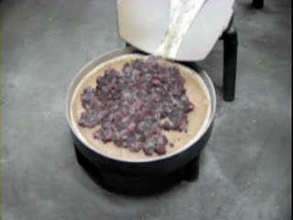
Nature of Explosive Mg Alloys
Oxidation
in solid state
Ignition
In liquid state
Flame temperatures of magnesium and magnesium alloys can reach 3,100°C (3,370 K; 5,610°F).

Slide 3
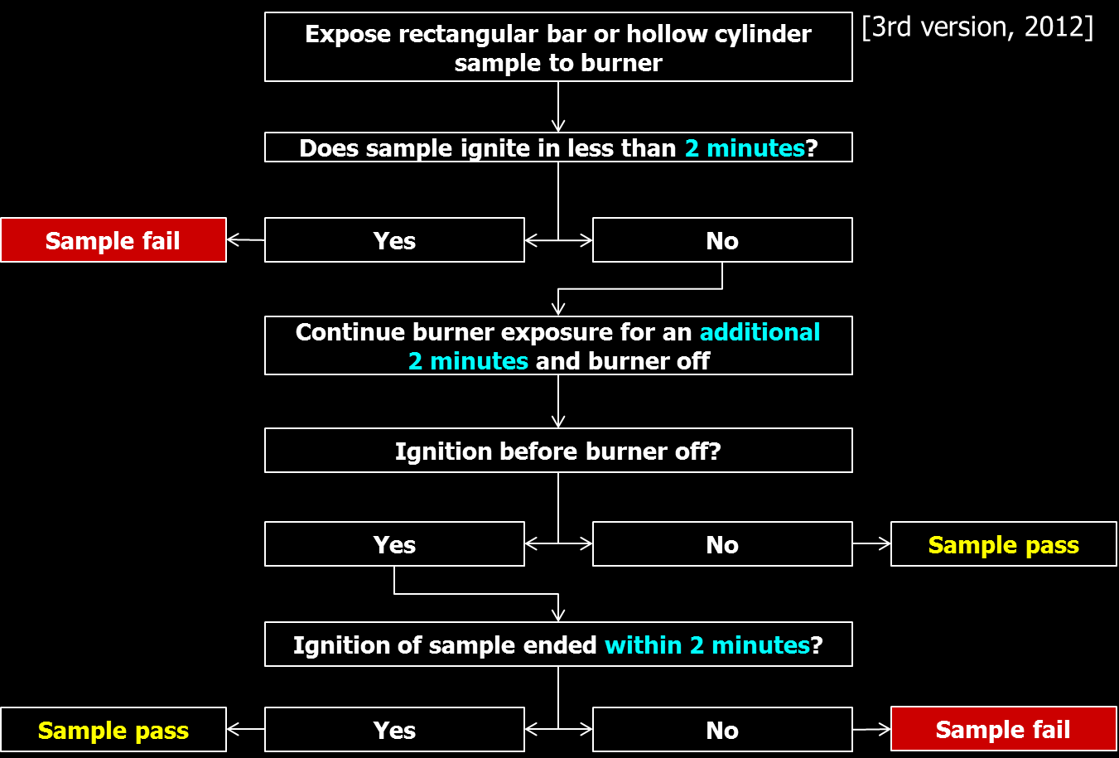
Requirements for Fire-proof Mg Alloys
Increasing ignition resistance
Improving the behavior of self-extinguishment
- alloying element having lower oxide formation energy than MgO
- alloying element having higher surface segregated tendency (larger Wigner-Seitz radius)
- alloying element to form the stable oxide layer of PBR≈1 (Pilling-Bedworth Ratio)
- alloying elements having higher melting point of each oxide and oxide mixtures

Slide 4
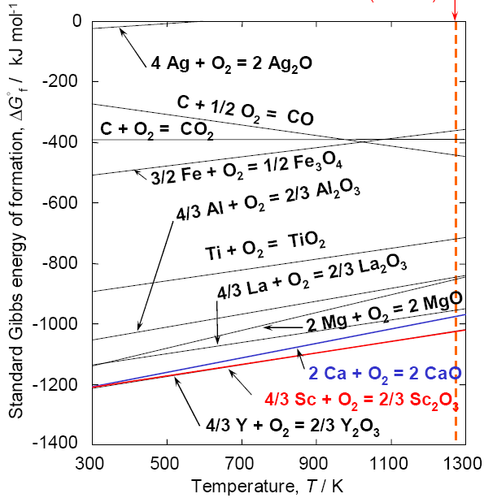
Alloying Elements for Fire-proof Mg Alloys
alloying element having lower oxide
formation energy than MgO : Ca, Sc, Y
alloying element having higher surface segregated tendency
alloying element to form the stable oxide layer of PBR≈1
Element | r_{ws}
Al | 0.15
Zn | -
Si | 0.16
Ca | 0.21
Sr | 0.19
Y | -
Ce | 0.20
Mg | 0.18
Element | Oxide | PBR
Al | Al2O3 | 1.29
Zn | ZnO | 1.59
Si | SiO2 | 1.89
Ca | CaO | 0.65
Sr | SrO | 0.66
Y | Y2O3 | 1.13
Ce | CeO2 | 1.07
Mg | MgO | 0.81
alloying elements having higher melting point of each oxide and oxide mixtures
oxide (Tm, °C) | eutectic (Tm, °C) | oxide (Tm, °C)
MgO (2,825) | (1,985) | Al2O3 (2,054)
 | (1,465) | SiO2 (1,723)
oxide (Tm, °C) | eutectic (Tm, °C) | oxide (Tm, °C)
MgO (2,825) | (2,374) | CaO (2,572)
 | ( - ) | Y2O3 (2,425)

Slide 5
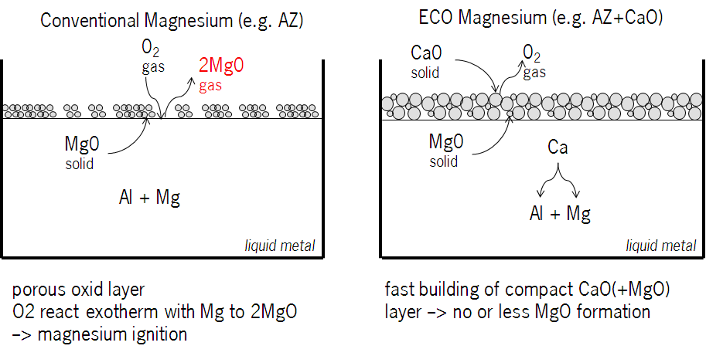
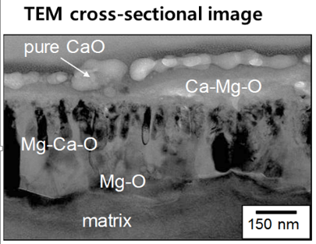
Introduction of ECO-Mg Approach & Alloys
Concept
Result
Conventional
all Mg alloys
CaO
(simple addition)
SHE Target
- Safety for process & part
- Health by Be- & SO₂-free
- Environment by SF₆-free
Property
- Internal soundness
- Grain refinement
- Proportional strength &
elongation values
+
Mechanism
Mg₂Ca in pure Mg & Al₂Ca in Mg alloys
Normal Mg
ECO-Mg
Notes:
Enter speaker notes here.

Slide 6
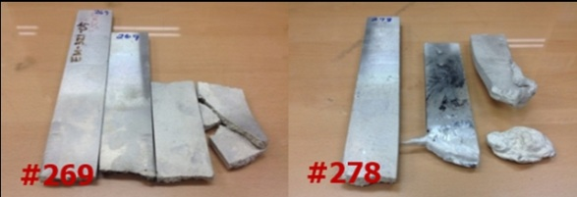
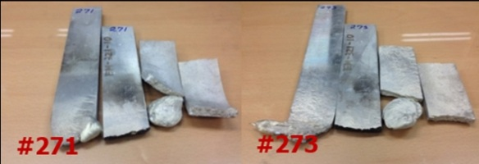
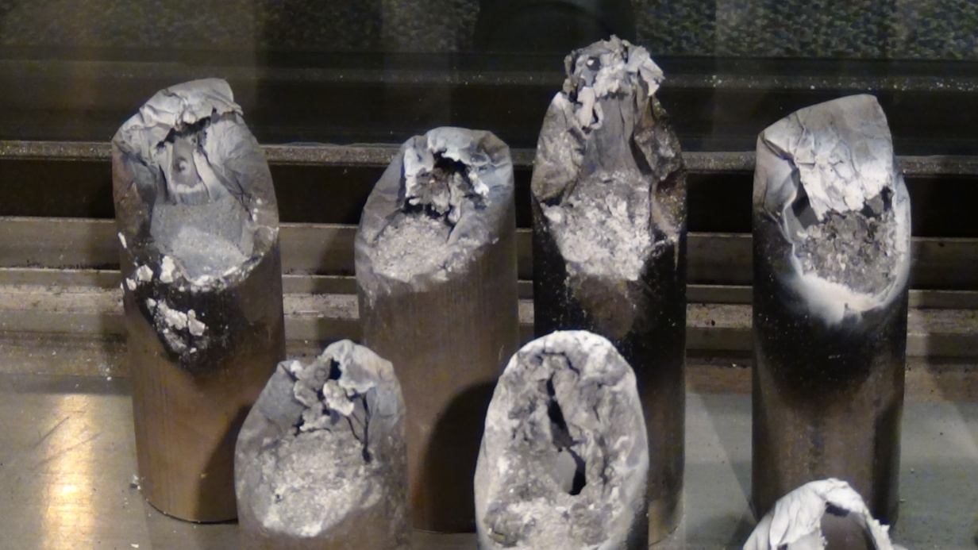
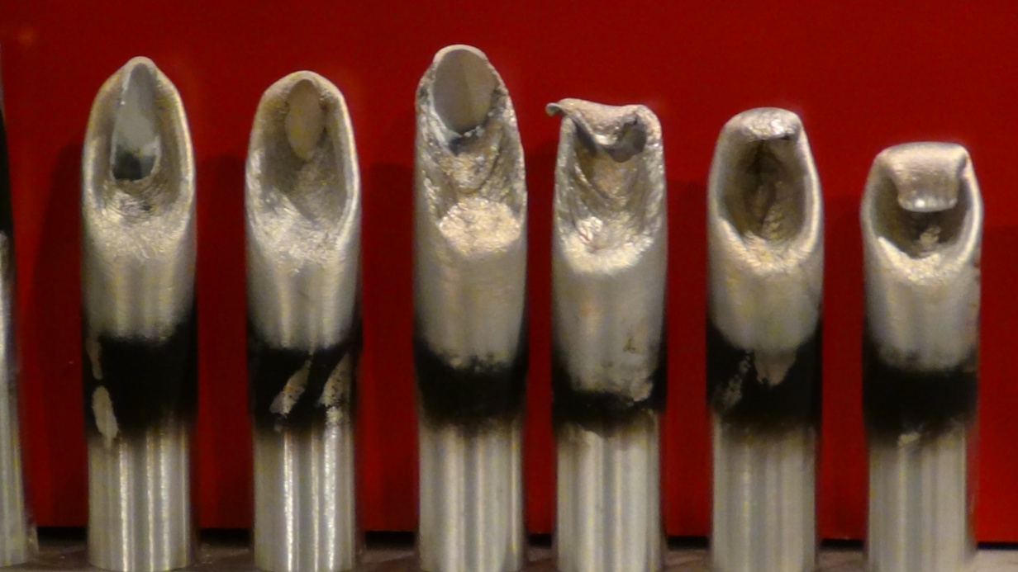
FAA Test Results of ECO-Mg
EM-3Z1-05
EM-3Z1-10
Fireproof commercial Mg alloys
Test No. | Alloy | Thick-ness (inches) | Melt (Sec) | Ignition (Sec) | Bar Begins to Burn (Sec) | Residue Begins to Burn (Sec) | Burner Off (Sec) | Bar Out (Sec) | Residue Out (Sec) | Total Bar Burn Duration | Total Residue Burn Duration | Sample Total Burn Duration
265 | ECO5 | 0.250 | 138 | 0 | 0 | 0 | 240 | 0 | 0 | 0.0 | 0.0 | 0
266 | ECO5 | 0.250 | 131 | 0 | 0 | 0 | 240 | 0 | 0 | 0.0 | 0.0 | 0
267 | ECO5 | 0.250 | 121 | 0 | 0 | 0 | 240 | 0 | 0 | 0.0 | 0.0 | 0
268 | ECO5 | 0.250 | 127 | 0 | 0 | 0 | 240 | 0 | 0 | 0.0 | 0.0 | 0
269 | ECO5 | 0.250 | 139 | 0 | 0 | 0 | 240 | 0 | 0 | 0.0 | 0.0 | 0
270 | ECO10 | 0.250 | 117 | 0 | 0 | 0 | 240 | 0 | 0 | 0.0 | 0.0 | 0
271 | ECO10 | 0.250 | 134 | 0 | 0 | 0 | 240 | 0 | 0 | 0.0 | 0.0 | 0
272 | ECO10 | 0.250 | 138 | 0 | 0 | 0 | 240 | 0 | 0 | 0.0 | 0.0 | 0
273 | ECO10 | 0.250 | 112 | 0 | 0 | 0 | 240 | 0 | 0 | 0.0 | 0.0 | 0
274 | ECO10 | 0.250 | 118 | 0 | 0 | 0 | 240 | 0 | 0 | 0.0 | 0.0 | 0
275 | ECO5 | 0.375 | 235 | 0 | 0 | 0 | 270 | 0 | 0 | 0.0 | 0.0 | 0
276 | ECO5 | 0.375 | 233 | 0 | 0 | 0 | 270 | 0 | 0 | 0.0 | 0.0 | 0
277 | ECO5 | 0.375 | 242 | 0 | 0 | 0 | 270 | 0 | 0 | 0.0 | 0.0 | 0
278 | ECO5 | 0.375 | 243 | 259 | 259 | 371 | 270 | 387 | 590 | 128.0 | 219.0 | 347
279 | ECO5 | 0.375 | 243 | 0 | 0 | 0 | 270 | 0 | 0 | 0.0 | 0.0 | 0
280 | ECO10 | 0.375 | 226 | 0 | 0 | 0 | 270 | 0 | 0 | 0.0 | 0.0 | 0
281 | ECO10 | 0.375 | 221 | 0 | 0 | 0 | 270 | 0 | 0 | 0.0 | 0.0 | 0
282 | ECO10 | 0.375 | 225 | 0 | 0 | 0 | 270 | 0 | 0 | 0.0 | 0.0 | 0
283 | ECO10 | 0.375 | 223 | 0 | 0 | 0 | 270 | 0 | 0 | 0.0 | 0.0 | 0
284 | ECO10 | 0.375 | 219 | 0 | 0 | 0 | 270 | 0 | 0 | 0.0 | 0.0 | 0
285 | ECO5 | 0.250 | 160 | 0 | 0 | 0 | 240 | 0 | 0 | 0.0 | 0.0 | 0
286 | ECO5 | 0.250 | 128 | 0 | 0 | 0 | 240 | 0 | 0 | 0.0 | 0.0 | 0
287 | ECO5 | 0.250 | 130 | 0 | 0 | 0 | 240 | 0 | 0 | 0.0 | 0.0 | 0
288 | ECO5 | 0.250 | 127 | 0 | 0 | 0 | 240 | 0 | 0 | 0.0 | 0.0 | 0
289 | ECO5 | 0.250 | 141 | 0 | 0 | 0 | 240 | 0 | 0 | 0.0 | 0.0 | 0
290 | ECO10 | 0.250 | 120 | 0 | 0 | 0 | 240 | 0 | 0 | 0.0 | 0.0 | 0
291 | ECO10 | 0.250 | 115 | 0 | 0 | 0 | 240 | 0 | 0 | 0.0 | 0.0 | 0
292 | ECO10 | 0.250 | 158 | 0 | 0 | 0 | 240 | 0 | 0 | 0.0 | 0.0 | 0
293 | ECO10 | 0.250 | 143 | 0 | 0 | 0 | 240 | 0 | 0 | 0.0 | 0.0 | 0
294 | ECO10 | 0.250 | 127 | 0 | 0 | 0 | 240 | 0 | 0 | 0.0 | 0.0 | 0
295 | ECO5 | 0.375 | 256 | 0 | 0 | 0 | 270 | 0 | 0 | 0.0 | 0.0 | 0
296 | ECO5 | 0.375 | 255 | 0 | 0 | 0 | 270 | 0 | 0 | 0.0 | 0.0 | 0
297 | ECO5 | 0.375 | 242 | 0 | 0 | 0 | 270 | 0 | 0 | 0.0 | 0.0 | 0
298 | ECO5 | 0.375 | 246 | 254 | 255 | 361 | 270 | 367 | 665 | 112.0 | 304.0 | 416
299 | ECO5 | 0.375 | 243 | 0 | 0 | 0 | 270 | 0 | 0 | 0.0 | 0.0 | 0
300 | ECO10 | 0.375 | 241 | 0 | 0 | 0 | 270 | 0 | 0 | 0.0 | 0.0 | 0
301 | ECO10 | 0.375 | 237 | 0 | 0 | 0 | 270 | 0 | 0 | 0.0 | 0.0 | 0
302 | ECO10 | 0.375 | 246 | 0 | 0 | 0 | 270 | 0 | 0 | 0.0 | 0.0 | 0
303 | ECO10 | 0.375 | 247 | 0 | 0 | 0 | 270 | 0 | 0 | 0.0 | 0.0 | 0
304 | ECO10 | 0.375 | 245 | 0 | 0 | 0 | 270 | 0 | 0 | 0.0 | 0.0 | 0
CaO added ECO-Mg alloys
EM-3Z1-05
EM-3Z1-10
EM-3Z1-15

Slide 7
DTA Ignition Results of ECO-Mg after FAA Test
* Heating up to 1300 ℃
Test No. | Alloy | DTA ignition temperature (℃) |  |  |  |  | Remarks
 |  | 1st trial | 2nd trial | 3rd trial | 4th trial | Average
269 | ECO5 | 729.5 | 833.9 * |  |  | 781.7
273 | ECO10 | No Burn | No Burn * | No Burn * | No Burn * | No Burn
276 | ECO5 | 805.9 * | 794.8 * |  |  | 800.4
280 | ECO10 | 1126.3 * | No Burn * |  |  | No Burn
- Specimen type : Spherical type - Heating rate : 10 ℃/min.
- Specimen weight : 7~16 mg - Atmosphere : Dry air
DTA
EDS
OM
Ignition test part
ICP

Slide 8
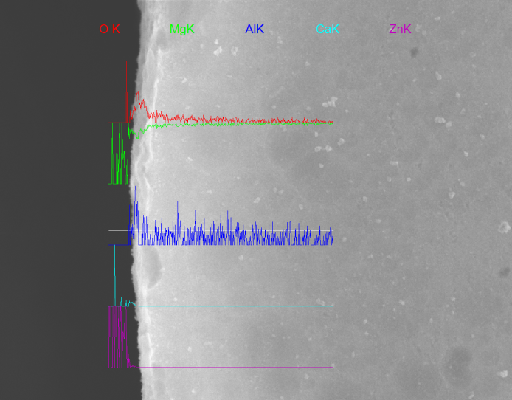
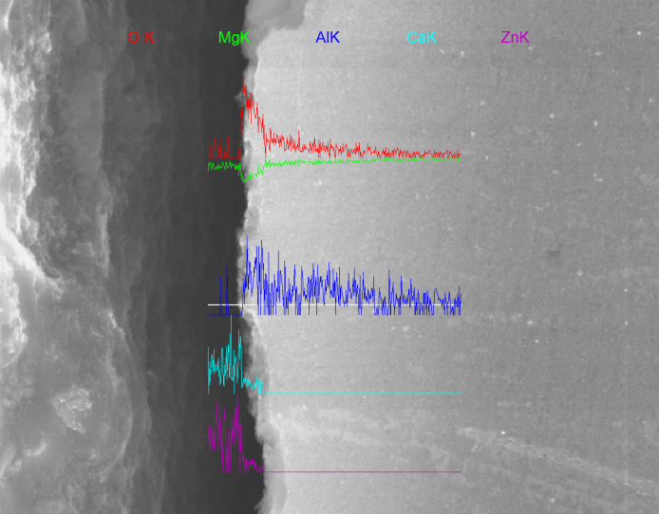
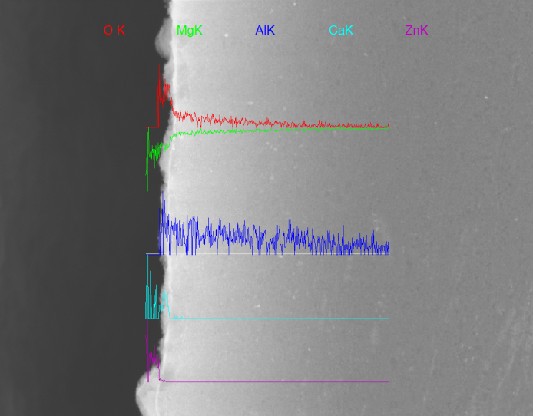
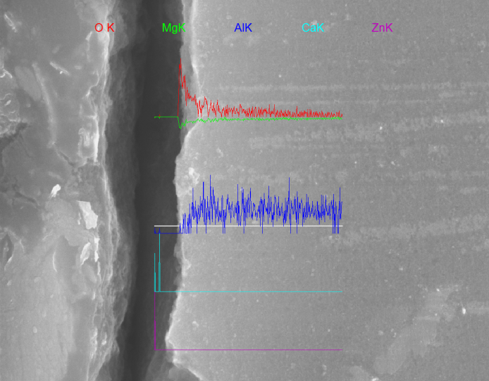
EDS Profiles of ECO-Mg after FAA Test
No. 269 (ECO5)
No. 276 (ECO5)

Slide 9
Ignition Results of intensified LNG by KITECH
Specimen | Melt | Ignition | Torch off | Extinguishment | Delta t, sec
AM30 | 2:08 | 1:52 | 2:22 | No | over 120
EM-3M0-05 | 2:17 | 2:32 | 3:02 | 3:04 | 2
EM-3M0-10 | 2:23 | - | 10:00 | - | -
EM-3M0-15 | 2:32 | - | 10:00 | - | -

Slide 10
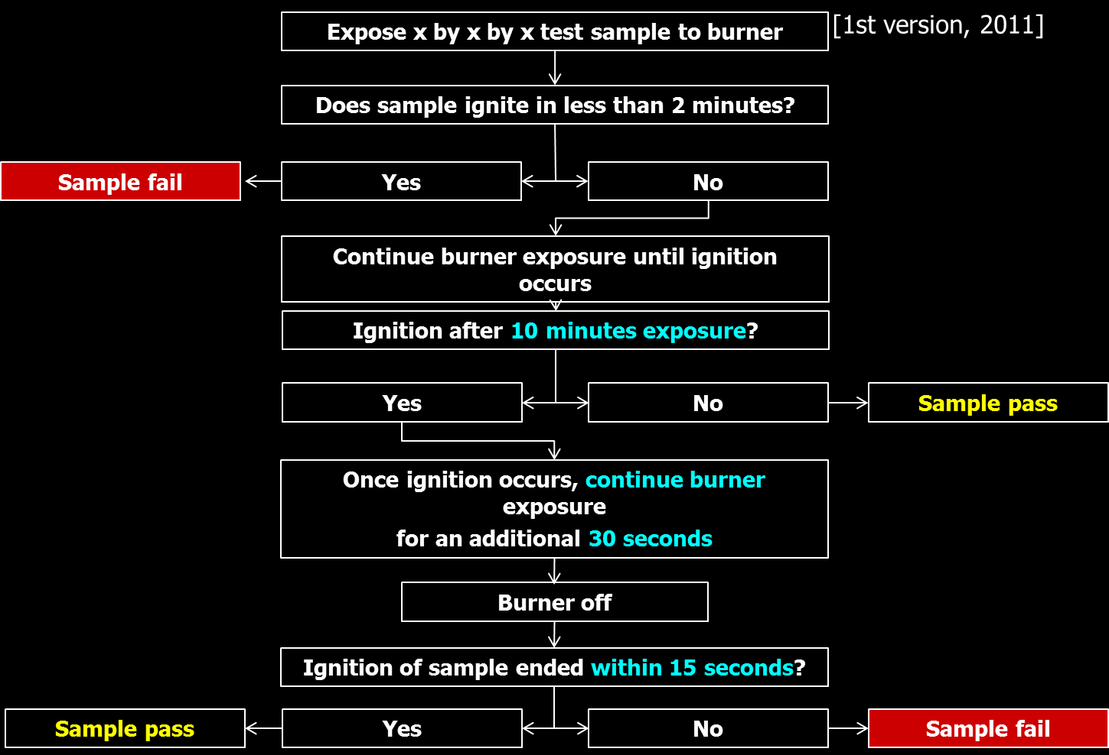
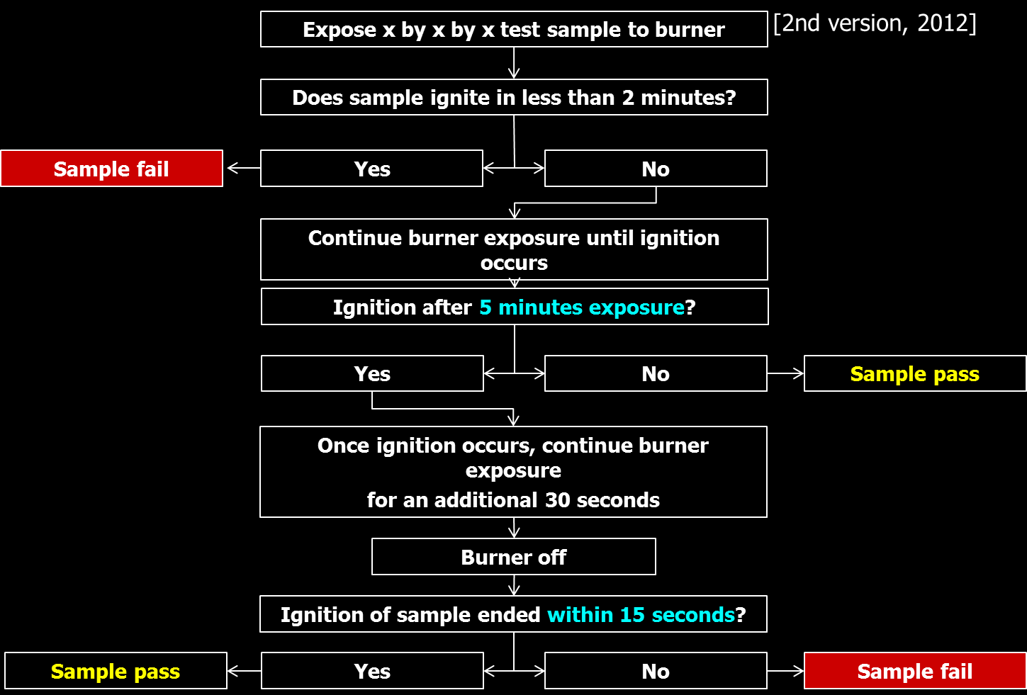
Lightened Requirements for Fire-proof Mg Alloys
 | 1st version | 2nd version | 3rd version
Time to ignition, min | 10 | 5 | 4
Delta t, sec | 30 + 15 | 30 +15 | 120
[Summary]
* Various ECO-Mg alloys with over 0.5 CaO are enough in terms of ignition resistance.
* Alloy design/devlopment is essential to meet
- cost-effectiveness,
- design-flexibility for cast net-shape, extruded profile, and shaped sheet, and
- improved mechanical properties, including fatigue strength.

Slide 11
Effect of Alloying Elements in Mg Alloys
(+)
Ambient tensile, compressive and fatigue strength
Castability
% Al
Cost
Creep strength
Ductility, impact strength
(-)
(+)
Creep strength
Cost
Ambient strength
% (Ca, Sr, RE)
Castability
Ductility, impact strength
(-)
[Source] Materials Science Forum, 419-422 (2003) 407

Slide 12
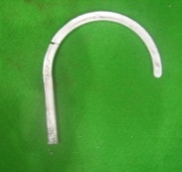
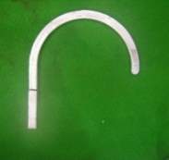
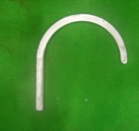
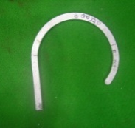
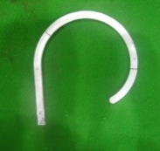
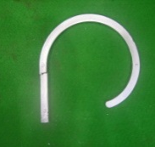
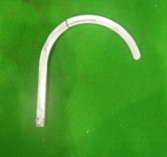
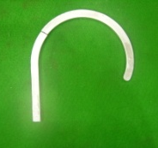
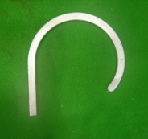
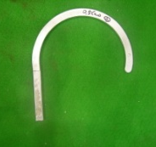
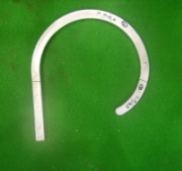
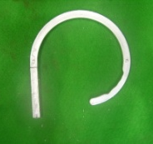
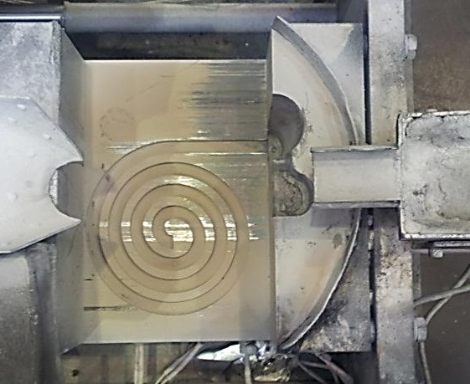
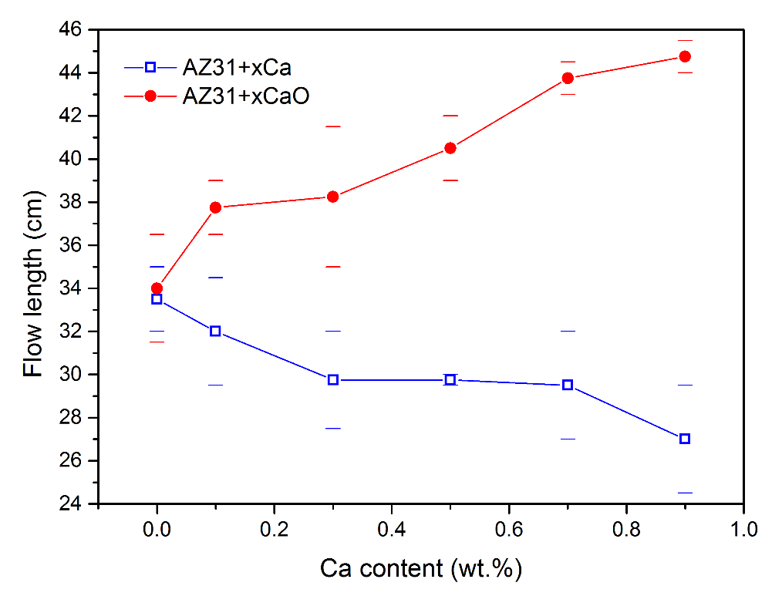
Effect of CaO on Spiral Fluidity of AZ31 ECO-Mg
 |  | CaO contents ( wt.%)
 |  | 0 | 0.1 | 0.3 | 0.5 | 0.7 | 0.9
AZ31-CaO | 1st
 | 2nd
36.5cm
36.5cm
35cm
42cm
43cm
44cm
31.5cm
39cm
41.5cm
39cm
44.5cm
45.5cm

Slide 13
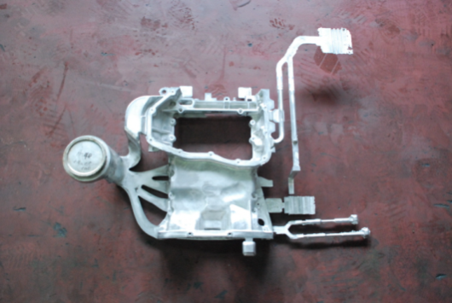
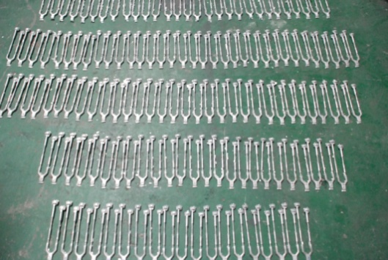
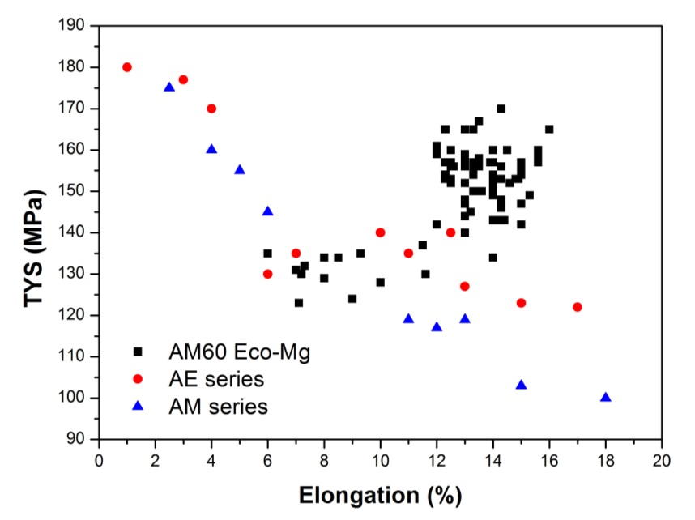
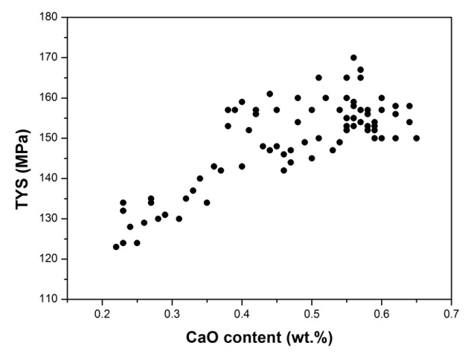
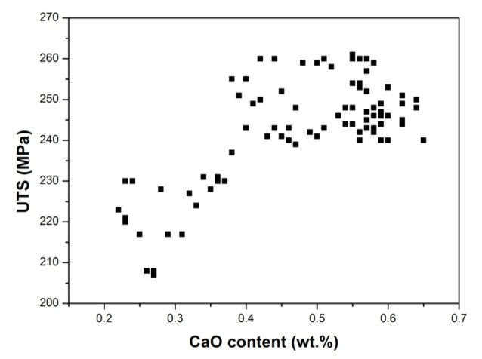
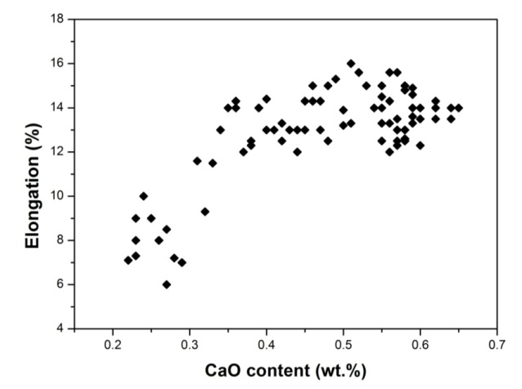
Die Cast AM60B ECO-Mg
Mechanical test specimens were obtained directly
by die casting even at the end of the product.

Slide 14
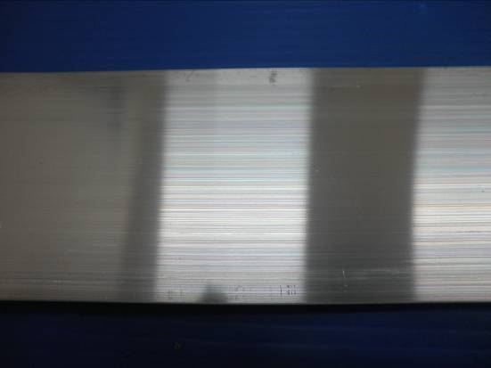
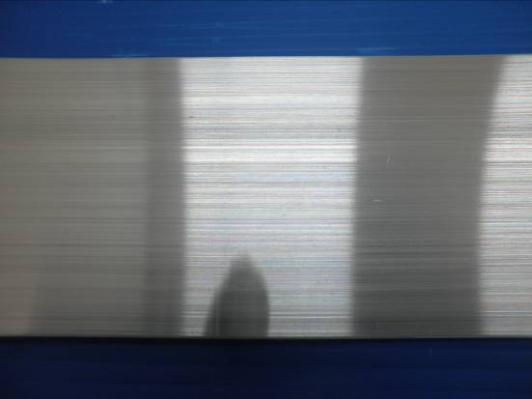
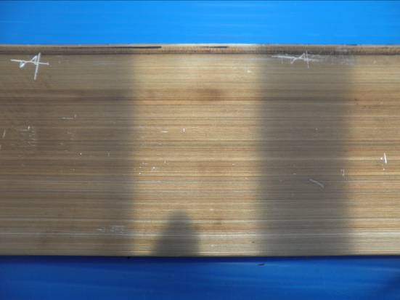
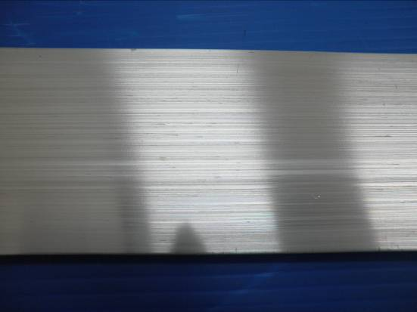
Extruded AZ31B ECO-Mg
Normal AZ31
AZ31-0.3wt% CaO
AZ31B 0.04m/min (1m/min)
ECO-AZ31B 0.04m/min (1m/min)
AZ31B 0.12m/min (3m/min)
ECO-AZ31B 0.12m/min (3m/min)
RAM Speed (Part Speed)

Slide 15
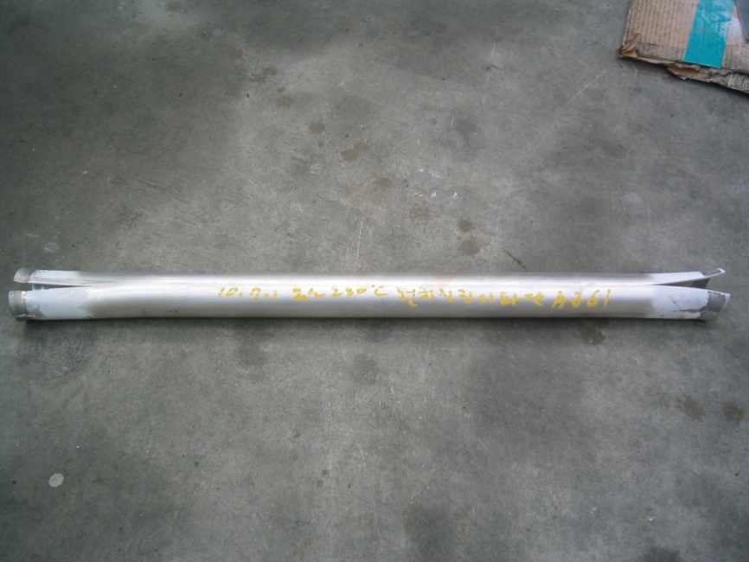
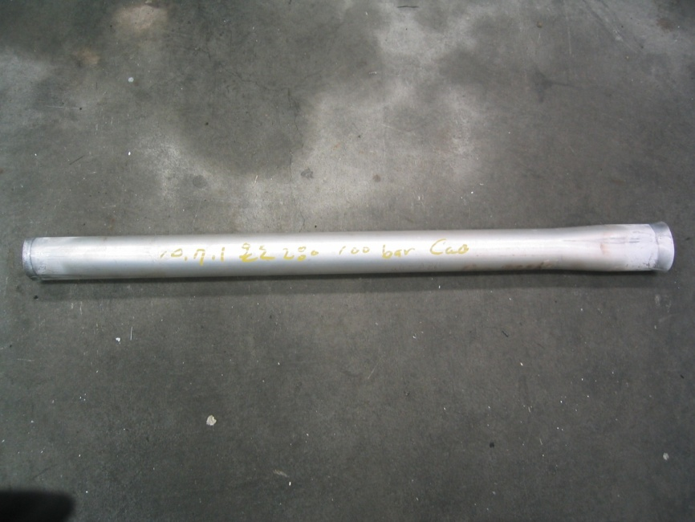
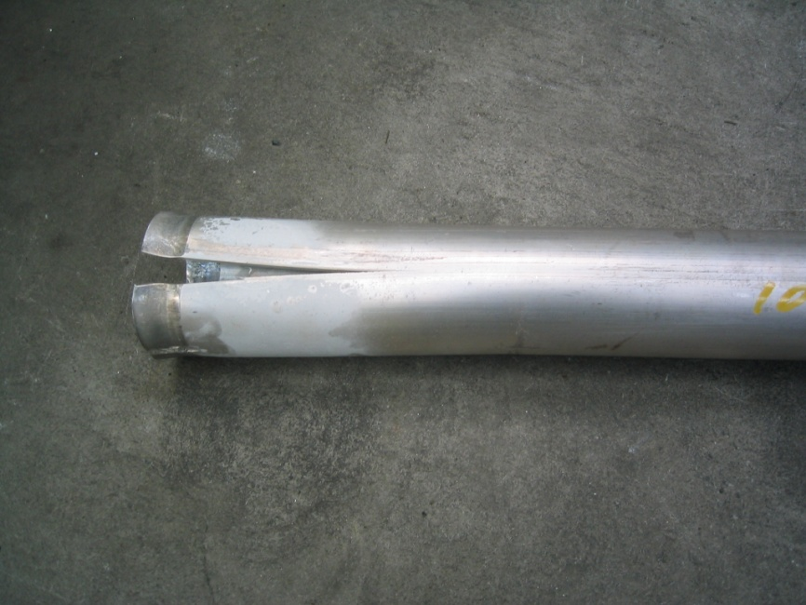
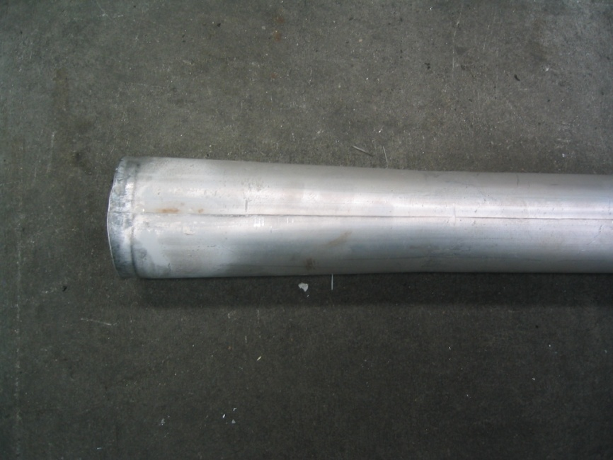
Hot Air Bulged AZ61 ECO-Mg
Normal AZ631
AZ61-0.5wt% CaO

Slide 16
Fatigue Strength of ECO-Mg
 | YS [MPa] | UTS [MPa] | EL [%] | Fatigue Strength [MPa]
AM30 | 177.3 | 310.2 | 16.5 | 130
AM30-0.5CaO | 184.3 | 313.8 | 21.3 | 168

Slide 17
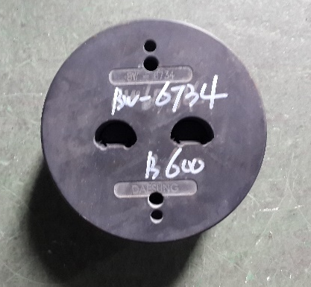
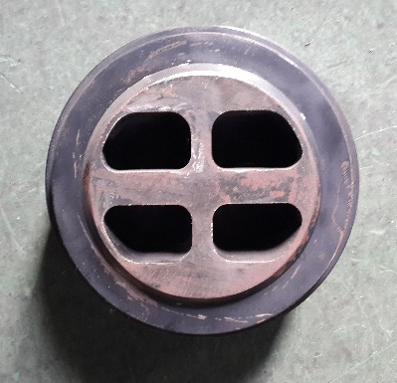
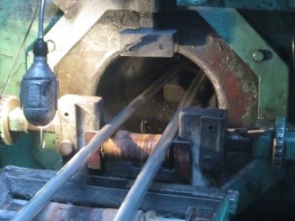
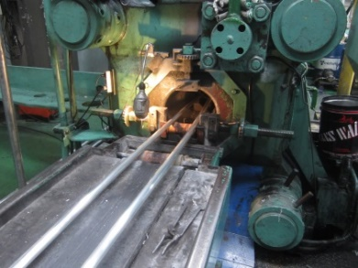
Net-shape Extruded Parts of ECO-Mg
Parts
Porthole dies for hollow extrusion
Front
Rear

Slide 18
Conclusion
* To meet safety issue: fire-proof Mg alloys
* To give beneficial weight reduction by fire-proof Mg alloys
- part stiffness and net-shape by Mg alloys with good formability
[vs] improved material strength with limited design flexibility

Slide 19
Overview of ECO-Mg Approach & Alloys
Conventional
all Mg alloys
+
CaO
(simple addition)
Al₂Ca Formation
(Mg₂Ca in pure Mg)
Non-SF6
AZ91, AM50/60 casting alloys
AZ31, AM30, AZ61 wrought alloys
improved fluidity & internal soundness
Recycling
Be-free
no burning at higher velocity & temp.
ECO-Mg
approach
CaO amount for melt quality
Melt
quality
CaO amount for DRX & texture
Part
Safety
Chip
Safety
Creep
resistant
Ignition
resistant
High-
strength
ECO-Mg
alloys
Bio-
degradable
Damping
Powder
controlled by
CaO & Al
die casting
gravity casting
controlled by
CaO
extrusion
gravity casting
controlled by
Icosahedral-
& LPSO-phase
Extrusion, etc.
controlled by
CaO & others
extrusion
gravity casting
pure Mg with
CaO & Si
casting
extrusion
property &
safety control
by CaO
PM
Notes:
Enter speaker notes here.

Slide 20
FAA 7th Triennial Aircraft Fire & Cabin Safety Conference
Development of Fire-proof ECO-Mg alloys
with process diversity
REFERENCE
Presented to: FAA 7th Triennial Conference, Philadelphia
By: Shae K. Kim, KITECH, Korea
Data: December 3, 2013

Slide 21
As-extruded Mechanical Properties of ECO-Mg
1. Conventional extruded Mg alloys
 | YS(MPa) | UTS(MPa) | El(%) | Ref
AZ31-F | 200 | 260 | 15 | www.matweb.com
AZ31-F | 135 | 235 | 7 | MEL
AZ61-F | 230 | 310 | 16 | www.matweb.com
2. MEL extruded Mg alloys
 | YS(MPa) | UTS(MPa) | El(%) | Ref
WE43 | 160 | 245 | 6 | Yttrium 3.7-4.3; Rare Earths 2.4-4.4
Electron 43 | 215 | 330 | 14 | Yttrium 3.7-4.3; Rare Earths 2.3-3.5
3. Extruded ECO-Mg alloys
 | YS(MPa) | UTS(MPa) | El(%) | Ref
AZO3105-F | 234.4 | 293.6 | 18.4 | AZ31 + 0.5CaO. Extruded Bar
AZO3105-T5 | 254.4 | 314.6 | 16.3 | AZ31 + 0.5CaO. Extruded Bar
AZO3110-F | 266.3 | 305.6 | 11.6 | AZ31 + 1.0CaO. Extruded Bar

Slide 22
High Strength ECO-Mg for Aerospace

Slide 23
Method & Specimen for Ignition Test
Safety for
product
Quantitative
Data
Safety for
burr and chip
specimen position
specimen shape & volume
torch test
tool shape/compaction
DTA
* Thermal Conductivity,
Emissivity & ?
furnace chip test
Ignition
edge
edge
Ignition
Ignition
Chip
bulk - cubic
bulk - sphere
Over 200
10-40
5-30
Deflection of data (K)
many times
1~5
1~2
Frequency of ignition

Slide 24
DTA Ignition Results of ECO-Mg
* machined spherical specimens of 8~9mg
■ AZ31
● AM30
904.08℃
842.25℃
857.35℃
825.54℃
778.28℃
740.41℃
592.32℃
576.34℃
0 CaO
0.5 CaO
1.0 CaO
1.5 CaO

Slide 25
Challenge for ECO-Mg Alloy
Mg Benefit
Mg Problem
Impacts
SF6 Gas Usage
GWP (CO2 x 23,900)
Lifetime (3,200 y)
Be Addition
Toxicity
Melt Quality
Process-ability
Property
Aluminum
Automobile
Burning of
Machined Chips
Safety
Special Storage
Steel
Automobile
Magnesium
Automobile
Oxidation & Burning
of Components
Safety
Recyclability

Slide 26
Non-SF6 Issue of Mg Alloy
 | GWP (CO₂=1) | Lifetime (year) | Cost | Toxicity | Corrosion
SF₆ | 23,900 | 3,200 | 16US$/kg | Non (reaction) | Corrosive
HFC-134a | 1,300 | 14.6 | 5.6US$/kg | Non (reaction) | Corrosive
Novec-612 | 1 | days | 90US$/kg | Non (reaction) | Corrosive

Slide 27
Mg-0.45Al-xBe vs Mg-0.45Al ECO-Mg; Melt protection
Ignition
Clean
Melt Temperature: 680 ℃
CO₂: 16.8 l/min
SF₆(%) | Mg-0.45Al-XppmBe |  |  |  | Mg-0.45Al-xwt%CaO
 | 0 | 5 | 10 | 20 | 0.01 | 0.05 | 0.1 | 0.3
0 (CO₂ 100%)
0.06
0.12
0.24
0.6

Slide 28
Thermodynamic Consideration of ECO-Mg Alloys
Conventional
all Mg alloys
+
CaO
(simple addition)
Al₂Ca Formation
(Mg₂Ca in pure Mg)
Al₂O₃, 400℃ | ZrSiO₄, 400℃
CaO, 400℃ | CaO, Room Temp.
Shae K. Kim, et al. : Mater. Trans. JIM 42 (2001) 539-542

Slide 29
Thermodynamic Consideration of ECO-Mg Alloys
Mg-CaO ⇒ Mg-Al-CaO
based on standard Gibbs free energy
∆G ̊ ⇒ ∆G
based on Mg-CaO System
K. Kondoh et al., Mater. Chem. & Phy. 129 (2011) 631

Slide 30
TEM Results of AZ31 ECO-Mg
1. Eco-Mg ingot 시편 종류 및 성분
3. AZ31 계열 시편 이차상 분석
CaO 0 wt. %
near-surface
micro size
Al-Mg-Zn
second- phase
 | CaO 0 wt.% | CaO 0.5 wt.% | CaO 1.0 wt.% | CaO 1.5 wt.%
AZ31 계열
AM30 계열
Mg
Zn
Al
Ca
Mn
CaO 1.0 wt. %
near-surface
micro size
Al-Ca
second- phase
Near-surface are
Mg
Zn
b)
Al
Ca
Mn
Internal area
AZ31, AM30 계열 시편에 CaO를 각각 0, 0.5, 1.0 그리고 1.5 wt.% 로 첨가하였고, 관찰 영역을 internal, near-surface area 로 나누어 TEM 분석 실시
a)
2. AZ31 계열 시편 미세구조 관찰
 | CaO 0 wt.% | CaO 0.5 wt.% | CaO 1.0 wt.% | CaO 1.5 wt.%
Internal area
Near-surface area
a)
-
-
b)
0001
-
-
-
220_{Al2Ca} // 010_{Mg}
Al₈Mn₅
Al₈Mn₅
Al₂Ca
Needle type Al₂Ca
111
220
0110
111_{Al2Ca} // 001_{Mg}
Al₁₂Mg₁₇
Al₂Ca
CaZn₁₃
Al₂Ca
Al₂Ca (FCC)
Mg (HCP)
[-112]_{Al2Ca} // [2-1-10]_{Mg}
Al₅Mg₁₁Zn₄
Needle type Al₂Ca
Needle type Al₂Ca
Needle type Al₂Ca
Al₁₂Mg₁₇
Al-Mn 계열
Al₂Ca
Al₂Ca
Mg
Zn
Al
Ca
Mn
CaO 함량 증가에 따라 조대한 크기 이차상은 Al₂Ca로 관찰되었고, 1.5 wt.% 첨가 시편에서는 internal area 에서 needle 형태의 Al₂Ca 이차상이 관찰됨
Needle 형태의 이차상 입자는 Al₂Ca 로 matrix 와 특정 방위관계를 형성하고 있는 것이 관찰되었고, 상대적으로 낮은 계면에너지를 가지는 방향인-11-1_{Al2Ca} // 001_{Mg} 으로 선택적 성장하는 것으로 판단됨

Slide 31
TEM Results of AM30 ECO-Mg
4. AM30 계열 시편 미세구조 관찰
5. AM30 계열 시편 이차상 분석
 | CaO 0 wt.% | CaO 0.5 wt.%
Internal area
Near-surface area
CaO 0 wt.%
Mg
Zn
Al
Ca
Mn
CaO 0.5 wt.%
Mg
Zn
Al
Ca
Mn
조대한 이차상은 주로 CaO 첨가 전 Al-Mn 계열이, 첨가 후에는 Al-Ca 계열이 관찰됨
EDS data
Inversed FFT
Elem. | Atom. %
Mg | 53.57
Al | 12.84
Ca | -
Mn | 6.60
Zn | -
-
330
336
Mg
Zn
Al₈Mn₅ (Rhombohedral)
110
012
Al₈Mn₅ (Rhombohedral)
Al
Ca
Mn
EDS data
Inversed FFT
Inversed FFT
Elem. | Atom. %
Mg | 80.55
Al | 12.84
Ca | -
Mn | 6.60
Zn | -
300
-
012
Mg
Zn
111
200
조대한 이차상은 CaO 첨가 전 Al-Mn 에서 첨가 후, Al₂Ca 로 관찰되었고 나노 크기 Al₂Ca 이차상은 needle 형으로 관찰됨
Al₈Mn₅ (Rhombohedral)
Al₂Ca (FCC)
Al
Ca
Mn
나노 크기 이차상은 CaO 첨가 전 구형과 rod 형 모두 Al₈Mn₅ 로, 첨가 후 구형은 Al₈Mn₅, needle 형은 Al₂Ca로 관찰됨

Slide 32
Fatigue Strength of ECO-Mg
Vickers hardness
: constant load (10g)
: holding time (10s)
: 10 times
: using average values
Tensile test
: Instron 8501
: room temperature and Lab. air
: strain rate: 1×10⁻³ /s
: 3 times
High cycle fatigue test
: Instron 8501
: room temperature
: stress ratio(R)=0.1
: Frequency = 20 Hz
: Run out = ~ 10⁷ cycles
- Before high cycle fatigue test, specimens were polished
with #2000 SiC papers (reduce surface roughness effect)
-Base on ASTM E466 - Standard practice for conducting
force controlled constant amplitude axial fatigue tests of metallic materials
Fractography
: SEM(Tescan, VEGA II LMU)
: tensile fractured surface and high cycle fatigue fractured surface

