Slide 1
HIC Simulation: Study of Parameters affecting HIC
Dirk Goetze

Slide 2
Agenda
Introduction
HIC study of a simple engineering model
Study of a seat submodel
Full-scale HIC simulation and test
Conclusions

Slide 3
Agenda
Introduction
HIC study of a simple engineering model
Study of a seat submodel
Full-scale HIC simulation and test
Conclusions

Slide 4
Introduction
Why implementing parameter studies and a continuous HIC monitoring in the seat development process?

Slide 5
Introduction
Aims
Analyze the head injury performance in the development phasees of a seat
Study of global parameters having an effect on HIC
Benchmark of different backrest designs and HIC features
Define seat limits (e.g. monitor masses, additional seat features)
Minimize the risk of HIC fails in customer programs

Slide 6
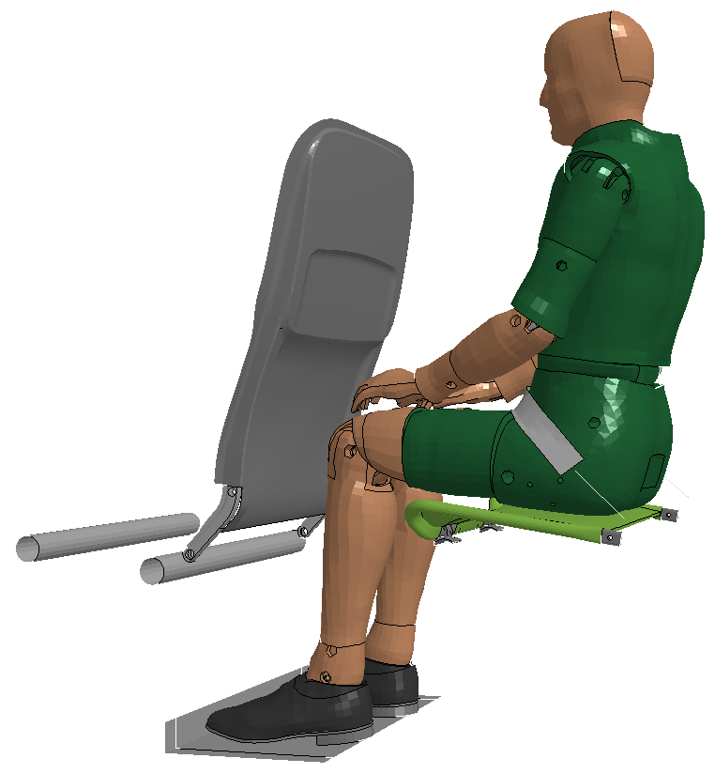
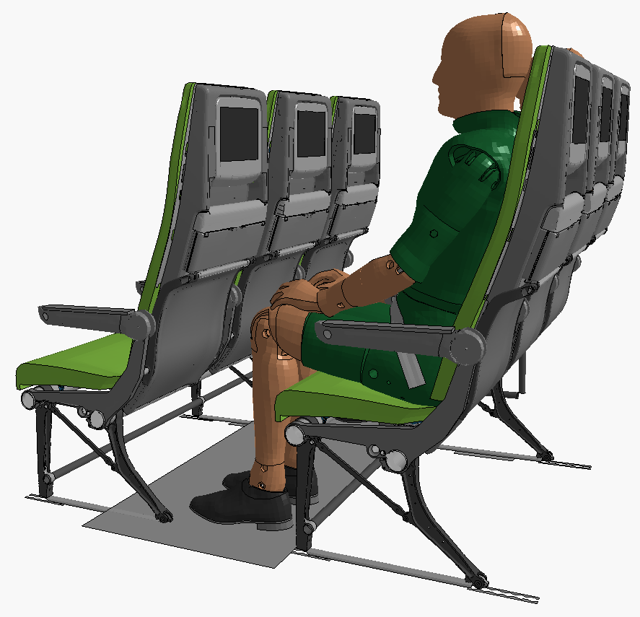
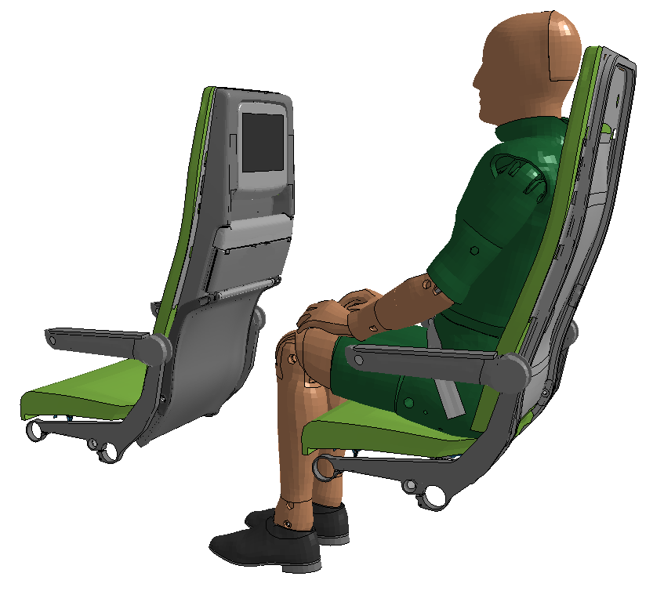
Introduction
Approach
1 - engineering model
backrest mass
center of gravity
stiffness
backrest angle
…
2 - submodel
dummy position (H-Point)
monitor influence
HIC feature benchmark
feature effectiveness
…
3 - full-scale model
comparison to submodel
comparison to test

Slide 7
Agenda
Introduction
HIC study of a simple engineering model
Study of a seat submodel
Full-scale HIC simulation and test
Conclusions

Slide 8
HIC study of an engineering model
Simulation setup
simple launch seat structure
simple backrest structure
no inflight entertainment modeled
weight increased to long range backrest
pitch distance from 28‘‘ - 35‘‘ (HIC C)
pitch distance from 31‘‘ - 38‘‘ (HIC A/B)
pitch parameter HIC A/B
38‘‘
31‘‘
pitch parameter HIC C
35‘‘
28‘‘

Slide 9
HIC study of an engineering model
HIC C over pitch distance at different backrest masses
critical HIC-C distance
stiffener in the lower part of the backrest
minor influence of mass at low pitch distance

Slide 10
HIC study of an engineering model
HIC A/B over pitch distance at different backrest masses
critical HIC-A/B distance
soft impact - sliding

Slide 11
HIC study of an engineering model
HIC C over pitch distance at different COGs
critical HIC-C distance
minor influence of COG at low pitch distance

Slide 12
HIC study of an engineering model
HIC C over pitch distance at different backrest stiffness
HIC
critical HIC-C distance
no influence of the backrest stiffness

Slide 13
Agenda
Introduction
HIC study of a simple engineering model
Study of a seat submodel
Full-scale HIC simulation and test
Conclusions

Slide 14
HIC study of a seat submodel
Simulation setup
detailed backrest model (table, monitor, stiffeners)
no influence of the seat base structure
analyzing HIC without the influence of the system
boundaries (overhang etc.)
very fast simulation model
pitch parameter
28‘‘
36‘‘

Slide 15
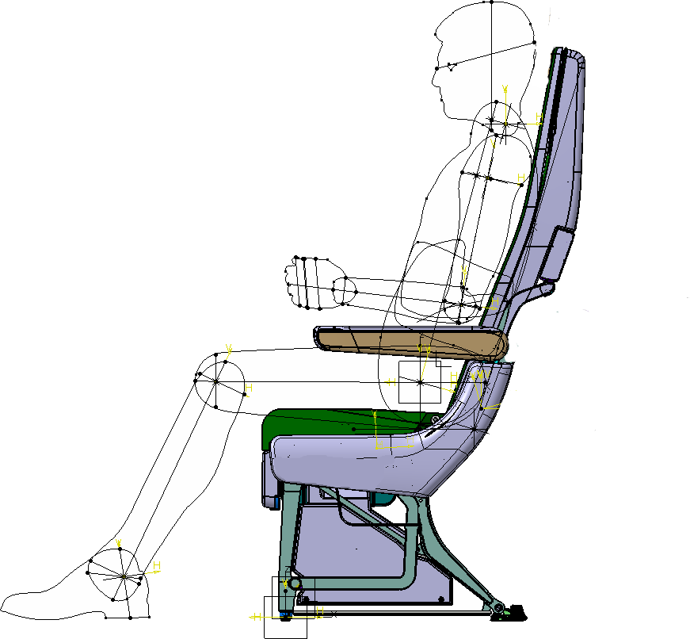
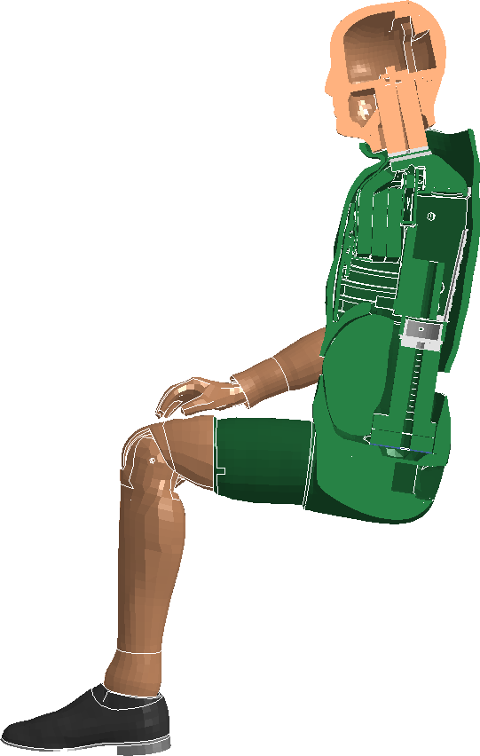
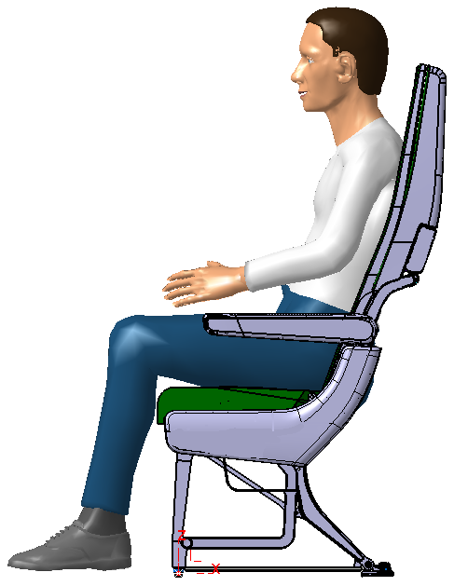
HIC study of a seat submodel
Dummy seating process
correlation of H-Point of HII FE-Dummy, Kieler Puppe and RAMSIS dummy
no seating simulation (reduce calc. time)
defined initial dummy position and cushion deformation
easy update of H-points in development process

Slide 16
HIC study of a seat submodel
Dummy seating process
calculated H-point is in the range of the measured H-points

Slide 17
HIC study of a seat submodel
HIC C over pitch distance
more elastic deformation of the heavy backrest

Slide 18
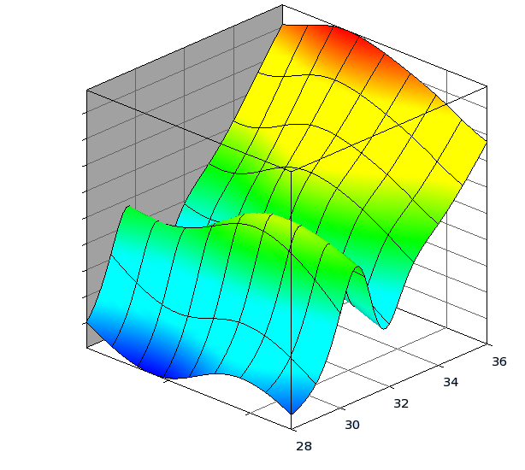
HIC study of a seat submodel
HIC C over pitch distance response surface
high resolution response surface is a map for the HIC
performance of the backrest
map can be expanded to any parameter
of interest
HIC
mass
pitch

Slide 19
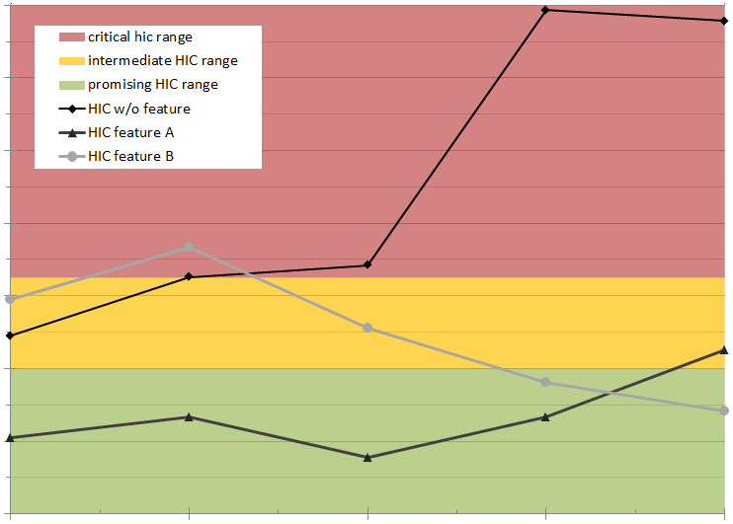
HIC study of a seat submodel
HIC feature benchmark
objective way to rate different
HIC features
allows to change the HIC feature for
another design if the performance
is better
28
29
30
31
32
pitch

Slide 20
Agenda
Introduction
HIC study of a simple engineering model
Study of a seat submodel
Full-scale HIC simulation and test
Conclusions

Slide 21
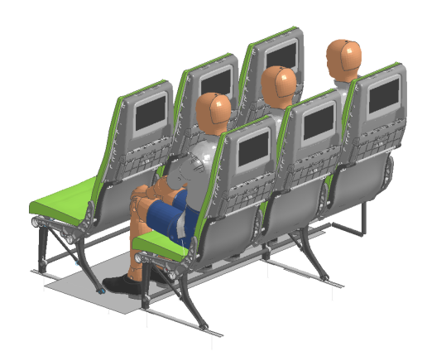
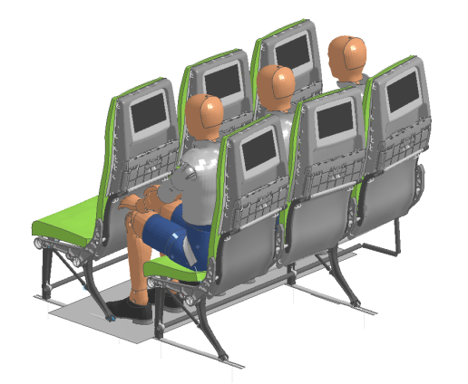
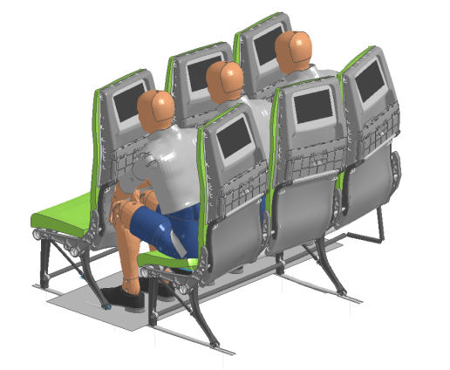
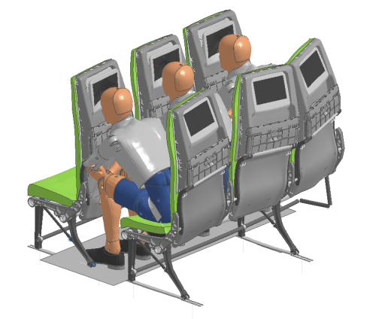
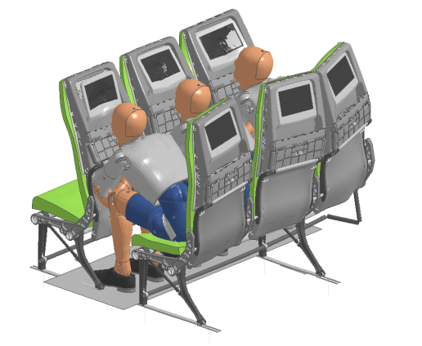
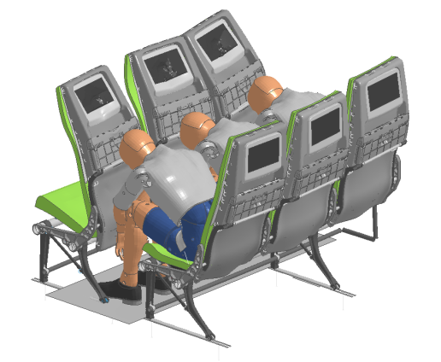
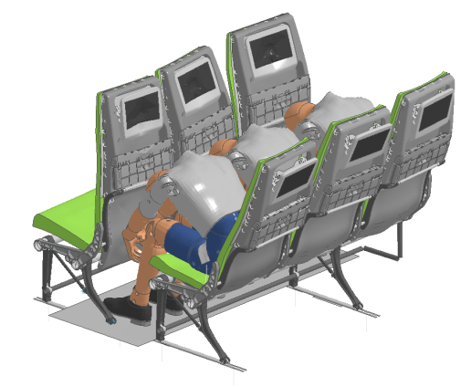
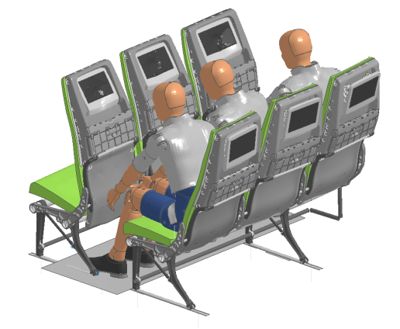
Full-scale HIC simulation and test
Full-scale simulation
t=0ms
t=135ms
t=165ms
t=185ms
t=200ms
t=240ms
t=280ms
t=380ms

Slide 22
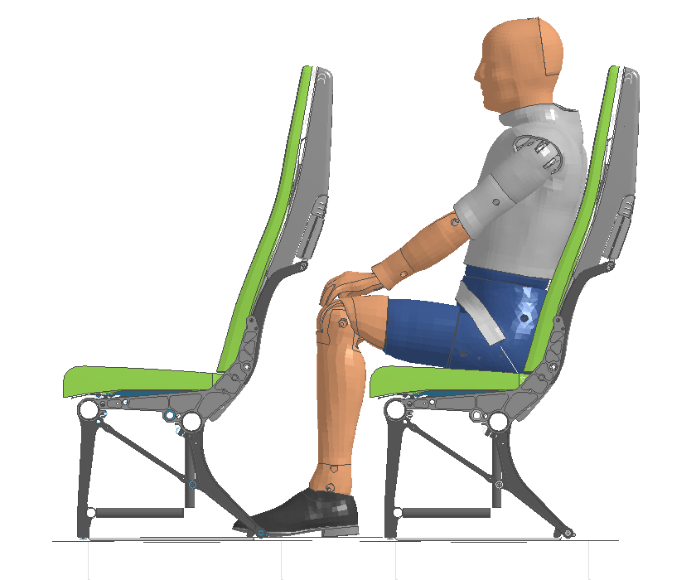
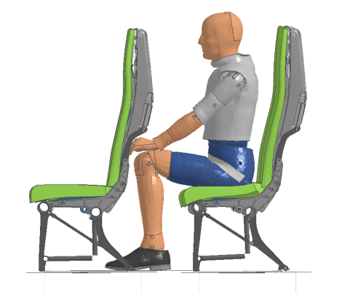
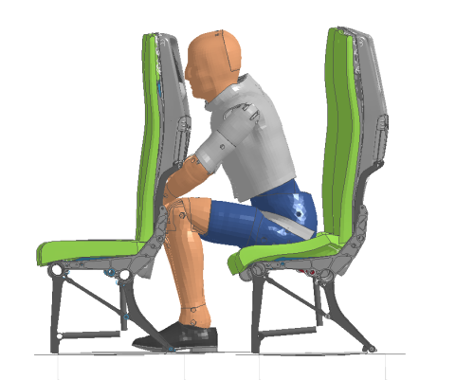
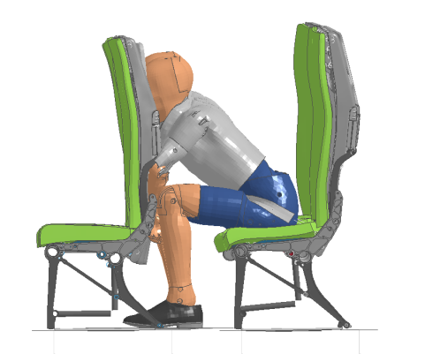
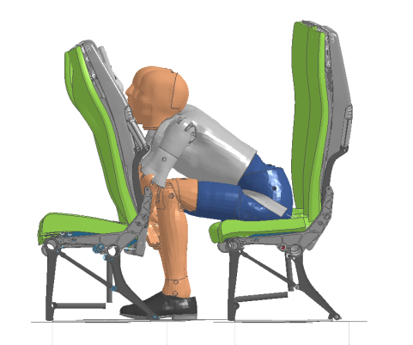
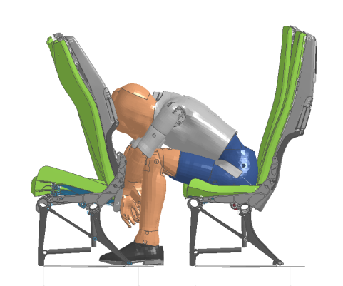
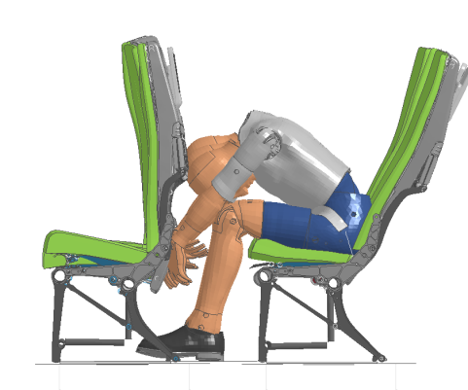
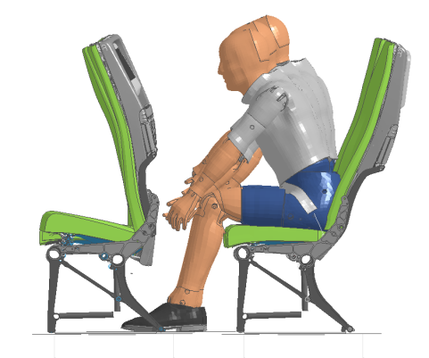
Full-scale HIC simulation and test
Full-scale simulation
t=0ms
t=135ms
t=165ms
t=185ms
t=200ms
t=240ms
t=280ms
t=380ms

Slide 23
Full-scale HIC simulation and test
Comparison full-scale model to submodel
submodel values in the range of the full-scale values
29'' submodel values are lower
influence of the seatbase can be more than 100 points

Slide 24
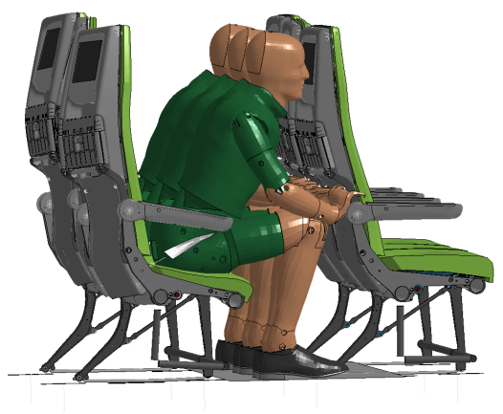
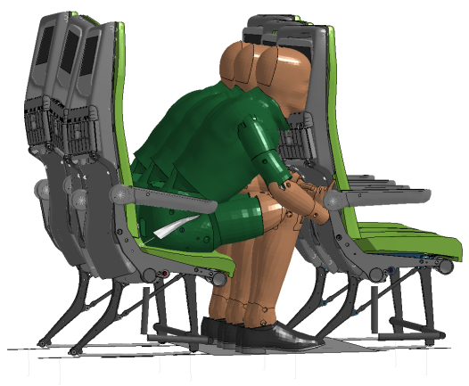
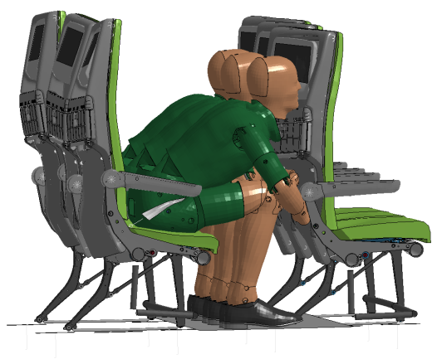
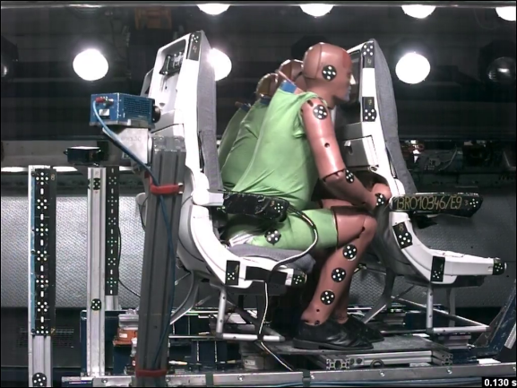
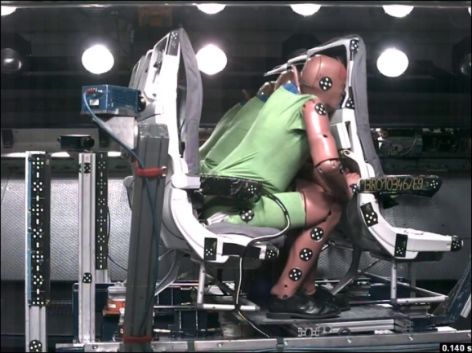
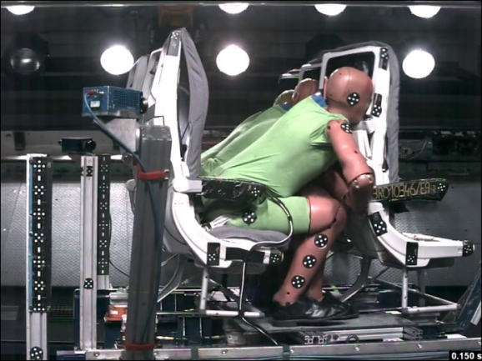
Full-scale HIC simulation and test
Comparison full-scale model to test
t = 130 ms
t = 140 ms
t = 150 ms
Good correlation of time and place
of head impact
similar deformation of the seat structure
Neck stiffness of FE-Dummy is too low

Slide 25
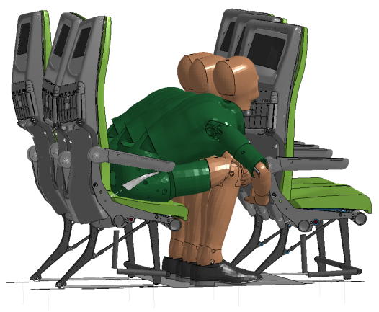
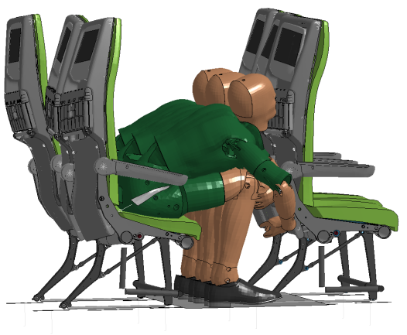
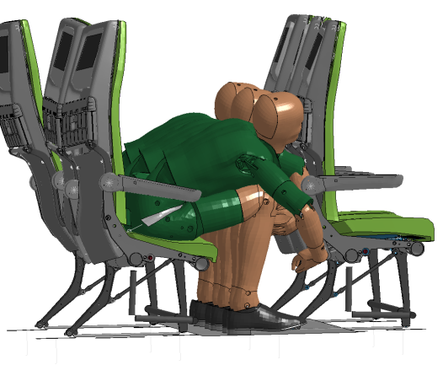
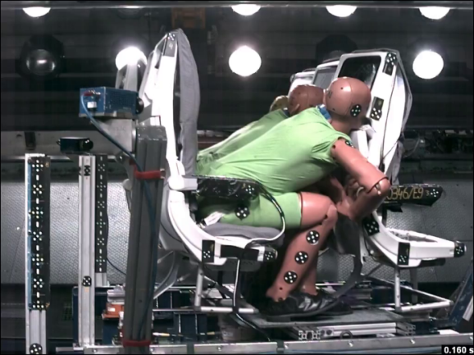
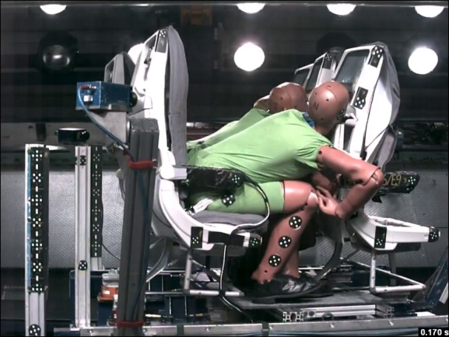
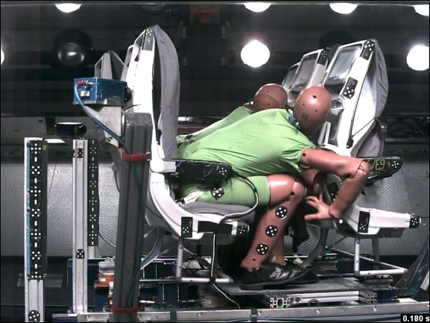
Full-scale HIC simulation and test
Comparison full-scale model to test
t = 160 ms
t = 170 ms
t = 180 ms
Test Dummy moves forward while the
FE-Dummy is sliding at the dining table
FE-Dummy is still sliding
head movement is more similar again
FE-Dummy and Test-Dummy are sliding
at the dining table

Slide 26
Agenda
Introduction
HIC study of a simple engineering model
Study of a seat submodel
Full-scale HIC simulation and test
Conclusions

Slide 27
Conclusions
several parameter studies were performed in the initial phase of the development process
the studies showed some basic characteristics of the backrest design
a submodel was used to analyze the new backrest in detail
the fast submodel allows to analyze different backrests designs, configurations and HIC features in detail
the results could be correlated to full-scale simulations and tests

Slide 28
Thank you for your attention
Dirk Goetze
Stress Engineer
RECARO Aircraft Seating GmbH & Co. KG
Daimlerstrasse 21
74523 Schwaebisch Hall
Telephone: +49 791 503-7000
Fax: +49 791 503-7163
Email: info@recaro-as.com
Internet: www.recaro-as.com

