Slide 1
Head Injury Criterion for Aviation Airbag Applications
The Seventh Triennial Fire & Cabin Safety Research Conference
Joseph A. Pellettiere, Chief Scientific and Technical Advisor for Crash Dynamics
December 2013

Slide 2
Objective
Purpose: Develop appropriate evaluation criteria for inflatable restraint impacts
Compare HIC Unlimited with HIC 15
Evaluate Nij where applicable/available
Compare Hybrid II with FAA Hybrid III
Will review and summarize video and testing from several studies of interest

Slide 3
Data Sources
Sled tests conducted as part of class demo
  Hybrid II with airbag
  2 FAA Hybrid III’s with airbags
Industry supplied data
  Compares HICu with HIC15
  Compares HICu with HIC15 and Hybrid II with FAA Hybrid III
CAMI research data
  Nij calculation for non-airbag tests

Slide 4


Head Injury Criterion (HIC)
Resultant head acceleration
Calculated after contact
No limit on duration
<1000 represents ~ 23% risk of AIS 3+ (severe) head injury
Applied in multiple directions

Slide 5
Neck Injury (Nij)
Focused on frontal and rearward motion
No shear limits
No lateral bending limits
<1 represents ~20% risk of AIS3+ (severe) neck injury
Tension
N_{te}
N_{tf}
No Injury
Extension
Flexion
N_{ce}
N_{cf}
Compression
N_{ij}=F_{z}/F_{zc} + M_{y}/M_{yc}
Notes:
F_{zc} = 6806 N (tension)
F_{zc} = 6160 N (compression)
M_{yc} = 310 Nm (flexion)
M_{yc} = 135 Nm (extension)
F_{t} = 4170 N
F_{c} = 4000 N

Slide 6
FMVSS 208 changes
Hybrid III adoption
  Improved biofidelity
  Increase measurement capability
Limiting HIC window provides:
  Equally stringent evaluation for long durations, with decrease acceptance level
  Increased stringency for short durations, where biomechanical certainty is not as strong
Nij adopted to address
  Airbag loading
  Fatalities to children

Slide 7
Data Summary
2 Class Demo tests
Part 23 Crew data
Industry supplied Part 25 data
CAMI research test data

Slide 8
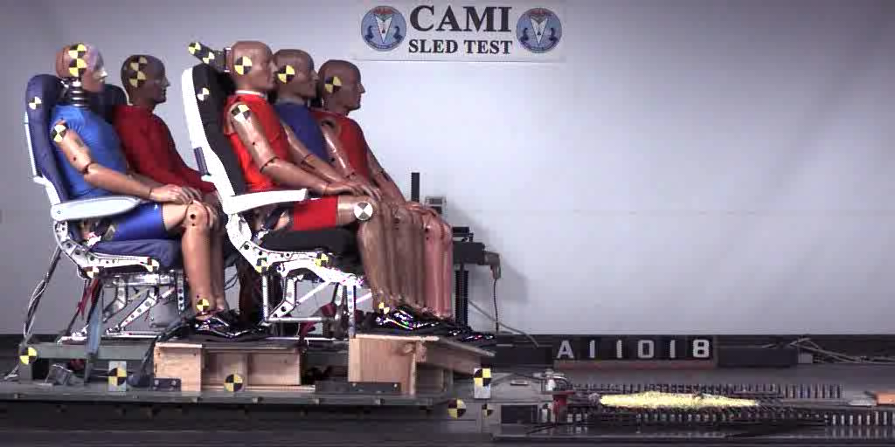
16 G 44 ft/s

Slide 9
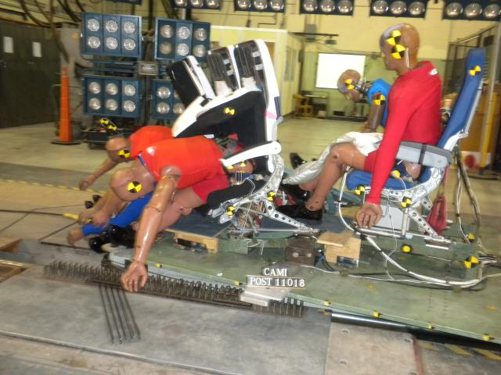
Left Side Occupant Head Impact (Hybrid-II)
Air Bag Contact

Slide 10
Hybrid II Airbag Contact
Notes:
Both passed, case where lower acceptance value of HIC 15 does not make it a fail!

Slide 11
Planned Test
16G, 44 ft/sec
Business class double
Hybrid II in front seat
FAA Hybrid III in launch seat
Barrier bag
Wedge bag

Slide 12
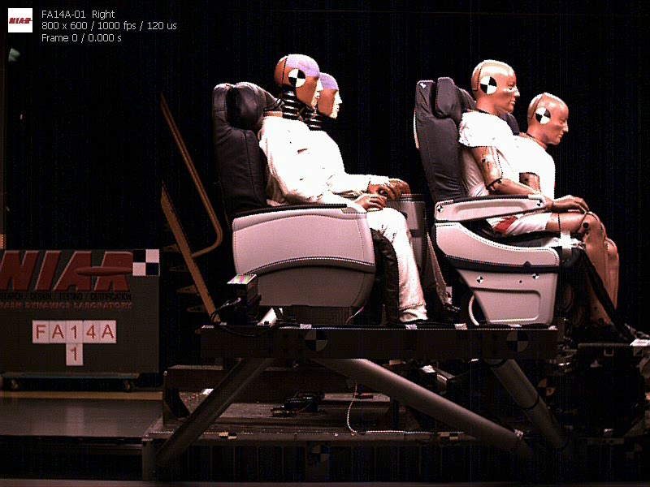
Barrier Bag

Slide 13
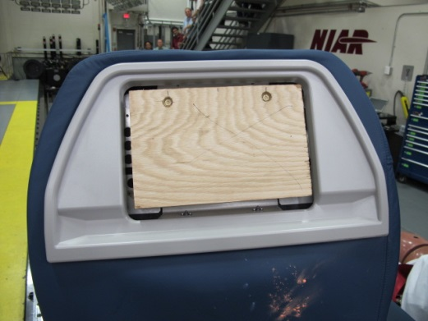
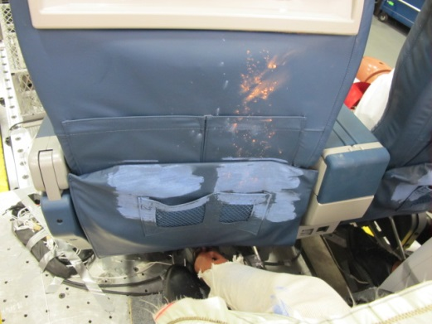
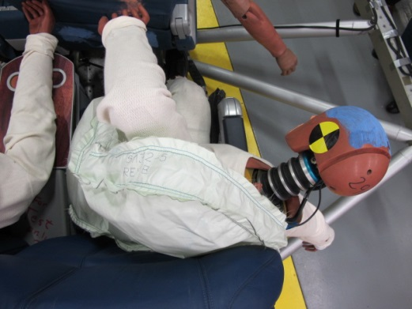
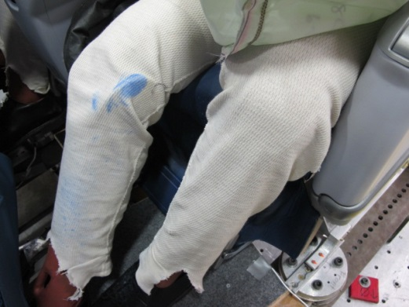
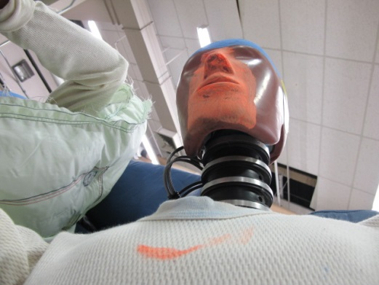
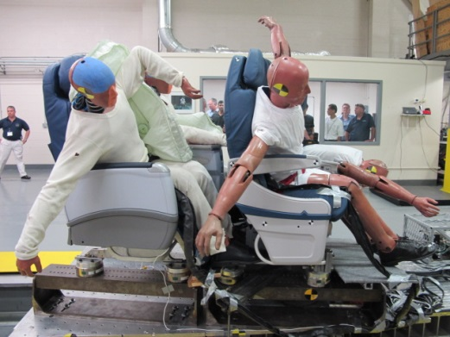
ATD Contacts- Left

Slide 14

Wedge Bag

Slide 15
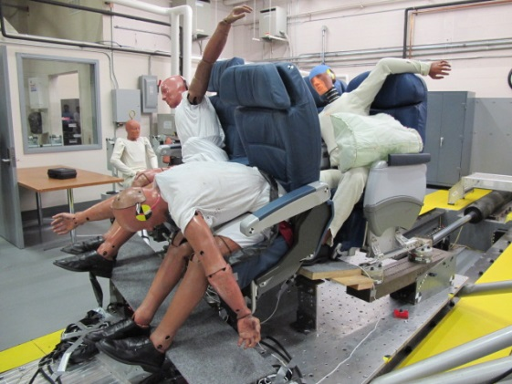
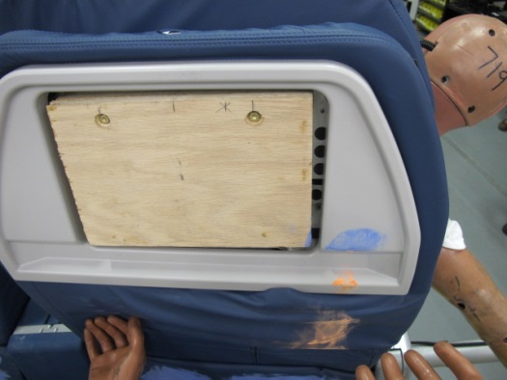
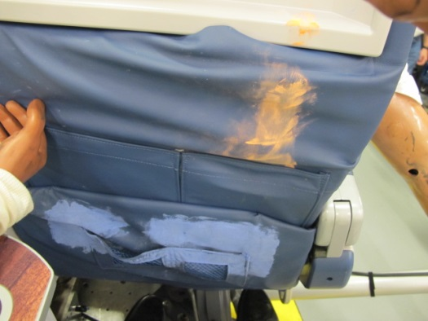
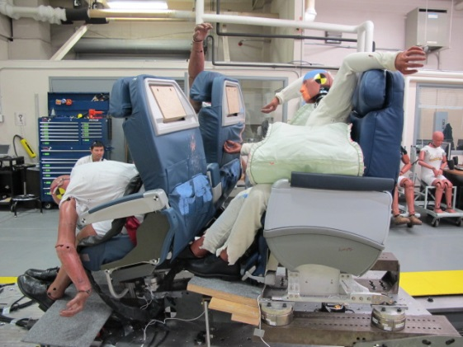
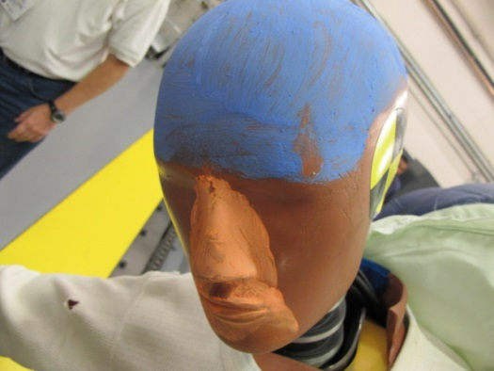
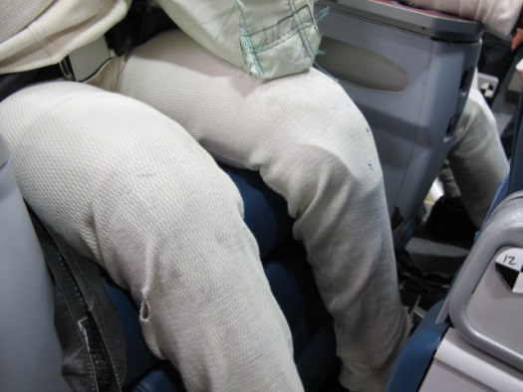
ATD Contacts- Right

Slide 16
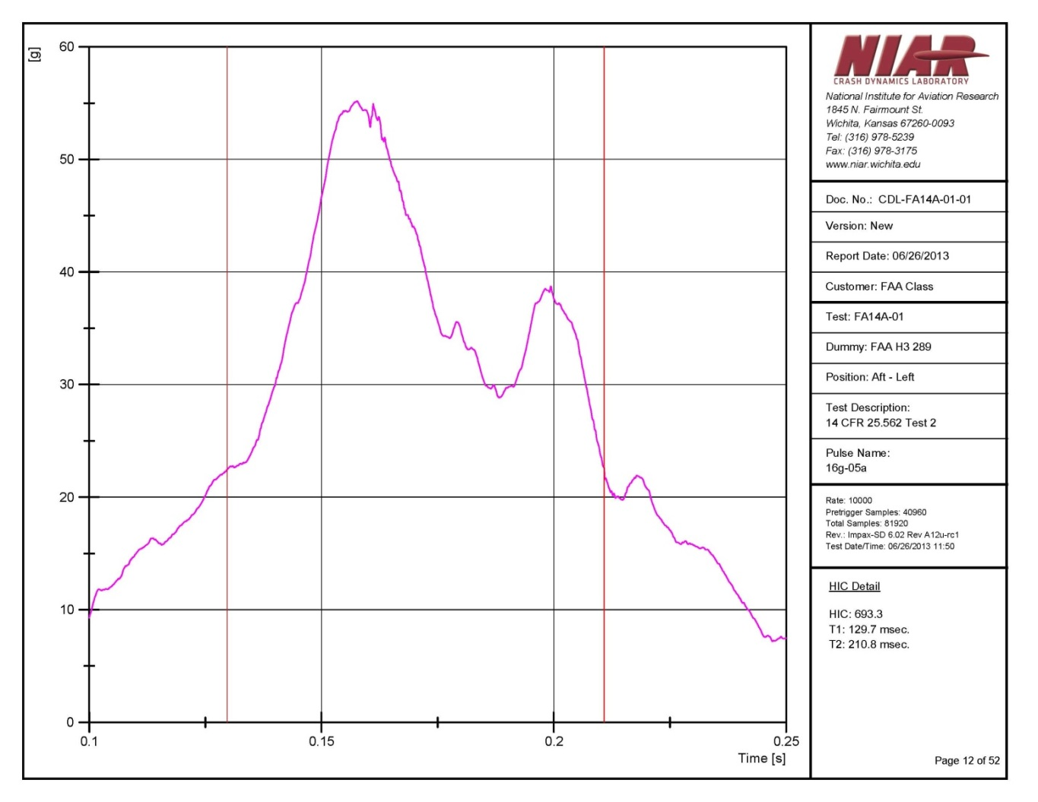
Left ATD HIC
No contact with fwd seat back
HIC: 693.3
T1= 129.7 ms
T2= 210.8 ms
HIC15: 306
T1=150.9 ms
T2=165.9 ms

Slide 17
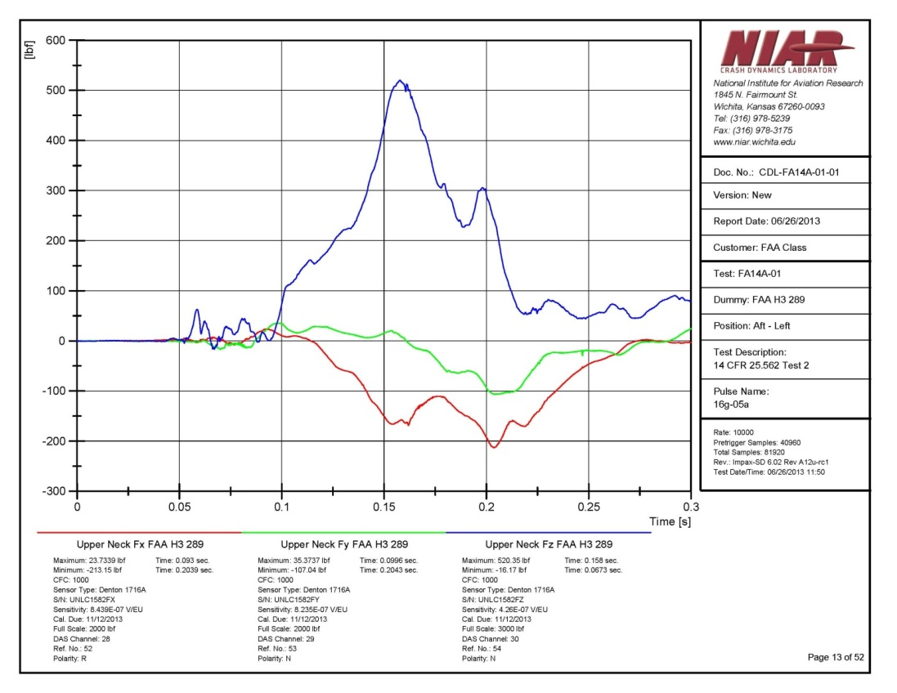
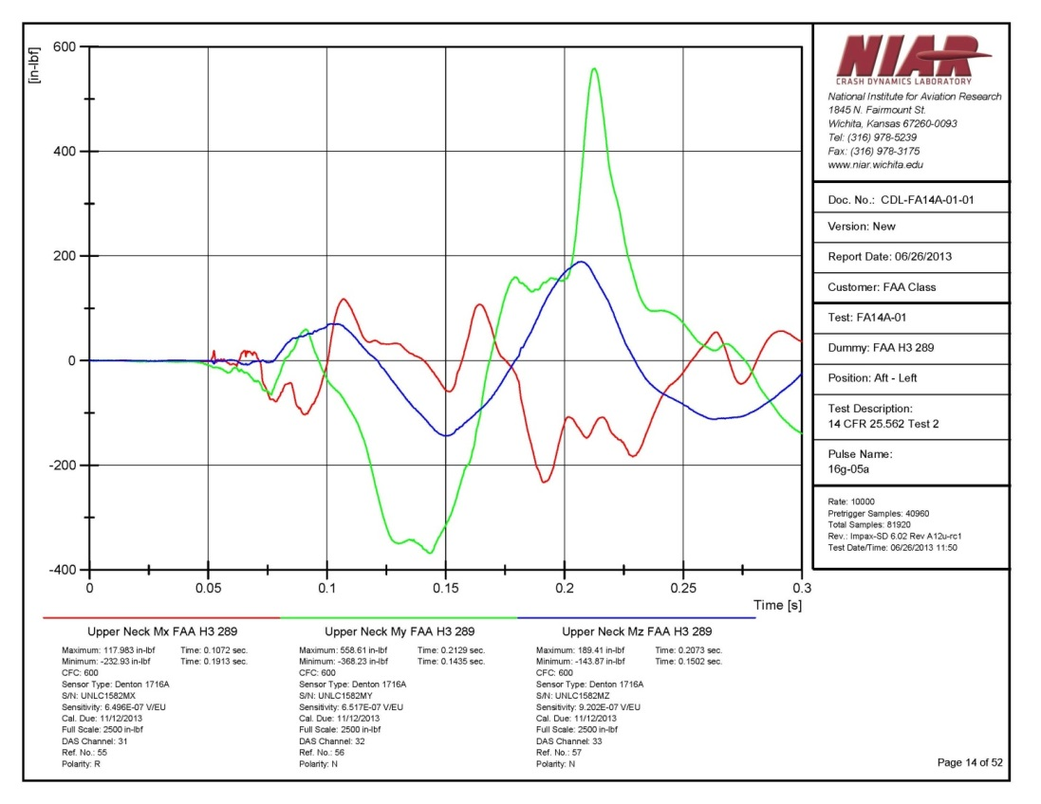
Left ATD Upper Neck
Nij =.46 @ 0.152
Forces Moments

Slide 18
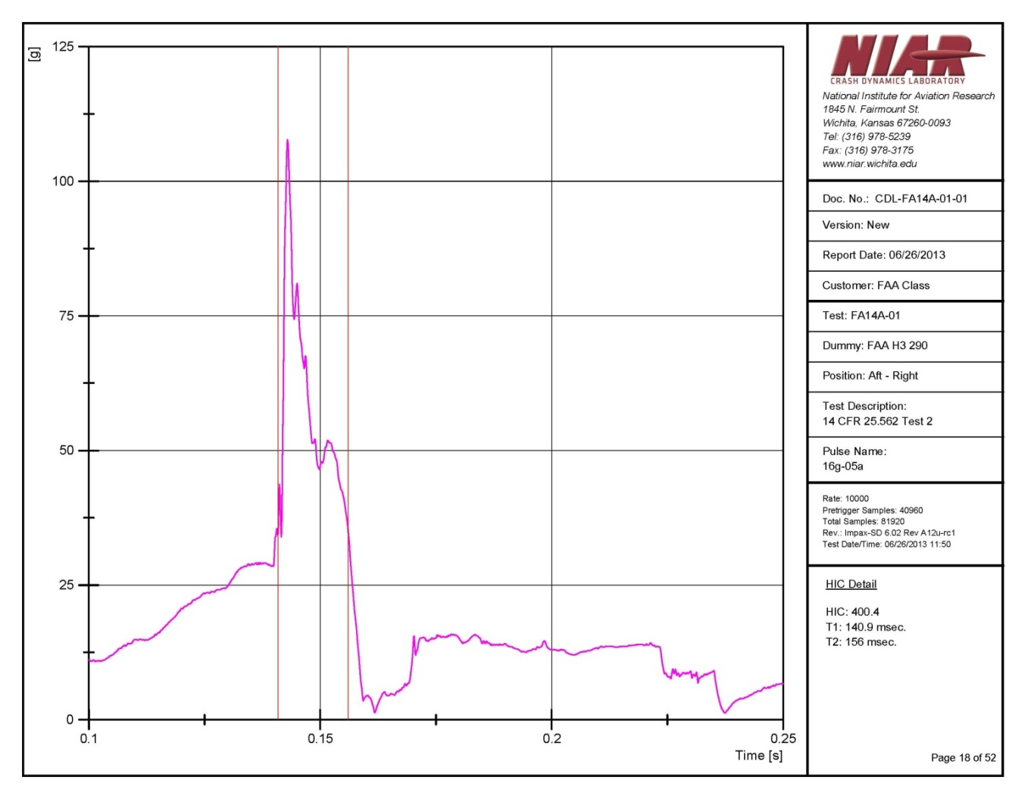
Right ATD HIC
Contact with fwd seat back
HIC: 400.4
T1= 140.9 ms
T2= 156.0 ms
HIC15: 400.4
T1=140.9 ms
T2=155.9 ms

Slide 19
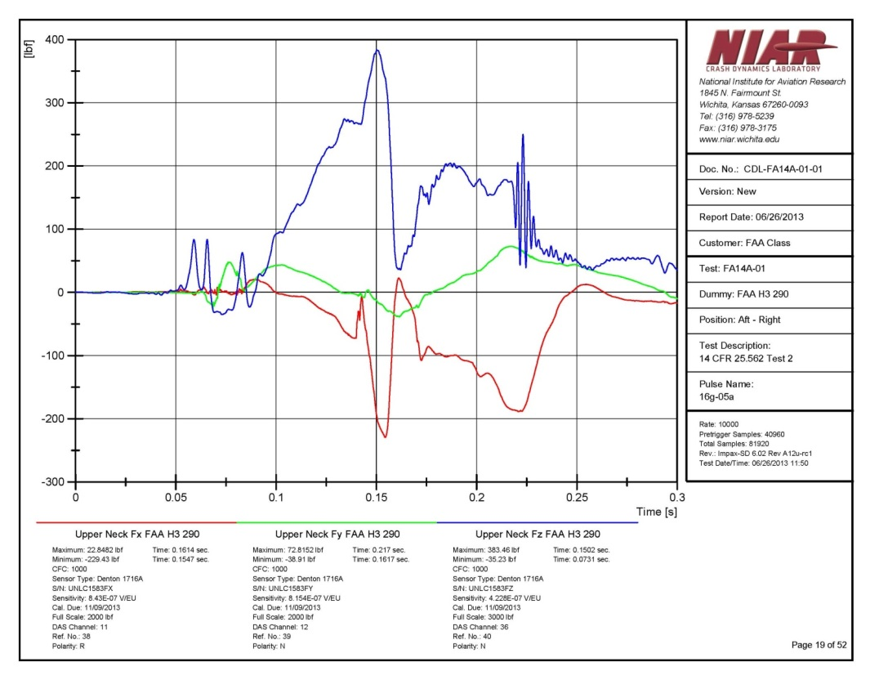
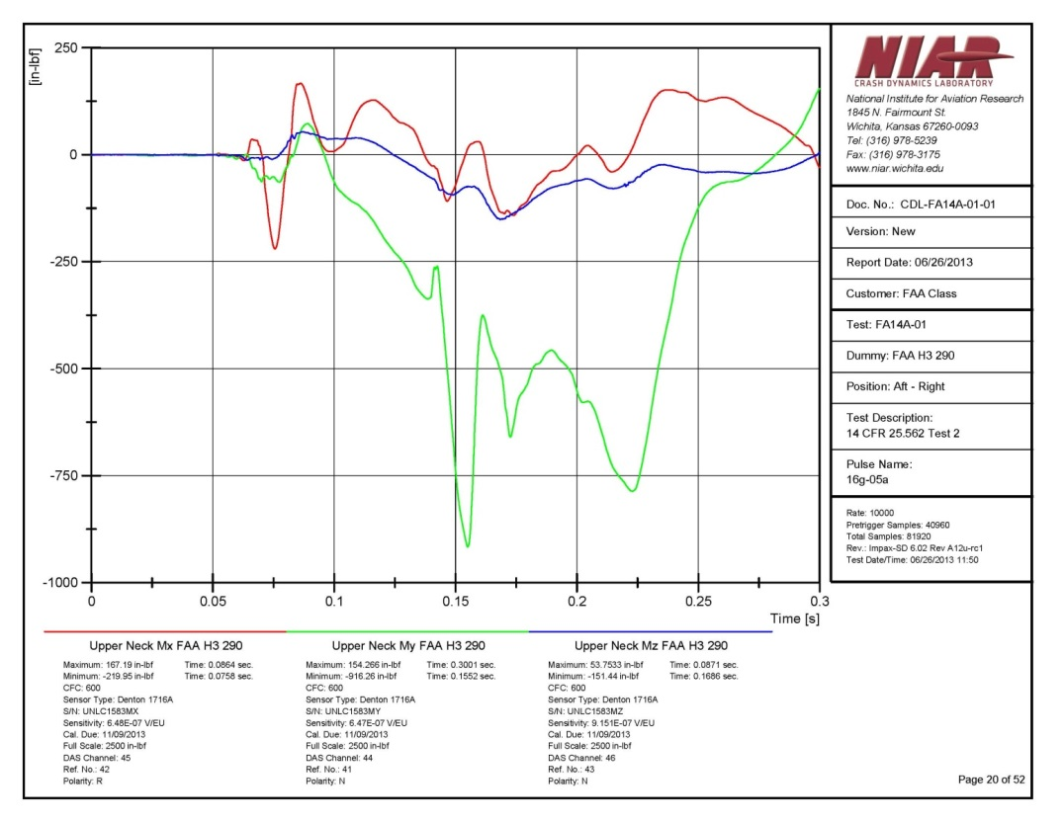
Right ATD Upper Neck
Nij =.85 @ 0.155
Forces Moments

Slide 20
Planned test summary
Only minor contact with inflatable restraint
HIC15 lower than HICu
All HICs passed
All Nij passed

Slide 21
HII vs. FAA HIII
Rigid Fixture
3 pt. Belt, Wedge bag
No head contact with wall
Part 23 crew (26G)
Neck data not collected
130 ms duration
 |  | Hybrid II |  |  | FAA Hybrid III
 |  |  | T1 | T2 |  | T1 | T2
HICu | Test1 | 1339 | 74 | 186 | 844 | 67 | 203
 | Test2 | 1294 | 73 | 193 | 1131 | 71 | 200
HIC15 | Test1 | 486 | 102 | 117 | 406 | 102 | 117
 | Test2 | 514 | 103 | 118 | 430 | 101 | 116
Notes:
HIC15 now passes where HICu fails, also note long duration of HICu window

Slide 22
HICu vs. HIC15
Test | HICu | HIC15
B1 | 1029 | 622
B2 | 1303 | 582
C1 | 1032 | 812
C2 | 1008 | 822
F1 | 1106 | 893
F2 | 1020 | 943
F3 | 1346 | 1186
F4 | 1174 | 864
Industry data
Non-airbag tests
Double peaks
HIC15 significantly lower
HIC15 generally chose first peak
2 cases where HIC15 < 700

Slide 23
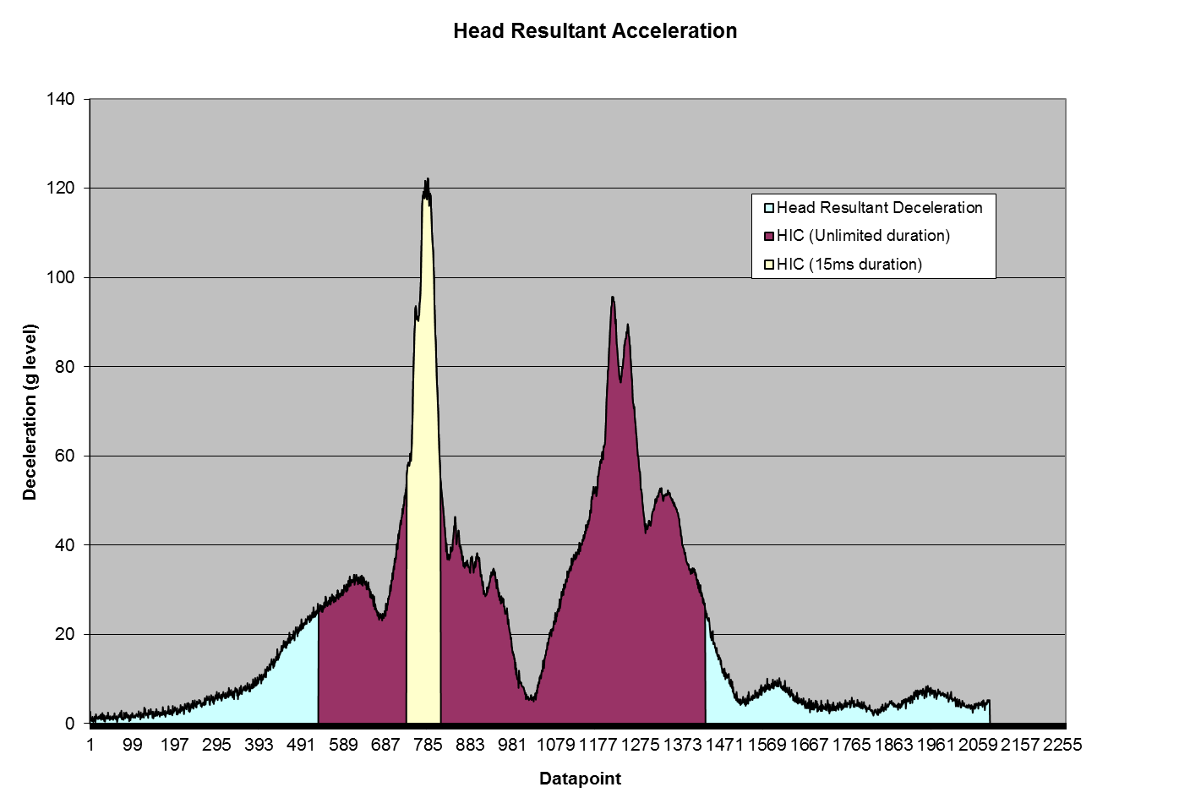
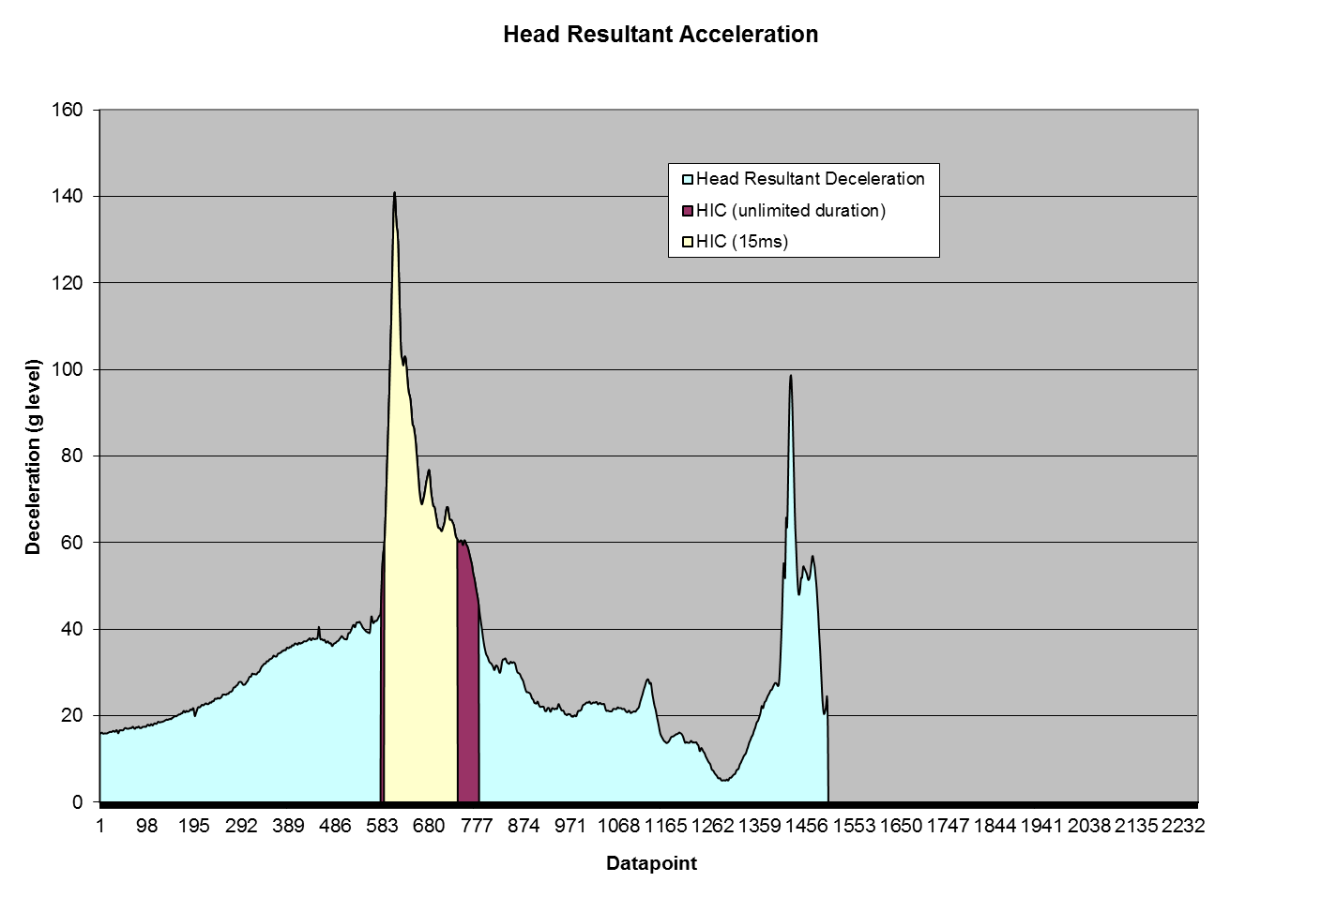
HICu vs. HIC15
HICu: 1029
HIC15: 622
HICu: 1020
HIC15: 943
Note: HICu includes both peaks together

Slide 24
Forward Facing Seat Nij*
No Contact
Torso
Contact
Dbl
Row
Wall
Wall &
Ledge
Seat Back
* DeWeese R, Assessment of Head and Neck Injury Potential for Occupants of Typical Aircraft Seats and Interior Configurations During Forward Impacts,Fifth Triennial International Aviation Fire and Cabin Safety Research Conference

Slide 25
Possible Solution
Modify HIC and use FAA Hybrid III with Neck Loads
Use HIC15 < 700
  Simple definition of contact, algorithm was able to calculate start/end times
  Generally takes only the first peak
Incorporate Nij <1 from FMVSS 208
Seats generally do not fail Nij
Notes:
No need to define when the “soft” contact ocurrs with the airbag

Slide 26
HIC 15
Use would eliminate failure from “lower” g longer duration contacts that would be typical of inflatables
Consistent with transition to HIC 15 in FMVSS 208
Limitation is if a secondary contact with a hard structure after an inflatable contact?

Slide 27
Conclusions
HIC15 good for airbag contacts
  Start usually after contact, good when you have soft contacts making it difficult to determine start
Nij only exceeded when HIC was also exceeded
In this series FAA Hybrid III generally had lower HIC values
  More pronounced with HICu vs. HIC15
Additional data to be collected and welcomed

