Slide 1
Performance of a Numerical Model of the ES-2re as a Function of Impact Angle
IAFCSRC
David Moorcroft
5 December 2013

Slide 2
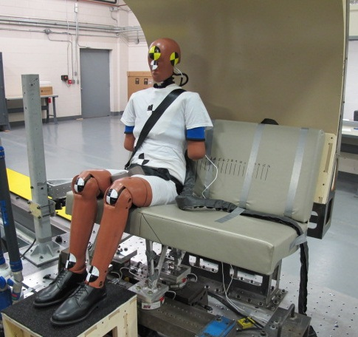
Side-Facing Seats
FAA Policy (PS-ANM-25-03-R1) requires testing with the ES-2re for purely side-facing seats
Evaluates risk of injury to head, neck, ribs (from contact and shoulder strap loads), abdomen, pelvis, and legs
Photo courtesy of Cessna

Slide 3
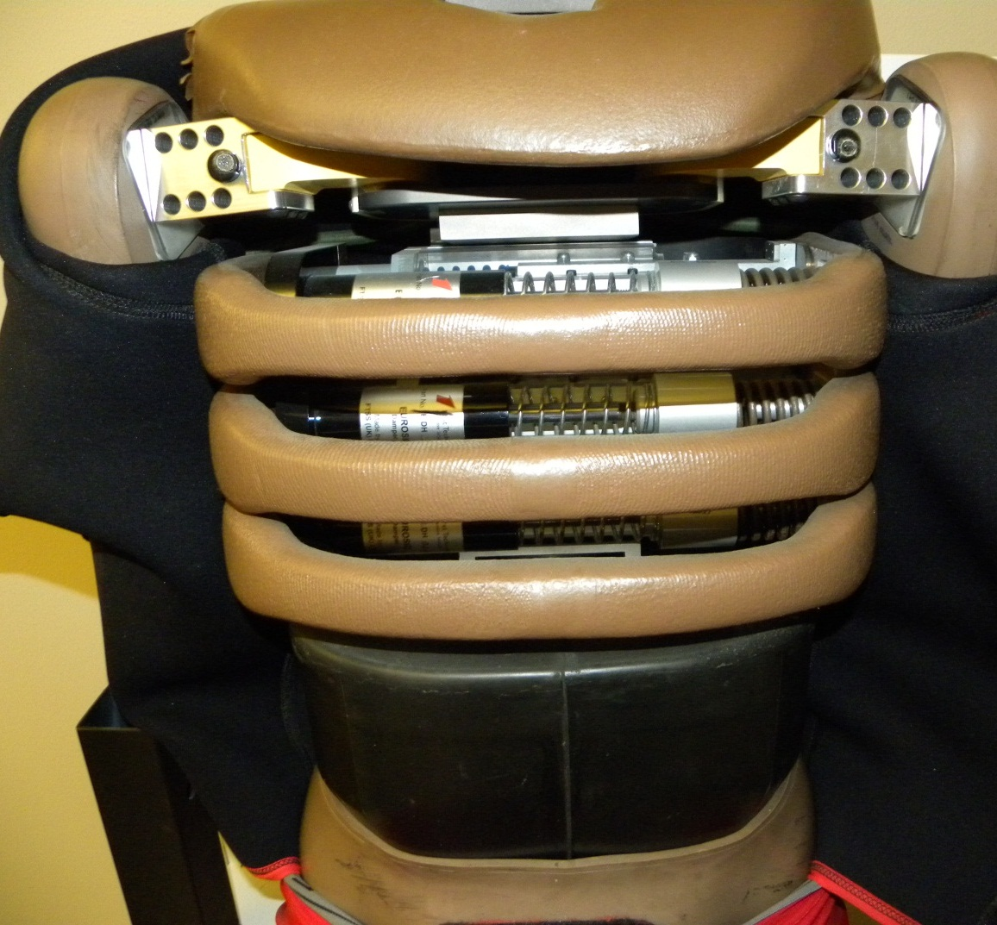
ES-2re
The ES-2re was specifically designed for lateral loading
Rib deflection instrumentation is designed for unilateral motion
Solid rubber abdomen casing

Slide 4
ES-2re Injury Criteria
Head: HIC < 1000 (23% risk of AIS 3+ head injury)
Upper Neck Tension Force < 405 lb (25% risk of AIS 3+ neck injury)
Upper Neck Compressive Force < 405 lb
Upper Neck Torque (x-axis) < 1018 in-lb
Upper Neck Shear < 186 lb
Upper Torso Strap Load < 1750 lb (50% risk of AIS 3+ chest injury)

Slide 5
ES-2re Injury Criteria
Upper, Middle, Lower Rib deflection < 1.73” (50% risk of AIS 3+ chest injury)
Front+Middle+Rear Abdominal Force < 562 lb (33% risk of AIS 3+ abdominal injury)
Pubic Symphysis Force < 1,350 lb (25% risk of AIS 3+ pelvic injury)
Lower Leg Flail Limit (35°)
Restraints must remain on ATD
Occupant Support Criteria

Slide 6
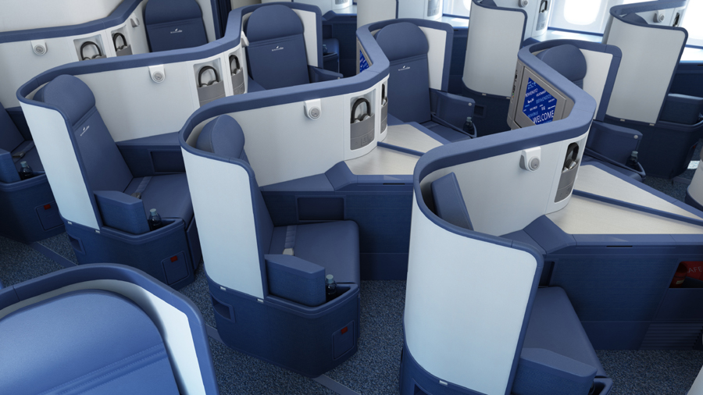
Obliquely-Mounted Seats
Obliquely-oriented seats presents a novel loading environment that may permit significant flailing with off-axis loading
An ATD capable of evaluating injury risks due to combined forward and lateral loading is necessary
Delta

Slide 7
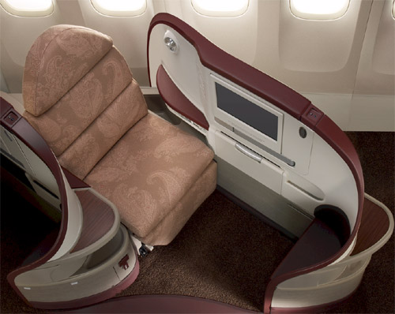
Obliquely-Mounted Seats
Current forward-facing ATDs cannot measure all the likely injuries
Construction of the ES-2re may not hold up to significant forward flail
Jet Airways

Slide 8
Oblique Flail: FAA-Hybrid III + Armrest

Slide 9
Methods
v-ATD of ES-2re (left-hand configuration)
Wall configuration and restraint system similar to 2005 CAMI tests
Report number: AM-07/13
Instrumentation per side-facing policy
Pulse applied from 90° to 30°(15° increments)
14 CFR Part 25.562 Test 2 pulse (16g peak, 90 ms rise time, 44 ft/s velocity change)
Simulations with and without shoulder strap
No strap is worst case for ineffective shoulder strap

Slide 10
Full Body Support Body-Centered Restraint

Slide 11
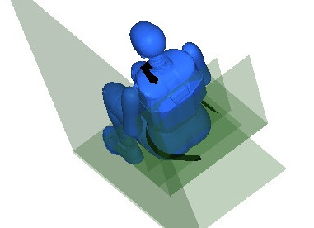
Full Body Support Body-Centered Restraint

Slide 12
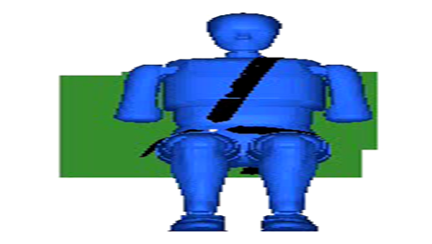
Wall Placement
10”
CAMI Wall
Virtual Wall
Numerical ES-2re arms stick out further than physical ATD
Moved wall 1” outboard to accommodate
Delays head contact

Slide 13
Point Comparison
Madymo 7.4.1
ES-2re
Quality-rate facet model, version 3.0.2
Left hand model
Test case: 90°
Full body support (wall), body-centered restraint
All other scenarios are an extrapolation
Point comparison provides limited confidence in model at other angles

Slide 14
Shoulder Strap, 90° Simulation

Slide 15
Test-Simulation Comparison
Injury Criteria | Limit | Test (A05065) | Simulation
HIC | 1000 | 537 | 770
Upper Neck Tension (lb) | 405 | 140 | 213
Upper Neck Compression (lb) | 405 | 162 | 152
Upper Neck Shear (lb) | 186 | 103 | 117
Upper Neck Torque (in-lb) | 1018 | 141 | 99
Upper Rib Deflection (in) | 1.73 | 1.1 | 0.70
Middle Rib Deflection (in) | 1.73 | 0.75 | 0.50
Lower Rib Deflection (in) | 1.73 | 0.55 | 0.32
Abdominal Forces (lb) | 562 | 45 | 134
Pubic Symphysis Force (lb) | 1350 | 203 | 748
Shoulder Strap Load (lb) | 1750 | 41 | 333

Slide 16
Test-Simulation Comparison
Injury Criteria | Limit | Test (A05065) | Simulation
HIC | 1000 | 537 | 770
Upper Neck Tension (lb) | 405 | 140 | 213
Upper Neck Compression (lb) | 405 | 162 | 152
Upper Neck Shear (lb) | 186 | 103 | 117
Upper Neck Torque (in-lb) | 1018 | 141 | 99
Upper Rib Deflection (in) | 1.73 | 1.1 | 0.70
Middle Rib Deflection (in) | 1.73 | 0.75 | 0.50
Lower Rib Deflection (in) | 1.73 | 0.55 | 0.32
Abdominal Forces (lb) | 562 | 45 | 134
Pubic Symphysis Force (lb) | 1350 | 203 | 748
Shoulder Strap Load (lb) | 1750 | 41 | 333

Slide 17
Test-Simulation Comparison
Injury Criteria | Limit | Test (A05065) | Simulation
HIC | 1000 | 537 | 770
Upper Neck Tension (lb) | 405 | 140 | 213
Upper Neck Compression (lb) | 405 | 162 | 152
Upper Neck Shear (lb) | 186 | 103 | 117
Upper Neck Torque (in-lb) | 1018 | 141 | 99
Upper Rib Deflection (in) | 1.73 | 1.1 | 0.70
Middle Rib Deflection (in) | 1.73 | 0.75 | 0.50
Lower Rib Deflection (in) | 1.73 | 0.55 | 0.32
Abdominal Forces (lb) | 562 | 45 | 134
Pubic Symphysis Force (lb) | 1350 | 203 | 748
Shoulder Strap Load (lb) | 1750 | 41 | 333

Slide 18
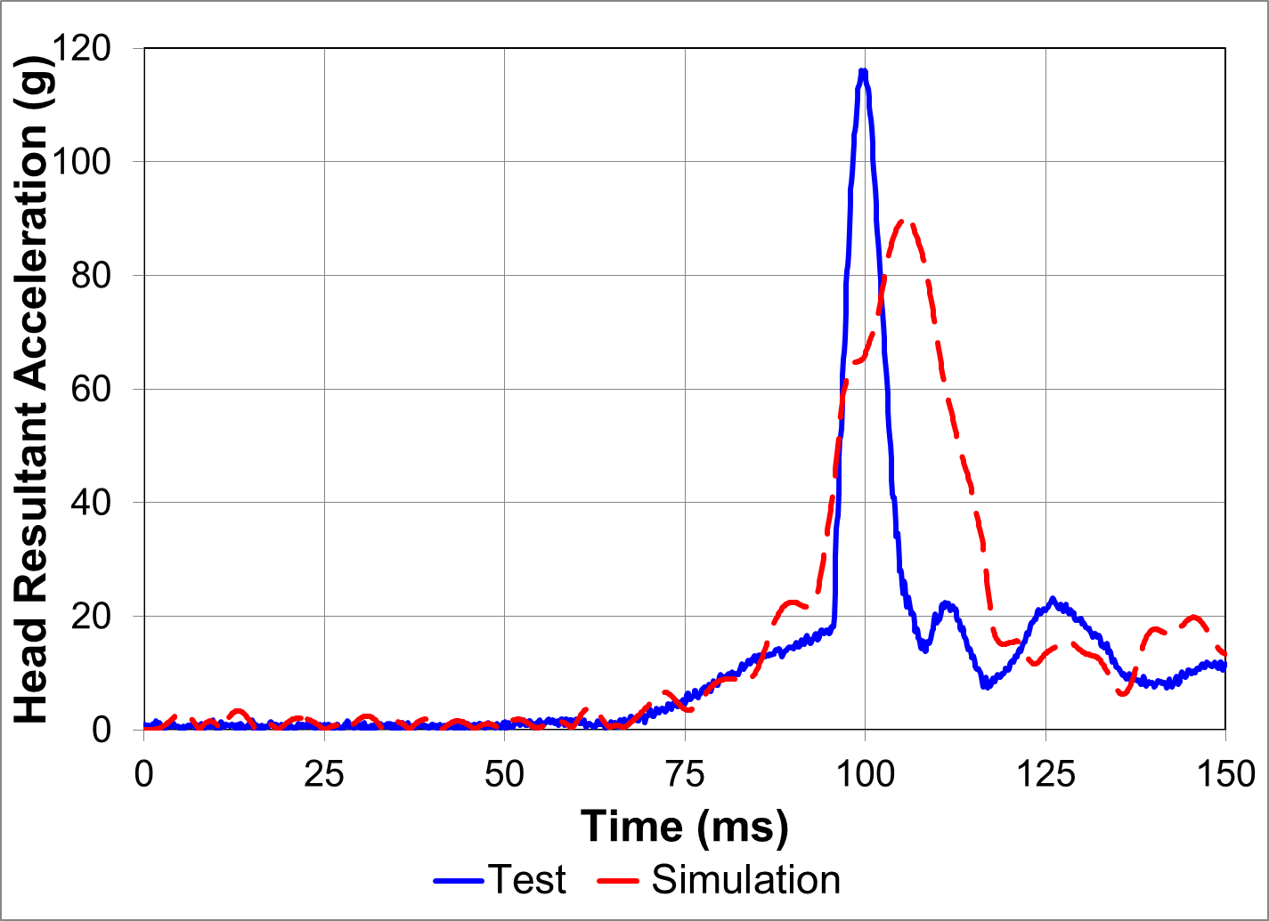
Head Acceleration

Slide 19
Head Contact
HIC is higher in simulation (770 vs. 537)
Head resultant has lower peak but wider duration
HIC duration: test Δt = 6.4, simulation Δt = 19.4
Similar energy, softer contact in simulation
1” difference in wall placement also a factor

Slide 20
Thorax Contact
Thorax interaction with wall different between test and simulation
Test: Arm is trapped between body and wall
Reduces loads (ATD and strap)
Increases deflections
Simulation: Shoulder rotates in front of ribs
Peak loads (ATD and strap) and deflections occur at or before shoulder rotation

Slide 21
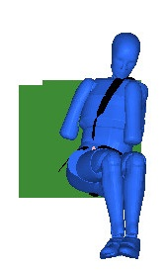
Shoulder Interaction

Slide 22
Pelvic Contact
Pubic Symphysis Force much higher
748 lb vs. 203 lb
Cause uncertain
May be related to simplified seat bottom cushion representation
No pelvic contact with wall
Value still half the injury limit

Slide 23
Point Comparison
The v-ATD to wall interaction is similar to the physical ATD to wall interaction from an injury criteria perspective
Mostly conservative
Simulation appears to be sufficient to show trends

Slide 24
Simulation Results: Shoulder Strap
Injury Criteria | 90° | 75° | 60° | 45° | 30°
HIC | 770 | 673 | 529 | 349 | 160
Upper Neck Tension (lb) | 213 | 193 | 189 | 253 | 260
Upper Neck Compression (lb) | 152 | 141 | 151 | 114 | 66
Upper Neck Shear (lb) | 117 | 90 | 66 | 62 | 33
Upper Neck Torque (in-lb) | 99 | 147 | 133 | 87 | 139
Upper Rib Deflection (in) | 0.70 | 0.63 | 0.32 | 0.15 | 0.13
Middle Rib Deflection (in) | 0.50 | 0.46 | 0.28 | 0.15 | 0.10
Lower Rib Deflection (in) | 0.32 | 0.34 | 0.27 | 0.11 | 0.05
Abdominal Forces (lb) | 134 | 85 | 84 | 69 | 197
Pubic Symphysis Force (lb) | 748 | 868 | 798 | 937 | 1004
Shoulder Strap Load (lb) | 333 | 434 | 557 | 804 | 930

Slide 25
Shoulder Strap, 45° Simulation

Slide 26
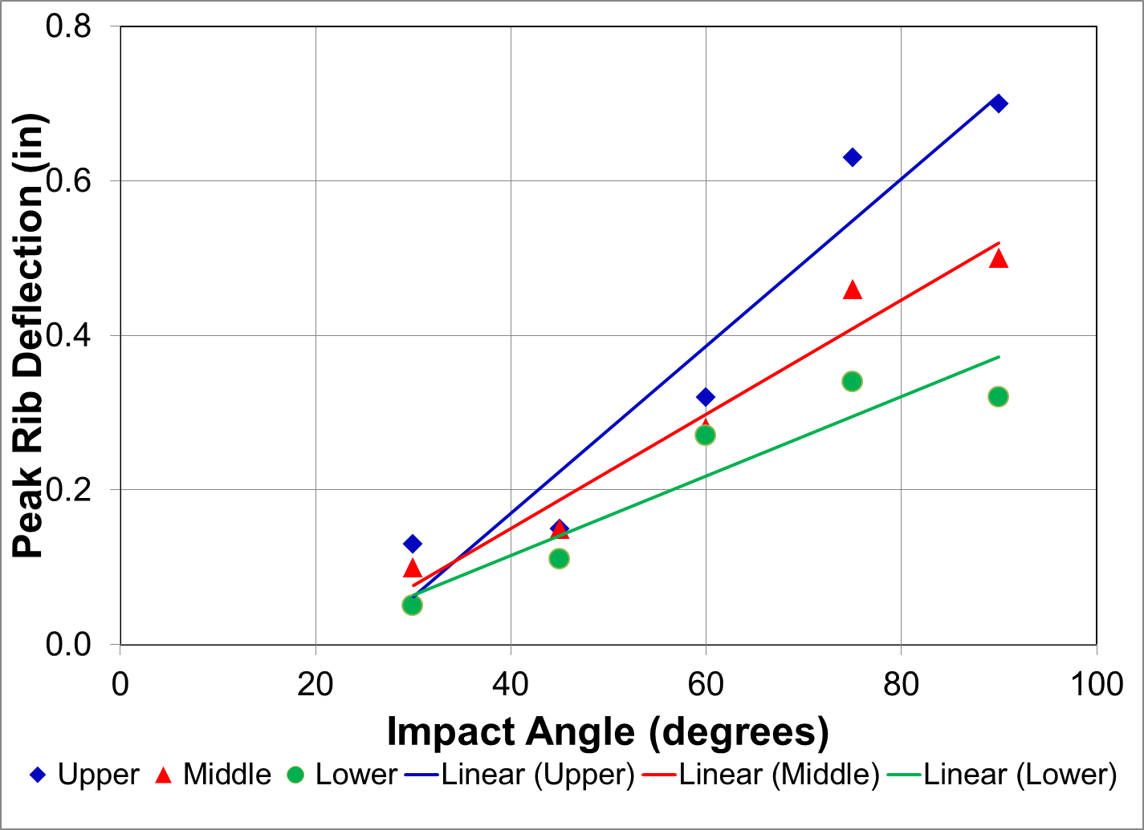
Rib Deflections (With Shoulder Strap)

Slide 27
Simulation Results: No Shoulder Strap
Injury Criteria | 90° | 75° | 60° | 45° | 30°
HIC | 858 | 758 | 677 | 533 | 427
Upper Neck Tension (lb) | 140 | 179 | 175 | 319 | 353
Upper Neck Compression (lb) | 204 | 351 | 296 | 261 | 121
Upper Neck Shear (lb) | 120 | 106 | 88 | 64 | 57
Upper Neck Torque (in-lb) | 399 | 177 | 188 | 134 | 147
Upper Rib Deflection (in) | 1.13 | 0.88 | 0.61 | 0.41 | 0.15
Middle Rib Deflection (in) | 0.56 | 0.47 | 0.39 | 0.19 | 0.08
Lower Rib Deflection (in) | 0.35 | 0.28 | 0.22 | 0.06 | 0.06
Abdominal Forces (lb) | 230 | 149 | 229 | 186 | 170
Pubic Symphysis Force (lb) | 782 | 853 | 1017 | 1634 | 1923
Values in red exceed injury criteria limit

Slide 28
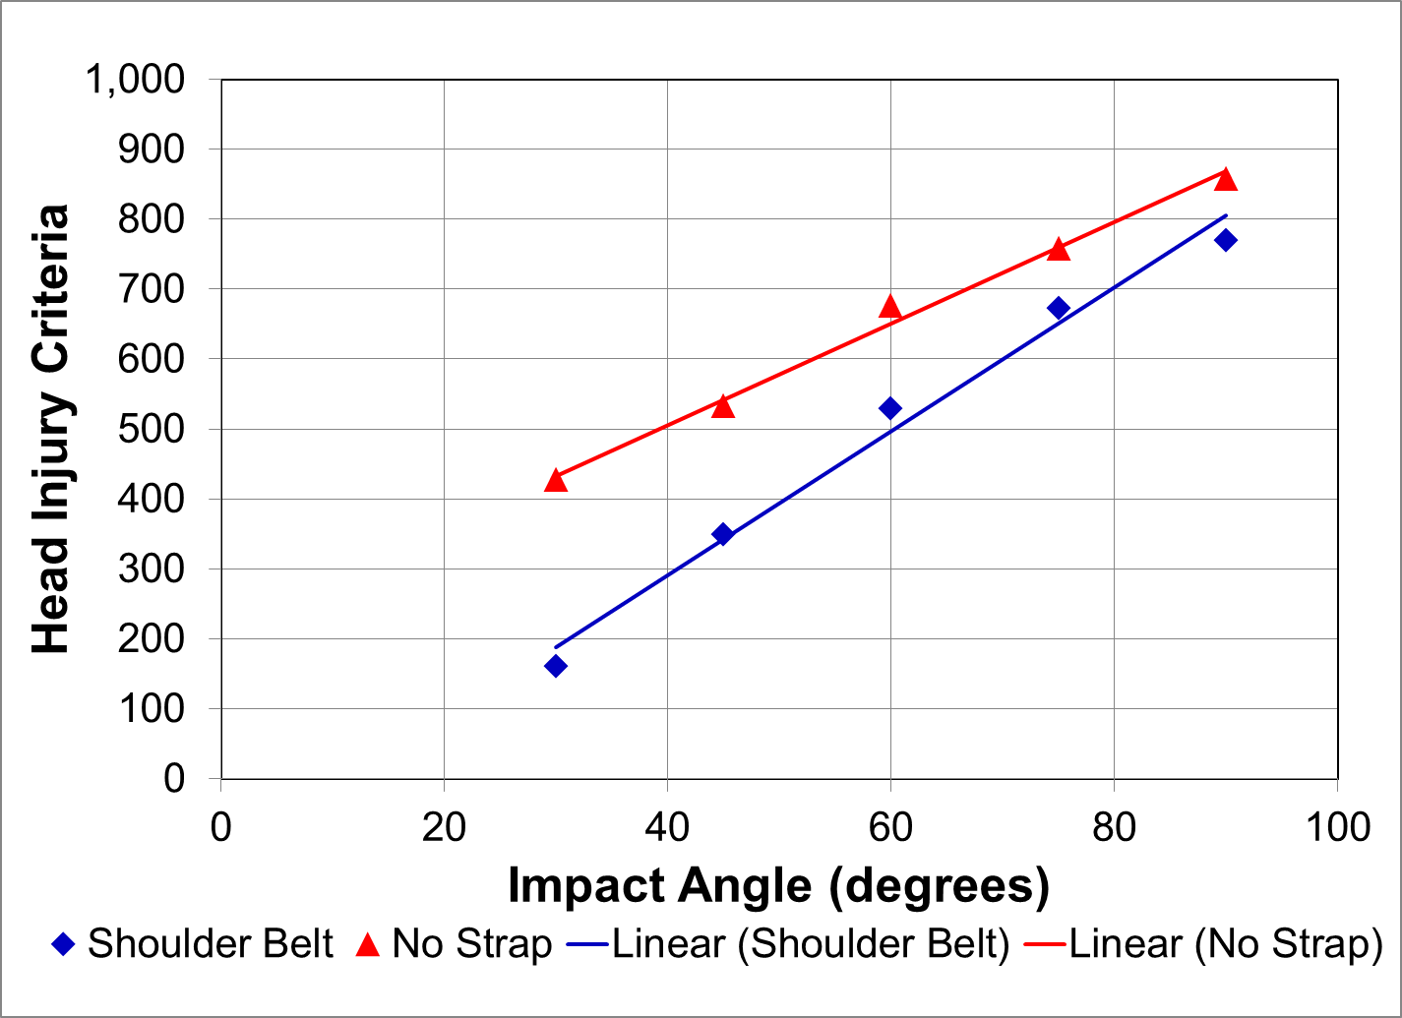
HIC

Slide 29
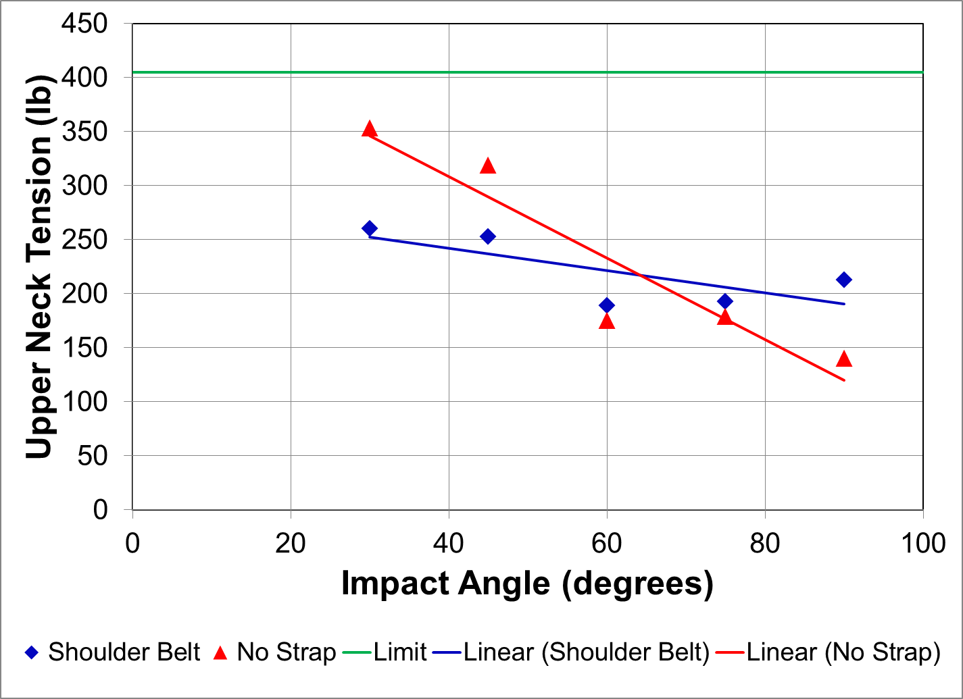
Upper Neck Tension

Slide 30
No Shoulder Strap, 30° Simulation

Slide 31
No Shoulder Strap, 30° Simulation

Slide 32
Conclusions (1)
When seated next to a padded full wall with an effective shoulder restraint and body-centered lap belt, the ES-2re v-ATD suggests that the injury criteria listed in PS-ANM-25-03-R1 are unlikely to be exceeded for any angle between 30° and 90°
More forward-facing angles are also unlikely to exceed the side-facing specific injury criteria
The ES-2re appears to be capable of avoiding internal damage in this configuration

Slide 33
Conclusions (2)
Simulations without a shoulder restraint suggests that the ES-2re v-ATD is not capable of flailing in a realistic manner
This configuration simulates an ineffective shoulder restraint
Internal damage to the ribs is likely to occur in this configuration

Slide 34
Future Work
Additional evaluations are needed to evaluate configurations that allow more occupant flailing (e.g., armrest)
It is unknown what unique injuries can occur in oblique seats; therefore, the instrumentation requirements are also unknown

Slide 35
Questions?

