Slide 1
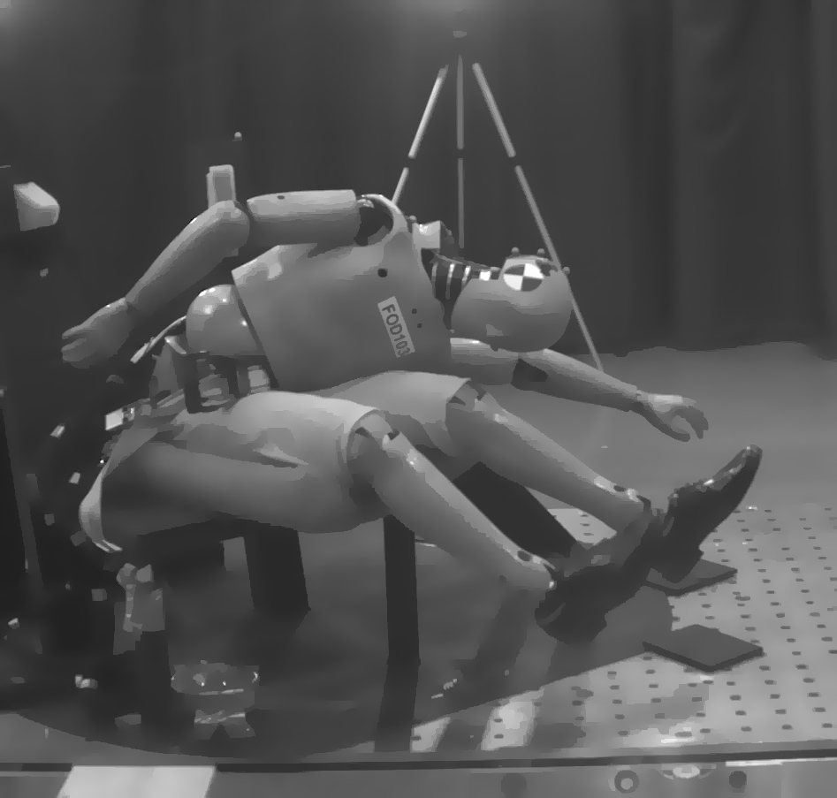
Oblique occupant injury research in the aircraft environment
J Humm, F Pintar, N Yoganandan
Medical College of Wisconsin
A Taylor, D Moorcroft ,R DeWeese
FAA CAMI

Slide 2
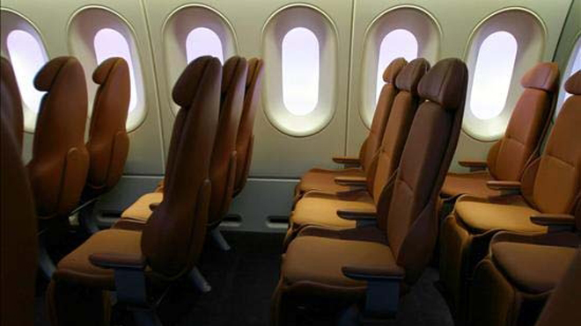
Occupant Protection
Static → Seat strength
Dynamic → Assess occupant injury
Original standard→ Forward facing seats

Slide 3
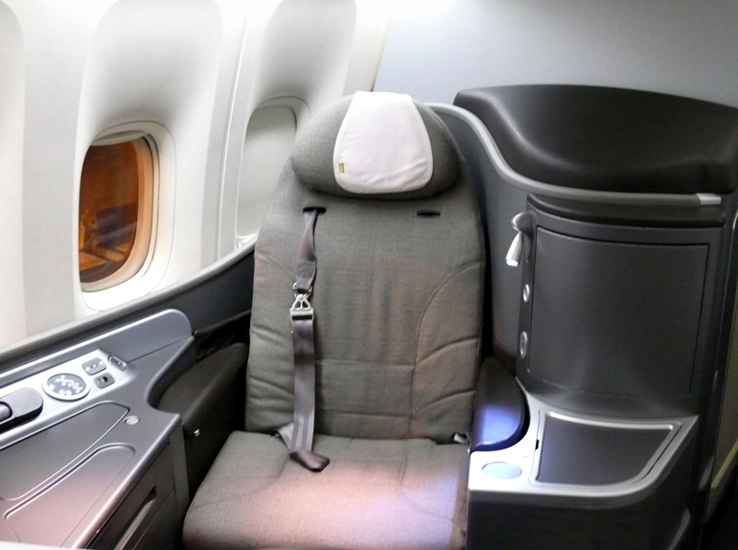
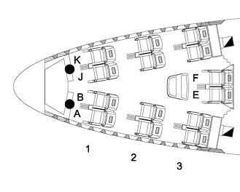
Oblique Seats
What type of injuries can we expect?
Injury criteria
Suitable ATD

Slide 4
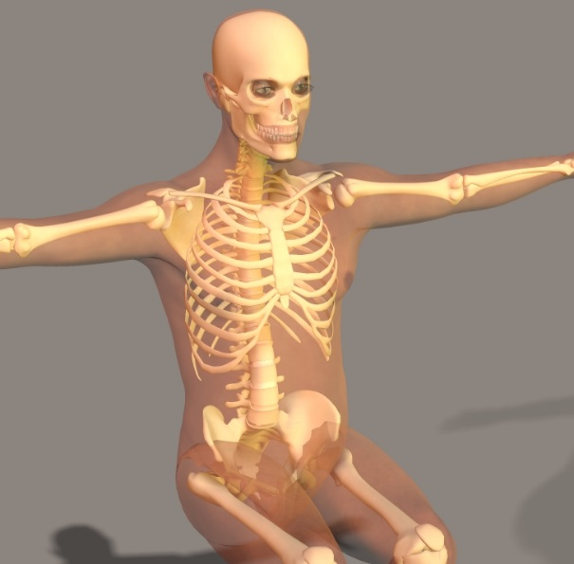
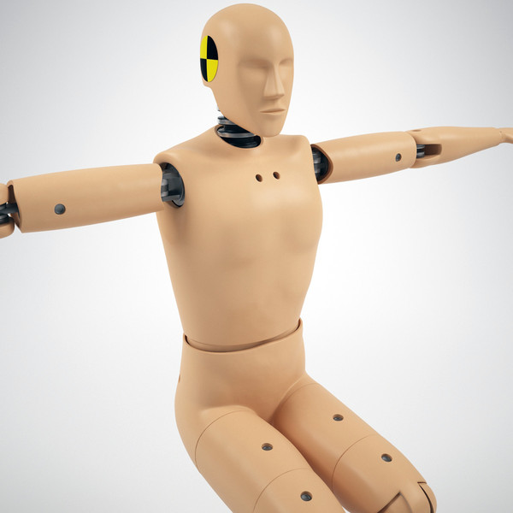
Injury Criteria
Post Mortem Human Surrogate (PMHS) to define human response
Yield Injury Reference Values (IRV)
Matched-paired test w/ATD
Same environment/loading conditions
Injury Assessment Reference Values (IARV)

Slide 5
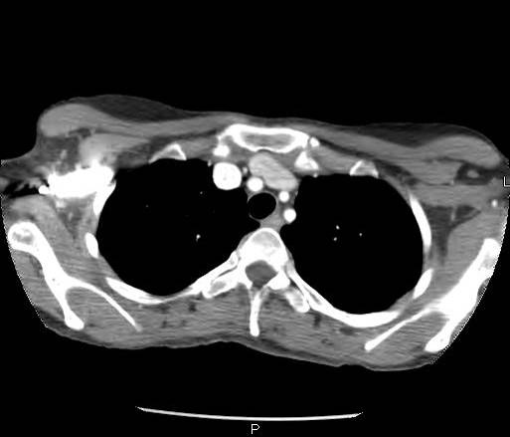
Lateral vs. Oblique
Manibrium (sternum)
Left brachiocephalic vein
Right brachiocephalic vein
Left common
carotid artery
Oblique
T4
90⁰ lateral
Right brachiocephalic artery
Left subclavian artery
T4

Slide 6
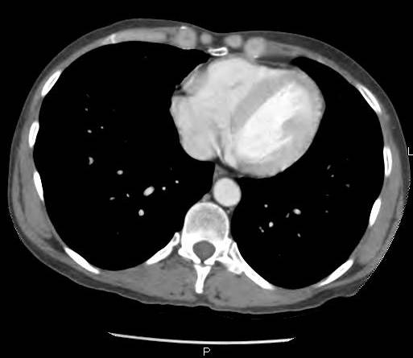
Lateral vs. Oblique
Right ventricle
Right atrium
Oblique
Pulmonary parenchyma
Left ventricle
90⁰ lateral
T10
Descending Aorta

Slide 7
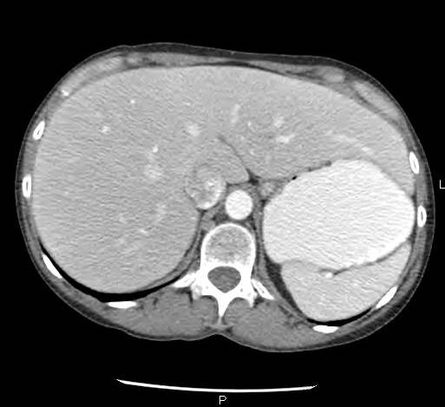
Lateral vs. Oblique
Inferior vena cava
Descending Aorta
Oblique
Liver
Stomach
T12
90⁰ lateral
Spleen

Slide 8
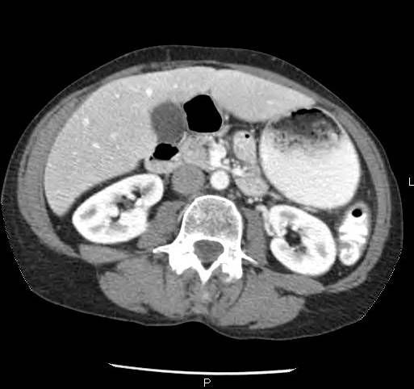
Lateral vs. Oblique
Colon
Descending Aorta
Gallbladder
Inferior vena cava
Stomach
Oblique
Liver
L3
90⁰ lateral
Right kidney
Left kidney

Slide 9
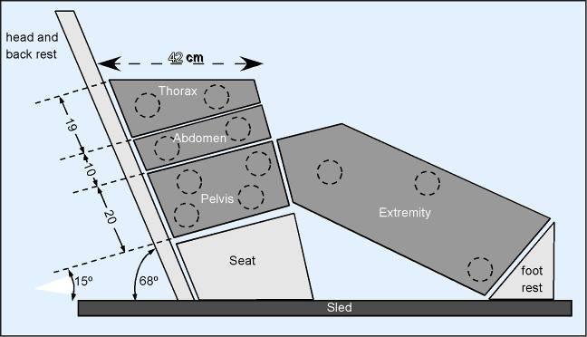
Previous Research - Side

Slide 10
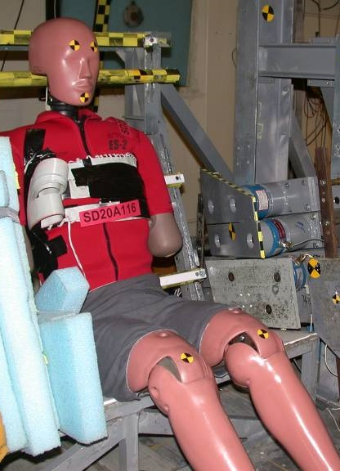
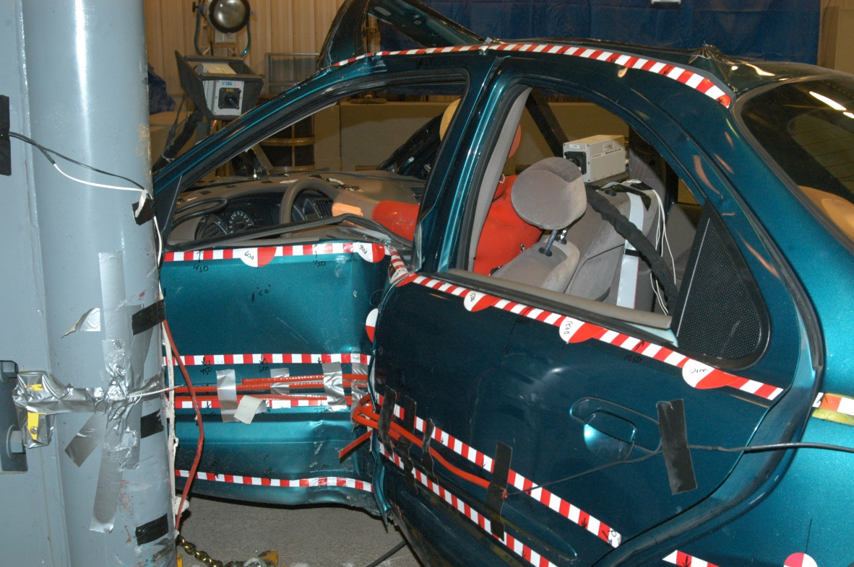
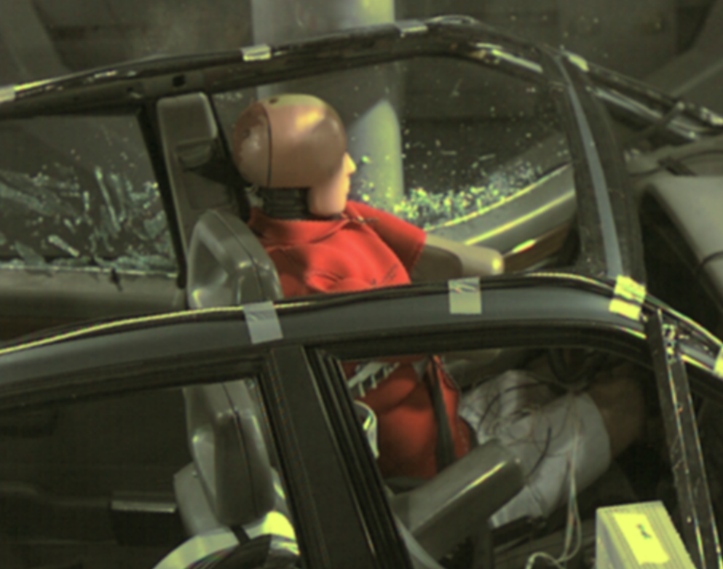
Oblique Research
Intruding vehicle structure

Slide 11
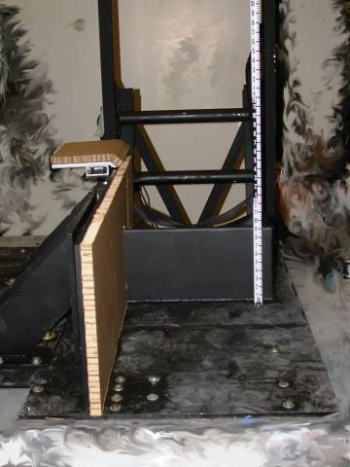
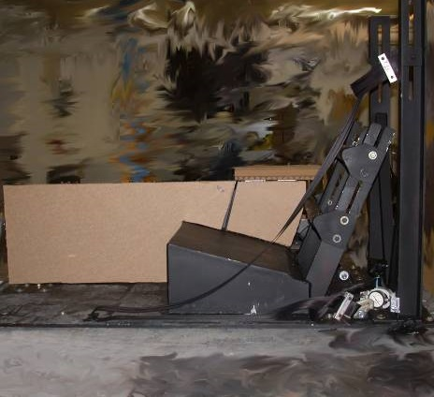
Far-Side Research
Side View
Frontal View

Slide 12
Far-Side Research

Slide 13
Far Side Impact: Injurious Events
8.3 m/s
PMHS had
6 right rib fxs
Outboard
shoulder Belt
Normal position
60 – degree
configuration - 3
<13.4 m/s
Shoulder Belt

Slide 14
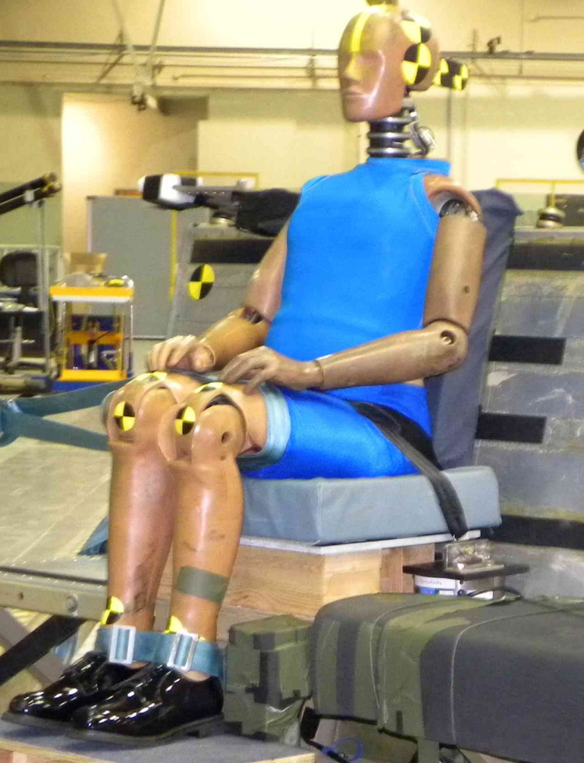
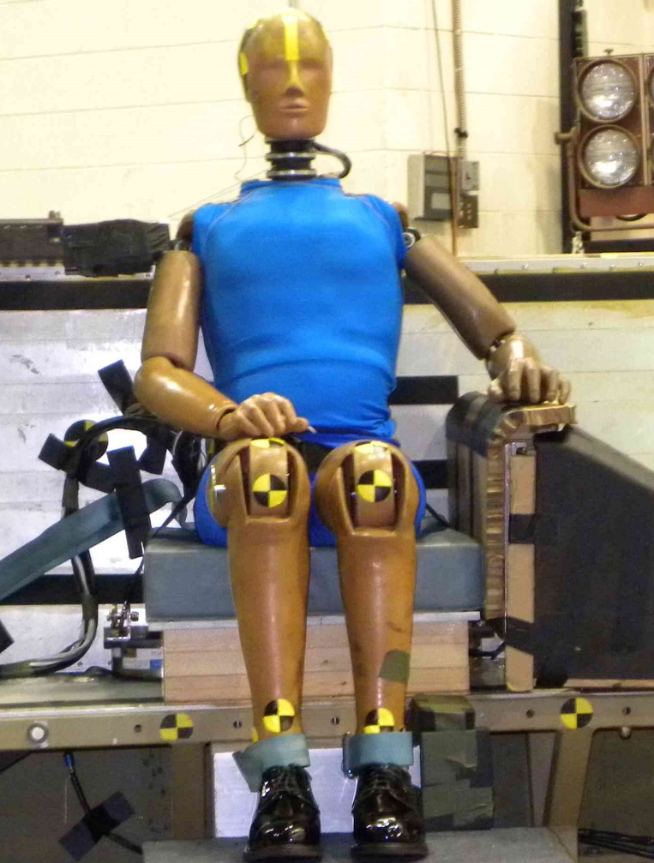
CAMI Sled Tests
Pelvis and legs restrained but not torso
Pelvis and legs restrained plus armrest

Slide 15
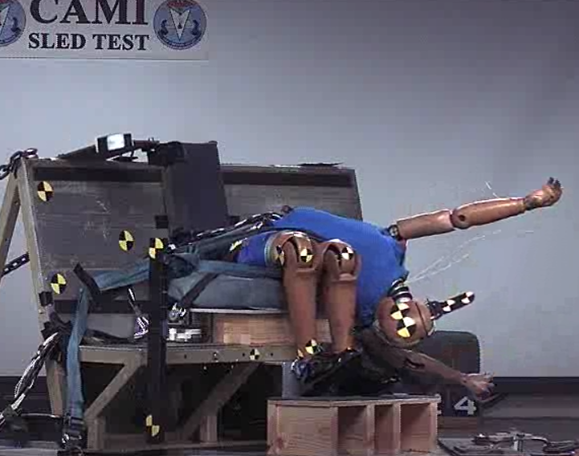
CAMI Sled Tests

Slide 16
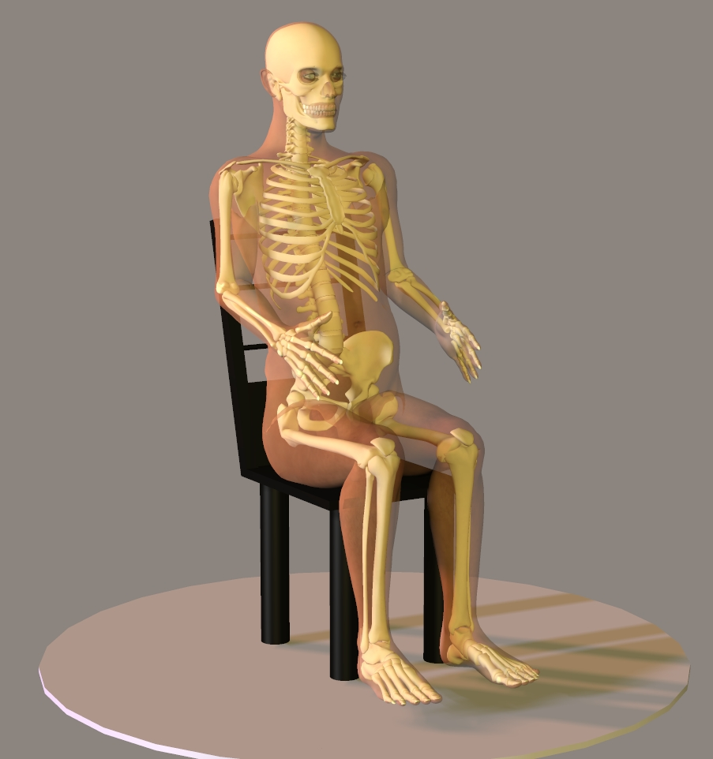
PMHS Setup
Impact

Slide 17
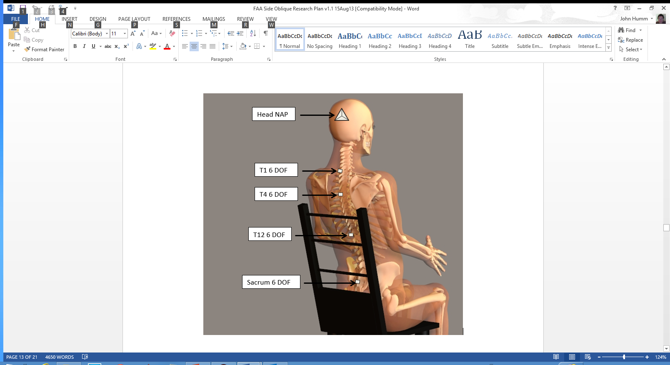
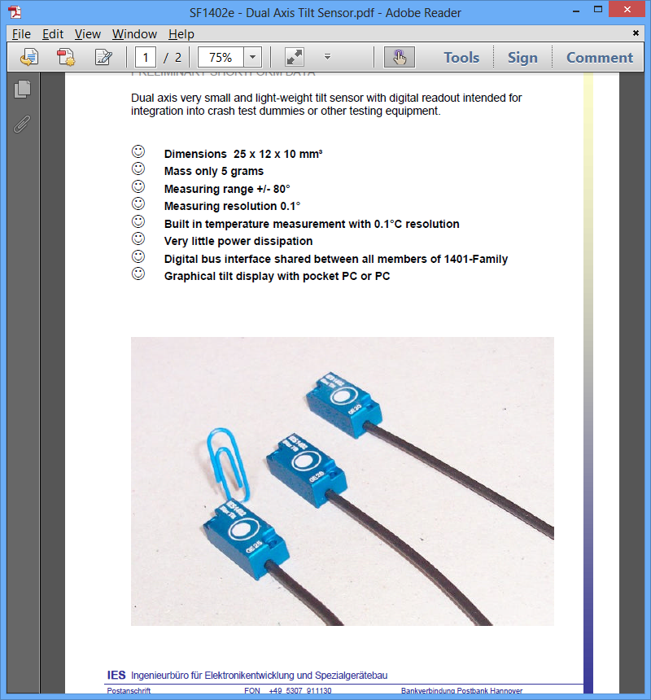
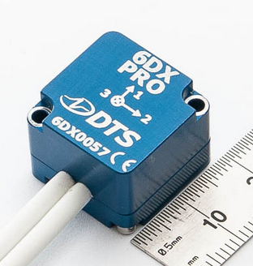
PMHS Instrumentation

Slide 18
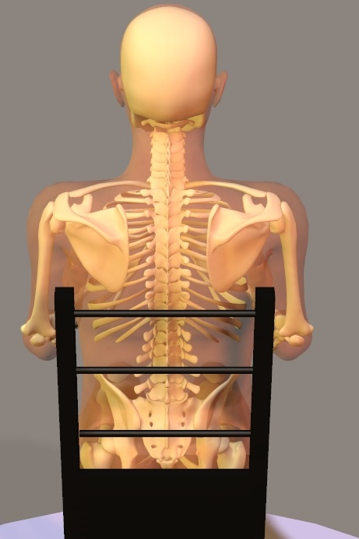
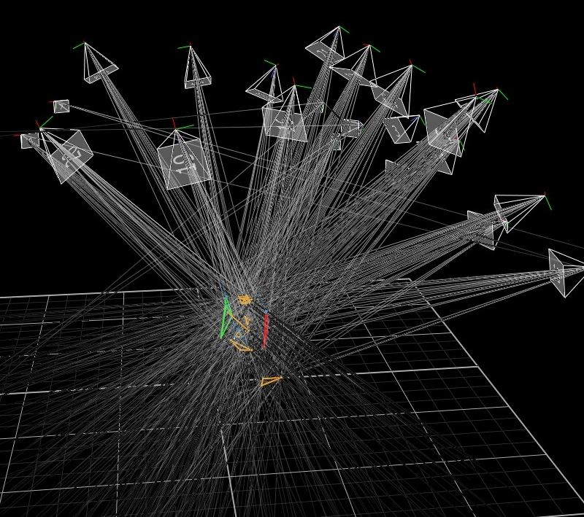
PMHS Instrumentation

Slide 19
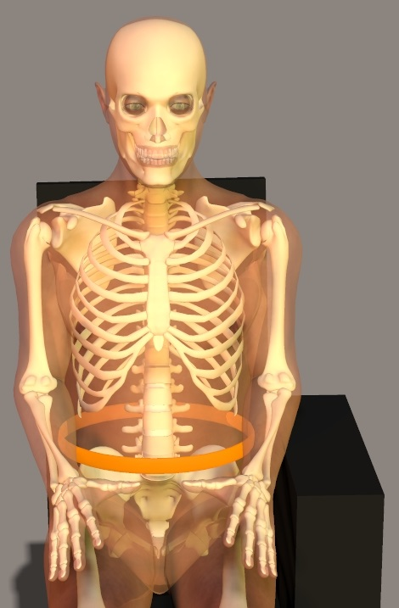
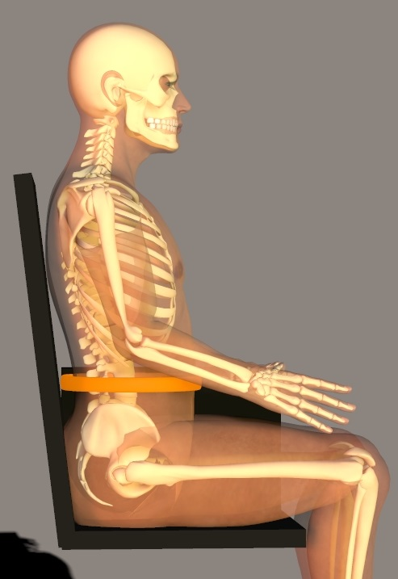
PMHS Instrumentation
Chestband

Slide 20
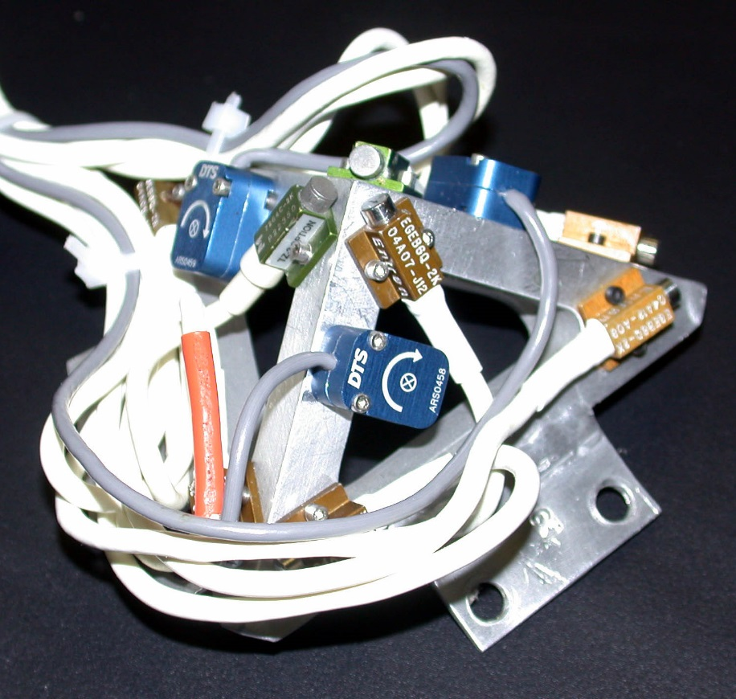
Injury Metrics

Slide 21
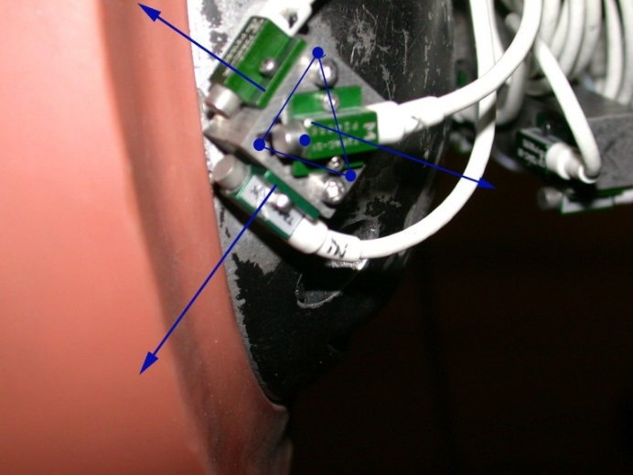
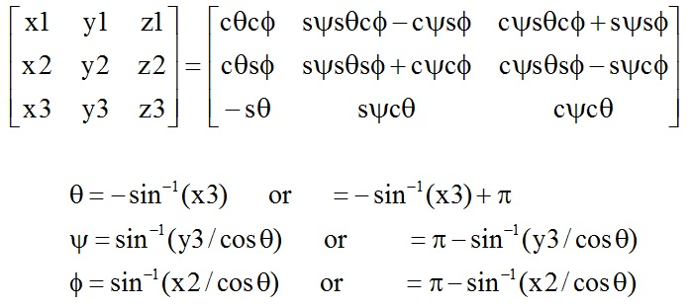
Sensor to Anatomical Axes

Slide 22
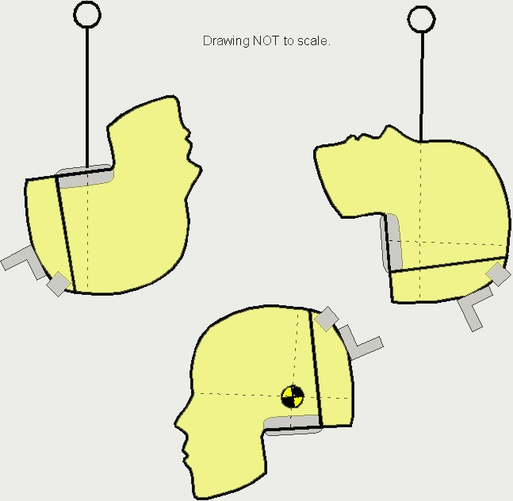
Head CG location

Slide 23
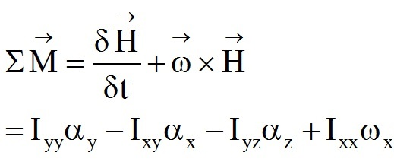


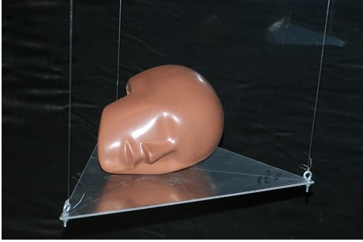
Head MOI Determination

Slide 24
Inverse Dynamics
Head CG, mass, MOI
Sensor locations, …
Acceleration signals
Angular velocities
Angular accelerations
CG accelerations
Sub-sample 1000 Hz
T1 CG locations
Head-T1 motions, 1000 Hz
Upper neck forces
Upper neck moments
Lower neck forces
Lower neck moments

Slide 25
Injury Metrics
Integrate ARS and compute angular displacement
Estimate of relative segmental rotation
Confirm with Vicon data

Slide 26
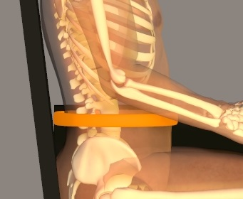

Injury Metrics
Gauge 1
Gauge 2
Gauge 59
δ_{o}
δ_{i}
δ_{i}

Slide 27
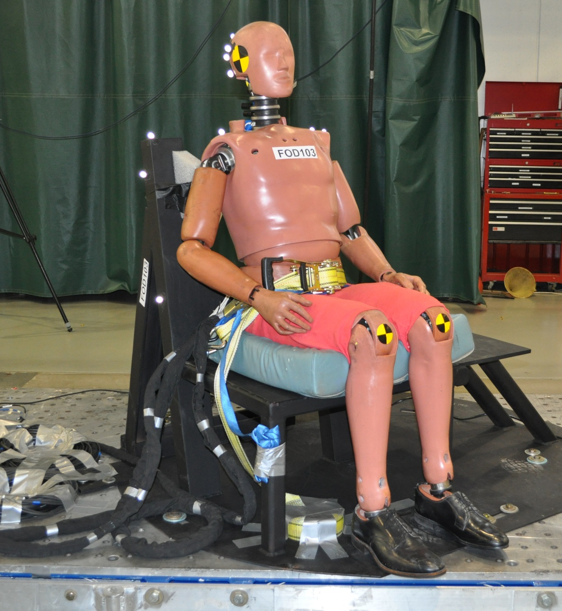
Preliminary Hybrid III Sled Tests

Slide 28
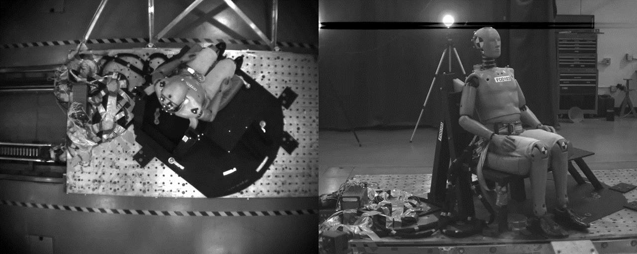
Preliminary Hybrid III Sled Tests

Slide 29
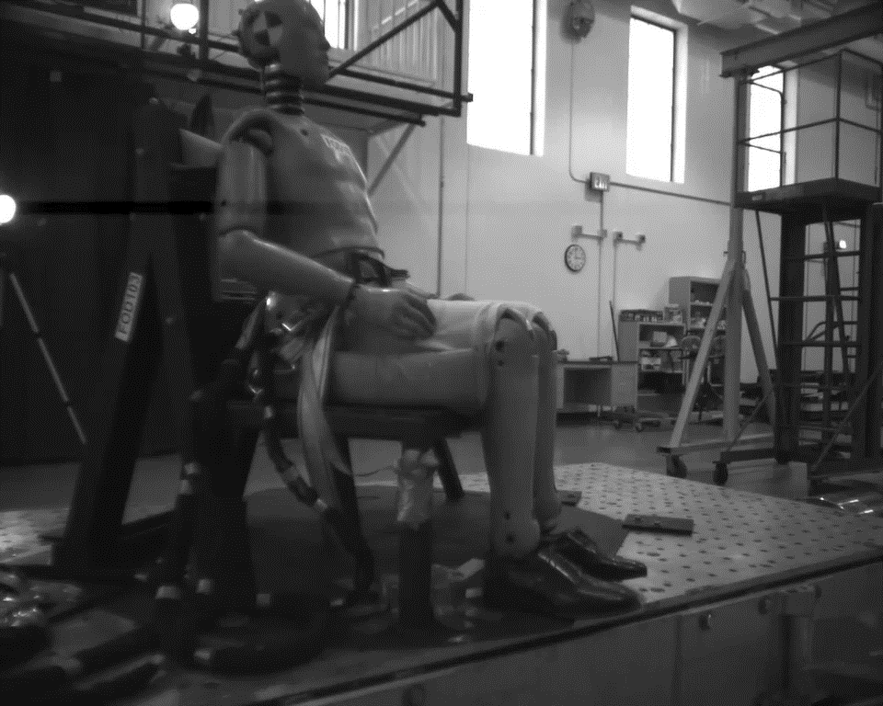
Preliminary Hybrid III Sled Tests

Slide 30
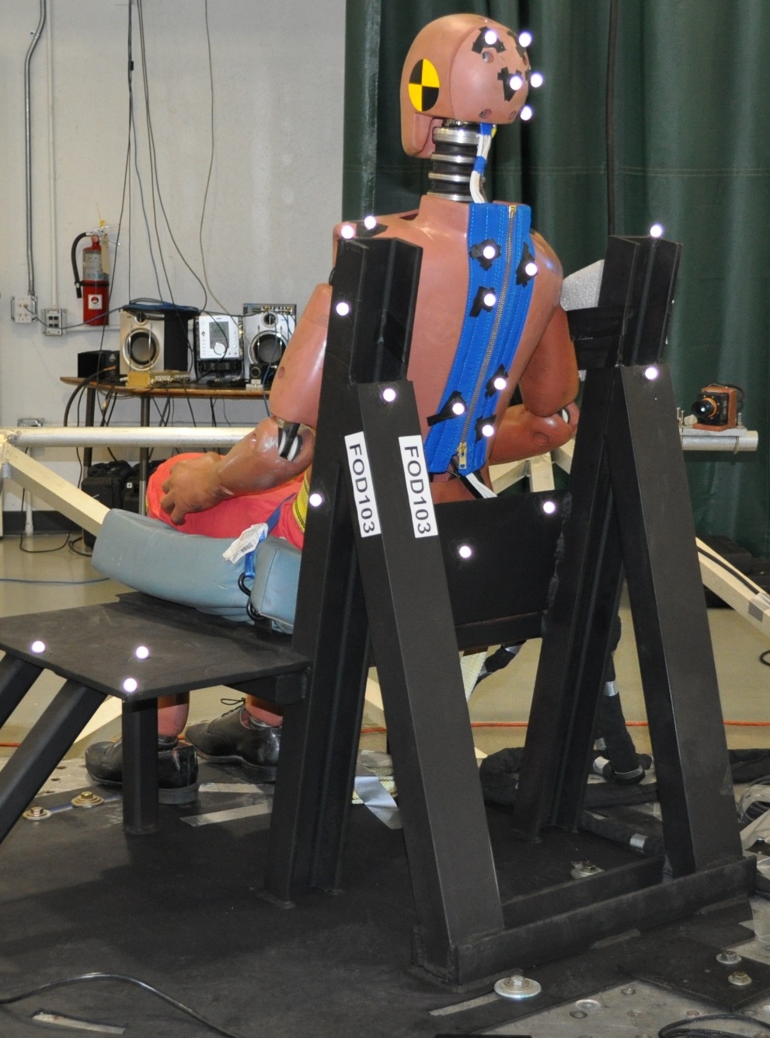
Vicon

Slide 31
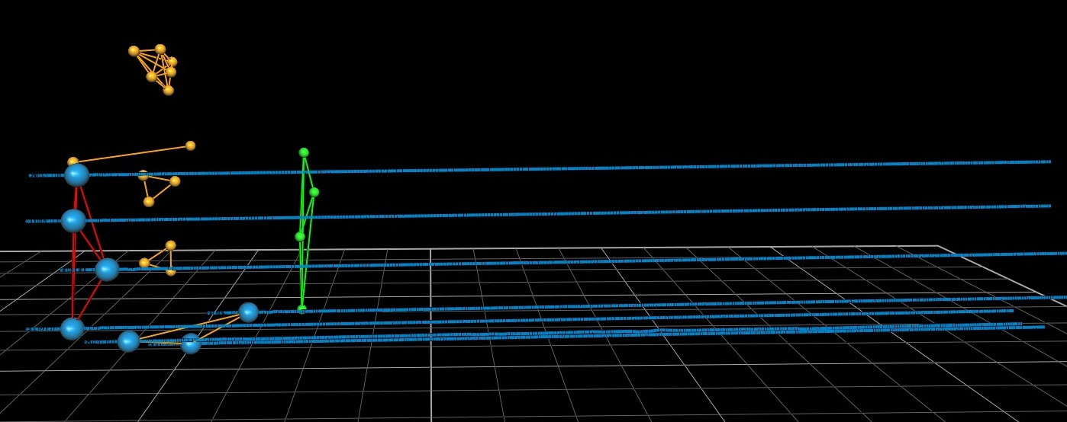
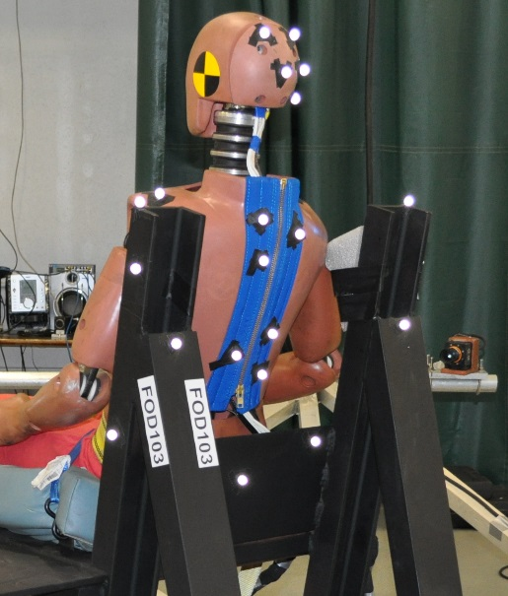
Vicon – Seat Motion
Impact

Slide 32
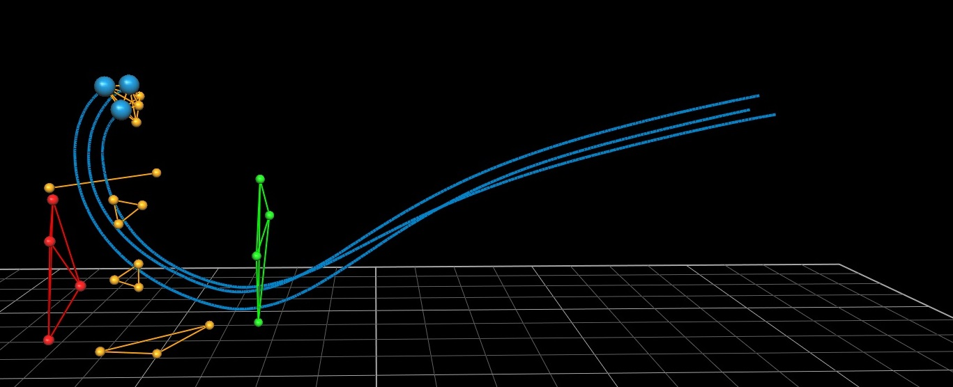
Vicon – Head Motion
Impact

Slide 33
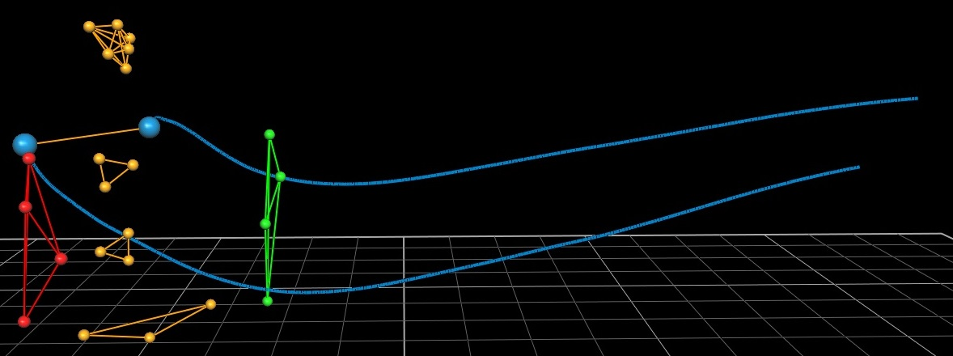
Vicon – Shoulder Motion
Impact

Slide 34
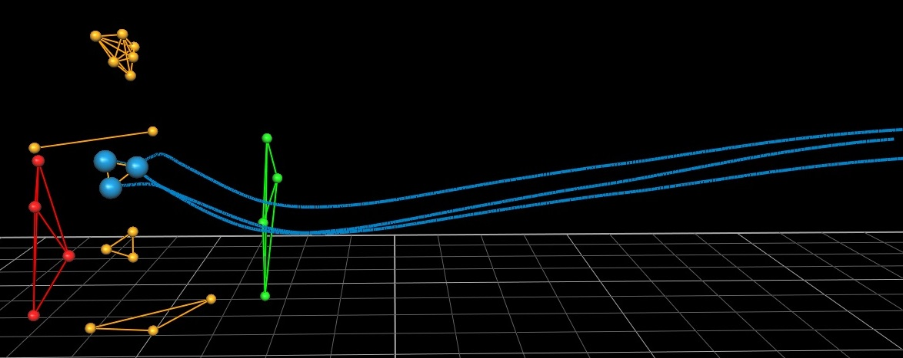
Vicon – T4 Motion
Impact

Slide 35
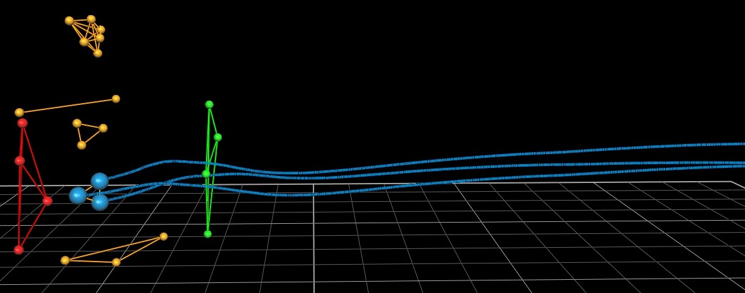
Vicon – T12 Motion
Impact

Slide 36
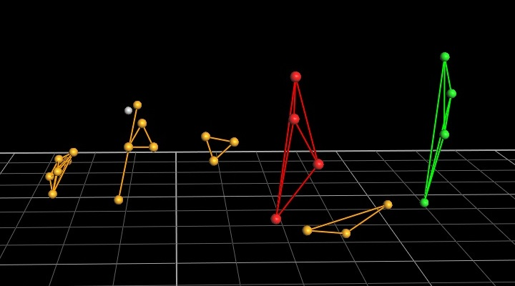
Vicon – Max Head Excursion

Slide 37
Summary
Injury biomechanics different in oblique (side and front)
Matched paired PMHS and dummy tests →good injury predictors
Head kinetics and spine kinematics
Abdomen deflection

Slide 38
Acknowledgments
FAA, Zablocki VA Medical Center, and MCW Department of Neurosurgery
Thanks

