Slide 1
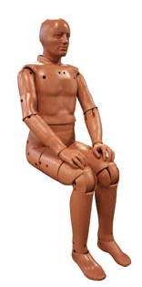
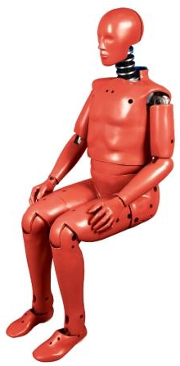
Dynamic Performance Evaluation
HII 50th %ile vs. FAA HIII 50th %ile
Gomez, Luis
Olivares, Gerardo
National Institute for Aviation Research (NIAR)
December 4th, 2013
The Seventh Triennial International Fire & Cabin Safety Research Conference

Slide 2
Agenda
Scope
Hybrid II 50th %ile vs. FAA Hybrid III 50th %ile
Dynamic Sled Test Configurations – Part 25.562 Test (2)
  2 pt., 3 pt., and 4 pt. belt configurations
  Head Path Analysis
    Maximum Excursion
    Head Velocity vs. Monument Distance
  Load Transfer Analysis
    Belt Loads
    Seat Pan Loads
Dynamic Sled Test Configurations – Part 25.562 Test (1)
  Rigid Seat
  4” Seat Cushion (Monolithic foam)
Conclusions – Dynamic Performance Comparison HII vs. FAA HIII

Slide 3
SCOPE
Dynamic Performance Evaluation
HII 50th %ile vs. FAA HIII 50th %ile

Slide 4
Scope
Compare and analyze Hybrid II and FAA Hybrid III 50th %iles compliance data to determine whether significant differences on the ATDs responses exist or not when related to aircraft seat certification.
Data comparison is conducted using results gathered from Part 25.562 tests. All tests were conducted at the NIAR sled accelerator. To reduce the scatter of the data, special care was taken while positioning the ATD between tests.
A rigid seat structure, including a foot stopper, was used on all sled tests.
8% elongation polyester webbing was used on all tests.
Data is separated into horizontal and vertical part 25.562 conditions, as well as by belt configuration.

Slide 5
HII 50th %ile vs. FAA HIII 50th %ile
Dynamic Performance Evaluation
HII 50th %ile vs. FAA HIII 50th %ile

Slide 6
Hybrid II 50th %ile
The Hybrid II ATD 50th %ile was introduced in 1972 by General Motors and the National Highway Traffic Safety Administration (NHTSA) and has been widely used in biomechanics research since then.
Federal Aviation Administration developed the dynamic certification requirements for aircraft seats during the 80’s based on the Hybrid II ATD 50th %ile.
Part | Weight (lb)
Head | 11.2
Upper Torso | 41.5
Lower Torso | 35.9
Upper Arms | 9.6
Lower Arms and Hands | 9.6
Upper Legs | 36.8
Lower Legs and Feet | 19.4
Total Weight | 164.0
Description | Dimension (in)
Head Circumference | 22.5
Head Width | 6.1
Head Length | 7.7
Erect Sitting Height | 35.7
Shoulder to Elbow Length | 13.8
Elbow to Finger Tip Length | 18.1
Buttock to Knee Pivot Length | 20.4
Knee Pivot to Floor Length | 19.6
*Source: Humanetics Crash Test Dummies Technical Information

Slide 7
FAA Hybrid III 50th %ile
The FAA Hybrid III was developed by FAA, Civil AeroMedical Institute (CAMI), Denton ATD, Inc., and Robert A. Denton, Inc. during the 90’s. It has better bio-fidelity, can be better instrumented, and is easier to find replacement elements compared with the Hybrid II.
The FAA HIII ATD is based on the automotive std. HIII ATD except for the lumbar-pelvis region and upper leg elements which are based on a Hybrid II to provide the proper alignment for an erect spine seat posture to accomplish the aviation requirements.
Part | Weight (lb)
Head | 10.0
Neck | 3.4
Upper Torso | 55.0
Lower Torso | 33.6
Arms & Hands - L & R | 19.4
Legs & Feet - L & R | 57.1
Total Weight | 164
Description | Dimension (in)
Head Circumference | 23.5
Head Width | 6.1
Head Length | 8.0
Erect Sitting Height | 35.7
Shoulder to Elbow Length | 13.3
Back of Elbow to Wrist Pivot | 11.7
Buttock to Knee Pivot Length | 23.3
Knee Pivot to Floor Length | 19.5
*Source: Humanetics Crash Test Dummies Technical Information

Slide 8
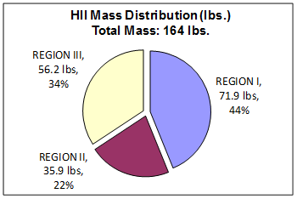
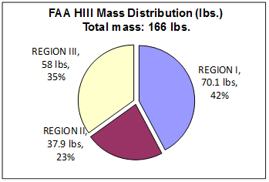
Hybrid II 50th %ile vs. FAA Hybrid III 50th %ile
HII
Regions | Body Part | HII (lb) | FAA HIII (lb)
I | Head | 11.2* | 10
 | Neck | 0 | 3.4
 | Upper Torso | 41.5 | 37.9
 | Upper Arm (both) | 9.6 | 8.8
 | Lower Arm & Hand (both) | 9.6 | 10
II | Lower Torso | 35.9 | 37.9
III | Upper Leg (both) | 36.8 | 34
 | Lower Leg & Foot (both) | 19.4 | 24
Total ATD Weight |  | 164 | 166
Region I (Mass above Lumbar Load Cell) |  | 71.9 | 70.1
Region II (Lower Torso) |  | 35.9 | 37.9
Region III (Low Extremities) |  | 56.2 | 58
FAA HIII
* Includes neck and head weight

Slide 9
2-Point belt 0 degrees part 25.562
Dynamic Performance Evaluation
HII 50th %ile vs. FAA HIII 50th %ile

Slide 10
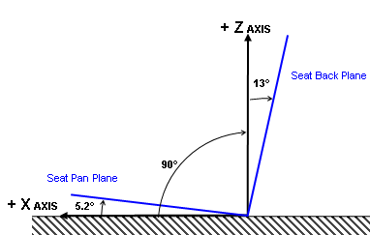
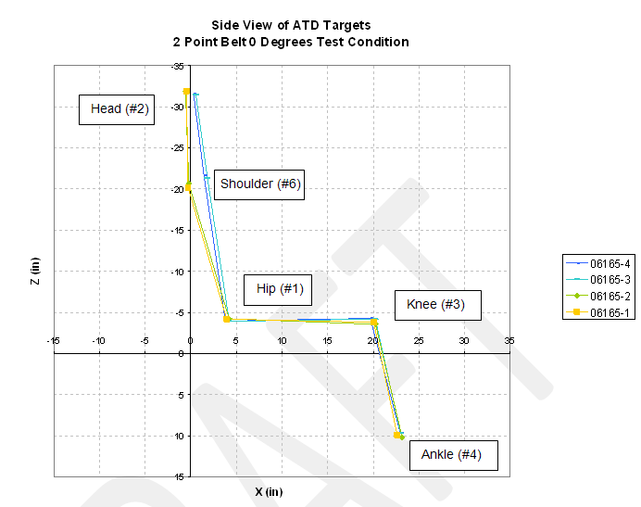
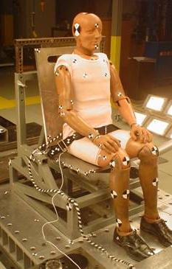
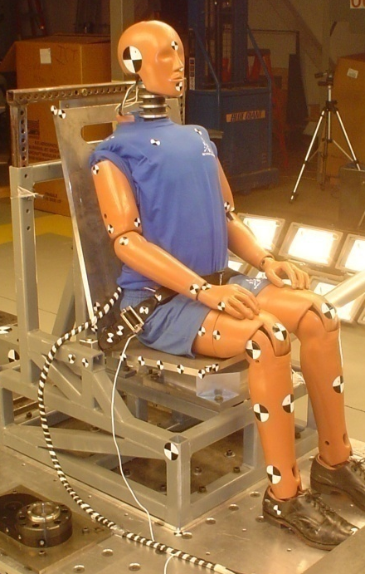
Test Description - 2-Pt belt 0 degrees Part 25.562
Seat Back & Seat Pan
Orientation
TEST #. | ATD Serial# | BELT TYPE | ANGLE (deg) | SEAT TYPE | BELT MAT. | CRASH PULSE
06165-3-4 | HYB II 698 | 2 | 0 | Rigid | 100% Polyester | 25.562
06165-1-2 | FAA HYB III 290 | 2 | 0 | Rigid | 100% Polyester | 25.562
HII
FAA HIII

Slide 11
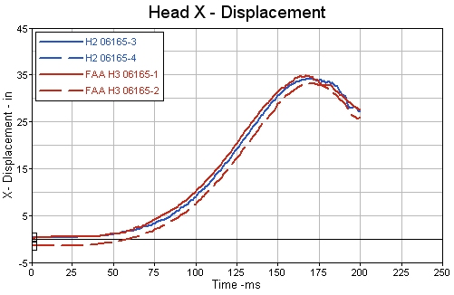
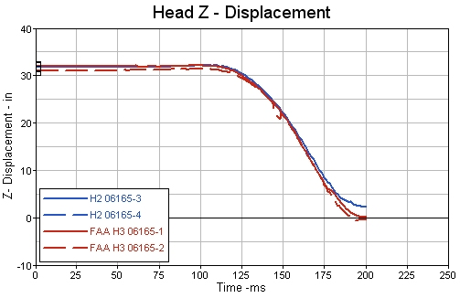
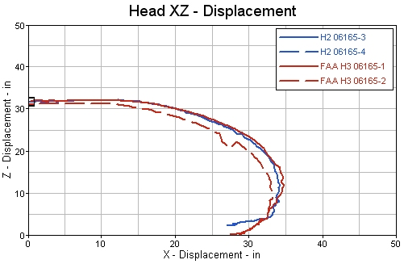
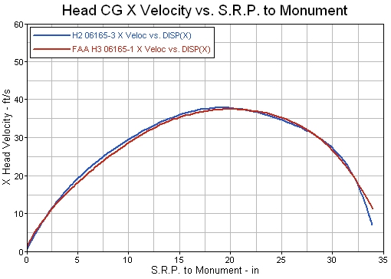
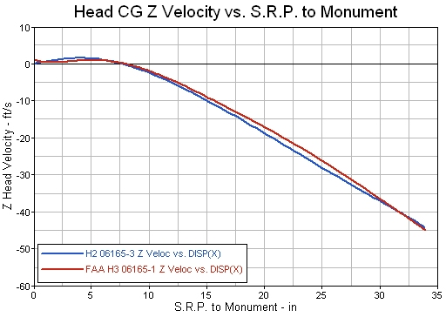
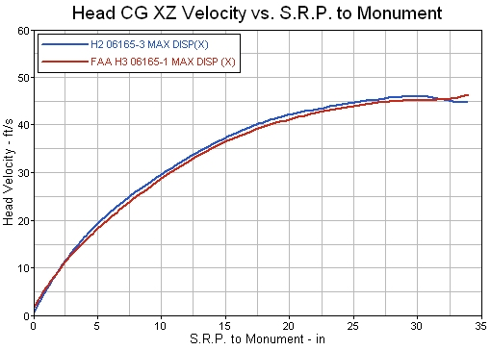
2-Pt belt 0 degrees Part 25.562
Head C.G. Disp./Vel. Comparison

Slide 12
2-Pt belt 0 degrees Part 25.562
Head Vel. Comparison w.r.t. Head Position
* Negative values means FAA HIII is under predicting with respect HII

Slide 13
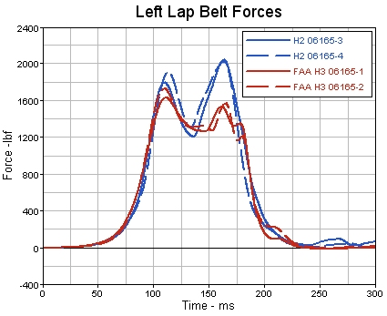
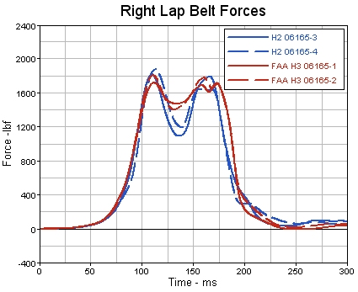
2-Pt belt 0 degrees Part 25.562
Belt Loads Comparison
Similar results were obtained for the right lap belt.
Left lap belt comparison shows larger differences between ATDs. These differences may be attributed to the differences in mass in lower body regions as well as the different kinematics of the upper torso.

Slide 14
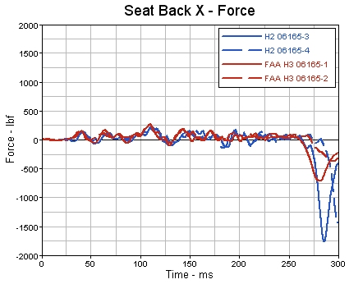
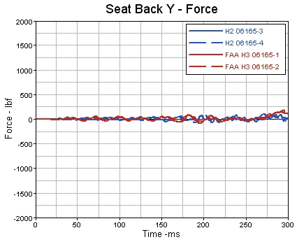
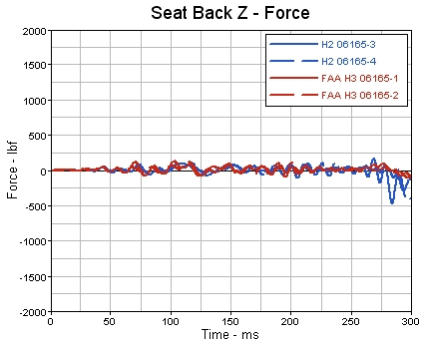
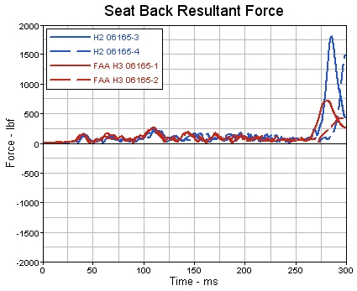
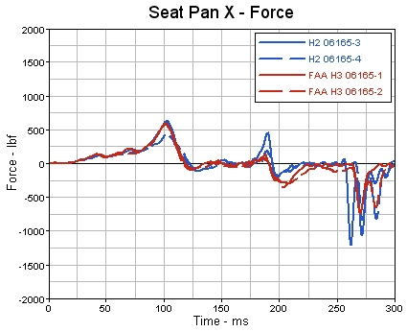
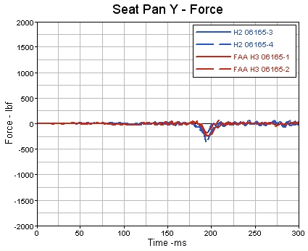
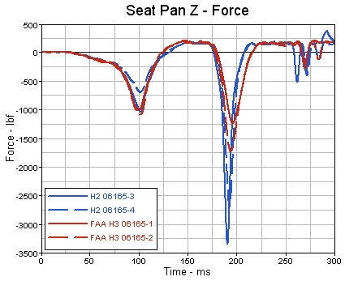
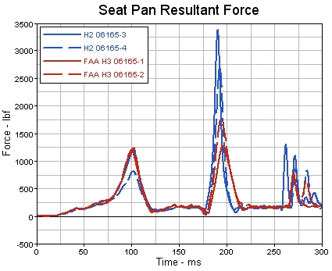
2-Pt belt 0 degrees Part 25.562
Seat Back/Pan Loads Comparison
*Note: Seat Pan and Back Loads (Tare Comp. and in Global Coordinates)
Overall both ATDs transfer similar loads to the rigid seat pan and seatback.

Slide 15
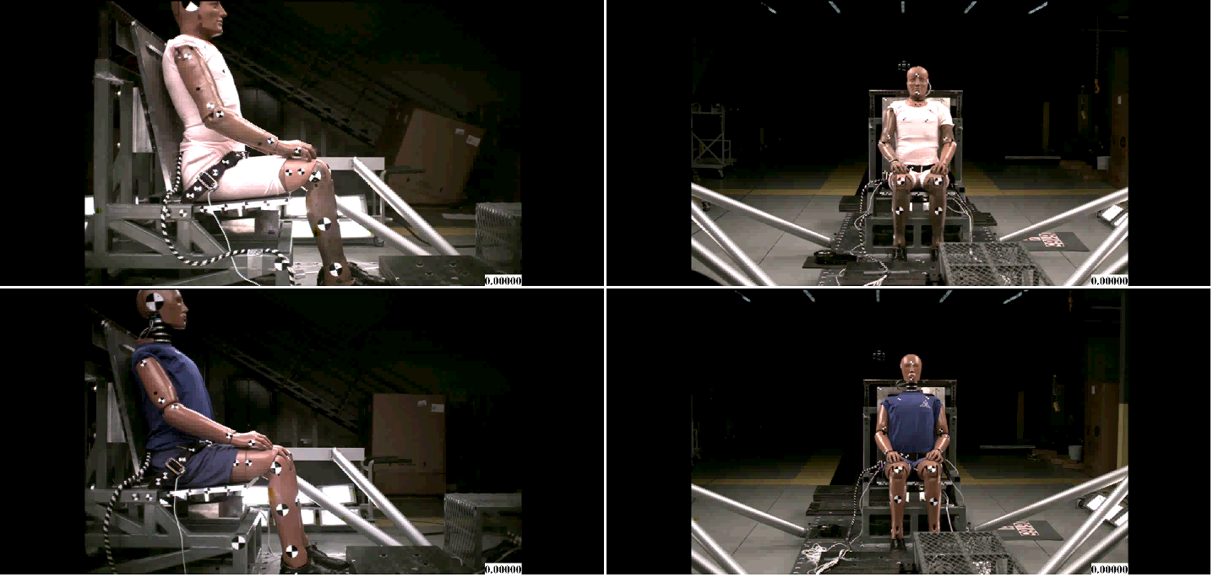
2-Pt belt 0 degrees Part 25.562
Videos HII vs. FAA HIII
Side View
Front View
HII
FAA
HIII

Slide 16
3-Point belt 0 degrees part 25.562
Dynamic Performance Evaluation
HII 50th %ile vs. FAA HIII 50th %ile

Slide 17
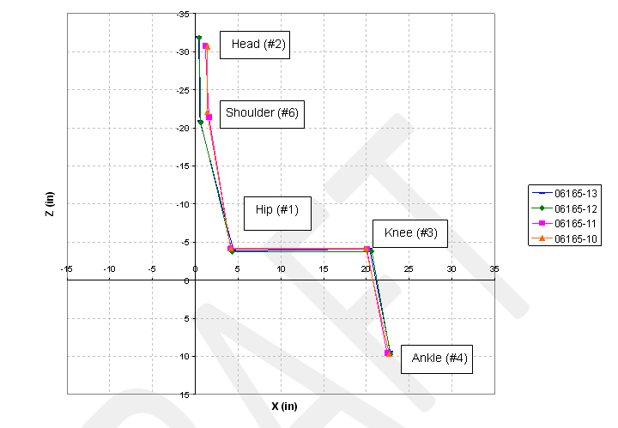
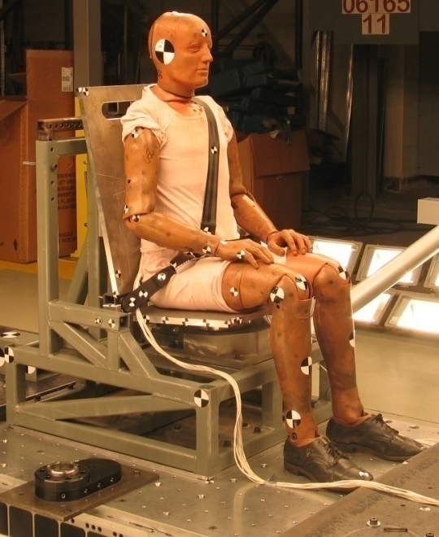
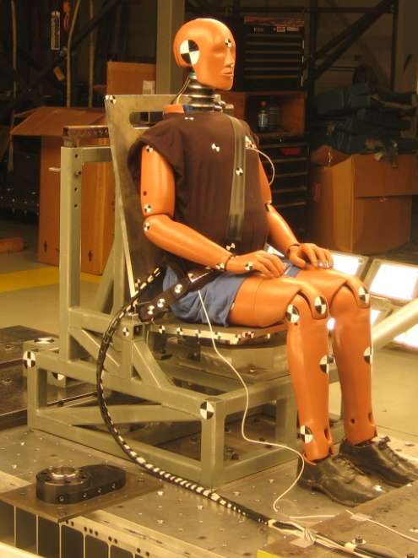
Test Description - 3-Pt belt 0 degrees Part 25.562
Seat Back & Seat Pan
Orientation
TEST #. | ATD Serial# | BELT TYPE | ANGLE (deg) | SEAT TYPE | BELT MAT. | CRASH PULSE
06165-10-11 | HYB II 656 | 3 | 0 | Rigid | 100% Polyester | 25.562
06165-12-13 | FAA HYB III 289 | 3 | 0 | Rigid | 100% Polyester | 25.562
HII
FAA HIII

Slide 18
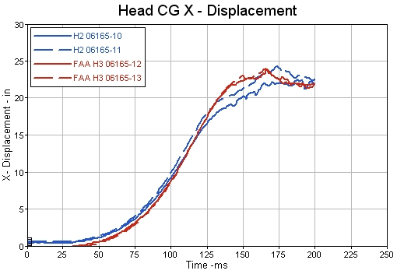
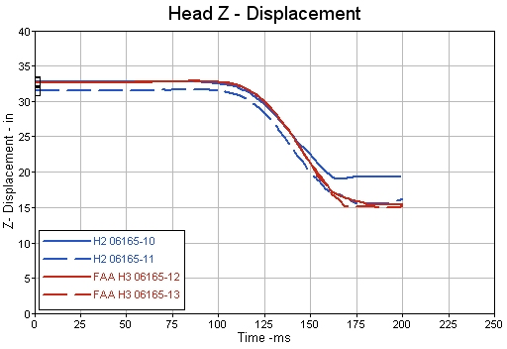
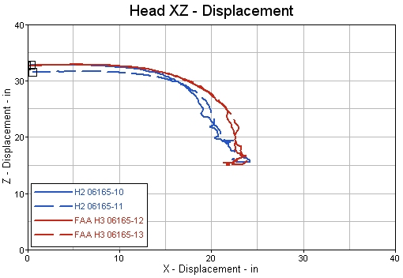
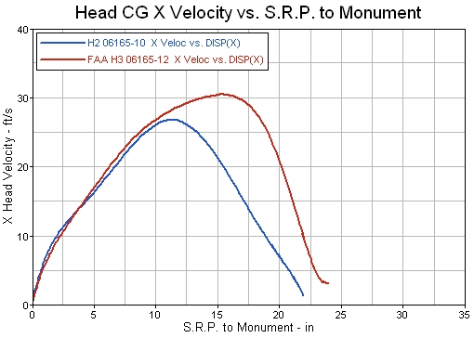
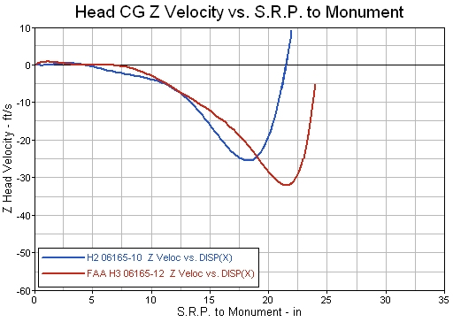
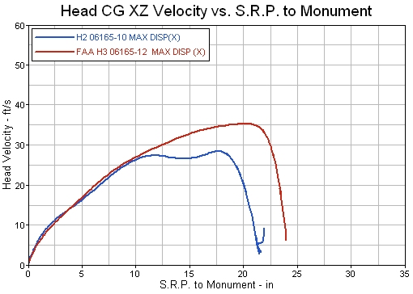
3-Pt belt 0 degrees Part 25.562
Head C.G. Disp./Vel. Comparison

Slide 19
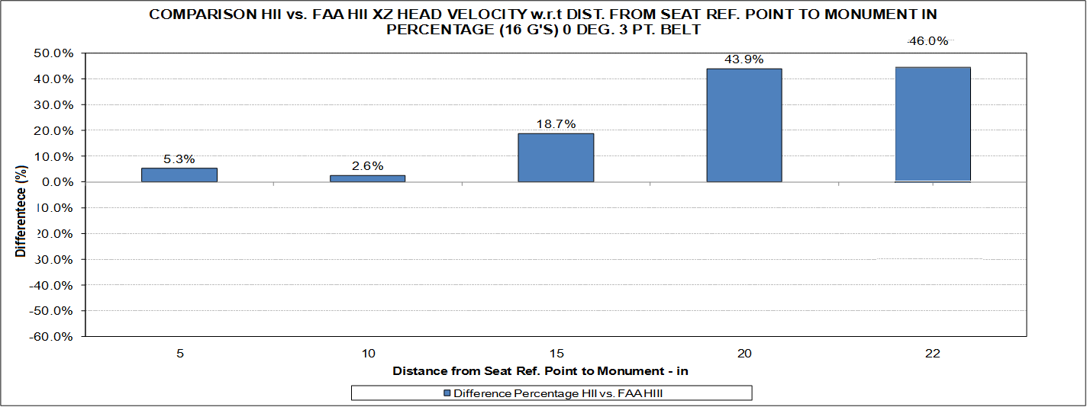
3-Pt belt 0 degrees Part 25.562
Head Vel. Comparison w.r.t. Head Position
* Negative values means FAA HIII is under predicting with respect HII

Slide 20
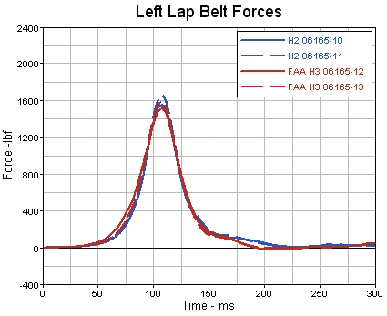
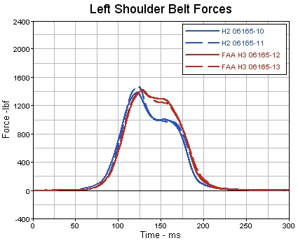
3-Pt belt 0 degrees Part 25.562
Belt Loads Comparison
Similar results were obtained for the left lap belt.
Left shoulder lap belt comparison shows some differences between ATDs. These differences may be attributed to the differences in mass in upper body regions as well as the different kinematics of the upper torso.

Slide 21
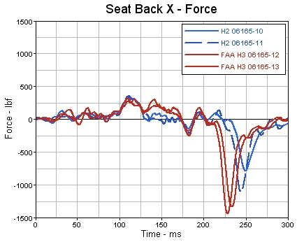
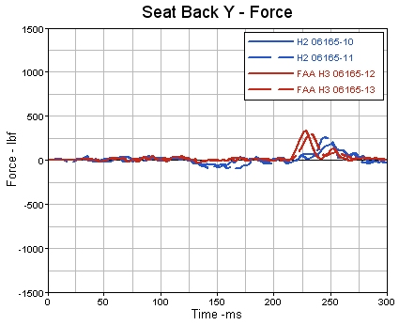
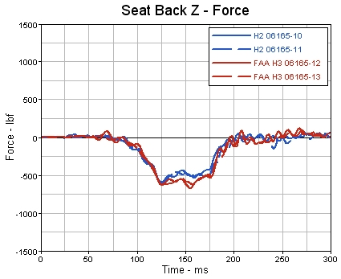
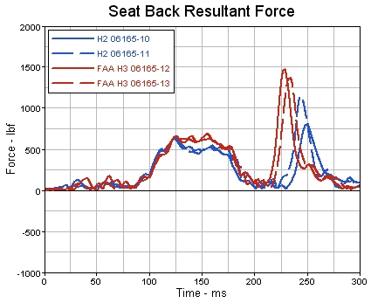
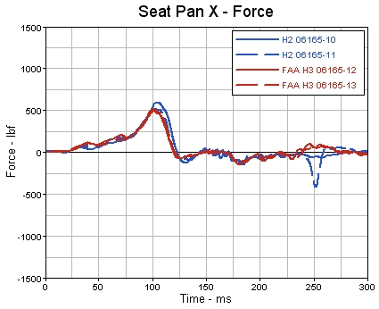
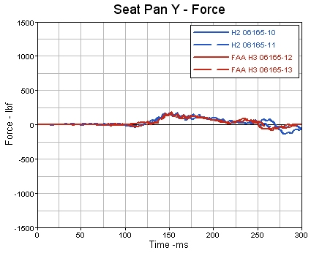
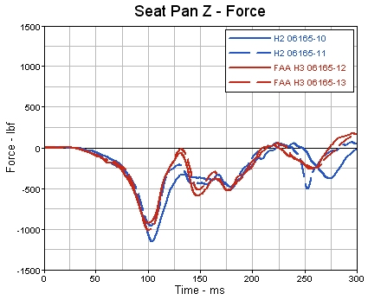
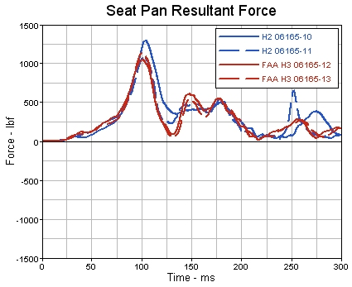
3-Pt belt 0 degrees Part 25.562
Seat Back/Pan Loads Comparison
*Note: Seat Pan and Back Loads (Tare Comp. and in Global Coordinates)
Overall both ATDs transfer similar loads to the rigid seat pan and seatback.

Slide 22
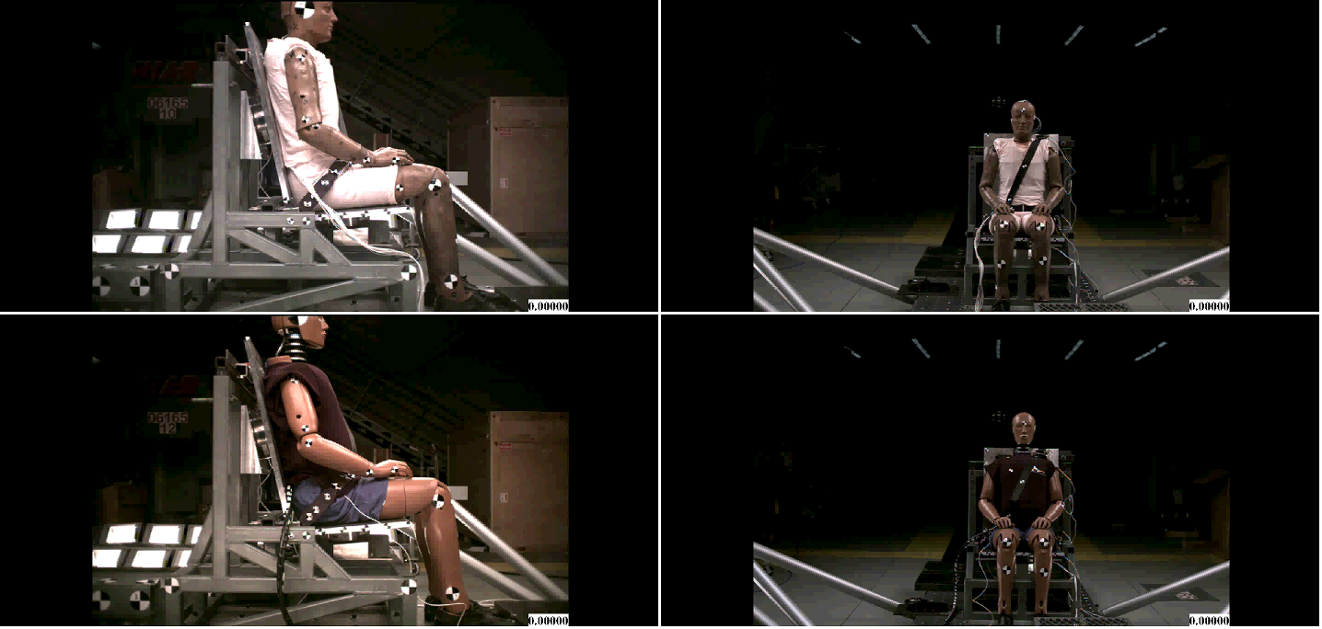
3-Pt belt 0 degrees Part 25.562
Videos HII vs. FAA HIII
Side View
Front View
HII
FAA
HIII

Slide 23
4-Point belt 0 degrees part 25.562
Dynamic Performance Evaluation
HII 50th %ile vs. FAA HIII 50th %ile

Slide 24
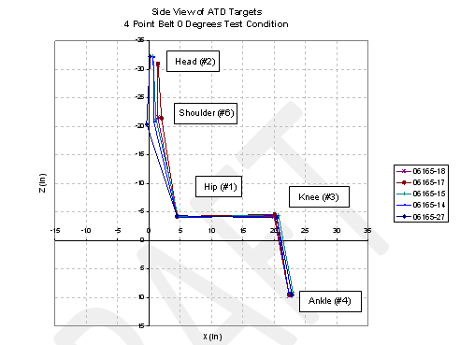
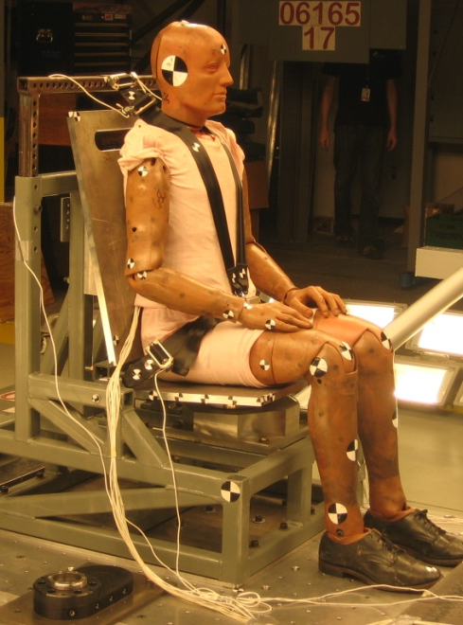
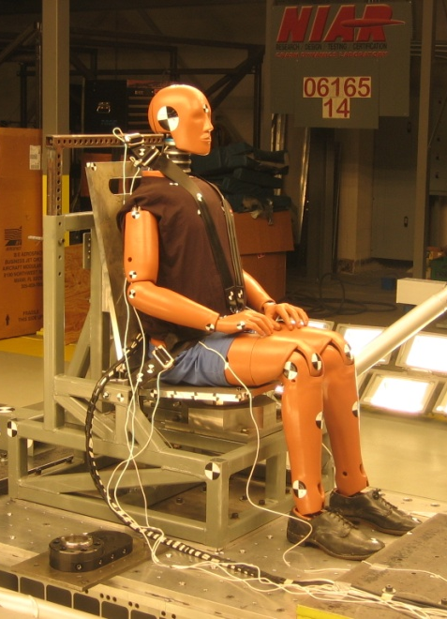
Test Description - 4-Pt belt 0 degrees Part 25.562
Seat Back & Seat Pan
Orientation
TEST #. | ATD Serial# | BELT TYPE | ANGLE (deg) | SEAT TYPE | BELT MAT. | CRASH PULSE
06165-17-18 | HYB II 656 | 4 | 0 | Rigid | 100% Polyester | 25.562
06165-14-15-27 | FAA HYB III 289 | 4 | 0 | Rigid | 100% Polyester | 25.562
HII
FAA HIII

Slide 25
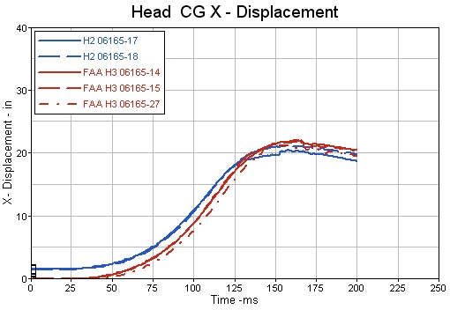





4-Pt belt 0 degrees Part 25.562
Head C.G. Disp./Vel. Comparison

Slide 26
4-Pt belt 0 degrees Part 25.562
Head Vel. Comparison w.r.t. Head Position
* Negative values means FAA HIII is under predicting with respect HII

Slide 27




4-Pt belt 0 degrees Part 25.562
Belt Loads Comparison
Similar results were obtained for the lap belts.
Slightly differences can be observed on the shoulder belts (both sides). These differences may be attributed to the differences in mass in upper body regions as well as the different kinematics of the upper torso.

Slide 28








4-Pt belt 0 degrees Part 25.562
Seat Back/Pan Loads Comparison
*Note: Seat Pan and Back Loads (Tare Comp. and in Global Coordinates)
Overall both ATDs transfer similar loads to the rigid seat pan and seatback.

Slide 29

4-Pt belt 0 degrees Part 25.562
Videos HII vs. FAA HIII
Side View
Front View
HII
FAA
HIII

Slide 30
2-Point belt 60 degrees part 25.562
Dynamic Performance Evaluation
HII 50th %ile vs. FAA HIII 50th %ile

Slide 31



Test Description - 2-Pt belt 60 degrees Part 25.562
Seat Back & Seat Pan
Orientation
TEST #. | ATD Serial# | BELT TYPE | ANGLE (deg) | SEAT TYPE | BELT MAT. | CRASH PULSE
06165-5,6,25,26 | HYB II 698 | 2 | 60 | Rigid | 100% Polyester | 25.562
06165-7,8,28 | FAA HYB III 289 | 2 | 60 | Rigid | 100% Polyester | 25.562
HII
FAA HIII

Slide 32


2-Pt belt 60 degrees Part 25.562
Lumbar Loads Comparison
All tests passed satisfactorily the Lumbar Fz criteria
Observe that the FAA HIII lumbar load is up to 23% larger than the one obtained with the HII.
This effect will be even larger for part 23.562 scenarios and highly cushioned configurations.

Slide 33








2-Pt belt 60 degrees Part 25.562
Seat Back/Pan Loads Comparison
*Note: Seat Pan and Back Loads (Tare Comp. and in Sled Global Coordinates)
Overall both ATDs transfer similar loads to the rigid seat pan and seatback.

Slide 34

2-Pt belt 60 degrees Part 25.562
Videos HII vs. FAA HIII
Side View
Front View
HII
FAA
HIII

Slide 35
2-Point belt 60 degrees cushion part 25.562
Dynamic Performance Evaluation
HII 50th %ile vs. FAA HIII 50th %ile

Slide 36



Test Description - 2-Pt belt 60 degrees Cushion
Part 25.562
Seat Back & Seat Pan
Orientation
TEST #. | ATD Serial# | BELT TYPE | ANGLE (deg) | SEAT TYPE | BELT MAT. | CRASH PULSE
06165-20,24,19A | HYB II 655 | 2 | 60 | Cushion | 100% Polyester | 25.562
06165-21,22,23 | FAA HYB III 289 | 2 | 60 | Cushion | 100% Polyester | 25.562
HII
FAA HIII

Slide 37


2-Pt belt 60 degrees Cushion Part 25.562
Lumbar Loads Comparison
  Despite all HII’s tests passed the lumbar criteria (all loads recorded similar peak values and were very close but below 1500 lbf), the FAA HIII did not (values in the range of 2000 lbf).
  The maximum difference recorded when biasing with the HII ATD of 63% is dramatic (≈900 lbf).
This difference can also be observed for part 23.562 scenarios, even without the cushion.

Slide 38








2-Pt belt 60 degrees Cushion Part 25.562
Seat Back/Pan Loads Comparison
*Note: Seat Pan and Back Loads (Tare Comp. and in Sled Global Coordinates)
In accordance with the previous slide, the FAA HIII ATD transfers higher seat pan loads on the Z axis.

Slide 39

2-Pt belt 60 degrees Cushion Part 25.562
Videos HII vs. FAA HIII
Side View
Front View
HII
FAA
HIII

Slide 40
Conclusions
Dynamic Performance Comparison
HII vs. FAA HIII
Dynamic Performance Evaluation
HII 50th %ile vs. FAA HIII 50th %ile

Slide 41
Conclusions
Head Excursion
  Similar head excursion is obtained for the 2pt belt configuration.
  FAA HIII has a larger head excursion for the 3pt and 4pt belt configurations (≈1.5”).
Head Velocity
  Due to the additional neck flexibility, the FAA HIII head velocity is larger, particularly for the 3pt and 4pt belt restraint systems.
  The difference in resultant head velocity increases as the head excursion increases (up to 60%).
Load Transfer
  Overall, the FAA HIII and HII ATDs transfer similar loads into the seat belt and the rigid seat. Nevertheless, for the 2pt configuration the HII ATD resulted in higher belt loads.
Lumbar Load
  In general, FAA HIII lumbar load is higher than the one obtained using the HII (≈20-60%).
  This difference increases as the vertical relative velocity of the upper torso increases (thick seat cushions and/or higher acceleration pulses (Part 23.562)).

Slide 42
Thank you
Luis Gomez, luismanuel@niar.wichita.edu
NIAR – www.niar.wichita.edu

