Slide 1
Comparison of Lower Extremity Kinematics in Side-Facing Seats for Aircraft Crashworthiness
J Humm, N Yoganandan, F Pintar
Medical College of Wisconsin
R DeWeese, D Moorcroft
FAA CAMI

Slide 2
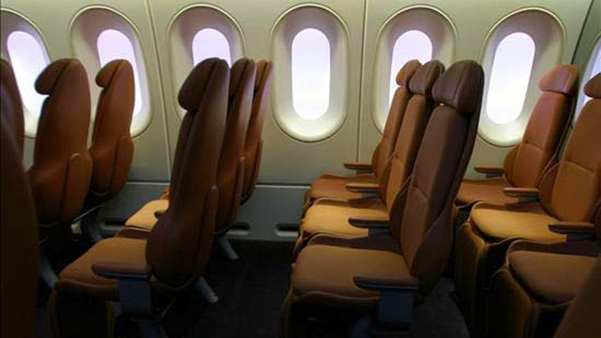
Occupant Protection
Static → Seat strength
Dynamic → Assess occupant injury
Original standard→ Forward facing seats

Slide 3
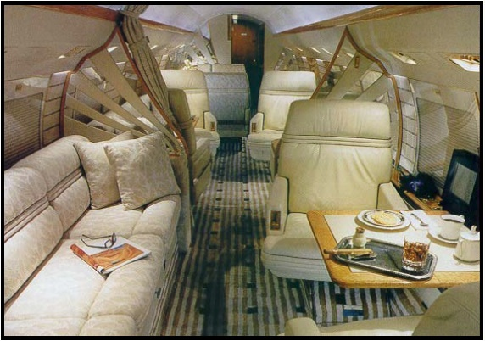
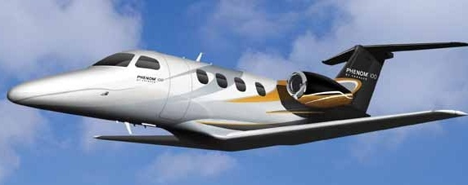
Side-Facing Seats
Certification
Exception from some standards
Additional test/design requirements
Goal: Certification at same safety level
Need: Injury criteria & biofidelic ATD

Slide 4
Injury Criteria
Post Mortem Human Surrogate (PMHS) to define human response
Yield Injury Reference Values (IRV)
Matched-paired test w/ATD
Same environment/loading conditions
Injury Assessment Reference Values (IARV)
Ex→ Hybrid III neck criteria

Slide 5
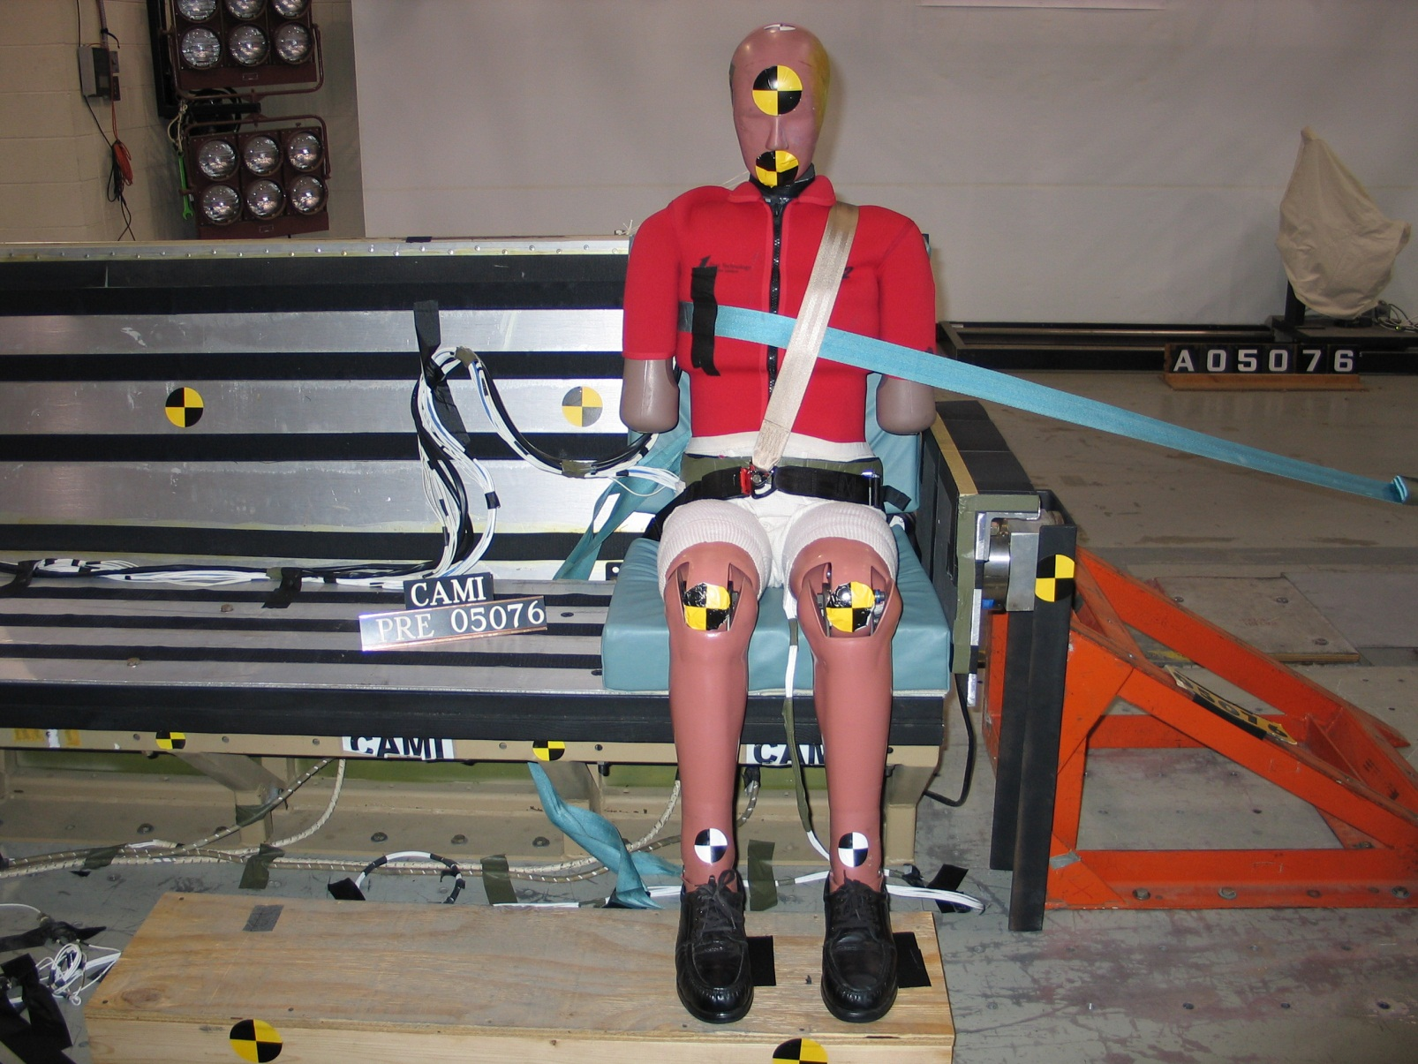
CAMI Sled Tests

Slide 6
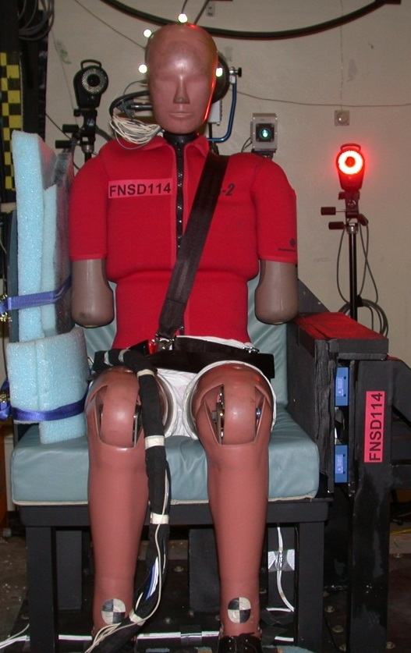
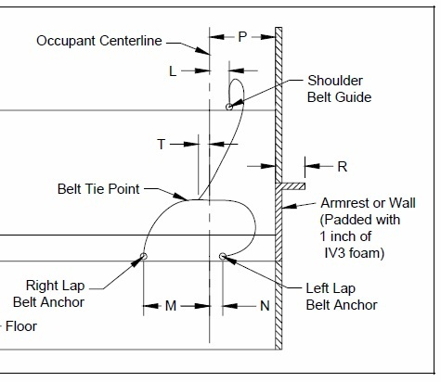
MCW Sled Tests

Slide 7
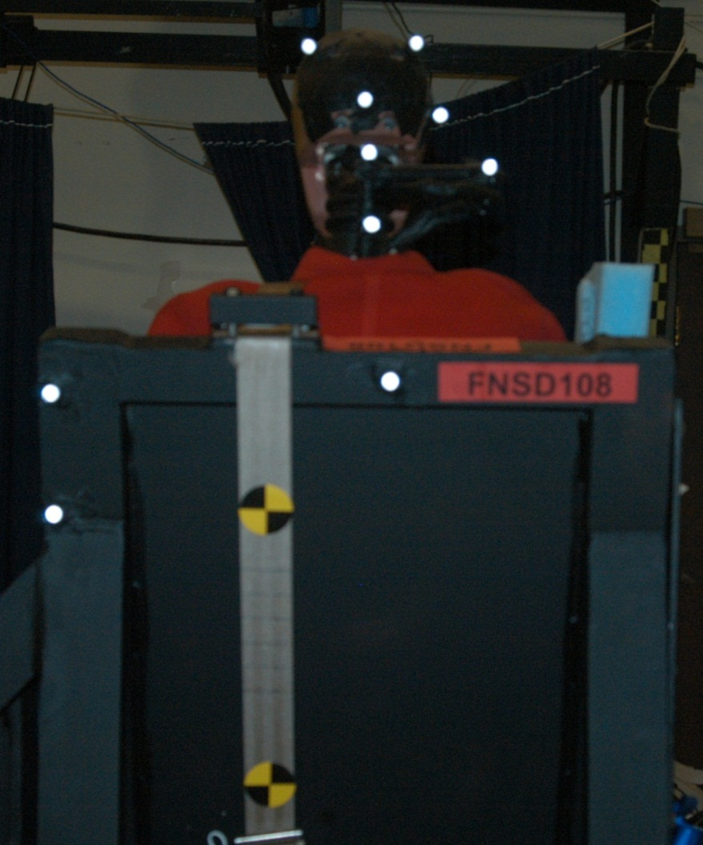
Test Design
Focused on head neck kinematics & injuries
3D motion capture
Minimal lighting
250-500 Hz video (front)

Slide 8
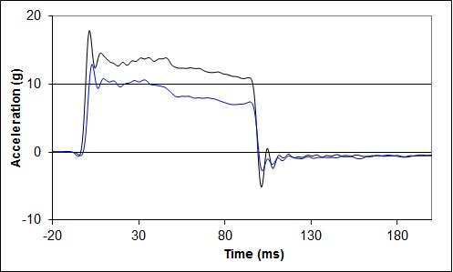
Acceleration Pulse
High = 12.5 m/s
Low = 8.7 m/s

Slide 9
ES2 Test

Slide 10
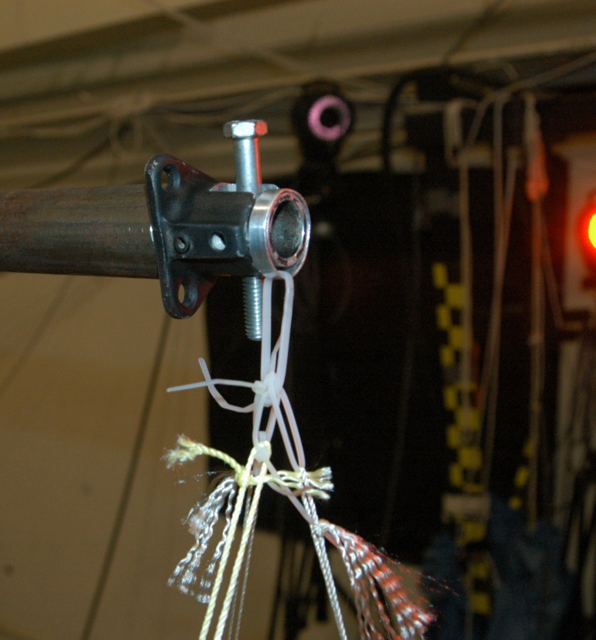
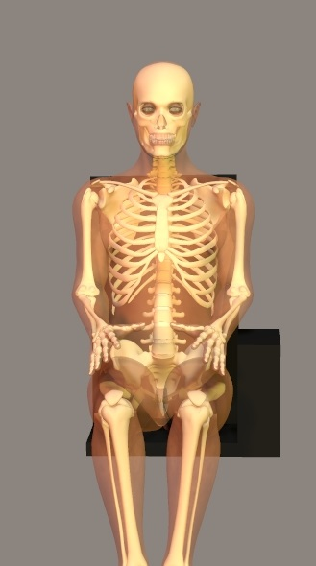
PMHS Setup

Slide 11
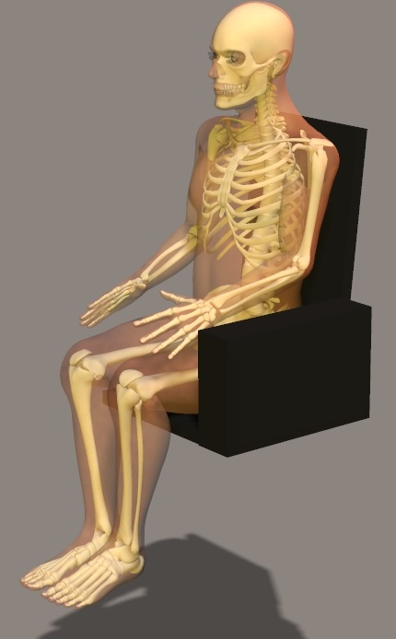
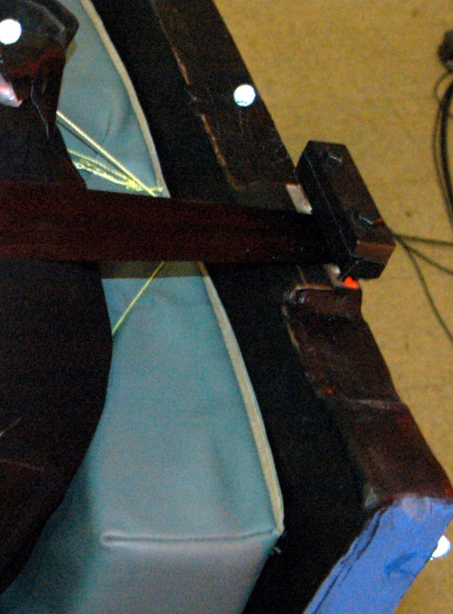
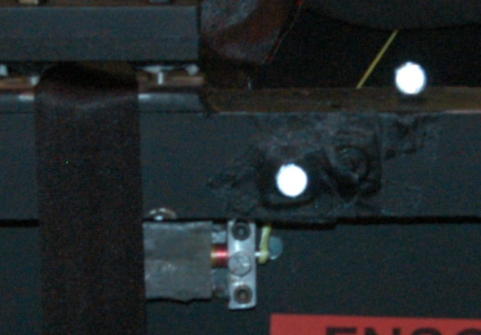
PMHS Setup

Slide 12
Specimen Information
ID | Age | Body Mass | Height | Velocity
 | Years | kg | m | m/s
109 | 59 | 64.4 | 1.68 | 12.5
110 | 55 | 76.2 | 1.84 | 12.5
115 | 57 | 81.3 | 1.82 | 8.7
116 | 47 | 74.5 | 1.75 | 8.7

Slide 13
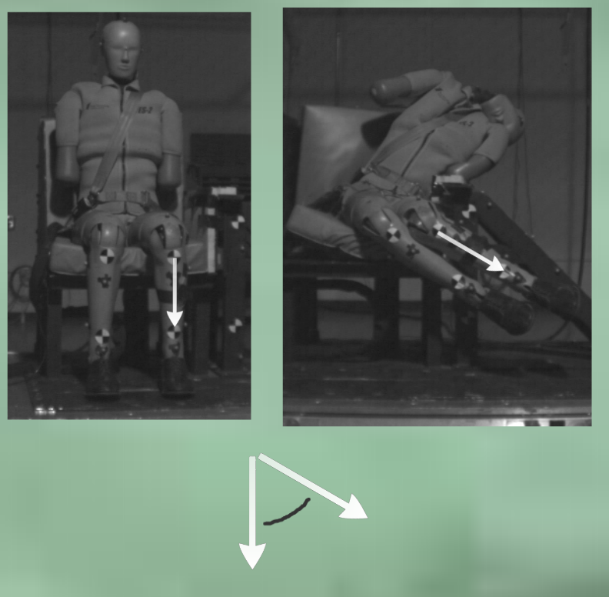
Data Collection PMHS
Femur internal rotation angle
Tibia Markers
High Speed Video (500 Hz)
Angle → Dot product
Tri-axial accelerometer @ pelvis → 12.5 kHz
Post test x-rays & autopsy

Slide 14
Results – Pelvis Acceleration

Slide 15
Results – Pelvis Acceleration

Slide 16
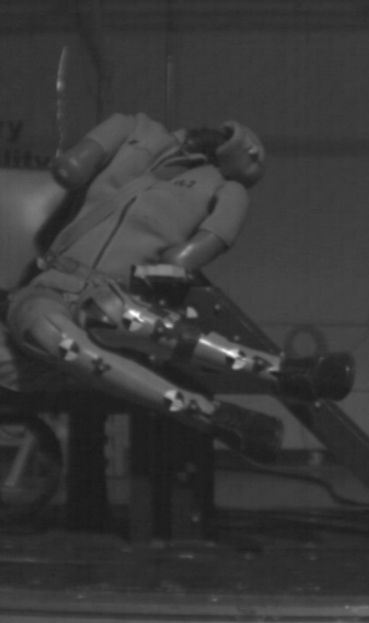
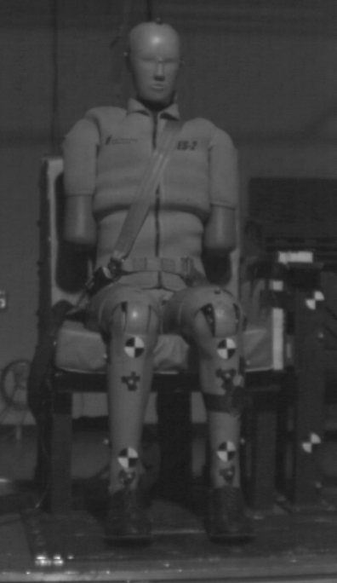
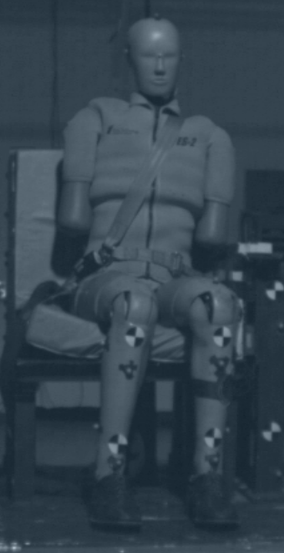
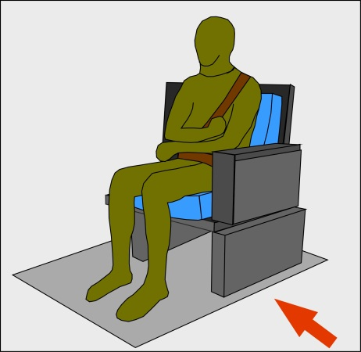
Results - Video

Slide 17
Results – Injury
ID | Velocity | Peak Angle | Lower Extremity Injury
 | m/s | deg
109 | 12.5 | - | Proximal subcapital femur fracture
110 | 12.5 | 89.4 | Distal femur fracture
115 | 8.7 | 58.5 | None
116 | 8.7 | 54.9 | None

Slide 18
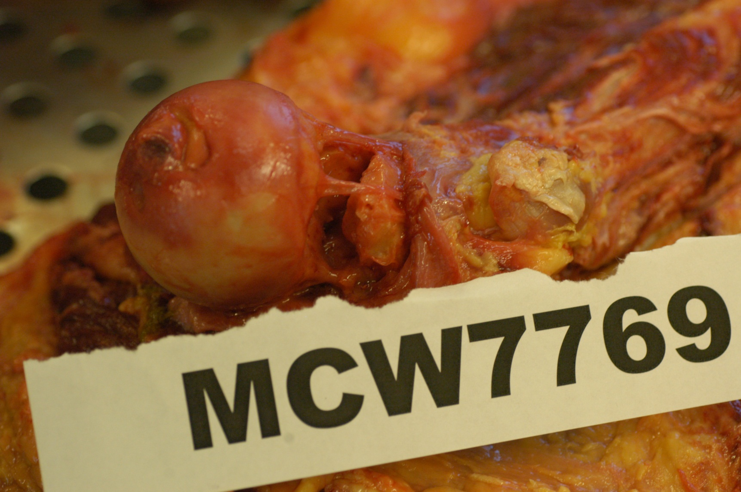
Proximal femur fracture

Slide 19
Distal femur fracture

Slide 20
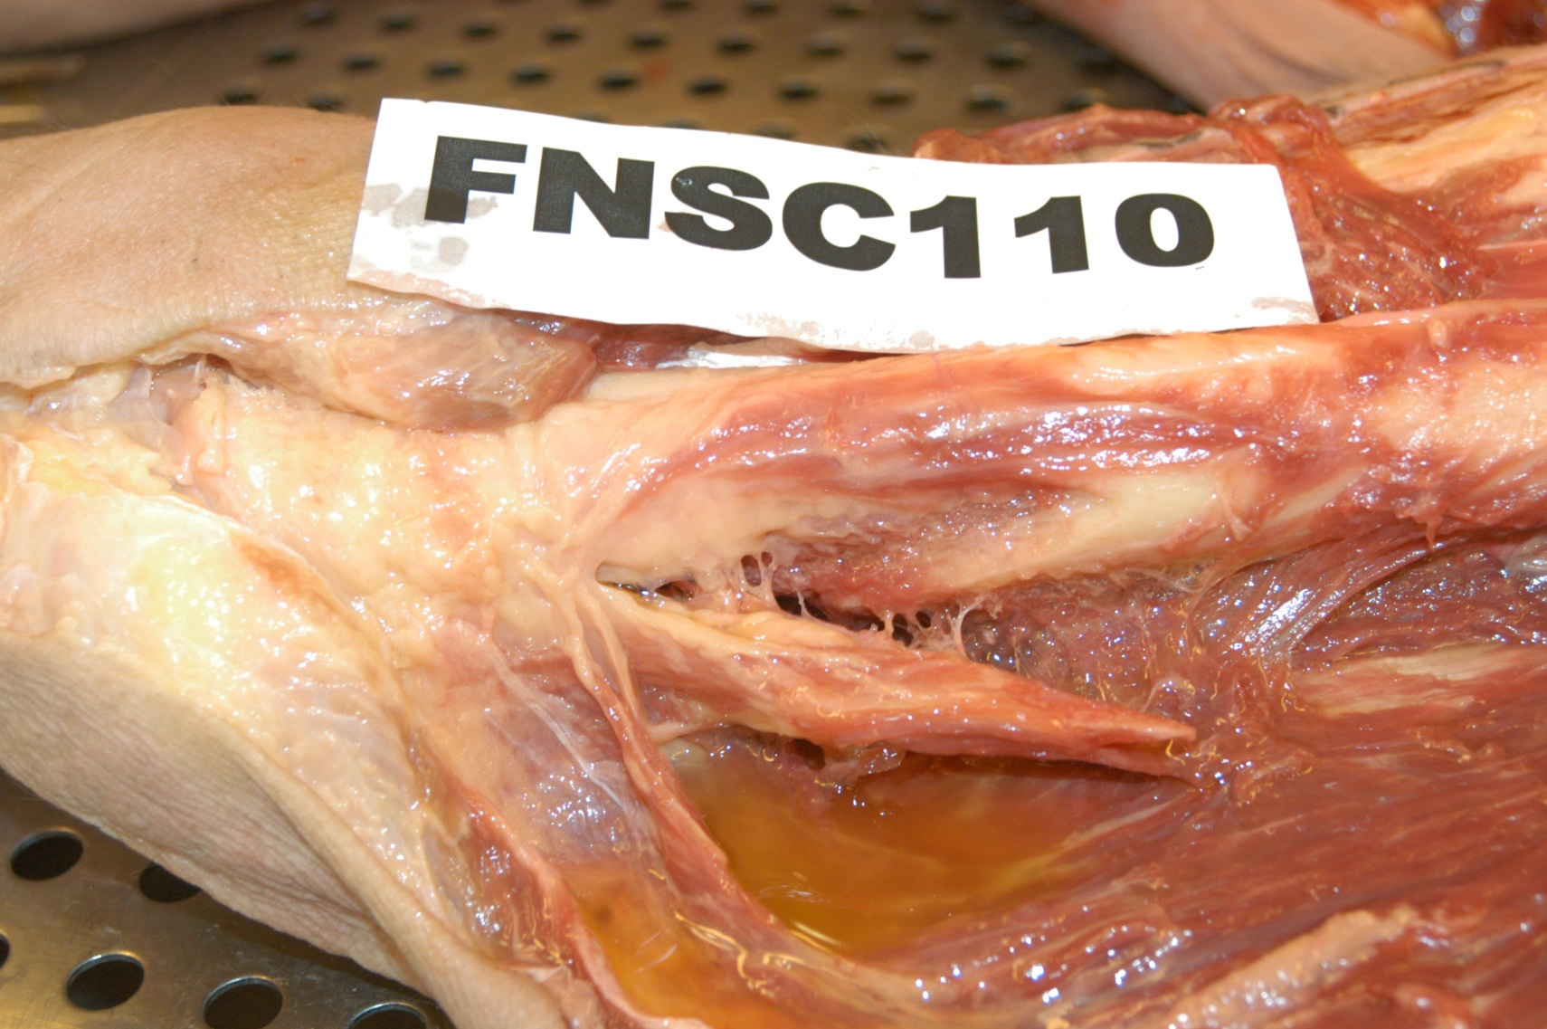
Distal femur fracture

Slide 21
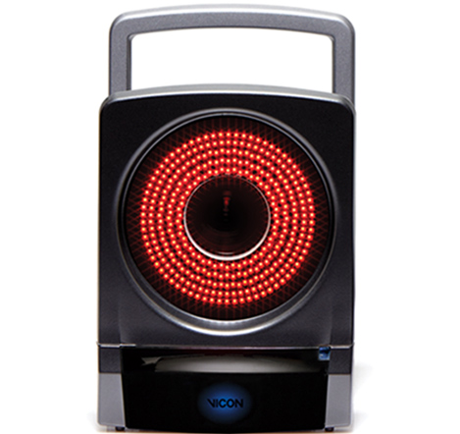
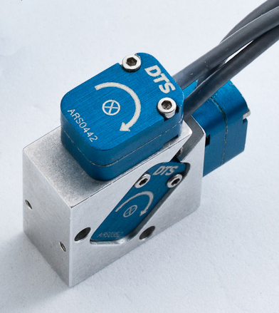
Follow up ES-2 Sled Tests
13 camera Vicon 3d motion capture system
1000 Hz
Tri-axial Angular Rate Sensor (ARS) on left tibia
Analog data @ 20 kHz
Simple angular measurement technique

Slide 22
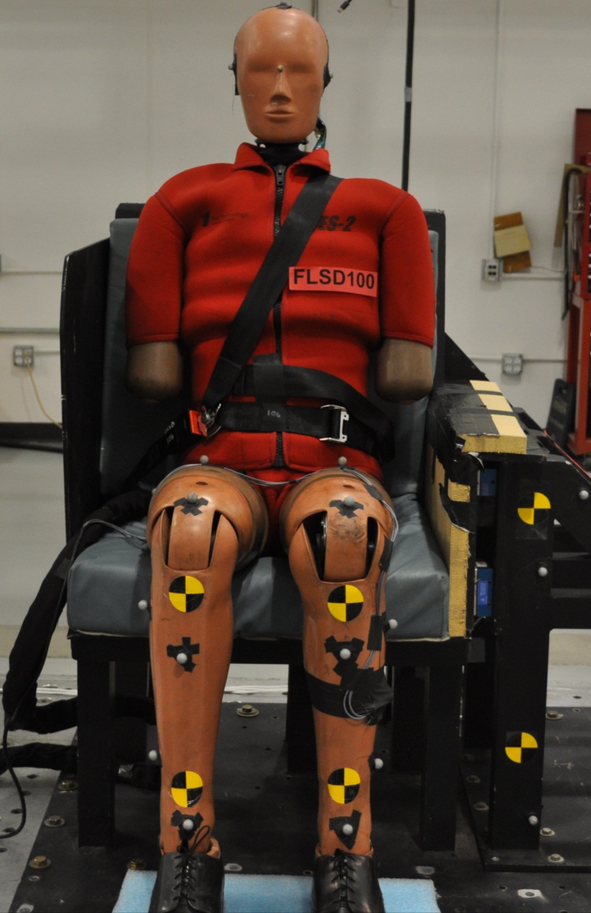
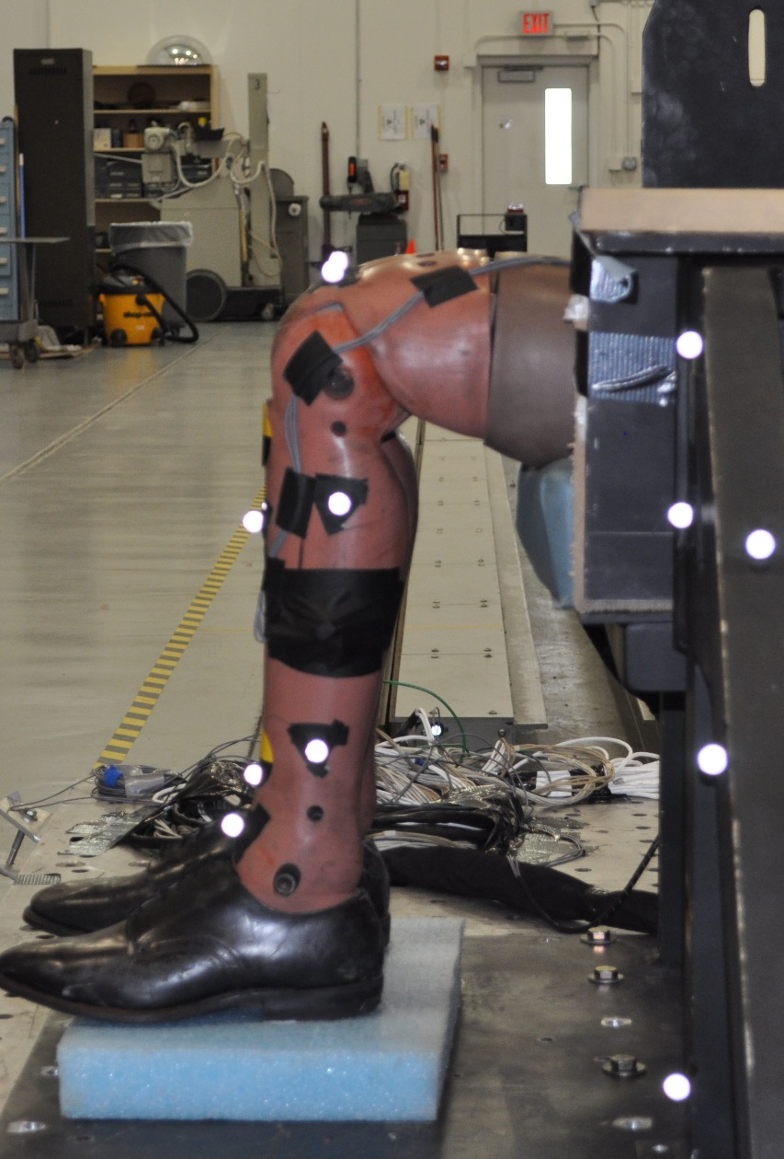
Follow up ES-2 Sled Tests

Slide 23
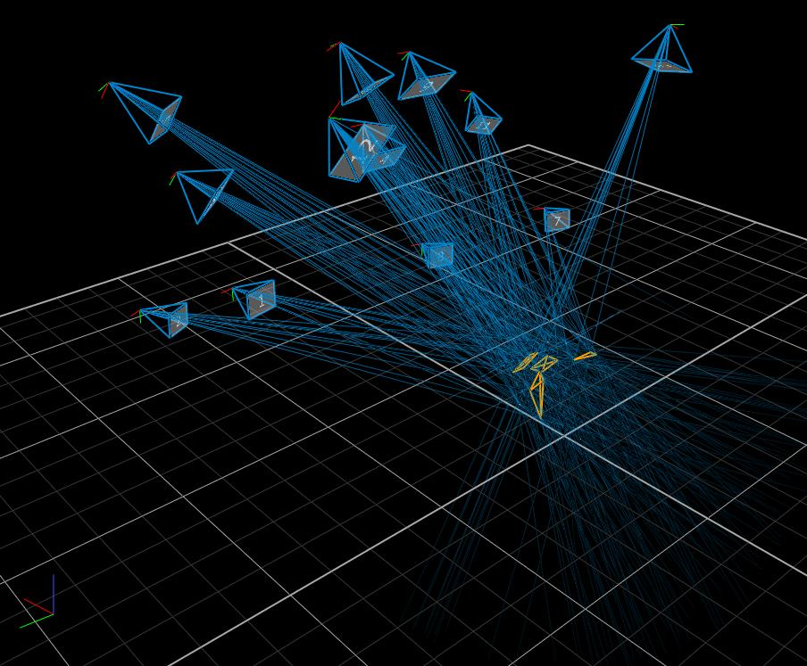
Vicon

Slide 24
Leg kinematics

Slide 25
Leg kinematics

Slide 26
3d motion

Slide 27
Angular Rate Sensor vs. Vicon Comparison

Slide 28
Conclusion
PMHS 2 velocities
Higher velocity produced leg injury
Lower velocity no leg injury
Some containment of leg may be necessary
ARS instrumentation is an accurate and reliable method for computing leg angular displacement
Fast
Does not rely on optics
ES-2 reaches end range of motion @ 8.7 and 12.5 m/s

Slide 29
Acknowledgments
FAA, Zablocki VA Medical Center, and MCW Department of Neurosurgery
Thanks

