Slide 1
US Army Handheld Fire Extinguisher Hardware Development for Use with Blended
HFC-227ea/Special Sodium Bicarbonate Agent
Leonard Lombardo – Aberdeen Test Center

Slide 2
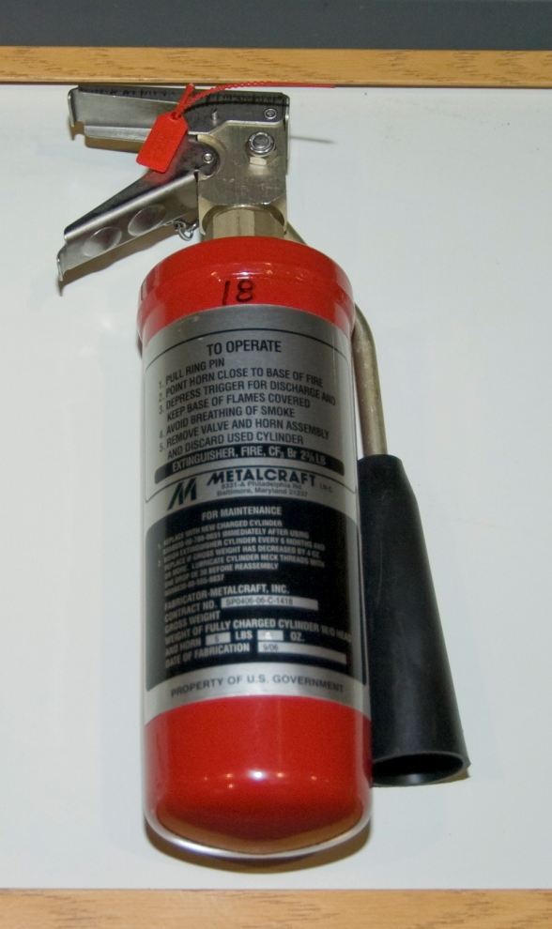
Background
Tasked to develop and test a replacement to the 2.75-lb Halon 1301 handheld fire extinguisher on legacy rotary wing weapon systems
Rationale
  Halon is an Class I Ozone Depleting Substance (ODS)
  A more environmentally friendly fire extinguishing agent was desired to eliminate the dependency on ODS
  (This is in-line with Army ODS Policy)
NOTE: The existing Halon 1301 configuration shown served as the baseline

Slide 3
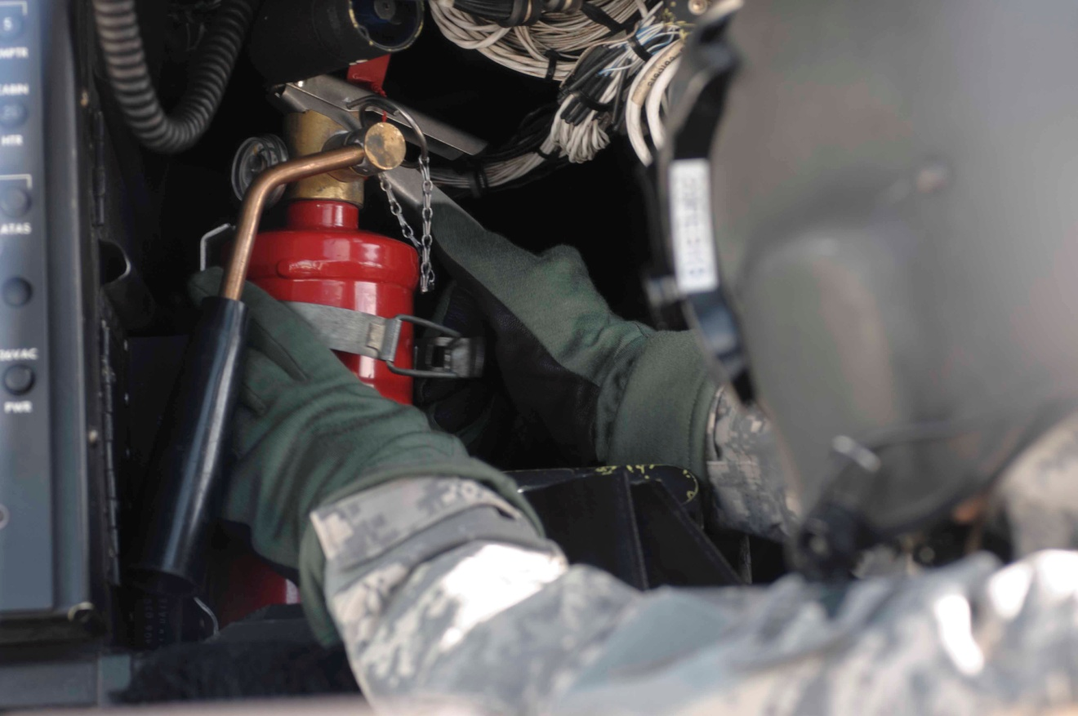
Application Unique Challenges
Use of the same cylinder size (Form, Fit, and Function) to eliminate the need for a aircraft redesign
  Increased agent volume
  Effect on agent flow rates
As effective as Halon Configuration
Temperature extremes
(Operational and Storage)
  High temperatures: issues with thermal expansion of the agent causing high pressures
  Low temperatures: issues maintaining agent flow
NOTE: The replacement configuration shown here during human factors testing

Slide 4
Early Nozzle Development
Optimized droplet size for suppression effectiveness is in part a function of boiling point (vapor pressure of agent)
  Discharge distance
  Spray characteristics
Spray discharge, throw, and angle should be optimized to take advantage of the heat of vaporization of the agent and to generate an inert blanket over the burning fuel

Slide 5
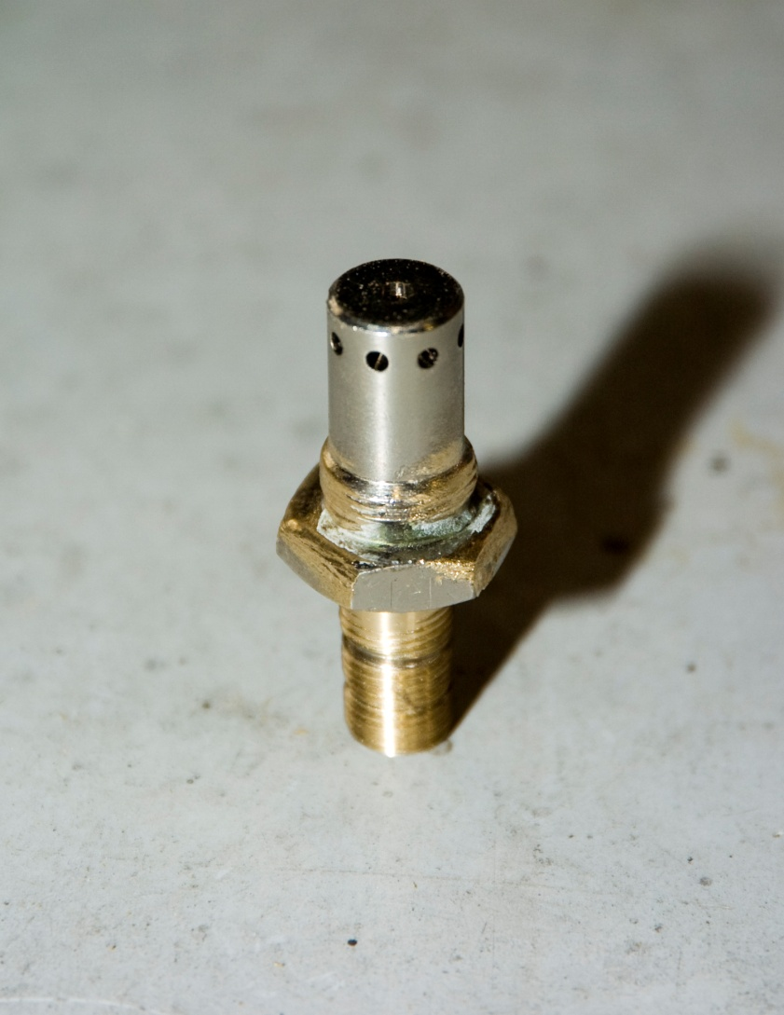
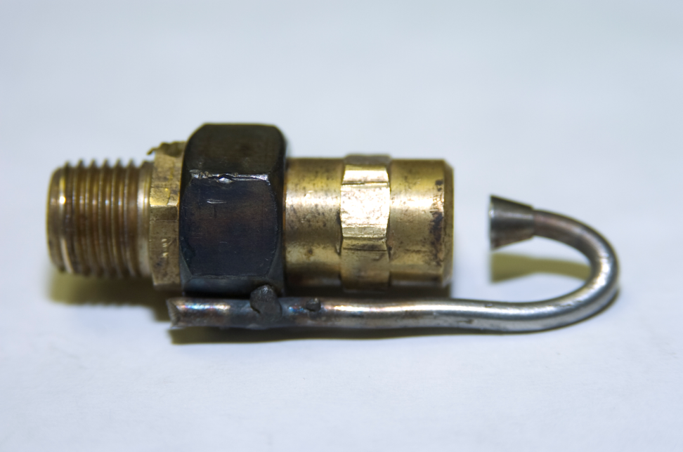
Nozzle Examples
Dozens of commercially available nozzle designs were evaluated along with many custom designs

Slide 6

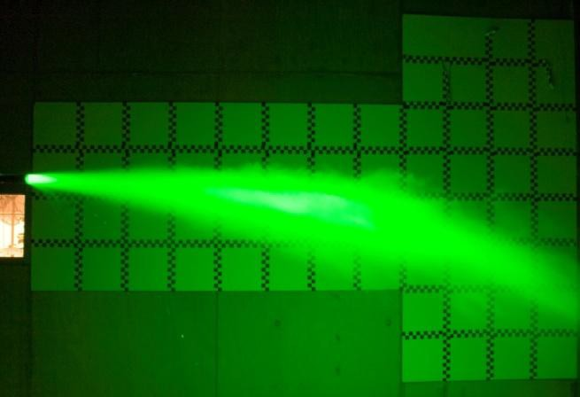
Spray Patterns
Multiple Co-Planar Lasers were utilized to show the spray patterns for optimization of agent/hardware
Droplets shown during these evaluations aided in making design adjustments to the nozzle and pressures

Slide 7
Effect of Sodium Bicarbonate (SBC)
SBC had been previously used to increase agent extinguishing performance in ground vehicles.
  Total flooding application
  Fast discharge (all at once, on the front end)
Our focus was more on dispersion of SBC:
  Greater surface area of a special SBC (SBC_{S}) is achieved by utilizing smaller particles. Two classes, SBC-1 and SBC-2 were developed.
  Smaller/Dryer particles increase ability to suspend in HFC-227ea and not cake when subjected temperature cycling
  Smaller particles are more effective in fire suppression

Slide 8
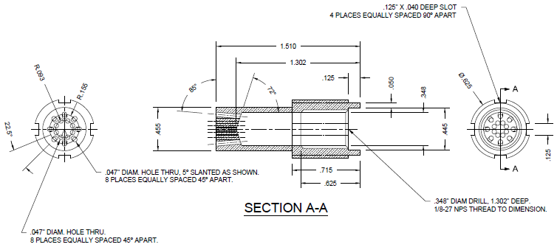
Selected Nozzle
Originally developed for Halotron I and Novec 1230
Sixteen holes intended to break up the spray
Effectively disperses SBC_{S}
Angled holes to separate droplets to increase range, cover more area

Slide 9
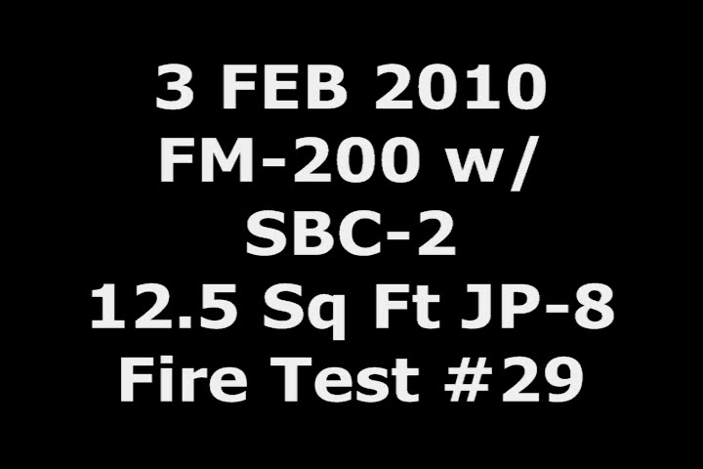
JP-8 Fire Extinguishment

Slide 10
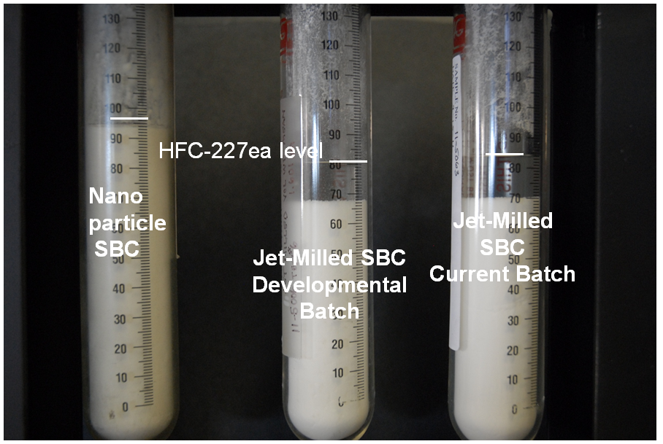
Challenge Filling Extinguishers
Early production attempts to fill extinguishers with a constant concentration of sodium bicarbonate failed
A method of keeping the slurry well mixed during the filling process was necessary
Note: Very early in the developmental testing, hand filling methods in a glove box were utilized successfully

Slide 11
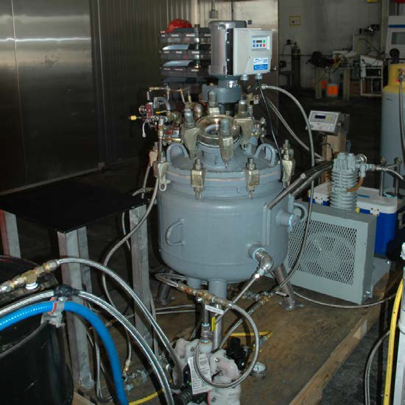
Solution
Reactor able to withstand high pressure from the HFC-227ea
Mixer keeps agent slurry (HFC-227ea/SBC_{S}) well mixed
Capable of sampling HFC-227ea/SBC_{S} to verify concentration

Slide 12
HFC-227ea/SBC_{S} Process Diagram

Slide 13
Detailed Test Plan Met Requirements for Army Rotary Wing Aircraft
(Production Representative Hardware Development)
Item | Criteria
Initial Inspection (1-18)
1 | Cylinder Shell
2 | Cylinder Volume……measure of aluminum cyl = 3 cu in less *
3 | Cylinder Contents/Charge
4 | Dimensions
5 | Mounting Bracket Latch
6 | Unlatching Process
7 | Removal Interference
9 | Pressure indicator Gauge
10 | Weight. No more than 3.6 kg (7lbs, 14 oz)
11 | Interface with Aircraft
12 | Interfacing Materials
13 | Agent Release Mechanism
14 | Operating Mechanism Locking Device/Safety
15 | Valve/Nozzle Assembly
16 | Siphon Tube
17 | Handle
18 | Exterior Surfaces
Safe Design (19-27)
19 | Stress Corrosion
20 | Safe to Handle
21 | Bracket Test Shock/Vibe
22 | Legacy Bracket Test
23 | Cylinder Retention on new bracket design
24 | Cylinder Fragmentation Resistance (non-shatterability)
25 | Hydrogen Embrittlement
26 | Immersion Corrosion Properties of Agent
27 | Aircraft Personnel Emergency Egress
* Steel cylinder passed all testing. A new lightweight Aluminum cylinder was evaluated , however failed to meet volume requirements.

Slide 14
Detailed Test Plan Met Requirements for Army Rotary Wing Aircraft
(Production Representative Hardware Development) Continued
Item | Criteria
Performance (28-31)
28 | Discharge Angle and Range
29 | Discharge Time and Amount
30 | Class B Fire Extinguishment
31 | Discharge Pattern
Operation (32-36)
32 | Method of Operation
33 | Bracket Unlatching Effort
34 | Discharge Effort
35 | Heavy Gloves/Arctic Mitten Operation
36 | Operating Mechanism Locking Device/Safety
Environmental Qualifications (37-52)
37 | Temperature Extremes
 | High Temperature
 | Low Temperature
 | Temperature Shock
38 | Altitude
39 | Humidity Exposure
40 | Fungus
41 | Salt Fog
42 | Sand and Dust Environment
43 | Acidic Atmosphere
44 | Functional Shock
45 | Bench Handling Shock
46 | Crash Hazard Shock
47 | Vibration Testing
48 | Drop Test
49 | Accelerated aging for rubber materials

Slide 15
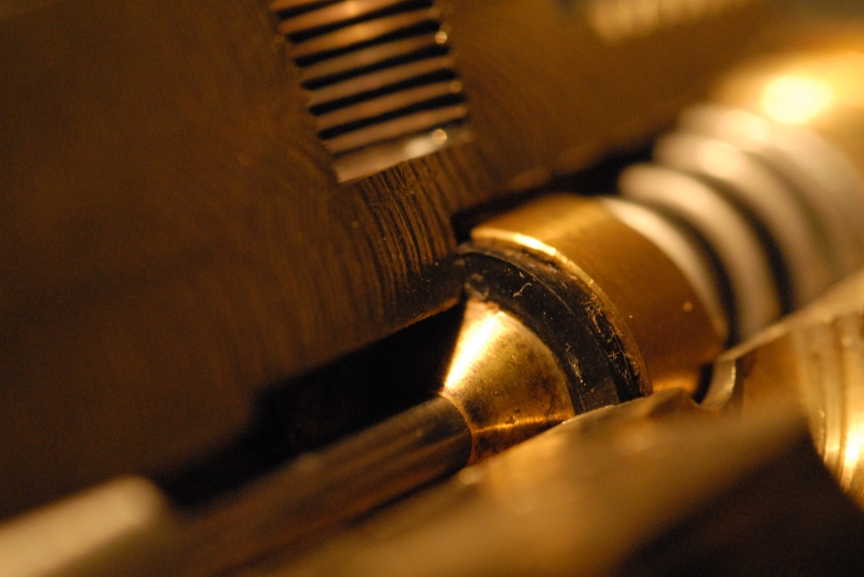
Hardware Problems Discovered/Resolved During Testing
(Production Representative Hardware Development)
Metal-to-metal contact preventing a proper seal
Problem identified as overlapping tolerances
Photo of Valve Seat cut to show internal surfaces

Slide 16
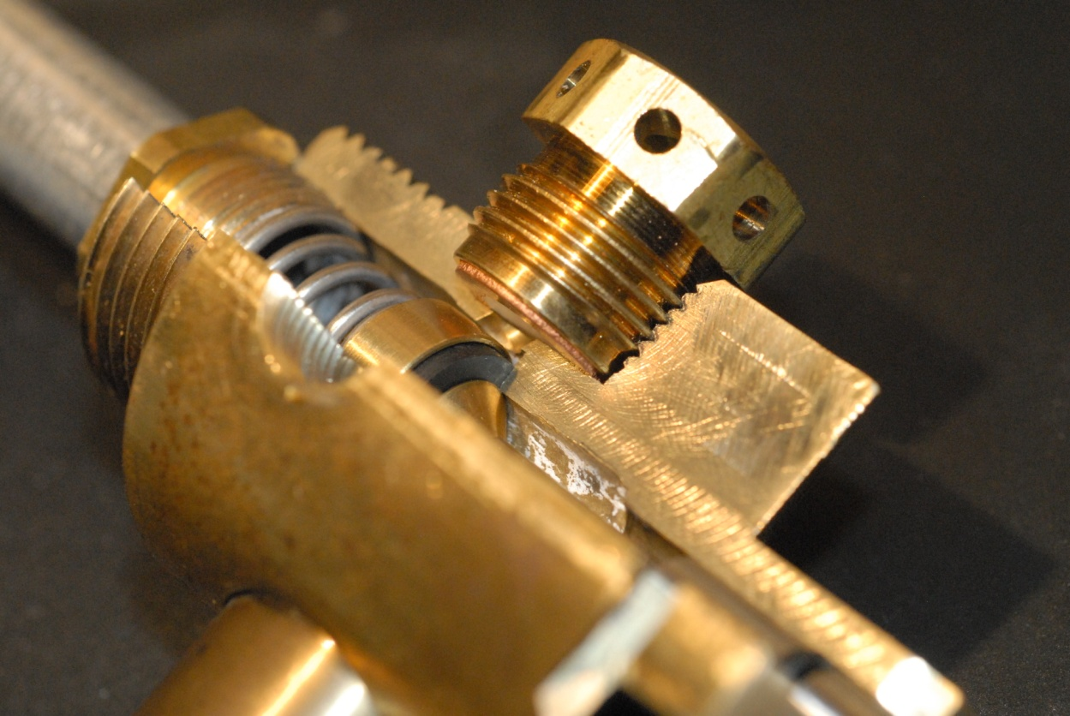
Problems Discovered/Resolved During Testing
Deformation of the burst disc seat led to premature failure during temp cycling
Resolved by reducing the machining depth
Photo of burst disc with valve cut to show seat deformation

Slide 17
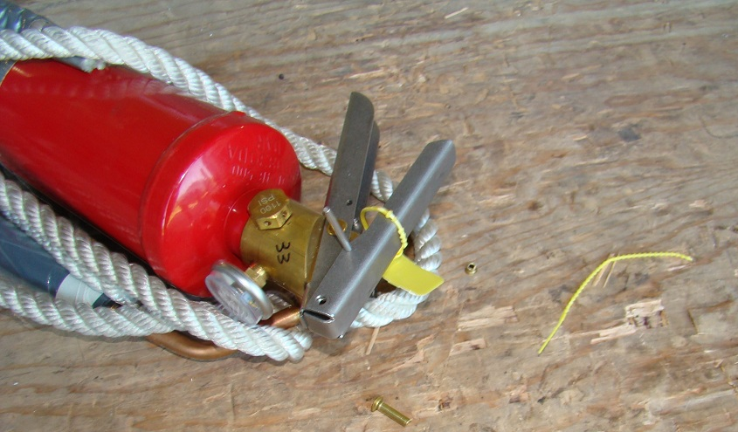
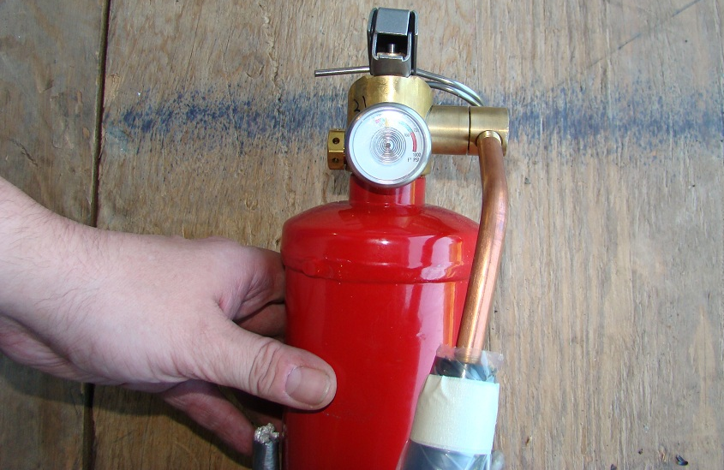
Problems Discovered/Resolved During Testing
This test is used to help ensure that the HHFE will be operational after a series of drops representative of what it could experience in the field
This test involves the HHFE being dropped six times from a height of four feet onto the 2-inch plywood shown in the picture which is backed by concrete
Upgrades to this design resolved issues with the pull pin, rivet and handle material that enabled the HHFE to successfully complete this test
Early Drop Test sample that resulted in a bent pull pin, rivet and handle

Slide 18
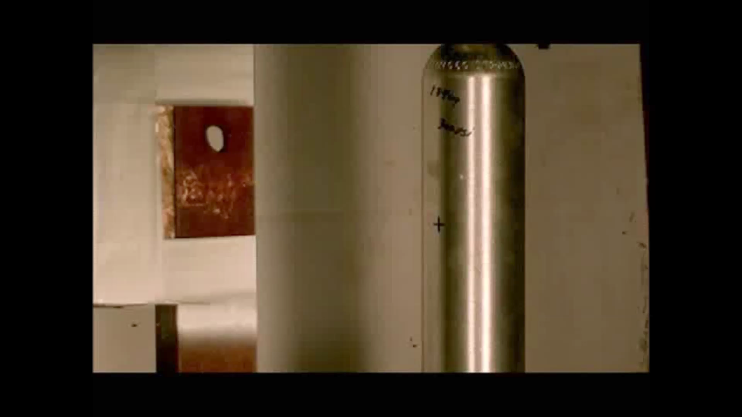
Problems Discovered/Resolved During Test
Ballistic testing of aluminum cylinder

Slide 19
Problem Discovered During Testing
Aluminum cylinder is desirable to reduce weight
Aluminum cylinder that met the volume requirement was not commercially available for testing
  Ullage was reduced affecting flow rates
  When agent volume was reduced to match the fill ratio, flow rate was still affected and there was not enough agent to extinguish the fire
Aluminum cylinder requirements are part of the specification (MIL-DTL-32403)
NOTE: The steel cylinder configuration passed all requirements within MIL-DTL-32403

Slide 20
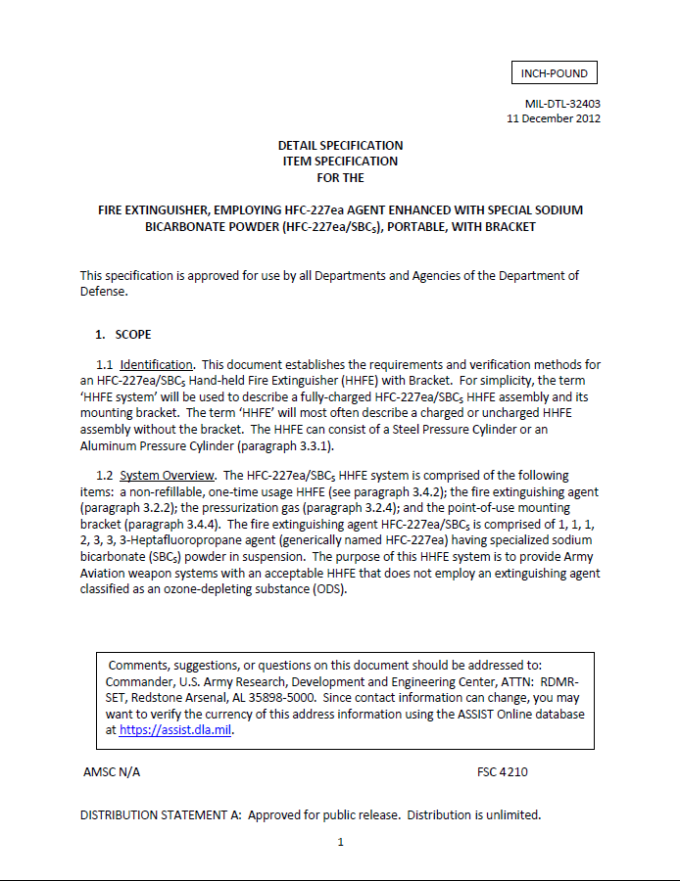
Documents that Support Fielding
Specification for hardware published December 2012
Safety confirmation released July 2013 from the Army Evaluation Center
Airworthiness Assessment completed September 2013

Slide 21
Program Leads and Key Contributors
Alivio Mangieri – AGSE PM Technical Branch
Tim Helton/Dr. J. Douglas Mather –
U.S. Army Aviation and Missile Command (AMCOM) G-4
Kevin Dowell and Leonard Lombardo – Aberdeen Proving Ground

Slide 22
Acknowledgements
Funding – PEO Aviation, Program Manager Aviation Systems, PM AGSE
Technical Management – Aviation Ground Support Engineering (AGSE)
Supporting Organizations
  Aviation and Missile Command (AMCOM) G-4
  Aberdeen Test Center (ATC), Intermediate Fire Lab
  Tyndall AFB - Air Force Research Laboratory (AFRL)
DuPont Company – contributed FM-200 and FE-36 agents and performed materials compatibility testing of HFC-227ea/SBC_{S} agent with HHFE hardware components
Quickfire USA – contributed powdered agent for crucial initial HFC227ea and SBC evaluations
3M Corporation – contributed Novec 1230
American Pacific Corporation – contributed Halotron-I

Slide 23
Questions
Any presentation related questions should be addressed to:
Mr. Tim Helton
U.S. Army Aviation and Missile Command (AMCOM) G-4
E-mail: tim.helton@us.army.mil

Slide 24
Backup Slides

Slide 25
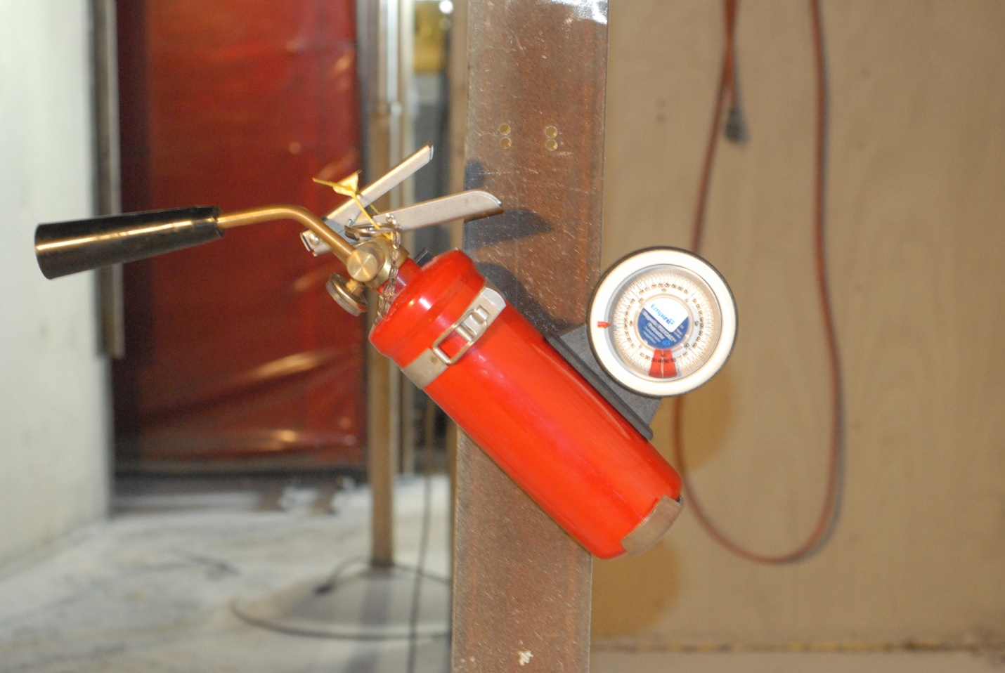
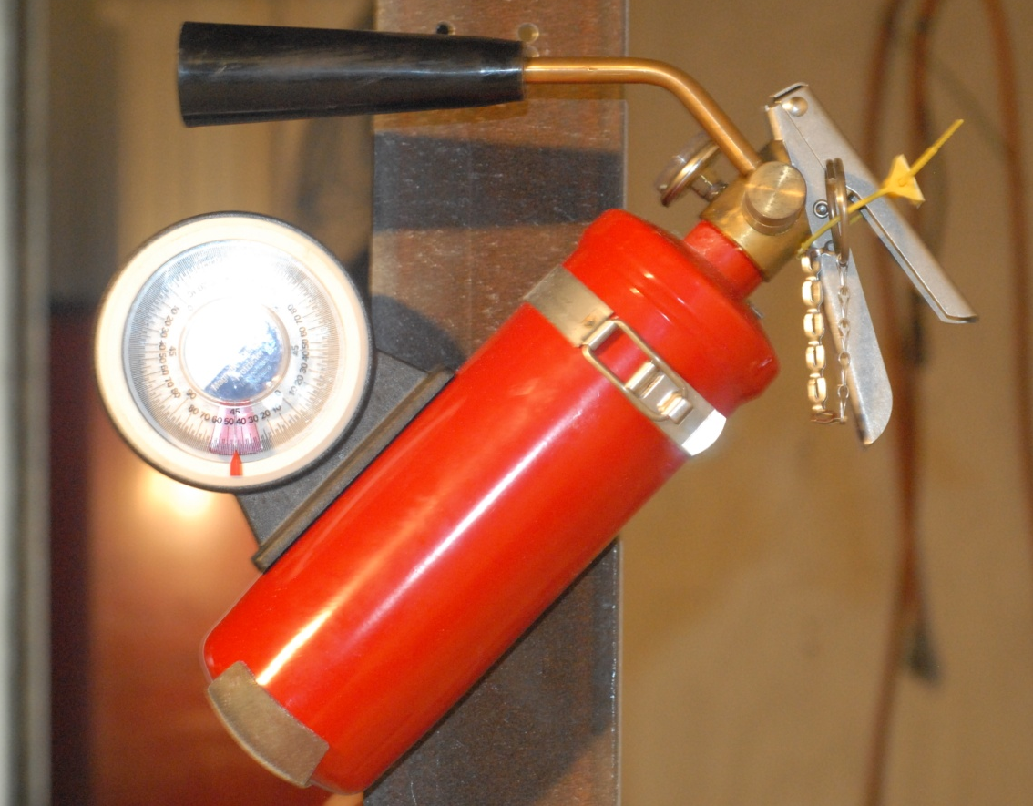
Discharge Angle and Range
This test is used to ensure that the HHFE is capable of discharging at least 90 percent of its contents from any orientation ranging from 45 degrees to ‑45 degrees from the vertical position with a range of four to ten feet for seven to nine seconds
Forward (+45°) Discharge Test
Reverse (-45°) Discharge Test

Slide 26
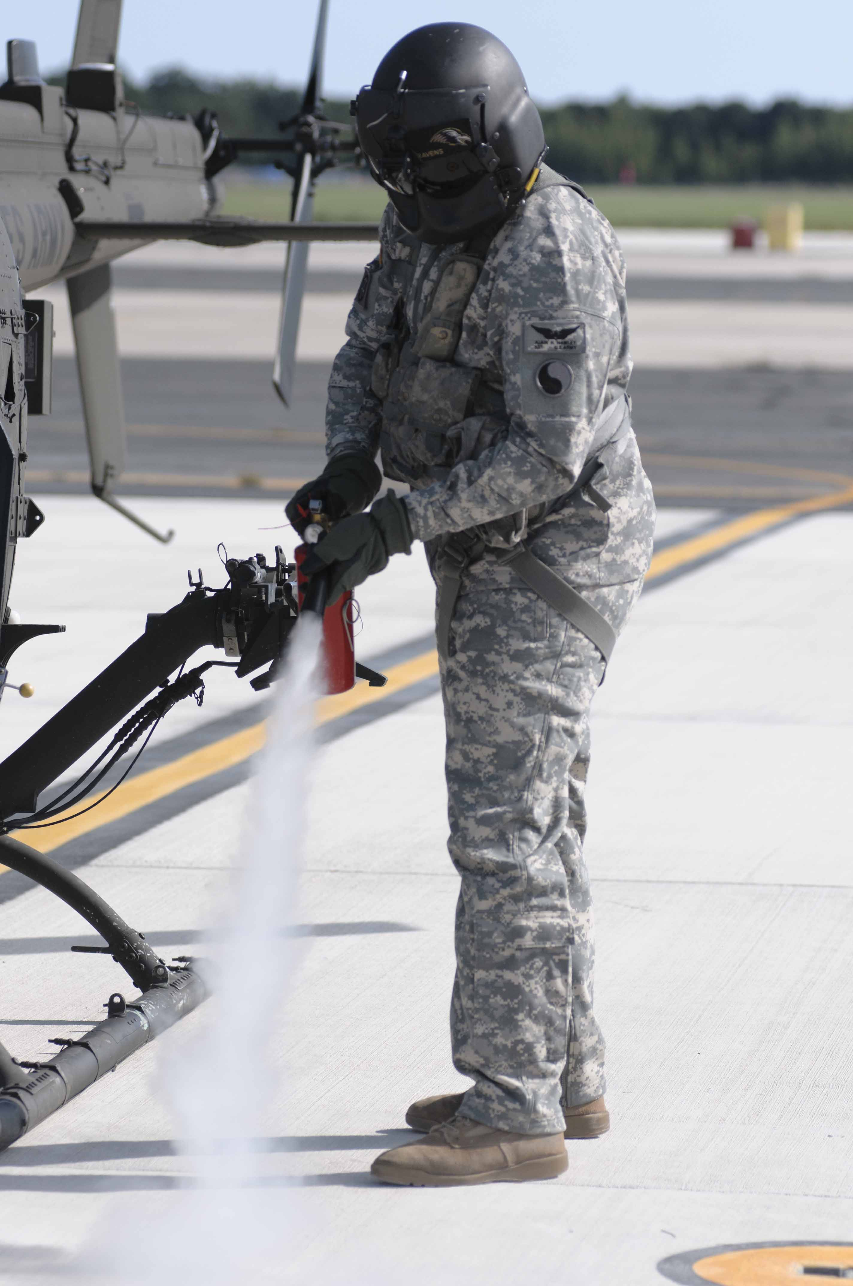
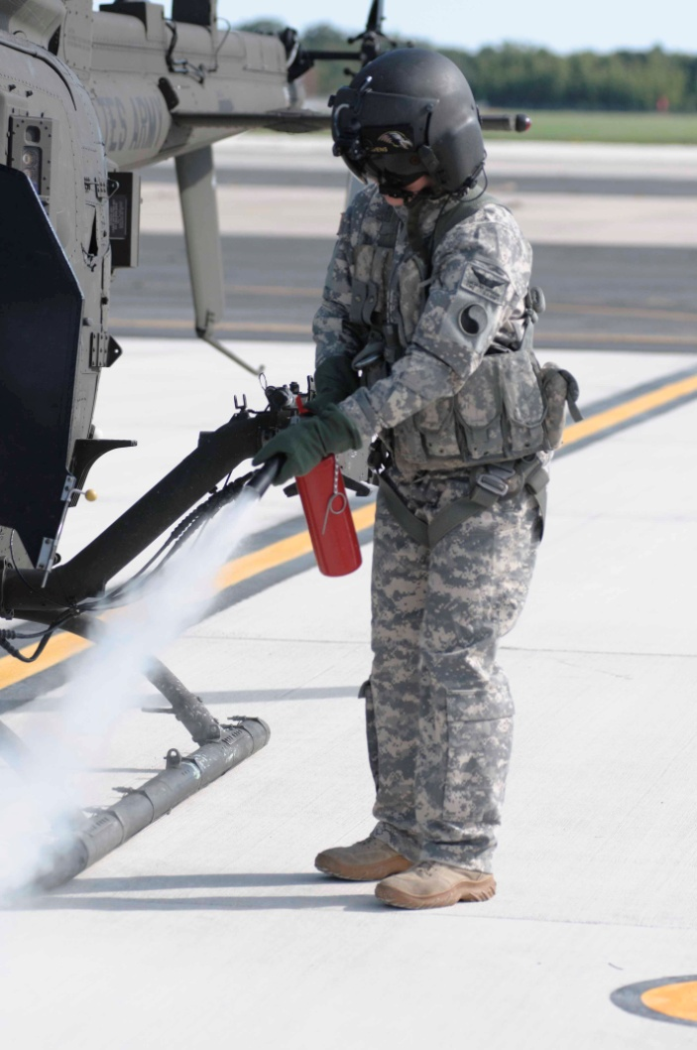
Operational Tests
Operational testing includes ensuring that most soldiers (5th percentile female to a 95th percentile male) will be able to individually operate the HHFE while wearing their proper personal protective equipment (PPE)
95th Percentile Male
Crewmember
5th Percentile Female
Crewmember

Slide 27
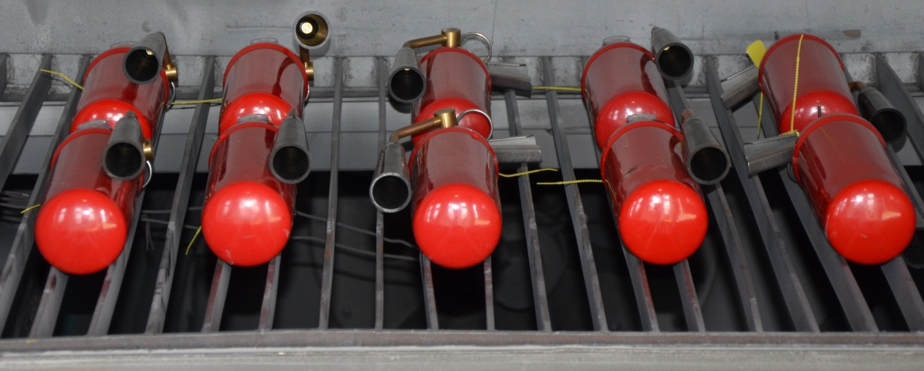
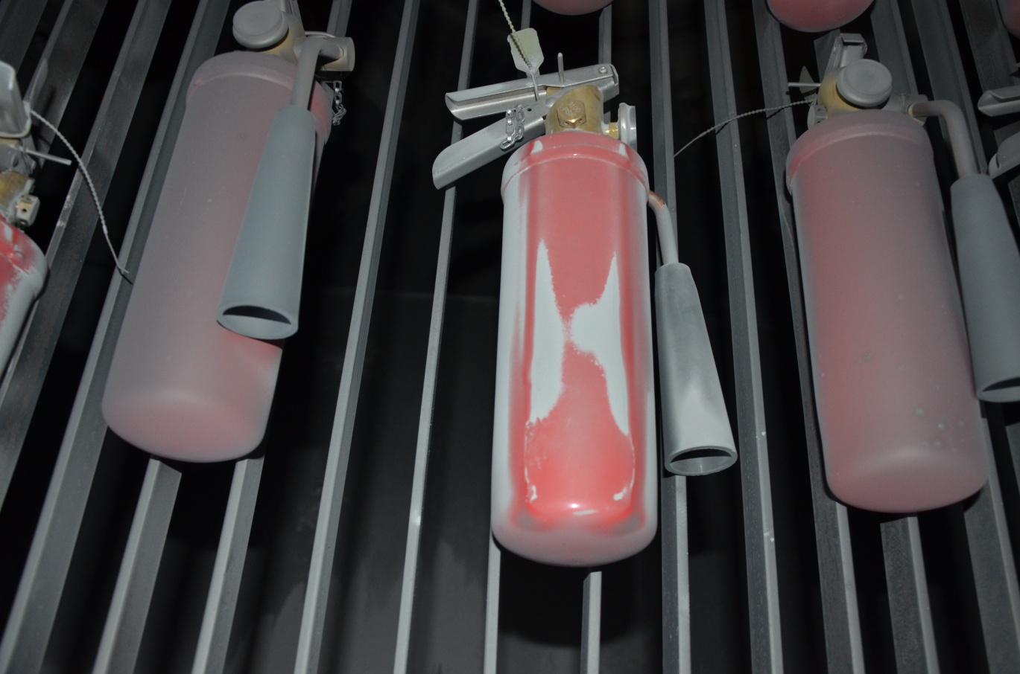
Blowing Dust Test
This test is used to help ensure that the HHFE will be operational after it is exposed to wind-blown dust during its life cycle on the aircraft. This test includes the HHFEs being exposed to wind speeds of 1750 feet/minute with a dust concentration of 0.3 grams/cubic foot.
HHFE test samples ready for Blowing Dust Test exposure
Blowing Dust Test Samples after exposure

Slide 28
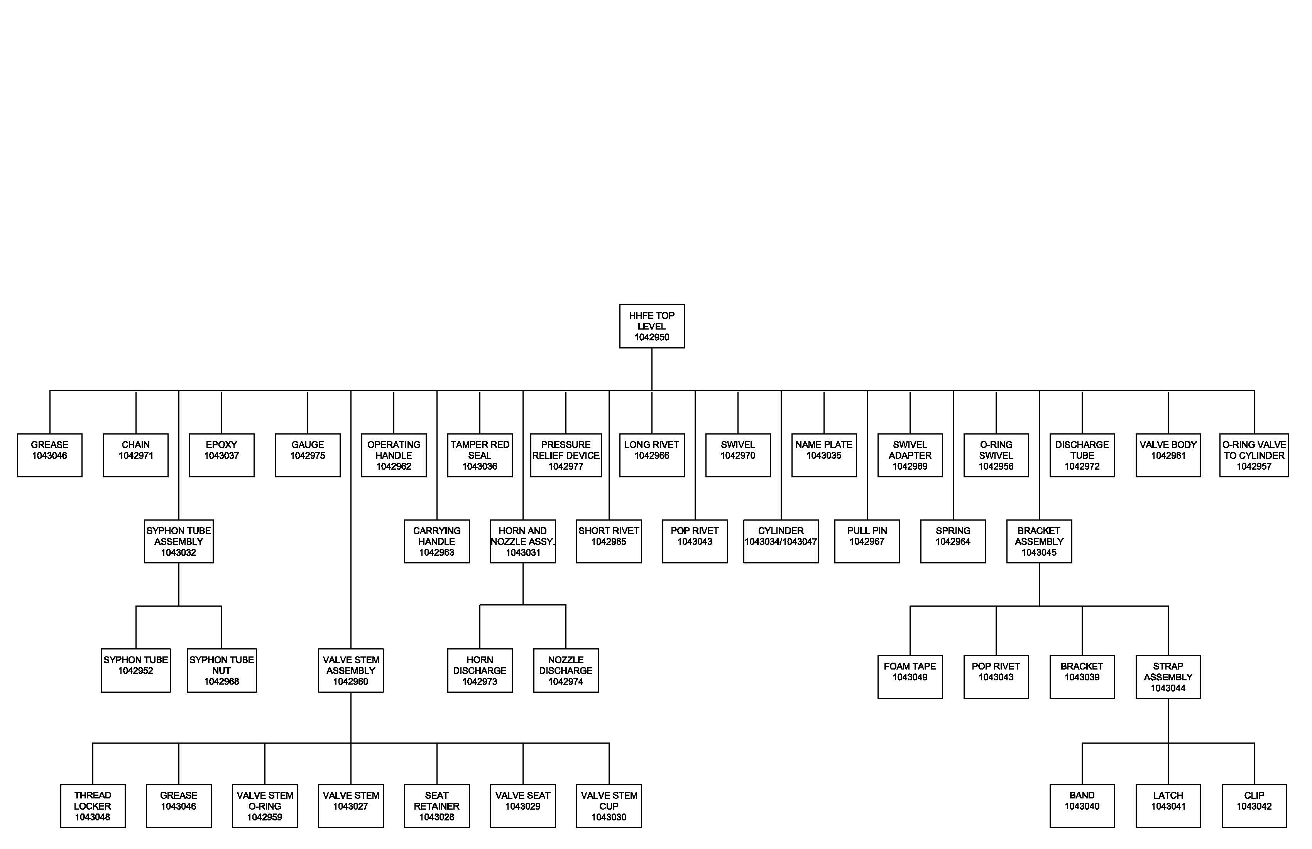
Technical Data Package (TDP)
Over 40 drawings make up the TDP

