Slide 1
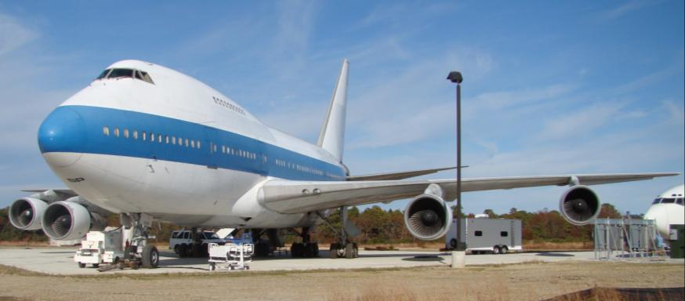
Flight Deck Smoke Penetration Testing
International Fire & Cabin Safety Research Conference. Philadelphia, PA
Robert Morrison, FAA Technical Center Fire Safety
December 5, 2013

Slide 2
Overview
Transport Airplane Directorate asked us to determine if current flight deck smoke penetration certification testing is adequate.
Using data from Fire Safety’s battery fire tests and certification smoke tests to setup a helium-injected Rosco theatrical smoke generator for testing on Fire Safety’s 747SP aircraft.
Test conditions on the 747SP aircraft will include smoke penetration tests using each individual pack selections. (i.e. only pack1, only pack2, and only pack 3)
Interim testing is being performed on Fire Safety’s Boeing 727 to reproduce main deck lithium battery fire smoke buoyancy characteristics.

Slide 3
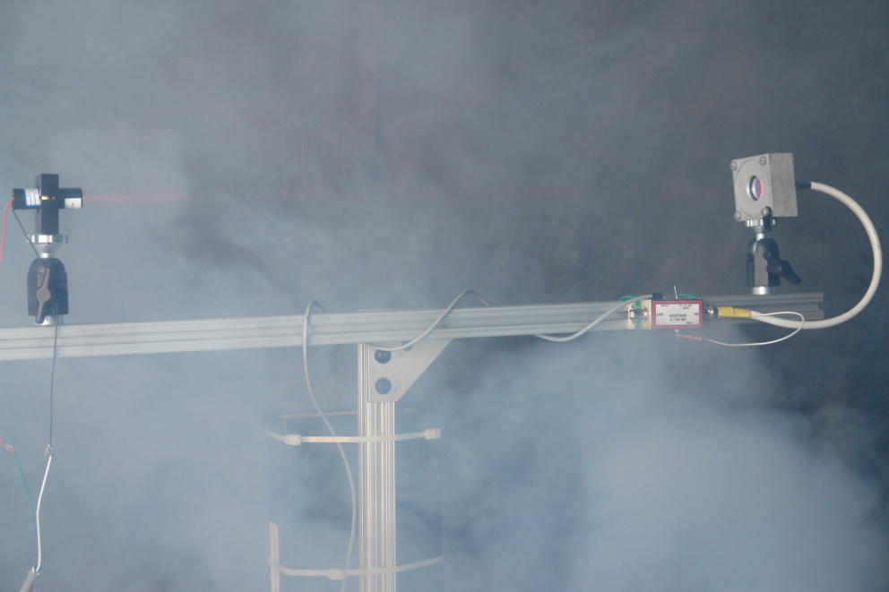
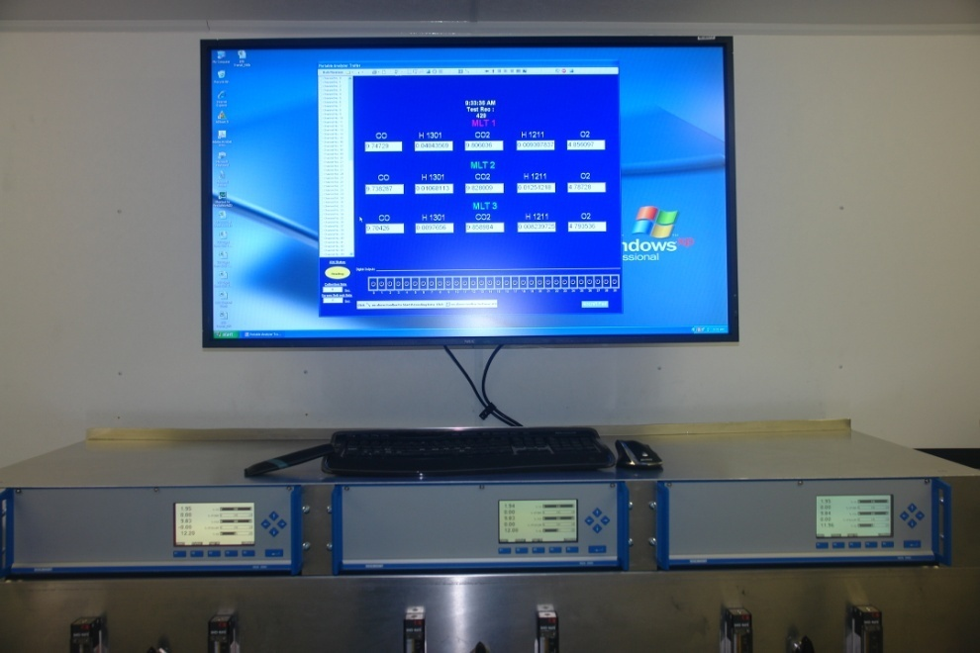
Background
We began preparing our Boeing 747SP aircraft
Instrumentation package
Laser Diode Smoke Meters
(2) installed in Flight Deck
(1) Portable
Portable Gas Analyzer Trailer
3 Sample systems
O₂
CO₂

Slide 4
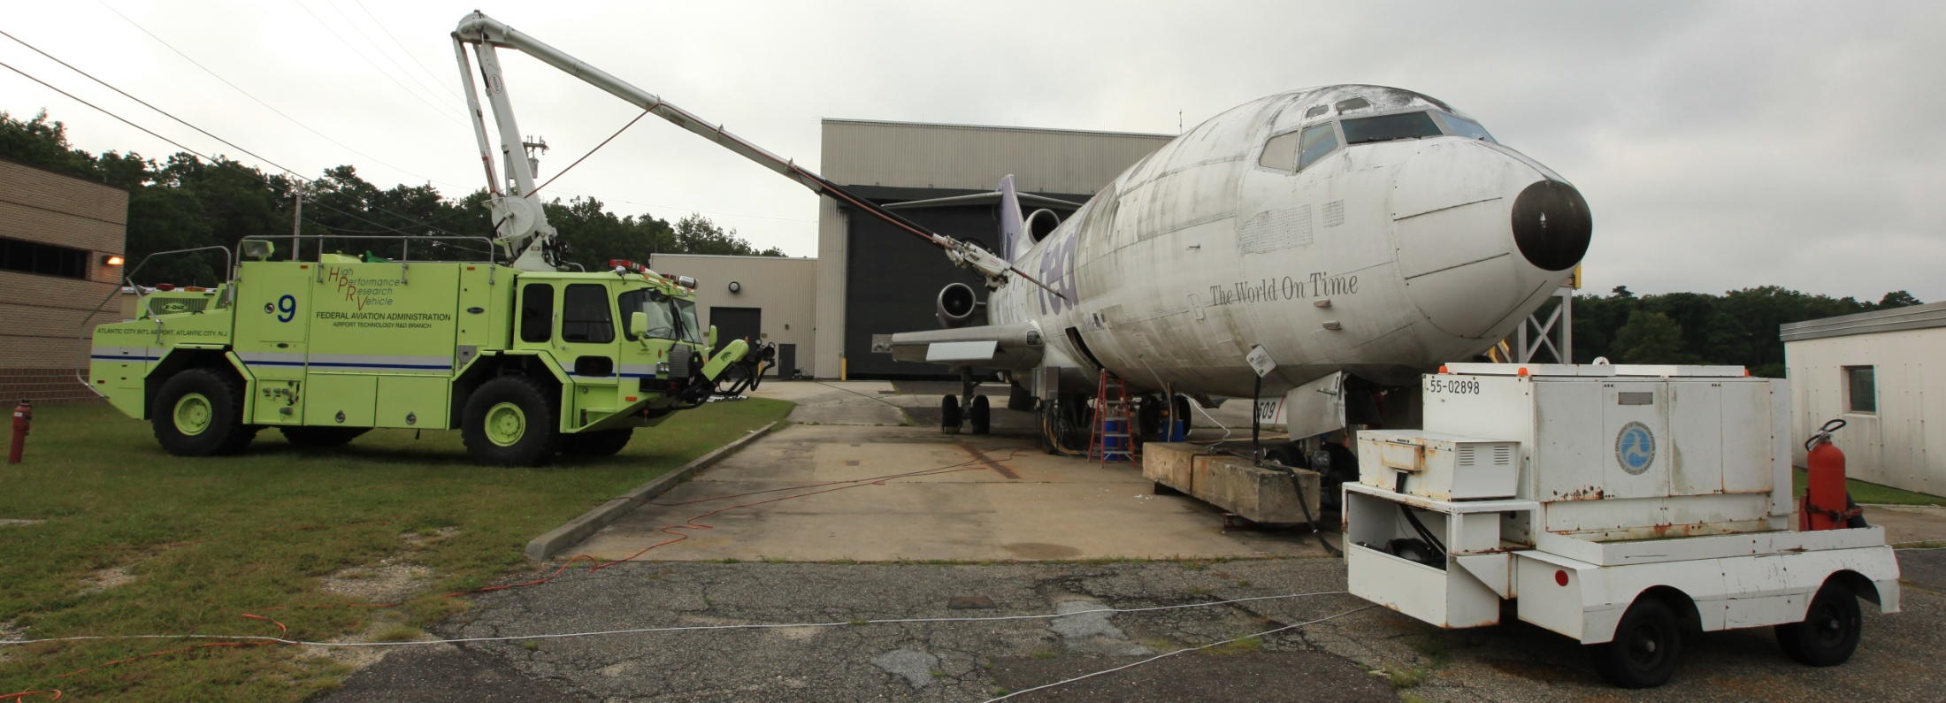
Background
Recently FAA Fire Safety ran a 4800 lithium primary battery fire test on Fire Safety’s Boeing 727.
The aircraft was configured to run in emergency mode with externally supplied preconditioned air set for maximum flow and the outflow valves adjusted to .5PSI differential

Slide 5
Background
It took as little as 16 minutes to completely obscure the flight deck.
The temperature and pressure rate of rise is very high with lithium type battery test fires.

Slide 6
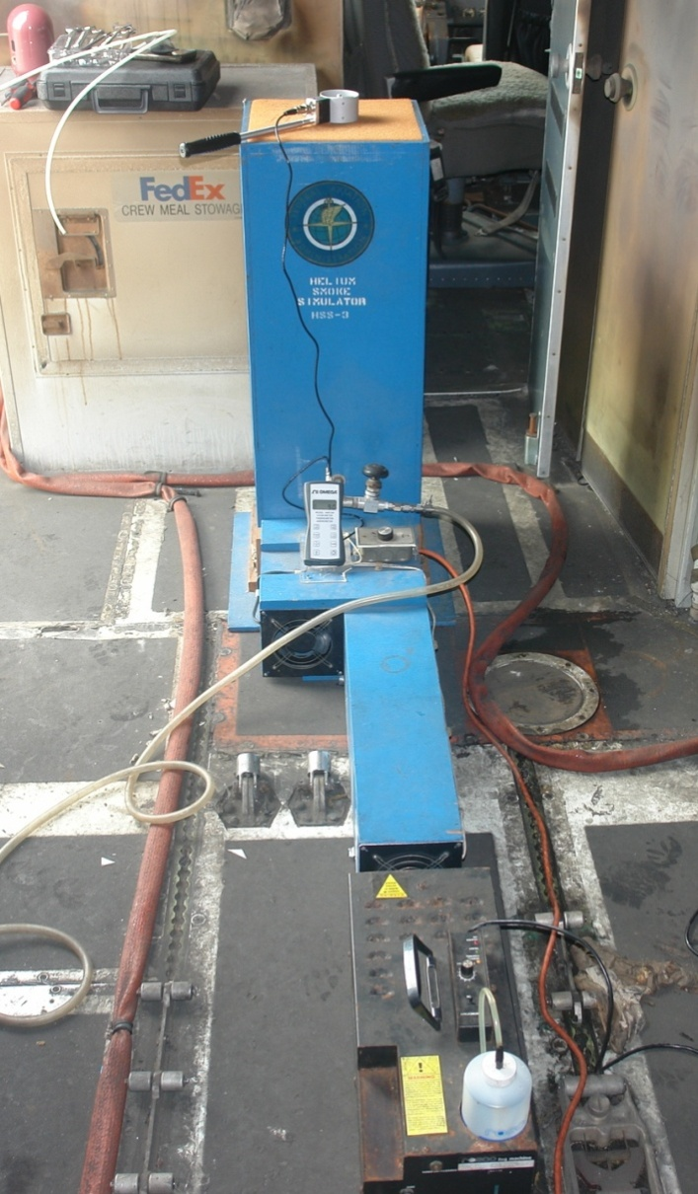
Interim Fire Safety 727 Testing
Configured 727 cabin for smoke certification test (AC25-9A)
We chose to run 2 types of smoke penetration tests
One with an FAA developed Helium-injected smoke box (adds buoyancy) and the other without.
In both tests (2) Rosco Model 1500 Pro theatrical smoke generators were used
Helium-injected Rosco theatrical smoke generator setup
Helium is turned on once smoke certification criteria is met and adjusted to 50% of initial O2 value
Muffin fan speed set to 100 CFM
50/50 mix of Air/Helium, giving equivalent buoyancy properties of air heated to 490°F

Slide 7
Interim Fire Safety 727 Testing
Test type 1 (2) stand alone Rosco theatrical smoke generators
Test type 2 Same as Test type 1 but adds helium into Rosco #1’s Smoke stream
Inject Helium into flow path once 18” visibility requirement is met
Rosco Gen #1
Rosco Gen #2

Slide 8
Interim Fire Safety 727 Testing
Test configuration
Emergency mode with no airflow to main cabin
Max air flow into ECS plenum feeding the flight deck.
Outflow valves set to maintain .5 PSI differential
Test results
Stand alone Rosco Model 1500 Pro theatrical smoke generator
No visible smoke in flight deck
Helium-injected Rosco Model 1500 Pro theatrical smoke generator
Faint wisps of smoke coming in at rear bulkhead ceiling area above the flight deck door
Smoke cleared with no measurable reduction in visibility

Slide 9
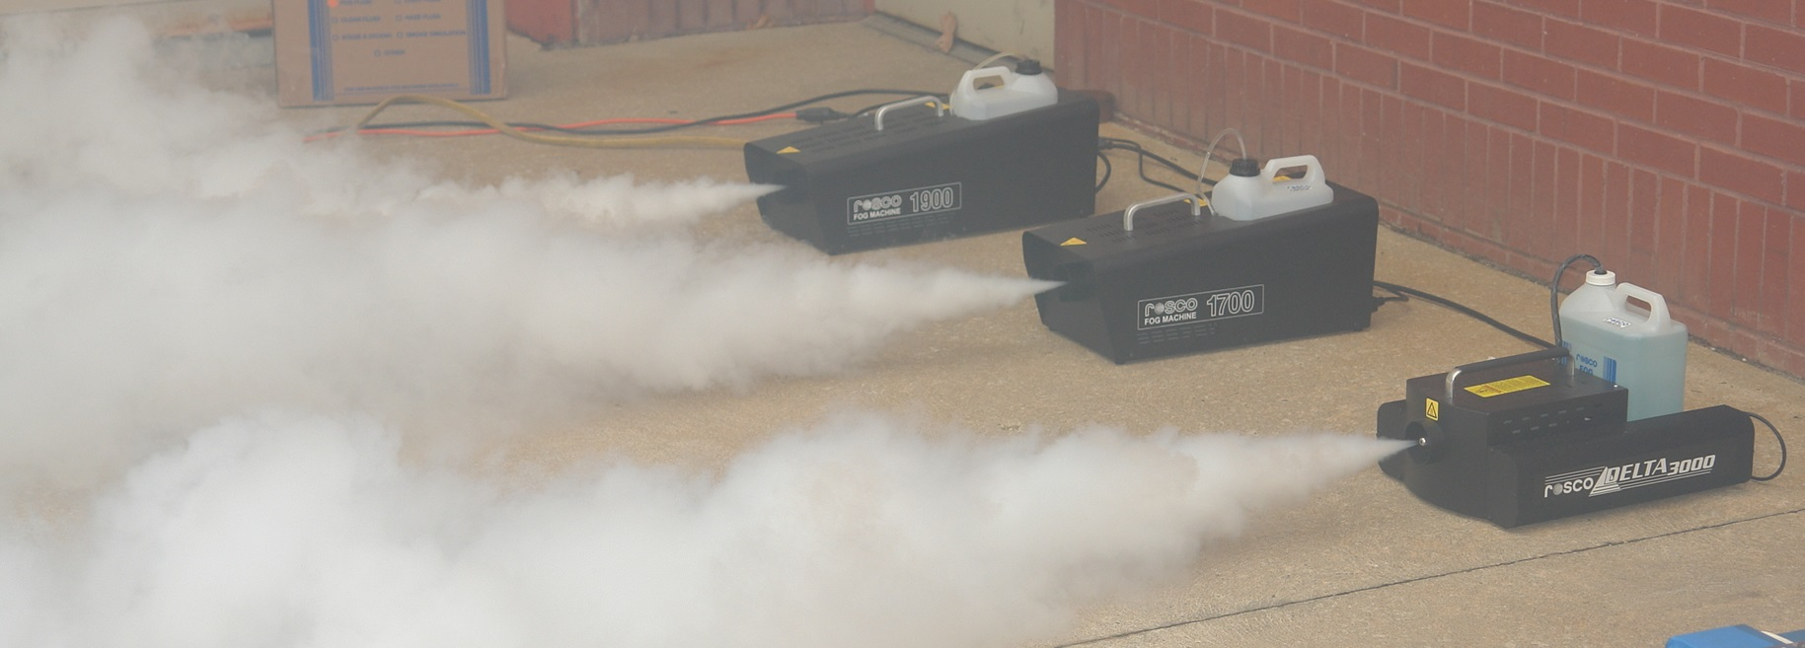
Interim Fire Safety 727 Testing
Intermittent smoke machine operation caused us to open up the 1500 Pro which showed corrosion and cracked fluid lines.
We ordered new Rosco generators; Rosco 1700, 1950, & 3000
Rosco 1700 is equivalent to AC25-9A specified 1500 Pro
Rosco 3000 is equivalent to AC25-9A specified 3000 Pro

Slide 10
Interim Fire Safety 727 Testing
Reran previous tests with same results.
Started adjusting Helium ratio in the Helium-injected Rosco theatrical smoke generator for the increased temperatures associated with lithium battery test fires.
Lots of trial and error
Last scenario tested was a 6% Oxygen (70/30 helium/air mix). Equivalent to 940°F Smoke Plume Air Temperature.
5 manifolded Helium bottles regulated at 90 PSI gives 20 minute operation
Lengthened second smoke runner mix tube
Replaced tired smoke box muffin fans per Report #DOT/FAA/CT-90/9
Using (2) Rosco 1700s, one in open cabin, the other to the Helium box
Current configuration was set for .5 PSID, emergency mode with no airflow to main cabin, max air flow into ECS plenum feeding the flight deck.
Results
Visible smoke in flight deck after 3 minutes of Helium box operation.
Light to medium obscuration at end of 20 minute test.

Slide 11
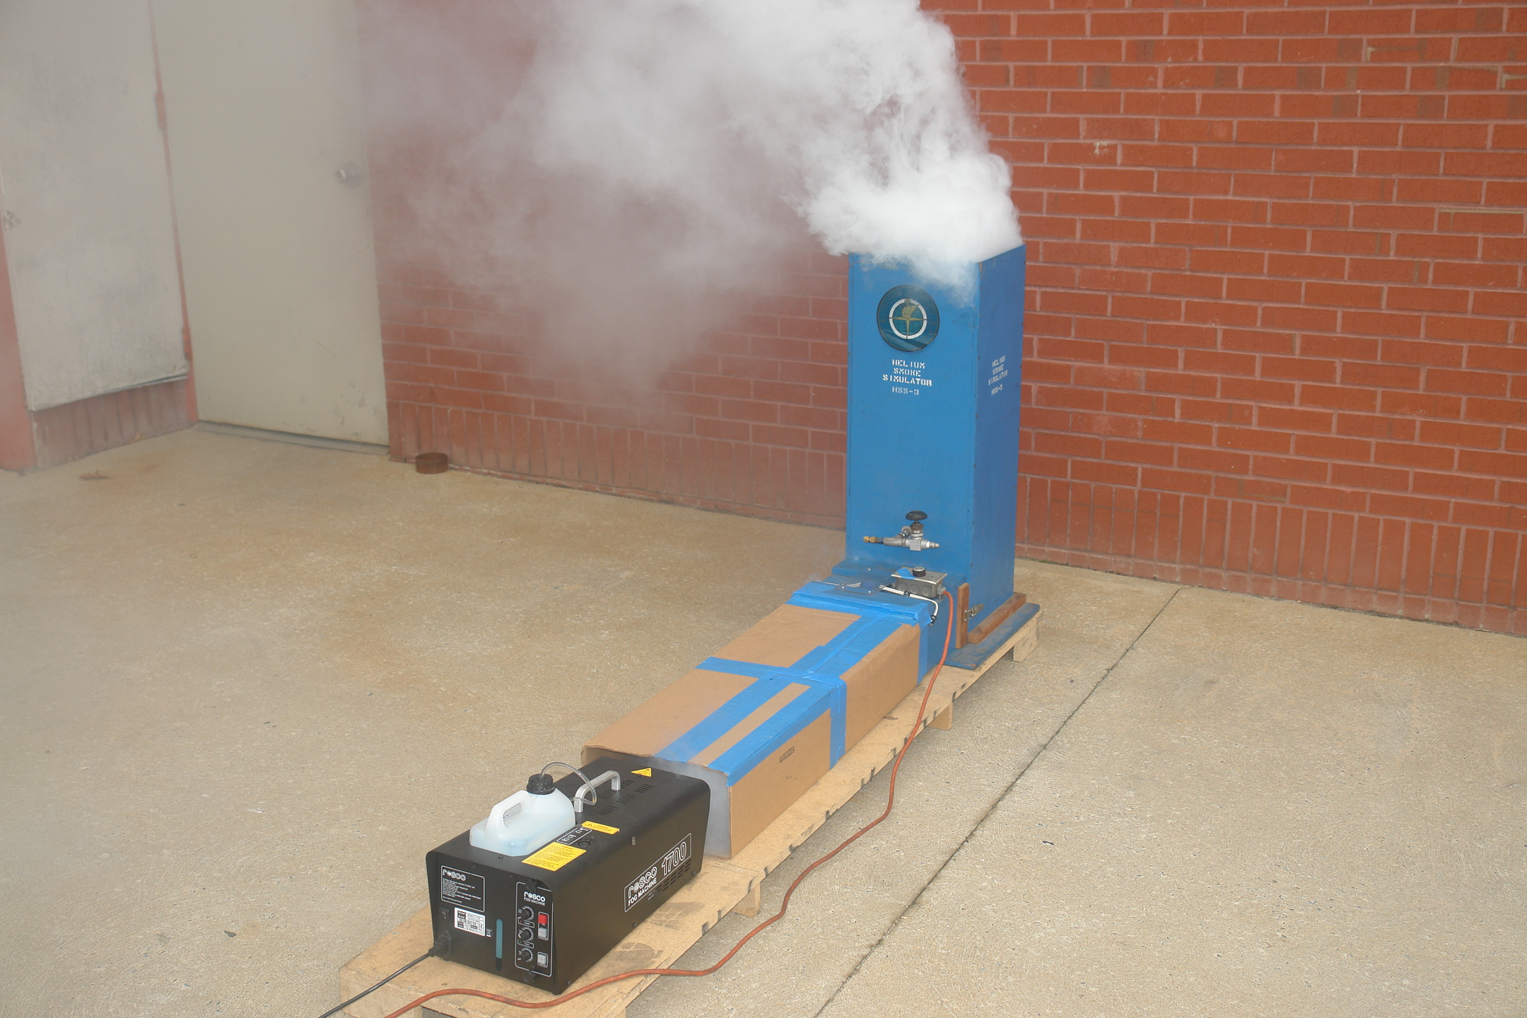

Slide 12
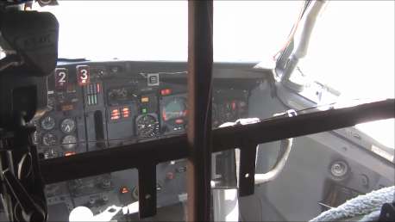
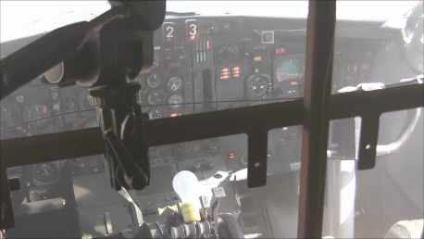
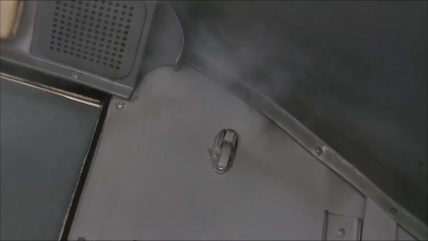
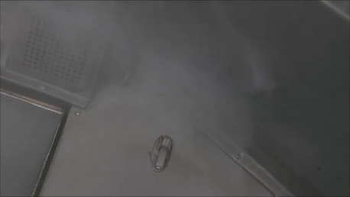
Helium on 3 Minutes
Helium on 6 Minutes
Helium on 3 Minutes
Helium on 6 Minutes

Slide 13
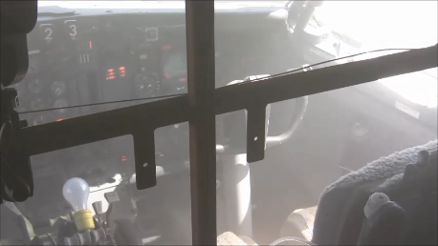
Helium on 3 Minutes
Helium on 10 Minutes
Helium on 3 Minutes
Helium on 10 Minutes

Slide 14
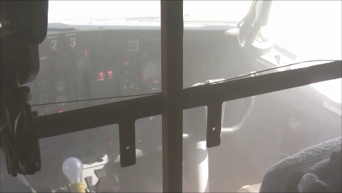
Helium on 3 Minutes
Helium on 12 Minutes
Helium on 3 Minutes
Helium on 12 Minutes

Slide 15
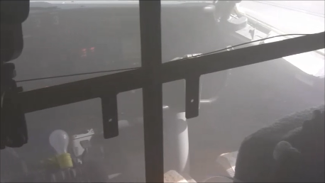
Helium on 3 Minutes
Helium on 20 Minutes
Helium on 3 Minutes
Helium on 20 Minutes

Slide 16
Interim Fire Safety 727 Testing
A repeat test is required due to the failure of recording the smoke density or reduction of light transmissibility in the flight deck for this test.
Following this test, on Sept 3, 2013, the final lithium primary battery test (test 10 of 10) resulted in an explosion in the Class C cargo/ECS compartment which blew out a 20 x 10 section of the floor out and ruptured all under floor ECS ducting.
Additionally
Flight deck bulkhead is bent and buckled
All overhead ECS ducting destroyed
Forward Cargo Compartment ceiling and rear wall destroyed
Problems applying external electrical power

Slide 17
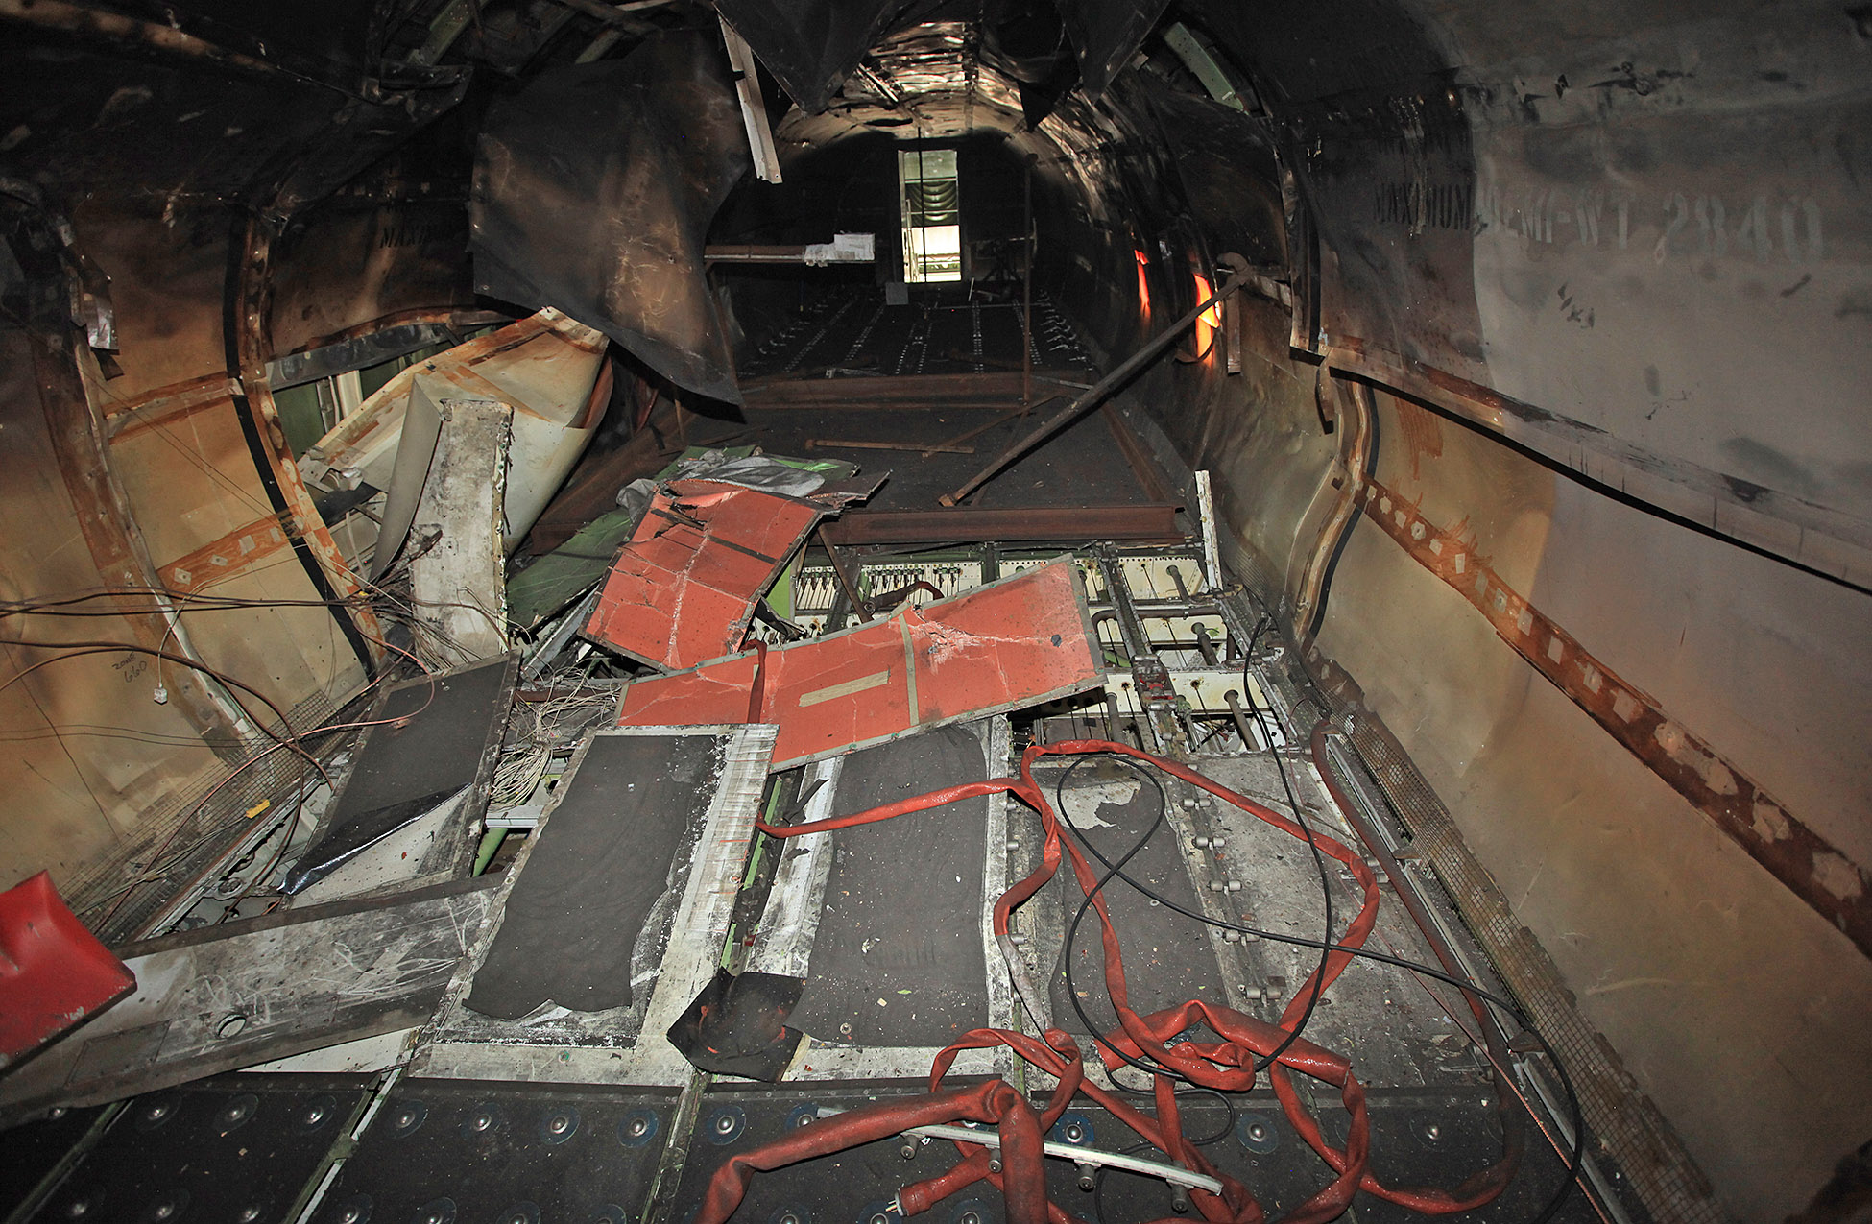

Slide 18
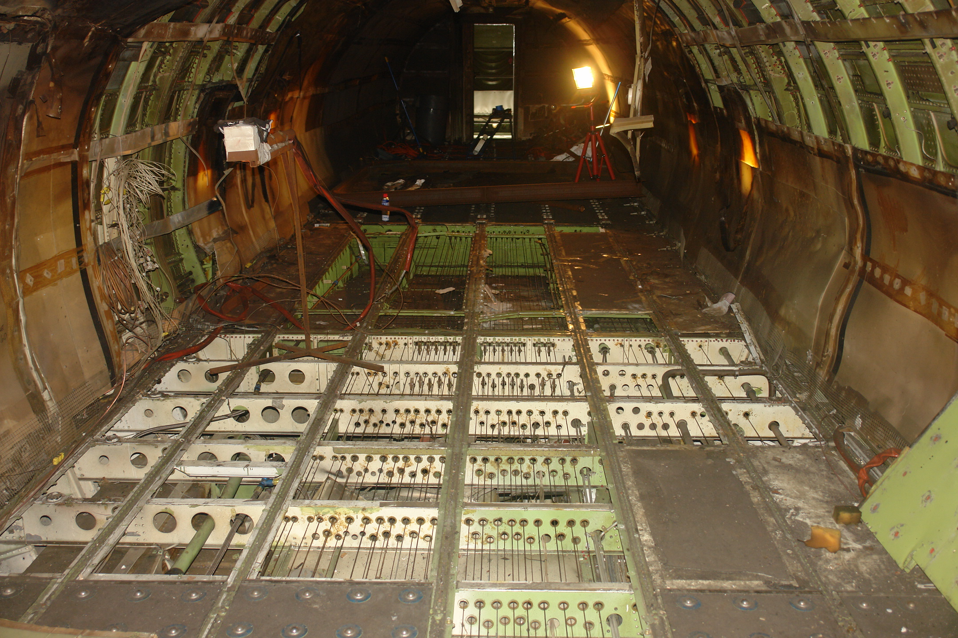

Slide 19
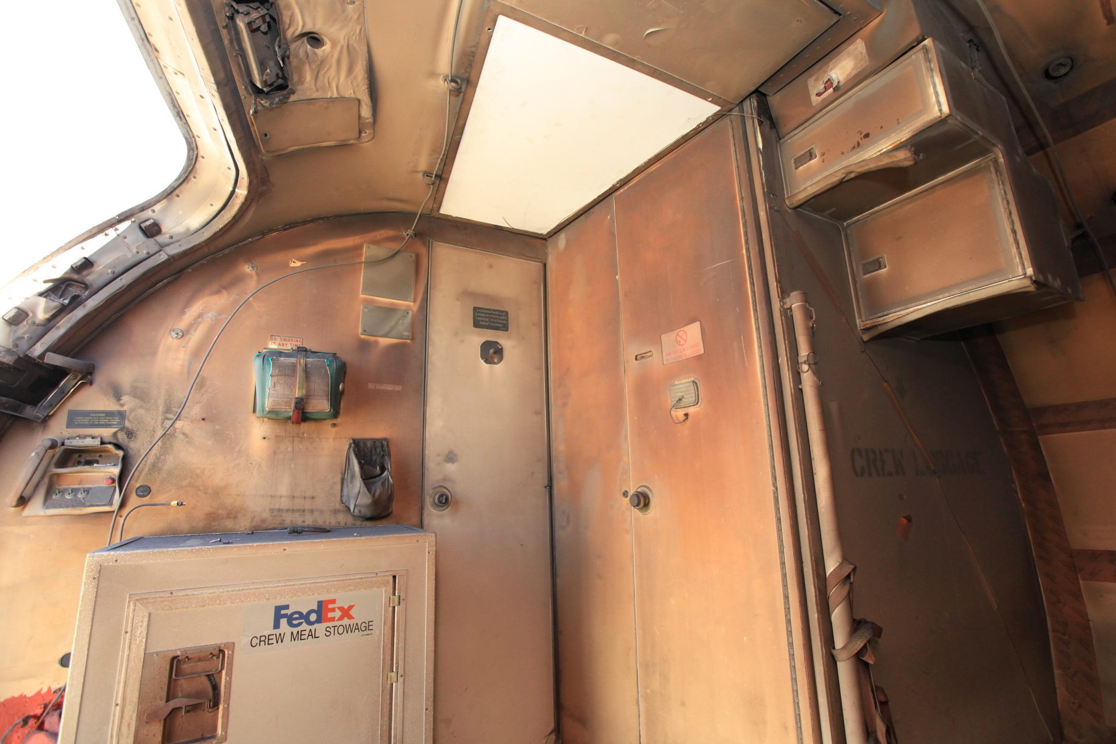

Slide 20
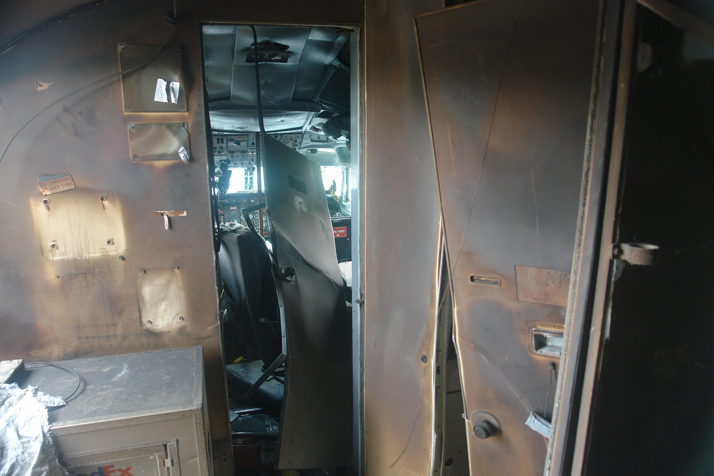

Slide 21
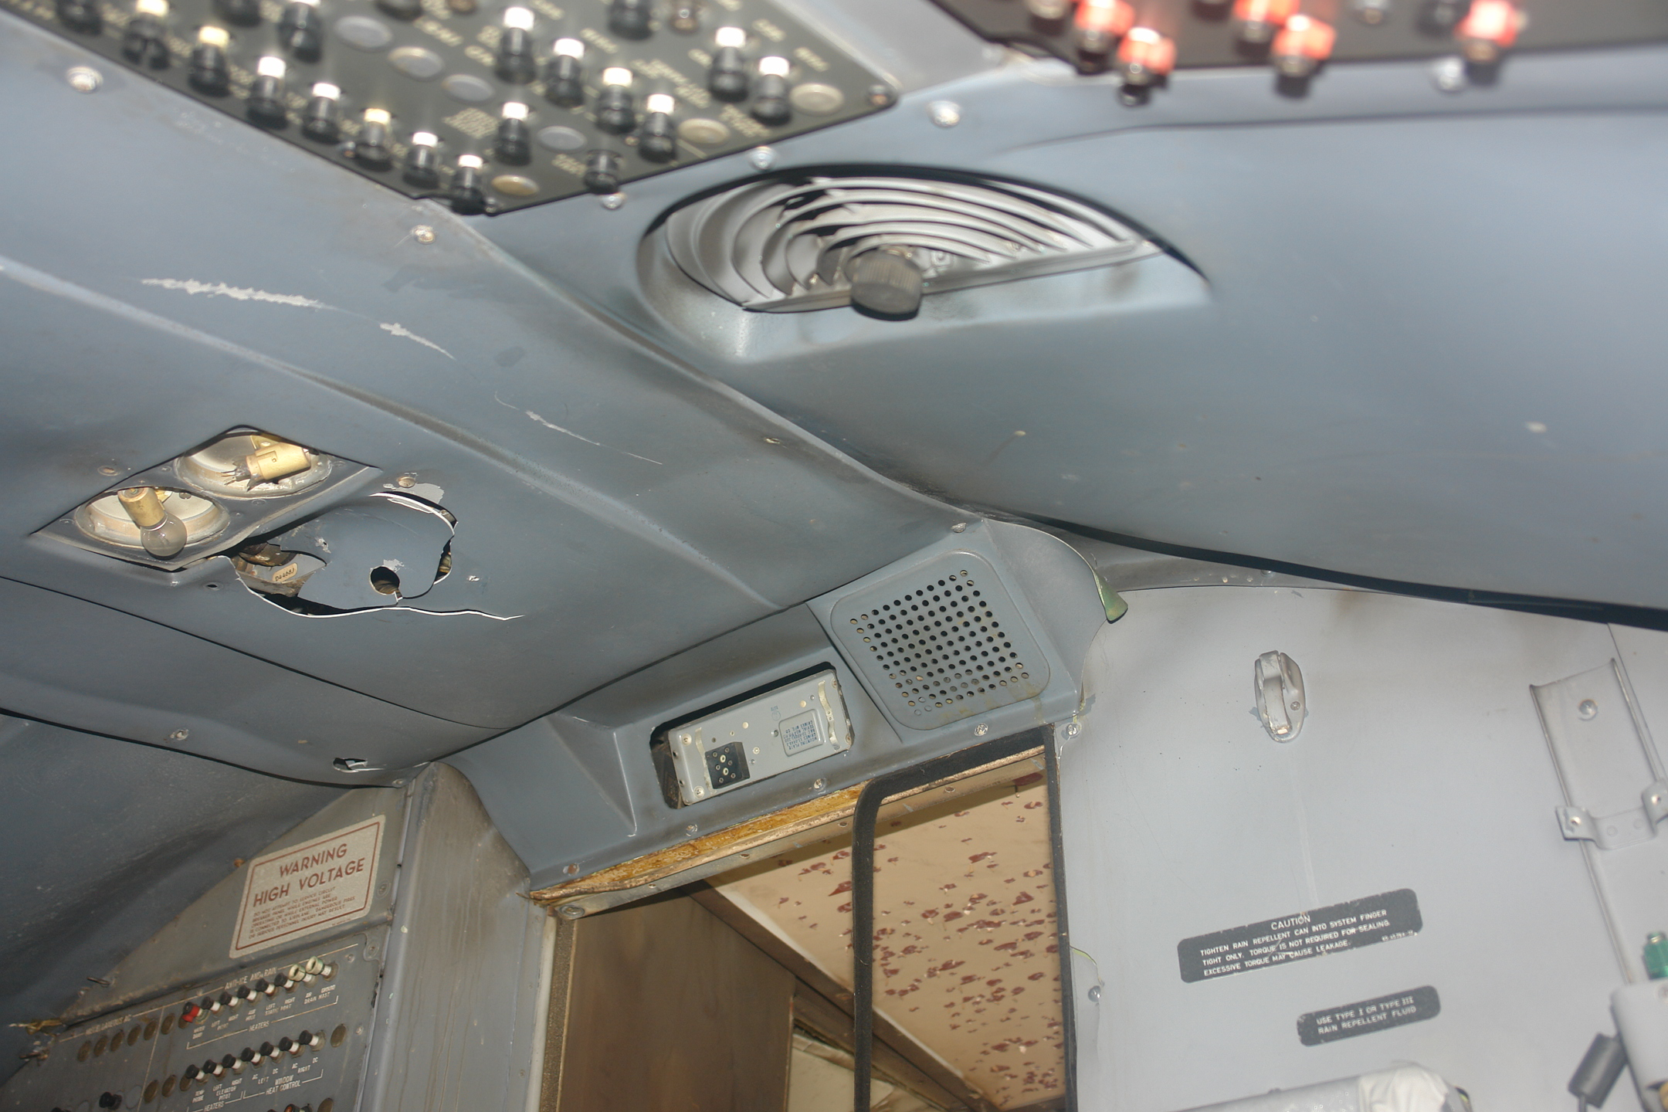

Slide 22
Planned Work
Restore Fire Safety’s 727 ECS, forward cargo, and main cargo deck areas for testing
FedEx has possible donor parts
Reaccomplish 6% oxygen smoke penetration certification test scenarios with Rosco 1700 and 3000 model theatrical smoke generators.
Measure the reduction in light transmission in the main cabin and the flight deck for both stand alone and Helium-injected Rosco theatrical smoke generators.
Discuss results with Transport Airplane Directorate before reconfiguring the 747SP for testing.
Contact Info & Questions: robert.morrison@faa.gov (609) 485-4507

