Slide 1



Formulation of Petroleum and
Alternative – Jet Fuel Surrogates
Peter S. Veloo
Exponent, Failure Analysis Associates, Los Angeles, CA
Sang Hee Won & Frederik L. Dryer
Department of Mechanical and Aerospace Engineering, Princeton University, NJ
Stephen Dooley
Department of Chemical and Environmental Sciences, University of Limerick, Ireland
The 7th International Aircraft Fire and Cabin Safety Research Conference
Philadelphia, PA
5th December 2013

Slide 2
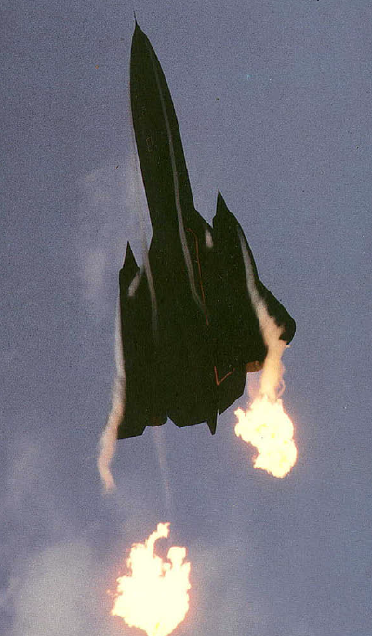
Gas Turbines and Chemical Kinetics
Coupling chemical kinetics and computational fluid mechanics for engine design
Kinetically limited processes
  Nitrogen oxide production
  Soot formation
  Flame stability
  Blow out
J Campbell, J. Chambers, Patterns in the sky: natural visualization of aircraft ﬂow ﬁelds. NASA SP-514,1994
Notes:
Why we care about chemical kinetics

Slide 3
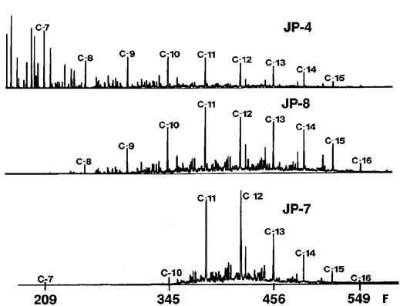
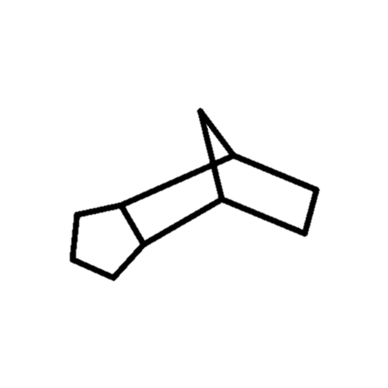
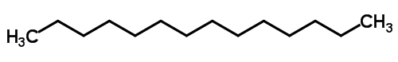
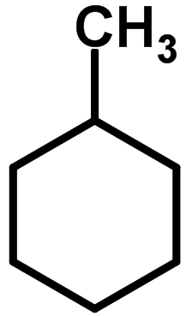
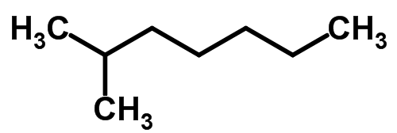
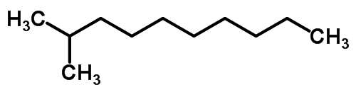
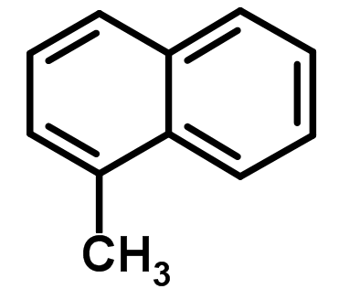
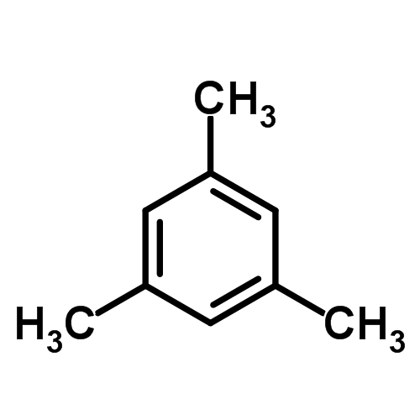
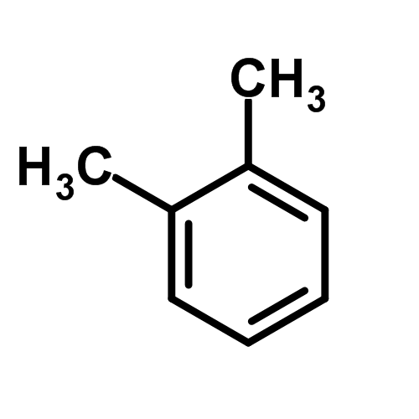
Aviation Fuels – Composition
Carbon Number Distributions
Hydrocarbon Class Distribution
JP-4
n-Parafins
Cycloparafins
JP-8
i-Parafins
JP-7
Naphthalenes
Alkylbenzenes
Distillation Temperature
T. Edwards, L.Q. Maurice, J. Propulsion Power 17 (2001)
Notes:
What is the problem I
Methylnaphtalene

Slide 4
Aviation Fuels – Fuel Variability
Fraction of delivered JP-8 fuels with specified properties
Aromatics Content
Cetane Index
Significant variability in physical and chemical properties
Current certification not highly constraining
Petroleum Quality Information System Annual Report (2009)
Notes:
What is the problem II

Slide 5
Surrogate Fuel Concept
Computational fluid dynamics coupled with detailed chemical kinetics requires a simplified fuel model
Real Fuel
Abundance
Surrogate Fuel
Distillation Temperature
Ideal surrogate fuel must emulate combustion behavior and physical properties of a target real fuel
Notes:
Introduce Concept of surrogate fuels

Slide 6
Surrogate Fuels – Previous Work
Numerous jet fuel surrogate postulations present in literature (e.g.):
  Sarofim et al. ─ Surrogate fuel to model jet fuel pool fires
  Bruno et al. ─ Surrogate fuel to model thermo-physical properties of jet fuel
Require detailed characterizations of target fuel (GC, NMR, …)
Significant uncertainty in chemical kinetics of selected surrogate compounds
Sarofim et al., Combust. Sci. Tech, 177 (2005) 715–739
T.J. Bruno et al., Ind. Eng. Chem. Res 45 (2006) 4371–4380
Notes:
Brief overview of state of surrogate modeling field/ limitations of the method

Slide 7
Surrogate Fuels – Present Approach
GOAL: Emulate gas phase combustion behavior of a target jet fuel
Notes:
Our Strategy – critical fuel property targets

Slide 8
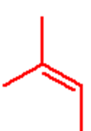
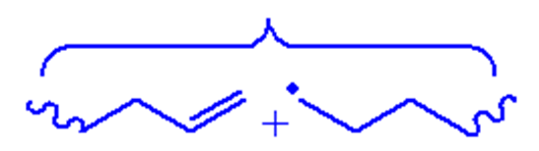
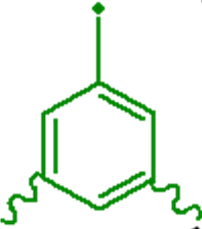
Real fuels – Many generic initial chemical functionalities
Fewer distinct chemical functionalities after initial oxidation
Surrogate fuel need only reproduce:
distinct chemical functionalities
C₄
C₃
C₂
C₁
Distinct functionalities govern radical and small species concentrations
CH₃O C₂H₅ C₂H₃ CH₃O₂
CH₃ HCO HO₂
H O OH
Notes:
Theory of Our Particular Methodology and Why it works

Slide 9
Surrogate Fuels – Present Approach
GOAL: Emulate gas phase combustion behavior of a target jet fuel
Identified critical combustion property targets:
  Adiabatic flame temperature
  Enthalpy of combustion
  Flame speed / burning rate
  Fuel diffusive properties
  Sooting propensity
  Auto-ignition
Manifest in important practical combustion behavior
Surrogate fuel must emulate critical fuel properties of target real fuel

Slide 10
Surrogate Fuels – Present Approach
Quantify critical fuel property targets:
  Adiabatic flame temperature
  Enthalpy of combustion
  Flame speed / burning rate
  Fuel diffusive properties
  Sooting propensity
  Auto-ignition
The ratio of hydrogen to carbon (H/C)
-CHN analysis (ASTM D5291)
Average molecular weight (MW_{avg})
Smoke point measurement (ASTM D1322)
Derived cetane number (ASTM D6890)
Notes:
Our Strategy – critical fuel property targets

Slide 11
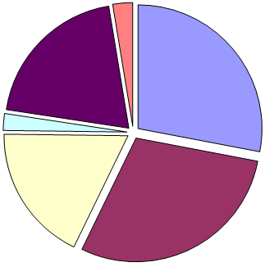
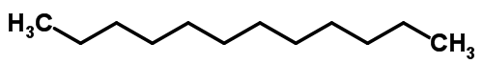
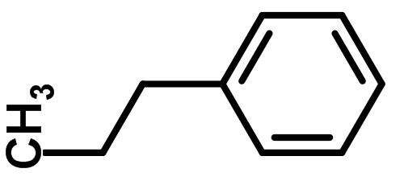
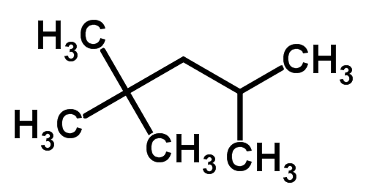

Case Study 1 – Fuel Surrogate for Jet A
n-Alkanes
28%
Selected Surrogate Fuel
Components
cyclo-Alkanes
20%
n-Dodecane
Naphthlenes
2%
iso-Octane
n-Propylbenzene
Alkylbenzenes
18%
iso-Alkanes
29%
1,3,5-Trimethylbenzene
Dooley et al., Combust Flame (2010) 157:2333-2339
Dooley et al., Combust Flame (2012) 159: 1444-4466
Notes:
CASE STUDY I – Formulating a surrogate for a typical Jet A – overview of composition and selection of surrogate compounds

Slide 12

Surrogate Fuel Formulation Algorithm
Characterize target Jet A
H/C
Cetane number
Smoke point
Average molecular weight
Characterize target Jet A
Characterize surrogate components and their mixtures
Develop library of target measurements for individual and mixtures of surrogate components
Emulate H/C, DCN, TSI, MWavg
Regression analysis to determine surrogate composition
Compare gas phase combustion characteristics between surrogate and target
Experimental observations
Intermediate species profiles
Flame speeds / extinction limits
Soot volume fraction
Ignition delay times
Notes:
Algorithm for generating surrogate mixture

Slide 13
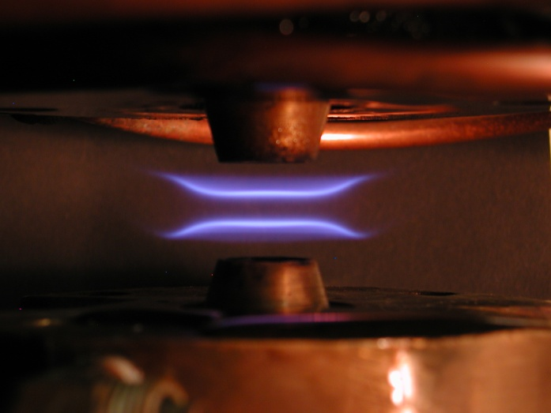
Surrogate Fuel Compared with Real Jet-A Fuel
Laminar Flame Speeds
p = 1 atm, T_{u} =400 K
Laminar Flame Speed, cm/s
❐ - Jet A
❒ - Surrogate
Equivalence Ratio, φ
Dooley et al., Combust Flame (2010) 157:2333-2339
Dooley et al., Combust Flame (2012) 159: 1444-4466
Notes:
Brief overview of experimental validation – all avenues

Slide 14
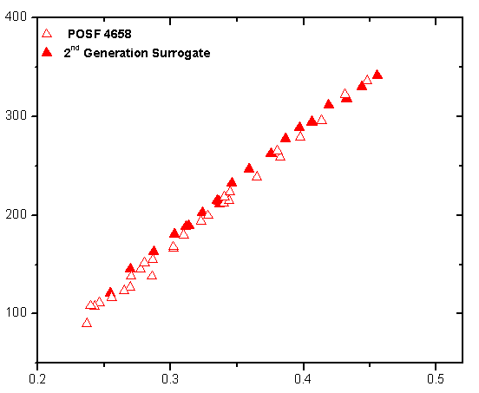
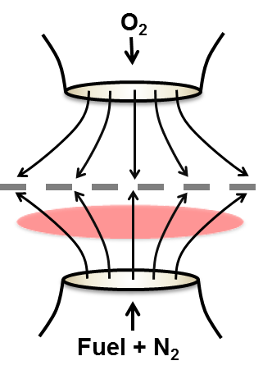
Surrogate Fuel Compared with Real Jet-A Fuel
Extinction Limits
❐ - Jet A
❒ - Surrogate
Extinction Strain Rate, s⁻¹
Fuel Mass Fraction, X_{Y}
Dooley et al., Combust Flame (2010) 157:2333-2339
Dooley et al., Combust Flame (2012) 159: 1444-4466
Notes:
What the counterflow configuration allows us to validate (laminar flame velocities, flame extinction (premixed, diffusion flames), flame ignition (premixed, diffusion, partial premixed))

Slide 15
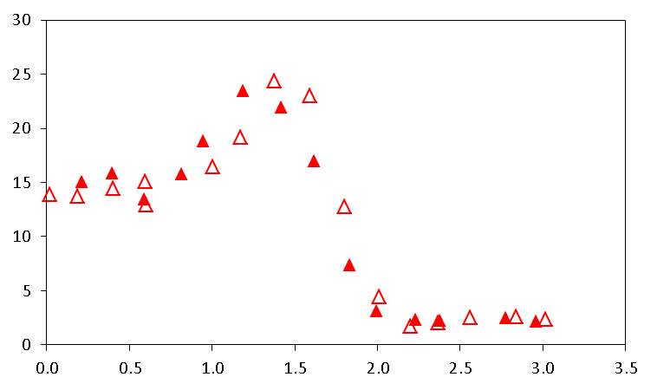
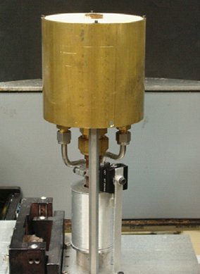
Surrogate Fuel Compared with Real Jet-A Fuel
Soot Volume Fraction
❐ - Jet A
❒ - Surrogate
Soot Volume Fraction (ppm)
Radial Location (mm)
Dooley et al., Combust Flame (2010) 157:2333-2339
Dooley et al., Combust Flame (2012) 159: 1444-4466
Notes:
Back to case study 1 – results of Surrogate fuel vs Real fuel – flame speeds and detailed speciation

Slide 16
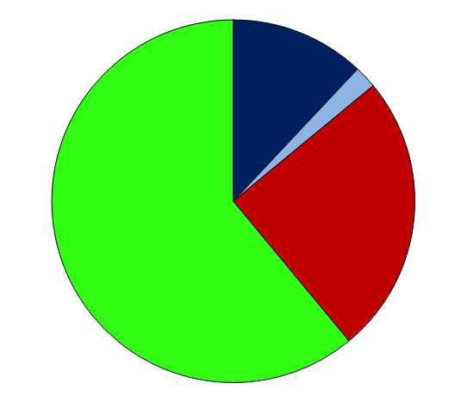
Case Study 2 – Fuel Surrogate for S-8
Selected Surrogate Fuel
Components
Normal-Alkanes
12%
Mono-methylated
Alkanes
61%
n-Dodecane
Di-methylated
Alkanes
25%
iso-Octane
Dooley et al., Combust Flame (2012) 159: 3014-3020
Notes:
CASE STUDY II – alternative aviation fuel

Slide 17
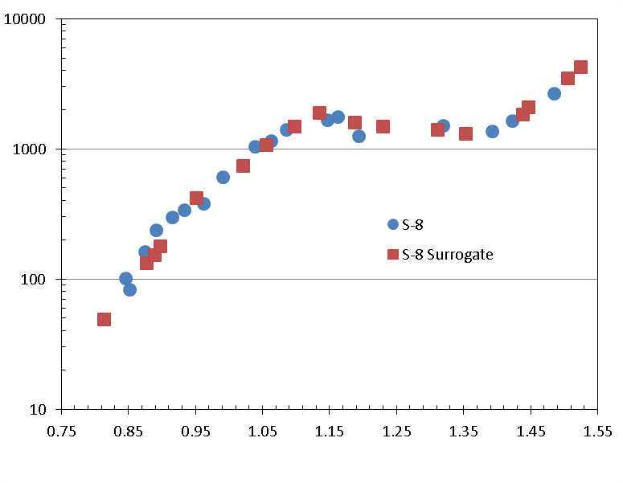
Surrogate Fuel Compared with Real S-8
Shock tube ignition delay times
Ignition Delay Time
1000K/T
Dooley et al., Combust Flame (2012) 159: 3014-3020
Notes:
Identify the problem – pyrolysis products from polymers – how to model? – select set of compounds that represent the same functional groups present during the pyrolysis of the polymer
Show some pictures identifying products what do we understand well?????

Slide 18
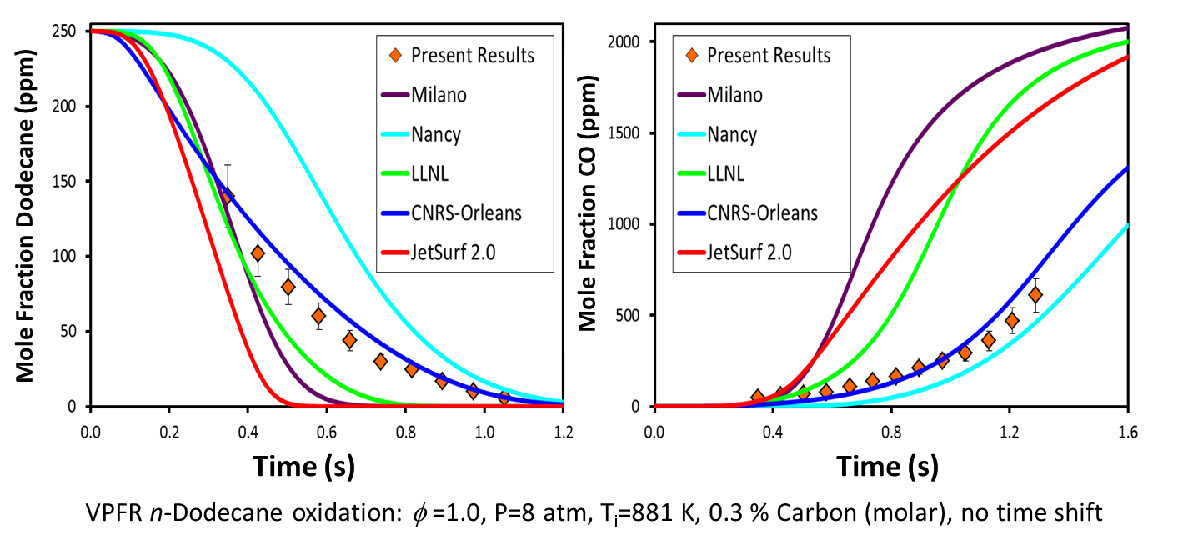
Chemical Kinetic Modeling
Large spread in predictions using latest chemical kinetic reaction models for surrogate components
  Lack of consensus within kinetic modeling community

Slide 19
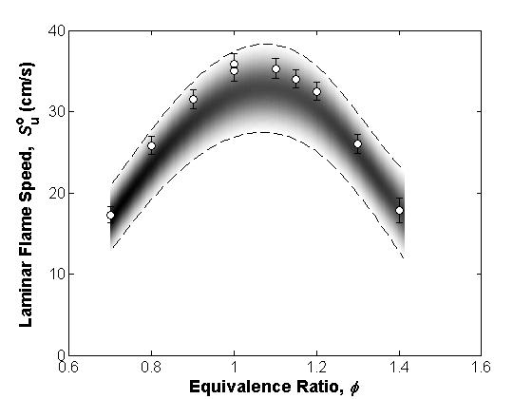
Uncertainties in Numerical Calculations
Propagation of uncertainties from rate parameters to numerical simulations
Numerical
Uncertainty

Slide 20
Concluding Remarks
Demonstrated surrogate fuel methodology to capture gas phase combustion behavior of aviation fuels
Reaction model rate parameter uncertainties require further reduction
Application of surrogate concept to polymer combustion
  Determine surrogates that represent functionalities present in gas phase pyrolysis products
Notes:
Concluding Remarks

