Slide 1
Flaming Combustion Calorimetry:
A New Tool for Flammability Assessment of Mg-scale Pyrolyzable Solid Samples
Fernando Raffan, Xi Ding, Stanislav Stoliarov
University of Maryland, College Park
Roland Kraemer
BASF

Slide 2
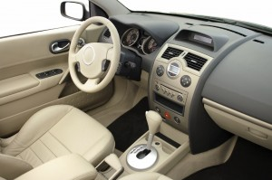

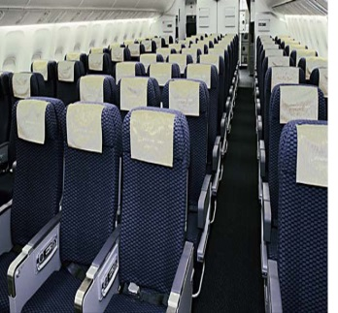
Brominated Flame Retardants
Introduction
Brominated Flame Retardants
Current Test Methods
Objectives of Current Work
Development of FCC
Design and Capabilities
Diagnostics
Parametric Testing and
Operating Conditions
Test Matrix
Data Analysis
Experimental Results
Polystyrene and Bromine
PBT and Al-DEP
Flame Temperatures
Conclusions and Future Work
Brominated flame retardants (BFRs) are widespread in their use due to their relative low cost/high performance
Recently, BFRs have been found to accumulate in human tissues and persist in the environment^{1,2}. Industry is moving towards suitable replacements
Understanding mechanisms of BFRs as gas phase combustion inhibitors can guide the research community towards a suitable replacement
A small scale screening tool for BFR replacements is highly desirable as it will considerably drive down costs during product development
1. http://www.epa.gov/oppt/existingchemicals/pubs/actionplans/pbde.html
2. http://www.nist.gov/el/fire_research/upload/1-Axelrad.pdf

Slide 3
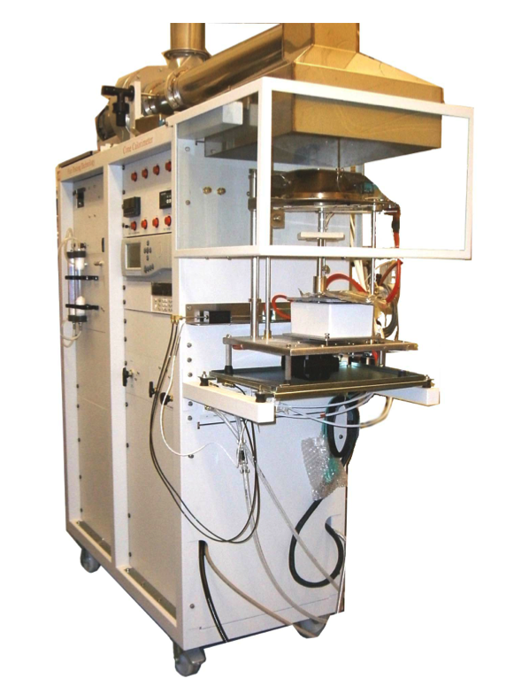
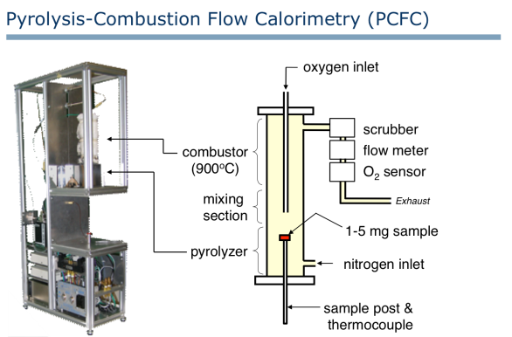
Current Test Methods
Cone Calorimetry
  Commonly used in fire testing
  Laminar-Transitional Diffusion flames
  Controlled incident heat flux
  Requires samples on the order of grams (expensive for new materials)
Micro Combustion Calorimetry (MCC)
  Laminar premixed reactor (no flame, complete combustion by design)
  Controlled pyrolysis (constant heating rate)
  Milligram sized samples

Slide 4
Objective of Current Work
Design and implement an apparatus that can study the flaming combustion of milligram scale solid samples in a well-controlled fashion
Correlate the measured gas-phase combustion efficiency with MCC and cone calorimetry results
Develop steps towards measurement of flame temperatures in polymers with/without flame retardants
The FCC
Flaming Combustion Calorimeter

Slide 5
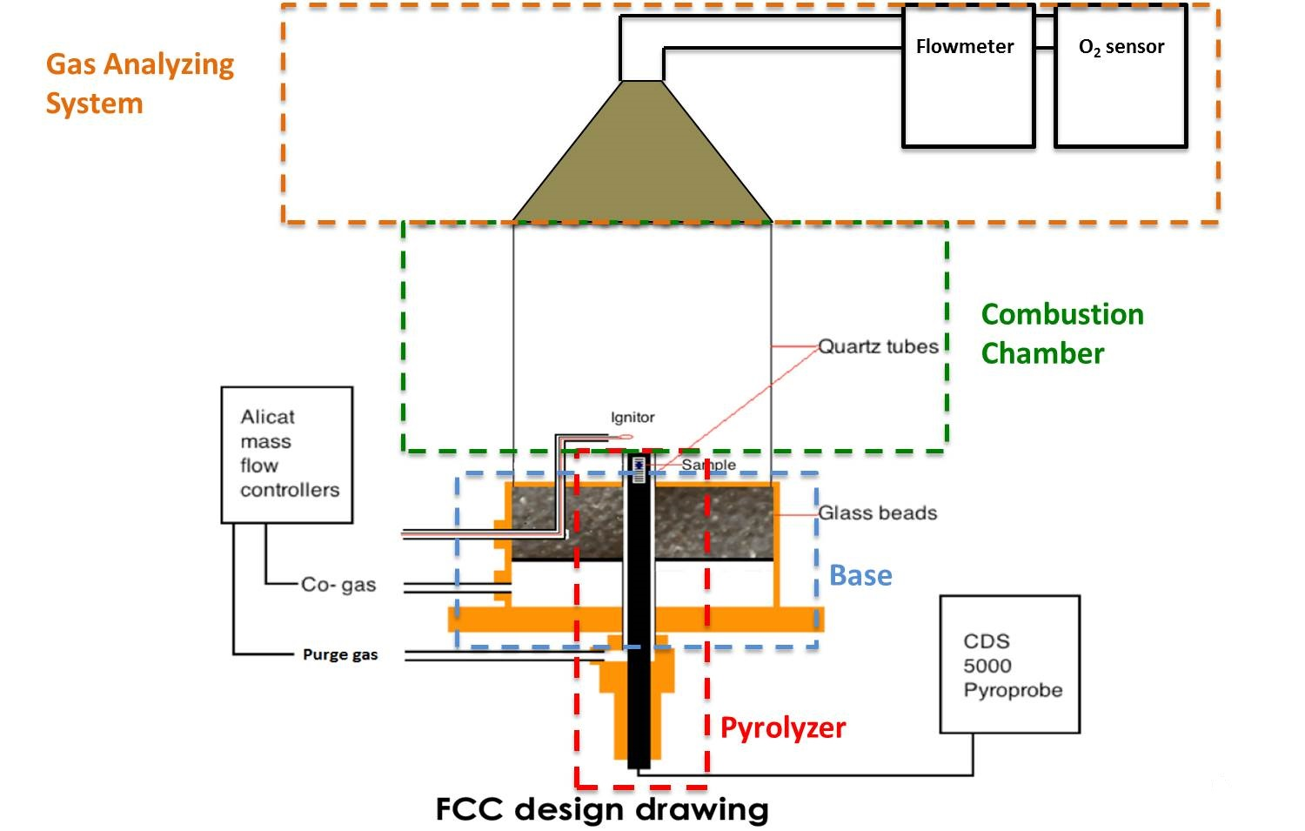
Design and Capabilities
Introduction
Brominated Flame Retardants
Current Test Methods
Objectives of Current Work
Development of FCC
Design and Capabilities
Diagnostics
Parametric Testing and
Operating Conditions
Test Matrix
Data Analysis
Experimental Results
Polystyrene and Bromine
PBT and Al-DEP
Flame Temperatures
Conclusions and Future Work

Slide 6
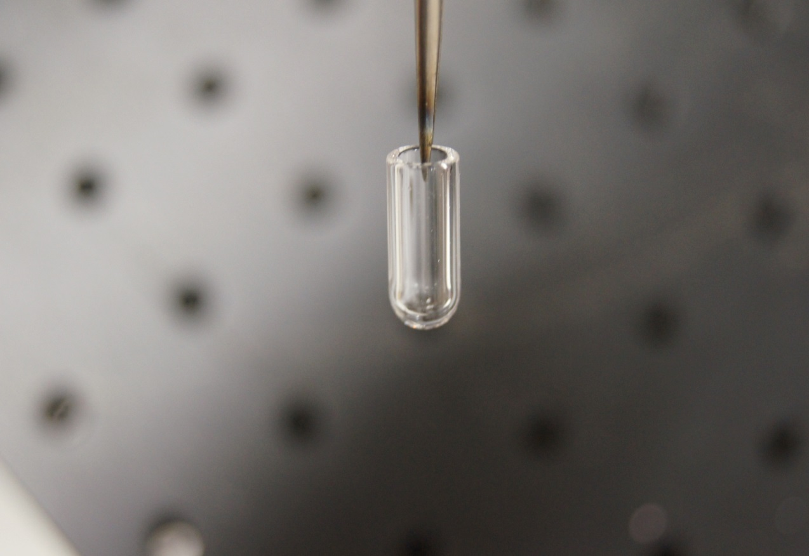
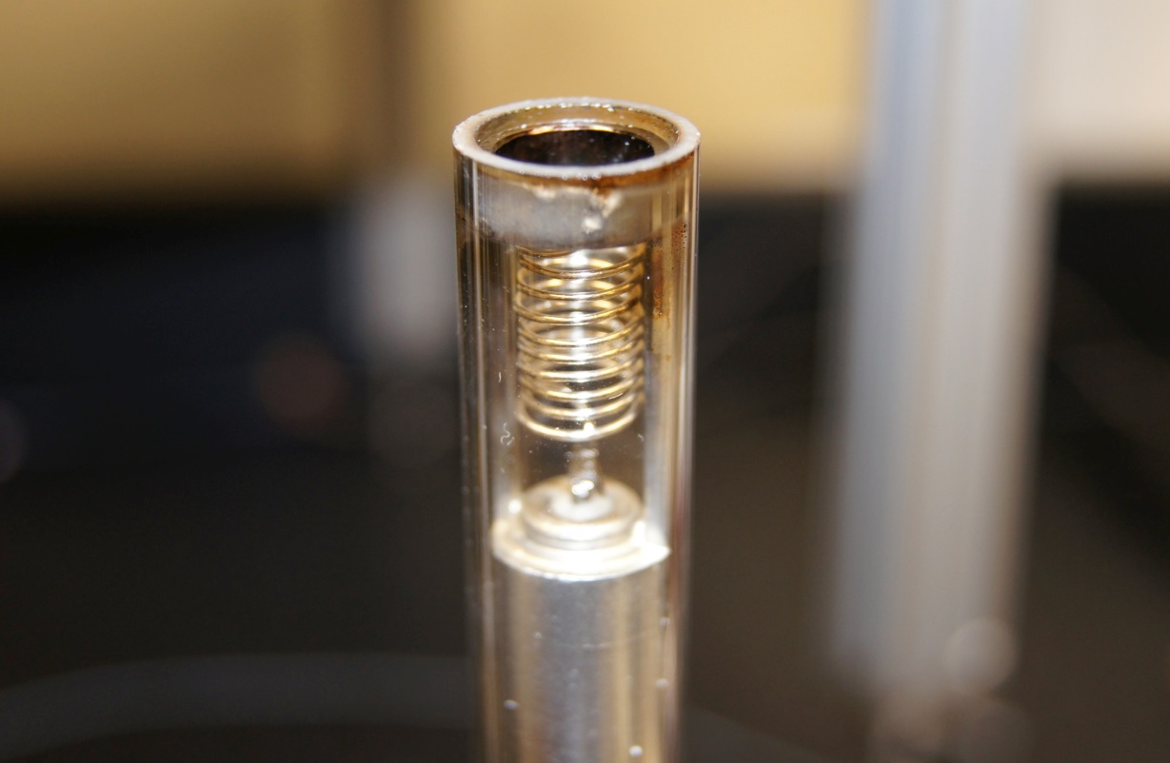
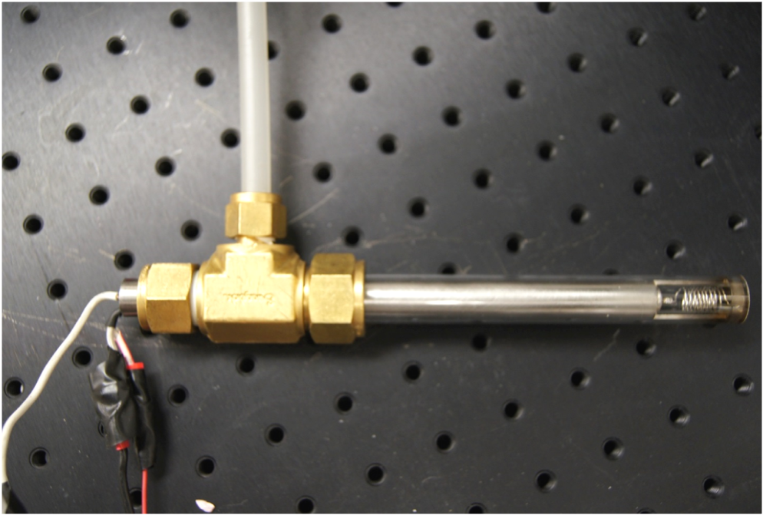
Pyrolyzer
Quartz tube
Sample tube
Purge gas
CDS 5000
Pyro-probe

Slide 7
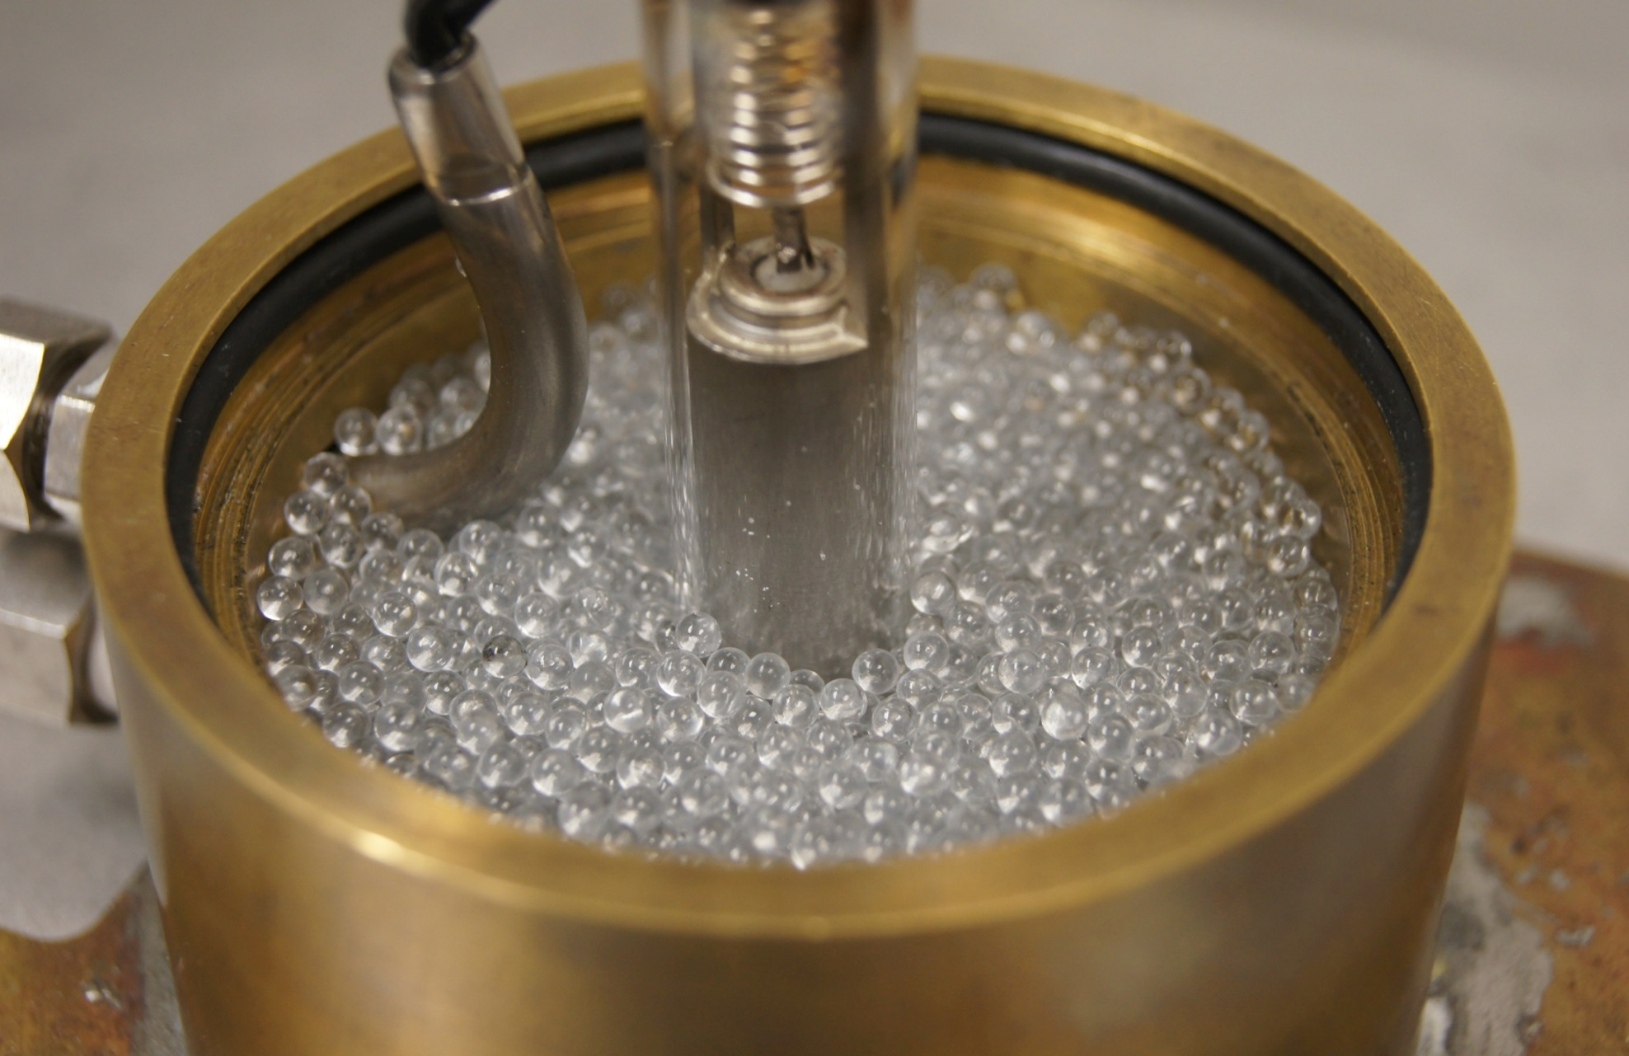
Base
Insert coflow and igniter hardware
Homogenize coflow
Seal assembly

Slide 8
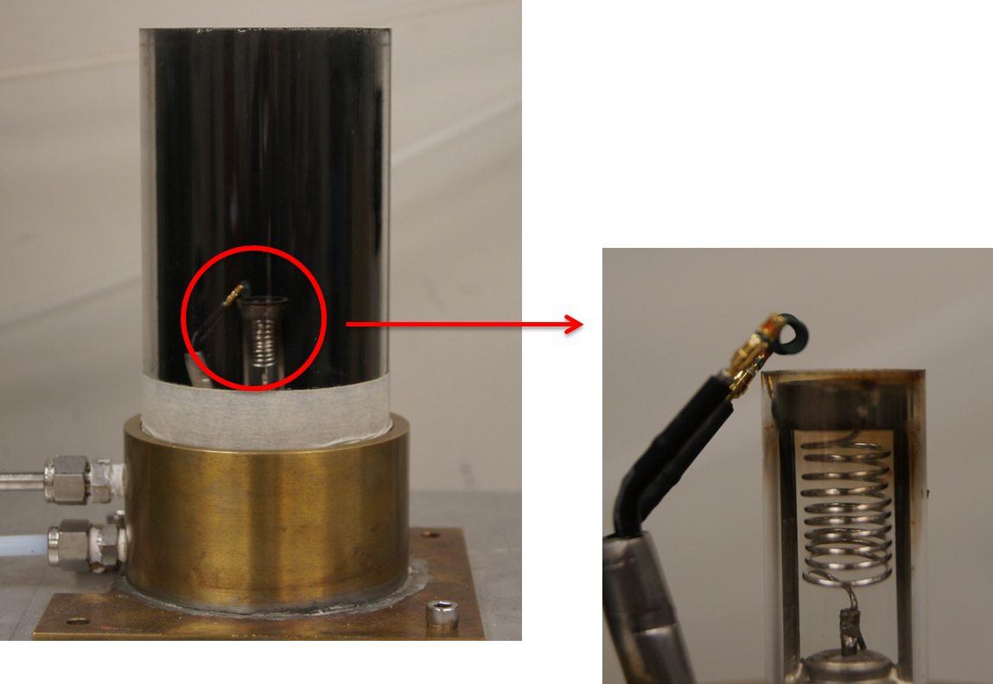
Combustion Chamber
Enclose combustion process
Provide optical access to the flame for gaining information like flame height, flame structure, combustion time

Slide 9
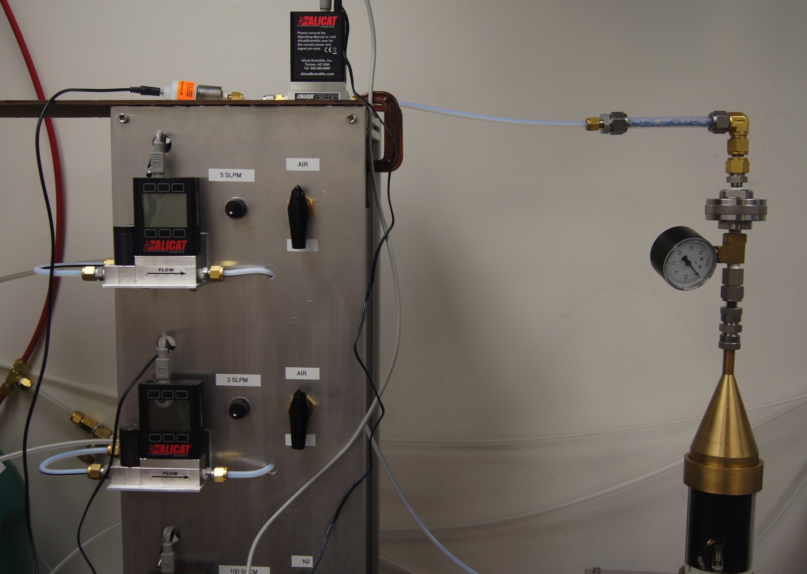
Gas Analyzing System
O₂ sensor
Drierite
Flow meter
Soot filter
Pressure gauge
Hood

Slide 10
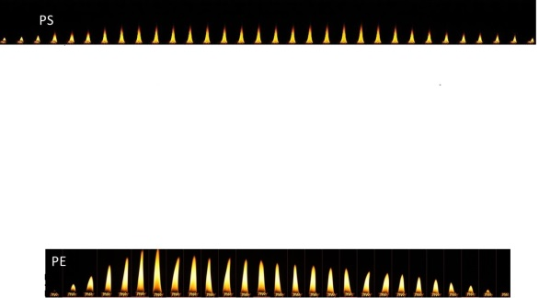
Capabilities
Introduction
Brominated Flame Retardants
Current Test Methods
Objectives of Current Work
Development of FCC
Design and Capabilities
Diagnostics
Parametric Testing and
Operating Conditions
Test Matrix
Data Analysis
Experimental Results
Polystyrene and Bromine
PBT and Al-DEP
Flame Temperatures
Conclusions and Future Work
Co-flow | 0 - 6.32 SLPM
O₂ % in co-flow | 0-100%
Purge gas | 0-100 SCCM
Heating rate | 0-32 K/s

Slide 11
Diagnostics
Introduction
Brominated Flame Retardants
Current Test Methods
Objectives of Current Work
Development of FCC
Design and Capabilities
Diagnostics
Parametric Testing and
Operating Conditions
Test Matrix
Data Analysis
Experimental Results
Polystyrene and Bromine
PBT and Al-DEP
Flame Temperatures
Conclusions and Future Work
O₂ consumption calorimetry
  Heat Release Rate
  Combustion Efficiency
  Soot Yield
2 color ratio pyrometry
  Flame Temperatures

Slide 12
O₂ consumption calorimetry
Huggett’s empirical observation: for most fuels, a more or less constant net amount of heat is released per unit mass of oxygen consumed for complete combustion. This constant is
  E = 13.1 + 0.6 kJ/g-O₂

Slide 13
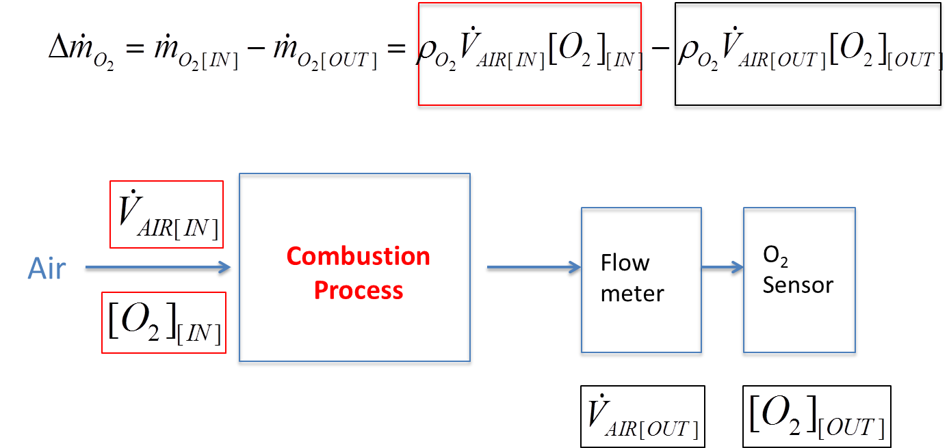
O₂ consumption calorimetry
Method 1: V_{AIR[IN]} = constant, [O₂]_{[IN]} = constant
Method 2: V_{AIR[IN]} = V_{AIR[out],} [O₂]_{[IN]} = constant

Slide 14
Introduction
Brominated Flame Retardants
Current Test Methods
Objectives of Current Work
Development of FCC
Design and Capabilities
Diagnostics
Parametric Testing and
Operating Conditions
Test Matrix
Data Analysis
Experimental Results
Polystyrene and Bromine
PBT and Al-DEP
Flame Temperatures
Conclusions and Future Work
Co-Flow Tests
Atmosphere composition tests
Heating Rate tests
Purge gas flowrate tests
Co-flow | 4 SLPM
O₂ inlet concentration | 20-21% (Air)
Heating rate | 10 K/s
Purge gas (N₂) | 100 SCCM
Operating Conditions

Slide 15
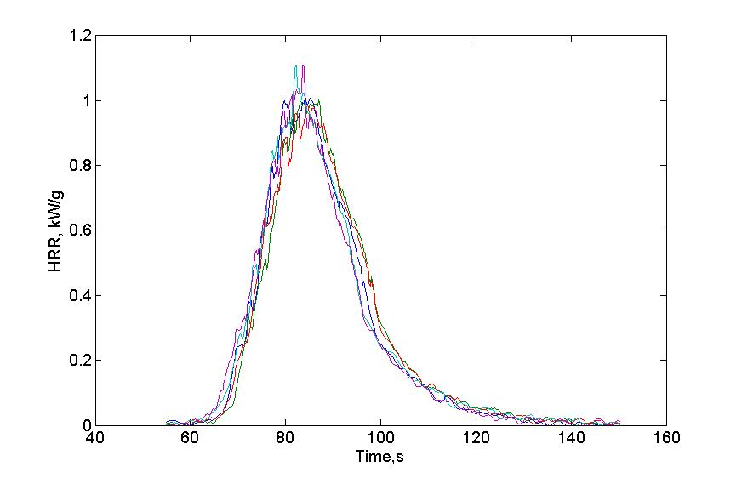
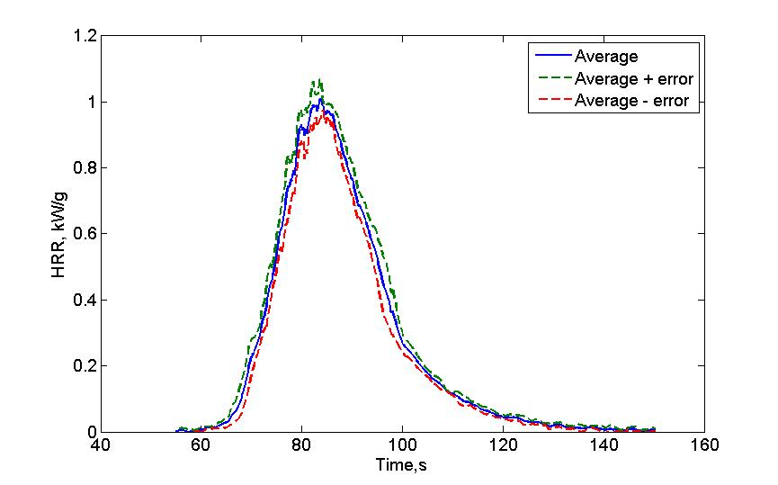
Repeatability
Introduction
Brominated Flame Retardants
Current Test Methods
Objectives of Current Work
Development of FCC
Design and Capabilities
Diagnostics
Parametric Testing and
Operating Conditions
Test Matrix
Data Analysis
Experimental Results
Polystyrene and Bromine
PBT and Al-DEP
Flame Temperatures
Conclusions and Future Work
5 PMMA Tests

Slide 16
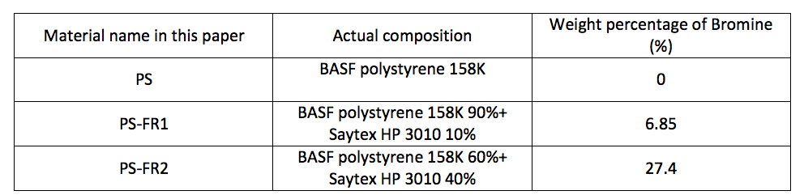
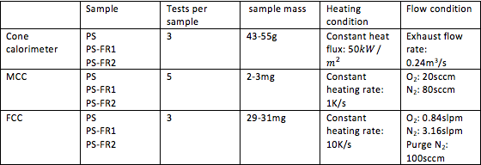
Polystyrene Family
Introduction
Brominated Flame Retardants
Current Test Methods
Objectives of Current Work
Development of FCC
Design and Capabilities
Diagnostics
Parametric Testing and
Operating Conditions
Test Matrix
Data Analysis
Experimental Results
Polystyrene and Bromine
PBT and Al-DEP
Flame Temperatures
Conclusions and Future Work

Slide 17
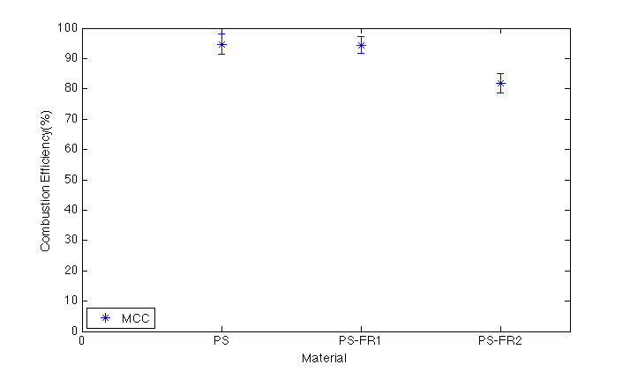
Results
Introduction
Brominated Flame Retardants
Current Test Methods
Objectives of Current Work
Development of FCC
Design and Capabilities
Diagnostics
Parametric Testing and
Operating Conditions
Test Matrix
Data Analysis
Experimental Results
Polystyrene and Bromine
PBT and Al-DEP
Flame Temperatures
Conclusions and Future Work
CE = measured O₂ consumption / theoretical O₂ consumption
(assuming complete combustion)

Slide 18
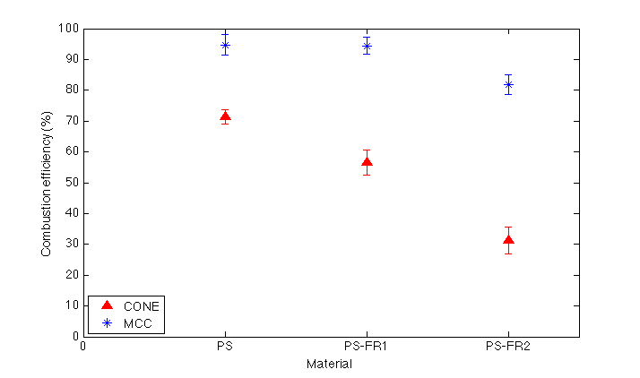
Results
Introduction
Brominated Flame Retardants
Current Test Methods
Objectives of Current Work
Development of FCC
Design and Capabilities
Diagnostics
Parametric Testing and
Operating Conditions
Test Matrix
Data Analysis
Experimental Results
Polystyrene and Bromine
PBT and Al-DEP
Flame Temperatures
Conclusions and Future Work

Slide 19
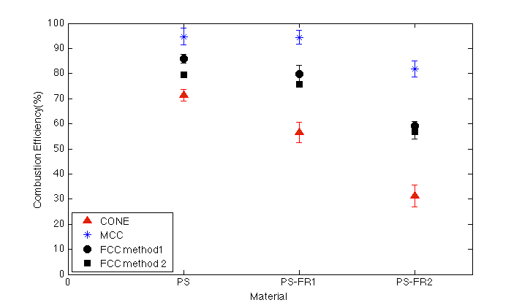
Results
Introduction
Brominated Flame Retardants
Current Test Methods
Objectives of Current Work
Development of FCC
Design and Capabilities
Diagnostics
Parametric Testing and
Operating Conditions
Test Matrix
Data Analysis
Experimental Results
Polystyrene and Bromine
PBT and Al-DEP
Flame Temperatures
Conclusions and Future Work
0.85
0.79
0.79
0.75
0.59
0.56

Slide 20
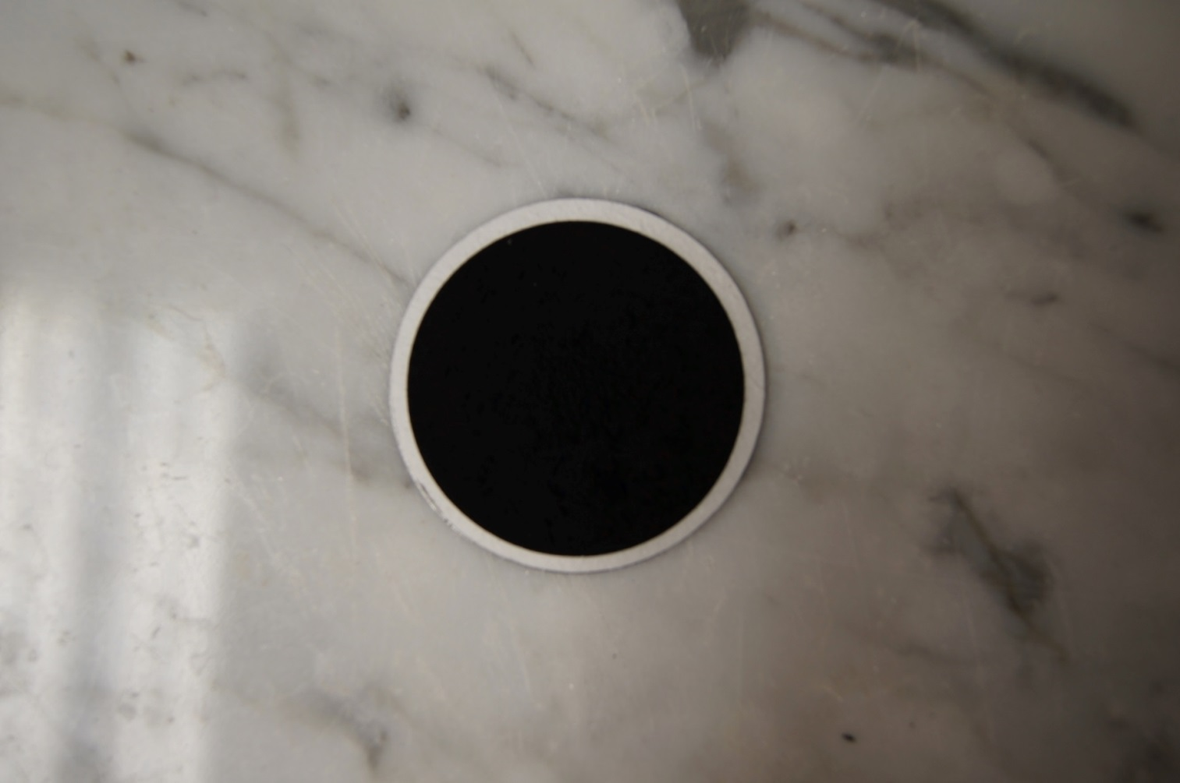
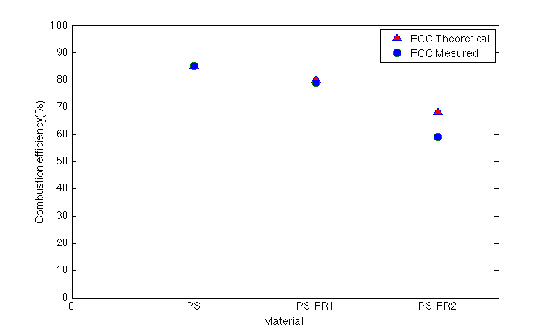
Analysis of FCC data
Introduction
Brominated Flame Retardants
Current Test Methods
Objectives of Current Work
Development of FCC
Design and Capabilities
Diagnostics
Parametric Testing and
Operating Conditions
Test Matrix
Data Analysis
Experimental Results
Polystyrene and Bromine
PBT and Al-DEP
Flame Temperatures
Conclusions and Future Work
FCC Theoretical
FCC Measured

Slide 21
Analysis of FCC data
For PS-FR2 ( 27.4 wt.% Br)
32%
Formation of soot
Gas phase combustion incompleteness:
43%
CO. yld (wt.%): 39.3%
Formation of CO and/or other incomplete combustion products
11%

Slide 22
Phosphorated flame retardants
Introduction
Brominated Flame Retardants
Current Test Methods
Objectives of Current Work
Development of FCC
Design and Capabilities
Diagnostics
Parametric Testing and
Operating Conditions
Test Matrix
Data Analysis
Experimental Results
Polystyrene and Bromine
PBT and Al-DEP
Flame Temperatures
Conclusions and Future Work
We have also studied a family of PBT with the addition of diethylphosphinate Al (Al-DEP) as flame retardant
PBT | 75% PBT 25% Glass
PBT-2 | 63% PBT 12% Al-DEP 25% Glass
PBT-3 | 55% PBT, 20% Al-DEP 25% Glass

Slide 23
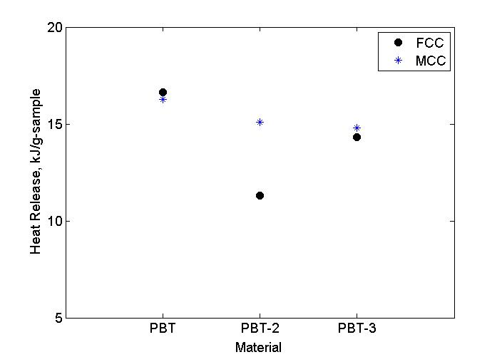
PBT
Introduction
Brominated Flame Retardants
Current Test Methods
Objectives of Current Work
Development of FCC
Design and Capabilities
Diagnostics
Parametric Testing and
Operating Conditions
Test Matrix
Data Analysis
Experimental Results
Polystyrene and Bromine
PBT and Al-DEP
Flame Temperatures
Conclusions and Future Work

Slide 24
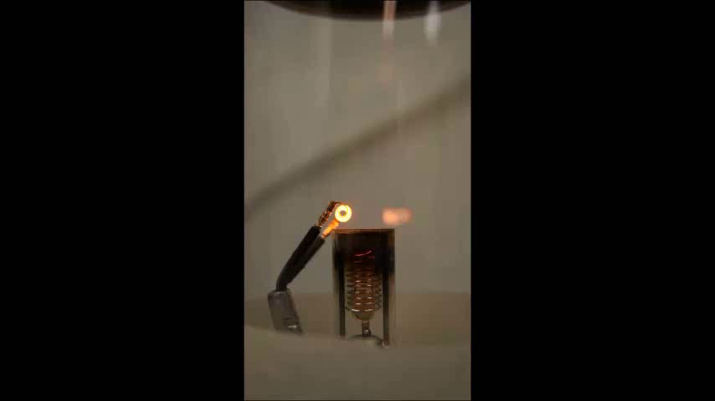
Flame Destabilization
Baseline PBT (no flame retardant)

Slide 25
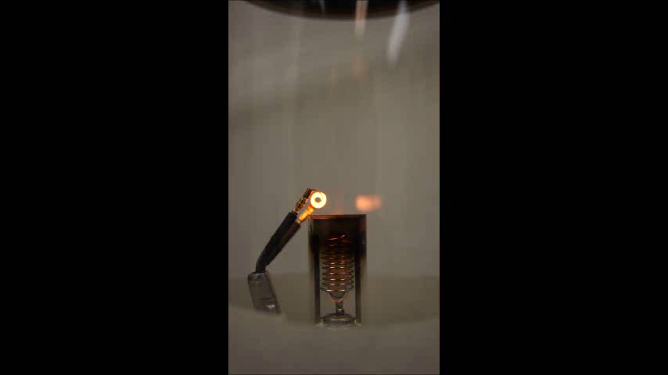
Flame Destabilization
63% PBT, 12% Al-DEP

Slide 26
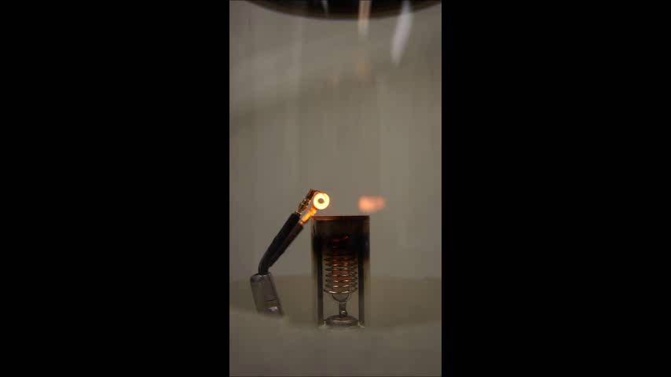
Flame Destabilization
63% PBT, 12% Al-DEP

Slide 27
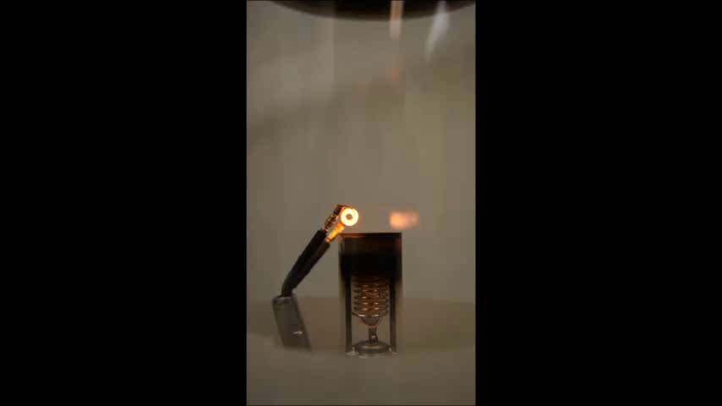
Flame Destabilization
55% PBT, 20% Al-DEP

Slide 28
Flame Temperatures
Introduction
Brominated Flame Retardants
Current Test Methods
Objectives of Current Work
Development of FCC
Design and Capabilities
Diagnostics
Parametric Testing and
Operating Conditions
Test Matrix
Data Analysis
Experimental Results
Polystyrene and Bromine
PBT and Al-DEP
Flame Temperatures
Conclusions and Future Work
In a fire, flame temperature is an indicator of relative strength of heat feedback to solid
Temperature measurements can guide us in determining how well can the flame sustain itself
We have measured temperatures in propane flames as initial step towards actual polymer fueled flames

Slide 29
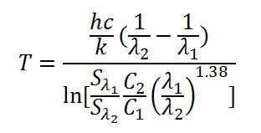
2 Color Ratio Pyrometry
Consumer DSLR camera modified to extend spectral response into NIR
Flame images taken with narrow bandpass filters at 2 distinct wavelengths λ₁, λ₂
Abel transform applied to images to recover radial intensity distribution S_{λ1}, S_{λ2} from line of sight measurements
h = Planck’s constant
c = Speed of light in a vacuum
k = Boltzmann’s constant
C₂/C₁ = Calibration constant

Slide 30
Introduction
Brominated Flame Retardants
Current Test Methods
Objectives of Current Work
Development of FCC
Design and Capabilities
Diagnostics
Parametric Testing and
Operating Conditions
Test Matrix
Data Analysis
Experimental Results
Polystyrene and Bromine
PBT and Al-DEP
Flame Temperatures
Conclusions and Future Work
650 nm
900 nm

Slide 31
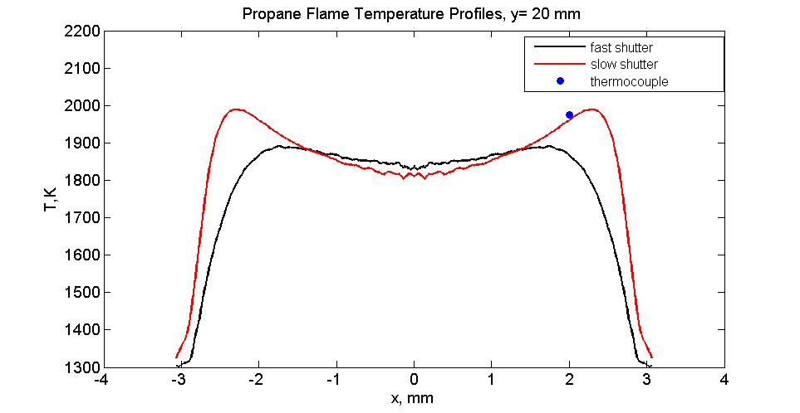
Introduction
Brominated Flame Retardants
Current Test Methods
Objectives of Current Work
Development of FCC
Design and Capabilities
Diagnostics
Parametric Testing and
Operating Conditions
Test Matrix
Data Analysis
Experimental Results
Polystyrene and Bromine
PBT and Al-DEP
Flame Temperatures
Conclusions and Future Work
650 nm
900 nm

Slide 32
Conclusions
Introduction
Brominated Flame Retardants
Current Test Methods
Objectives of Current Work
Development of FCC
Design and Capabilities
Diagnostics
Parametric Testing and
Operating Conditions
Test Matrix
Data Analysis
Experimental Results
Polystyrene and Bromine
PBT and Al-DEP
Flame Temperatures
Conclusions and Future Work
We have successfully developed a new tool to test the flammability of mg-scale pyrolyzable solids, the FCC
The FCC has shown sensitivity to Bromine and Phosphorus
FCC versatility allows to operate beyond a simple screening tool. Fully instrumented research tool allows to explore several operating conditions
First steps have been made towards the non-intrusive measurement of flame temperatures from polymer fuels

Slide 33
Future Work
Introduction
Brominated Flame Retardants
Current Test Methods
Objectives of Current Work
Development of FCC
Design and Capabilities
Diagnostics
Parametric Testing and
Operating Conditions
Test Matrix
Data Analysis
Experimental Results
Polystyrene and Bromine
PBT and Al-DEP
Flame Temperatures
Conclusions and Future Work
Explore additional polymers and flame retardants
Investigate flame temperatures under unsteady conditions, using polymer fuels (are brominated flames cooler?)
Iterate on FCC design to improve robustness and usability

Slide 34
Acknowledgments
BASF
Dr. Richard Lyon (FAA)
Richard Walters (FAA)
Colleen Frances (UMD)
Hai Qing Guo (UMD)
Dr. Peter Sunderland (UMD)

Slide 35
Thank you!
Questions?

Slide 36
Backup Slides

Slide 37
Method 1
Baseline V_{AIR} signal before test start
Air
Combustion Process
Flow
meter
O₂
Sensor
Baseline [O₂] signal before test start

Slide 38
Method 2
=
Air
Combustion Process
Flow
meter
O₂
Sensor
Baseline [O₂] signal before test start

Slide 39
2 Color Ratio Pyrometry
According to Planck’s law, the radiative emission of a body is a function of temperature, wavelength and emissivity
Manipulation of Planck’s law shows that temperature can be expressed as a function of wavelength, emitted radiation and emissivity
If the relationship between emitted radiation and detected intensity of a camera is linear and known (through calibration), then the body’s temperature can be expressed as a function of detected intensity ratios, wavelengths and emissivities

Slide 40
Data analysis
Calculate Heat of complete combustion of each polymer assuming Huggett’s principle
X 13.1 kJ/g-O₂
Chemical formula of PS: (C₈H₈)n,
Chemical formula of Saytex HP 3010 flame retardant: (C₈H_{5.3}Br_{2.7})n.
 | PS | PS-FR1 (6.85% Br) | PS-FR2 (27.4% Br)
Chemical formula | (C₈H₈)_{n} | (C₈H_{7.892}Br_{0.108})_{n} | C₈H_{7.514}Br_{0.486})_{n}
∆H_{c}(kJ/g) | 40.3 | 37.4 | 28.8

Slide 41
Data analysis
Calculate gas-phase combustion efficiency
THR is the measured heat release normalized by initial sample mass
ΔH_{char}= 34.9 kJ/g, assuming char consists of pure carbon
char.yld is the char yield (char mass normalized by initial sample mass)

Slide 42

Analysis of FCC data
Soot yield is measured in FCC. Thus, theoretically the maximum combustion efficiency that can be measured in FCC is:
CE_{max} =
ΔH_{char} = ΔH_{soot} = 34.9 kJ/g, assuming both char and soot consist of pure carbon.
ΔH_{c} is the heat of complete combustion of a given material

