Slide 1
Commercial Alternatives to Deca BDE
S.V. Levchik, ICL-IP America, 430 Saw Mill Rriver Rd., Ardsley, NY, 10502,
M. Leifer, S. Lifshitz and D. Pelah, ICL-IP, P. O. Box 180, Beer Sheva 84101, Israel

Slide 2
Decabromodiphenyl Oxide, Deca-BDE

Slide 3
Background
A decade ago Deca-BDE was the second after TBBA most widely used brominated commercial flame retardant.
Since Deca-BDE has a broad spectrum of application it has been a workhorse FR for over 30 years
Although more advanced FRs were in the market, low cost and availability ensured Deca-BDE deep penetration to all major sectors of the economy including aerospace industry
We believe that Deca-BDE helped to save many lives and millions of dollars in property damage

Slide 4
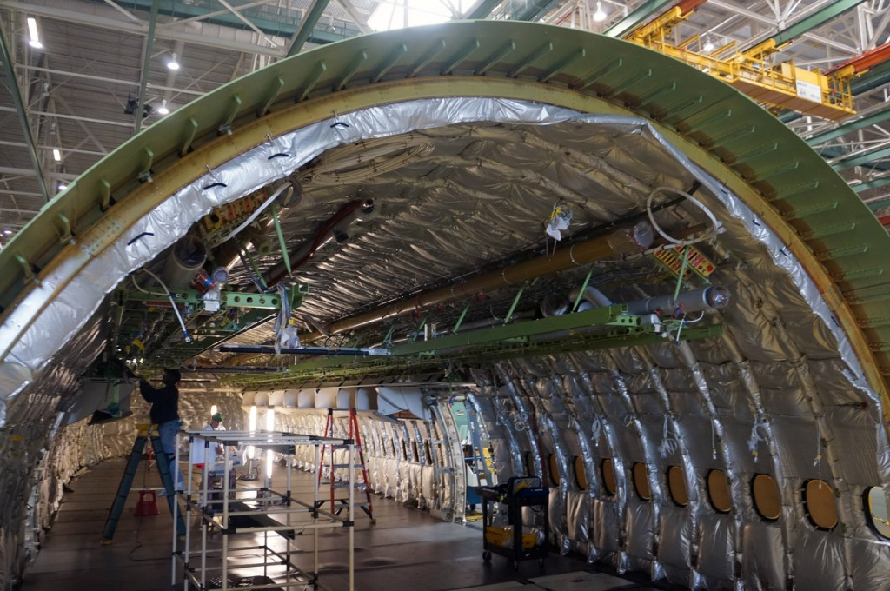
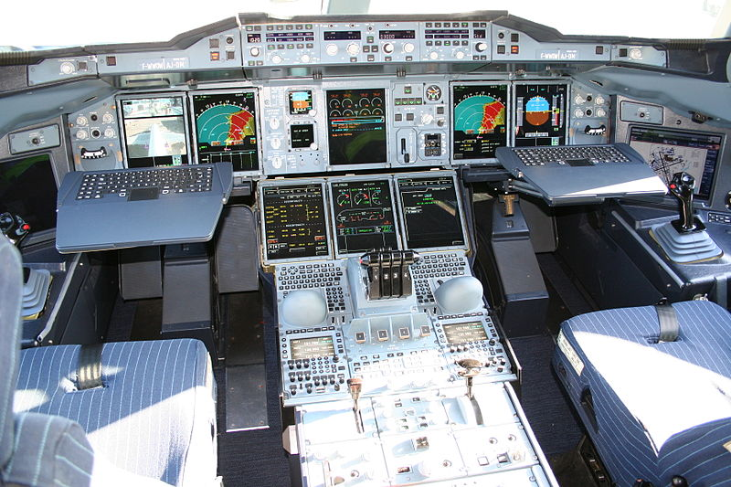
Use of Deca-BDE in Airplanes
Adhesives and Tapes
Composites
Ducting & Molded Parts
Electrical/Electronics
Emergency Equipment
Fabrics & Films
Insulation
Interiors
Sealants

Slide 5
Polymeric FRs
ICL-IP advocates broader use of polymeric or high molecular weight brominated and phosphorus FRs
Polymeric FRs have advantages:
Low water solubility, thus, not expected to be toxic to aquatic organisms
Not likely to be bioavailable, e.g. no bioaccumulation is expected
USA EPA- “Polymers are not readily absorbed by biological species and thus are relatively non toxic”= low risk
EU REACH- “exemption for polymers”
Leaching and migration is not likely
Due to high thermal stability polymer FRs show good performance during recycling

Slide 6
Brominated FRs
Brominated FRs (BFRs) provide combination of gas phase and condensed phase action via chemical and physical mechanisms.
BFRs are the most effective flame retardants and therefore they are used in highly flammable polymers
BFRs are typically used at relatively low loading, therefore impact on physical properties of the polymer is low
At present time there is no acceptable substitution for BFRs in ABS, HIPS and polyolefins
Halogen-free FRs are available for polyesters, nylons, epoxy resins and PU foams,
Often they fall short on physical properties and price-performance

Slide 7
Brominated Epoxy, F-2000
F-2000 is a series of oligomers and polymers which differ by molecular weight and softening temperature
Low molecular weight products give good resin flow
High molecular weight products have good thermal stability
F-2000 series show good UV stability compare to other aromatic BFRs

Slide 8
Brominated Epoxy, F-2000

Slide 9
End-capped brominated epoxy, F-3000
Because of the presence of epoxy groups F-2000 series polymers tend to adhere to hot metal surfaces
This may cause appearance of black spots in extruded resin
End-capping eliminates problem of adhesion to the metals
Br content increases

Slide 10
End-capped brominated epoxy, F-3000

Slide 11
V-0 ABS

Slide 12
Poly(pentabromobenzyl acrylate), FR-1025
Polymeric BFR with Br content 71%
High thermal stability, 5% weight loss is at 330°С
Softening temperature is relatively low, 190-220°С
Main application is in PP, PE, PBT and polyamides
Copolymerized with acrylates it is used for finishing textiles
Proprietary FR to ICL-IP

Slide 13
Glass-filled PBT, V-0, 0.8 mm

Slide 14
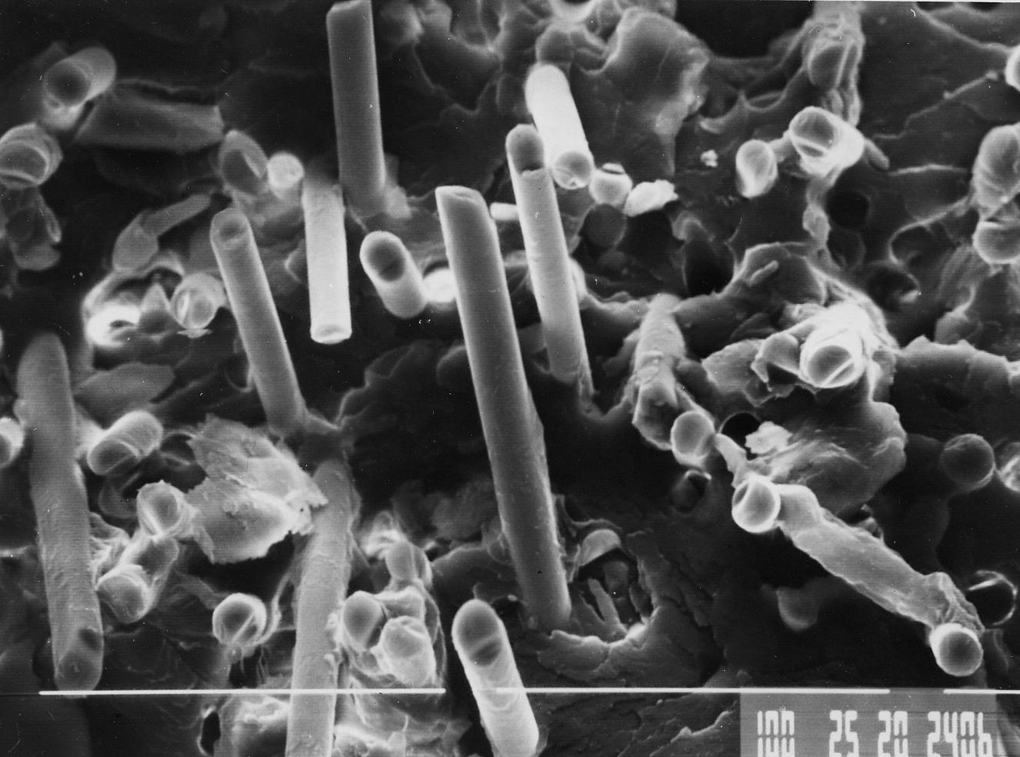
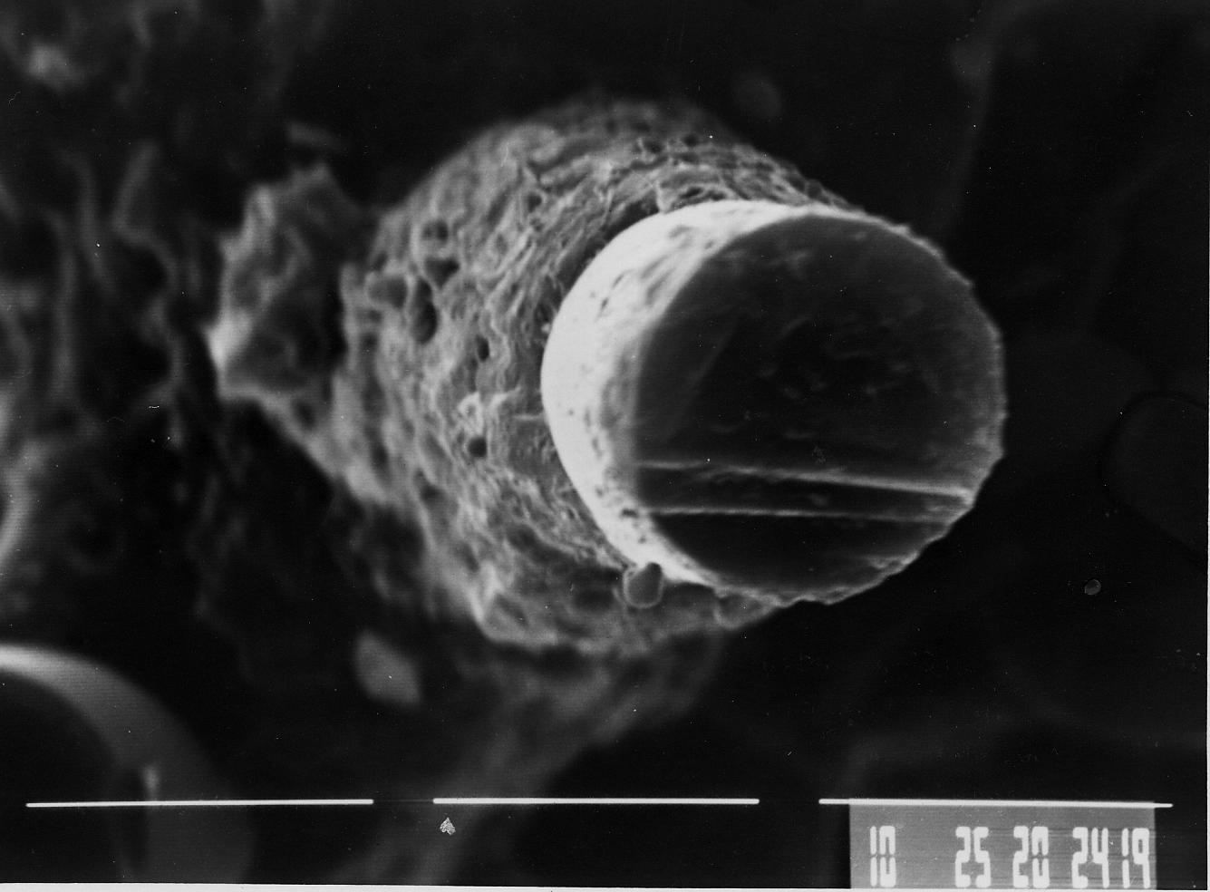
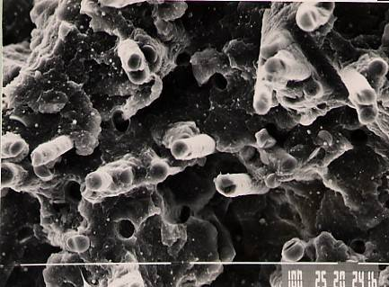
SEM of GF PBT+FR-1025 fracture
with FR-1025
Ref. no FR

Slide 15
Thermal Aging at 190⁰C GFR PBT with FR-1025
100
75
50
25
0
FR-1025 in PBT
Strength retention, %
Ref PBT No FR
250 500 750 1000
Time, h

Slide 16
Brominated polystyrene, FR 803P
High molecular weight BFR, M_{w} = 600000.
Br content 66%
Very high thermal stability, 5% weight loss is at 360°С
Very high softening temperature, 265-325°С
Main application is in PBT, PET and polyamides
ICL doesn’t sell FR-803P in the USA

Slide 17
Glass filled PA-6.6, V-0, 1.6 mm

Slide 18
HSE Profile of ICL-IP Polymeric FRs
Nontoxic, not irritant to intact skin, not irritant or mild irritant to the eyes (below level of classification) and not skin sensitizers
Not mutagenic
Not classified by IARC (International Agency for Research on Cancer)
Not included in the NTP (National Toxicology Program) 12th Report on Carcinogens
Based on products molecular weight, aquatic toxicity and bioaccumulation potential are not expected
Not considered being PBT

Slide 19
Decabromodiphenyl Ethane, FR-1410
In many applications it is a drop in replacement of Deca-BDE
Bromine content only slightly lower than Deca-BDE 82%
It was developed in 90s as a Deca-BDE alternative which is not direct precursor to dioxins
Unless significant cost saving pressure, compounders are reluctant to use it because of structural similarity with Deca-BDE
HSE profile
Nontoxic, non-irritating and not a skin sensitizer
Not mutagenic, no effect were found in developmental toxicity test
Nontoxic to aquatic organisms, not readily biodegradable and not bioaccumulative. Thus, not considered being PBT.

Slide 20
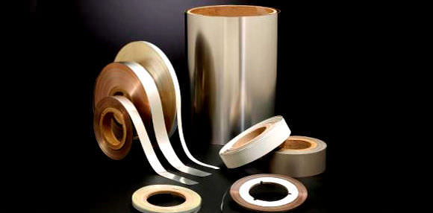
Tris(tribromoneopentyl phosphate), FR-370
Contains 70% Br and 3% P
It melts at 180 С, and therefore promotes resin flow during compounding and molding
Main use is in PP, especially in outdoor applications because FR-370 has very good UV stability
Can be used in PP fibers
It is used in adhesives and pressure sensitive tapes
It can be also used in HIPS and ABS for V-2 rating

Slide 21
FR-370
HSE Profile
Nontoxic, minimal irritant to eyes, not irritant to intact skin and not a skin sensitizer.
No neurotoxic effects was found in a delayed neurotoxicity study with hens.
Not mutagenic
Not classified by IARC and not included in the NTP 12th Report on Carcinogens
Nontoxic to aquatic organisms, not readily biodegradable, shows evidence of inherent biodegradability.
Shows low potential for bioaccumulation in aquatic organisms.
Not considered being PBT.

Slide 22
Bis (2,3-dibromopropyl ether) of TBBA, FR-720
Contains 68 % Br, and half of Br is aliphatic
It melts at about 113-117°С
Main use is in V-2 PP
It is very efficient and thermally stable.
Because FR-720 tends to migrate to the surface “bloom”, is always used at low loading, typically below 5 wt. %
HSE profile
Nontoxic, minimal irritant to eyes, not irritant to intact skin and not a skin sensitizer.
Not mutagenic
Not classified by IARC and not included in the NTP 12th Report on Carcinogens
Nontoxic to aquatic organisms, not readily biodegradable, and shown to be not bioaccumulative in earthworms. Thus, not considered being PBT.

Slide 23
Tris(tribromophenoxy) triazine, FR-245
FR-245 was developed by ICL-IP in cooperation with DKS, Japan
It specifically targets HIPS and ABS
Bromine content (67 %) is lower than Deca-BDE
It melts at about 230°С which perfectly matches processing temperatures of HIPS and ABS
Very good melt resin flow
Requires very little ATO
HSE profile
Nontoxic, not irritant to intact skin and eyes and not a skin sensitizer
Nontoxic in a repeated dose study
Not mutagenic
Not classified by IARC and not included in the NTP 12th Report on Carcinogens
Not toxic to aquatic organisms, not readily biodegradable and not bioaccumulative. Thus, not considered being PBT.

Slide 24
Low ATO Systems, FR-245

Slide 25
Halogen-free alternatives
Halogen-free FRs are mostly represented by phosphorus FRs, melamine or melamine salts, inorganic hydroxides
Mode of flame retardant action of non-halogen FRs is polymer specific
Therefore Deca-BDE replacement may require also switch to different polymer associated with redesign and requalification
Organophosphates are specific to oxygen- or nitrogen-containing polymers.

Slide 26
Resorcinol bis(diphenyl phosphate) Fyrolflex®RDP
Fyrolflex®RDP
P – 10.9 %
Very good thermal stability
Main use in PC/ABS and PPO/HIPS
Housings of business machines and computers
Limited application in HIPS and ABS for V-2 rating
Some applications in PWB
Growing use in textiles
Cannot be used in polyolefins

Slide 27
Fyrolflex® Sol-DP
Fyrolflex® Sol-DP is a new addition to the bis-phosphates family.
Since Fyrolflex® Sol-DP is a free flowing powder there is no need for special metering equipment.
Applications are similar to Fyrolflex®RDP
Appearance | White powder
Melting point, °C | 101-108
Specific gravity | 1.3
Phosphorus content, % | 10.5
Acidity, mg KOH/g | <0.1
Assay, wt. % | >98
TGA,5% weight loss, °C | 335
Water solubility | Insoluble

Slide 28
HSE Profile of Bisphosphates
Nontoxic, not irritant to intact skin, mild irritant to the eyes and not skin sensitizers
Nontoxic in a repeated dose study
Nontoxic in a reproductive study
Not mutagenic
Not classified by IARC and not included in the NTP 12th Report on Carcinogens
Nontoxic to aquatic organisms, can be not readily or readily biodegradable, have low bioaccumulation potential.
Not considered being PBT.

Slide 29
Fyrolflex® RDP, Sol-DP / PC/ABS

Slide 30
Magnesium hydroxide, FR-20
FR-20-100 – untreated
FR-20-200 (S7/S10) - stearic acid surface treated
FR-20-300 (S10) - vinyl silane surface treated
FR-20-400 (S5/S7) – amino silane surface treated
FR-20-500 – polysiloxane coated (coming to the market in 2013)
It is used in polyolefins, elastomers, polyamides and PVC
Excellent smoke suppression properties in PVC
It is required > 50% FR-20 to achieve V-0 in polyamides
In halogen-free W&C formulations it required > 60 % to achieve VW-1

Slide 31
Conclusions
Because of the pressure of NGOs on OEMs Deca-BDE was withdrawn from the USA market
Depending on final applications there are many commercial Deca-BDE alternatives
Use of halogen-free alternatives is still limited to certain type of polymers.
ICL-IP and other FR producers strongly advocate use of polymeric FRs
All Deca-BDE alternatives have favorable human health and environmental profiles.

Slide 32
Some Legal Notes
Disclaimer of Warranty and Limitation of Liability
Information on this presentation is provided "as is" without warranty of any kind, either express or implied, including, but not limited to, the implied warranties of merchantability, reliability, completeness, fitness for a particular purpose or non-infringement.
We do not warrant the accuracy of the information set out on this presentation. It may contain technical inaccuracies or errors and/or non-updated data. Information may be changed or updated without notice.
We expressly disclaim all liability in respect to any actions taken or not taken based on any or all of the information provided on or through the presentation. In no event will ICL-IP or its affiliates be liable to any part or any direct, indirect, punitive, special or other consequential damages for any use of this presentation, including, without limitation, any lost profits, or loss of business opportunities, business interruption, loss of programs or other data on your information handling system or otherwise, even if we are expressly advised of the possibility of such damages.
Intellectual Property
The trademarks, service marks, trade names, logos and other indications of origin displayed in this presentation, are to our best knowledge owned by ICL or its affiliates by any third party who has granted ICL-IP or its affiliates a right to use them on this site. Nothing contained herein should be construed as granting the right to use any such marks displayed in this presentation without the written permission of the owner thereof.

