Slide 1

Novel Polymeric, Non-Halogen Flame Retardants
with Broad Applicability in Multiple Industries
The Seventh Triennial International Fire & Cabin Safety Research Conference
December 2 – 5, 2013
Jan-Pleun Lens

Slide 2
General Introduction and Company Profile
Product Introduction
Applications
- Fibers
- Thermoplastic Polyurethane (TPU)
- Polycarbonate (PC)
- Thermosets
Recap and Future Outlook

Slide 3
General Introduction and Company Profile
Product Introduction
Applications
- Fibers
- Thermoplastic Polyurethane (TPU)
- Polycarbonate (PC)
- Thermosets
Recap and Future Outlook

Slide 4


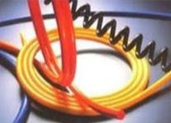
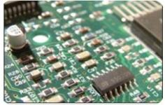
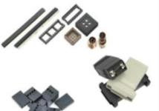
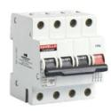
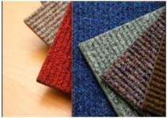
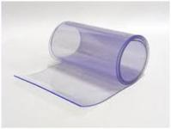
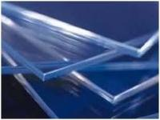
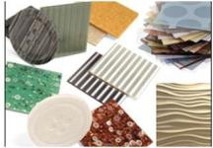
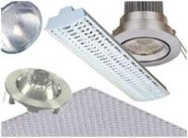

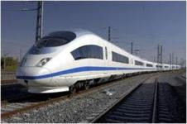
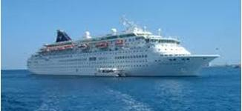

~5% of all Plastics contain Flame Retardants
Electrical Equipment and Consumer Electronics (EE&CE)
Housings
Wire and cable
PCB’s
Connectors
Mcb’s
Building & Construction (B&C)
Carpeting
Thermoplasts
Sheet
Laminates
Lighting
Transportation
Average Annual Growth Rate of Flame Retardants ~6-7%

Slide 5

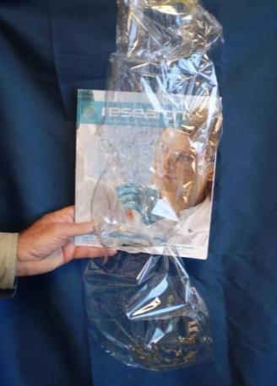

NOFIA Polyphosphonates, A Unique FR Solution
Plastic with current FR additives
Plastic with NOFIA FR
Small molecules end up in environment
Large molecules trapped in plastic
Polymer:
  Permanent and will not migrate out
  Minimal impact on host plastic properties
  Possible to use plastic processing methods
Non-halogen flame retardant
Extreme FR properties
High melt flow
Transparent
Range of toughness

Slide 6
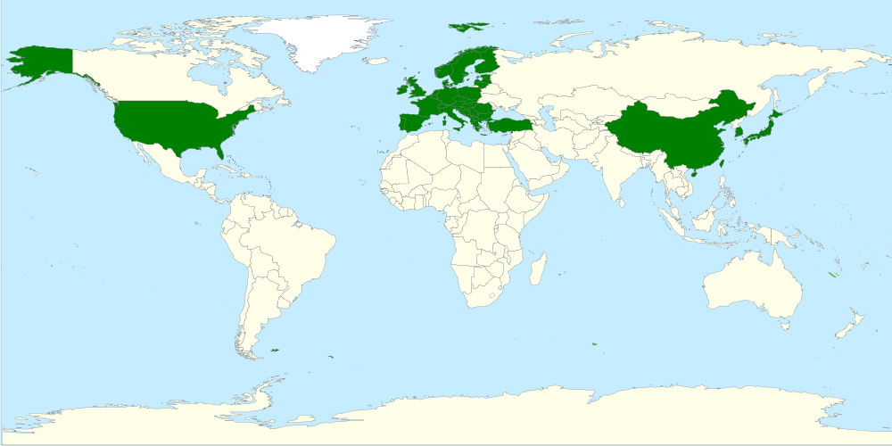
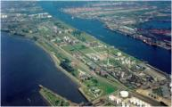
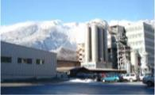
FRX POLYMERS’ Global Growth
2013
Antwerp, BE
Commercial Plant
2010
Chur, CH
Pilot Plant
2007
Chelmsford, MA
HQ, R&D
2010-2012
Agents / Distributors
- Japan
- Taiwan
- South Korea
- China
- Europe
HQ, R&D
Production
Sales Offices

Slide 7










Global Recognition for FRX POLYMERS
  Large group of global investors:
  Abu Dhabi, Belgium, Canada, Germany, Israel, Switzerland, United States
  2008 - Frost and Sullivan “Product Innovation of the Year Award for Flame Retardants”
  2009 - Featured on The Economic Report - CNN and FOX
  - Winner of Society of Plastics Engineers Clean Technology Forum Business Plan Competition
  2012 - Global Cleantech Top 100 Companies
  - Global Going Green Top 200 Companies
  - Featured on CNN Money
  2013 - Frost & Sullivan “New Product Innovation Award”
  - Flanders Foreign Investment Trophy
  (aired on “Kanaal Z” in Belgium)

Slide 8
General Introduction and Company Profile
Product Introduction
Applications
- Fibers
- Thermoplastic Polyurethane (TPU)
- Polycarbonate (PC)
- Thermosets
Recap and Future Outlook

Slide 9
Polymerization Characteristics
Polymerization to obtain polyphosphonates
Polymerization to obtain polycarbonates
  Base catalyzed polycondensation process (transesterification) to make high Mw polymer
  Requires high temperatures (~300°C) and high vacuum (<1 mbar)
  Very efficient, solvent free polymerization process
    Environmental quotient (E-factor, total mass of waste/mass of desired product) ~ 0
    100% atom economy of P-based monomer and polymer process
  Choice of catalyst is essential to make high quality polyphosphonates

Slide 10
Polyphosphonates and Copolymers
Polymerization to obtain FRX POLYMERS’ polyphosphonates
  By changing the DPMP / DPC ratio, any polymer can be made between a pure polycarbonate and a pure polyphosphonate
  By changing the ratio of DPMP (and/or DPC) towards the dihydroxy compound and by changing reaction conditions, the Mw and the type of end groups can be modified
  Patent No. US6,861,499, US7,816,486, US7,645,850

Slide 11
FRX POLYMERS’ Products - Characteristics
Nofia HM1100
Nofia COPOs
Nofia Oligomers
-X = different functionalities
X
X
  Polyphosphonate
  (P ~ 11wt%)
  High molecular weight
  (40-100,000 g/mole, PS)
  Tg ~ 100-105°C
  Plastic pellets
  Typically used as blend component in plastics
  Polyphosphonate-co-carbonate (P ~ 3-7 wt%)
  High molecular weight
  (40-100,000 g/mole, PS)
  Tg ~ 120-135°C
  Plastic pellets
  Used as stand alone polymer or blend component in plastics
  Phosphonate or phosphonate-co-carbonate
  Low molecular weight
  (1,000 – 6,000 g/mole)
  5 - 90 mg KOH/g
  Solid white material
  Used as additive or as reactive ingredient in thermoset plastics

Slide 12
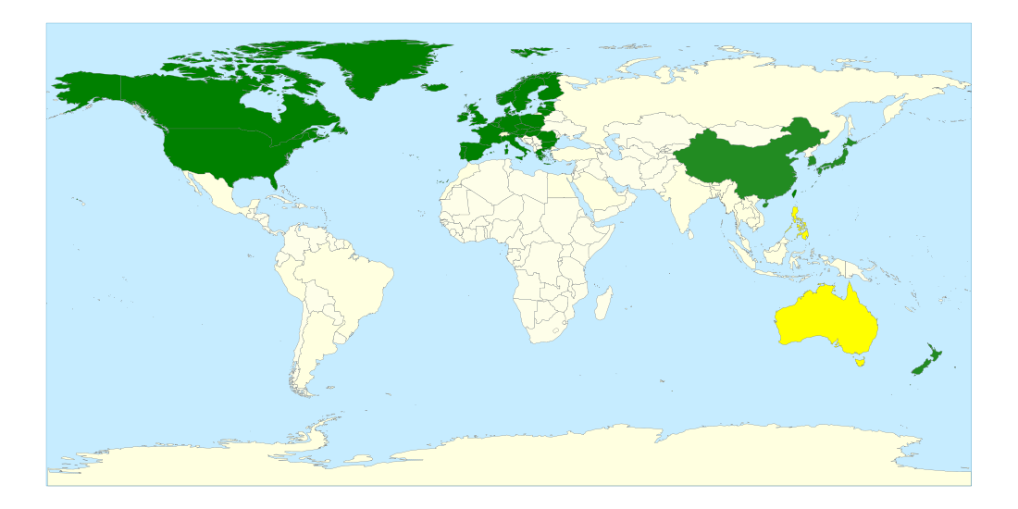
Global Registration NOFIA Products
  Registration of Polymers completed in 7 of 9 required countries: USA, Canada, Japan, China, S-Korea, Taiwan, New Zealand, Philippines, and Australia
  EU - monomers that are used to make polymers need to be registered under REACh
EU
DPMP REACh registered per May ‘13
China
Completed all products
Canada
Completed all products
S Korea
Completed all products
Japan
Completed all products
USA
Completed all products
Taiwan
Completed all products
Australia, Philippines
Testing completed
Tentative timing 2014 - 2015
New Zealand
All Polymers exempt

Slide 13
General Introduction and Company Profile
Product Introduction
Applications
- Fibers
- Thermoplastic Polyurethane (TPU)
- Polycarbonate (PC)
- Thermosets
Recap and Future Outlook

Slide 14
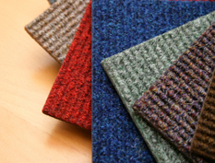
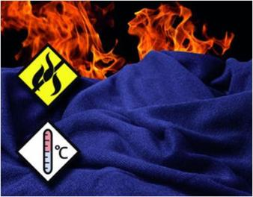

Fibers (Carpets, Textiles, Artificial Wigs)
NOFIA delivers:
  Melt processability → dry blending with the base fiber-polymer at the hopper
  Flexibility of base polymer (e.g. use recycle PET)
  Flexibility of addition level of FR
  FR performance at relatively low loadings
  No limitation in fiber diameter
  Enhancement of spinning process and eliminates need for filter packs,
  No deterioration of fiber properties
  No secondary operations to add FR compound necessary
  No migration
Target Polymer System
  Polyesters
FRX POLYMERS’ Solution
  NOFIA HM1100
Notes:
NOFIA HM1100 is polymeric. It is provided in plastic pellets and can be added directly to the PET pellets in any quantity. This offers a large flexibility to the customers. Depending on the application, they can add more or less of the HM1100 and make the change over on the fly. When using FR PET chips, they are limited to the specific FR concentration in the chip.
Because customers can add HM1100 as pellets to the extruder together with PET, they can use any grade of PET. Some of our customers actually use recycled PET, which offers a good cost savings compared to using the more expensive PET grades.
Because HM1100 is a polymer, it will not migrate out of the polymer blend. With low molecular weight FR additives, migration can happen during processing which would lead to a layer of the FR additive on the surface of the fiber, which is unwanted and can lead to pollution in the down stream process. Also, during usage, low molecular weight FR additives can migrate out of the fibers and possibly come into the environment and people/animals can get them into their system. Finally, when the low Mw FR additives migrate out of the final fibers, the FR properties of the product will get lost.
With low Mw FR additives, there is a limit to the diameter of the fiber that can be spun. The thickness of the fibers can not be smaller than the particle size of the low Mw FR (e.g. Exolit products). because HM1100 is polymeric, there is no such limitation. The only limitation would be the melt strength of the material and so far we have experienced that fibers with HM1100 have an excellent melt strength.
Because HM1100 is part of the polymer matrix, the customers can eliminate the need for filter packs.
Using HM1100 directly in the fiber also eliminates the need for any secondary operation where fiber producers would use a dip coating process to coat FR additives on the outside of the fibers, which even gives also more problems with migration than when small molecular weight FR additives would be added to the polyester during extrusion.
The fibers can be used for textiles (e.g. curtains etc), carpets, and wigs.

Slide 15
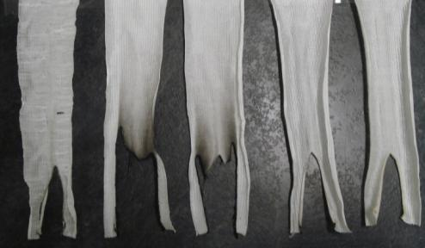
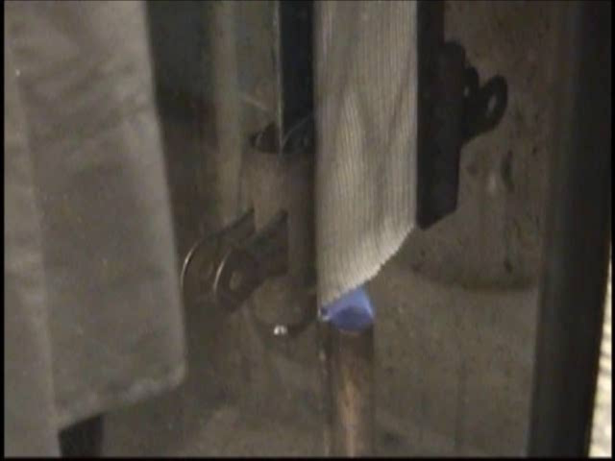
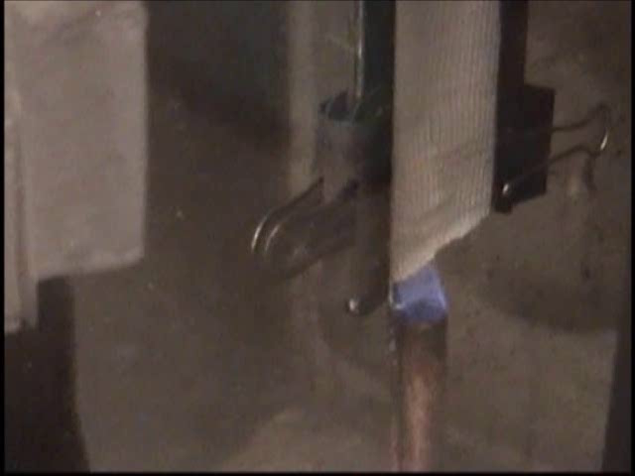
PET/HM1100 Fibers for Textiles – Lab Tests
ASTM D6413-99, Standard test Method for Flame Resistance of Textiles
PET blends with HM1100 were melt spun into 5-8 and 18-22 denier fibers.
Fibers showed good FR behavior when tested according to ASTM 701.
Increasing HM1100
PET
PET/
HM1100
PET
PET/HM1100
Notes:
ASTM D6413-99
Fabric samples (3x12”) woven from these compositions were tested according 12s exposure, 0.75’ above a 1.5” flame).
The char length was determined using a weight of 120g (tearing force).
NF P 92-504 (1995)
Circular knitted fabric specimens were made from a false-twisted PET yarn (130, dtex (225), f 38 bright-3.5 dtex/filament).
Washing, drying and conditioning of all specimens was conducted according to ISO 6330 (2000-2008), using washing procedure 5A.
15

Slide 16
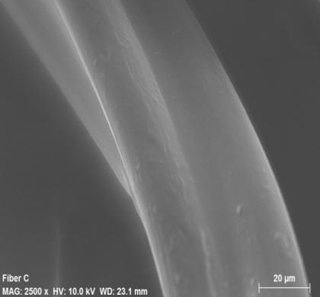
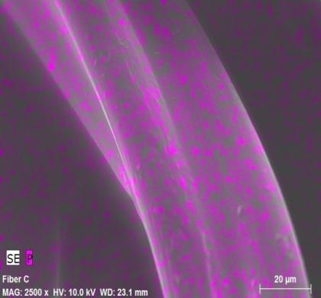
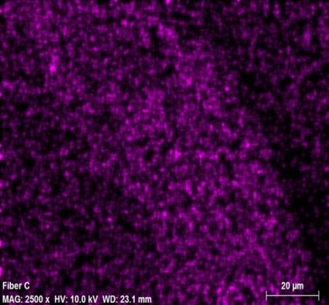
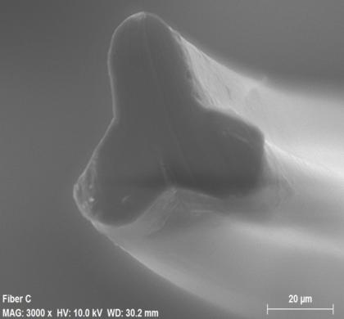
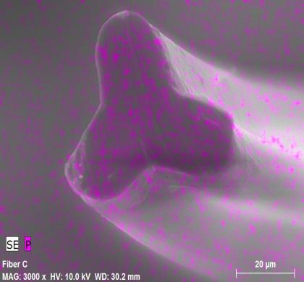
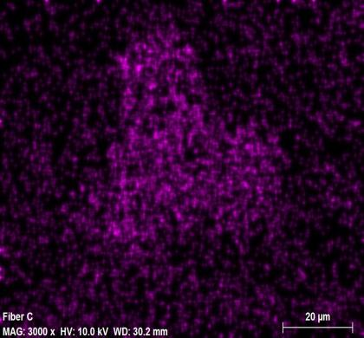
Uniform P-Distribution in throughout Fibers
Top surface
Cross section
SEM images of fiber surface with P-mapping (purple).

Slide 17
General Introduction and Company Profile
Product Introduction
Applications
- Fibers
- Thermoplastic Polyurethane (TPU)
- Polycarbonate (PC)
- Thermosets
Recap and Future Outlook

Slide 18
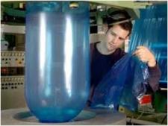
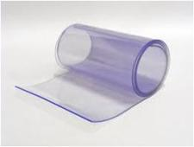
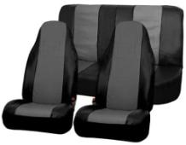
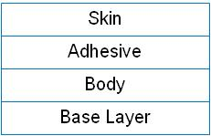

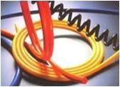
TPU Molding and Extrusion Applications
Transparent film/sheet
Artificial Leather
Wire & Cable
  NOFIA HM1100
  NOFIA OL5000
  E162, E-84, Class A
  Transparent, completely miscible blend!
  Excellent retention of physical properties
  Processable via sheet or blown film process
  NOFIA OL1001 / OL3001
  NOFIA OL3000 / OL5000
  MVSS302 (HB < 4”/min)
  Miscible with top layer (skin) and adhesive (TPU)
  No migration
  Improved hydrolytic stability
  NOFIA HM1100
  NOFIA OL5000
  VW 1 (UL1581)
  Easy processing, good melt strength
  Smooth surface appearance
  Higher elongation at unchanged shore hardness

Slide 19
General Introduction and Company Profile
Product Introduction
Applications
- Fibers
- Thermoplastic Polyurethane (TPU)
- Polycarbonate (PC)
- Thermosets
Recap and Future Outlook

Slide 20
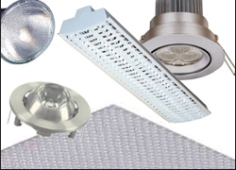
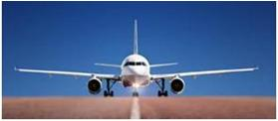
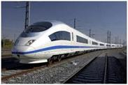
NOFIA Fit for PC (Blend) Applications
Construction / Lighting
  Transparent UL94 V0 at 0.25mm
  Higher melt flow index than typical PC
  Enables more detailed and complex shapes
Transportation
  Flame Smoke Toxicity (FST) Capability
    Transparent
    Excellent flame performance
    Heat Release
    Good impact resistance
    Processable – Film, Sheet
Notes:
In transportation many applications relate to PVC replacement

Slide 21
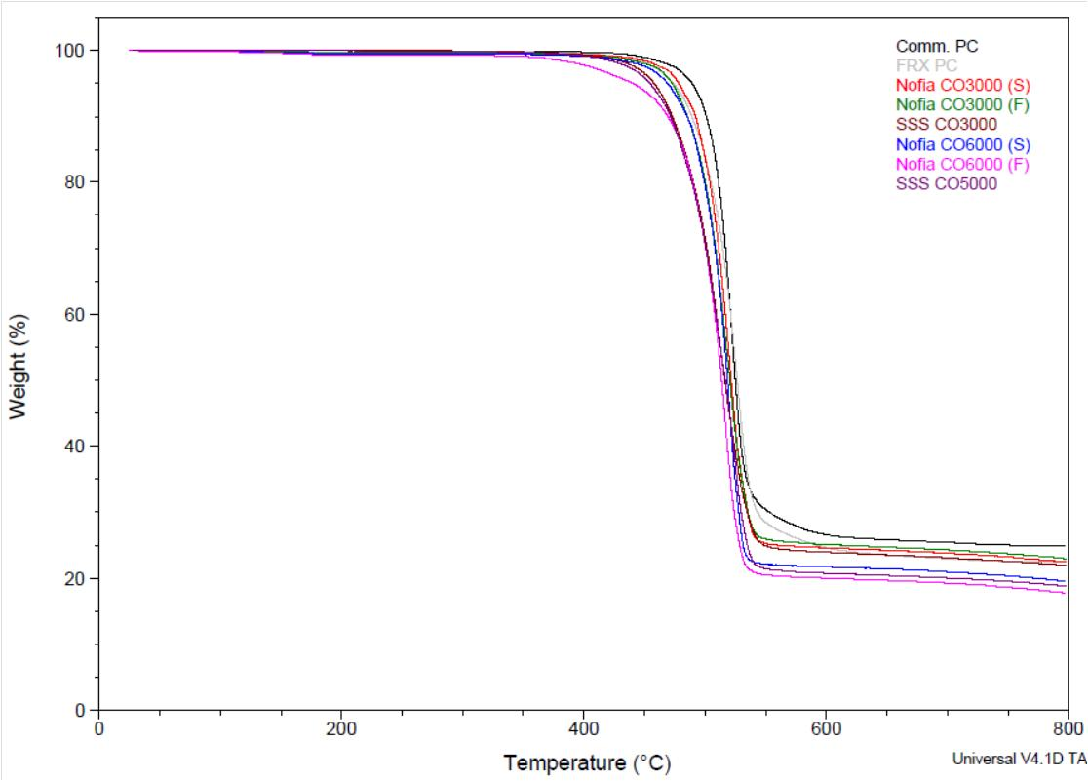
TGA Data of NOFIA Polyphosphonates
Nitrogen
Air
Polycarbonate

Slide 22
Nofia CO3000 vs NHFR PC data
V0/0.25mm
Comparable to PC
Ductile <2mm
10°C lower than PC
Comparable to PC

Slide 23
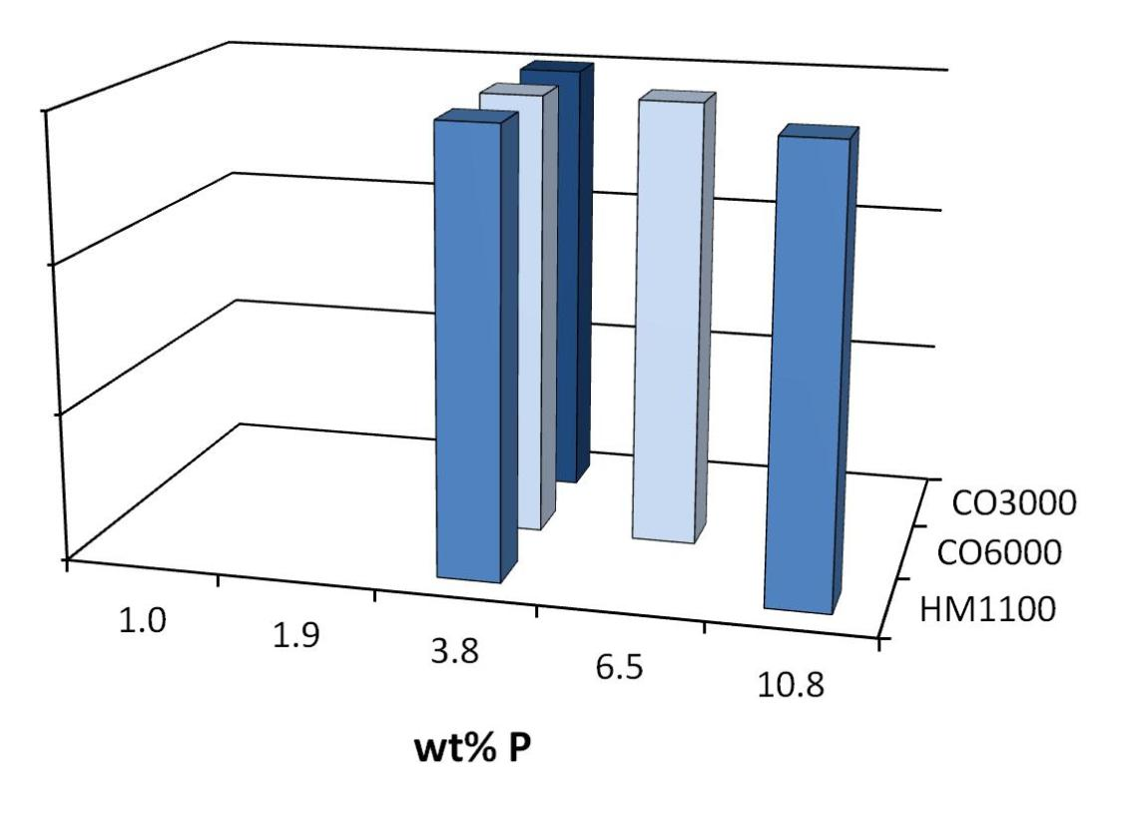
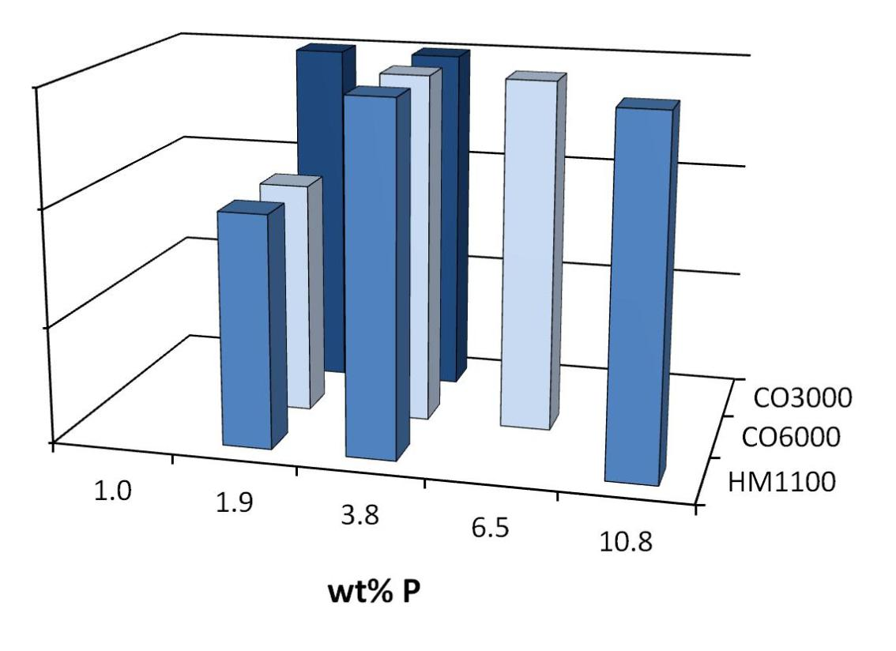
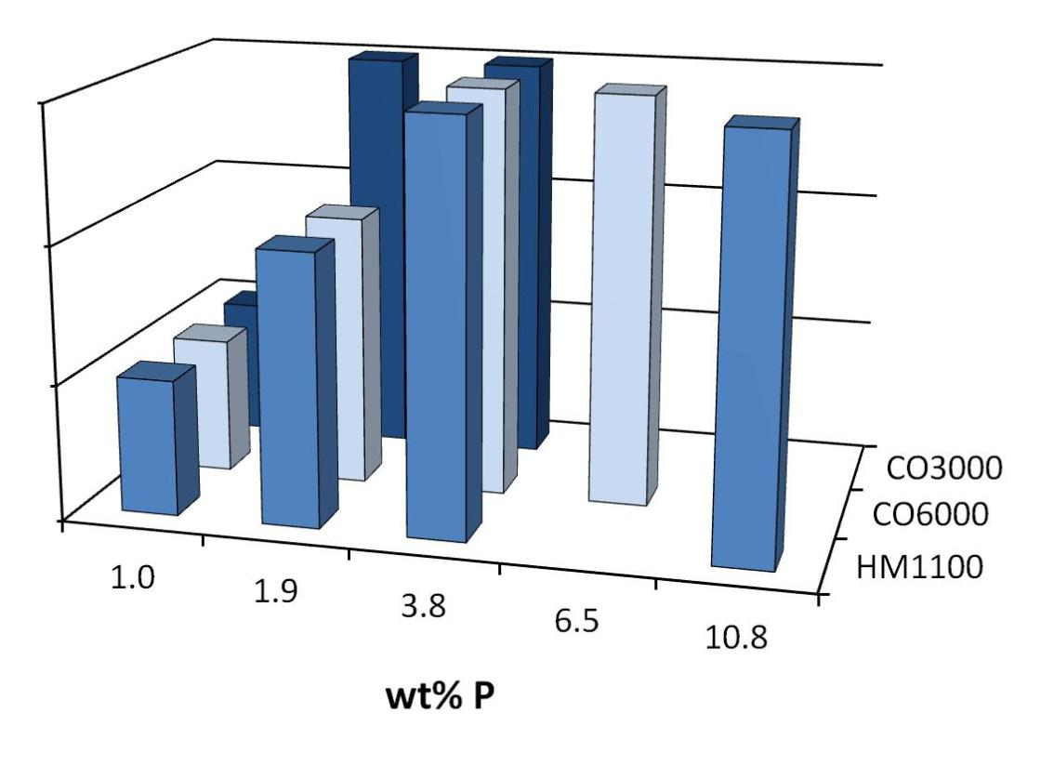
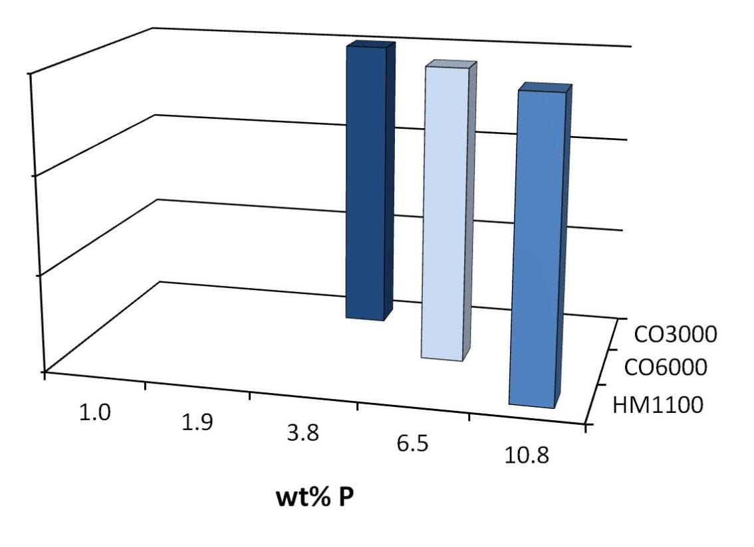
UL94 Results for PC / NOFIA Blends at 0.4mm
50%
100%
100%
V0
V0
60%
100%
35%
V1
30%
V1
25%
18%
15%
V2
V2
9%
35wt% NOFIA HM1100 + 65wt% PC

Slide 24
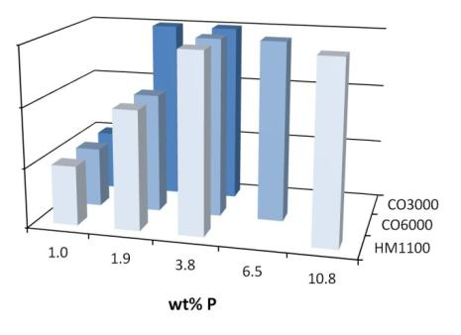
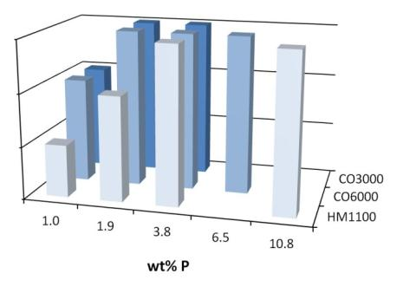
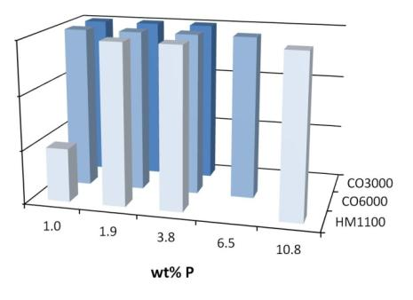
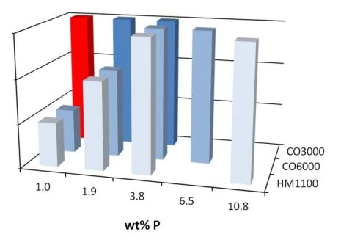
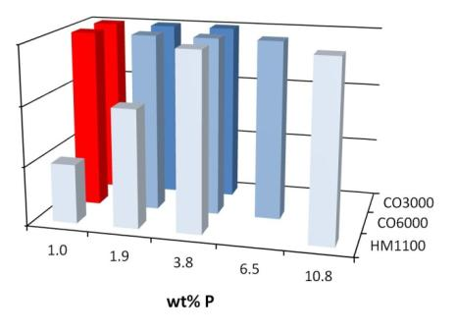
UL94 Results for PC / NOFIA Blends
0.4mm
0.8mm
1.6mm
V0
V0
V0
V1
V1
V1
V2
V2
V2
Addition of 0.1 wt% of Rimar Salt
V0
V0
V0
V1
V1
V1
V2
V2
V2
CO3000 Most Effective in PC
Notes:
Going to thinner thicknesses, it becomes more difficult to flame retard PC.
State of the art for NHFR transparent PC is V0/1.6mm

Slide 25
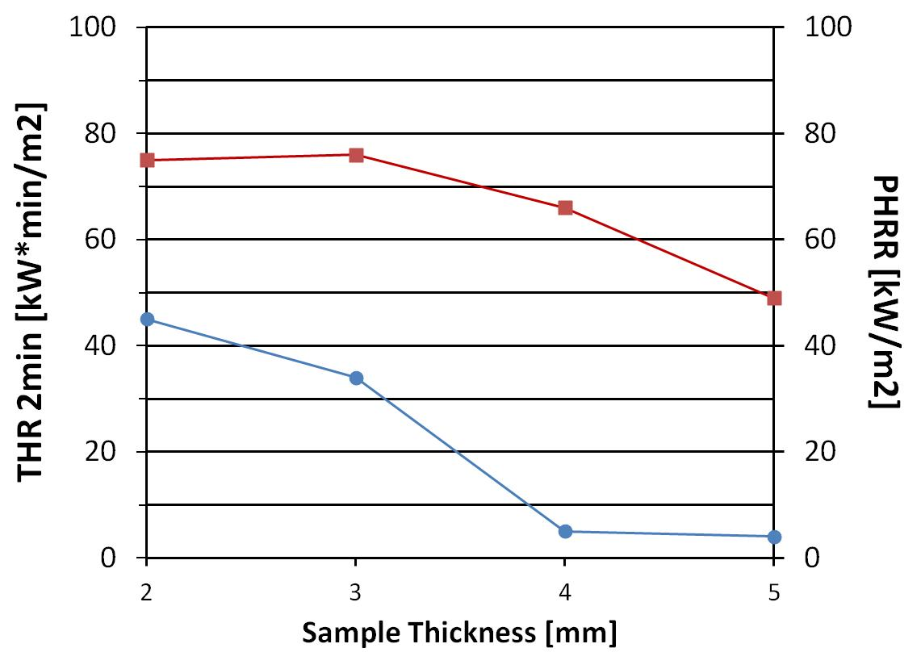
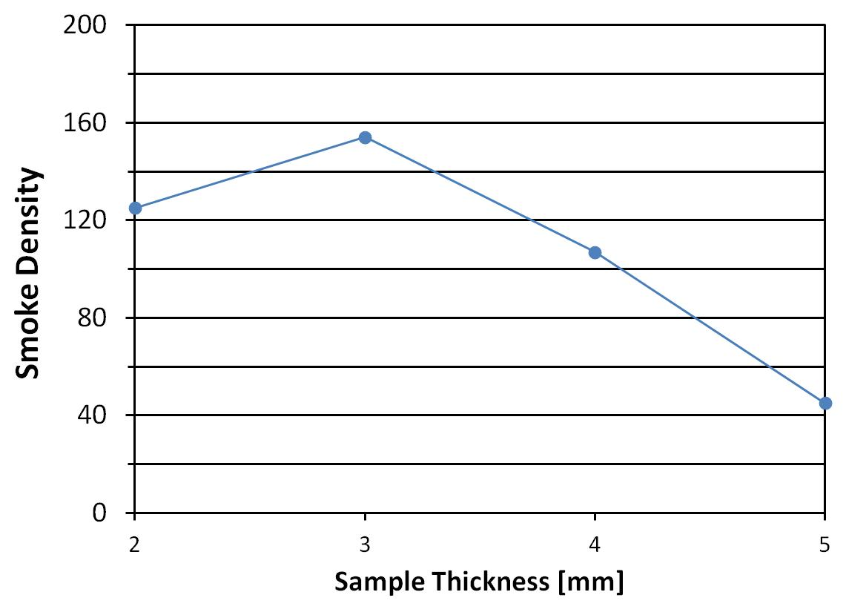
OSU and Smoke Data for NOFIA CO3000
OSU (FAR 25.853)
Smoke Density ABD0031 (<200) (ASTM E662)
NOFIA CO3000 has good total heat release and smoke properties that are within spec for OSU (FAR 25.853).
NOFIA CO3000 has ~50% lower peak heat release rate than PC (150-200 kW/m²) but not good enough to pass the specification for Peak Heat Release Rate (PHRR) of 55 kW/m².
Future goal: Obtain additional improvement (~>25%) in PHRR
Notes:
THR (Total heat Release) and PHRR specifications < 55 kW/min/m2 and kW/m2, respectively
Smoke generation specification <200

Slide 26
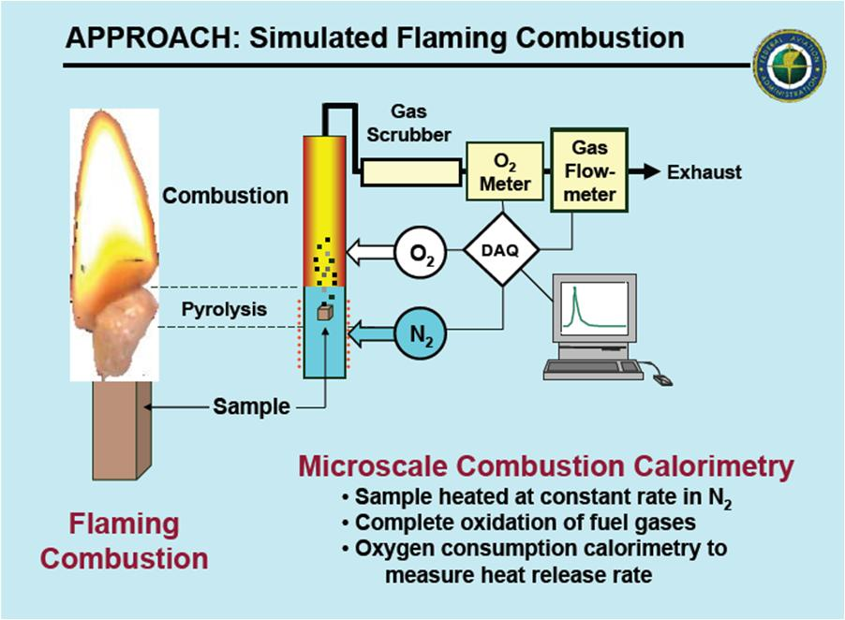
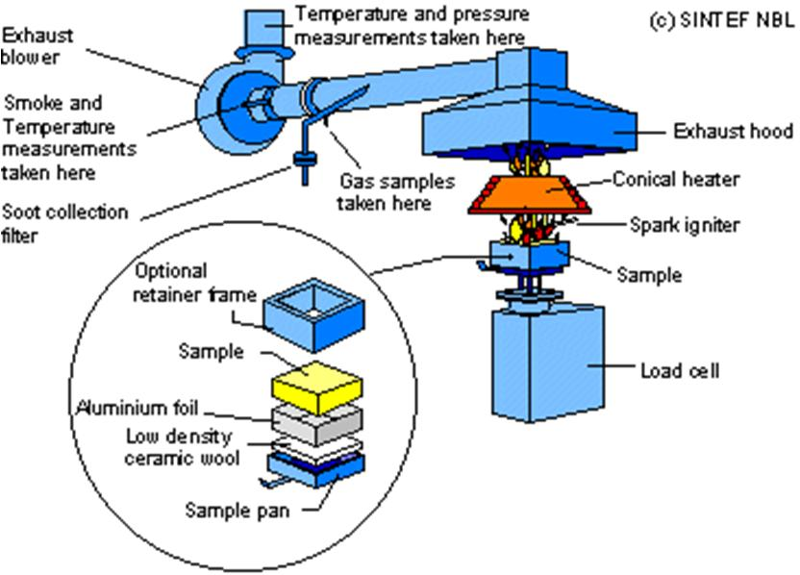
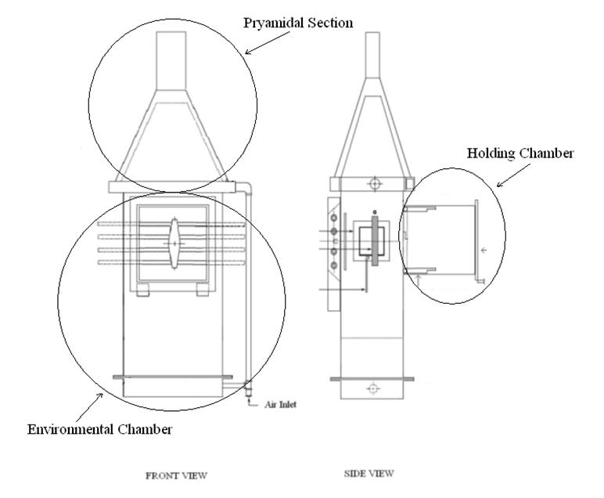
Testing – Heat Release Properties
Small Scale
Lab Scale Up
Pilot Plant
Pyrolysis Combustion Flow Calorimeter
(PCFC), also known as Micro Cone Calorimetry (MCC)
ASTM D7309
Material Needed: Few mg
Output:
  Heat of Combustion or Fire Load
  Ignition Temperature
  Heat Release Rate
  Heat Release Capacity: Fundamental Material Property
Cone Calorimeter
ISO 5660 / ASTM E1354
Material Needed: 100x100mm plaque
Output:
  Rate of heat release
  Time to ignition
  Critical ignition flux
  Mass loss rate
  Smoke release rate
  Effective heat of combustion
  CO2, CO release
OSU and Smoke Density
FAR 25.853 / ASTM E906 and ASTM E662
Material Needed: 150x150mm plaque
Output:
  Heat Release (2 min total)
  Heat Release Rate (peak)
  Heat Flux Density
  Smoke Density

Slide 27

Correlation between Cone Calorimeter and MCC
Difficult to
predict
correlation PCFC / Cone – OSU or
PCFC / Cone – UL94 in area of 200-600

Slide 28

Pyrolysis Combustion Flow Calorimeter (PCFC)
Micro Combustion Calorimetry
Temp rise β = 1 K/s, 150-750°C
Measure oxygen consumption
Polyphosphonate shows single step thermal decomposition process
Polyphosphonate
Acknowledgement: Richard Lyon, Federal Aviation Administration

Slide 29




Pyrolysis Combustion Flow Calorimeter (PCFC)
linear
interaction
λ = -0.183, R² = 0.86
λ = -0.035, R² = 0.98
λ = 0.231, R² = 0.98
Acknowledgement: Richard Lyon, Federal Aviation Administration

Slide 30
PCFC - Peak Heat Release Rate NOFIA Series
Reasonable agreement between two data sets (measured at different labs), except for 100% poplyphosphonate (need to repeat).
Good agreement between data for samples from Lab Scale and semi-commercial scale → scale does not affect HRR properties
Minimum at 20-40 mole%DPP is a true minimum? → interaction (synergy) between carbonate and phosphonate bonds?
CO3000 type of material shows ~25% reduction of PHRR compared to regular PC (OSU showed that CO3000 ~50% reduction in PHRR compared to regular PC) → PCFC and OSU data don’t scale in the same way.
S1 = Lab Scale (150g)
S2 = Lab Scale (1.5kg)
SC = Semi Commercial (80kg)
C= Commercial

Slide 31
Cone - Higher Values Indicate Greater Fire Hazard
300
4.0
PC
ASTM E 1354 Cone Calorimeter at
External Heat Flux, q_{ext} = 50 kW/m²
3.5
250
3.0
200
2.5
Average Heat Release Rate ( ), kW/m²
2.0
Heat Release Parameter ( ), HRP
150
NOFIA CO3000
1.5
NOFIA CO6000
1.0
100
NOFIA HM1100
0.5
50
0
0
2
4
6
8
10
12
Weight Percent Phosphorus (% P)

Slide 32
Higher Values Indicate Gas Phase Activity
Average Values for q_{ext} = 35, 50 and 75 kW/m²
0.35
1500
1400
0.30
HM1100
1300
0.25
CO6000
1200
CO/CO₂ ( ), kg/kg
0.20
CO3000
1100
Smoke Extinction Area ( ), m²/kg
1000
0.15
900
0.10
800
PC
0.05
700
0
2
4
6
8
10
12
Weight Percent Phosphorus (% P)

Slide 33
Higher Residual Mass in Cone Because Surface Layer Protects Underlying Polymer from Pyrolysis
0.7
Cone calorimeter
0.6
0.5
0.4
Unpyrolyzed mass
Residual Mass Fraction, w/w
0.3
CO3000
CO6000
HM1100
0.2
MCC or TGA
(no increase in char yield with P)
PC
0.1
0
2
4
6
8
10
12
Weight Percent Phosphorus (% P)

Slide 34
Condensed Phase Mechanism is Thermal Protection
0.9
HM1100
0.8
MCC or TGA
PC
0.7
CO3000
CO6000
0.6
Thermal shielding by intumescence prevents volatilization of fuel
Volatile Fraction, kg/kg
0.5
0.4
0.3
Cone calorimeter
0.2
0
2
4
6
8
10
12
Weight Percent Phosphorus (% P)

Slide 35
General Introduction and Company Profile
Product Introduction
Applications
- Fibers
- Thermoplastic Polyurethane (TPU)
- Polycarbonate (PC)
- Thermosets
Recap and Future Outlook

Slide 36
Reactive versus Additive Oligomers
Reactive
Additive

Slide 37
Main OL Applications
OL Product | Resin | Market
OL1001 | Epoxy PU UPET | Electronic Equipment (Adhesives, Printed Circuit Boards) Building & Construction (Cable jacketing), Industrial Building & Construction
OL3000 | UPET TPU | Building & Construction Industrial
OL3001 | Epoxy PU UPET | Electrical Equipment (Printed Circuit boards) Building & Construction, Artificial Leather Building & Construction
OL5000 | Epoxy TPU UPET | Building & Construction Cable Jacketing, Transportation, Building & Construction, Electrical Equipment , Building & Construction

Slide 38





Use of NOFIA OL1001 like other FR Additives
ECH
Epoxy Resin
FR Additives
FR Additives
FR Additives
Curing Agent
FR Additives
FR Additives

Slide 39


Use of NOFIA OL1001 as a Curing Agent
ECH
Epoxy Resin
FR Additives
FR Additives
FR Additives
Curing Agent
FR Additives
FR Additives

Slide 40
UPET Applications
Application | Examples | Competitive Products | Benefits of NOFIA OL5000
Transparent | sky lights | RDP, TEP | Improved strength
Structural panels | transportation -trains, boats, buses | APP, RDP (with ATH) | Improved: tensile strength HDT (+20-23°C) pot life (3 days vs 1 day)
Building and construction | decorative laminates architectural panels | Halogenated | Non-blooming Improved resistance to humidity
Passed FR tests:
DIN 5510-2 (S4, ST2 and SR2) and also NFF 16.01 (MIFI & MIFO) with OL5000/ATH system.

Slide 41


UPET Panels containing OL5000 pass ASTM E162
Control
NOFIA
Class B
Class A
Control

Slide 42
General Introduction and Company Profile
Product Introduction
Applications
- Fibers
- Thermoplastic Polyurethane (TPU)
- Polycarbonate (PC)
- Thermosets
Recap and Future Outlook

Slide 43











Current markets/polymer systems
Nofia HM1100
Nofia COPOs
Nofia Oligomers
  Polymer System
  Polyesters (PET, PBT, PTT)
  TPUs
  Markets
  Electrical Equipment
  Consumer Electronics
  Fibers
  Building and Construction
  Applications
  Connectors
  Commercial carpet
  Specialty textiles
  TPU films, sheet
  Polymer System
  PC, Polyesters
  PC blends (PC/ABS)
  Markets
  Consumer Electronics
  Lighting
  Building and Construction
  Transportation
  Applications
  Housings for electronic equipment
  Light diffusers
  Transparent sheets
  Polymer System
  Epoxies
  Unsaturated polyesters
  Markets
  Electronics
  Building and Construction
  Transportation
  Applications
  Printed Circuit boards
  Composites
  Decorative laminates and panels

Slide 44




First Commercial Plant in Antwerp
Groundbreaking Sep 20, 2012
Start Production 4th Quarter 2013
“As a new, innovative company, with a sound focus on sustainability, FRX Polymers has its right place here in Flanders.” -Kris Peeters, minister-president of the Government of Flanders

Slide 45
Acknowledgements:
R&D Team at FRX POLYMERS
Dr. Jan-Pleun Lens
FRX POLYMERS
200 Turnpike Road
Chelmsford, MA 01824, USA
Tel: +1 (978) 856-4145
Fax: +1 (978) 250-4533
Email: jplens@frxpolymers.com
www.frxpolymers.com

