Slide 1

LES of Vertical Turbulent Wall Fires
Ning Ren¹, Yi Wang¹, Sebastien Vilfayeau², Arnaud Trouvé²
1. FM Global, Research, Norwood, MA, USA
2. University of Maryland, College Park, MD, USA

Slide 2
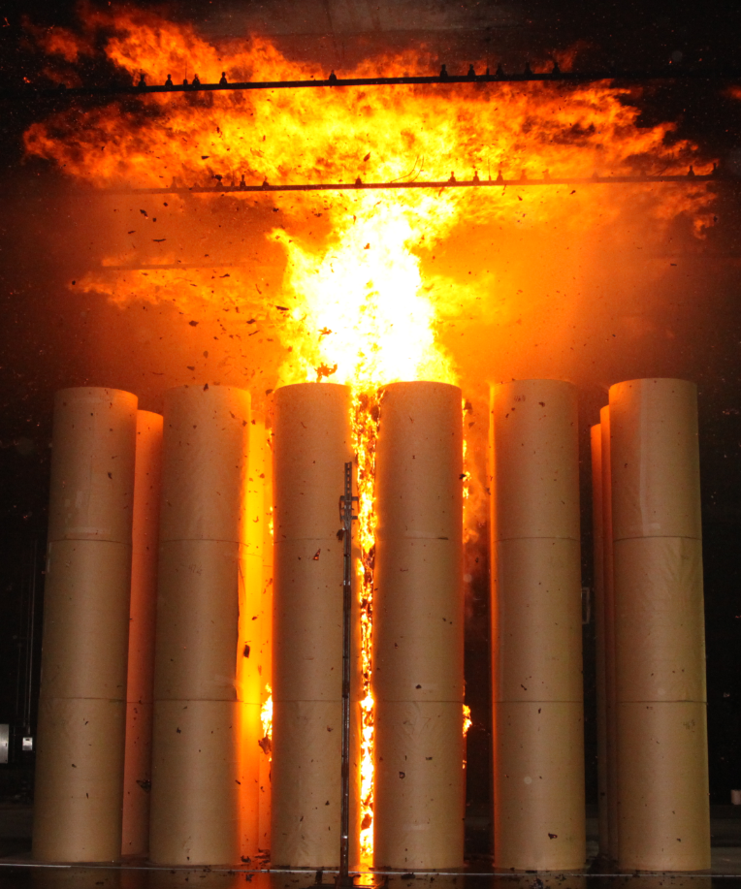
Background
Industrial-scale fire tests
  Reduce fire loses
  Expensive
  Limited configurations
Fire modeling
  Understand physics
  Reduce large scale tests
Challenges
  Multi-physics
  Multi-phases
6 m

Slide 3
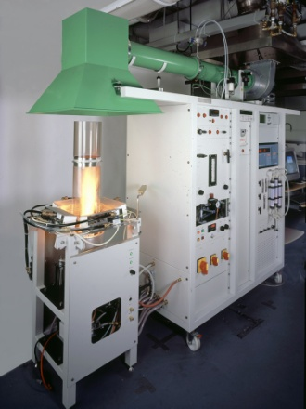
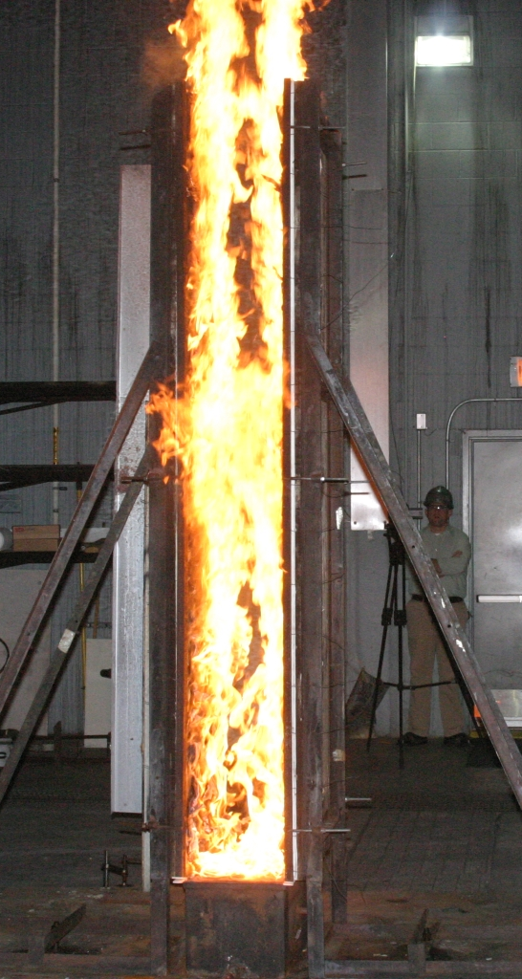
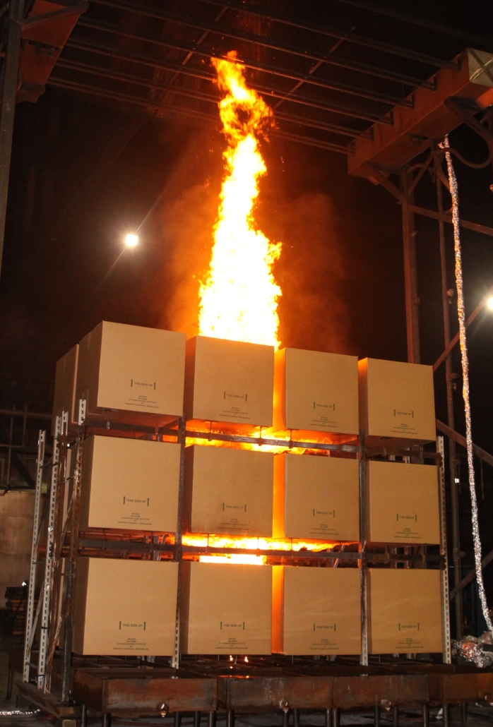
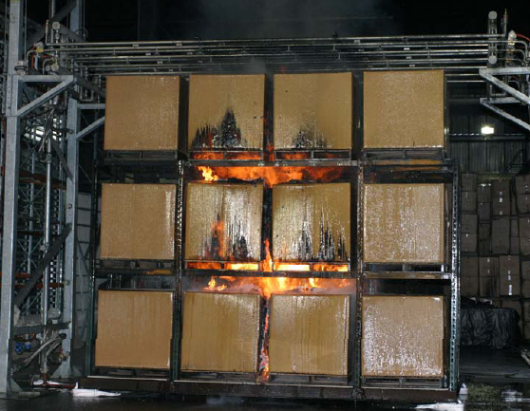
Background

Slide 4
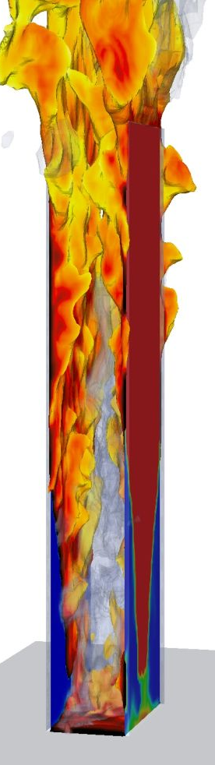
Tools – FireFOAM
Open-source fire model (FM Global)
  www.fmglobal.com/modeling (2008-Present)
Based on OpenFOAM
  A general-purpose CFD toolbox (OpenCFD, UK)
Main features
  Object-oriented C++ environment
  Advanced meshing capabilities
  Massively parallel capability (MPI-based)
  Advanced physical models:
    turbulent combustion, radiation
    pyrolysis, two phase flow, suppression, etc.

Slide 5
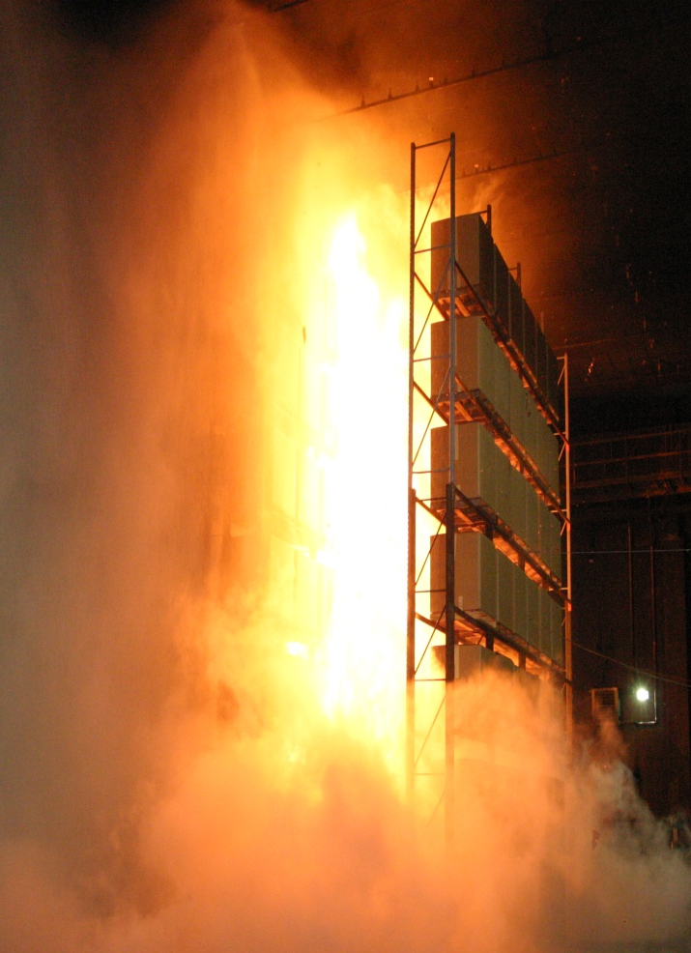
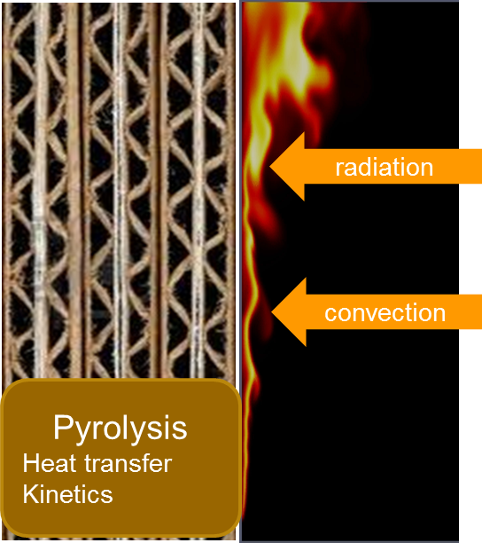
Background
Industrial-scale Fire Test
Multi-physics interaction
Difficult to instrument
Vertical wall fire is a canonical problem

Slide 6
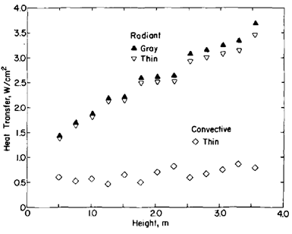
Background
Experiments
  Orloff, L., et.al (1974) PMMA
  Ahmad, T., et.al (1979)
  Markstein, G.H., de Ris, J. (1990)
  de Ris, J., et.al (1999)
Modeling
  Tamanini, F. (RANS,1975) PMMA
  Kennedy, L.A., et.al (RANS,1976)
  Wang, Y.H., et.al (RANS, 1996)
  Wang, Y.H., et.al (FDS, 2002)
  Xin, Y. (FDS, 2008)
Orloff, L, et.al (PMMA)
Challenges
  High grid requirement
  Buoyancy driven
  Mass transfer
  Reacting boundary flow

Slide 7
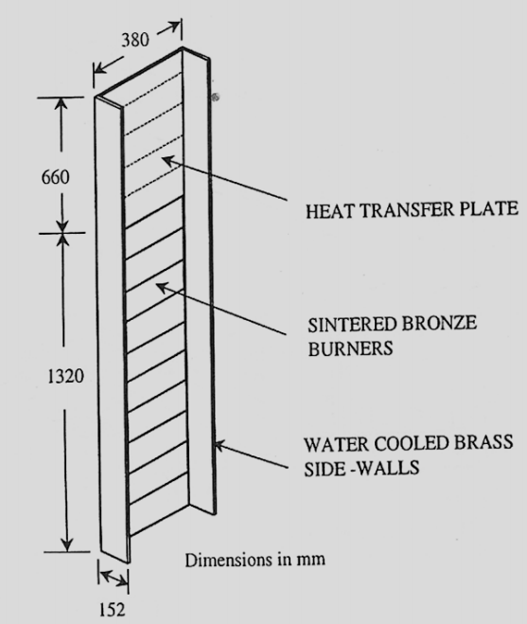
Experiments –
(J. de Ris et al., FM, 1999)
(J. de Ris et al., Proc. 7th IAFSS, 2002)
Prescribed flow rates
  Propylene
  Methane
  Ethane
  Ethylene
Water cooled vertical wall
Diagnostics
  Temperature
  Radiance
  Heat flux
  Soot depth

Slide 8
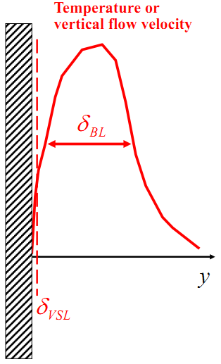
Grid requirement
Momentum driven flow (Piomelli et al., 2002)
Natural convection (Holling et al., 2005)
Wall Fires
  10~20 cells across the flame
    3mm to start
2 cm

Slide 9
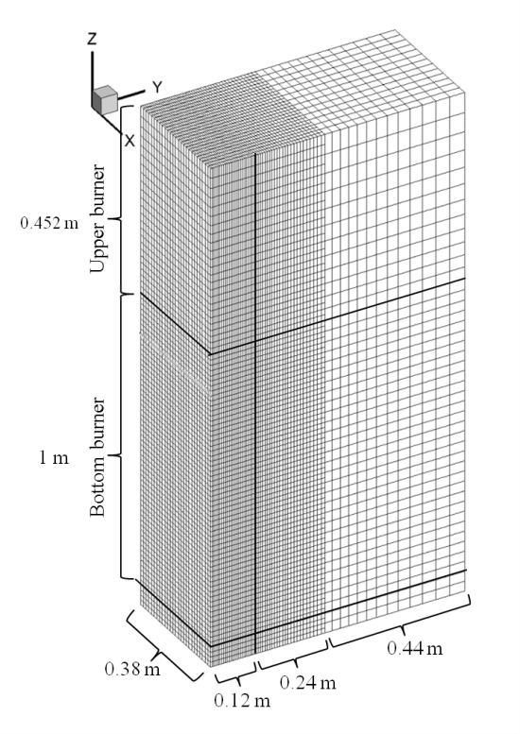
Mesh and B.C.
Base line – 3 mm grid
  ΔY ~ 3 mm, ΔX ~ 7.5 mm, ΔZ ~ 7.7 mm (ΔX :ΔY :ΔZ ~ 2.5:1:2.5)
  0.8 M cells, CFL = 0.5
  1.5, 2, 3, 5, 10, 15 and 20 mm
B.C.
  Cyclic (periodic) in span-wise
  Entrainment BC at the side
  Fixed temperature, T = 75 ˚C
  Propylene
    8.8, 12.7, 17.1, 22.4 g/m²s

Slide 10
Turbulence Model
WALE Model
K-equation model
Wall adaptive local eddy viscosity model
Zero for pure shear flow
O(y³) near wall scaling
Two deficiencies:
Laminar region with pure shear
Wrong scaling at near wall region
O(1) instead of O(y³)
No need to calculate k_{sgs}

Slide 11
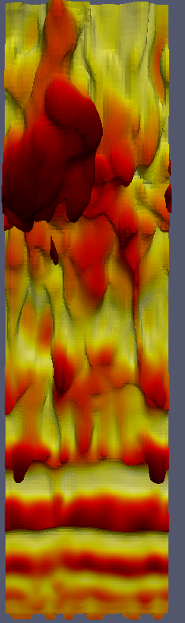
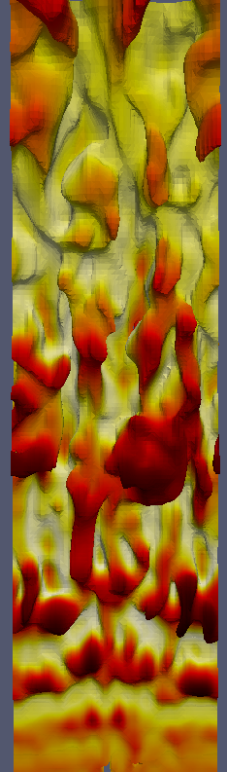
Wall-Adaptive Local Eddy Viscosity
K-Eqn Model
WALE Model

Slide 12
Combustion Model
Eddy Dissipation Concept (EDC model)
  Mixing controlled reaction
K-equation model
WALE model

Slide 13
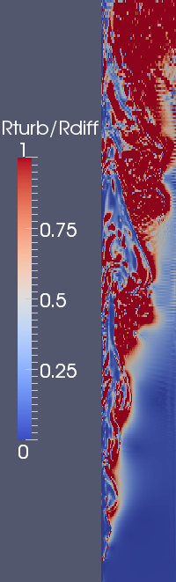
Combustion Model
Eddy Dissipation Concept (EDC model)
  Mixing controlled reaction
Turbulence reaction rate
Diffusion reaction rate

Slide 14
Radiation Model
Fixed radiant fraction
  Finite volume implementation of Discrete Ordinate Method (fvDOM)
  Optically thin assumption
Soot/gas blockage (χ_{rad} is reduced by 25%)
Fuel | Methane CH₄ | Ethane C₂H₆ | Ethylene C₂H₄ | Propylene C₃H₆
Wall Fire (de Ris measurement) | 15% | 17% | 24% | 32%
Simulation (account for blockage) | 12% | 13% | 18% | 25%

Slide 15
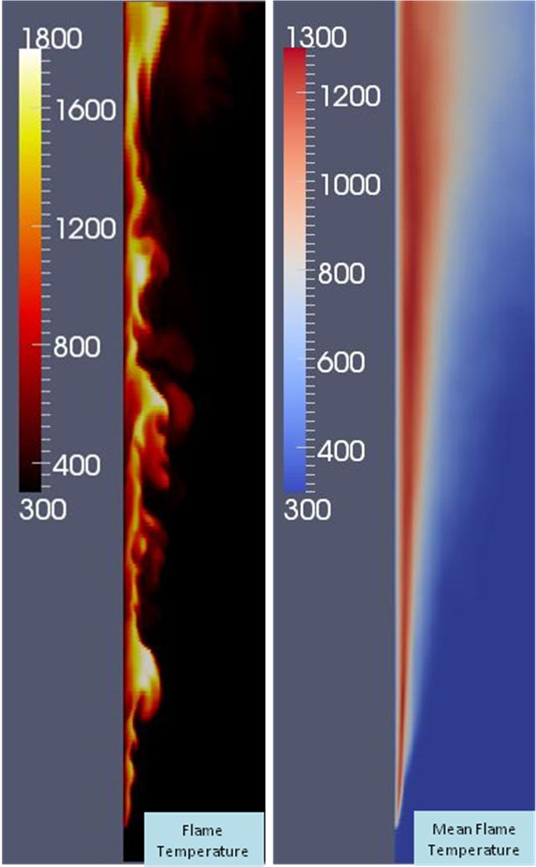
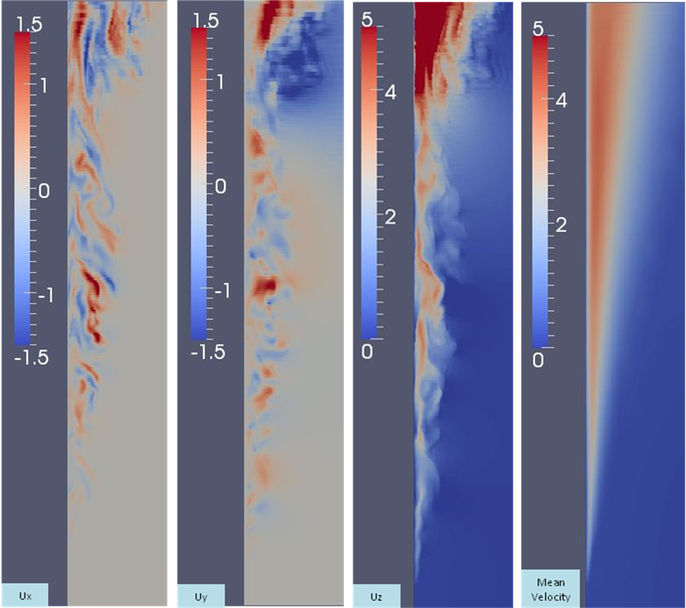
Flame topology
K
K
m/s
m/s
m/s
m/s
span-wise
wall-normal
stream-wise

Slide 16
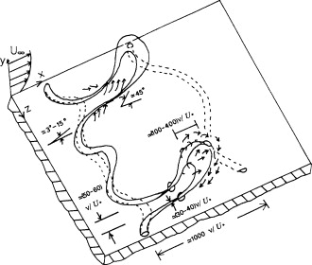
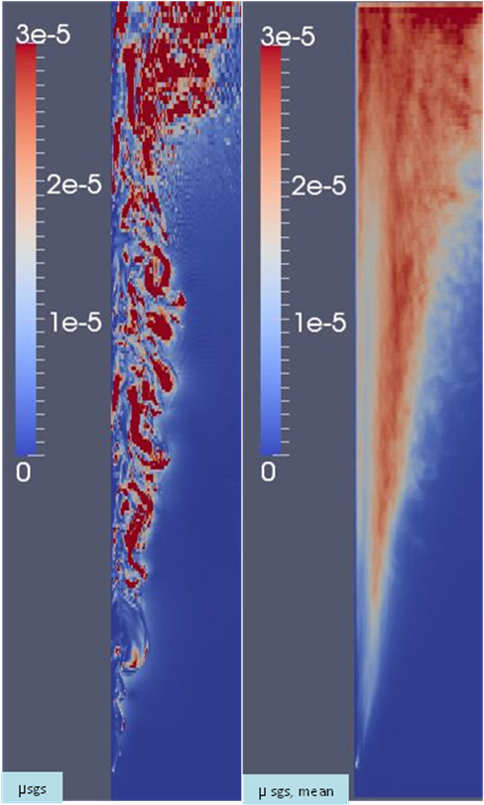
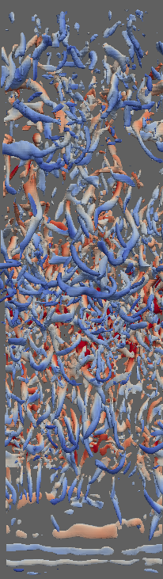
Flame topology
Wallace, J.M., 1985
kg/m/s
kg/m/s
Q, wall-normal view

Slide 17
Heat flux – (de Ris Model)
Soot volume
fraction
Soot
depth
Blockage
Side-wall
Flame radiation
temperature
Flame emissivity
Heat transfer
coefficient
Fuel blowing effect

Slide 18
Grid Convergence ( =17.1 g/m²s, C₃H₆)
Fully Turbulent
Fully Turbulent
Fully Turbulent

Slide 19
Heat Flux – Flow Rates (Δ=3 mm, C₃H₆)

Slide 20
Heat Flux – Fuels (Δ=3 mm)

Slide 21
Convective Heat Flux: Blowing Effect
17.1g/m²s
Pyrolysis
Zone
Flaming
Zone
Pyrolysis
Zone
Flaming
Zone

Slide 22
Temperature (C₃H₆)

Slide 23
Summary and future work
Summary
  Near wall turbulence and combustion models are important
  Good agreements are obtained for wall-resolved modeling
  10~20 cells across the flame are needed
  Convective heat flux is important in the downstream flaming zone
Future work
  Test soot model for radiation
  Improve turbulence and combustion models for coarse-grained modeling
  Wall function study

Slide 24
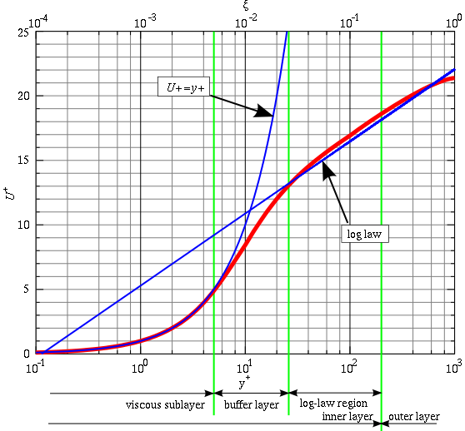
Ongoing work – wall function
Log-Law
Blowing effect (Stevenson, 1963)

Slide 25
Ongoing work – wall function
(Δ=15 mm)
(17.1 g/m²s, C₃H₆)

Slide 26
Ongoing work – wall function
(Δ=15 mm)
Fuel blowing effect

Slide 27
Acknowledgement
John de Ris
Funded by FM Global
  Strategic research program on fire modeling

Slide 28
Temperature (C₃H₆)

Slide 29
Temperature – Elevation (17.1 g/m²s, C₃H₆)
Inner layer
Outer layer

Slide 30
Coarse grid
Convective heat flux
  Temperature gradient
  Combustion
Radiative heat flux
  Combustion

Slide 31
A temporary approach
K-equation
K-equation, WALE
Minimize the influence of combustion
Better turbulence & combustion model needed in future

