Slide 1

Fire Model Uncertainty from a Regulatory Point of View
Kevin McGrattan
National Institute of Standards and Technology
Gaithersburg, Maryland, USA

Slide 2
Background
In 2004, the US Nuclear Regulatory Commission amended its requirements for fire protection, allowing licensees to adopt NFPA* 805, a performance-based, risked-informed standard for fire protection in nuclear power plants.
NFPA 805 allows fire modeling as long as the models have been verified and validated.
In 2007, US NRC and EPRI (Electric Power Research Institute) issued a V&V study of five different fire models.
In 2013, the V&V study has been updated.
* National Fire Protection Association

Slide 3
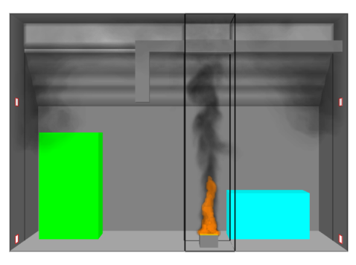
Models Selected for NRC/EPRI V&V
Fire Dynamics Tools (FDTs) Empirical correlations used by US NRC
Fire-Induced Vulnerability Evaluation (FIVE) Empirical correlations used by EPRI
Cons. Fire & Smoke Transport (CFAST) NIST two-zone fire model
MAGIC Électricité de France zone model
Fire Dynamics Simulator (FDS) NIST CFD Model
Empirical Models Zone Models CFD Models

Slide 4
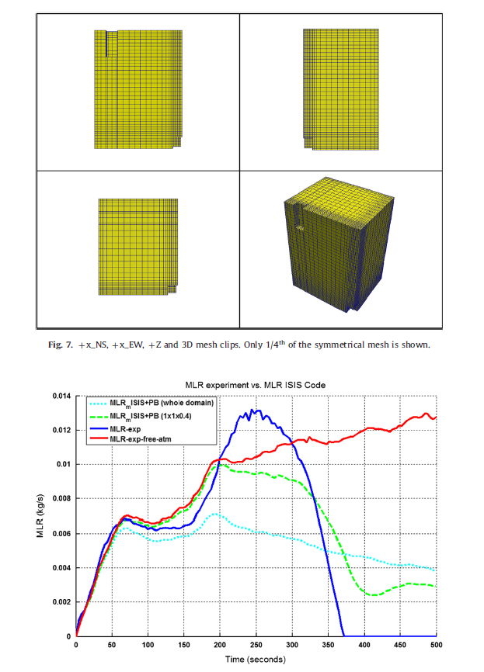
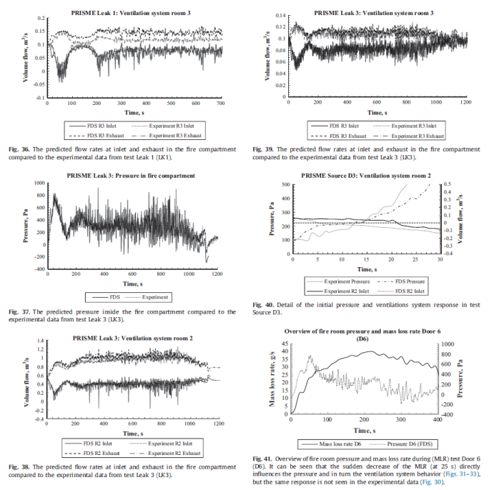
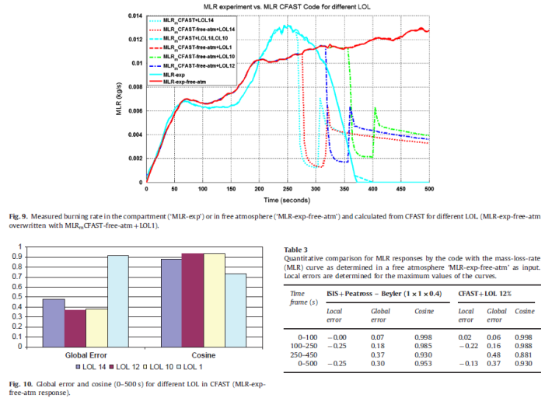
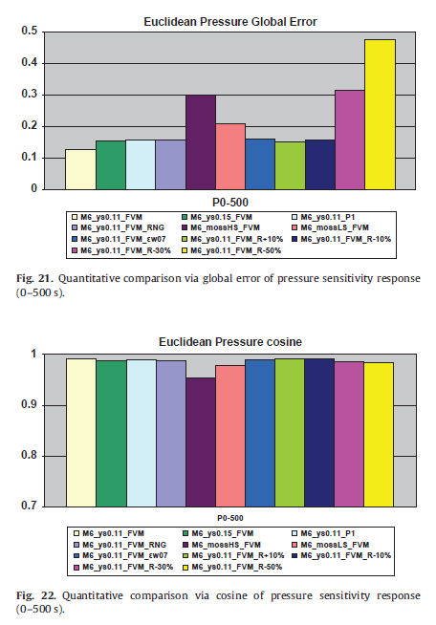
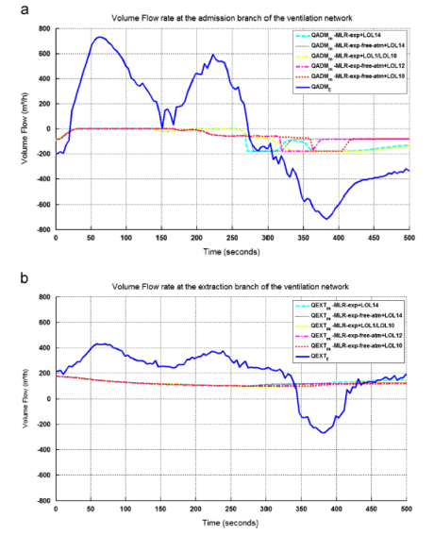
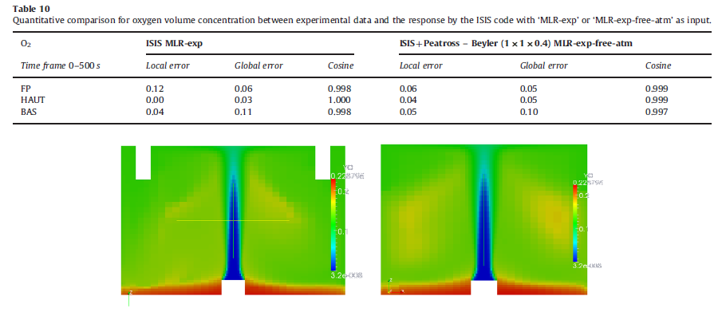
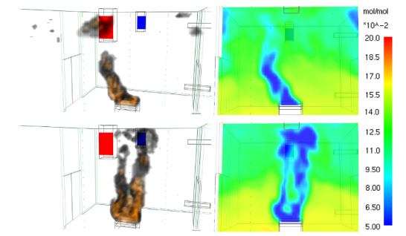
Extracted from Fire Safety Journal, Vol. 62, 2013

Slide 5
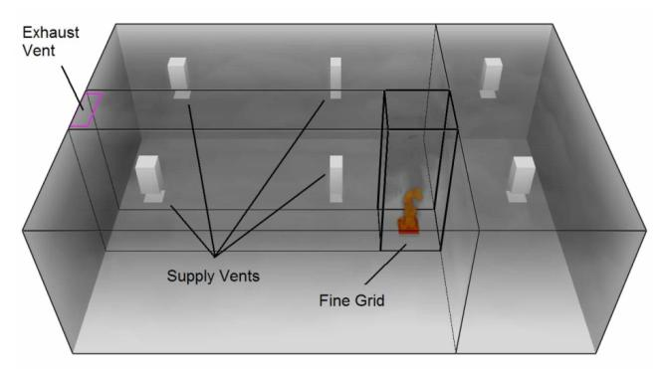
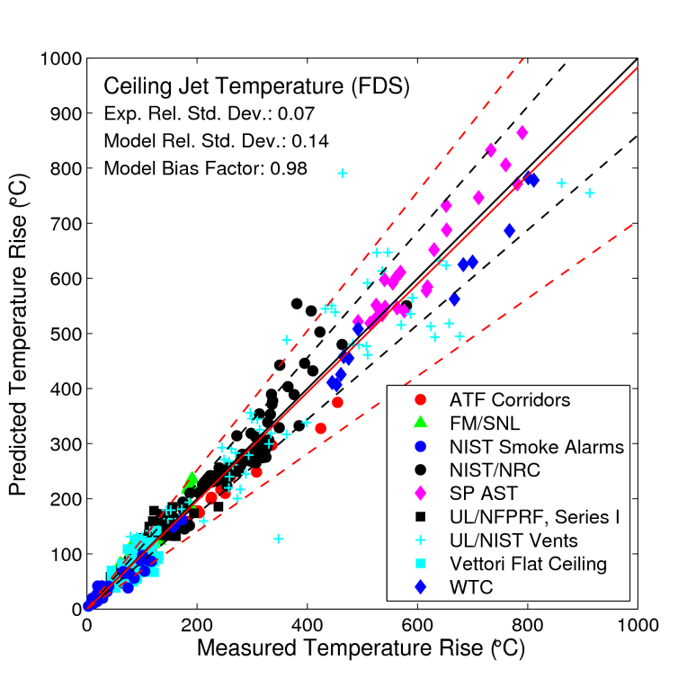
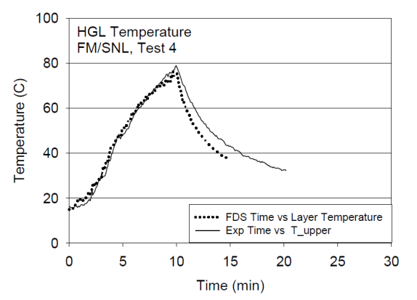
US NRC/EPRI Fire Model Validation Study NUREG-1824

Slide 6
Experimental Uncertainty
Example: Hot Gas Layer (HGL) Temperature
According to an empirical correlation (Quintiere et al.)
Uncertainty in HRR measurement is approximately 7.5%
Uncertainty in HGL temperature prediction: 2/3 x 7.5% = 5%
Combine (via quadrature) this propagated input uncertainty with the measurement uncertainty of approximately 5% to yield a combined relative uncertainty of 7%

Slide 7
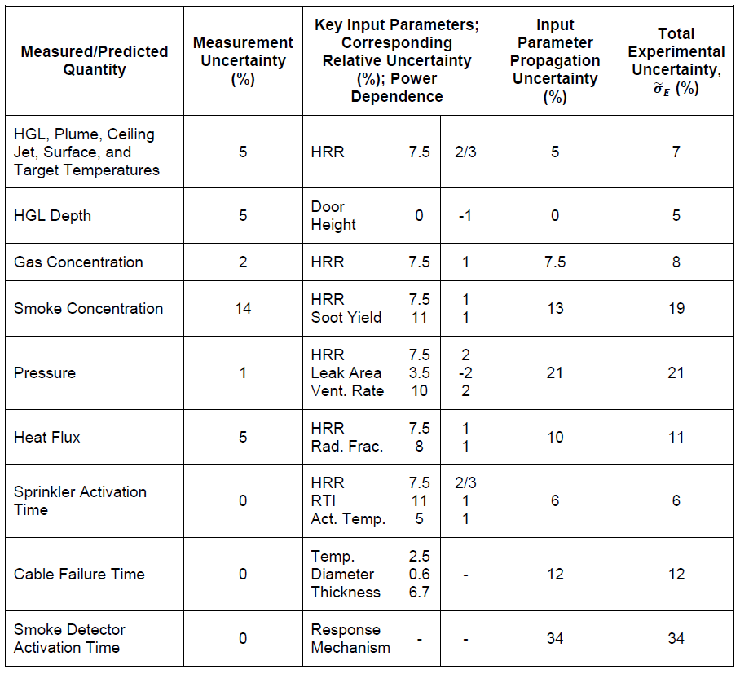
Summary of Experimental Uncertainty Estimates

Slide 8
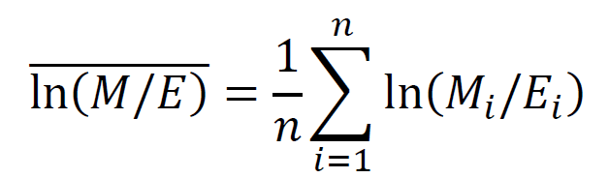
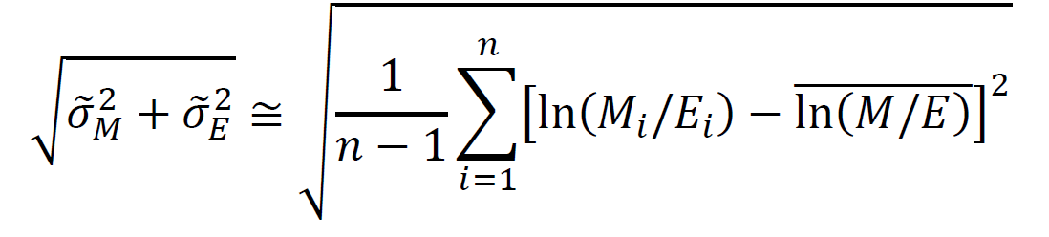
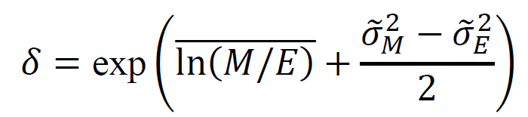
Given a set of model predictions, $M_{i}$, and experimental measurements, $E_{i}$, calculate a bias factor, $δ$, and relative standard deviation, ${\tilde{σ}}_{M}$

Slide 9
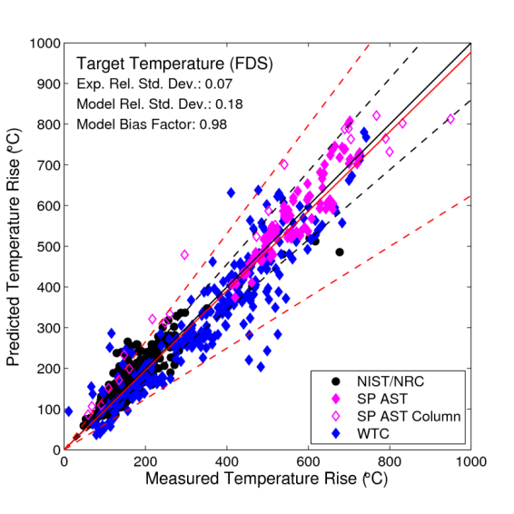
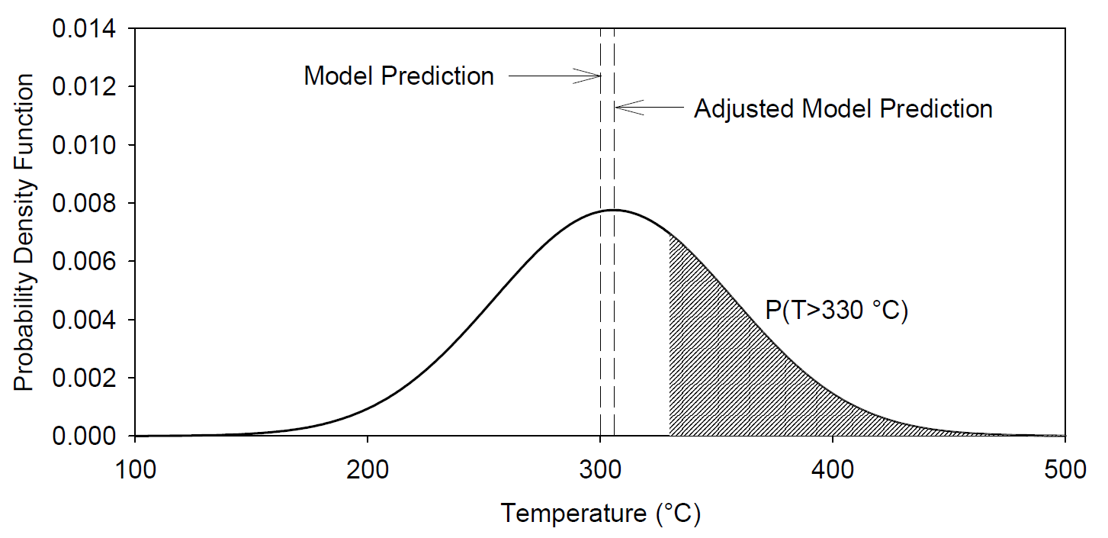
(Left) Typical results from a validation study. The black lines indicate the experimental uncertainty and the red lines indicate the model uncertainty.
(Below) Given a model prediction of 300 °C, what is the probability that the actual temperature might exceed 330 °C, the failure temperature of the given target?

Slide 10
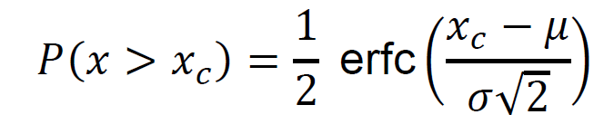


Procedure for Calculating Model Uncertainty
Critical Value
Model Prediction
Model Bias
Model Standard Deviation

Slide 11
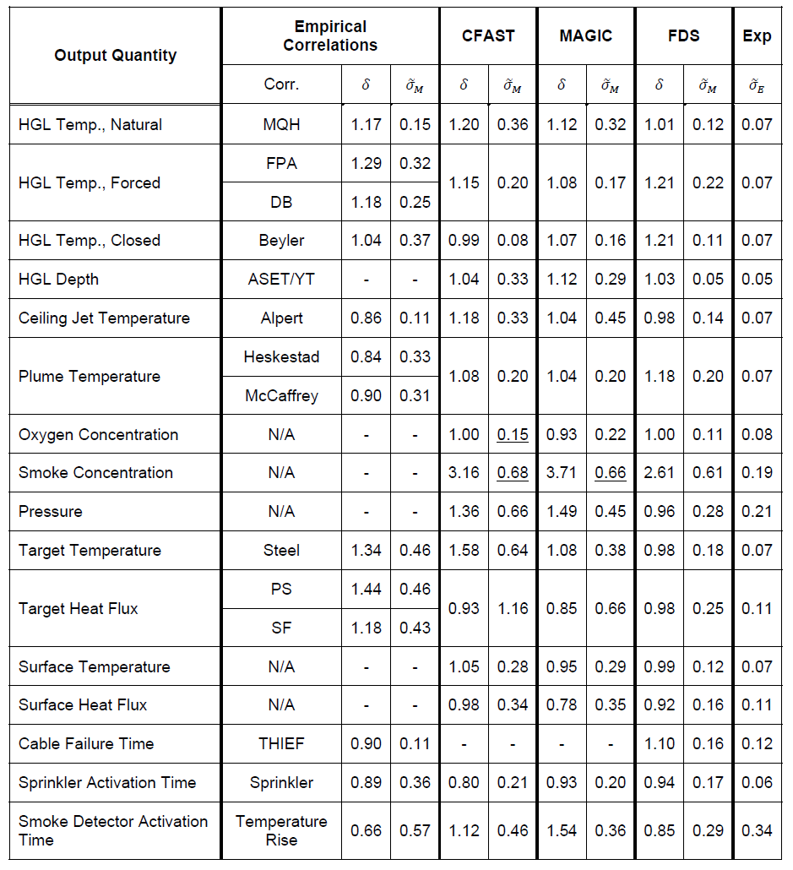
Models of Interest
Summary of
Validation Study for all Models
Quantities
of Interest

Slide 12
For which fire scenarios is the fire model valid?
r_{cj}
r
H
H
f
r
L_{f}
D
L

Slide 13
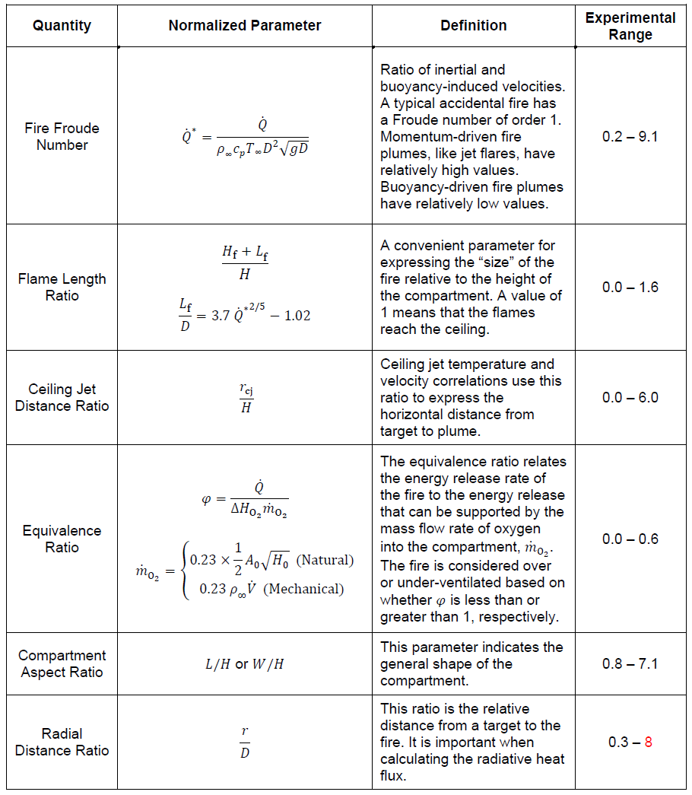

Slide 14
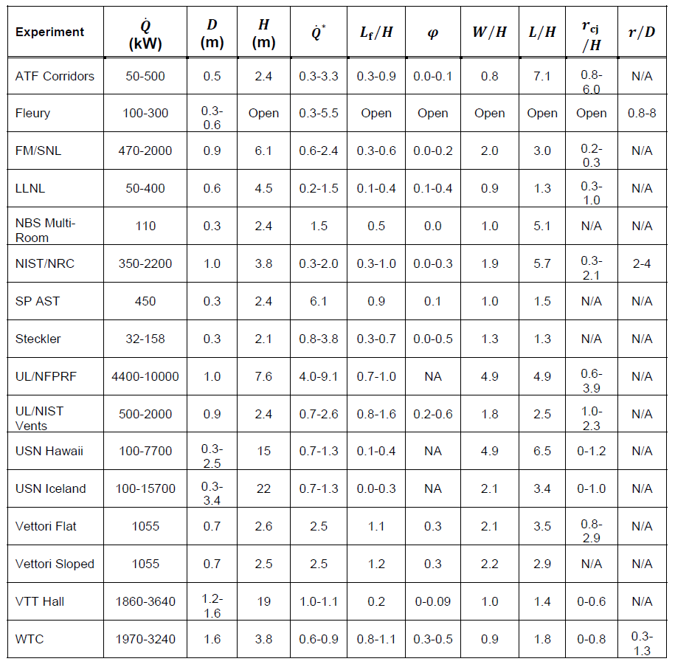
For what range of parameters are the models validated?
Notes:
Validation Guide

Slide 15
Basic questions asked by the Authority Having Jurisdiction (AHJ):
Has the model been verified and validated?
If yes, for what range of test conditions has the model been validated?
And, how accurate is the model?

Slide 16
Acknowledgments:
US Nuclear Regulatory Commission, Office of Nuclear Regulatory Research
Electric Power Research Institute
References:
NUREG-1824, V&V of Selected Fire Models for Nuclear Power Plant Applications, US Nuclear Regulatory Commission
NUREG-1934, Nuclear Power Plant Fire Modeling Application Guide, US Nuclear Regulatory Commission

