Slide 1
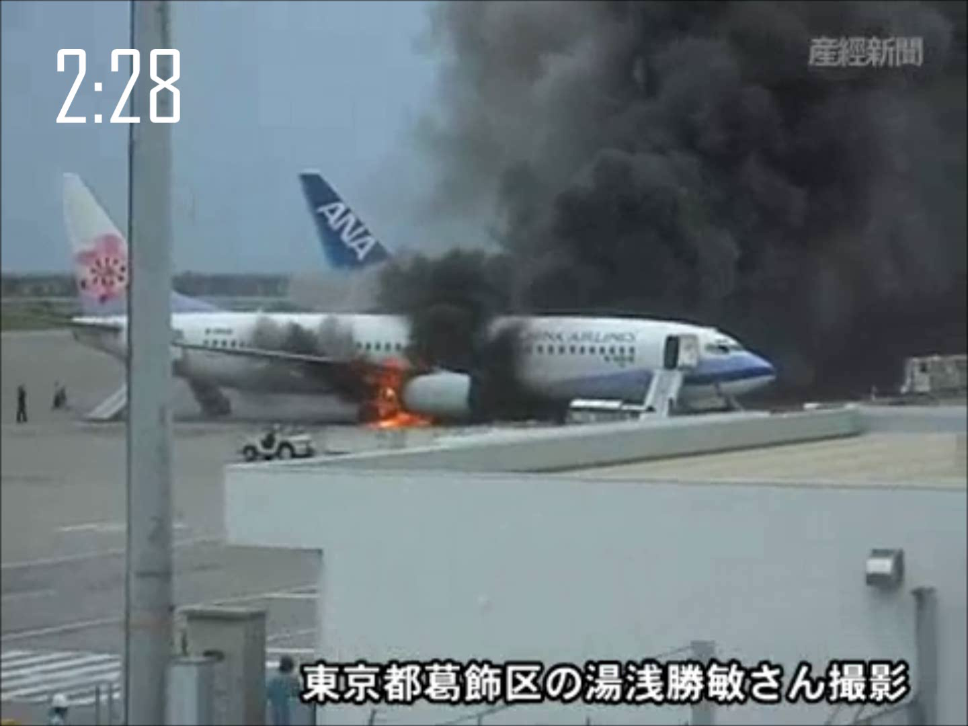
Notes:
In 2007 occurred an aviation accident Okinawa (Japan). an aircraft landed safely and reached the parking position when suddenly a fire boke out.

Slide 2
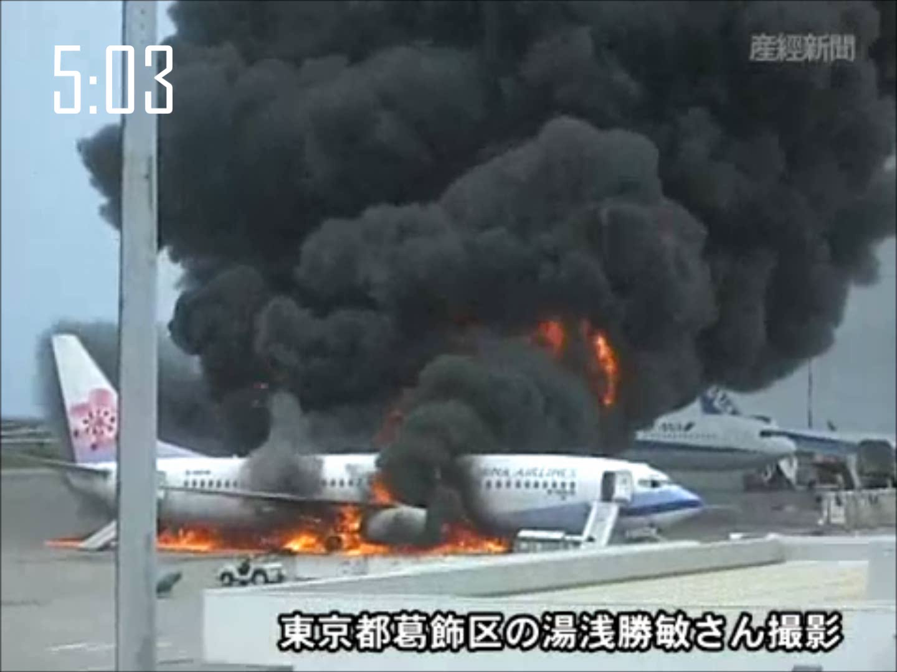
Notes:
- We can the see that fuel and the flame are totally spread out under the hole length of thh fuselage
What happens now that the aluminium, the hull of the plane an the complete structure starts to weaken under the massive heat.
The result is, that the aft part of the plane starts to bent under its own weight until it breaks from the rest of the plane.

Slide 3

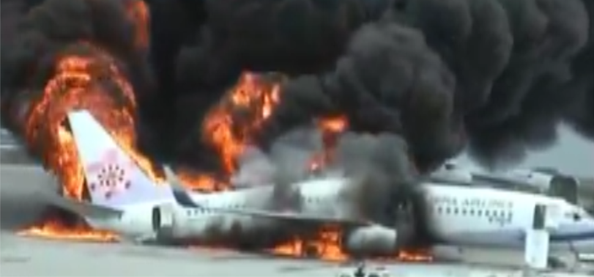
Start of evacuation 1:31 min
STRUCTURAL INTEGRITY
1:56min
End of evacuation 3:27 min
Fully developed fire 1:00 min
Collapse of fuselage 5:33 min
Structural integrity 4:33 min
source: youtube.com (HANA SAN327)
Notes:
Lets summarize what we just saw in the video during evacuation and how long it took.
1 minute and 31sec after the breakout of fire the evacuation started
3 minutes and 27sec all passengers and crew were successfully evacuated from the aircraft
So it took 1min 56sec to get everyone out of the burning plane
The key issu here is that the structural stability of this aluminum aircraft remained for 4:33min
And now we are going the next step with our project testing the structural integrity of composites in fire and that we do in an intermediate-scale

Slide 4

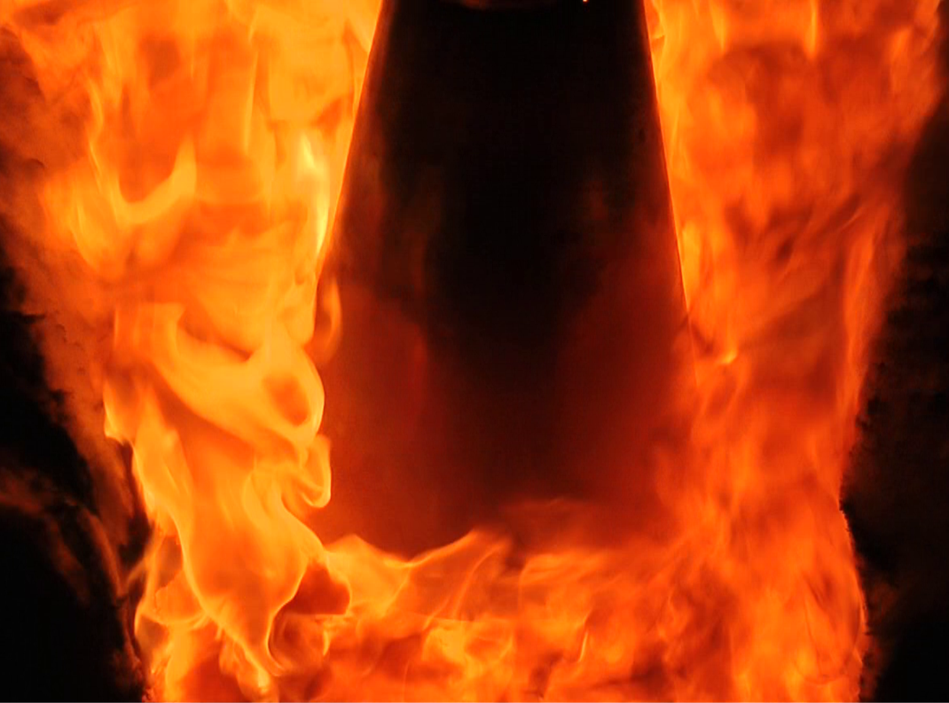

FIRE & CABIN SAFETY RESEARCH CONFERENCE
Structural Integrity in Fire:
An intermediate-scale Approach for Testing Composites
Bernhard Schartel
Sebastian Timme
Andreas Hoerold
Volker Trappe
Manfred Korzen
BAM Federal Institute for Materials
Research and Testing
Unter den Eichen 87, 12205 Berlin
bernhard.schartel@bam.de
Notes:
I am Sebastian Timme an engineer of aerospace and working on the project composites with the support of Dr. Schartel and …….. at the BAM Federal Institute for Materials Research and Testing in Berlin, Germany

Slide 5
Today´s Composites
CONTENT
Intermediate-scale Test Setup
Calibration of Burner
Composites in Fire - Results
Conclusion
Notes:
After some facts of today´s composites I introduce you the Intermediate-scale test setup that we successfully operate at the BAM
Followed by the results of the burner calibration I will present you the results of different carbon composite structures in Fire
And finally come to conclusion

Slide 6


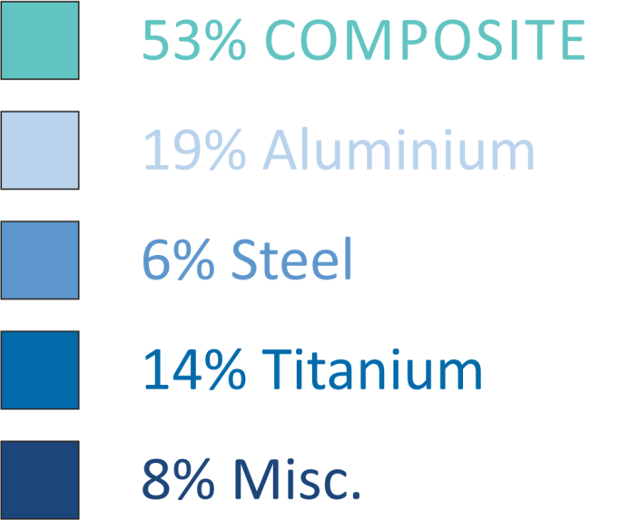
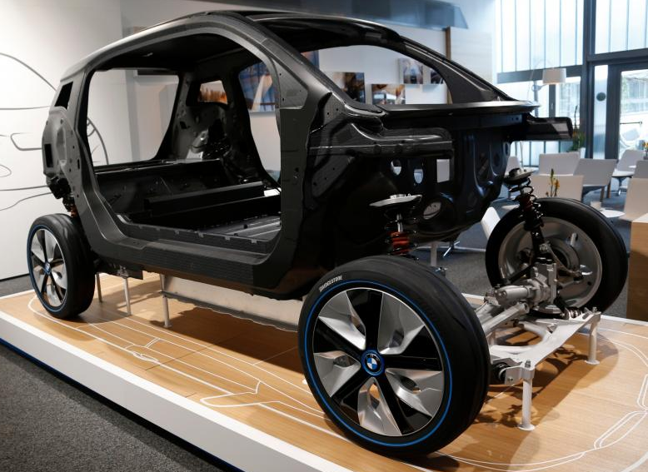
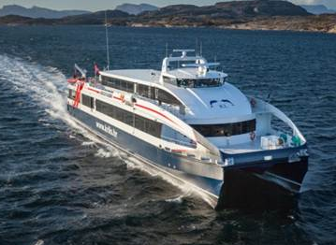
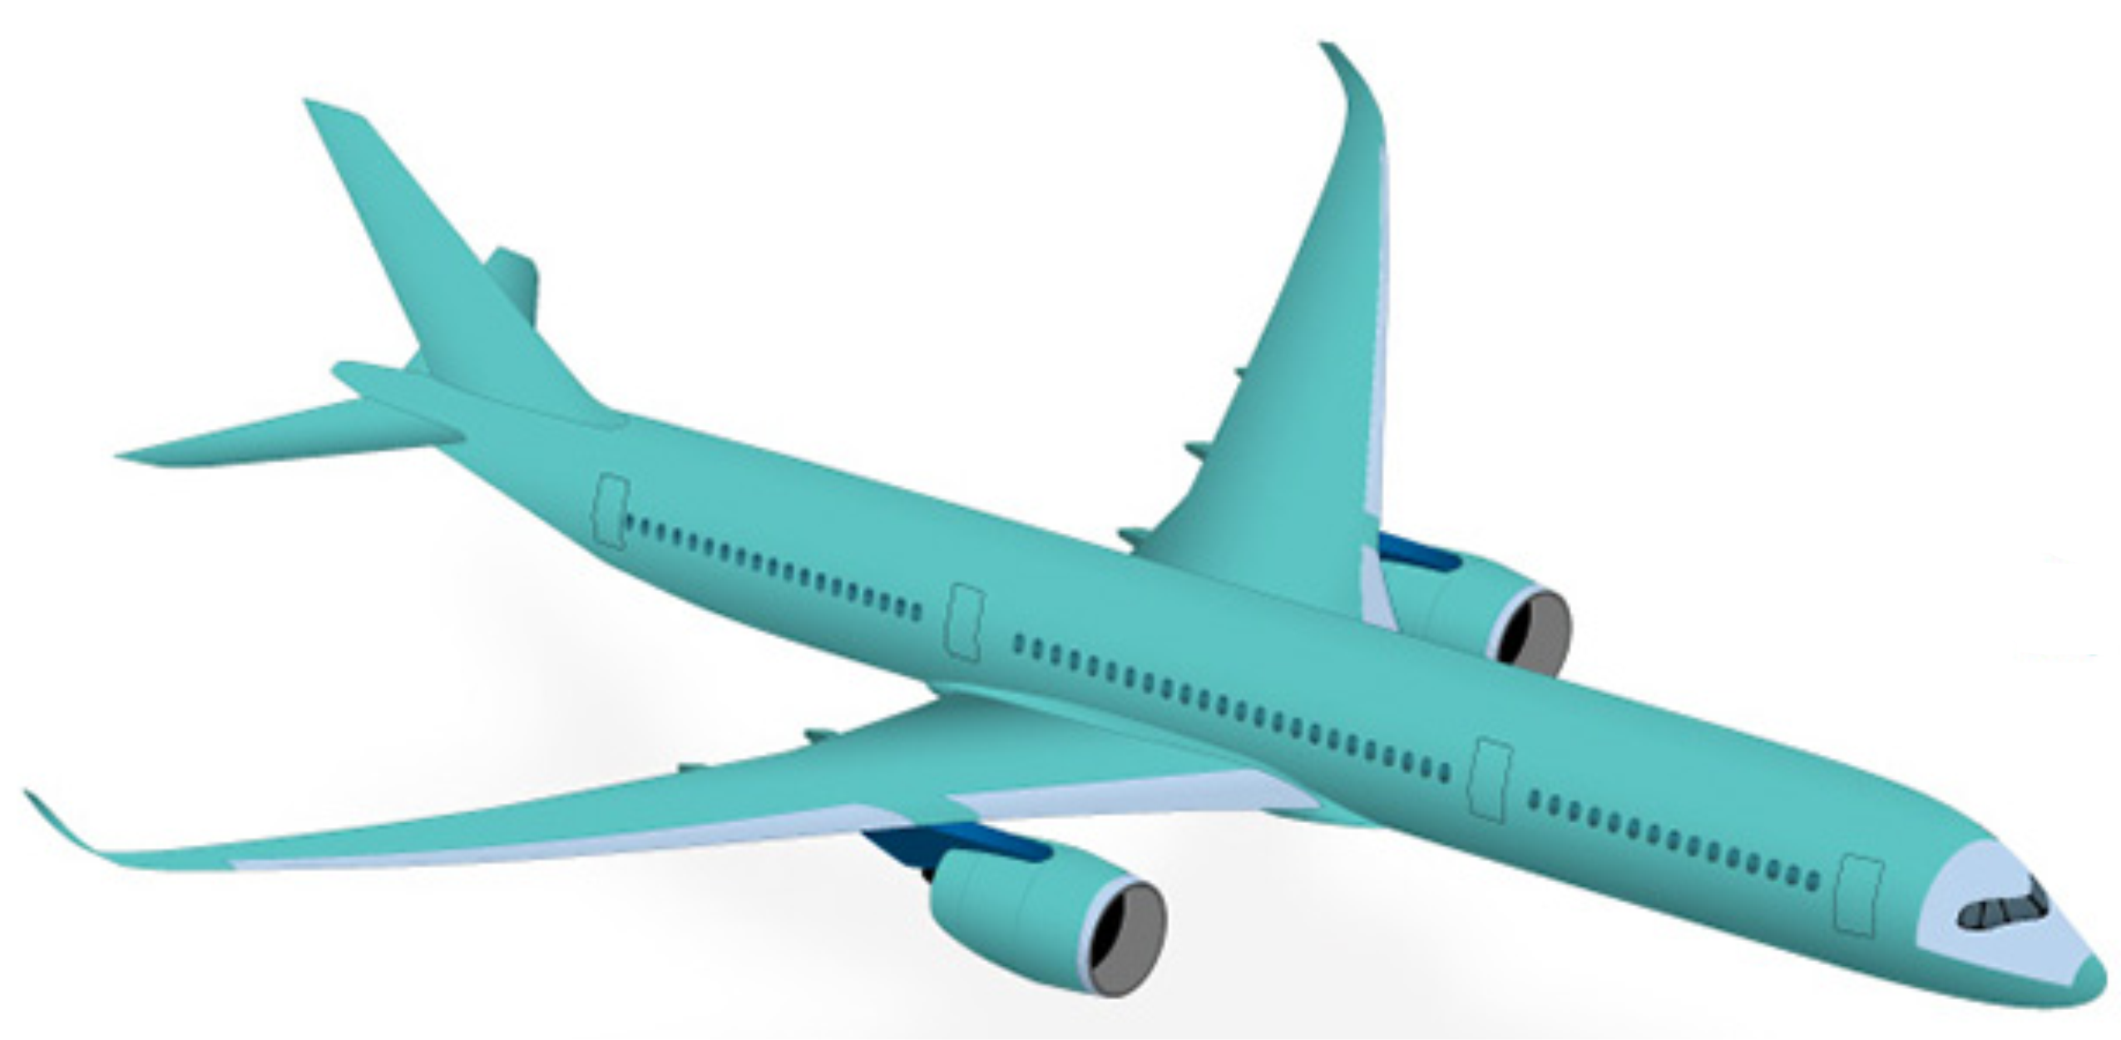


Usage of CFRP in public transportation
TODAYS´S COMPOSITES
www.bmw.de
www.braa.no
BMW i3/8 carbon bodywork
Catamaran carbon ferry
www.boeing.com
www.airbus.com
787 Dreamliner
Airbus A350
Notes:
The usage of CFRP increases permanently also in vehicles of public transportation.

Slide 7
Structural performance of CFRP in fire is complex
TODAYS´S COMPOSITES
No burn through, but still collapse
Carbon fibers ≈ 1100 °C
RTM6 resin TG = 180°C
Modification of CFRP to ensure structural stability of 4min
Notes:
The structural behavior of fiber reinforced polymers in fire is complex
In comparison to aluminum, carbon composites in general do not burn through but still collapse after short times in fire.
That can be explained when we consider the properties of the carbon fibers and the resin. by because of the carbonization in the production process the carbon fibers are quite flame resistant up to 1100°C
Contrary to the fibers, the resin reaches its glass transition temperature at about 180°C when we talk about the RTM6 resin and burns completely with higher temperatures
That why we have a different behavior of composites compared to metal like aluminum
The aim of this project is to modify the CFRP to resist the fully developed fire for at least 4min

Slide 8
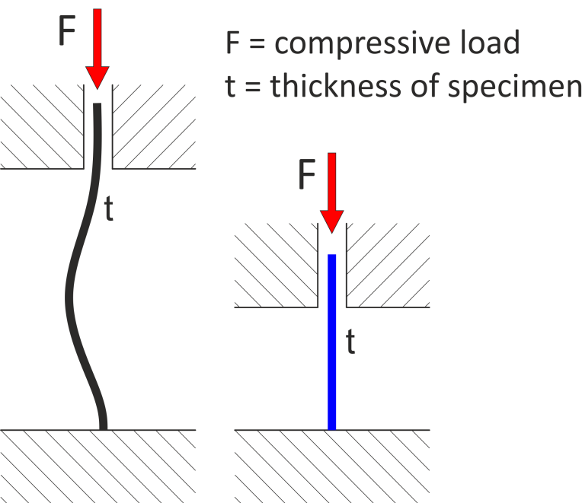
Full-scale test immense costs and hard realization
INTERMEDIATE-SCALE
Bench-scale test:
Stability behavior depends on specimen´s size
Intermediate-scale: 500x500 mm
Bench-scale: 100x100 mm
Notes:
A Full-scale test would produce immense costs and the realization would be very difficult
Bench scale tests were made by Dr. Schartel to investigate the influence of different flame retardant systems but of course the stability behavior is heavily dependent of the specimen´s size.
That is illustrated by the following figure. A specimen in intermediate-scale of 500x500mm and a thickness t compressed by a force F would show a lower stability then a specimen of the same thickness in the bench-scale. Scaling down the thickness is limited that’s why the intermediate-scale a very good compromise between the costs and attaining realistic results
How can a structure look like that we are able to test?!

Slide 9
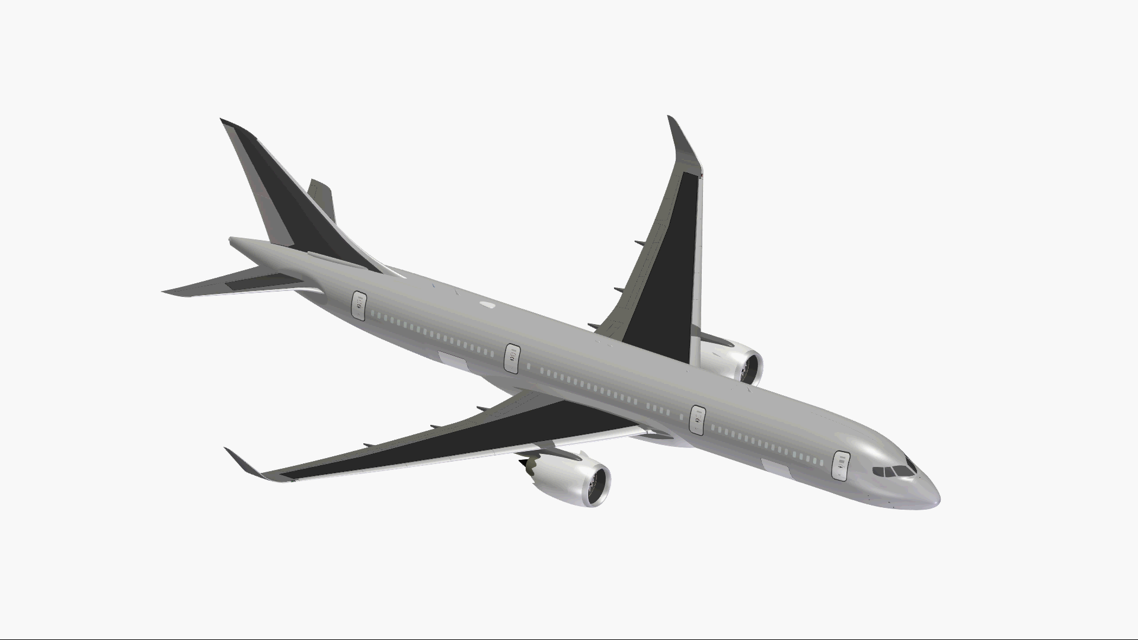
INTERMEDIATE-SCALE
Notes:
-therefor we can have look to this aircaft model

Slide 10
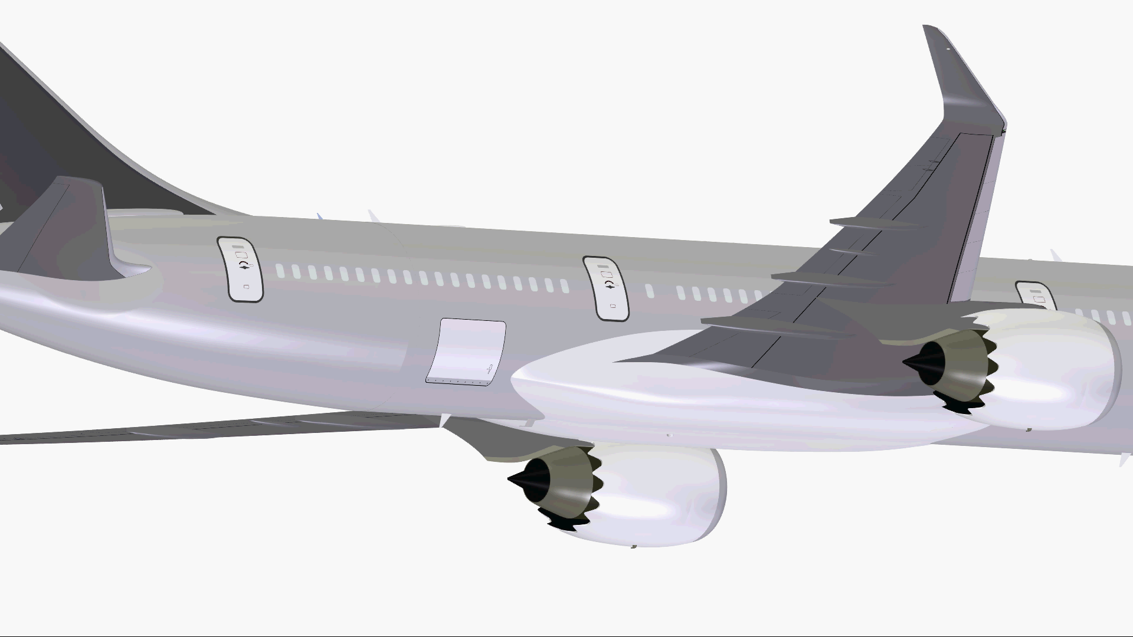
INTERMEDIATE-SCALE
Notes:
- We will have a look to the critical area of the aircraft where it broke in the video
- The upper part is under a tensile load and the lower part is under a compressive load, where the compressive load is the more critical one for carbon composites

Slide 11
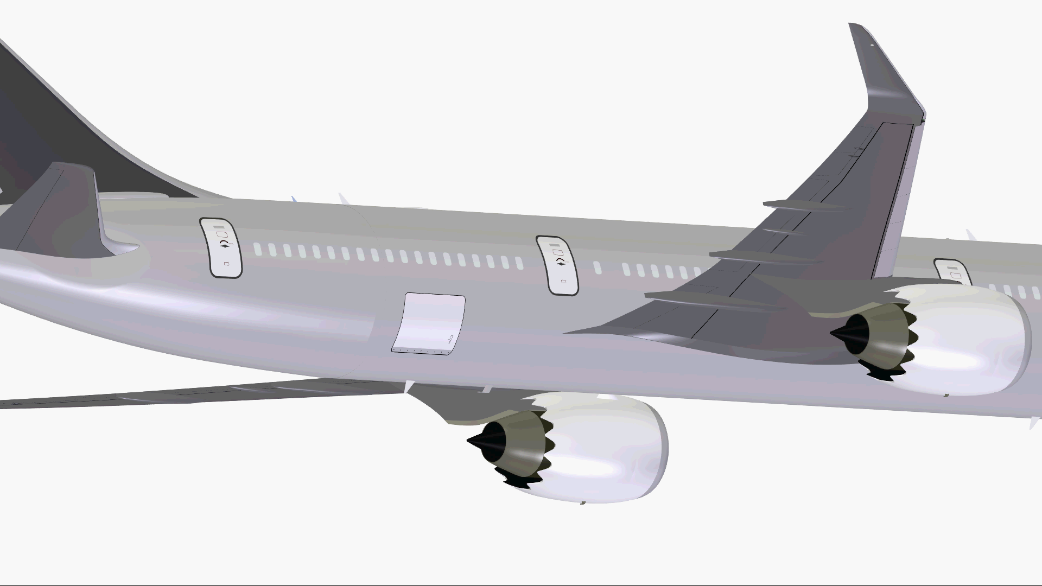

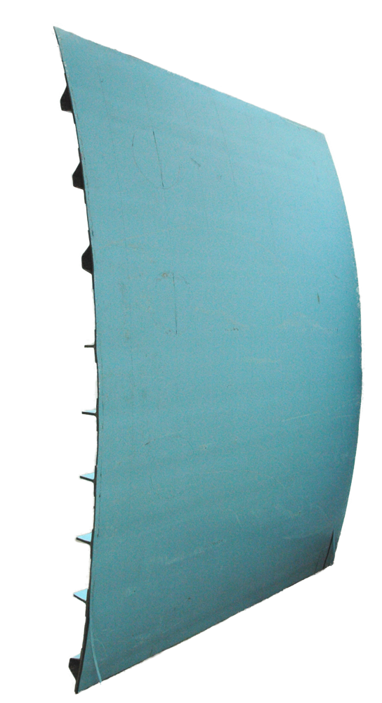
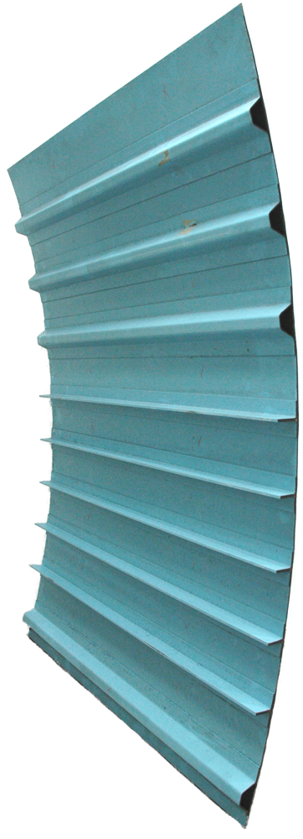
Outside view
INTERMEDIATE-SCALE
Inside view
500mm
500mm
1
2
4
3
Typical CFRP structure
Notes:
Here we have a typical CFRP airframe structure with a very thin skin reinforced by stringers
We will tailor this structure in specimens that we can handle in an intermediate scale
- How are we going to test this shell specimens.

Slide 12
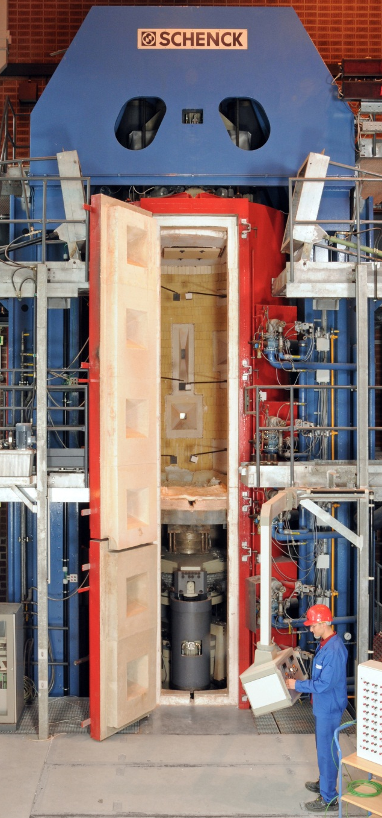
Boundary conditions for fire testing
INTERMEDIATE-SCALE TEST SETUP
Fire and compressive load
Smoke exhaust cleaning system
3.6 m
Column test furnace @ BAM
Height adjustable 3.6 – 5.6 m
Hydraulic system: 6 MN compressive load
Transfer of force into specimen ?
Source: BAM
Notes:
First of all To perform fire tests we have to fulfil certain boundary conditions
At first we need an environment where we can expose a carbon composite to a fully developed fire and simultaneously put a compressive load on it.
Secondly we need a smoke exhaust cleaning system to clean the air before we release it to the open environment.
These requirements are fulfilled by the column test furnace we have at the BAM
The height (hait) of the test space can be adjusted form 3.6 to 5.6m
The hydraulic system of the test furnace can provide a compressive load up to 6 MN
To transfer the compressive load into the specimen we need an compressive device, the intermediate-scale test bench!

Slide 13
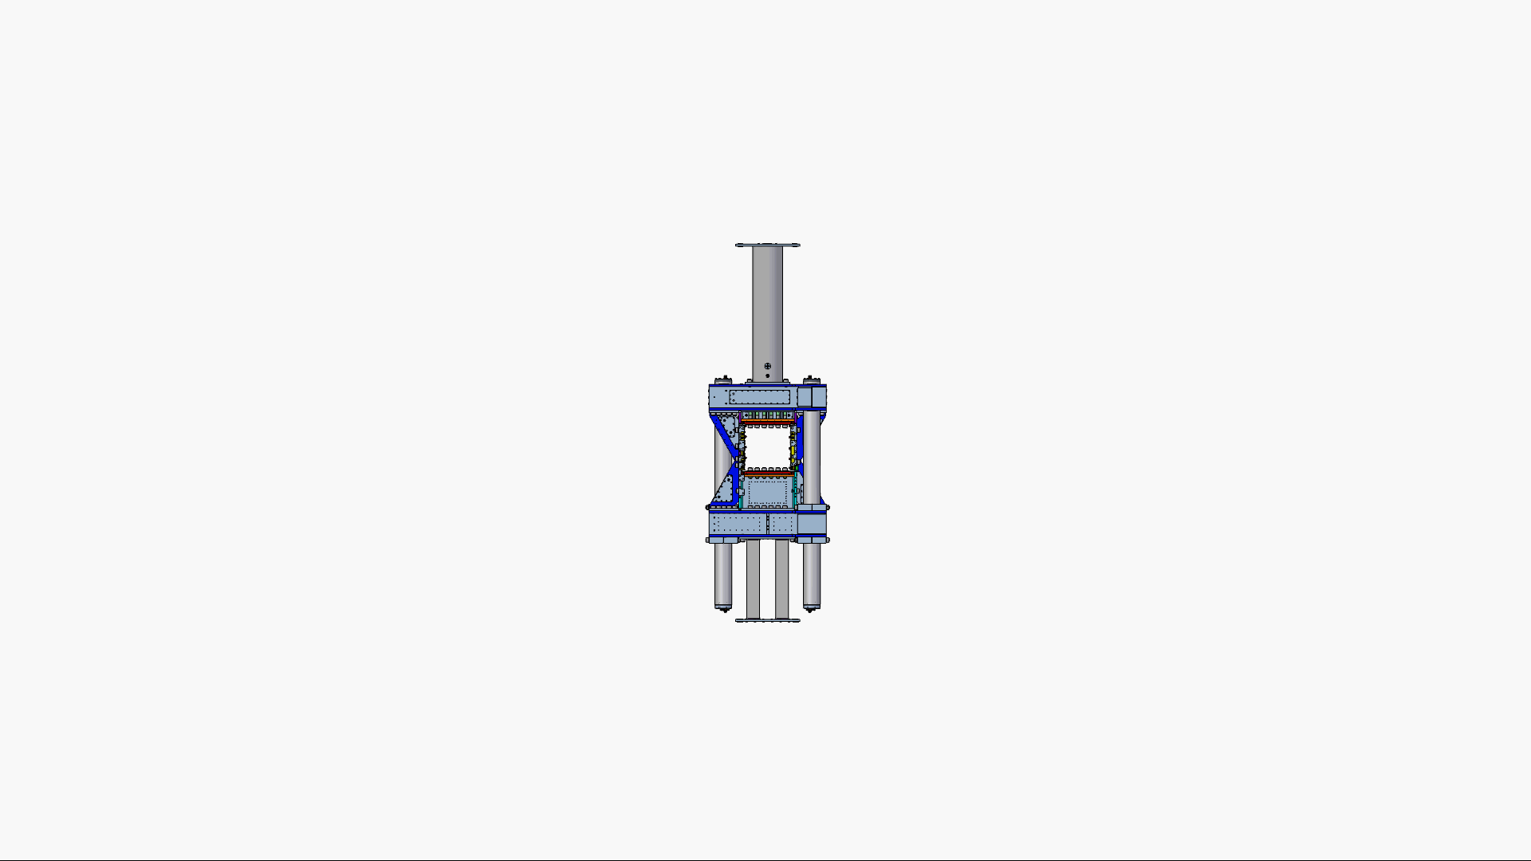

INTERMEDIATE-SCALE TEST BENCH
Conception
Construction
Built up
@

Slide 14
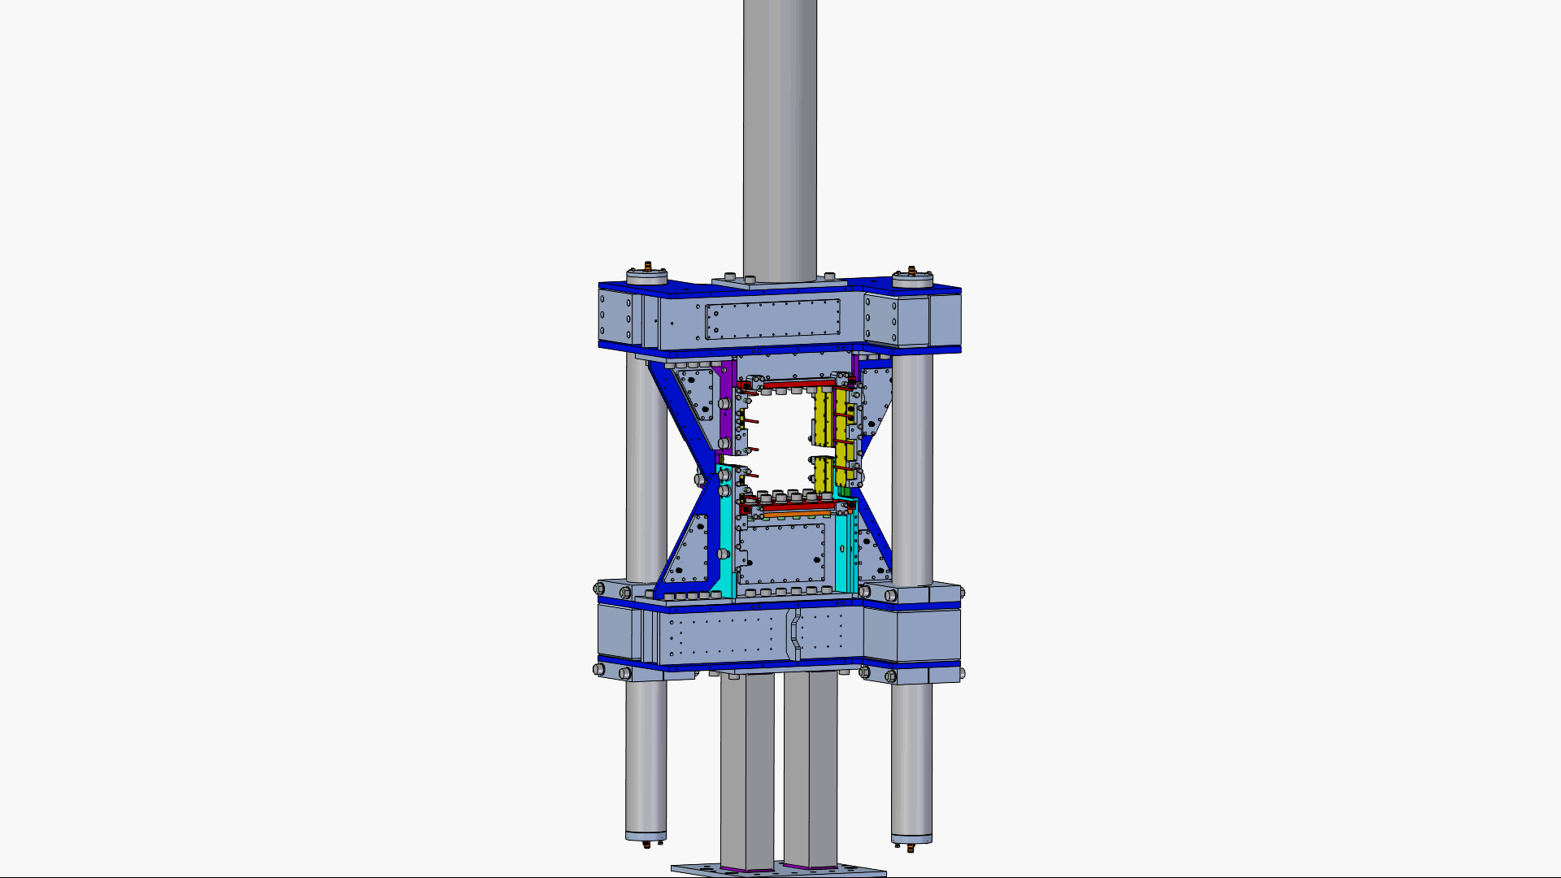
INTERMEDIATE-SCALE TEST SETUP
Upper adapter column
Upper cross-head
Guide column
lower cross-head
lower adapter column
Notes:
- In a explosion view we can differ between the main parts.
That are the upper and lower adapter column that transfer the pressure to the test bench
The upper und lower cross-head and the guide columns that ensure a linear moving between the lower and upper part of the test bench
We can have a closer look to the specimen clamping

Slide 15
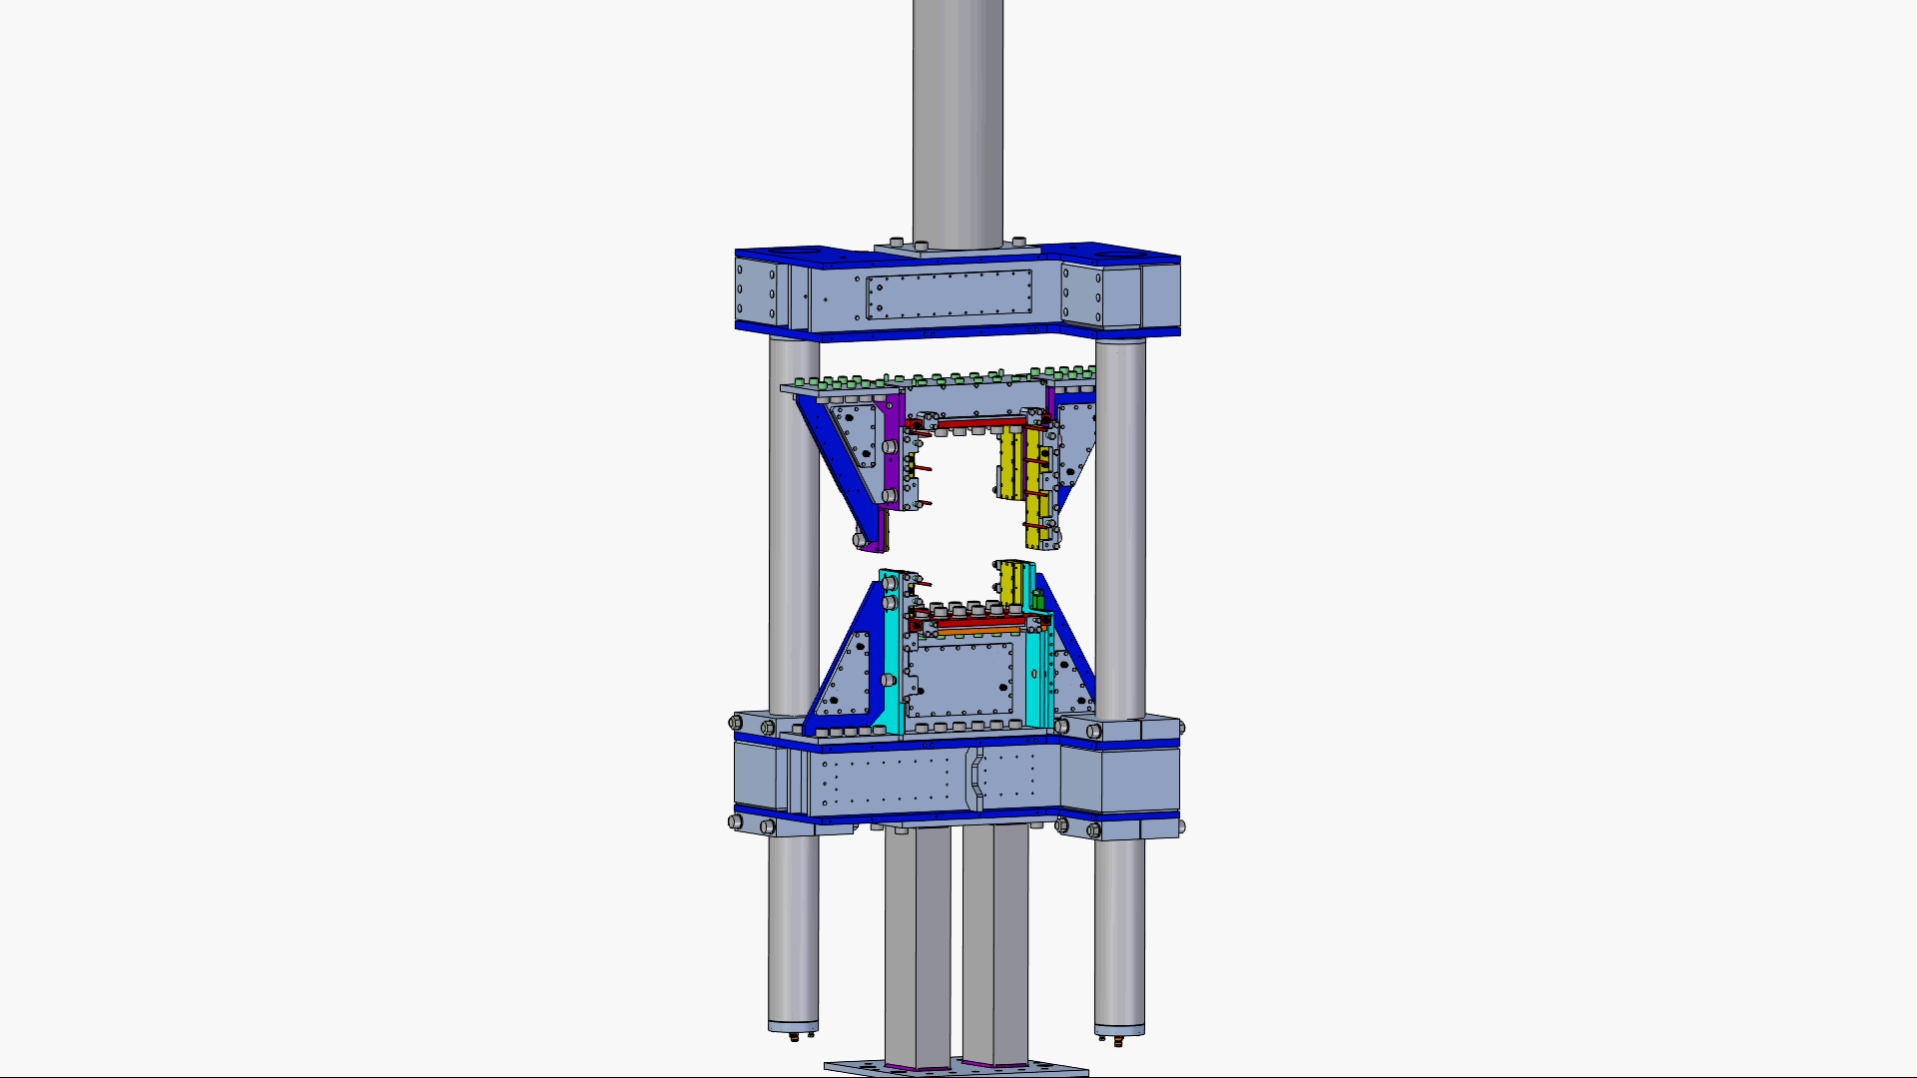
INTERMEDIATE-SCALE TEST BENCH
Side bearing
(yellow)
Lower and upper bearing (red)
Notes:
- In red colours you can detect the upper and lower bearing
- And In yellow colours you can identify the side bearing which beacause of sharpe edges ensures an easy support of the specimen.

Slide 16
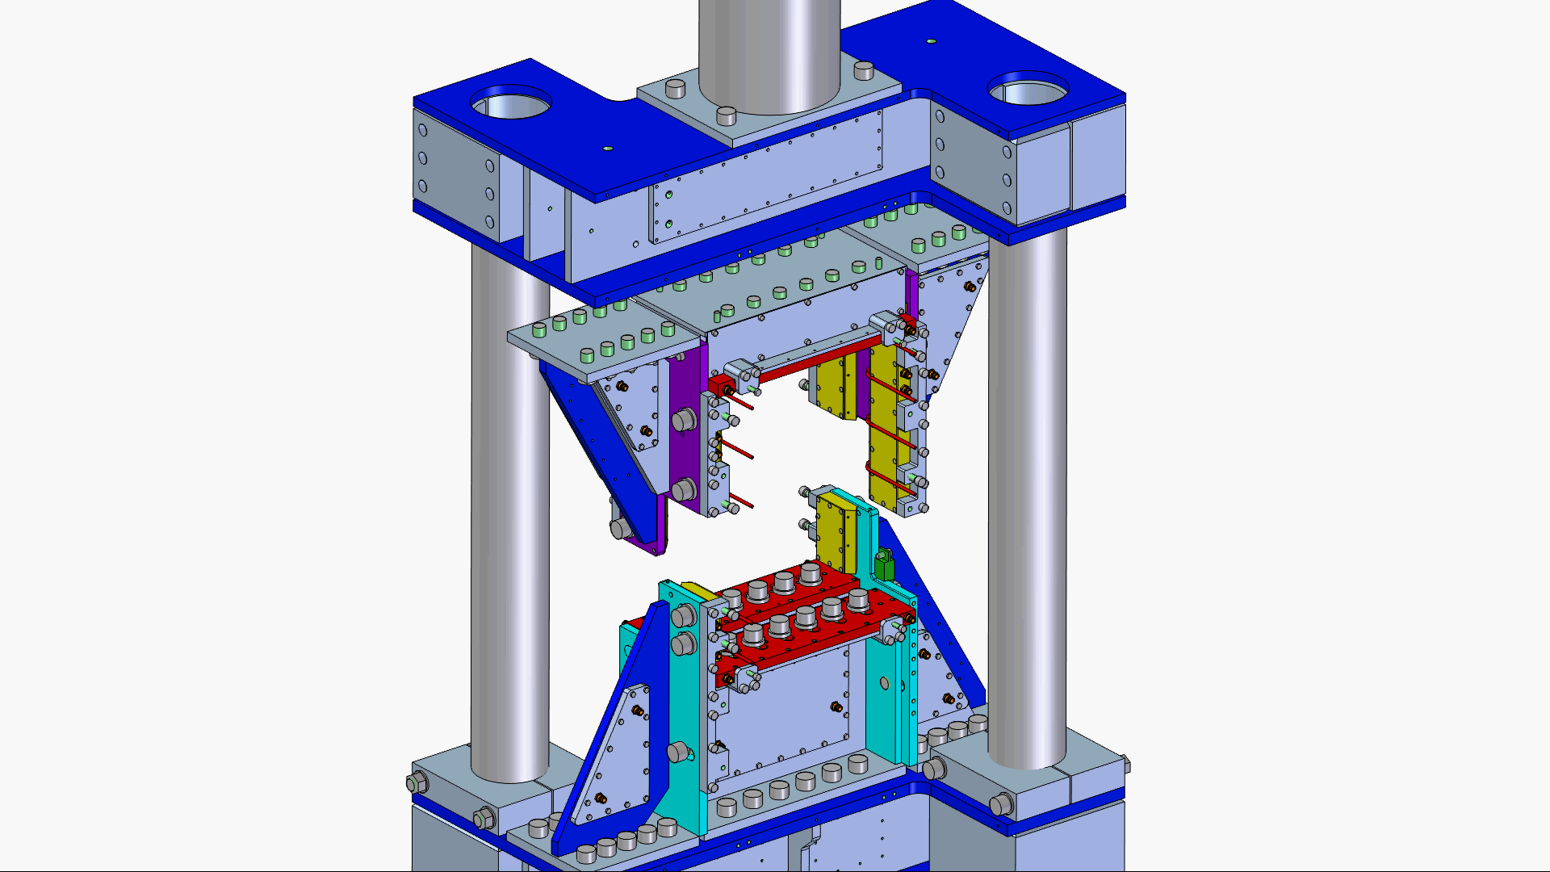
INTERMEDIATE-SCALE TEST BENCH

Slide 17
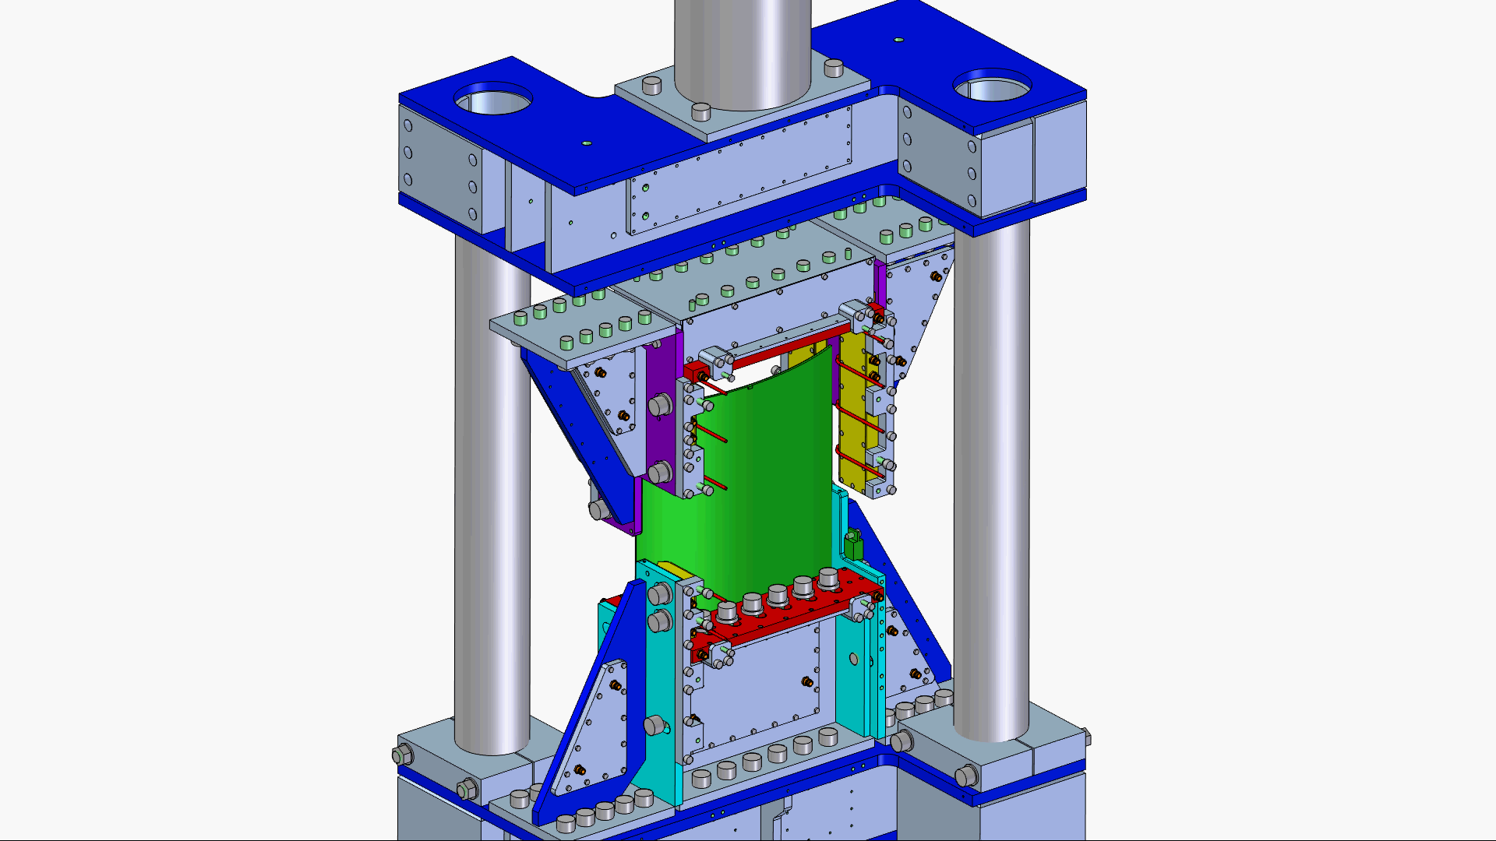
INTERMEDIATE-SCALE TEST BENCH

Slide 18
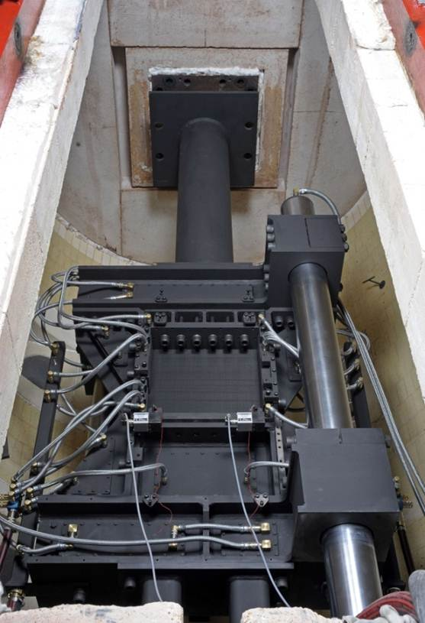
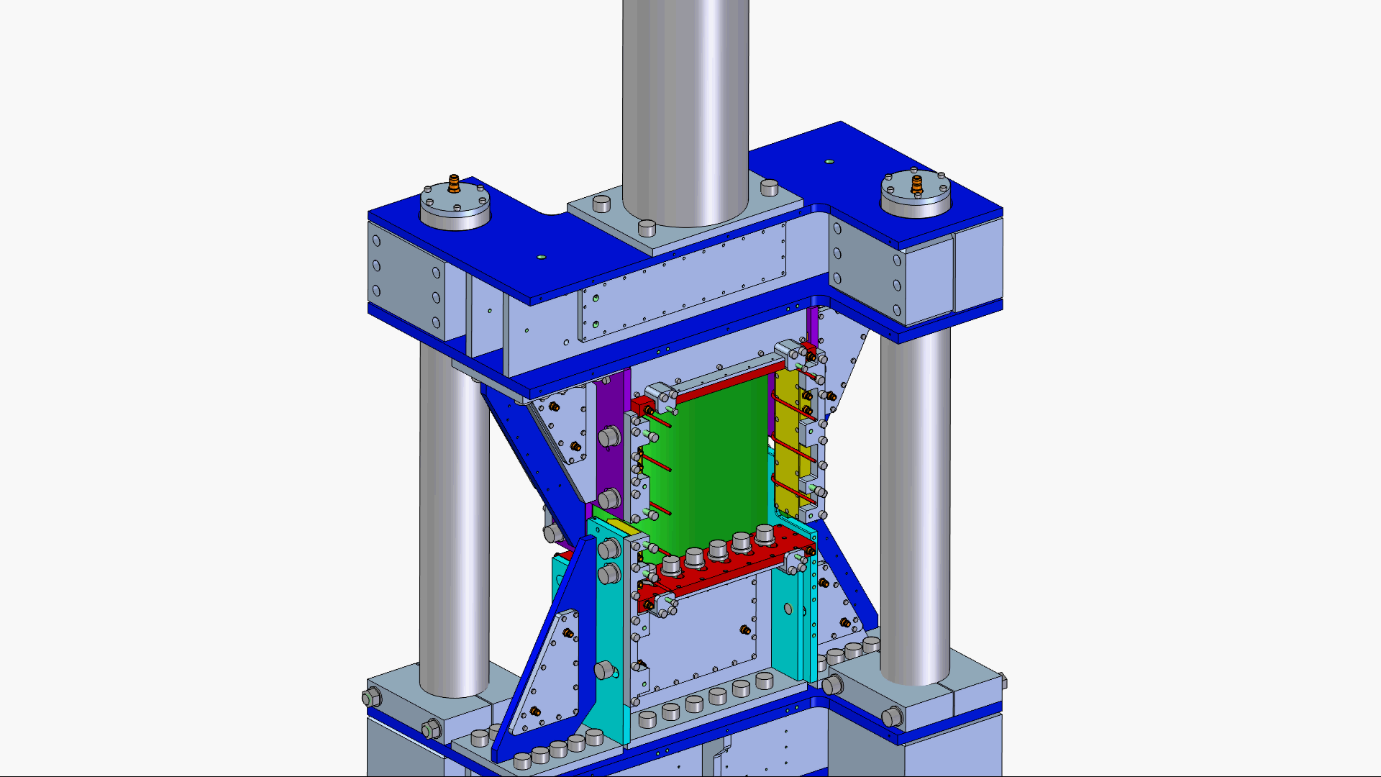
INTERMEDIATE-SCALE TEST BENCH

Slide 19
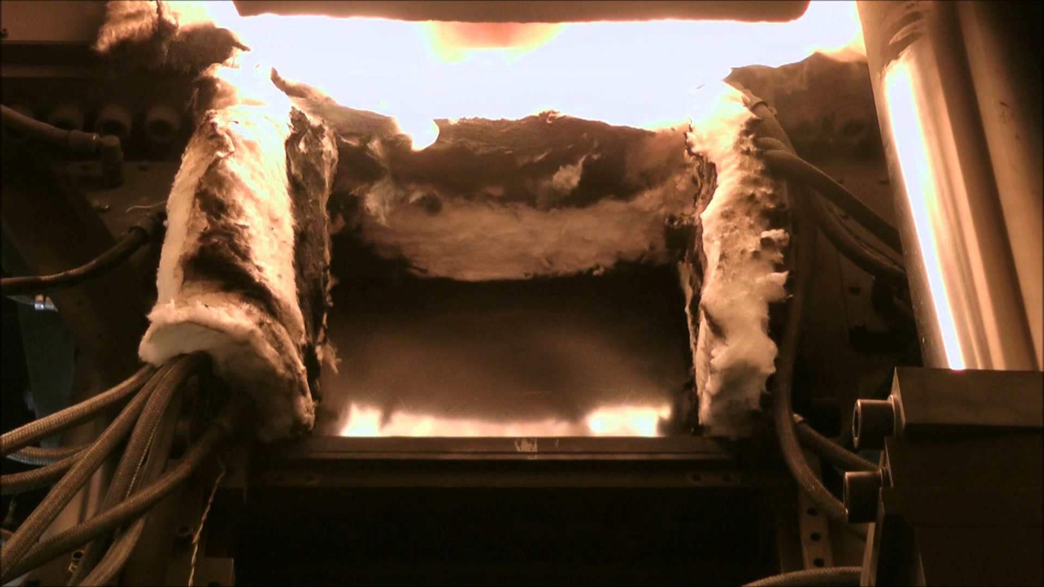
INTERMEDIATE-SCALE TEST BENCH

Slide 20
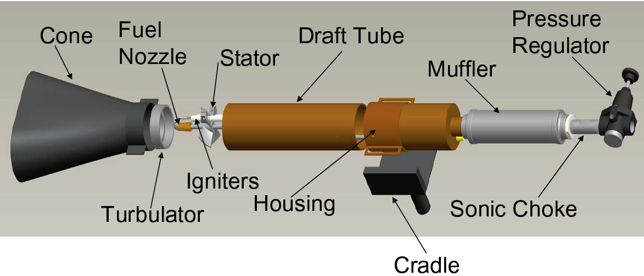
Next Generation Burner (ME 1500-1)
CALIBRATION OF BURNER
source: FAA
In Use for international established fire tests of the FAA
(FAR 25.856(b))
Simulates a post crash fire (≈ 18.2 W/cm² at 100mm distance)
Notes:
For the composite in fire tests we decided to use The next generation burner shown in this picture with its single components.
We selected this burner because it is in use for international established fire tests developed by the FAA
It was constructed to simulate a fully developed post crash fire with a heat flux of 18.2 Watt per square cm

Slide 21
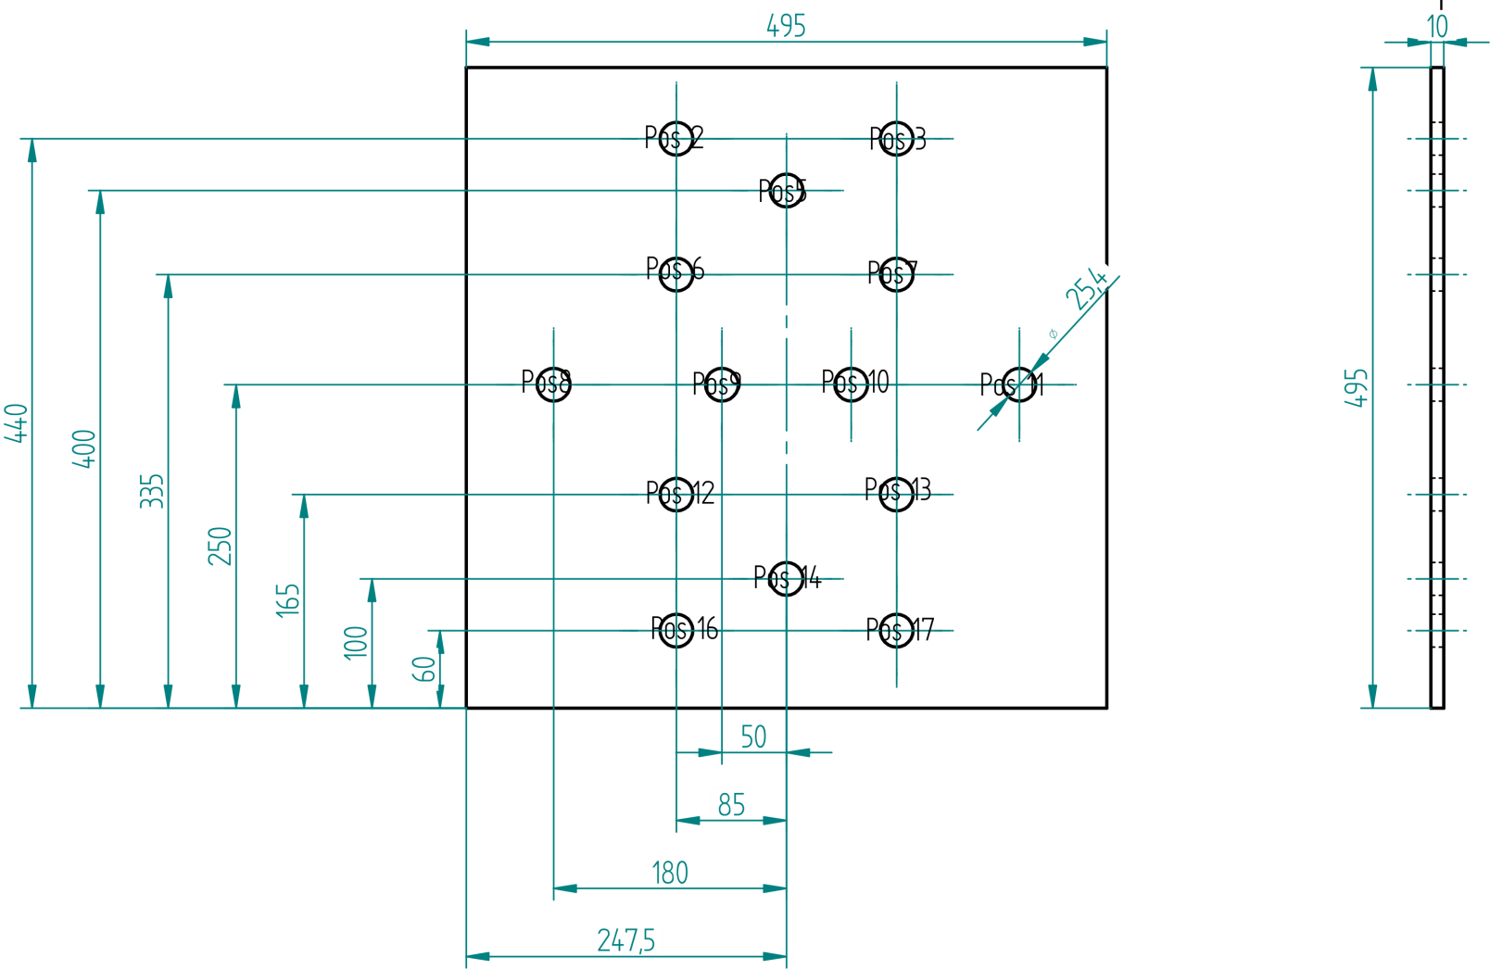
Heat flux mapping with perforated non-inflammable plate
CALIBRATION OF BURNER
Measurement at different positions
Notes:
To calibrate the burner and to measure the heat flux distribution we made a heat flux mapping
At diffierent defined positions we measure the heat flux with a calorimeter

Slide 22
Procedure according FAA Burner Calibration Guidelines
CALIBRATION OF BURNER
Warm up 120s
Stabilization of colorimeter 60s
Data uptake 30s
Average heat flux ≈ 18.2 W/cm²
Notes:
We do the calibration according to the FAA Burner Calibration Guideline
You have to ignite the burner and let it warm up for 120 sec in an upper position and then turn the burner onto the specimen
After the calorimeter stabilized we take up data for 30sec
The avarage heat flux within this 30sec should be 18.2 W/cm²

Slide 23
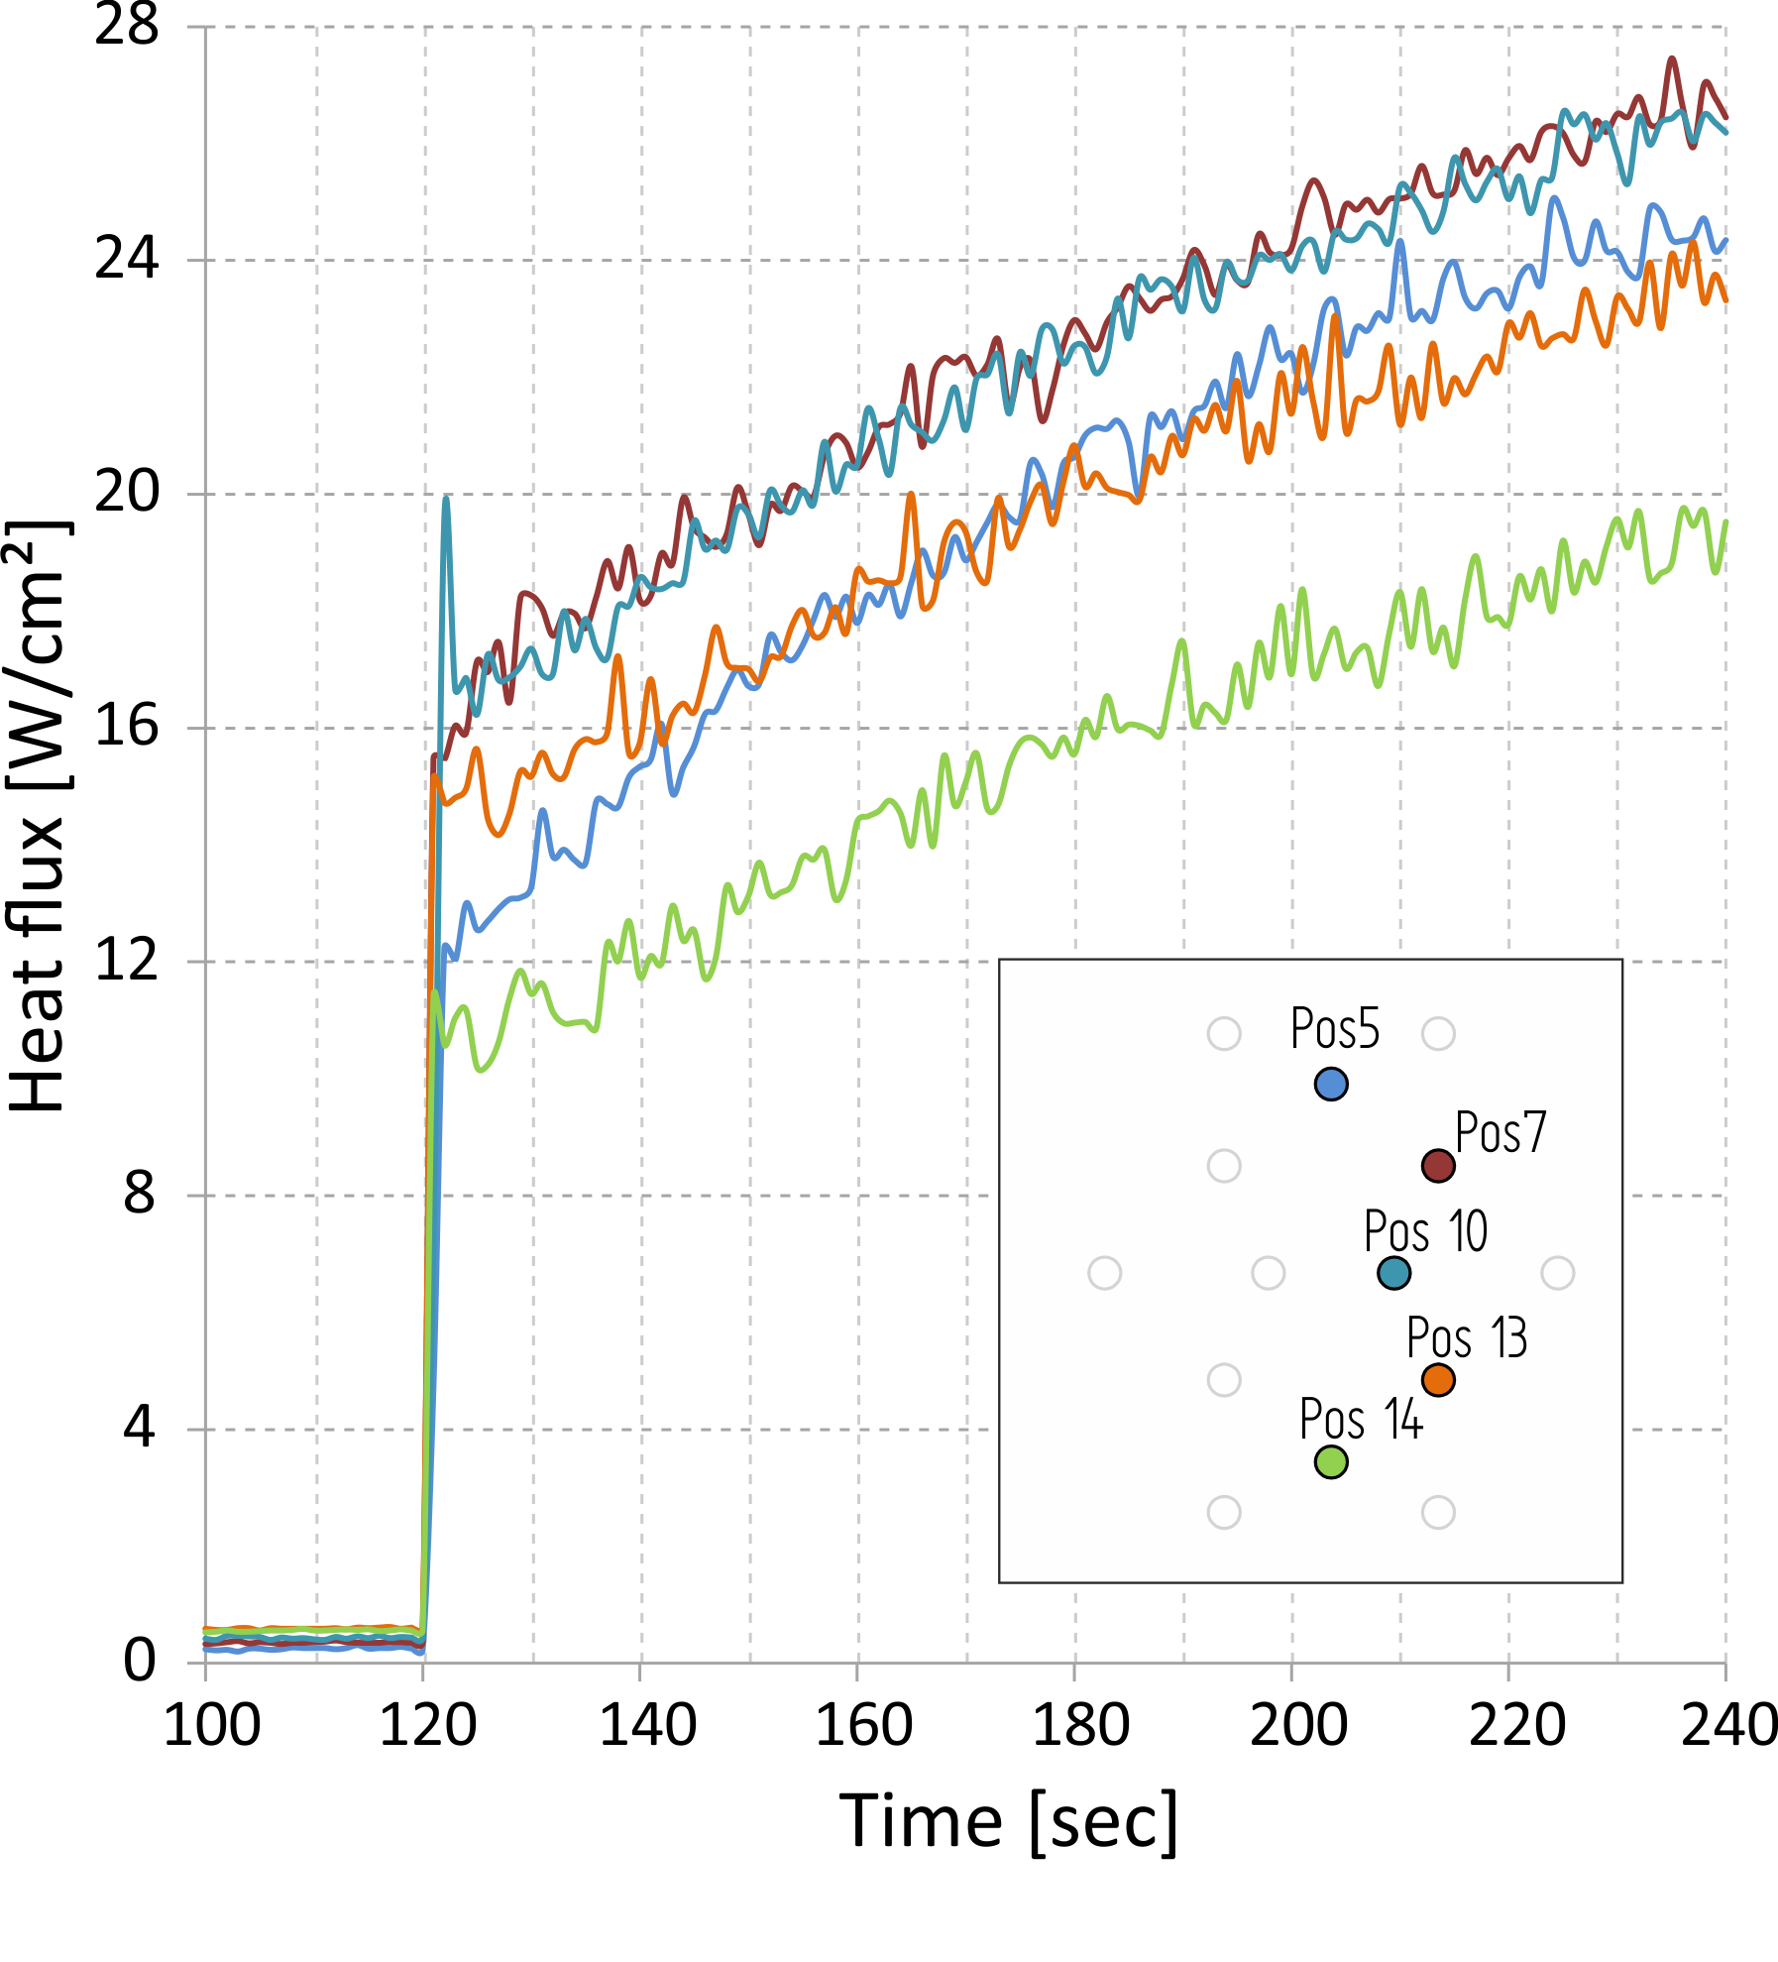
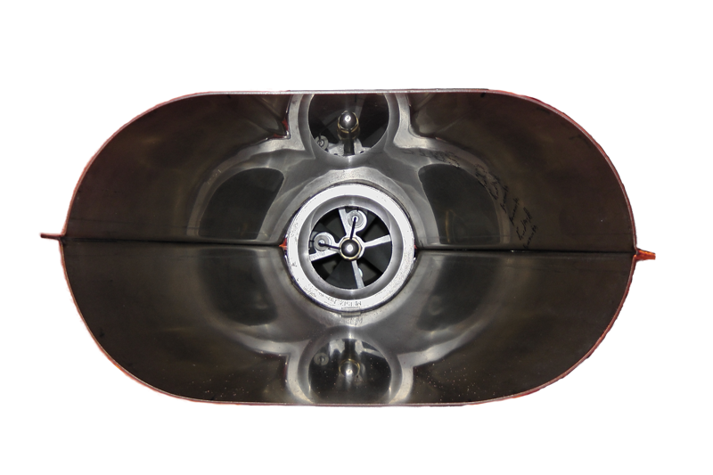
CALIBRATION OF BURNER
Warm up 120s
After 60s no constant heat flux
Elliptical cone
Notes:
I selected significant positions for this diagram for a better realization of the heat flux trend
After the warm up phase of 120sec we turn the burner onto the plate with the colorimeter and immediately measure a heat flux at all positions.
After the stabilization time for the calorimeter the heat flux still increases and reaches values high above the demand of 18 w/cm²
This results were obtained with the elliptical cone used by the FAA

Slide 24
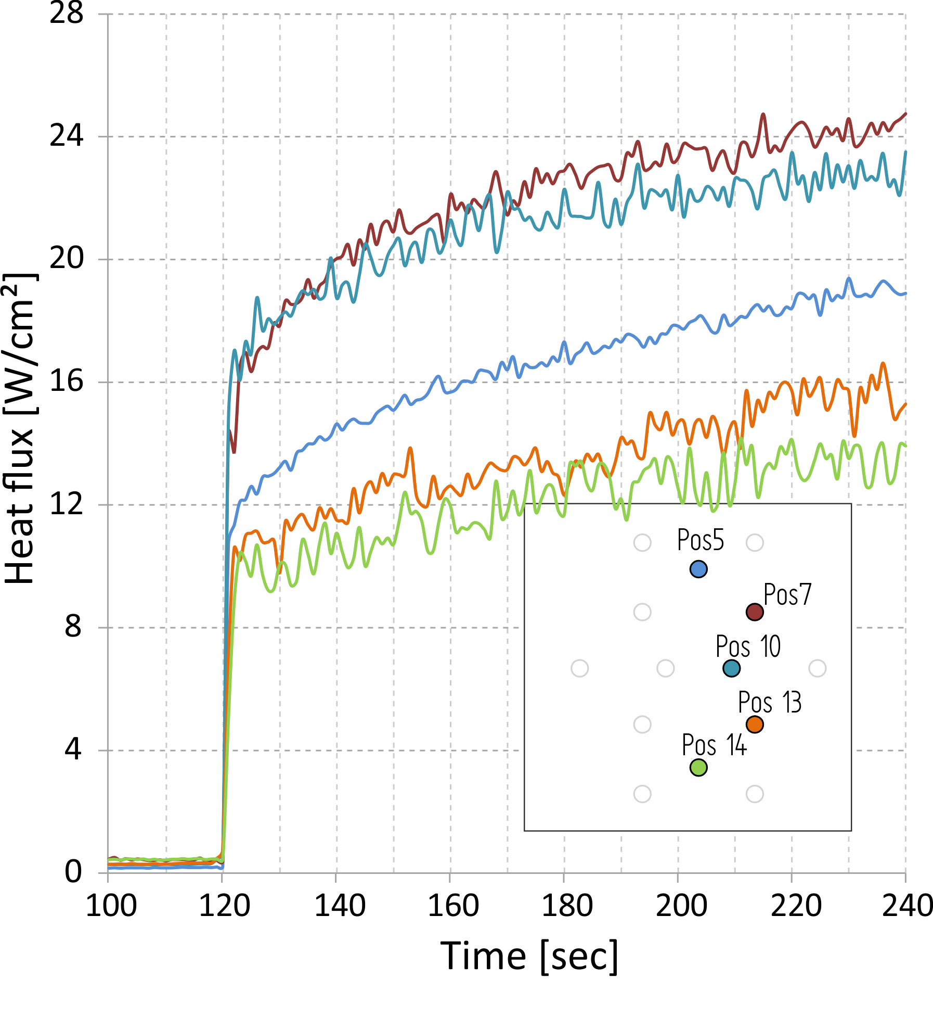
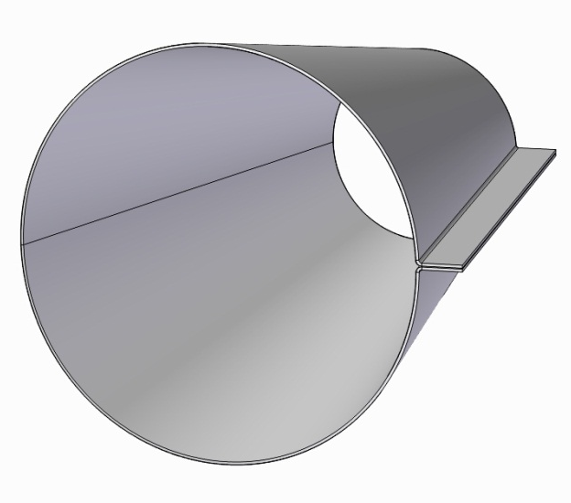
CALIBRATION OF BURNER
Reduction of Fuel/Air
Round cone
Better behavior after stabilization
Higher gradient in vertical heat flux distribution
Notes:
To optimize the heat flux distribution we decided to reduce the air and fuel pressure with a constant air/fuel ratio.
We also wanted to try a round cone.
The round cone was designed that the exhaust area has the same size like the one from the elliptical cone
We can identify a better behavior of the heat flux after the stabilization time it is nearly constant
The reduction of air and fuel pressure results in a lower heat flux and we come close to the demand of an average of 18w/m² but the negative effect is that we have a worse vertically heat flux distribution over the specimen´s area.

Slide 25
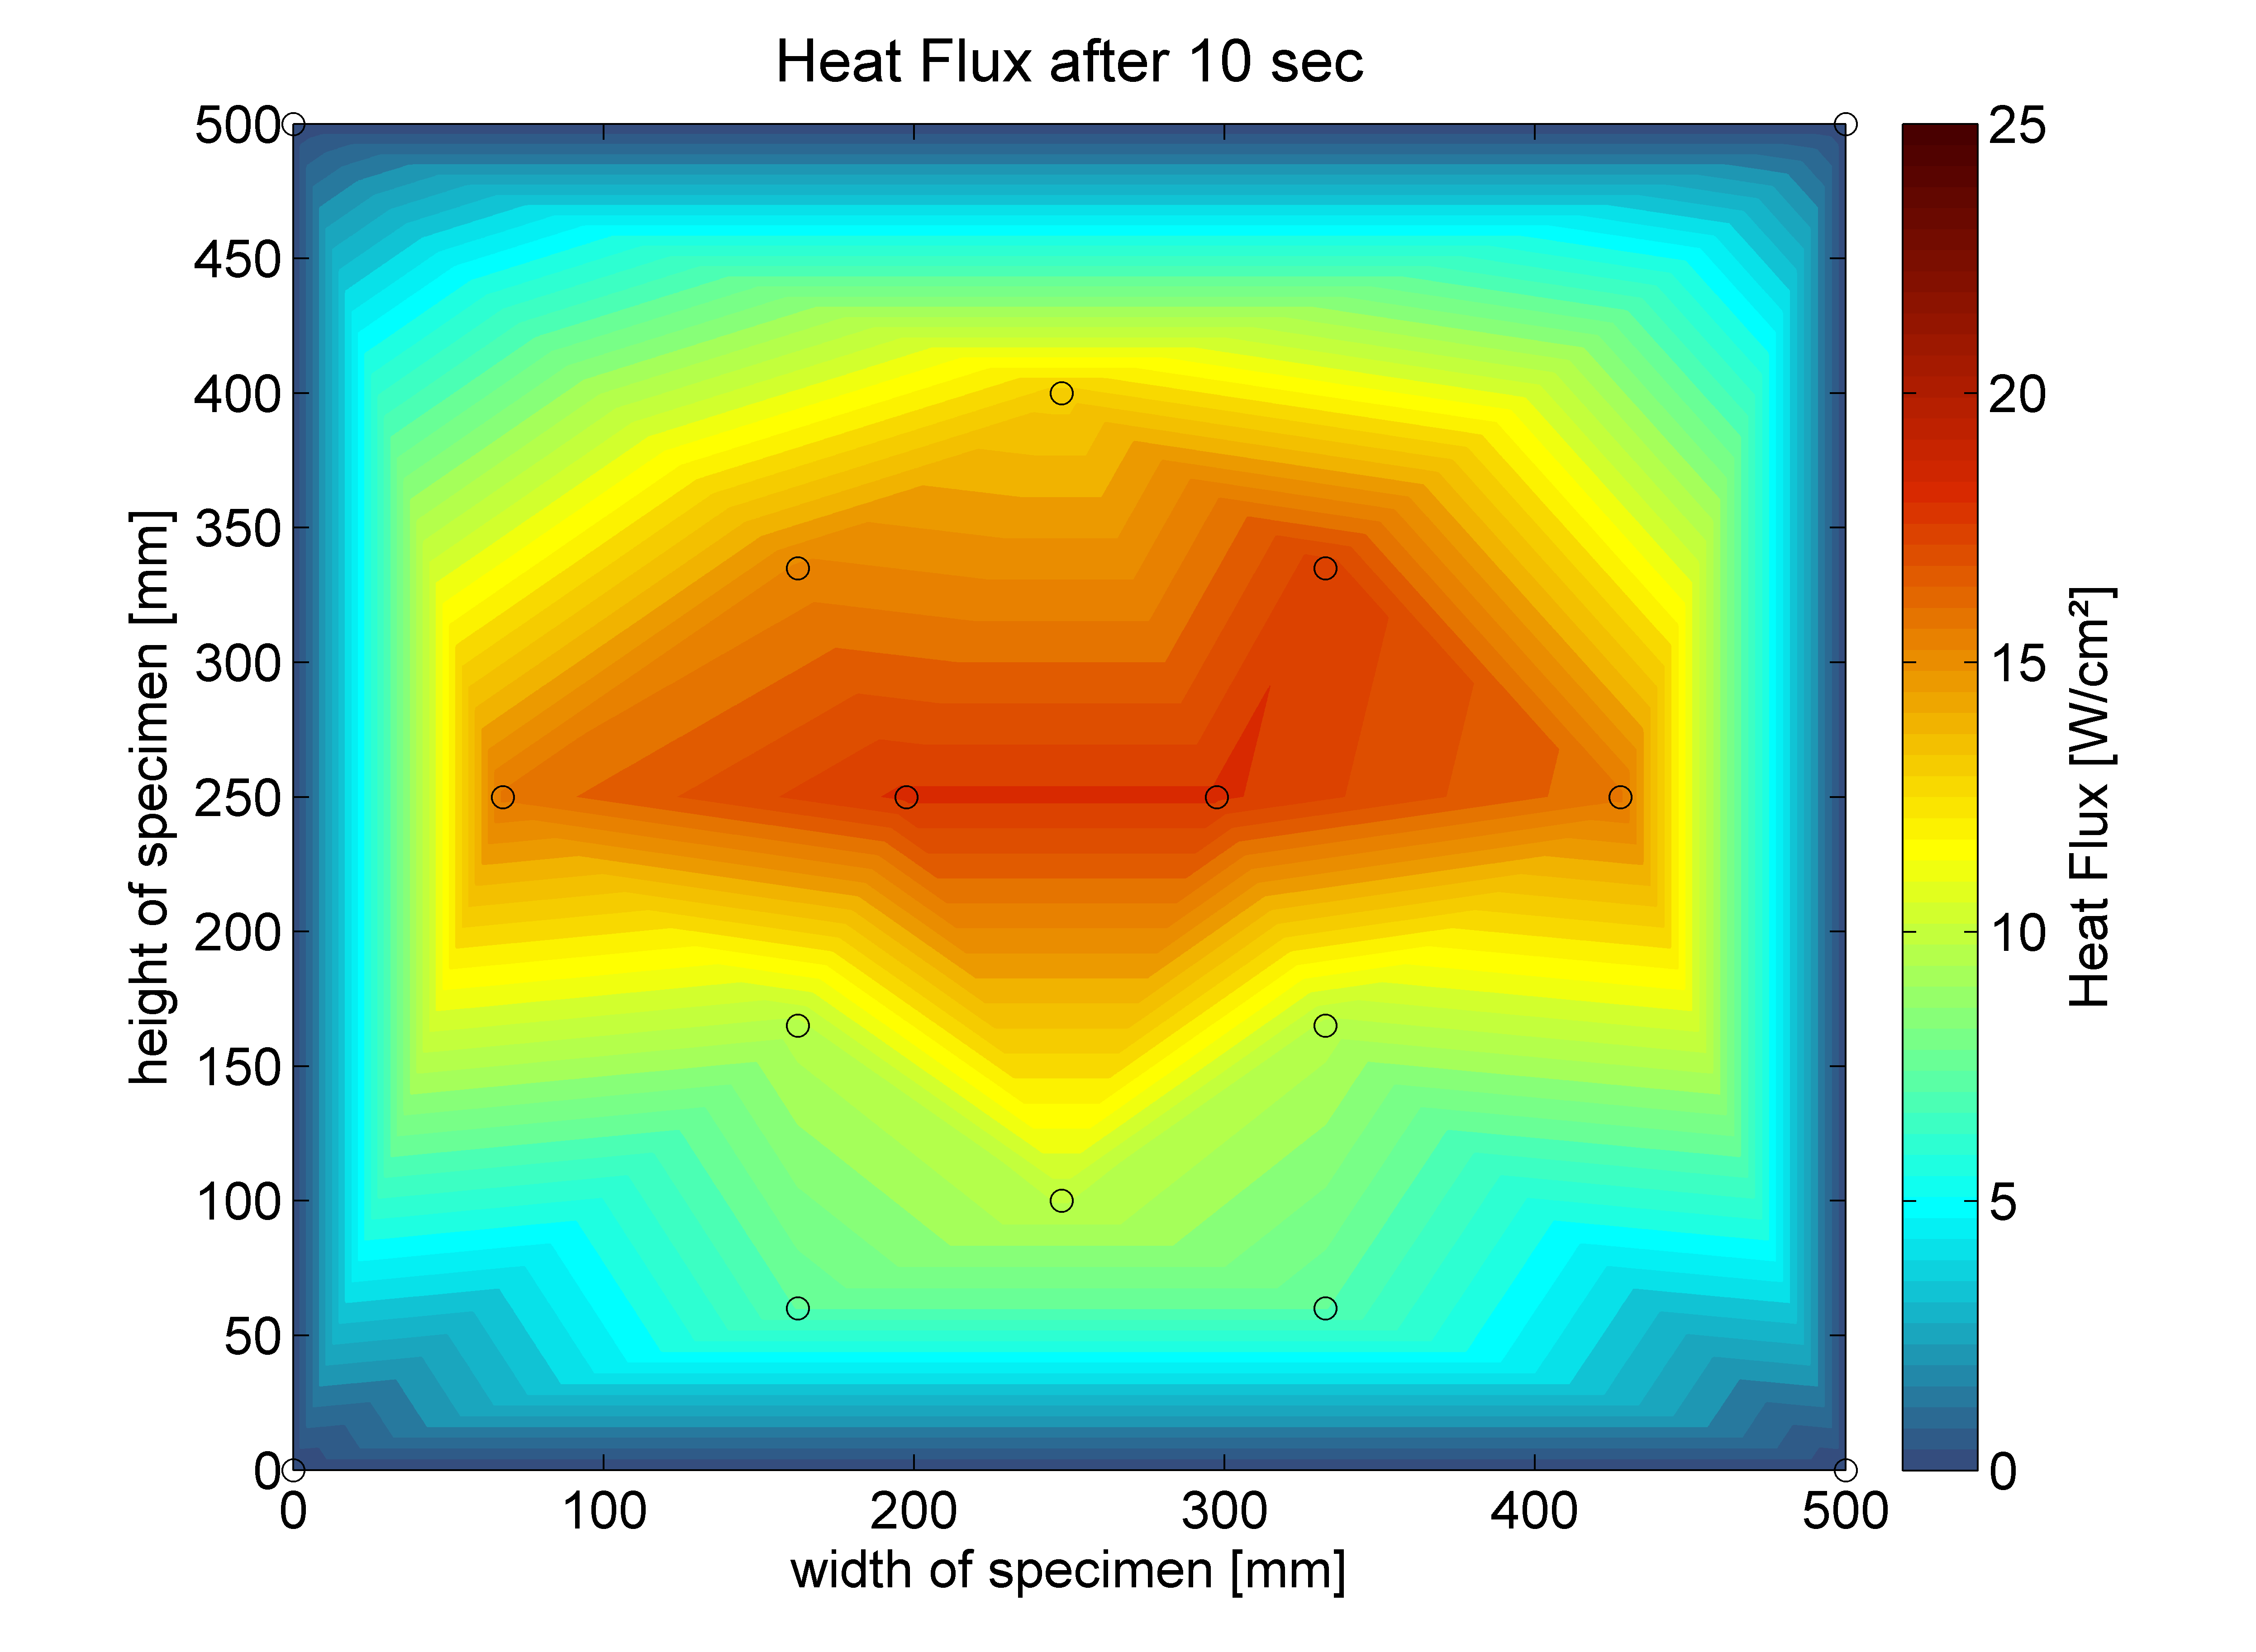
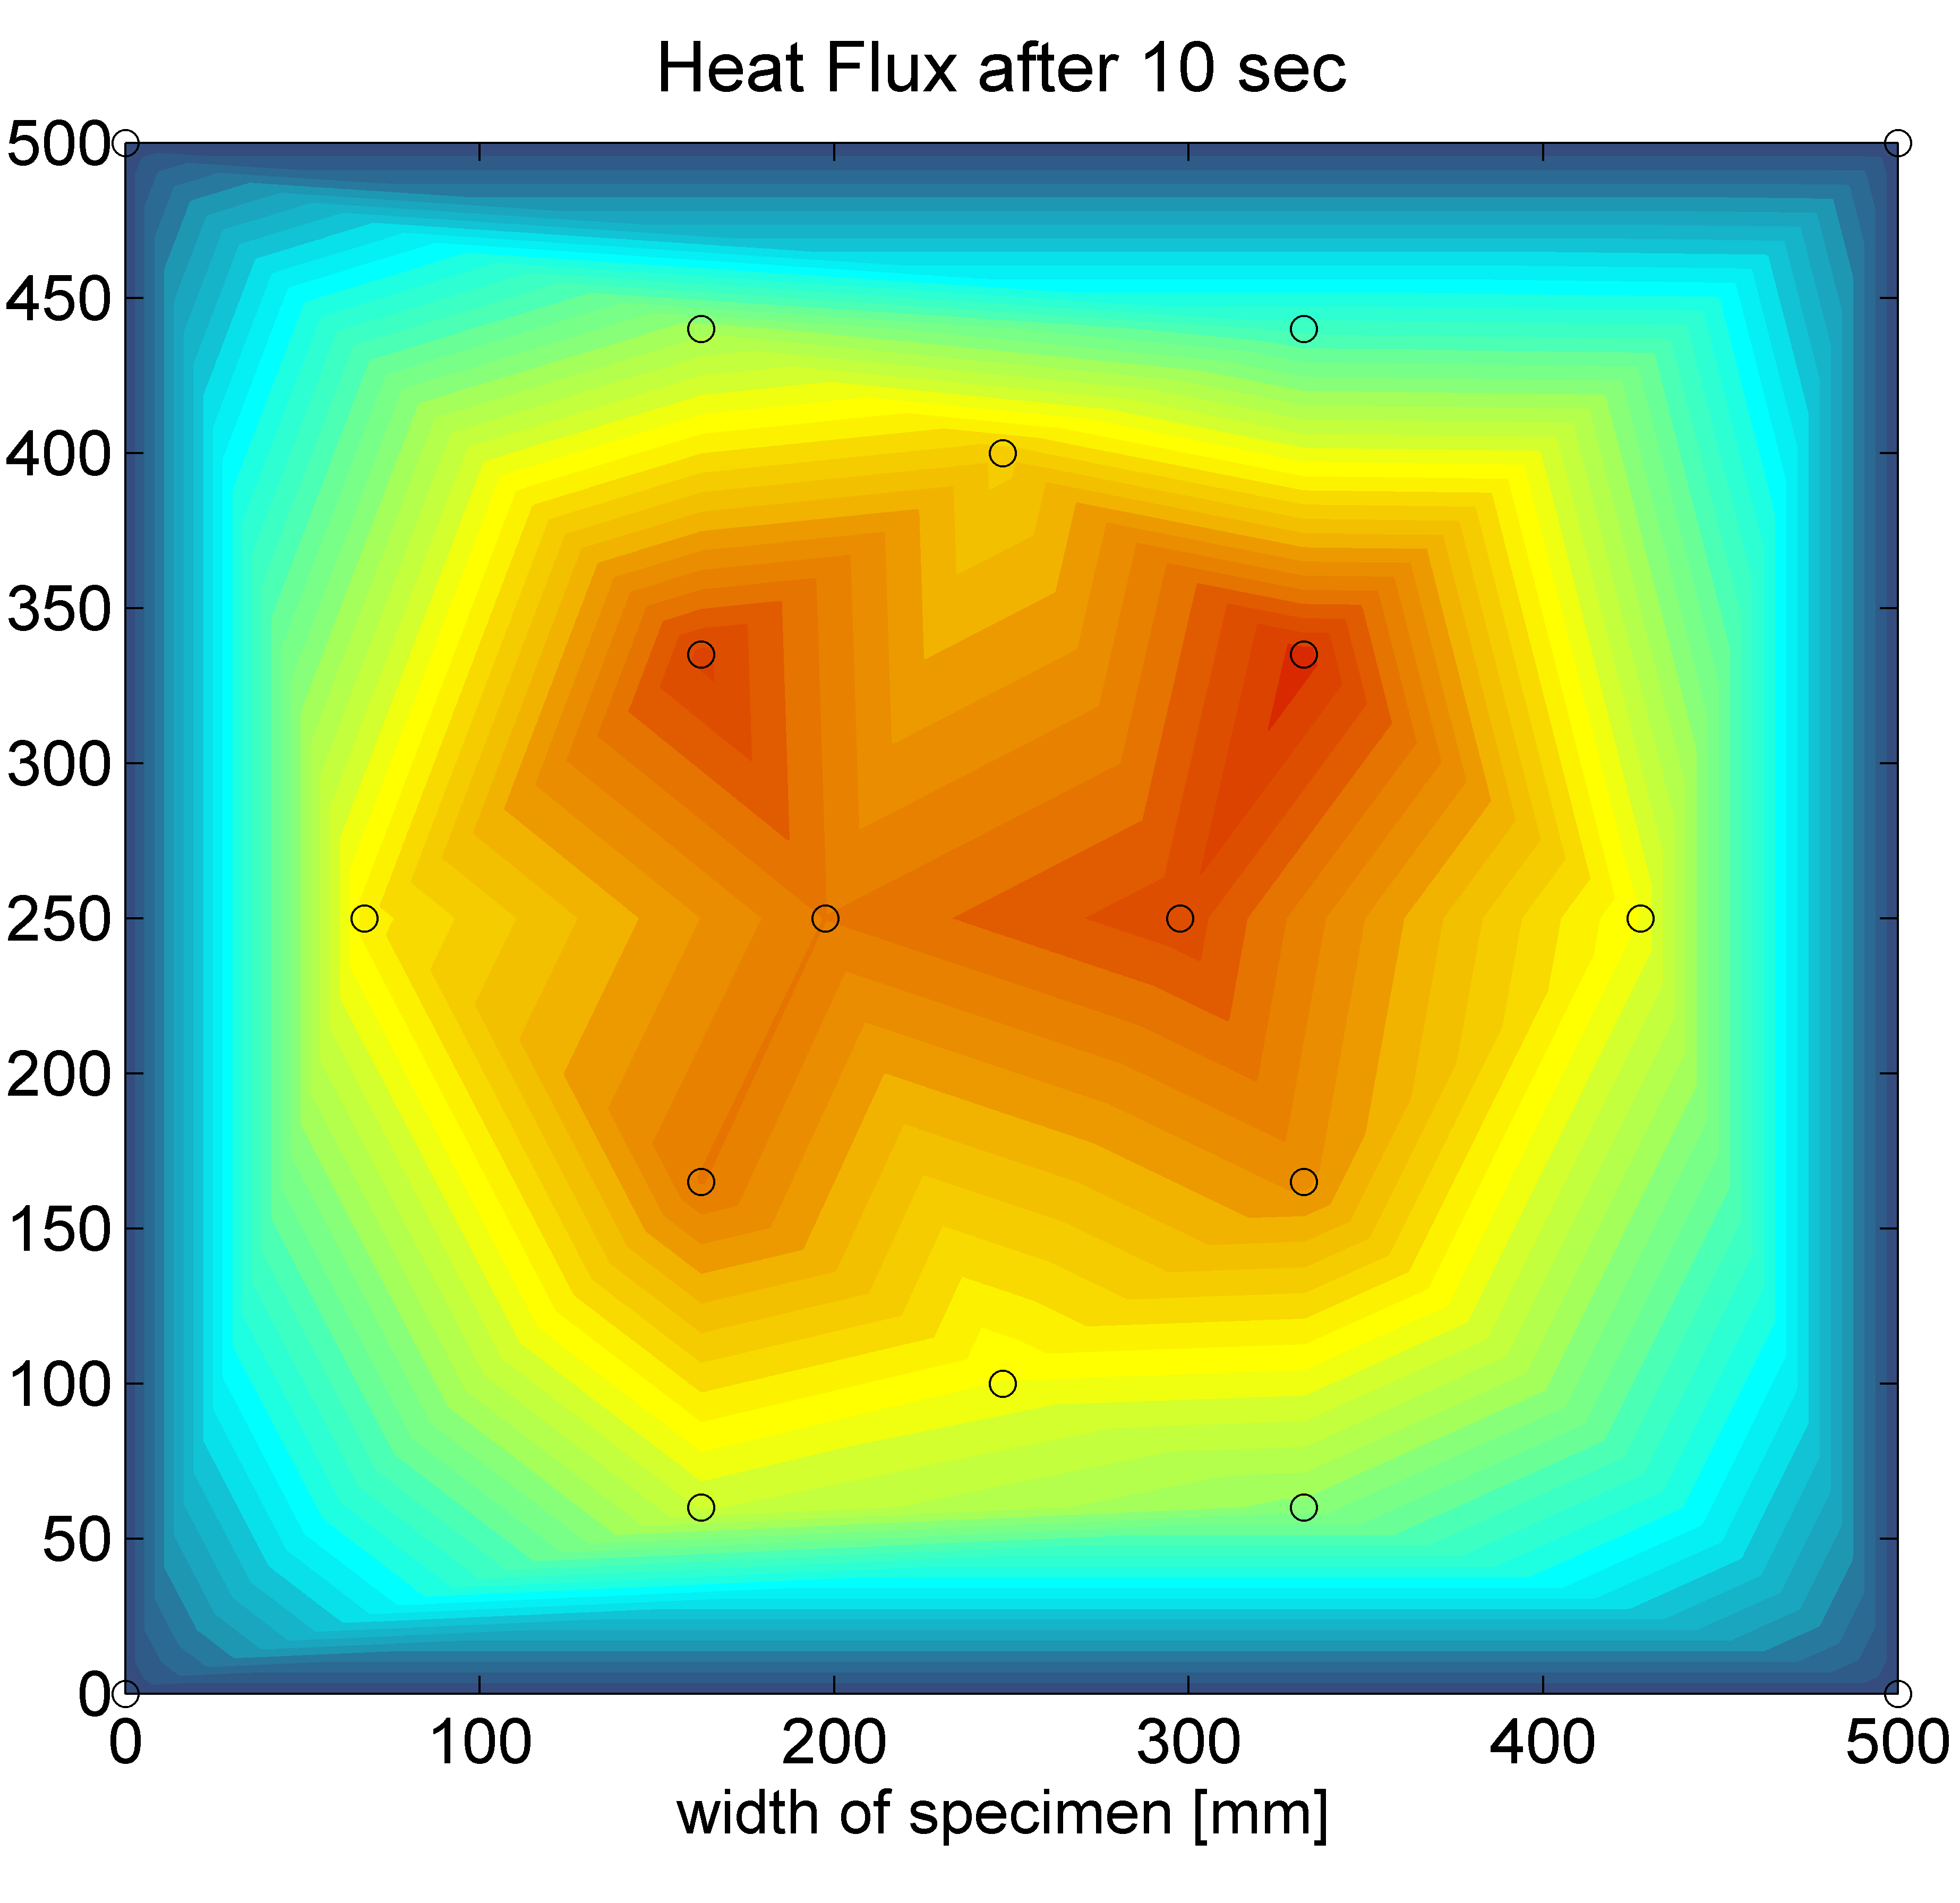
CALIBRATION OF BURNER
Round cone
Elliptical cone
Notes:
In this figures we see the heat flux distribution after 10 sec of fire
Beacause of the lower air fuel ratio the flames dont reach the lower part of the specimen‘s surface

Slide 26
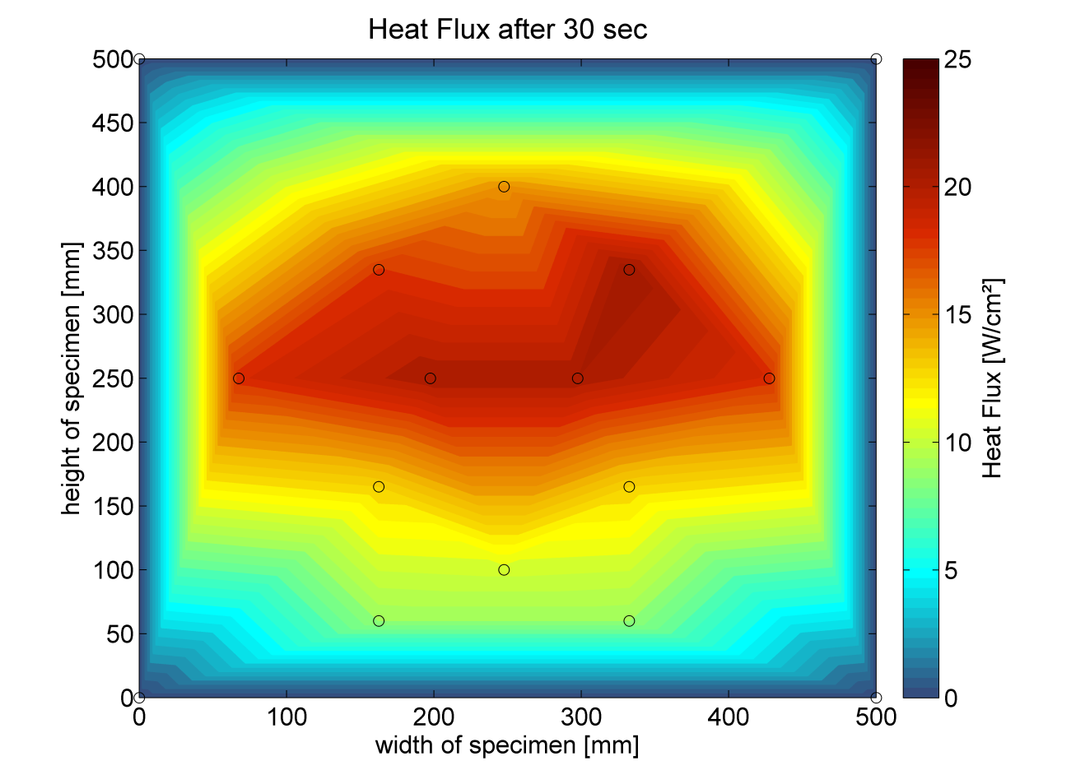
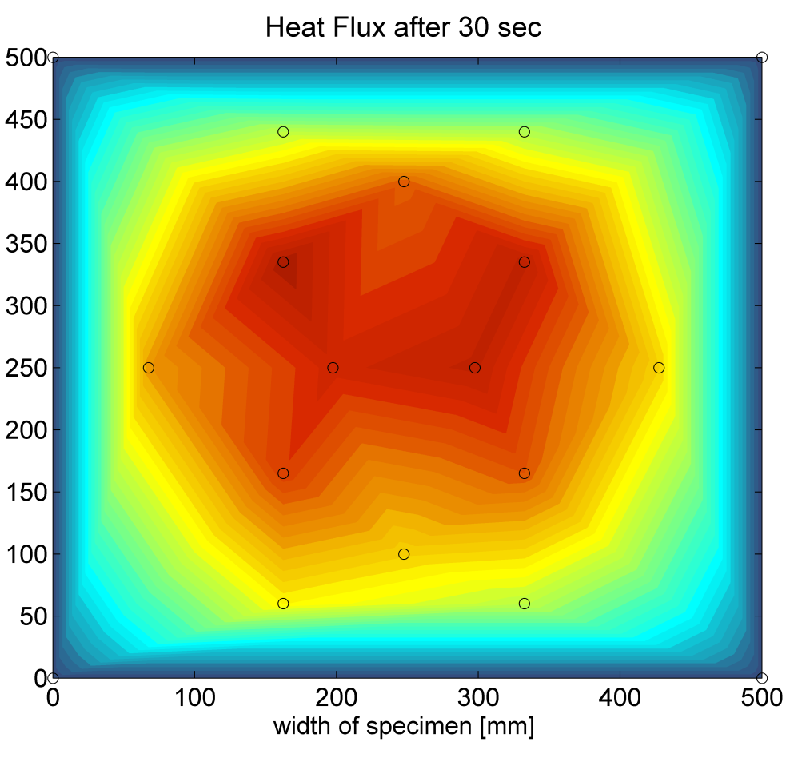
CALIBRATION OF BURNER
Round cone
Elliptical cone
Reduction in air/fuel pressure:
reduces the maximum heat flux
improves the stabilization of the heat flux
reduces vertical heat spread
Influence of round cone not clearly detectable
Notes:
But what we can see after 30sec of fire that with the round cone perhaps we have a better horizontal heat flux distribution

Slide 27
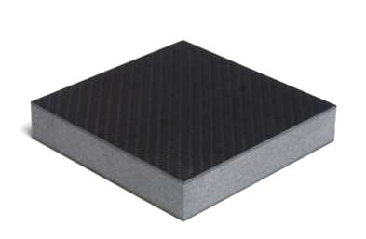
Several tests with carbon sandwich composites (20 mm)
FIRE TESTING RESULTS
Carbon layers
PMI Core
Detection of failure load in a cold test
Failure load -> 394 kN
Notes:
So far: Several tests with carbon sandwich composites have been made
A composite sandwich generally consits out of 3 layers. Here 2 carbon layers built the outer skin which hull the core, here a PMI core
The testing procedure is first to detect the limit failure load of the structure with a cold test

Slide 28
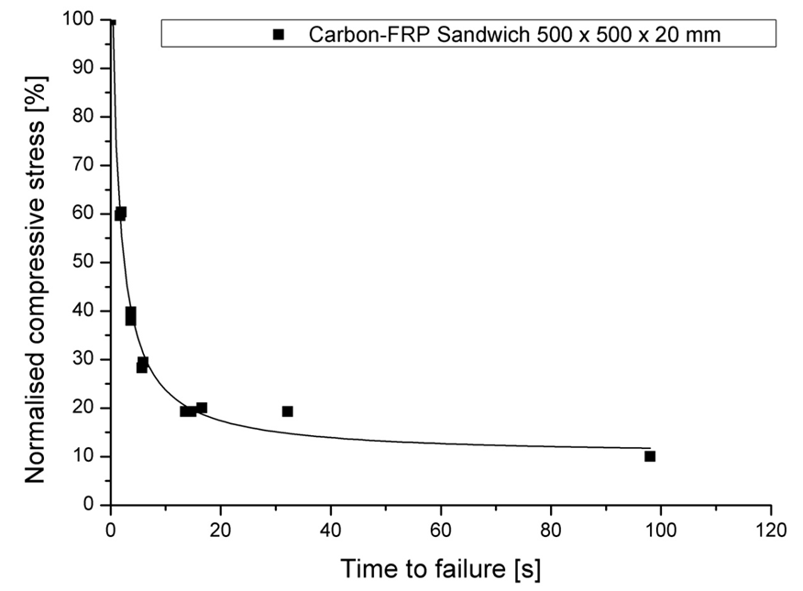
Fire test with different compressive loads
FIRE TESTING RESULTS
Notes:
Taking the cold test failure load as a starting point for the fire tests we can see that for different loads we receive different times to failure whereas the results have good reproducebility
Important to see is that down to a failure load of 20% we dont attain times to failure of over 40 sec. If you compare it to failure time of the aliminium structure of about 4 minutes, it is way to low and it is not possible to guarentee an evacuation of the carbon vessle

Slide 29
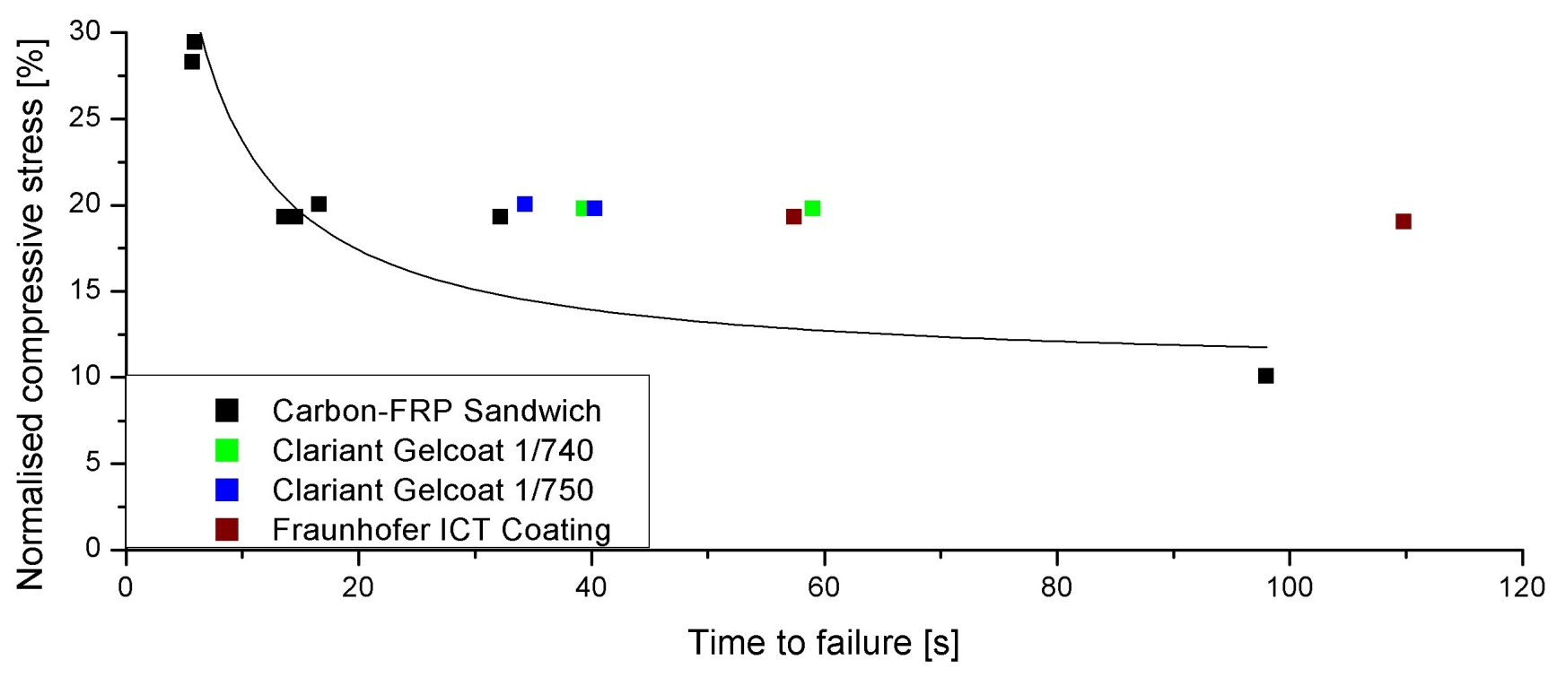
Intumescent coatings at 20% failure load
FIRE TESTING RESULTS
Material | Coating | Average | Error | Improvement
Carbon-FRP Sandwich | 0 mm | 19 s | 6.5 s
Clariant Gelcoat 1/740 | 1.4 mm | 49 s | 10 s | + 150%
Clariant Gelcoat 1/750 | 1.4 mm | 37 s | 3 s | + 95 %
Fraunhofer ICT Coating | 0.8 mm | 84 s | 26 s | + 342 %
Notes:
One way to prolong the time to failure could be the application of intumesent coatings.
A list with already tested coitings you can see here and the results of the fire testing with the different coatings here with that graph at a failure load of 20%.
The result is that we can clearly is that with an intumescent coating we attain a prolongation of of about 340% with the Fraunhofer ICT Coating
We can have a closer look to this results

Slide 30
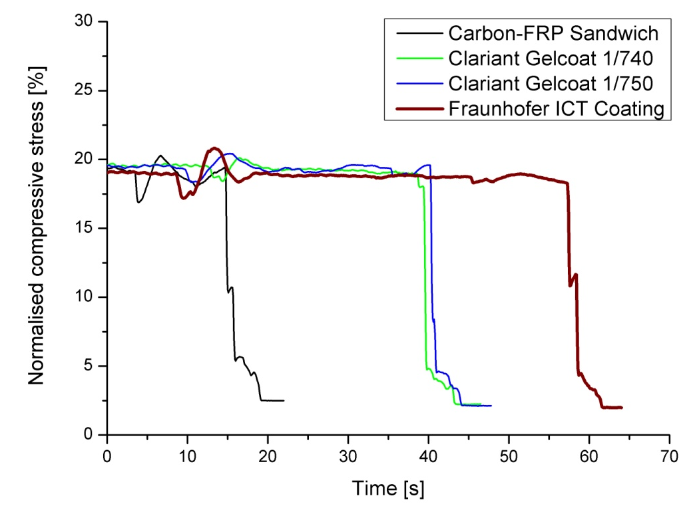
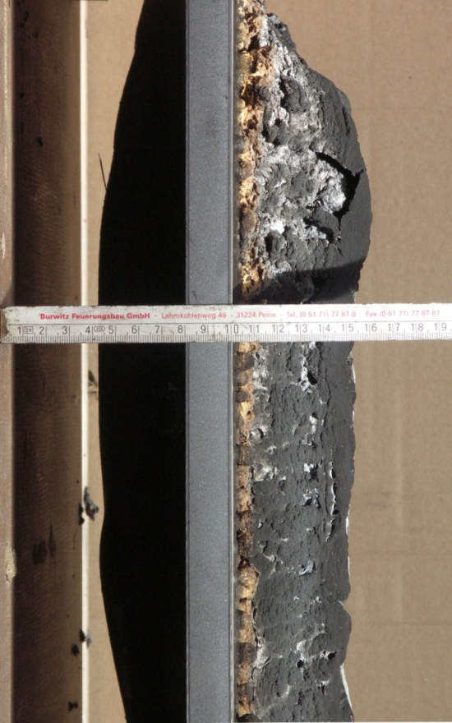
Fraunhofer ICT Coating
FIRE TESTING RESULTS
Time to Failure: 57sec (180%)
Immediately self extinguishing after burner turn off
Notes:
-We can see here the times to failure of the three different coatings.
- Very promising is the Fraunhofer ICT coating with which we can achieve a time to failure in the test of 57sec

Slide 31
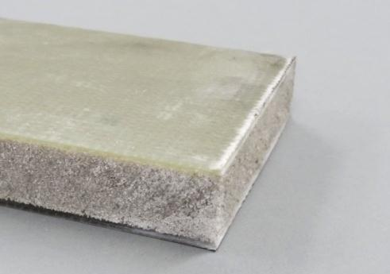
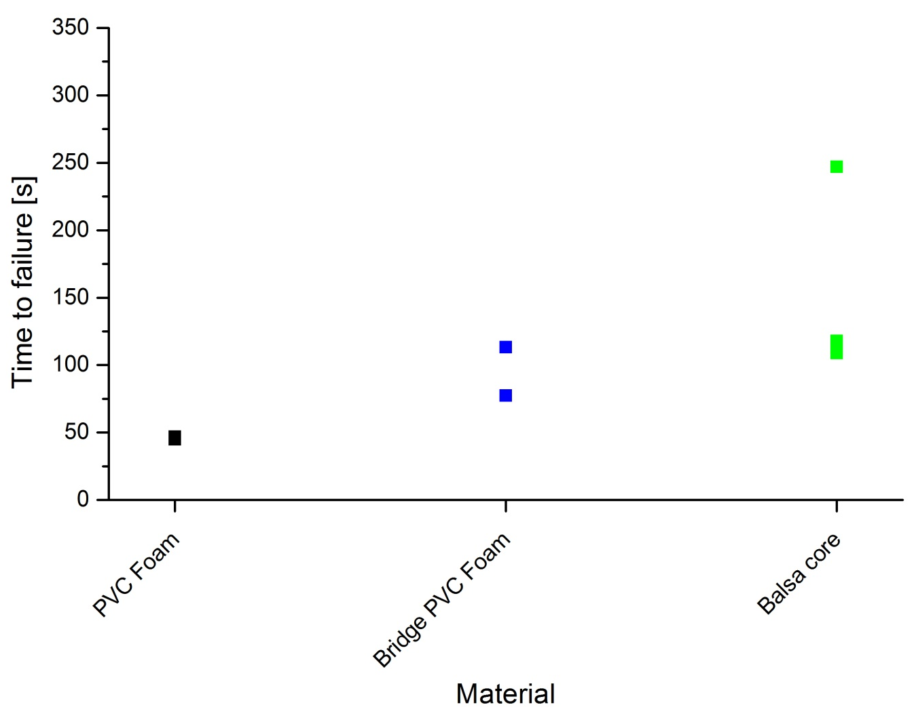
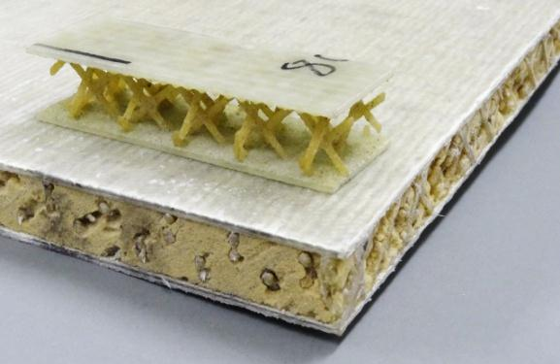
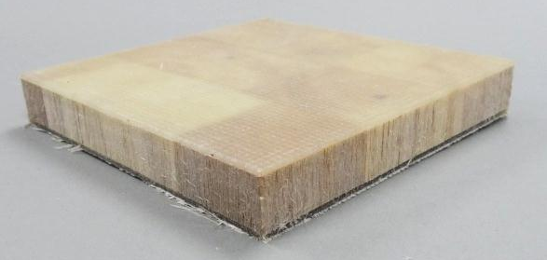
Influence of core materials – Fire test
FIRE TESTING RESULTS
20% failure load of GFRP Sandwich with PVC foam
PVC Foam
Bridge PVC Foam
Balsa core
Notes:
- Another way for sandwich is to use their selfprotection by optimizing the sandwich construction
Variance of times to failure of balsa core sandwichs
Sandwich composites produce a higher stiffness because of their composition but they also cause different and more complex failure mechanisms then an full composite structure.
Here it would be necessary to perform more tests to receive a meaningful statement

Slide 32
First tests with aircraft comparable structure
FIRE TESTING RESULTS
Multilayered carbon composite -> quasi isotropic
Detection of limit load and stability failure load in cold test
Measuring of total compressive load
Strain gauge on front and back side
Temperature on back side (10 thermocouples)

Slide 33
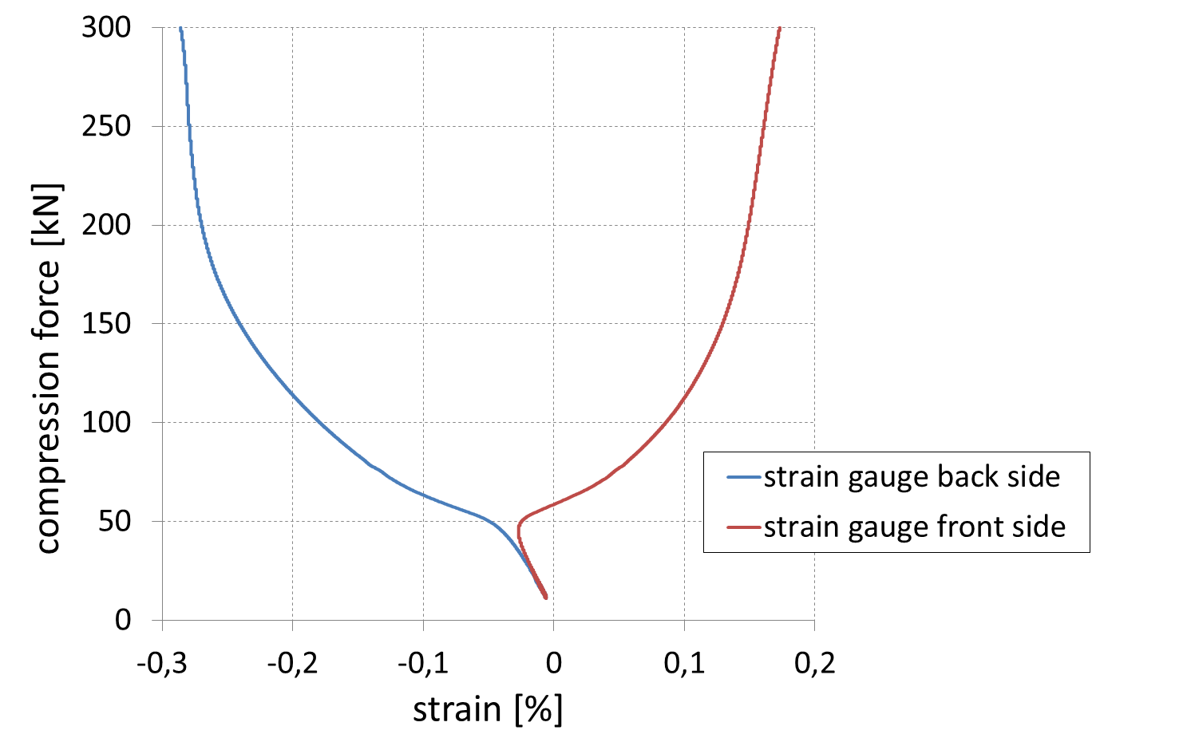
50 kN stability failure load
FIRE TESTING RESULTS
300 kN structural failure load
Notes:
- The back side got compressed and the front side got streched
Bacause of the low accuracy and capability of the hydraulic system under 100kN we decided for the fire test just to take the weight load of the upper part of the test bench as the compressive load, which is 10kN and 20% of the stability failure load (3% limit load).
Although we had a verly low compressive load onto this specimen we could measure a failure in structural stability after quite 60 sec.

Slide 34
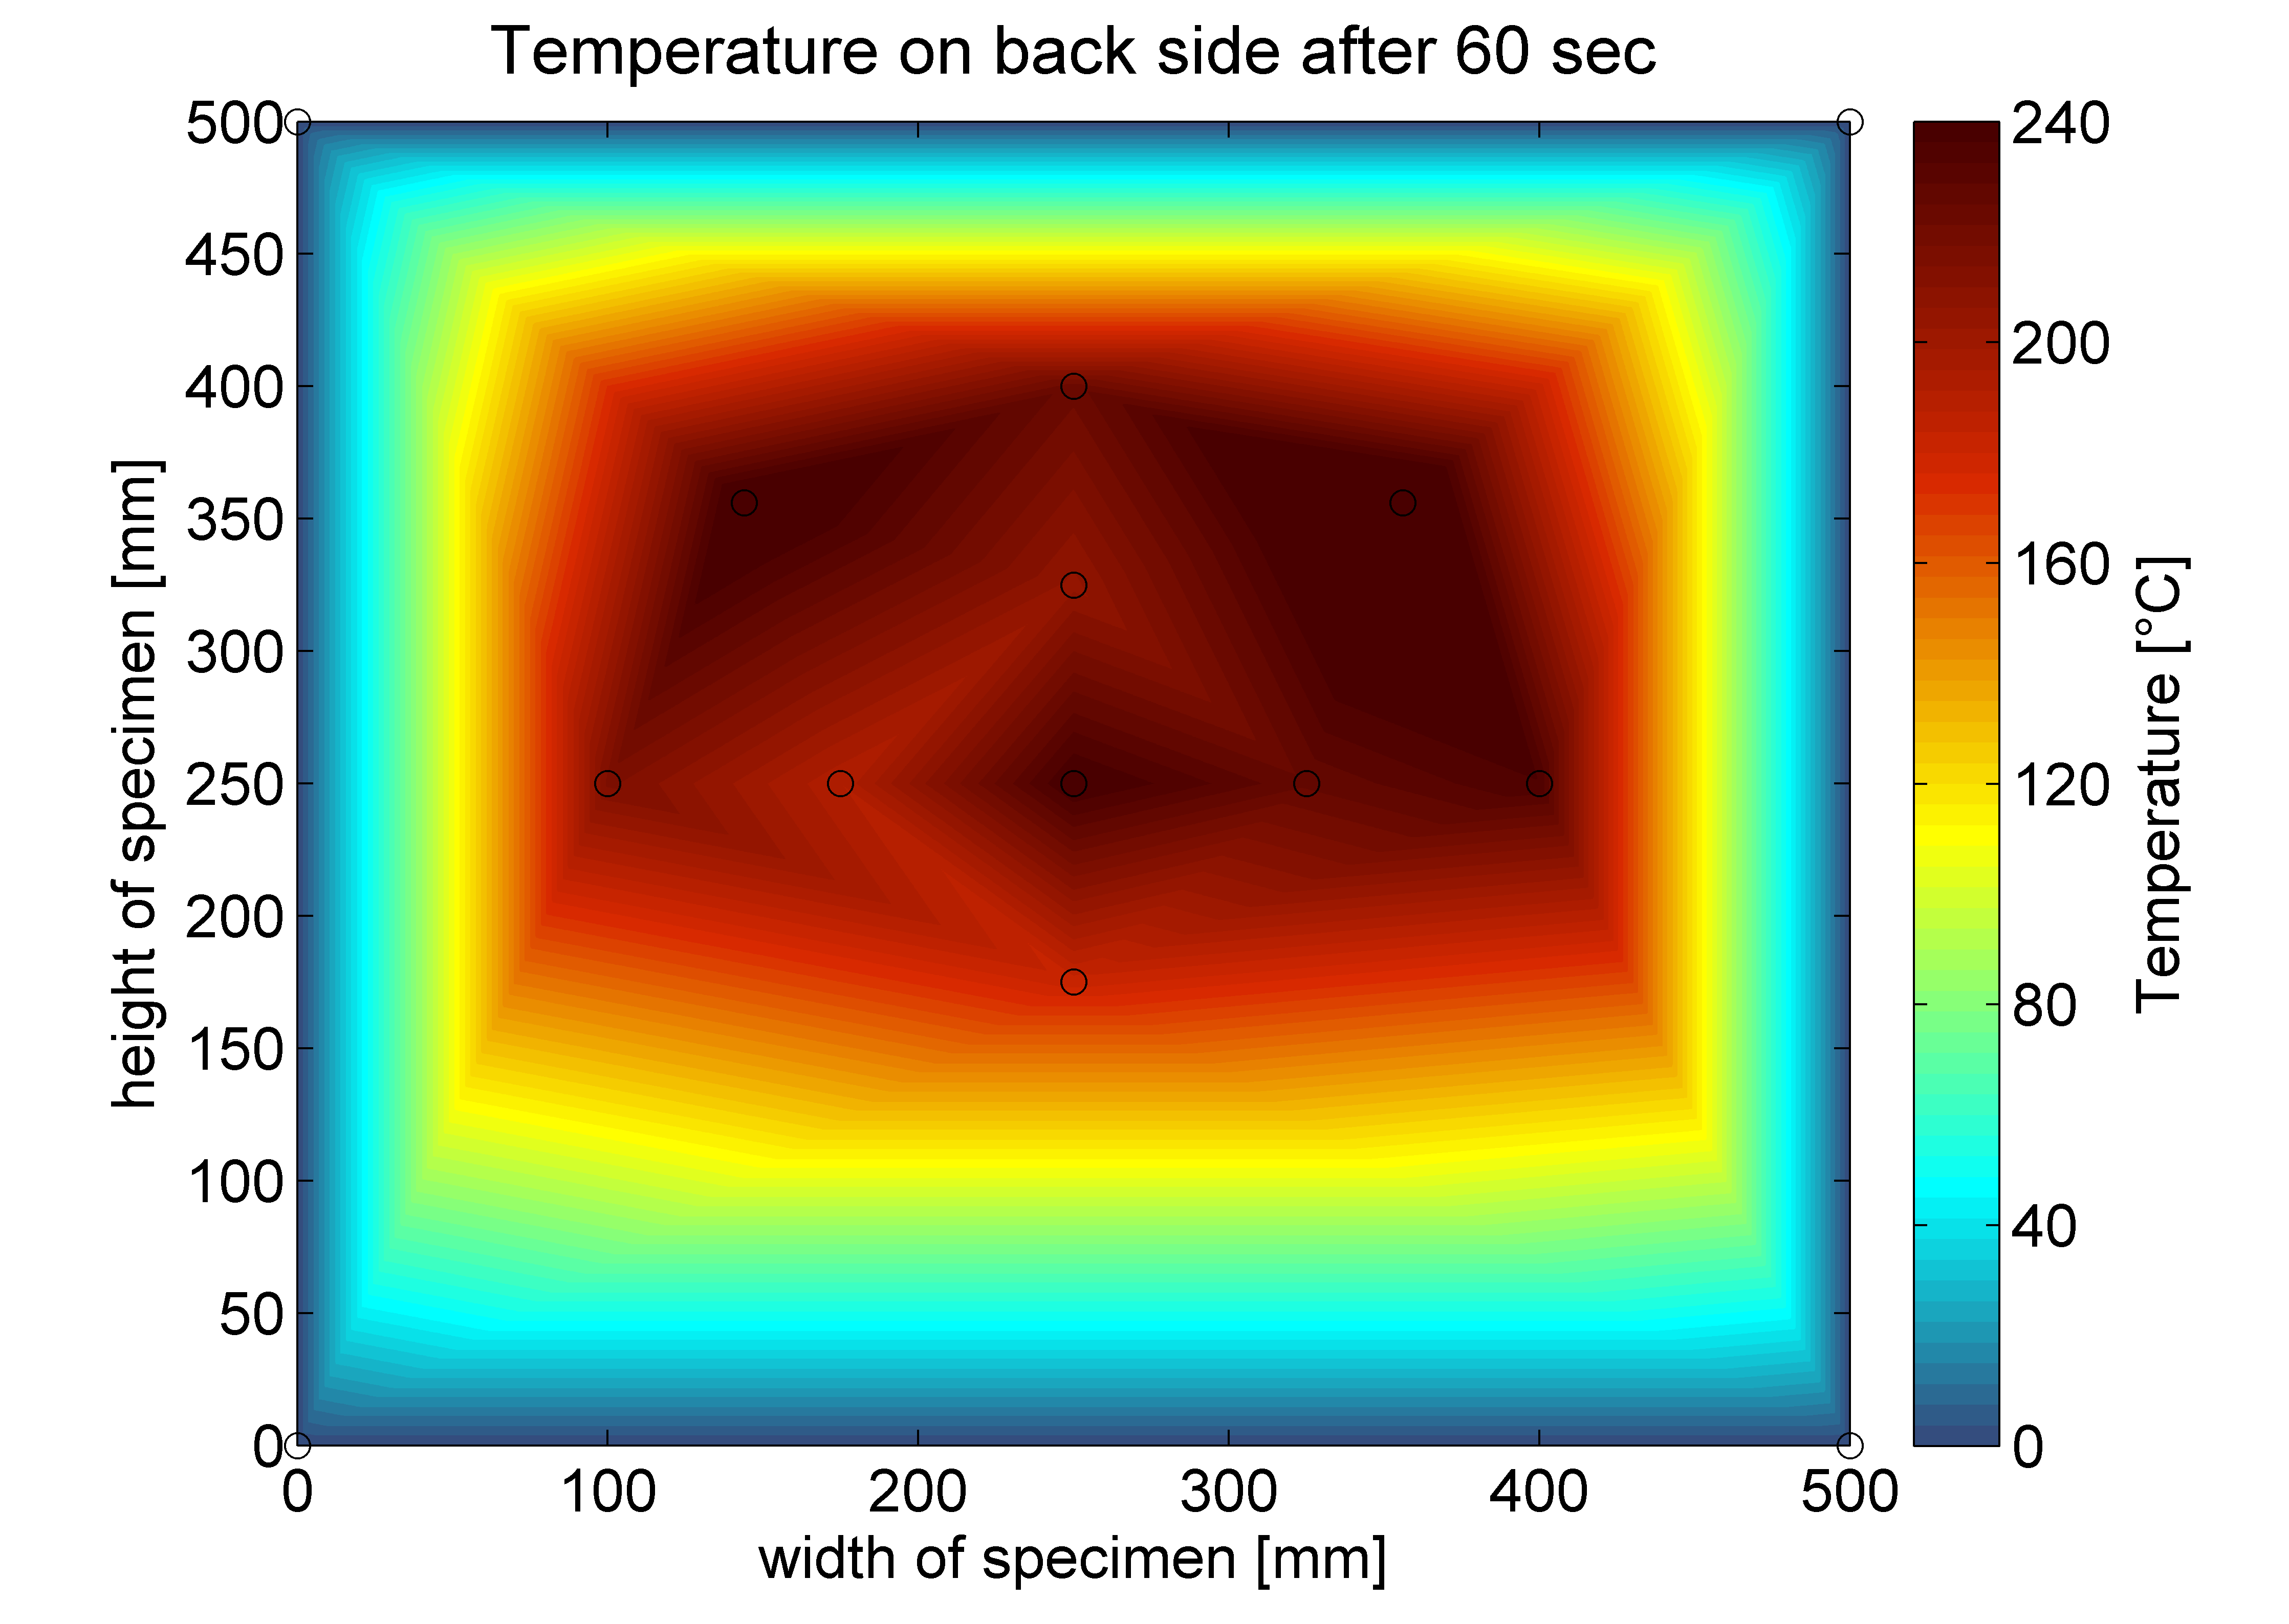
Time to failure: 60 sec
FIRE TESTING RESULTS

Slide 35
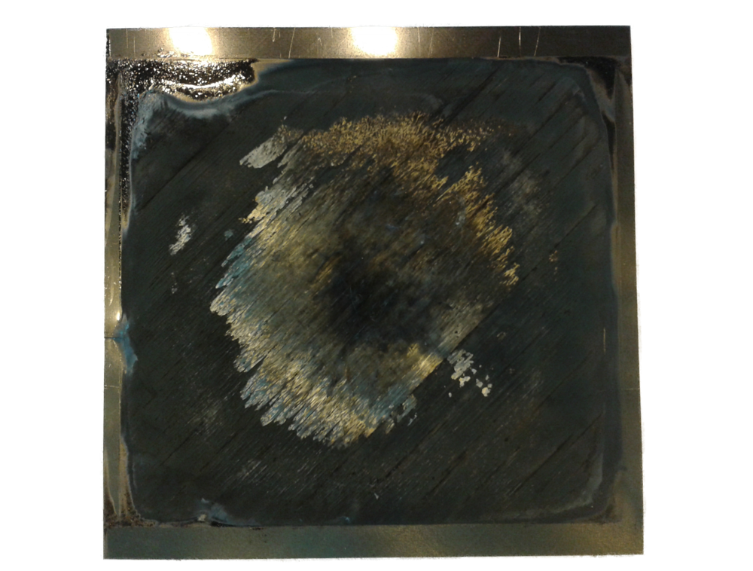
Structural failure
FIRE TESTING RESULTS
Thermal isolation
Burned resin
Not burned edges

Slide 36
CONCLUSION
Structural integrity of composites in fire is an actual challenge in transportation and construction: aviation, shipping, …
Our approach: Mechanical testing with fire at the same time
Our approach: Intermediate-scale testing
Results so far: Fantastic
Next step: airframe shell structures
Thank you

Slide 37
Fraunhofer ICT: based on melamine-urea resin with a phosphoric ester as hardener; cermic filler combination was incorporated
Clariant 1/740/750: epoxy gelcoats with flame retardant based on ammonium polyphosohate
Notes:
The Fraunhofer Institute for Chemical Technology ICT provided a coating (further on mentioned coating A) based on a melamine-urea resin with a phosphoric ester as hardener that is related to patent EP 1 678 268 B1. Additionally a ceramic-filler combination was incorporated, which is able to form a ceramic layer and thereby improve the stability of the foam under severe conditions. The thickness of the grey-coloured coating (further on mentioned coating A) was very homogeneous between 0.8 and 1 mm.
Furthermore two different epoxy gelcoats were provided and applied by the Clariant AG with a flame retardant based on ammonium polyphosphate (Exolit® AP 422). The thickness of the cream-coloured EP gelcoat 1/740 (further on mentioned coating B) was between 1.0 and 1.3 mm, whereas the thickness of the white-coloured EP gelcoat 1/750 (further on mentioned coating C) was between 1.0 and 1.5 mm. Sandwich specimens were sandblasted and framed before the gelcoat was filled in and distributed over the surface.

