Slide 1
Effect of Moisture on Ignitability of Polymers.
Natallia Safronava ª, Richard E. Lyon ^{b}, Sean B. Crowley ^{b}, Stanislav I. Stoliarov ^{c}
ª Technology and Management International, LLC (TAMI)
^{b} Federal Aviation Administration , William J. Hughes Technical Center, Atlantic City International Airport, NJ
^{c} Department of Fire Protection Engineering, University of Maryland
The Seventh Triennial International Fire & Cabin Safety Research Conference,
Philadelphia Marriott Downtown, PA,19107,
December 2-5, 2013

Slide 2
Background
Moisture has been shown to have a noticeable effect on the ignitability of combustible solids.
In the case of wood, moisture increases time to ignition ( t_{ign} proportional the weight fraction of moisture).
A previous study of poly(aryletheretherketone) PEEK showed that the ignitability of this high temperature engineering plastic is sensitive to the presence of absorbed moisture (P. Patel 2011).
In the case of PEEK, moisture decreases the time to ignition. Premature ignition of wet samples was attributed to the appearance of an optically and thermally distinct surface layer of water vapor bubbles (E. Oztekin 2012).
Up to 2 minutes variation was found in ignition times between wet and dry specimens for PEEK samples.
The present research extends this work to include five other engineering plastics : PC, POM, PPSU, PA66 and PMMA.

Slide 3
Why time to ignition is so important?
Flame Spread Rate (Velocity) is Inversely Proportional to t_{ign}
Flame Spread Velocity =
Vertical Upward
UL 94 V
FAA VBB

Slide 4
Polymers Description
The polymers examined in this study spanned a range of thermal stability, morphology and chemical affinity for water.
Polymer name | Solid state | T_{g}, ⁰C | T_{m}, ⁰C | T_{ign}, ⁰C | H₂O content %, wet, w/w
Polycarbonate (PC) | Amorphous | 145 | N/A | 500 | 0.6
Polyoxymethylene (POM) | Crystalline | 120 | 165 | 344 | 1.8
Polyamide 6,6 (PA66) | Crystalline | 50 | 262 | 456 | 9.2
Polyphenylsulfone (PPSU) | Amorphous | 230 | N/A | 575 | 1.4
Polymethylmethacrylate (PMMA) | Amorphous | 100 | N/A | 317 | 2.4

Slide 5
Environmental Conditions
Specimens having dimensions 100 mm x 100 mm were cut directly from as-supplied sheets and exposed to three different environmental conditions.
The first group, called DRY samples, was held under vacuum at 100 ⁰C.
The second group, called WET samples, was immersed in distilled water at 80 ⁰C.
The third group of specimens was conditioned in a 50% relative humidity chamber at 25 ⁰C and is referred to as RH50.
Specimens were periodically removed from the conditioning environments, lightly dried, and weighted to determine the mass of H₂O absorbed/desorbed during the conditioning.

Slide 6
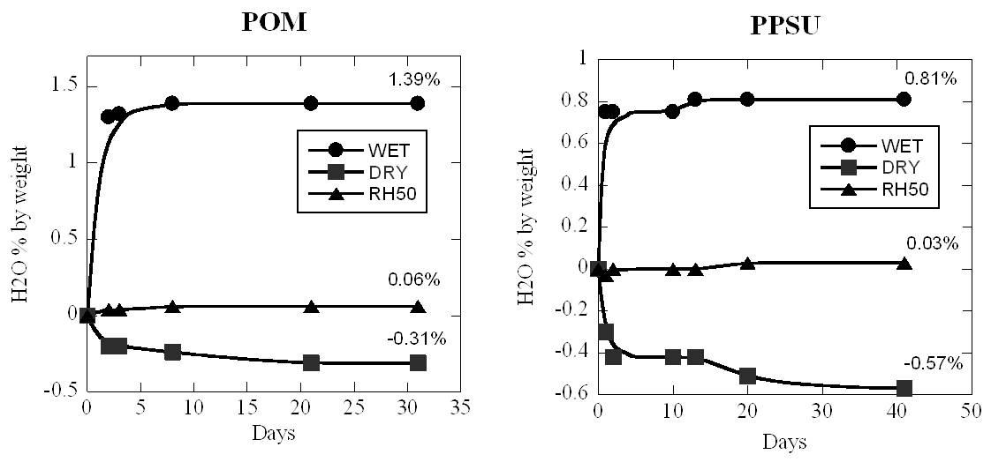
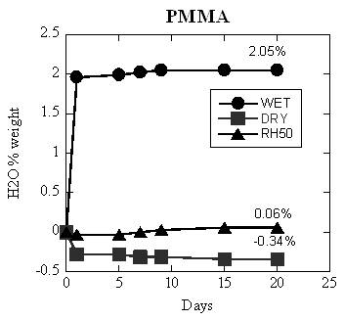
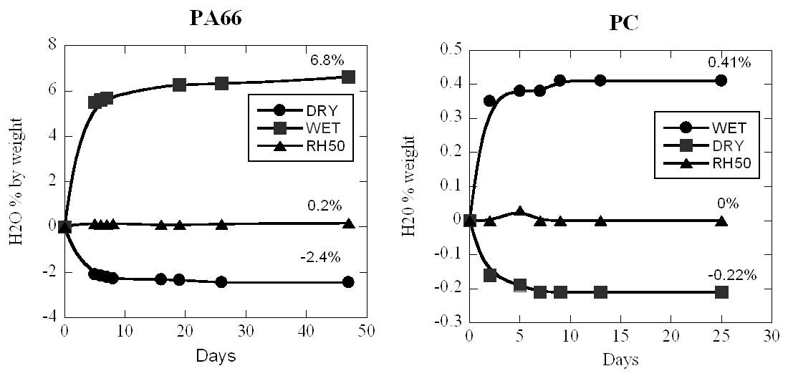
Samples preparation

Slide 7
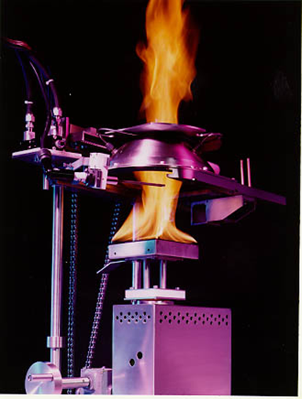

Fire Testing
The time to ignition and heat released by burning polymers was measured using a fire calorimeter operating on the oxygen consumption.
Specimens were exposed to a range of external heat fluxes from 10 kW/m² to 75 kW/m²
Time to ignition (t_{ign}), surface temperature at ignition (T_{ign}), mass loss rate and the heat release rate (HRR) during subsequent burning was recorded as a function of time.

Slide 8
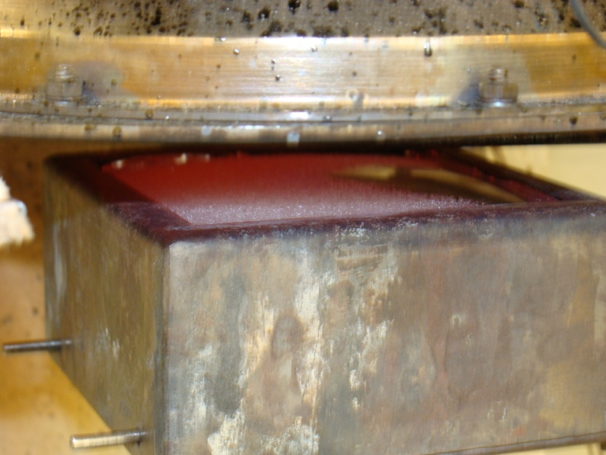
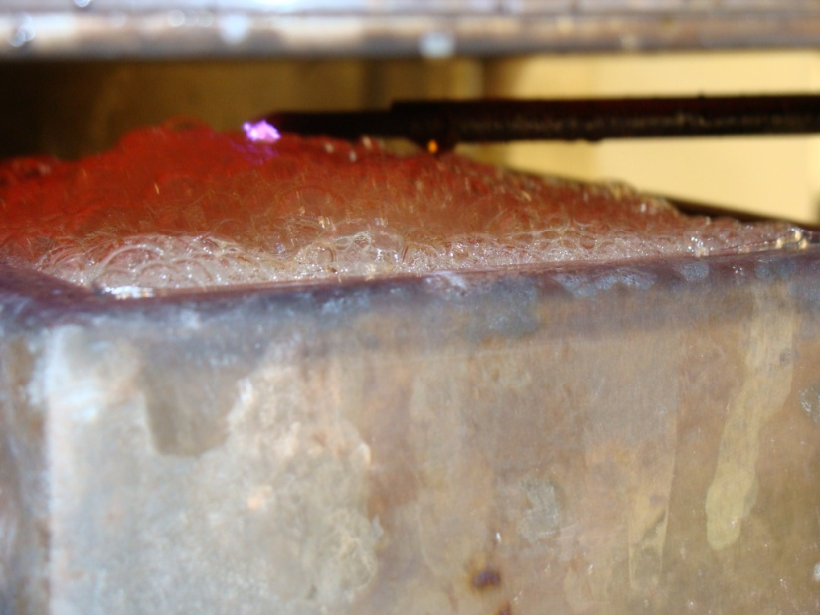
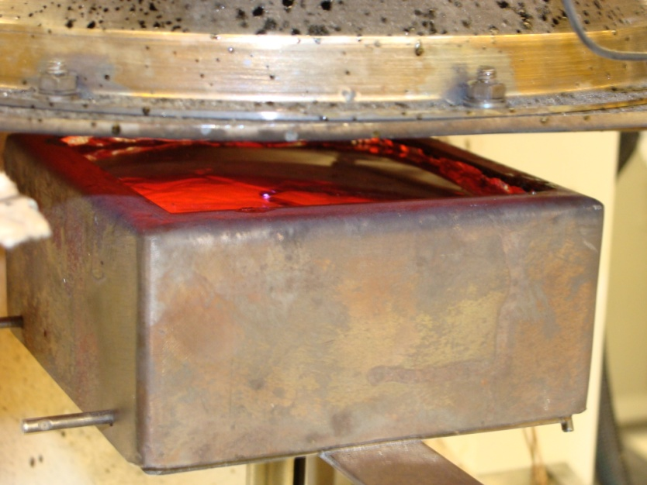
Visual Observations, PC
Photographs of
Dry and Wet Surfaces
of PC prior ignition

Slide 9
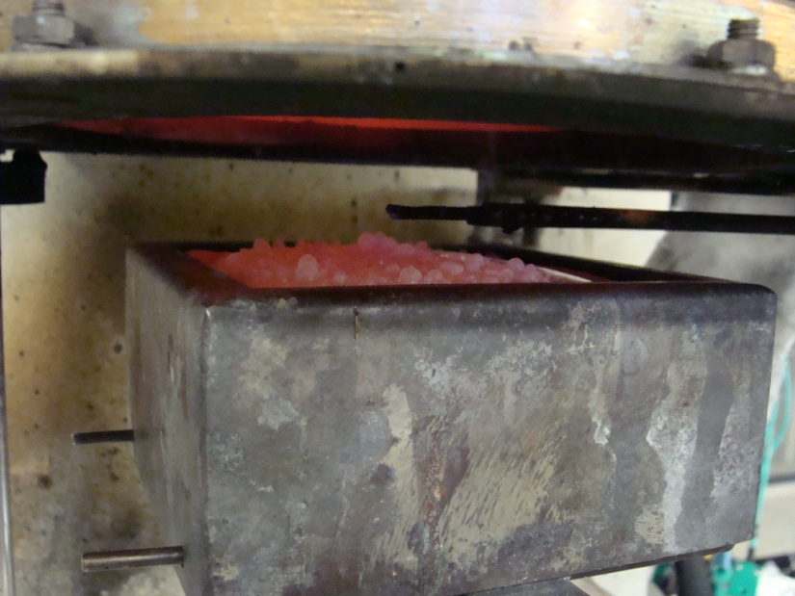
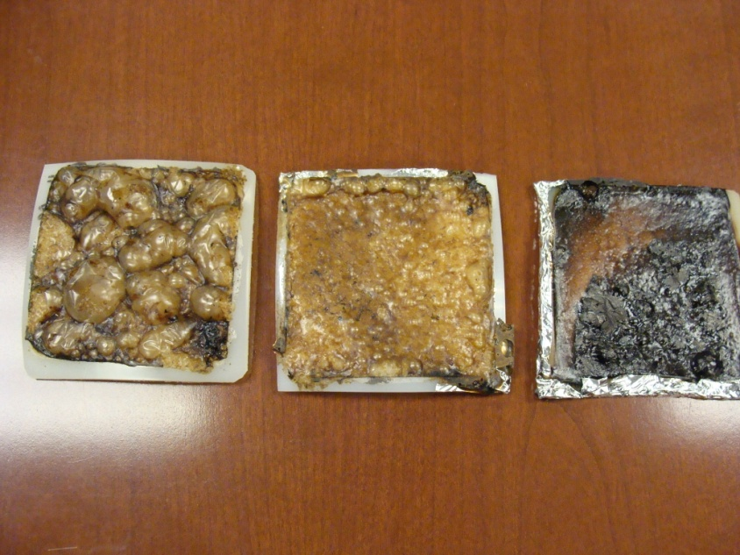
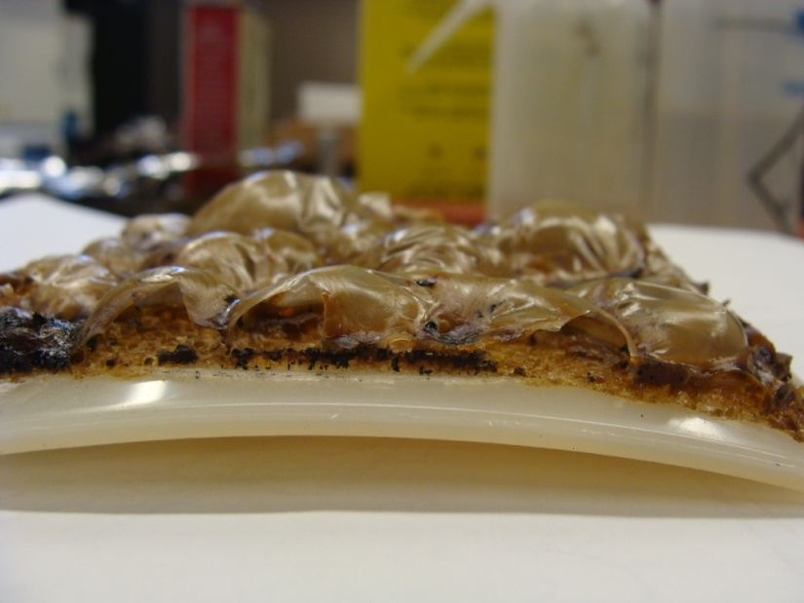
Visual Observations, PA66
Wet
sample prior ignition
Wet, RH50 and Dry samples after removal from cone.
Wet
sample
removed
after ignition

Slide 10
PC

Slide 11
PA66

Slide 12
PPSU

Slide 13
POM

Slide 14
PMMA

Slide 15
Approach
Ignition is a critical phenomenon governed by thermal and chemical properties of the solid polymer.
There is a variety of proposed criteria for piloted ignition, that can be roughly divided into thermal (solid) and chemical (gas phase) criteria [1].
Examples of thermal criteria are critical radiant heat flux (CHF) and/or ignition temperature (T_{ign}).
For a thermally thin sample
[1] R.E. Lyon and J.G. Quintiere, Piloted Ignition of Combustible Solids, Combustion & Flame, 151, 551-559 (2007)

Slide 16
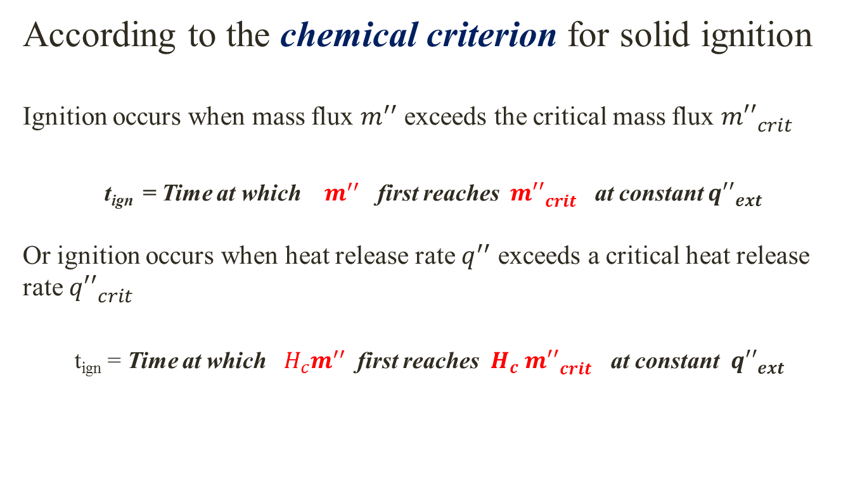
Approach cont.
According to the chemical criterion for solid ignition
Ignition occurs when mass flux $m^{′′}$ exceeds the critical mass flux ${m′′}_{crit}^{}$
t_{ign} = Time at which $m^{′′}$ first reaches ${ m′′}_{crit}^{}$ at constant ${q′′}_{ext}^{}$
Or ignition occurs when heat release rate $q^{′′}$ exceeds a critical heat release rate ${q′′}_{crit}^{}$
t_{ign} = Time at which ${H_{c}^{}m}^{′′}$ first reaches $H_{c}$ ${m′′}_{crit }^{}$at constant ${q′′}_{ext}^{}$

Slide 17


Parameters of the Thermal Theory of ignition
Heat Transfer
Thermal Theory
Thermal response time τ =
Following function was fitted through experimental data t_{ign} versus external heat flux, with 2 adjustable parameters
The critical heat flux for piloted ignition (CHF) was also calculated using T_{ign}
y=$m_{1}ln⁡(\frac{x}{x−m_{2}}$)

Slide 18
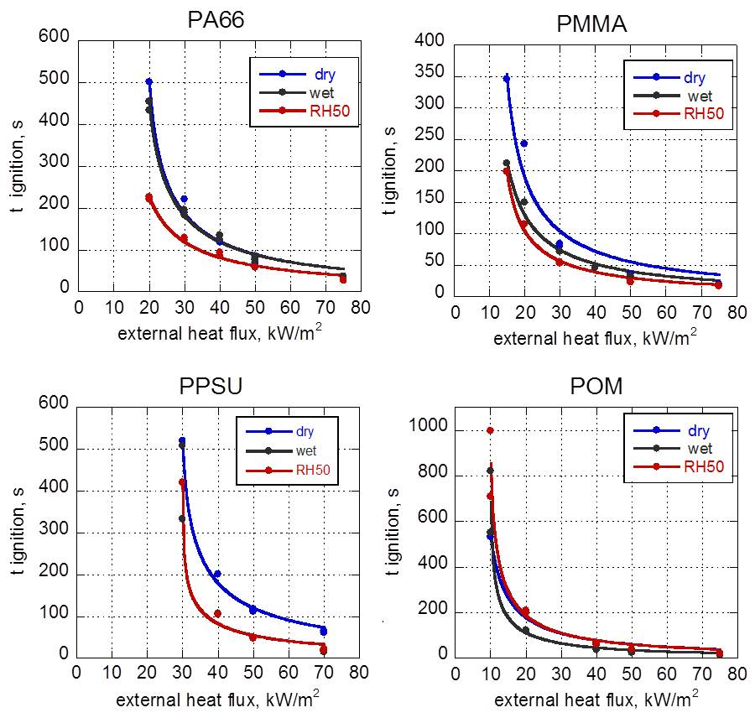
Fit to the data gives thermal response time and CHF

Slide 19
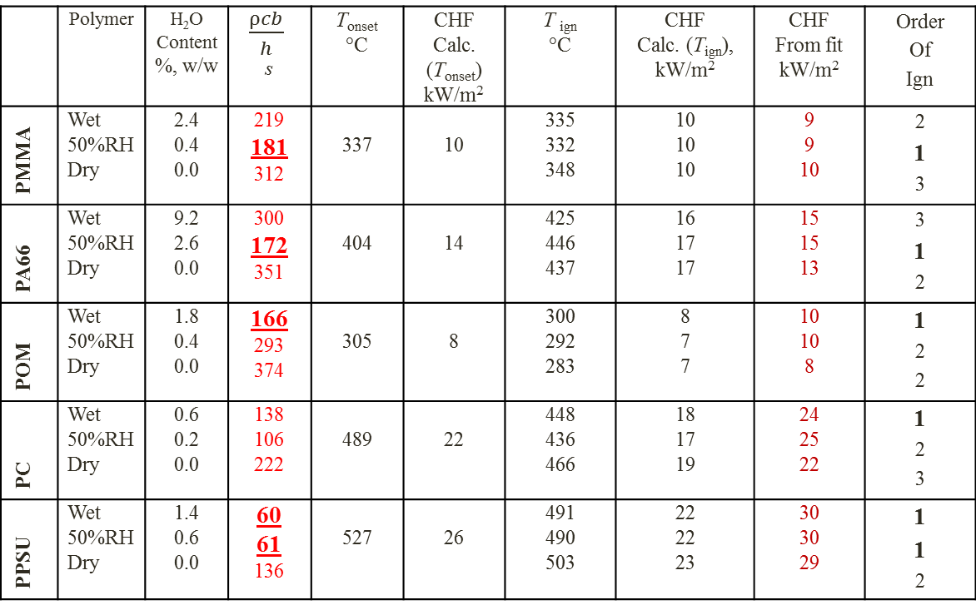
Ignition Parameters
Fit
Parameter 1
Fit
Parameter 2
MCC
Testing
Cone
Experiments
 | Polymer | H₂O Content %, w/w | $\frac{ρcb}{h}$ s | T_{onset} °C | CHF Calc. (T_{onset}) kW/m² | T _{ign} °C | CHF Calc. (T_{ign}), kW/m² | CHF From fit kW/m² | Order Of Ign
PMMA | Wet 50%RH Dry | 2.4 0.4 0.0 | 219 181 312 | 337 | 10 | 335 332 348 | 10 10 10 | 9 9 10 | 2 1 3
PA66 | Wet 50%RH Dry | 9.2 2.6 0.0 | 300 172 351 | 404 | 14 | 425 446 437 | 16 17 17 | 15 15 13 | 3 1 2
POM | Wet 50%RH Dry | 1.8 0.4 0.0 | 166 293 374 | 305 | 8 | 300 292 283 | 8 7 7 | 10 10 8 | 1 2 2
PC | Wet 50%RH Dry | 0.6 0.2 0.0 | 138 106 222 | 489 | 22 | 448 436 466 | 18 17 19 | 24 25 22 | 1 2 3
PPSU | Wet 50%RH Dry | 1.4 0.6 0.0 | 60 61 136 | 527 | 26 | 491 490 503 | 22 22 23 | 30 30 29 | 1 1 2

Slide 20
Critical mass flux calculations
Specific mass loss data from cone experiments was smoothed a few times to obtain reasonable curve going through data points.
Cone data for POM RH50 sample at 50 kW/m²
Savitzky-Golay filter was applied to the data points to increase signal-to-noise ratio
Ignition time is 37 s.
Critical mass flux calculated to be 3 g/m²-s

Slide 21
Parameters of the Chemical Ignition Criteria
Polymer | Conditioning | H₂O Content | Critical Mass Flux, | Heat of Combustion of Fuel Gases, H_{c} | Critical Heat Release Rate, | Order Of Ign.
 |  | %, w/w | g/m²-s | kJ/g | kW/m²
PMMA | Wet RH50 Dry | 2.4 0.4 0 | 3.0 2.1 2.7 | 25.0 | 75 53 68 | 2 1 3
PA66 | Wet RH50 Dry | 9.2 2.6 0 | 4.2 2.0 1.1 | 28.4 | 119 62 31 | 3 1 2
POM | Wet RH50 Dry | 1.8 0.4 0 | 1.8 2.0 2.1 | 14.0 | 25 28 29 | 1 2 2
PC | Wet RH50 Dry | 0.6 0.2 0 | 3.3 2.9 3.8 | 26.6 | 88 77 101 | 1 2 3
PPSU | Wet RH50 Dry | 1.4 0.6 0 | 1.8 1.1 4.8 | 22.1 | 40 24 106 | 1 1 2
*Calculation error for critical mass flux calculations is large.

Slide 22
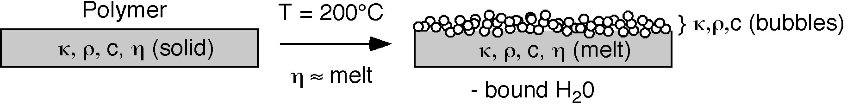
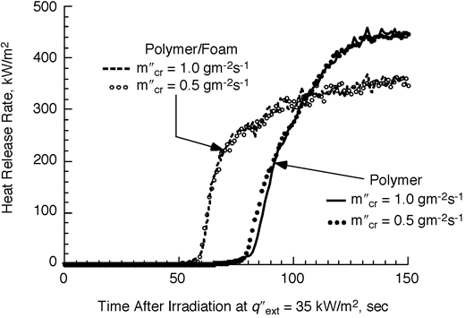
ThermaKin simulations
In ThermaKin model, moisture-containing polymers would undergo a phase change from solid polymer to foamed polymer at 200⁰C. Properties of the foamed polymer were adjusted accordingly.
Additional calculations were performed to test the chemical criteria for ignition, in which critical mass flux was reduced by the factor of 2.

Slide 23
Discussion
The polymers examined in this study had wet and/or RH50 samples ignited earlier than dry samples.
Premature ignition did not always correlate with the amount of water in the polymer, but the presence of water was a prerequisite for premature ignition.
Thermal response time could account for observed results in the thermal criterion for ignition ( CHF and T_{ign} were not affected by moisture).
The chemical criteria for ignition (mass flux and heat release rate) did not explain the effect of moisture on ignitability.

Slide 24
Conclusions
Moisture in hydrocarbon polymers has a large and variable effect on the time of ignition and on heat release rate histories.
Environmental conditioning of samples using standard procedures is highly recommended for regulatory tests of fire performance where repeatability and reproducibility are important.

