Slide 1
A Novel Approach to Predicting Upward Flame Spread over Polymers
Isaac T. Leventon
Stanislav I. Stoliarov

Slide 2
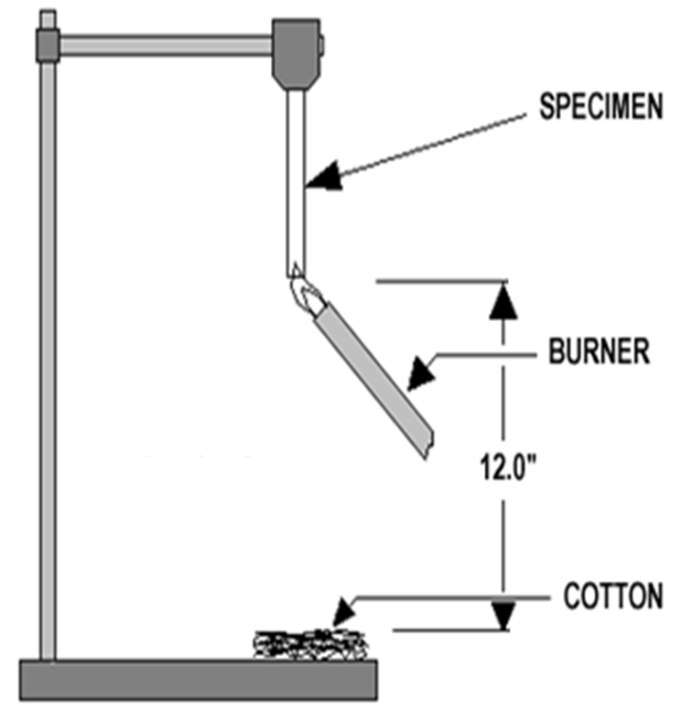
The Fire Problem
Introduction
The Fire Problem
Thermal Model
Early Models of Flame Spread
Purpose of Study
Experimental Work
Experimental Process
Flame Spread
Experimental Results
Material Burning Behavior
Measured Heat Flux
Flame Heat Flux Model
Modeling Work
Flame Heat Feedback
Flame Spread
Conclusions and Future Work
Surface flame spread is a key determinant of early fire growth
Flame to surface heat feedback controls material burning rate
Widely used standards assessing material flammability show:
Limited predictive capabilities outside of standard test conditions
Conflicting assessments between tests
UL 94 Test Schematic

Slide 3
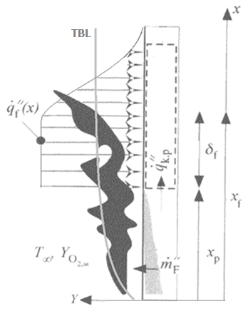
Thermal Model of Upward Flame Spread
Introduction
The Fire Problem
Thermal Model
Early Models of Flame Spread
Purpose of Study
Experimental Work
Experimental Process
Flame Spread
Experimental Results
Material Burning Behavior
Measured Heat Flux
Flame Heat Flux Model
Modeling Work
Flame Heat Feedback
Flame Spread
Conclusions and Future Work
Notes:
Flame spread is known to be controlled by a positive feedback between coupled processes of solid degradation and gas phase combustion.
As gaseous degradation products react with the ambient oxidizer in a diffusion flame, a fraction of heat produced in this reaction is transferred back to the solid,
causing further degradation and production of flammable gases.
In vertical wall flames, this process has a potential for rapid growth because gasified fuel moves upward, driven by natural convection,
and burns downstream from where it is created, thus allowing for heat transfer to a region of the solid that is not yet degrading.

Slide 4
Early Flame Spread Models
Introduction
The Fire Problem
Thermal Model
Early Models of Flame Spread
Purpose of Study
Experimental Work
Experimental Process
Flame Spread
Experimental Results
Material Burning Behavior
Measured Heat Flux
Flame Heat Flux Model
Modeling Work
Flame Heat Feedback
Flame Spread
Conclusions and Future Work
Early analytical models
Additional influences to consider
Heat transfer mechanism
Transient flame/material behaviors
Temperature dependent material properties
Sample thickness/width/aspect ratio
Transition to turbulence
Notes:
Assumptions
constant flame height
single values of flame to surface heat flux to describe the heat feedback profile
simplified in-depth heat transfer
Simplified material degradation mechanisms
Assume, a priori, linear or exponential growth rate

Slide 5
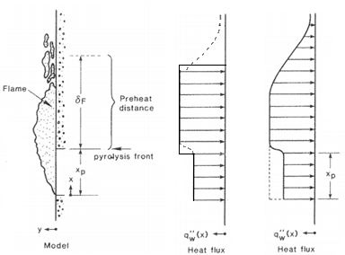
Early Flame Spread Models
Introduction
The Fire Problem
Thermal Model
Early Models of Flame Spread
Purpose of Study
Experimental Work
Experimental Process
Flame Spread
Experimental Results
Material Burning Behavior
Measured Heat Flux
Flame Heat Flux Model
Modeling Work
Flame Heat Feedback
Flame Spread
Conclusions and Future Work
Computational Models
Predict material response to a flame induced heat flux
How to describe this heat flux
Flame height
Heat feedback profile
Steady state (peak) heat flux
Form/shape, decay region
Notes:
This image is from Hasemi, 1984 [Experimental Wall Flame Heat Transfer Correlations for the Analysis of Upward Wall Flame Spread]
A careful understanding of incident heat flux is required in any attempt at predicting material burning rate – Rhodes/Quintiere
Solid phase pyrolysis models have evolved from one-dimensional, steady-state formulations to two-dimensional, time-resolved solvers with multi-reaction degradation chemistry and temperature and composition resolved thermophysical properties[10], [11].
20-35 kW/m2 constant heat flux:
[9] J.L. Consalvi, Y. Pizzo, B. Porterie, Fire Saf. J.43 (2008) 351–362
[11] K. Tsai, J. Turnbull, G. Will, D. Drysdale, Fire Saf. Sci.7 (2002) 117–128

Slide 6
Purpose of Study
Introduction
The Fire Problem
Thermal Model
Early Models of Flame Spread
Purpose of Study
Experimental Work
Experimental Process
Flame Spread
Experimental Results
Material Burning Behavior
Measured Heat Flux
Flame Heat Flux Model
Modeling Work
Flame Heat Feedback
Flame Spread
Conclusions and Future Work
Better resolve flame to surface heat feedback at the critical length scale
Predict flame to surface heat feedback solely as a function of
material burning rate
Notes:
I should be clear here. The development of this expression dates back almost two years and was presented at the 2011 Combustion Symposium.
In that work, a flame heat flux expression was developed based on highly spatially refined measurements of flame heat flux taken at 1 cm intervals from 2 to 15 cm above the base that was ignited to allow for upward flame spread
In this study, we have refined that expression with additional measurements taken on samples ignited by a new burner

Slide 7
Purpose of Study
Introduction
The Fire Problem
Thermal Model
Early Models of Flame Spread
Purpose of Study
Experimental Work
Experimental Process
Flame Spread
Experimental Results
Material Burning Behavior
Measured Heat Flux
Flame Heat Flux Model
Modeling Work
Flame Heat Feedback
Flame Spread
Conclusions and Future Work
Couple empirical model of flame heat feedback with advanced pyrolysis model to simulate early stages of upward flame spread
Generalize model to describe the burning behavior of a range of materials through straightforward scaling

Slide 8
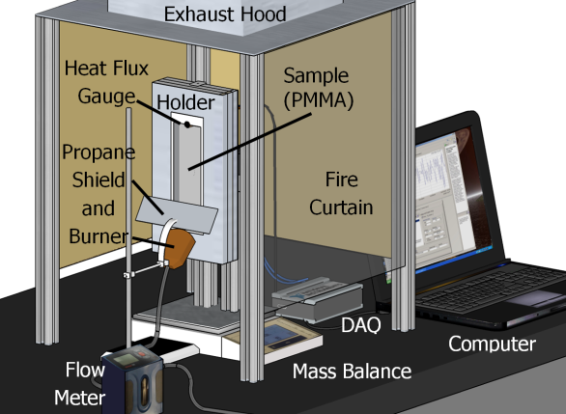
Test Apparatus
Introduction
The Fire Problem
Thermal Model
Early Models of Flame Spread
Purpose of Study
Experimental Work
Experimental Process
Flame Spread
Experimental Results
Material Burning Behavior
Measured Heat Flux
Flame Heat Flux Model
Modeling Work
Flame Heat Feedback
Flame Spread
Conclusions and Future Work

Slide 9
Test Apparatus
Introduction
The Fire Problem
Thermal Model
Early Models of Flame Spread
Purpose of Study
Experimental Work
Experimental Process
Flame Spread
Experimental Results
Material Burning Behavior
Measured Heat Flux
Flame Heat Flux Model
Modeling Work
Flame Heat Feedback
Flame Spread
Conclusions and Future Work
Notes:
A straightforward extension of the above methodology to provide height-resolved heat flux measurements is to canvass a sample with multiple heat flux gauges; however, such an approach, while efficient, has significant drawbacks. The most notable among them are potential distortions in the temperature and flow structure of the gaseous boundary layer and temperature of the burning material due to a contact with multiple thermostated elements. Therefore, in this work, height-resolved heat flux was obtained by preparing samples with heights ranging from 2 to 15 cm in 1 cm increments, measuring heat flux at the top of each one as a representative section of the full sized sample, and combining these measurements to produce a complete heat feedback profile across a 15 cm sample
Originally we studied this profile with a 1 cm spatial resolution for heat flux measurements → 16 measurements from x = 2 to 15 cm
In these tests, we had a burner issue (go to next page)

Slide 10
Experimental Procedure
Introduction
The Fire Problem
Thermal Model
Early Models of Flame Spread
Purpose of Study
Experimental Work
Experimental Process
Flame Spread
Experimental Results
Material Burning Behavior
Measured Heat Flux
Flame Heat Flux Model
Modeling Work
Flame Heat Feedback
Flame Spread
Conclusions and Future Work
Ignite sample base with propane burner; 125 s exposure
Allow flame to propagate freely upwards for 475 s or until full sample involvement
Measure flame to surface heat feedback at 8 heights (from 3 to 17.5 cm above base of sample)
Notes:
A straightforward extension of the above methodology to provide height-resolved heat flux measurements is to canvass a sample with multiple heat flux gauges; however, such an approach, while efficient, has significant drawbacks. The most notable among them are potential distortions in the temperature and flow structure of the gaseous boundary layer and temperature of the burning material due to a contact with multiple thermostated elements. Therefore, in this work, height-resolved heat flux was obtained by preparing samples with heights ranging from 2 to 15 cm in 1 cm increments, measuring heat flux at the top of each one as a representative section of the full sized sample, and combining these measurements to produce a complete heat feedback profile across a 15 cm sample
Originally we studied this profile with a 1 cm spatial resolution for heat flux measurements → 16 measurements from x = 2 to 15 cm
In these tests, we had a burner issue (go to next page)

Slide 11
Ignition Source Heat Flux Profile
Introduction
The Fire Problem
Thermal Model
Early Models of Flame Spread
Purpose of Study
Experimental Work
Experimental Process
Flame Spread
Experimental Results
Material Burning Behavior
Measured Heat Flux
Flame Heat Flux Model
Modeling Work
Flame Heat Feedback
Flame Spread
Conclusions and Future Work
Notes:
New burner was designed to eliminate complications (a stretched/dual flame structure) observed shortly after ignition in previous tests

Slide 12
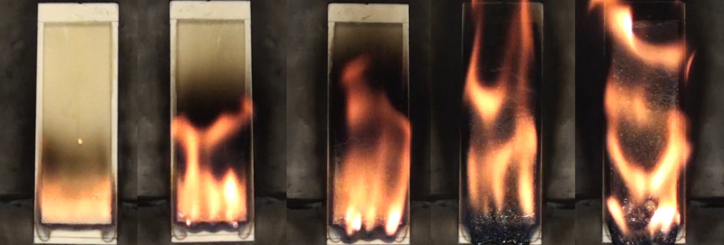
Flame Spread
t = 15 s t = 60 s t = 105 s t = 150 s t = 240 s
Notes:
Early stages after ignition, nice small, uniform (across the sample’s width) laminar flame.
Not wholly turbulent, but we begin to see that L→T transition as the flame grows.

Slide 13
Sample Mass Loss Rate
Introduction
The Fire Problem
Thermal Model
Early Models of Flame Spread
Purpose of Study
Experimental Work
Experimental Process
Flame Spread
Experimental Results
Material Burning Behavior
Measured Heat Flux
Flame Heat Flux Model
Modeling Work
Flame Heat Feedback
Flame Spread
Conclusions and Future Work

Slide 14
Sample Mass Loss Rate
Introduction
The Fire Problem
Thermal Model
Early Models of Flame Spread
Purpose of Study
Experimental Work
Experimental Process
Flame Spread
Experimental Results
Material Burning Behavior
Measured Heat Flux
Flame Heat Flux Model
Modeling Work
Flame Heat Feedback
Flame Spread
Conclusions and Future Work

Slide 15
Measured Flame Heat Flux
Introduction
The Fire Problem
Thermal Model
Early Models of Flame Spread
Purpose of Study
Experimental Work
Experimental Process
Flame Spread
Experimental Results
Material Burning Behavior
Measured Heat Flux
Flame Heat Flux Model
Modeling Work
Flame Heat Feedback
Flame Spread
Conclusions and Future Work
x = 7.5 cm

Slide 16
Measured Flame Heat Flux
Introduction
The Fire Problem
Thermal Model
Early Models of Flame Spread
Purpose of Study
Experimental Work
Experimental Process
Flame Spread
Experimental Results
Material Burning Behavior
Measured Heat Flux
Flame Heat Flux Model
Modeling Work
Flame Heat Feedback
Flame Spread
Conclusions and Future Work

Slide 17
Measured Flame Heat Flux
:
Introduction
The Fire Problem
Thermal Model
Early Models of Flame Spread
Purpose of Study
Experimental Work
Experimental Process
Flame Spread
Experimental Results
Material Burning Behavior
Measured Heat Flux
Flame Heat Flux Model
Modeling Work
Flame Heat Feedback
Flame Spread
Conclusions and Future Work

Slide 18
Steady State Flame Heat Flux
Introduction
The Fire Problem
Thermal Model
Early Models of Flame Spread
Purpose of Study
Experimental Work
Experimental Process
Flame Spread
Experimental Results
Material Burning Behavior
Measured Heat Flux
Flame Heat Flux Model
Modeling Work
Flame Heat Feedback
Flame Spread
Conclusions and Future Work
x = 17.5 cm

Slide 19
Steady State Flame Heat Flux
Introduction
The Fire Problem
Thermal Model
Early Models of Flame Spread
Purpose of Study
Experimental Work
Experimental Process
Flame Spread
Experimental Results
Material Burning Behavior
Measured Heat Flux
Flame Heat Flux Model
Modeling Work
Flame Heat Feedback
Flame Spread
Conclusions and Future Work

Slide 20
Normalized Flame Heat Flux
Introduction
The Fire Problem
Thermal Model
Early Models of Flame Spread
Purpose of Study
Experimental Work
Experimental Process
Flame Spread
Experimental Results
Material Burning Behavior
Measured Heat Flux
Flame Heat Flux Model
Modeling Work
Flame Heat Feedback
Flame Spread
Conclusions and Future Work
20

Slide 21
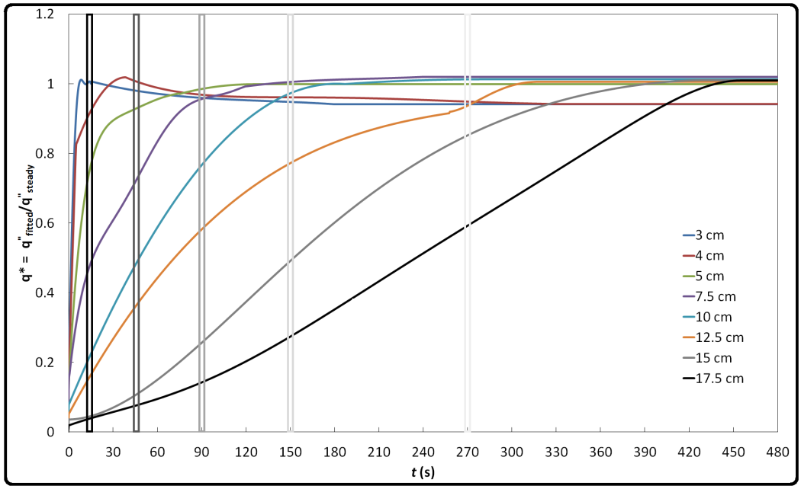
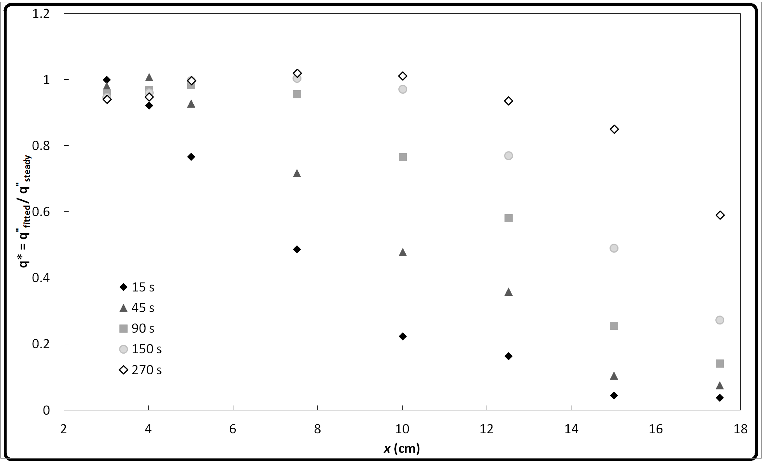
Flame Heat Flux Profile
Introduction
The Fire Problem
Thermal Model
Early Models of Flame Spread
Purpose of Study
Experimental Work
Experimental Process
Flame Spread
Experimental Results
Material Burning Behavior
Measured Heat Flux
Flame Heat Flux Model
Modeling Work
Flame Heat Feedback
Flame Spread
Conclusions and Future Work

Slide 22
Flame Heat Flux Profile
Introduction
The Fire Problem
Thermal Model
Early Models of Flame Spread
Purpose of Study
Experimental Work
Experimental Process
Flame Spread
Experimental Results
Material Burning Behavior
Measured Heat Flux
Flame Heat Flux Model
Modeling Work
Flame Heat Feedback
Flame Spread
Conclusions and Future Work
Heat feedback profile across a 17.5cm sample
(90s after ignition; dm’/dt = 0.037 g s⁻¹cm⁻¹)

Slide 23
Determining Flame Height, x_{f}
Introduction
The Fire Problem
Thermal Model
Early Models of Flame Spread
Purpose of Study
Experimental Work
Experimental Process
Flame Spread
Experimental Results
Material Burning Behavior
Measured Heat Flux
Flame Heat Flux Model
Modeling Work
Flame Heat Feedback
Flame Spread
Conclusions and Future Work
Flame height is defined as the highest position along the sample at which

Slide 24
Flame Heat Flux Beyond x_{f}
Introduction
The Fire Problem
Thermal Model
Early Models of Flame Spread
Purpose of Study
Experimental Work
Experimental Process
Flame Spread
Experimental Results
Material Burning Behavior
Measured Heat Flux
Flame Heat Flux Model
Modeling Work
Flame Heat Feedback
Flame Spread
Conclusions and Future Work

Slide 25
Flame Heat Flux Model
Introduction
The Fire Problem
Thermal Model
Early Models of Flame Spread
Purpose of Study
Experimental Work
Experimental Process
Flame Spread
Experimental Results
Material Burning Behavior
Measured Heat Flux
Flame Heat Flux Model
Modeling Work
Flame Heat Feedback
Flame Spread
Conclusions and Future Work

Slide 26
Flame Heat Feedback Model Predictions
Introduction
The Fire Problem
Thermal Model
Early Models of Flame Spread
Purpose of Study
Experimental Work
Experimental Process
Flame Spread
Experimental Results
Material Burning Behavior
Measured Heat Flux
Flame Heat Flux Model
Modeling Work
Flame Heat Feedback
Flame Spread
Conclusions and Future Work

Slide 27
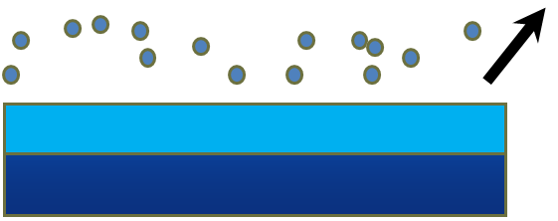
Solid Phase Material Response
Introduction
The Fire Problem
Thermal Model
Early Models of Flame Spread
Purpose of Study
Experimental Work
Experimental Process
Flame Spread
Experimental Results
Material Burning Behavior
Measured Heat Flux
Flame Heat Flux Model
Modeling Work
Flame Heat Feedback
Flame Spread
Conclusions and Future Work
Flexible, computational
pyrolysis solver – ThermaKin2D
Computes the rate of material degradation and gaseous fuel production from physical and chemical properties of a solid
Components are defined by a series of temperature dependent material properties
Volatiles
Flame
Heat Flux
A B + C
Chemical reaction
Conduction
Virgin layer
Condensed phase is represented by a mixture of components (A, B,C), which interact chemically and physically.
Notes:
ThermaKin2D is a flexible computational pyrolysis solver, was used in this study to calculate the material response of PMMA– specifically, its gasification rate- when subjected to external heat.
Fully validated, predict the behavior of non-charring (PMMA, PS, HDPE) and charring materials (PC PVC)

Slide 28
Degradation Mechanism
Introduction
The Fire Problem
Thermal Model
Early Models of Flame Spread
Purpose of Study
Experimental Work
Experimental Process
Flame Spread
Experimental Results
Material Burning Behavior
Measured Heat Flux
Flame Heat Flux Model
Modeling Work
Flame Heat Feedback
Flame Spread
Conclusions and Future Work
Material degradation mechanism defined by:
First order Arrhenius Reaction rates:
Temperature dependent material properties (density, heat capacity, thermal conductivity, gas transfer)
Notes:
ξ is the concentration of a given component expressed in the units of mass per unit volume ((mass fraction) ρ ).
Emissivity, and absorption coefficient defined as constant values
In a previous work [1], data collected from milligram-scale tests of 7 non-charring materials, including PMMA, was used to obtain their degradation mechanisms, thermodynamic properties of material components, and the energetics associated with the thermal degradation processes. In this manuscript, an extension of that work is presented in which bench scale experiments on PMMA provided its thermal transport properties (i.e. thermal conductivity). Temperature measurements taken in these tests, along with the results of detailed pyrolysis modeling, were used to determine a final degradation mechanism for this material, which included a glass transition state, and its corresponding (temperature dependent) thermal conductivity. The pyrolysis model constructed here was validated by comparison against an independent set of gasification experiments that provided sample mass loss rate (MLR) history in response to three different external heat fluxes (which capture a range of boundary conditions typical of likely fire scenarios).

Slide 29
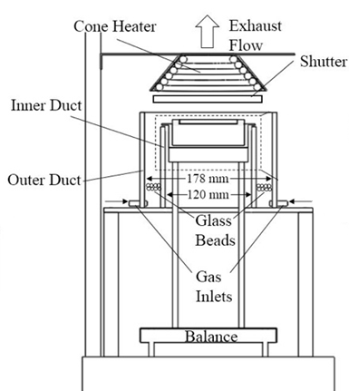
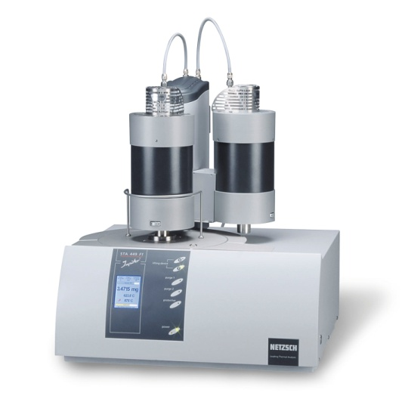
Degredation Mechanism
Milligram Scale Testing
Bench Scale Testing
Thermogravimetric Analyzer (TGA)
Kinetics: A, E
Differential Scanning Calorimetry (DSC)
Thermodynamics
Specific heat, C_{p}
Heats of
Decomposition, h_{decomp}
Melting, h_{melt}
Cone Calorimeter
Thermal Conductivity, k
Absorption coefficient, a
Acknowledgements: Jing Li, University of Maryland

Slide 30
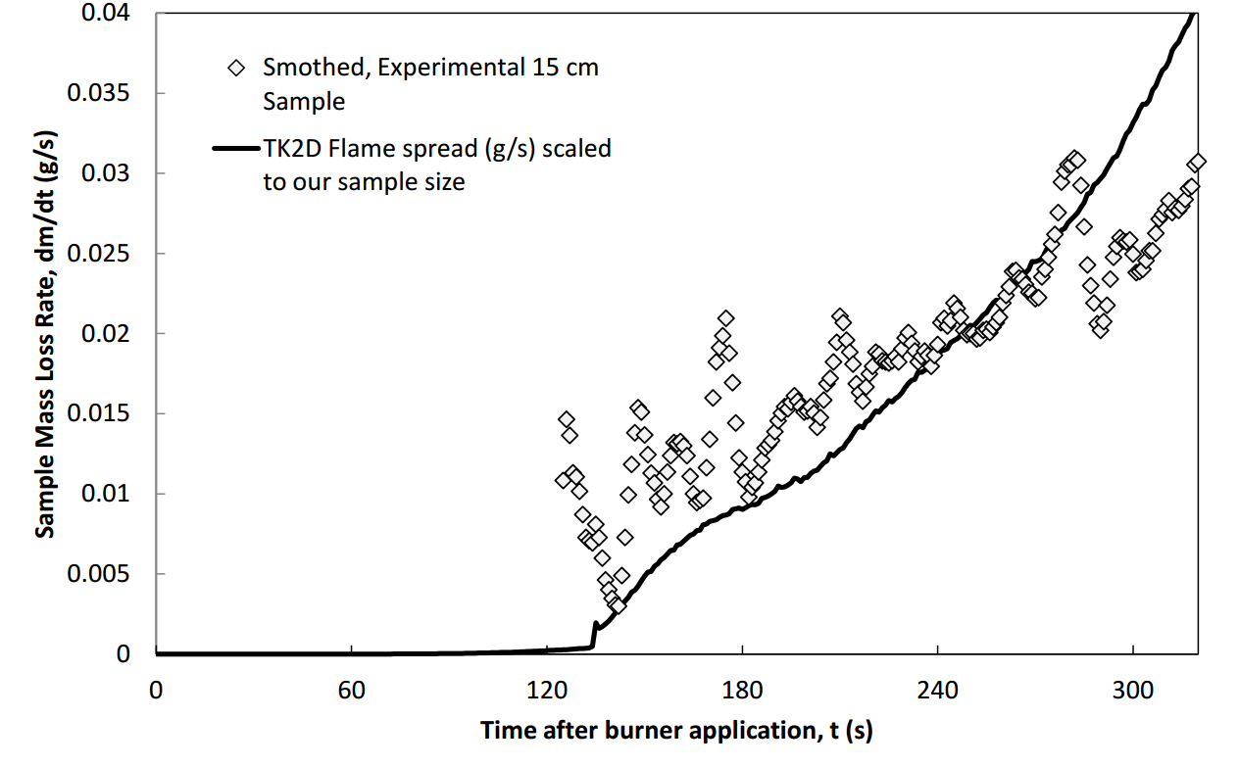
Simulation of Upward Flame Spread
Introduction
The Fire Problem
Thermal Model
Early Models of Flame Spread
Purpose of Study
Experimental Work
Experimental Process
Flame Spread
Experimental Results
Material Burning Behavior
Measured Heat Flux
Flame Heat Flux Model
Modeling Work
Flame Heat Feedback
Flame Spread
Conclusions and Future Work

Slide 31
Introduction
The Fire Problem
Thermal Model
Early Models of Flame Spread
Purpose of Study
Experimental Work
Experimental Process
Flame Spread
Experimental Results
Material Burning Behavior
Measured Heat Flux
Flame Heat Flux Model
Modeling Work
Flame Heat Feedback
Flame Spread
Conclusions and Future Work

Slide 32
Additional Materials, ABS
10 x 5 cm ABS slabs following burning in
the horizontal and vertical configuration

Slide 33
Additional Materials, ABS

Slide 34
Additional Materials, HIPS
Introduction
The Fire Problem
Thermal Model
Early Models of Flame Spread
Purpose of Study
Experimental Work
Experimental Process
Flame Spread
Experimental Results
Material Burning Behavior
Measured Heat Flux
Flame Heat Flux Model
Modeling Work
Flame Heat Feedback
Flame Spread
Conclusions and Future Work

Slide 35
Additional Materials, POM
Introduction
The Fire Problem
Thermal Model
Early Models of Flame Spread
Purpose of Study
Experimental Work
Experimental Process
Flame Spread
Experimental Results
Material Burning Behavior
Measured Heat Flux
Flame Heat Flux Model
Modeling Work
Flame Heat Feedback
Flame Spread
Conclusions and Future Work

Slide 36
Conclusions
Introduction
The Fire Problem
Thermal Model
Early Models of Flame Spread
Purpose of Study
Experimental Work
Experimental Process
Flame Spread
Experimental Results
Material Burning Behavior
Measured Heat Flux
Flame Heat Flux Model
Modeling Work
Flame Heat Feedback
Flame Spread
Conclusions and Future Work
Carefully obtained highly resolved measurements of heat feedback profile of an upward spreading flame
Created correlation predicting flame to surface heat flux, solely as a function of sample burning rate
Testing additional polymers (ABS, POM, HIPS) to determine how flame heat flux model can be generalized through straightforward scaling

Slide 37
Conclusions
Introduction
The Fire Problem
Thermal Model
Early Models of Flame Spread
Purpose of Study
Experimental Work
Experimental Process
Flame Spread
Experimental Results
Material Burning Behavior
Measured Heat Flux
Flame Heat Flux Model
Modeling Work
Flame Heat Feedback
Flame Spread
Conclusions and Future Work
Coupled flame heat flux model with solid phase computational pyrolysis solver, ThermaKin2D
Developed a fully parameterized model to simulated upward flame spread

Slide 38
Flame Heat Flux Beyond x_{f}
Introduction
The Fire Problem
Thermal Model
Early Models of Flame Spread
Purpose of Study
Experimental Work
Experimental Process
Flame Spread
Experimental Results
Material Burning Behavior
Measured Heat Flux
Flame Heat Flux Model
Modeling Work
Flame Heat Feedback
Flame Spread
Conclusions and Future Work

Slide 39
Comparison of x_{f} expressions
Introduction
The Fire Problem
Thermal Model
Early Models of Flame Spread
Purpose of Study
Experimental Work
Experimental Process
Flame Spread
Experimental Results
Material Burning Behavior
Measured Heat Flux
Flame Heat Flux Model
Modeling Work
Flame Heat Feedback
Flame Spread
Conclusions and Future Work

Slide 40
Flame Spread
Introduction
The Fire Problem
Thermal Model
Early Models of Flame Spread
Purpose of Study
Experimental Work
Experimental Process
Flame Spread
Experimental Results
Material Burning Behavior
Measured Heat Flux
Flame Heat Flux Model
Modeling Work
Flame Heat Feedback
Flame Spread
Conclusions and Future Work
Notes:
To justify combining measurements in this fashion, one must consider the main assumption in doing so - measuring the heat flux at the top of a shorter sample of PMMA yields the same result as measuring the heat flux at that sample height in a 15 cm tall sample. This assumption is reasonable because relatively minor changes in the conditions downstream of the measurement location (associated with the replacement of PMMA with Kaowool PM insulation) are expected to have negligible effect on the state of the reacting flow at the measurement location.

Slide 41
Effects of Heat Flux Gauge Water Temperature
Introduction
The Fire Problem
Thermal Model
Early Models of Flame Spread
Purpose of Study
Experimental Work
Experimental Process
Flame Spread
Experimental Results
Material Burning Behavior
Measured Heat Flux
Flame Heat Flux Model
Modeling Work
Flame Heat Feedback
Flame Spread
Conclusions and Future Work
x =5 cm
x = 15 cm

Slide 42
Flame Heat Flux Uniformity Across Sample Width
Introduction
The Fire Problem
Thermal Model
Early Models of Flame Spread
Purpose of Study
Experimental Work
Experimental Process
Flame Spread
Experimental Results
Material Burning Behavior
Measured Heat Flux
Flame Heat Flux Model
Modeling Work
Flame Heat Feedback
Flame Spread
Conclusions and Future Work
x =7.5 cm
x = 15 cm

Slide 43
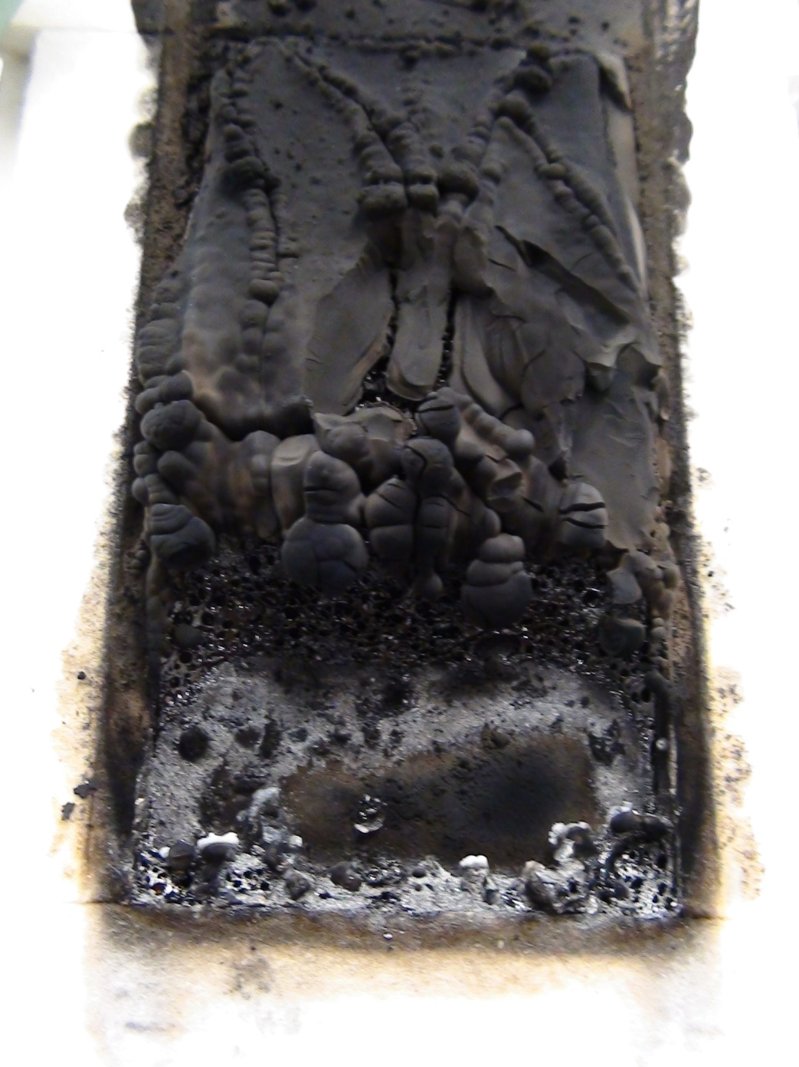
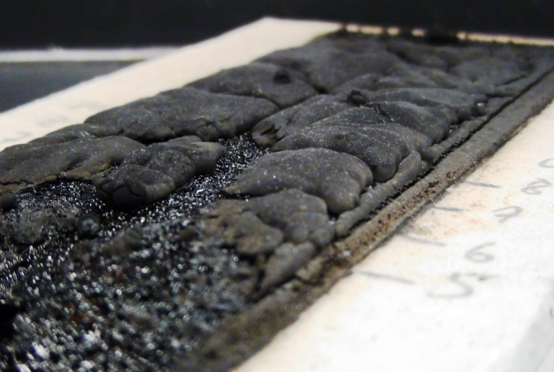
Soot Deposition on ABS
Notes:
To justify combining measurements in this fashion, one must consider the main assumption in doing so - measuring the heat flux at the top of a shorter sample of PMMA yields the same result as measuring the heat flux at that sample height in a 15 cm tall sample. This assumption is reasonable because relatively minor changes in the conditions downstream of the measurement location (associated with the replacement of PMMA with Kaowool PM insulation) are expected to have negligible effect on the state of the reacting flow at the measurement location.

Slide 44
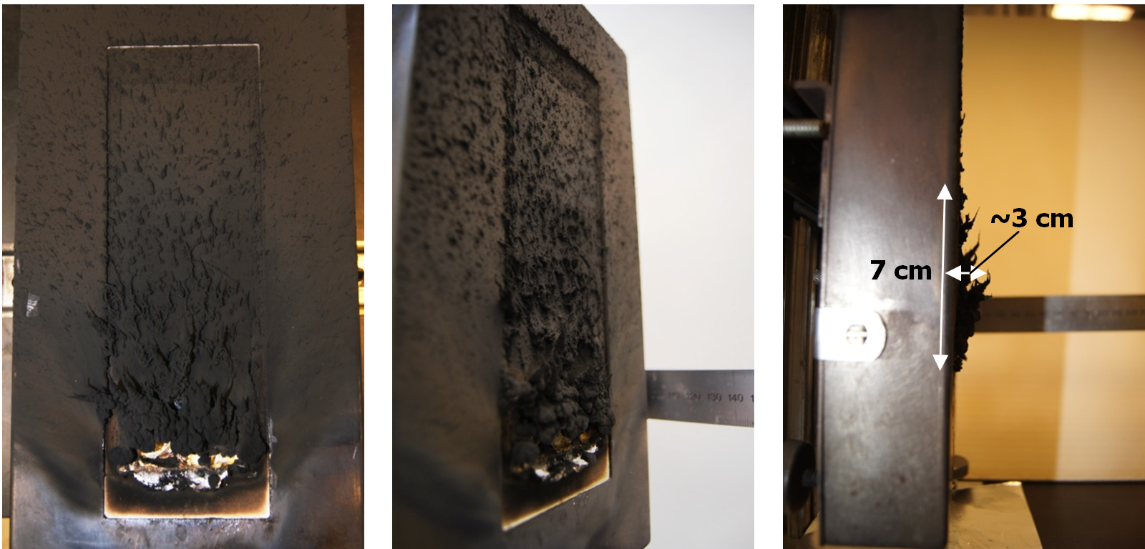
Soot Deposition on HIPS
Notes:
To justify combining measurements in this fashion, one must consider the main assumption in doing so - measuring the heat flux at the top of a shorter sample of PMMA yields the same result as measuring the heat flux at that sample height in a 15 cm tall sample. This assumption is reasonable because relatively minor changes in the conditions downstream of the measurement location (associated with the replacement of PMMA with Kaowool PM insulation) are expected to have negligible effect on the state of the reacting flow at the measurement location.

