Slide 1
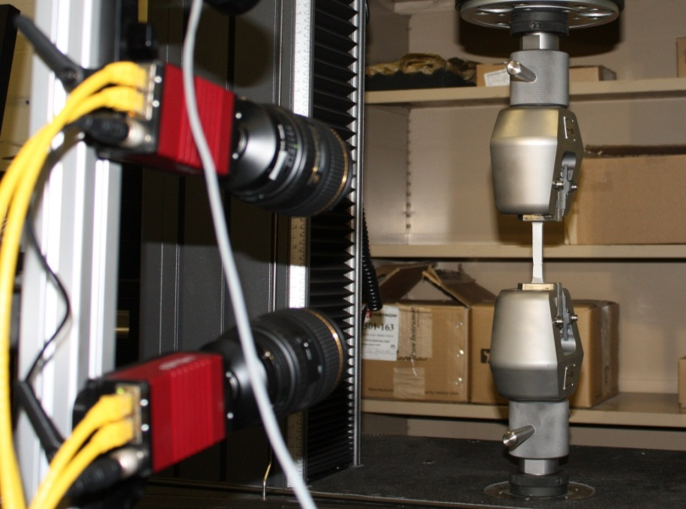
Simultaneous Strain and Temperature Field Measurements for Thermo-Structural Response during Fires
Brian Lattimer¹, Nathan Cholewa², Patrick Summers¹, Christian Rippe¹, and Scott Case²
¹Mechanical Engineering Department
²Engineering Science and Mechanics Department

Slide 2
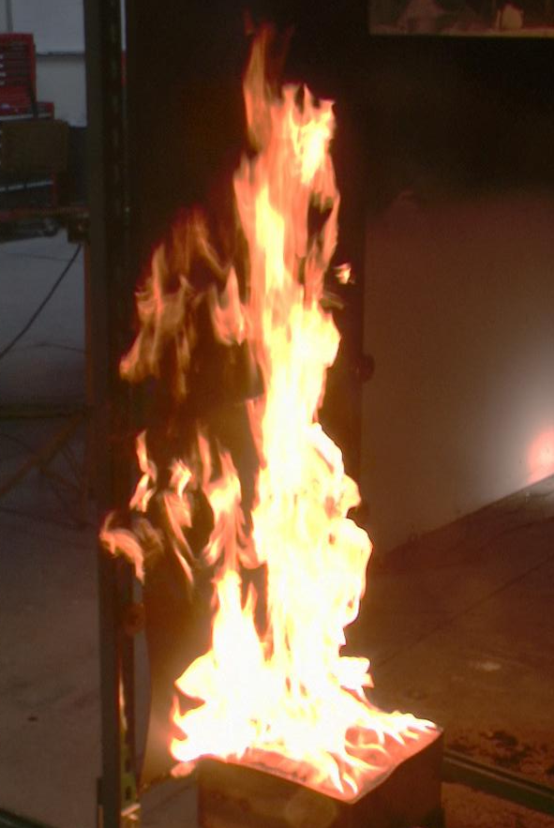
Motivation
Fires inside or adjacent to structures
  Produce non-uniform exposures and temperatures
  Result in complex structural behavior
Point measurements provide limited information about the thermal and structural response during fires
  Hot spots and weak points not known prior to testing
  Structural failure may depend on many variables that are difficult to anticipate
    Load redistribution
Non-contact full-field measurements of deflection, strain, and temperature
  Provide more complete picture of response
  Assist in assessing reasons for failure at particular locations

Slide 3
Outline
Digital Image Correlation (DIC) and IR thermal imaging overview
Thermo-structural experiments
  Uniaxial tensile tests
  Failure of welded aluminum
  Sandwich composite panels
  Aluminum burn-through
Future applications
  Intermediate scale tests
  Large-scale

Slide 4
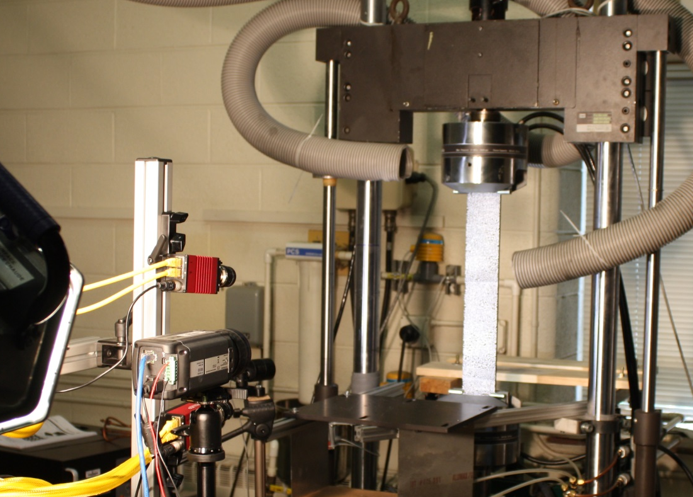
DIC – IR Thermal Imaging System
DIC system
  Stereoscopic tracking of dots on surface of interest to determine deflections and strains
  Two Allied GX 1660 2MP cameras, 66Hz maximum acquisition
IR Thermal imaging
  Surface temperature and heat flux mapping
  FLIR SC660 thermal imaging camera
    640 x 480 resolution, -40°C to 2000°C, 7-14 micron range
Synchronized DIC and thermal imaging
  Allow subtraction of thermal strains
  Direct relation of pixel information between two systems

Slide 5
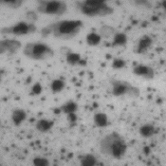
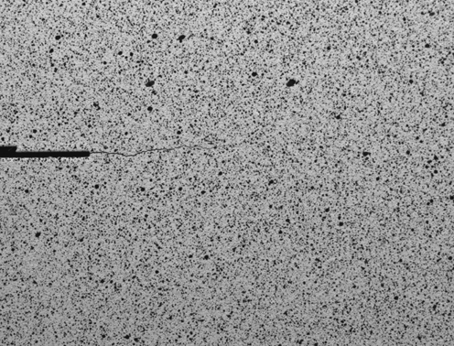
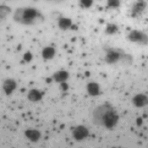
Digital Image Correlation Method
DIC is a non-intrusive method that can provide full-field displacements and strains
  High strain (>2000%)
  Scalable from coupon sample to full-scale based on camera resolution and dot size
Sample preparation consists of applying a contrasting stochastic dot pattern to the background
t_{o}
Groups of pixels can be tracked by minimizing a chosen correlation function
If suitable lighting is maintained, displacement accuracies of 0.01 pixels can be achieved
t_{n}

Slide 6
DIC – IR Camera Calibration and Preparation
Detailed assessment have been done on appropriate paints
  Characterized emissivity of individual and speckled paints with impact of applied layers and color differences
Specialty calibration blocks developed for simultaneous calibration of DIC and IR camera to allow for fusing data
Speckle pattern application techniques to provide appropriate size dots for tracking at scale of interest

Slide 7
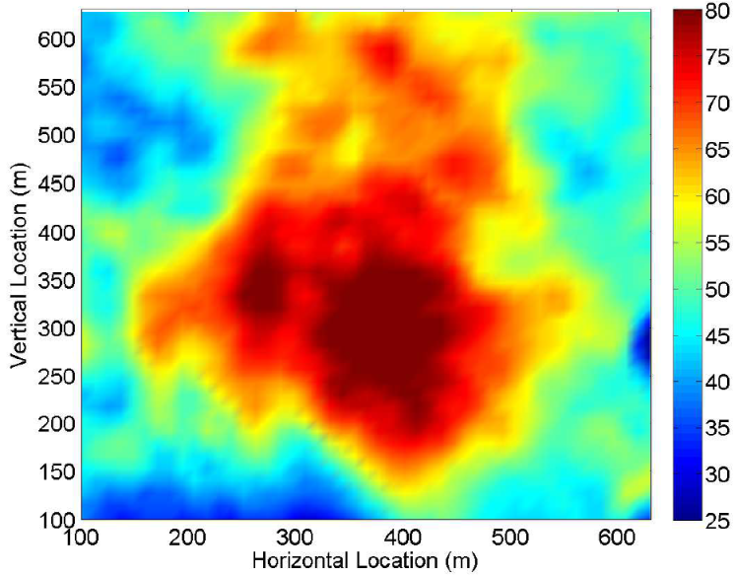
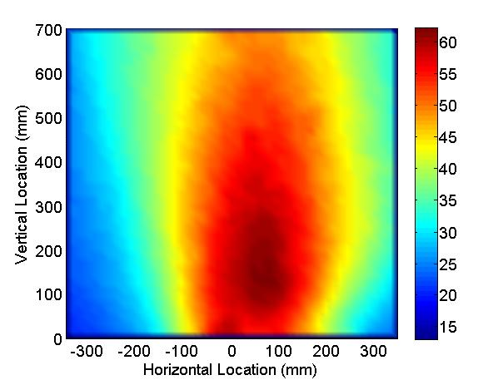
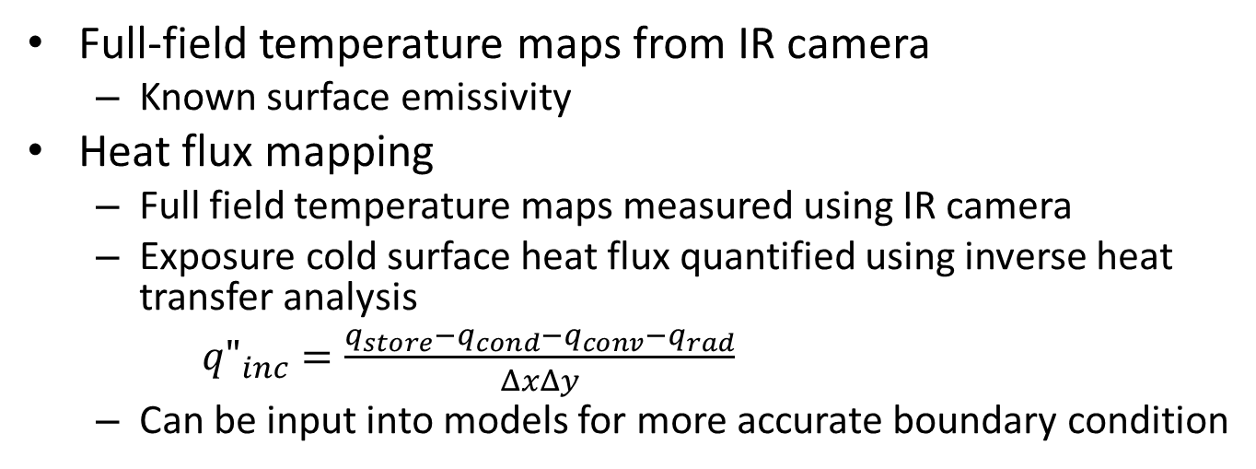
IR Thermal Imaging and Heat Flux Mapping
Full-field temperature maps from IR camera
  Known surface emissivity
Heat flux mapping
  Full field temperature maps measured using IR camera
  Exposure cold surface heat flux quantified using inverse heat transfer analysis
  ${q"}_{inc}=\frac{q_{store}−q_{cond}−q_{conv}−q_{rad}}{ΔxΔy}$
  Can be input into models for more accurate boundary condition
Horizontal Plate
q” (kW/m²)
Vertical Plate
q” (kW/m²)

Slide 8
Outline
DIC and IR thermal imaging overview
Thermo-structural experiments
  Uniaxial tensile tests
  Failure of welded aluminum
  Sandwich composite panels
  Aluminum burn-through
Future applications
  Intermediate scale tests
  Large-scale

Slide 9
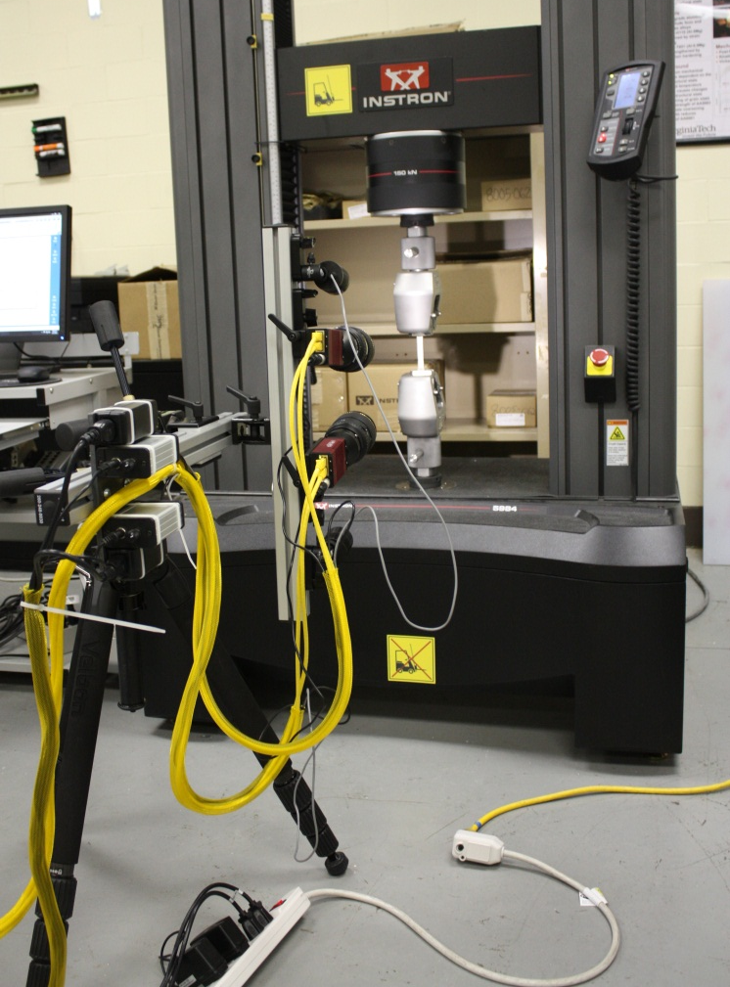
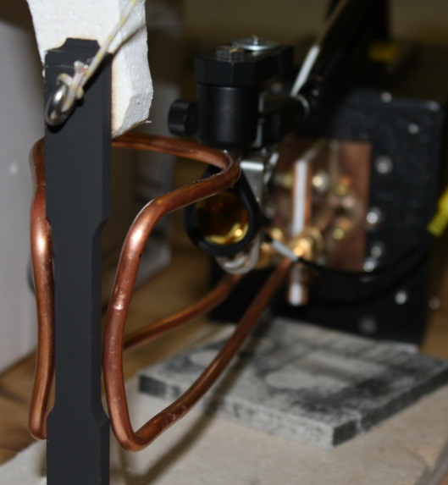
Uniaxial Tensile Tests – Residual Mechanical Properties
Explore kinetically-driven evolution of AA5083 and AA6061 residual mechanical behavior following fire exposure
  Heating rates reflective of fires
    Bare aluminum: 250°C/min
    25mm insulation: 25°C/min
    50mm insulation: 5°C/min
Detailed residual behavior evolution for work-hardening model development
  Heating rate: 15°C/min
  Temperatures: 200 – 500°C

Slide 10
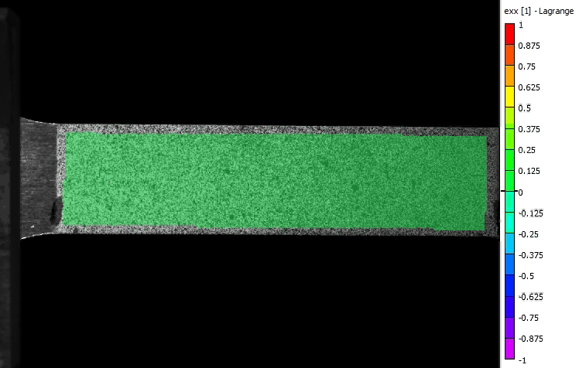
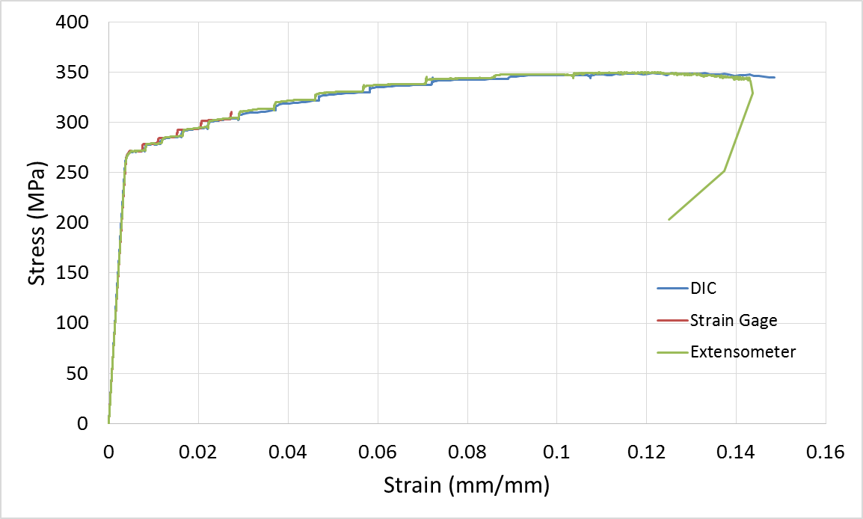
Uniaxial Tension Test – as-received AA5083-H116
Validated DIC for determining mechanical properties
  Within 1% of strain gage / extensometer data
Visualize material mechanical response during test
  Can select most appropriate location to obtain entire stress-strain curve at high strains
  Serrated yielding, also known as the Portevin-Le Chatelier (PLC) effect, evident in DIC

Slide 11
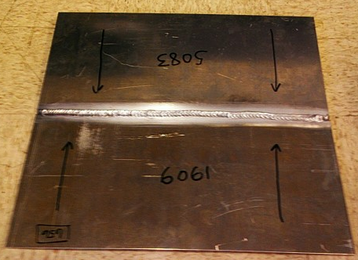
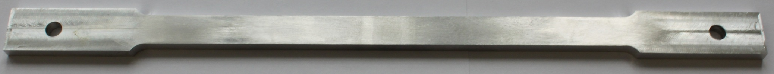
Aluminum Weld Failure during Fire
Aluminum plates MIG welded
  5083-5083, 6061-6061, 5083-6061
  All welds use 0.035” 5183 filler wire and 75He/25Ar shield gas
Welded samples were tested as-received and skimmed flat
Skimmed Test Sample
7.5 in
12 in

Slide 12
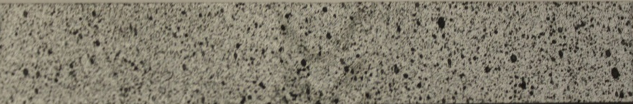

Hardness profile defines weld sub-regions
Weld
Weld
6061 HAZ
5083 Base
6061 Base
5083 HAZ
Left-6061 Base
Left-6061 HAZ
Right-6061 Base
Right-6061 HAZ
Weld Direction

Slide 13
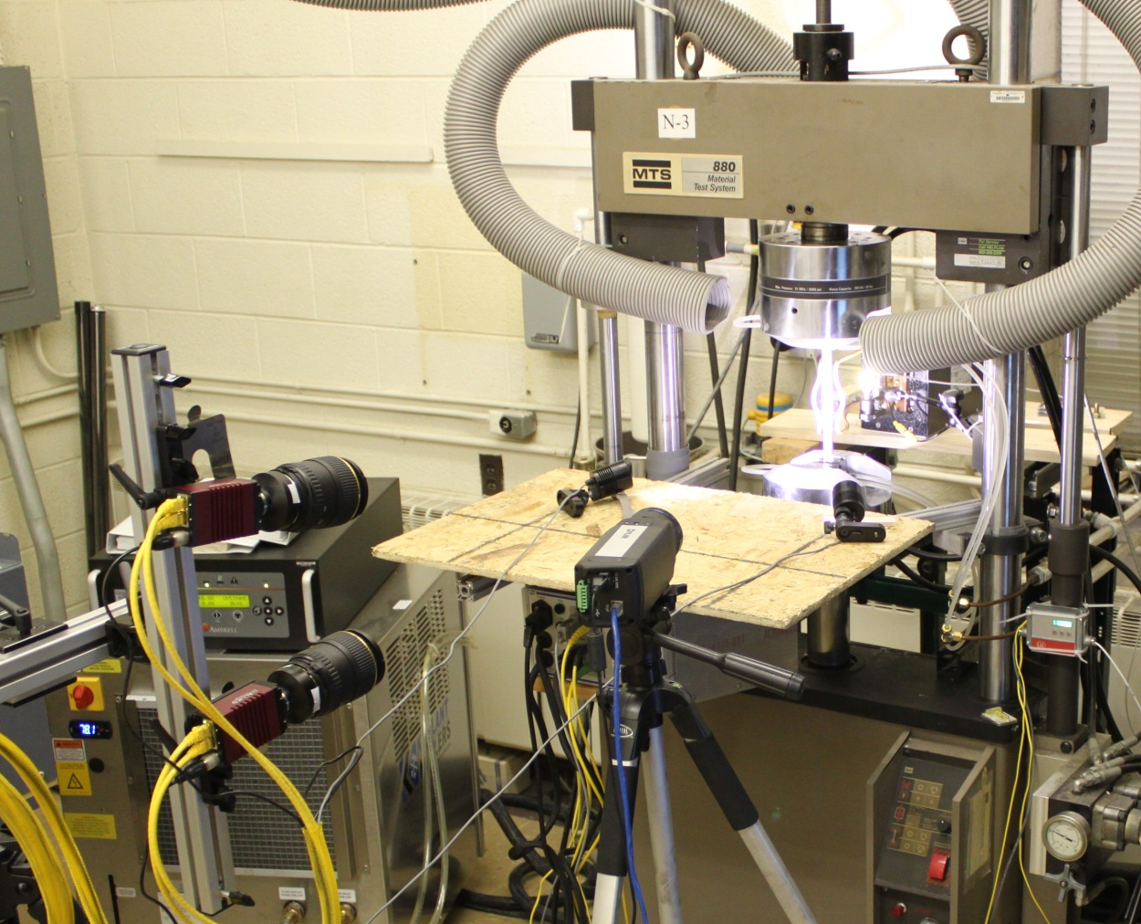
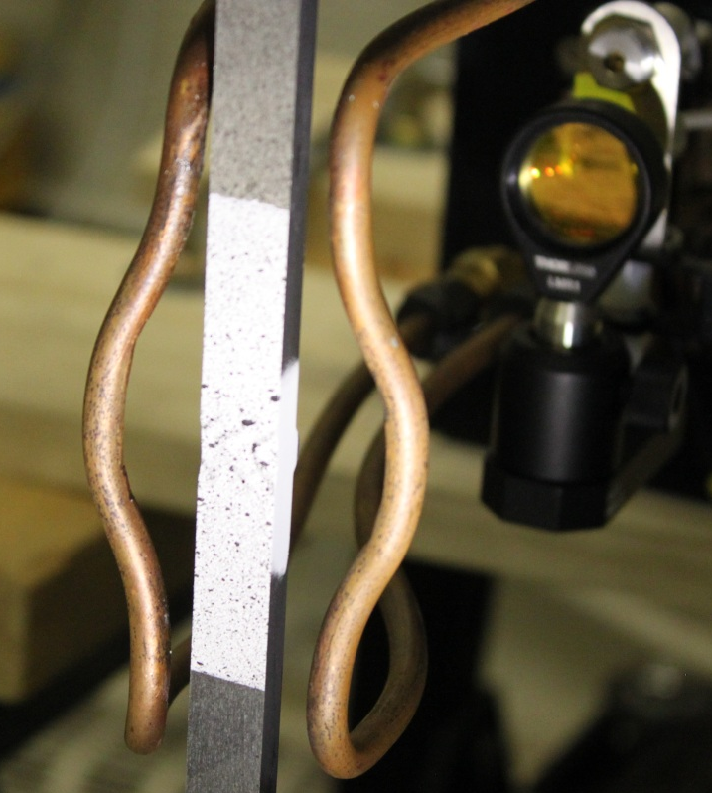
Experimental Setup
Induction heater used to heat and hold sample to desired temperature
Uniaxial tensile test with constant strain rate (10⁻³s⁻¹) until failure
Induction heating of sample

Slide 14
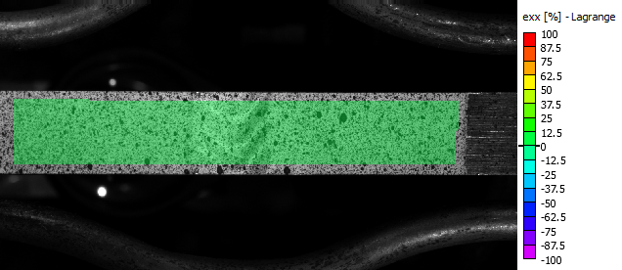
DIC Results: 6061–5083 at 100°C, Unskimmed
εxx (%)
6061
5083

Slide 15
Weld sub-regions analyzed using DIC
Results show interesting relationship occurring between weld region and HAZ
Strain results averaged over each weld sub-region
Stress-strain curves can then be plotted resulting in the average mechanical response of the various sub-regions

Slide 16
DIC Results: 6061–5083 at 100°C , Un-skimmed
Weld zone displays strain hardening behavior while HAZ shows a strain softening behavior
Cross-over in stress –strain curves indicates the movment of higher strain region to 6061 HAZ region
Relationship is maintained from RT to 300°C, at which point the material response of all zones become similar

Slide 17
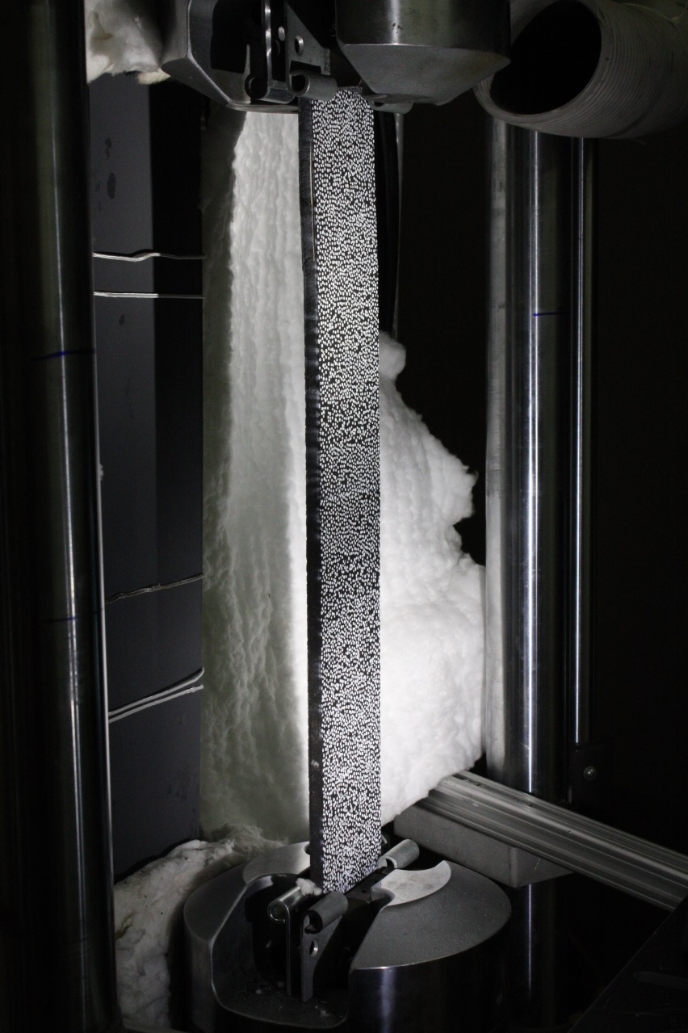
Sandwich Composite Thermo-Structural Test
Investigating the changes in failure mechanisms for sandwich composites during fire
Constant applied compression load
  10-50% room temperature buckling load
  Fixed-fixed boundary conditions
Heat flux of 10 kW/m² with radiant heater plate
DIC and IR system imaging unexposed surface during thermal exposure with applied load
Steel plate
radiant heater
Speckled sample
(cold face)

Slide 18
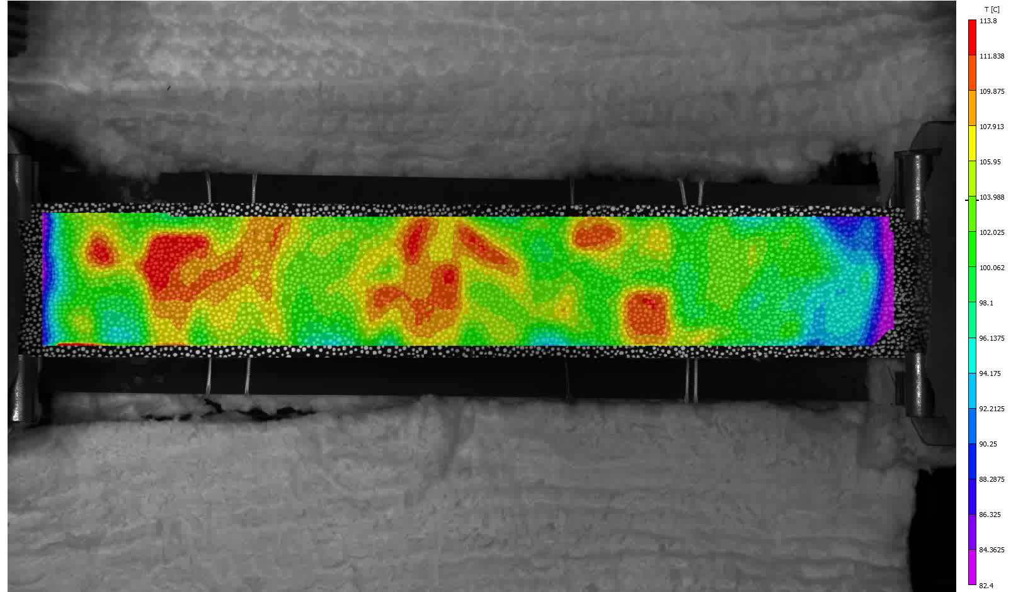
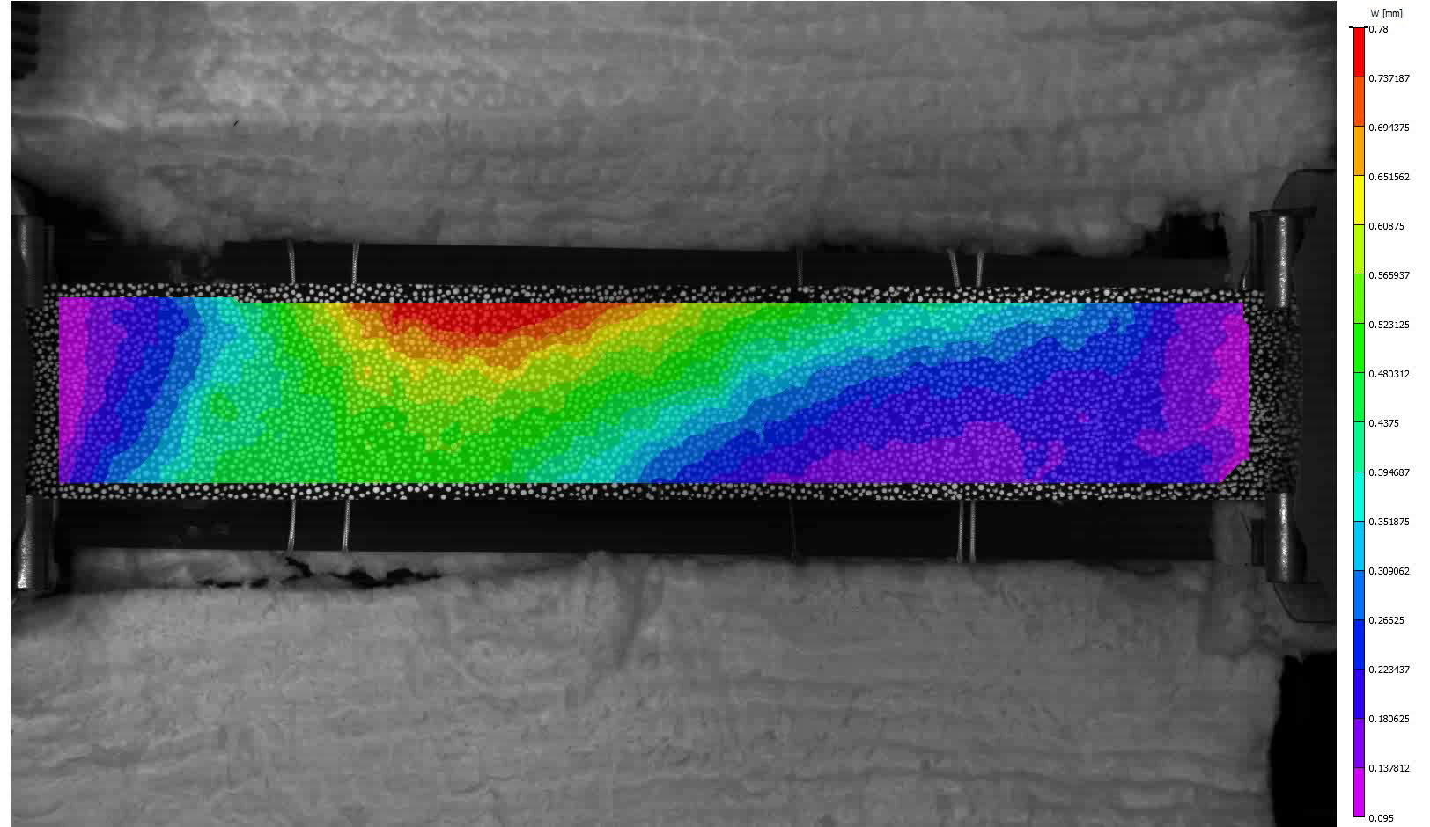
Sandwich Composite Deflection and Temperature
Temperature
Delamination clearly observed
Out-of-plane deflection
In both DIC and IR imaging

Slide 19
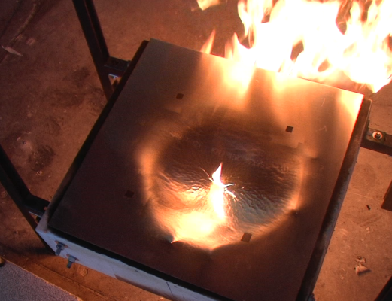
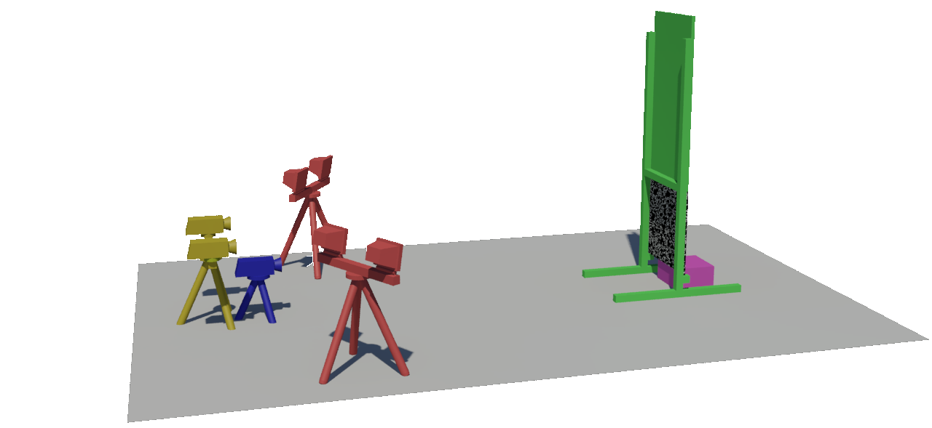
Aluminum Burn-through
Modeling and experimental measurement of burn-through for aluminum plates during fires
  Horizontal and vertical configurations
Experiments with 2 ft x 2 ft plates with fire in contact with plate
  Variable fire size and plate thickness
Horizontal Burn-Through due to Impinging Fire

Slide 20
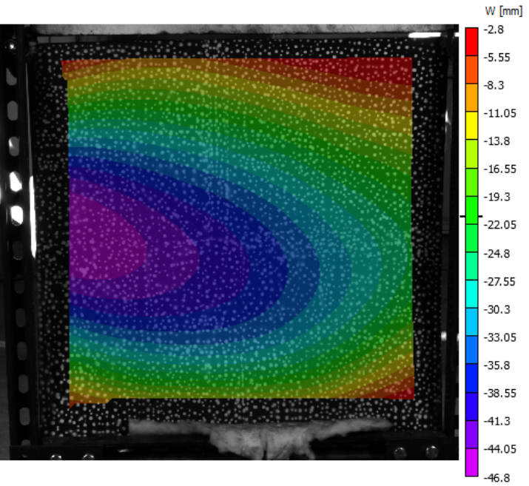
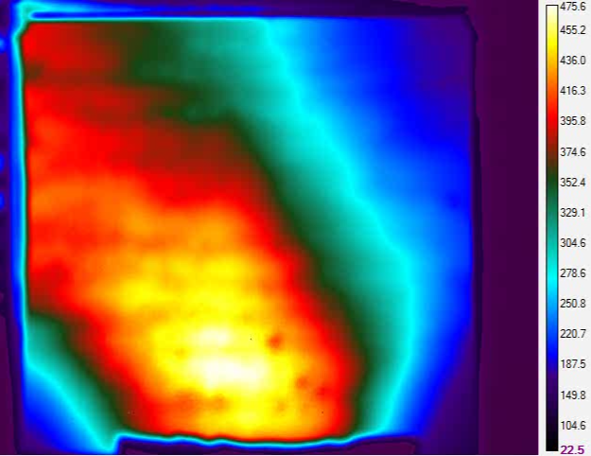
DIC and IR in Vertical Burn-Through Test
Can quantify plate deformation and temperatures during burn-through test

Slide 21
Outline
DIC and IR thermal imaging overview
Thermo-structural experiments
  Uniaxial tensile tests
  Failure of welded aluminum
  Sandwich composite panels
  Aluminum burn-through
Future applications
  Intermediate scale tests
  Large-scale

Slide 22
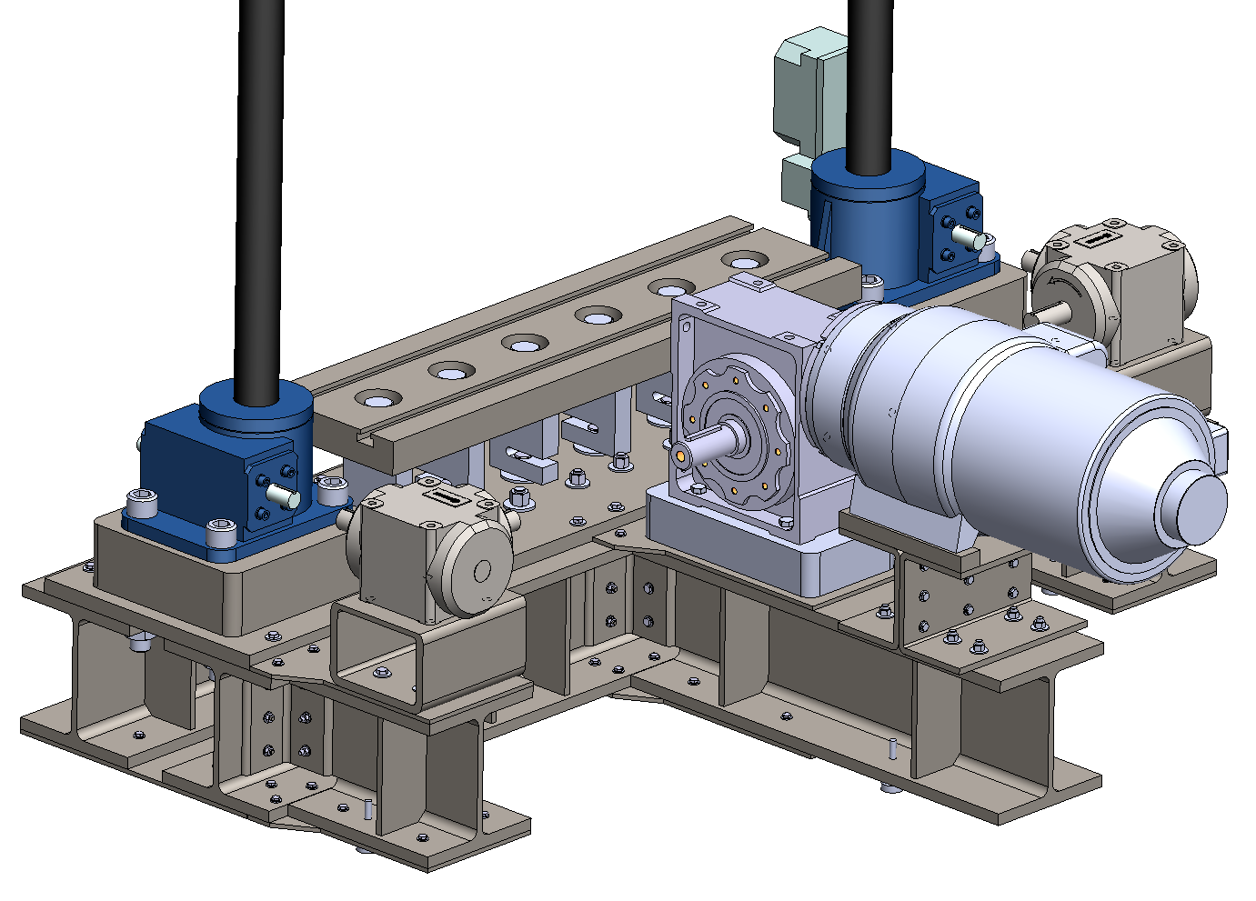
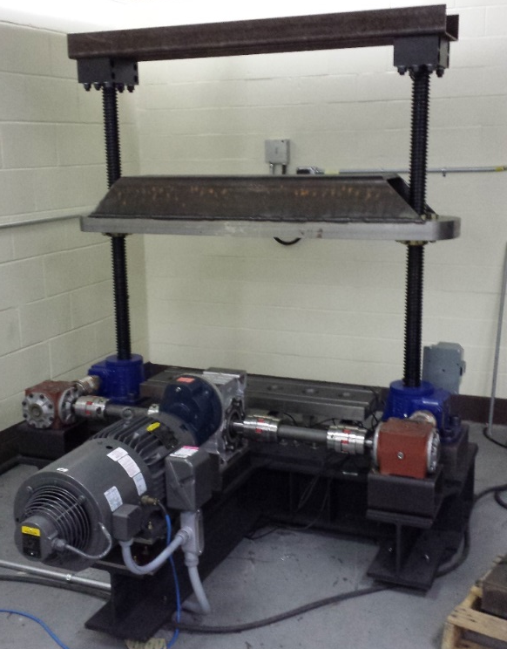
Intermediate-Scale Load Frame
Screw driven via electric motor
  Control system for load control or displacement controlled testing
Max Load
  80,000 lbf tension/compression
Operating Envelope:
  Compression: 36 in. x 40 in
  Tension: 30in. x 40 in
2ft x 3ft electric radiant heating
Two 20-ton Screw Jacks
Speed Reducer
Drive Motor
Six 15kip Load Cells
Overall Dimensions: 65 in. x 73 in.
Frame Compliance: 1.13 μin/lb (0.0065 mm/kN)
Mean Stiffness: 8.83 x 10⁵ lb/in (153 kN/mm)

Slide 23
New DIC – IR System for Large-Scale
New high resolution DIC with multiple IR cameras
  Two high resolution Allied GE4000 11 MP (4008 x 2642) capable of 5 Hz image acquisition
Imaging on a range of scales
  Side of buildings
  Large sub-assemblies
  High resolution on coupon samples
Evaluating in our civil engineering structures lab with full-scale test planned next summer on a building

Slide 24
Conclusions
DIC / thermal imaging system developed to quantify thermo-structural response of materials during fire exposures
  Temperature distribution
  Deflection and strain distributions
System permits post test evaluation of critical areas where failure occurs as well as interrogation of other regions to determine reasons for failure
System is scalable for use from coupon to full-scale applications
  Methods have been developed and validated for scales up to 1.5 m
  Near term experiments with newly acquired system to begin providing results on full-scale test articles

Slide 25
Acknowledgements
Funding provided by the Office of Naval Research and the Naval Engineer Education Consortium

